Slide 1
Data Structures Sorting Algorithms
Notes:
# Every module has the following content
* Title (1 slide)
* Table of Contents (1 slide) – where are we in the material?
* Motivation (1 slide) – why do we need this module?
* Anchor Task (1x) – introduce the key problem handled by this module
* Objectives (1x)
* Theory Section (1 subtitle + more slides) or Demo Section (1 subtitle + more slides)
* Summary (1x) * References (1x)

Slide 2
Objectives
Looking ahead – in this chapter, we’ll consider
Elementary Sorting Algorithms
Decision Trees
Efficient Sorting Algorithms
Sorting in the Standard Template Library

Slide 3
Classifying Sorting Methods
Internal and external sorting
Sorting "in place" and sorting, using additional data structures.
The worst case and the average case complexity.
Sorting with comparisons and sorting "digitally"
Stable and unstable algorithms
"inefficient, but easy" and “efficient, but hard” (also hard to memorize) algorithms.

Slide 4
The behavior of algorithms
Some may differ depending on the original state of the data set (sorted, unsorted, partially sorted)
Others may behave the same way regardless of the data
Typically, we obtain a best case, worst case, and average case
We may also find that the number of comparisons and number of data movements don’t apparently coincide
An algorithm maybe very efficient in one case, and perform poorly on the other
Yet another consideration is the complexity of the algorithms themselves
Some methods are considerably less efficient than others
However, for smaller data sets, they may prove to be faster, because their coding is simpler and executes faster

Slide 5

Sorting data in an array
Assume that the data table is A[0..n-1]
We can compare any pair of elements directly: For any two elements in the array, we have either $x<y$, or $x=y$, or $x>y$.
We want to sort the table in non-decreasing order:
$$A[0]≤A[1]≤A[2]≤⋯≤A[n−1]$$

Slide 6
Typical States in Tables
Many simple algorithms allow to illustrate the sortable array – its division in regions.
Ordered part | Unordered part

Slide 7
Insertion Sort
Any element in the unordred part is inserted into its right place.
5 | 7 | 10 | 15 | 8 | 1 | 20 | 9 | 4
5 | 7 | 8 | 10 | 15 | 1 | 20 | 9 | 4
1 | 5 | 7 | 8 | 10 | 15 | 20 | 9 | 4
1 | 5 | 7 | 8 | 10 | 15 | 20 | 9 | 4
1 | 5 | 7 | 8 | 9 | 10 | 15 | 20 | 4
1 | 4 | 5 | 7 | 8 | 9 | 10 | 15 | 20

Slide 8
Insertion Sort
function InsertionSort(table A[0..n-1])
{Order by inserting every element somewhere in the left part}
for i from 1 to n-1 do
j = i { j goes leftwards until it finds the place for A[i]}
x = A[i]
while j >= 1 and A[j-1] > x do
A[j] = A[j-1]
j = j-1
A[j] = x

Slide 9
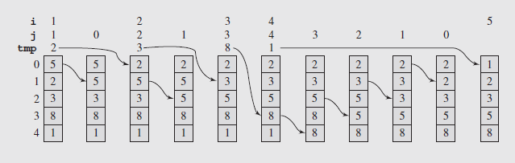
Insertion Sort
The sort can be implemented with the following code:
insertionsort(arr[],n)
for i = 1 to n-1:
move all arr[j] greater than arr[i] by one position;
place data[i] in its proper position;
Notes:
template<class T>
void insertionSort(T data[], int n) {
for (int i = 1, j; i < n; i++) {
T tmp = data[i];
for (j = i; j > 0 && tmp < data[j – 1]; j--)
data[j] = data[j – 1];
data[j] = tmp; } }

Slide 10
Selection Sort
At every step find the smallest element in the unsorted part to place it at the beginning of the unsorted part.
2 | 3 | 5 | 7 | 10 | 15 | 9 | 20 | 11
2 | 3 | 5 | 7 | 9 | 15 | 10 | 20 | 11
2 | 3 | 5 | 7 | 9 | 10 | 15 | 20 | 11
2 | 3 | 5 | 7 | 9 | 10 | 11 | 20 | 15
2 | 3 | 5 | 7 | 9 | 10 | 11 | 15 | 20

Slide 11
Selection Sort
function SelectionSort(table A[0..n-1]):
{Order the table A by repeated selection of the smallest element.}
for i from 0 to n-2 do
j = i {j is the index of the smallest element in A[0..n-1] }
for k from i+1 to n-1 do
if A[k] < A[j] then
j = k
A[i]↔A[j]

Slide 12
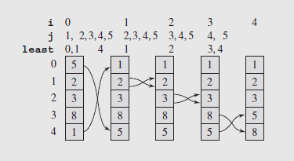
Selection Sort
Selection Sort (continued)
The pseudocode for the algorithm reflects its simplicity:
selectionsort(data[],n)
for i = 0 to n-2
select the smallest element among data[i], . . . , data[n-1];
swap it with data[i];
The last value for i is n – 2 since if all items have been looked at and placed except for the last, then the n^{th} element has to be the largest
Fig. 9.2 The array [5 2 3 8 1] sorted by selection sort
Notes:
template<class T>
void selectionsort(T data[], int n) {
for (int i = 0,j,least; i < n-1; i++) {
for (j = i+1, least = i; j < n; j++)
if (data[j] < data[least])
least = j;
swap(data[least],data[i]);
}}

Slide 13
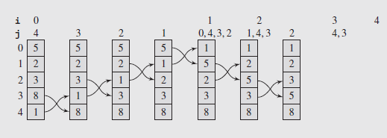
Bubble Sort
The pseudocode for this algorithm appears below:
bubblesort(data[],n)
for i = 0 to n-2
for j = n-1 down to i+1
swap items in positions j and j-1 if they are out of order;
The main disadvantage to bubble sort is the "bubbling" process - each item gradually moves step by step to the appropriate end of the list.
Turtles – small values near the end of the list slow the sorting down tremendously.
Notes:
template<class T>
void bubblesort(T data[], int n) {
for (int i = 0; i < n-1; i++)
for (int j = n-1; j > i; --j)
if (data[j] < data[j-1])
swap(data[j],data[j-1]);
}

Slide 14
Heap Sort
Unordered part has the heap (reverse order).
Exchange the heap minimum with its end.
Restore the heap property.
Ordered part | Unordered part
 | Heap (root at the right)
 |  | ... | Remaining heap
 | Restored heap

Slide 15
Heap Sort
procedure HeapSort (table A[0 .. n-1]):
{Sort by converting A into a heap and then selecting smallest elements.}
InitializeHeap(A[0 .. n-1])
for i from 0 to n-2 do
A[i]↔A[n-1]
Heapify(A[i+1 .. n-1])

Slide 16
Heap Sort
function InitializeHeap (table A[0 .. n-1]):
{Make A into a Heap.}
for i from 1 to n-1 do Heapify(A[0 .. i])

Slide 17
Heap Sort
function Heapify(table A[i .. j]):
{ Initially A[i .. j - 1] is partially ordered}
{ At the end A[i .. J] is partially ordered}
if RC(j) >= i and A[RC(j)] <= A[LC(j)] and A[RC(j)] < A[j] then
A[j]↔A[RC(j)]
Heapify(A[i .. RC(j)])
else if LC(j) >= i and A[LC(j)] < A[j] then
A[j]↔A[LC(j)]
Heapify(A[i .. LC(j)])

Slide 18

Heap Sort complexity
Heapify – $O(log⁡n)$
InitializeHeap – n times $O(log⁡n)$ => $O(n∙log⁡n)$
HeapSort - $O(n log⁡n)$ + $n$ times $O(log⁡n)$=> $O(n∙log⁡n)$

Slide 19
Merge Sort
Algorithm uses "divide and conquer"
Table is divided in half and on every part the same algorithm is called.
After these calls both parts are assumed to be ordered.
The function Merge() merges two sorted arrays into a single table by comparing the currently selected elements from either part.

Slide 20
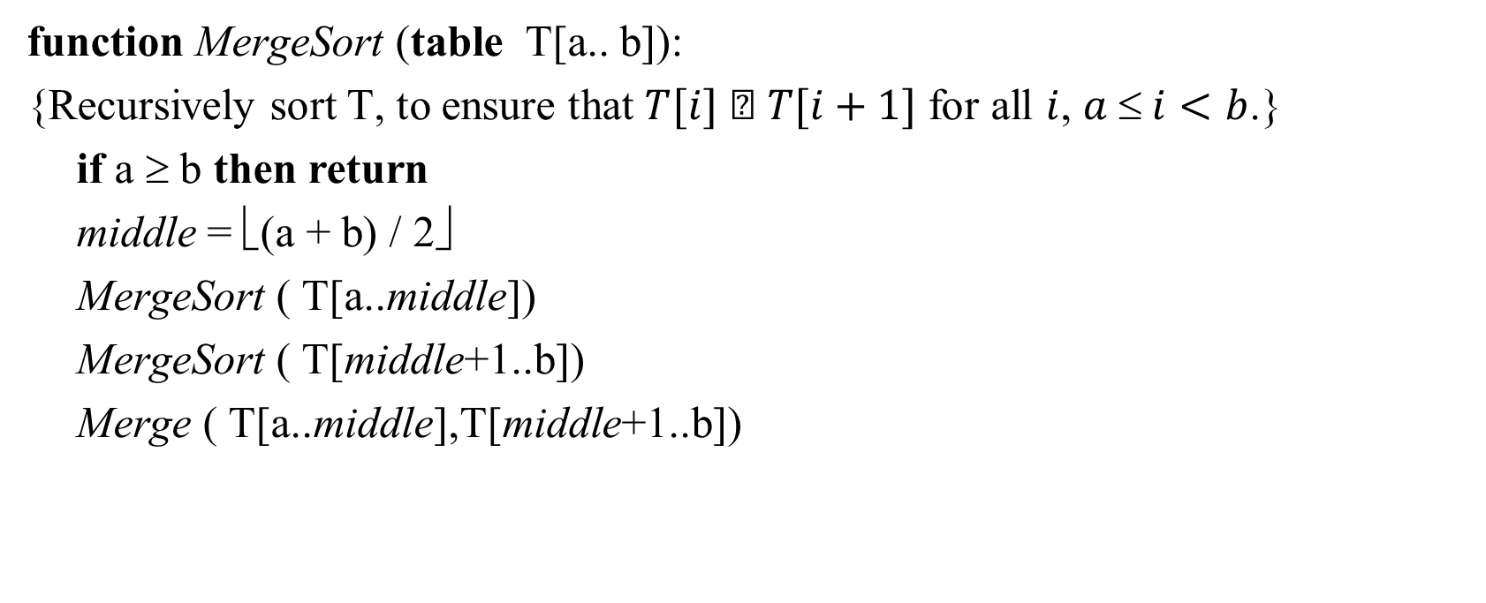
MergeSort
function MergeSort (table T[a.. b]):
{Recursively sort T, to ensure that $T[i]  T[i+1]$ for all $i$, $a  i<b$.}
if a ≥ b then return
middle = ⎣(a + b) / 2⎦
MergeSort ( T[a..middle])
MergeSort ( T[middle+1..b])
Merge ( T[a..middle],T[middle+1..b])

Slide 21
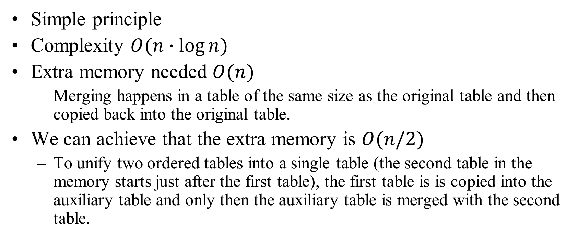
Analysis of MergeSort
Simple principle
Complexity $O(n∙log⁡n)$
Extra memory needed $O(n)$
Merging happens in a table of the same size as the original table and then copied back into the original table.
We can achieve that the extra memory is $O(n/2)$
To unify two ordered tables into a single table (the second table in the memory starts just after the first table), the first table is is copied into the auxiliary table and only then the auxiliary table is merged with the second table.

Slide 22
Divide-and-Conquer Paradigm
Divide-and conquer is a general algorithm design paradigm:
Divide: divide the input data S in two disjoint subsets S₁ and S₂
Recur: solve the subproblems associated with S₁ and S₂
Conquer: combine the solutions for S₁ and S₂ into a solution for S
The base case for the recursion are subproblems of size 0 or 1
Merge-sort is a sorting algorithm based on the divide-and-conquer paradigm
Like heap-sort
It uses a comparator
It has O(n log n) running time
Unlike heap-sort
It does not use an auxiliary priority queue
It accesses data in a sequential manner (suitable to sort data on a disk)

Slide 23
Merge-Sort
Merge-sort on an input sequence S with n elements consists of three steps:
Divide: partition S into two sequences S₁ and S₂ of about n/2 elements each
Recur: recursively sort S₁ and S₂
Conquer: merge S₁ and S₂ into a unique sorted sequence
Algorithm mergeSort(S, C)
Input sequence S with n elements, comparator C
Output sequence S sorted
according to C
if S.size() > 1
(S₁, S₂) ← partition(S, n/2)
mergeSort(S₁, C)
mergeSort(S₂, C)
S ← merge(S₁, S₂)

Slide 24
Merging Two Sorted Sequences
The conquer step of merge-sort consists of merging two sorted sequences A and B into a sorted sequence S containing the union of the elements of A and B
Merging two sorted sequences, each with n/2 elements and implemented by means of a doubly linked list, takes O(n) time
Algorithm merge(A, B)
Input sequences A and B with n/2 elements each
Output sorted sequence of A ∪ B
S ← empty sequence
while ¬A.empty() ∧ ¬B.empty()
if A.front() < B.front()
S.addBack(A.front()); A.eraseFront();
else
S.addBack(B.front()); B.eraseFront();
while ¬A.empty()
S.addBack(A.front()); A.eraseFront();
while ¬B.empty()
S.addBack(B.front()); B.eraseFront();
return S

Slide 25
How to Merge? (Temp. Array)
If it is run on a single array split in half, the array looks like this: array1 = [1 4 6 8 10 2 3 5 22]
Normally, a temporary array is needed during the merging process
We can pass indexes to the beginning and end of array1
Once the merge is complete, the temporary array can be transferred back into array1

Slide 26
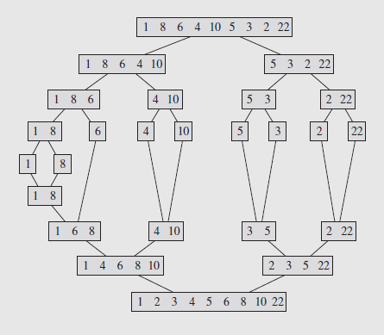
MergeSort Visualized
How many comparisons?
In which order we create the sorted subarrays?
How the chunks are physically represented?
In what order are they created?

Slide 27
Analysis of Merge-Sort
The height h of the merge-sort tree is O(log n)
at each recursive call we divide in half the sequence,
The overall amount or work done at the nodes of depth i is O(n)
we partition and merge 2^{i} sequences of size n/2^{i}
we make 2^{i+1} recursive calls
Thus, the total running time of merge-sort is O(n log n)
depth | #seqs | size
0 | 1 | n
1 | 2 | n/2
i | 2^{i} | n/2^{i}
… | … | …

Slide 28
Summary of Sorting Algorithms
Algorithm | Time | Notes
selection-sort | O(n²) | slow in-place for small data sets (< 1K)
insertion-sort | O(n²) | slow in-place for small data sets (< 1K)
heap-sort | O(n log n) | fast in-place for large data sets (1K — 1M)
merge-sort | O(n log n) | fast sequential data access for huge data sets (> 1M)

Slide 29
Quicksort: Intro
Quicksort is similar to Merge Sort.
An essential improvement – no need for extra space to store intermediate results.
Ordering happens in the same table where the elements are stored.
Quicksort uses a few external variables (not large arrays).
Quicksort algorithm ensures that the table is split into two (unequal) parts (and any element in the first part does not exceed any element in the second part).
Apply this recursively by subdividing the tables again, and so on.
Ideally want to pivot on median, but it usually do not search for it.
Notes:
The data preprocessing before the recursive call should be linear time and should not use extra memory.
It is desirable to split the table in two nearly equal parts – to reduce the number of recursive calls.
Ideally we could wish to use the median element. But searching for the median would require linear time; so we try to use something close to median.

Slide 30
Quicksort: Use of Pivot
The element that divides table at every step is named pivot. The simplest flavor – the pivot is always the leftmost element of an unsorted array.
If we assume that the input table is randomly shuffled, we can expect that the pivot would usually divide the table in a reasontably balanced way.
Scan the table from the left to the right and find element that is larger than the pivot.
Also scan the table from right to left and search for an element that is less or equal to the pivot.
When both such elements are found, swap them and continue scanning.
Finding and swapping stops, when both scans meet somewhere. Finally swap the pivot to the last element less or equal to the pivot.

Slide 31
Quicksort
QuickSort is a randomized sorting algorithm based on the divide-and-conquer paradigm:
Divide: pick a random element x (called pivot) and partition S into
L elements less or equal than x
E – pivot x itself
G – elements greater than x
Recursion: sort L and G using the same QuickSort
Conquer: join L, E and G (simple concatenation in place – zero time.)
x
x
L
G
E
x

Slide 32
Quick Sort Example
9 | 1 | 11 | 17 | 13 | 18 | 4 | 12 | 14 | 5
9 | 1 | 11 | 17 | 13 | 18 | 4 | 12 | 14 | 5
 | ⇒ | ⇒ |  |  |  |  |  |  | ⇐
9 | 1 | 5 | 17 | 13 | 18 | 4 | 12 | 14 | 11
 |  |  | ⇒ |  |  | ⇐ | ⇐ | ⇐
9 | 1 | 5 | 4 | 13 | 18 | 17 | 12 | 14 | 11
 |  |  | ⇐ | ⇐ ⇒ | ⇐

Slide 33
Quick Sort Example
9 | 1 | 5 | 4 | 13 | 18 | 17 | 12 | 14 | 11
 |  |  | ⇐ | ⇐ ⇒ | ⇐
9 | 1 | 5 | 13 | 4 | 18 | 17 | 12 | 14 | 11
9 | 1 | 5 | 4 | 13 | 18 | 17 | 12 | 14 | 11
4 | 1 | 5 | 9 | 13 | 18 | 17 | 12 | 14 | 11

Slide 34
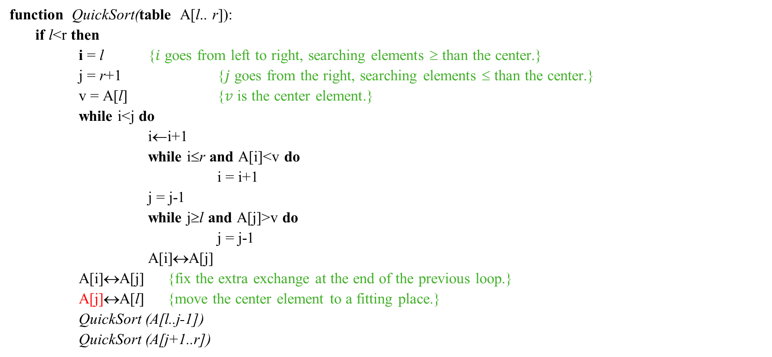
Quick Sort
function QuickSort(table A[l.. r]):
if l<r then
i = l {$i$ goes from left to right, searching elements ≥ than the center.}
j = r+1 {$j$ goes from the right, searching elements ≤ than the center.}
v = A[l] {$v$ is the center element.}
while i<j do
i←i+1
while i≤r and A[i]<v do
i = i+1
j = j-1
while j≥l and A[j]>v do
j = j-1
A[i]↔A[j]
A[i]↔A[j] {fix the extra exchange at the end of the previous loop.}
A[j]↔A[l] {move the center element to a fitting place.}
QuickSort (A[l..j-1])
QuickSort (A[j+1..r])

Slide 35

QuickSort analysis
The expected sorting time $O(n∙log⁡n)$
Worst case happens, if everything is already sorted – $O(n^{2})$
The algorithm works best, if data is randomly shuffled
The necessary memory for recursions (up to $O(n)$)
Very many recursive calls

Slide 36
Quicksort: Time Complexity
We partition an input sequence as follows:
We remove, in turn, each element y from S and
We insert y into L, E or G, depending on the result of the comparison with the pivot x
Each insertion and removal is at the beginning or at the end of a sequence, and hence takes O(1) time
Thus, the partition step of quick-sort takes O(n) time. (Also – on all the sub-arrays created later at every stage.)
Question: How many stages do we need? (May be unequal in separate branches)
Notes:
quicksort(array[])
if length(array) > 1
choose bound; // partition array into subarray1 and subarray2
while there are elements left in array
include element either in subarray1 = {el: el ≤ bound}
or in subarray2 = {el: el ≥ bound};
quicksort(subarray1);
quicksort(subarray2);

Slide 37
Worst-case Running Time
The worst case for quick-sort occurs when the pivot is the unique minimum or maximum element
One of L and G has size n − 1 and the other has size 0
The running time is proportional to the sum
n + (n − 1) + … + 2 + 1
Thus, the worst-case running time of quick-sort is O(n²)
depth | time
0 | n
1 | n − 1
… | …
n − 1 | 1
…

Slide 38
Expected Running Time
Consider a recursive call of quick-sort on a sequence of size s
Good call: the sizes of L and G are each less than 3s/4
Bad call: one of L and G has size greater than 3s/4
A call is good with probability 1/2
1/2 of the possible pivots cause good calls:
7 2 9 4 3 7 6 1 9
7 2 9 4 3 7 6 1
2 4 3 1
7 9 7 1 → 1
1
7 2 9 4 3 7 6
Good call
Bad call
1 2 3 4 5 6 7 8 9 10 11 12 13 14 15 16
Bad pivots
Good pivots
Bad pivots

Slide 39
Expected Running Time, Part 2
Probabilistic Fact: The expected number of coin tosses required in order to get k heads is 2k
For a node of depth i, we expect
i/2 ancestors are good calls
The size of the input sequence for the current call is at most (3/4)^{i/2}n
Therefore, we have
For a node of depth 2log_{4/3}n, the expected input size is one
The expected height of the quick-sort tree is O(log n)
The amount or work done at the nodes of the same depth is O(n)
Thus, the expected running time of quick-sort is O(n log n)

Slide 40
Summary of Sorting Algorithms
Algorithm | Time | Notes
selection-sort | O(n²) | in-place slow (good for small inputs)
insertion-sort | O(n²) | in-place slow (good for small inputs)
quick-sort | O(n log n) expected | in-place, randomized fastest (good for large inputs)
heap-sort | O(n log n) | in-place fast (good for large inputs)
merge-sort | O(n log n) | sequential data access fast (good for huge inputs)

Slide 41
Lower-Bound on Sorting
Algorithm compares n elements, x₁, x₂, …, x_{n}.
How many comparisons to sort a list of length n ?
Sorting algorithms are binary trees with arcs yes (Y) or no (N)
The nonterminal nodes represent comparisons; terminal nodes represent orderings of the list.
This type of tree is referred to as a decision tree
Is x_{i} < x_{j}?
yes
no
Notes:
The height of the decision tree is a lower bound on the running time
Every input permutation must lead to a separate leaf output
If not, some input …4…5… would have same output ordering as …5…4…, which would be wrong
Since there are n!=1⋅2 ⋅ … ⋅n leaves, the height is at least log (n!)

Slide 42
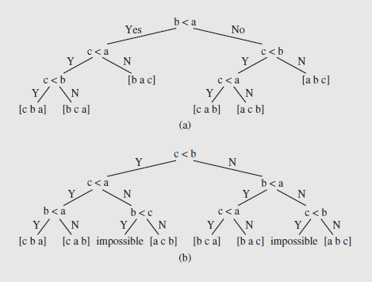
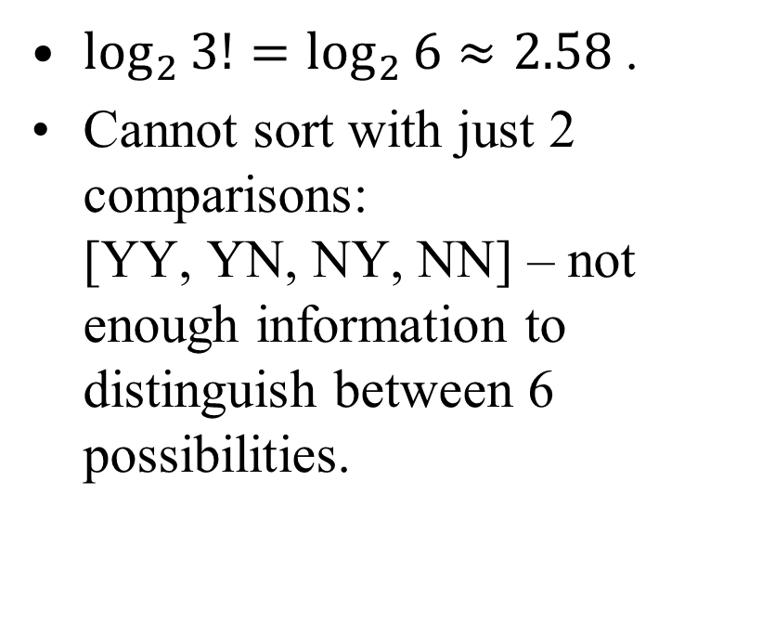
Three Comparisons for n=3
$\log_{2}{3!=\log_{2}{6≈2.58 }}$.
Cannot sort with just 2 comparisons: [YY, YN, NY, NN] – not enough information to distinguish between 6 possibilities.

Slide 43
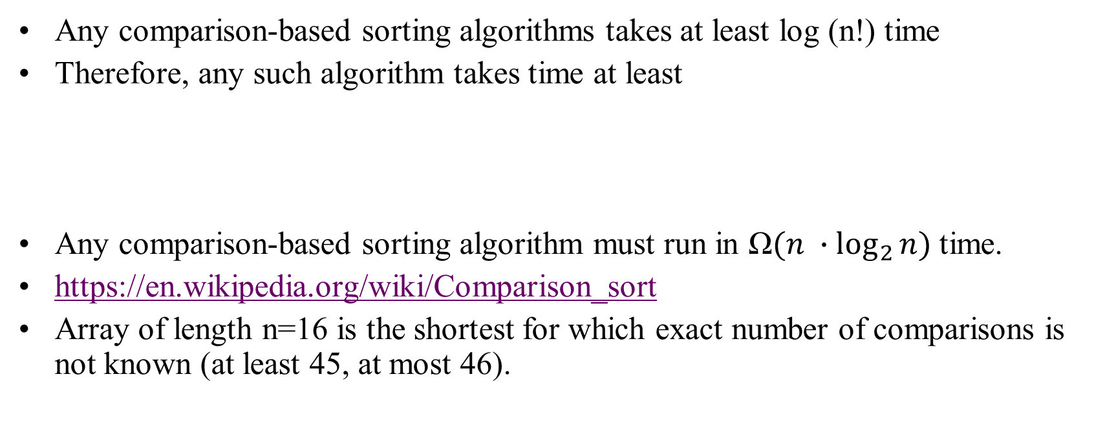
The Lower Bound
Any comparison-based sorting algorithms takes at least log (n!) time
Therefore, any such algorithm takes time at least
Any comparison-based sorting algorithm must run in $\text{Ω}(n ∙\log_{2}{n})$ time.
https://en.wikipedia.org/wiki/Comparison_sort
Array of length n=16 is the shortest for which exact number of comparisons is not known (at least 45, at most 46).

Slide 44

Decision Trees (continued)
It can be proven that the path length from the root to a randomly chosen leaf in an m-leaf decision tree is not less than $\log_{2}{m}$
In addition, the required number of comparisons, $\log_{2}{(n!) }$ for both the average and worst cases is O(n $\log_{2}{n}$)
So the best that can be expected for average cases is O(n $\log_{2}{n}$)

Slide 45
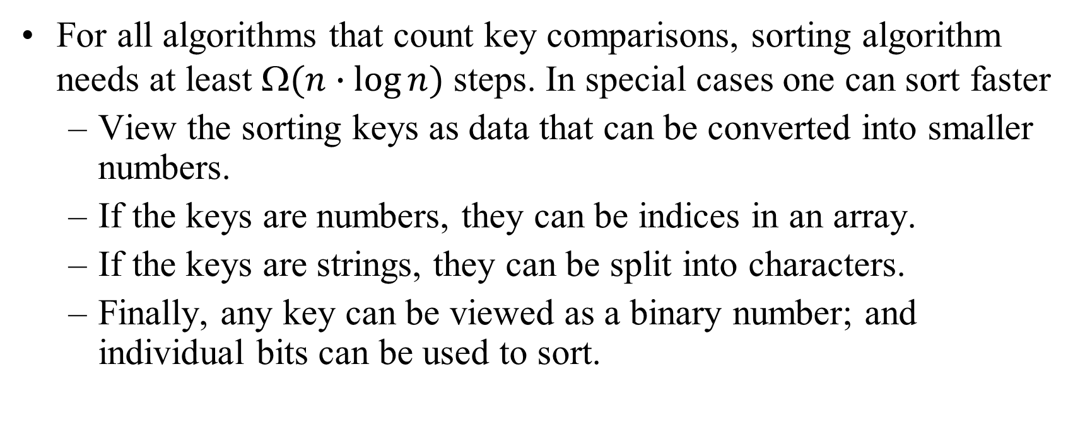
Digital Sorting – General Approach
For all algorithms that count key comparisons, sorting algorithm needs at least $(n∙log⁡n)$ steps. In special cases one can sort faster
View the sorting keys as data that can be converted into smaller numbers.
If the keys are numbers, they can be indices in an array.
If the keys are strings, they can be split into characters.
Finally, any key can be viewed as a binary number; and individual bits can be used to sort.

Slide 46
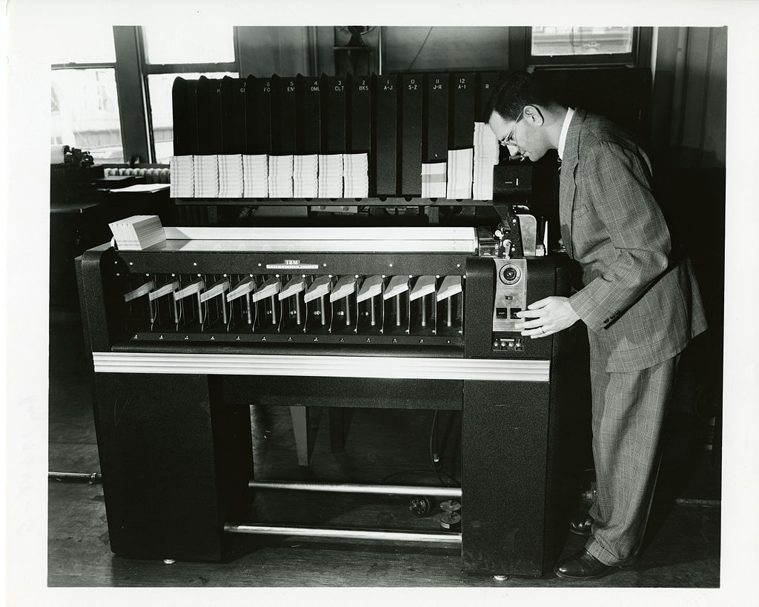
Classical Sorting Approach
Puched cards: Keys (such as postal indices, etc.) take fixed number of positions.
Typically starts from the last position (then moves backwards).
Sorts into buckets. Collect them from the buckets, stack them on top of each other and sort by the next position.
And so on...
IBM, US Census (since 1923)

Slide 47
RadixSort
CX | AX | BZ | BY | AZ | BX | AY
CX | AX | BX | BY | AY | BZ | AZ
X |  |  | Y |  | Z
AX | AY | AZ | BX | BY | BZ | CX
A |  |  | B |  |  | C
AX | AY | AZ | BX | BY | BZ | CX

Slide 48
RadixSort algorithm
function RadixSort (table A[0..n-1]):
{A is the array of pointers to be ordered.}
{S[0..N-1] is a table of queues.}
for i from 0 to K-1do S[i] = MakeEmptyQueue()
for k from 0 to K-1do
for j from 0 to n-1do
Enqueue(A[j], S[Keyk(A[j])])
j = 0
for i from 0 to N-1do
until IsEmptySet(S[i]) do
A[j] = Dequeue(S[i])
j = j+1

Slide 49
Bucket-Sort: Revisited
Let be S be a sequence of n (key, element) entries with keys in the range [0, N − 1]
Bucket-sort uses the keys as indices into an auxiliary array B of sequences (buckets)
Phase 1: Empty sequence S by moving each entry (k, o) into its bucket B[k]
Phase 2: For i = 0, …, N − 1, move the entries of bucket B[i] to the end of sequence S
Analysis:
Phase 1 takes O(n) time
Phase 2 takes O(n + N) time
Bucket-sort takes O(n + N) time
Algorithm bucketSort(S, N)
Input sequence S of (key, element) items with keys in the range [0, N − 1] Output sequence S sorted by increasing keys
B ← array of N empty sequences
while ¬S.empty()
(k, o) ← S.front()
S.eraseFront()
B[k].insertBack((k, o))
for i ← 0 to N − 1
while ¬B[i].empty()
(k, o) ← B[i].front()
B[i].eraseFront()
S.insertBack((k, o))

Slide 50
Example
Key range [0, 9]
7, d
1, c
3, a
7, g
3, b
7, e
Phase 1
1, c
3, a
3, b
7, d
7, g
7, e
B
0
1
2
3
4
5
6
7
8
9
∅
∅
∅
∅
∅
∅
∅
Phase 2
1, c
3, a
3, b
7, d
7, g
7, e

Slide 51
Properties and Extensions
Key-type Property
The keys are used as indices into an array and cannot be arbitrary objects
No external comparator
Stable Sort Property
The relative order of any two items with the same key is preserved after the execution of the algorithm
Extensions
Integer keys in the range [a, b]
Put entry (k, o) into bucket B[k − a]
String keys from a set D of possible strings, where D has constant size (e.g., names of the 50 U.S. states)
Sort D and compute the rank r(k) of each string k of D in the sorted sequence
Put entry (k, o) into bucket B[r(k)]

Slide 52
Radix-Sort
Radix-sort is a specialization of lexicographic-sort that uses bucket-sort as the stable sorting algorithm in each dimension
Radix-sort is applicable to tuples where the keys in each dimension i are integers in the range [0, N − 1]
Radix-sort runs in time O(d( n + N))
Algorithm radixSort(S, N)
Input sequence S of d-tuples such
that (0, …, 0) ≤ (x₁, …, x_{d}) and (x₁, …, x_{d}) ≤ (N − 1, …, N − 1) for each tuple (x₁, …, x_{d}) in S Output sequence S sorted in lexicographic order
for i ← d downto 1
bucketSort(S, N)

Slide 53
Radix-Sort for Binary Numbers
Consider a sequence of n b-bit integers x = x_{b − 1} … x₁x₀
We represent each element as a b-tuple of integers in the range [0, 1] and apply radix-sort with N = 2
This application of the radix-sort algorithm runs in O(bn) time
For example, we can sort a sequence of 32-bit integers in linear time
Algorithm binaryRadixSort(S)
Input sequence S of b-bit integers Output sequence S sorted
replace each element x of S with the item (0, x)
for i ← 0 to b − 1
replace the key k of each item (k, x) of S with bit x_{i} of x
bucketSort(S, 2)

Slide 54
Example
Sorting a sequence of 4-bit integers
1001
0010
1001
1001
0001
0010
1110
1101
0001
0010
1101
1001
0001
0010
1001
0001
1101
0010
1101
1101
1110
0001
1110
1110
1110

Slide 55
Lexicographic Order
A d-tuple is a sequence of d keys (k₁, k₂, …, k_{d}), where key k_{i} is said to be the i-th dimension of the tuple
Example:
The Cartesian coordinates of a point in space are a 3-tuple
The lexicographic order of two d-tuples is recursively defined as follows
(x₁, x₂, …, x_{d}) < (y₁, y₂, …, y_{d}) ⇔ x₁ < y₁ ∨ x₁ = y₁ ∧ (x₂, …, x_{d}) < (y₂, …, y_{d})
I.e., the tuples are compared by the first dimension, then by the second dimension, etc.

Slide 56
Lexicographic-Sort
Algorithm lexicographicSort(S)
Input sequence S of d-tuples Output sequence S sorted in lexicographic order
for i ← d downto 1
stableSort(S, C_{i})
Let C_{i} be the comparator that compares two tuples by their i-th dimension
Let stableSort(S, C) be a stable sorting algorithm that uses comparator C
Lexicographic-sort sorts a sequence of d-tuples in lexicographic order by executing d times algorithm stableSort, one per dimension
Lexicographic-sort runs in O(dT(n)) time, where T(n) is the running time of stableSort
Example:
(7,4,6) (5,1,5) (2,4,6) (2, 1, 4) (3, 2, 4)
(2, 1, 4) (3, 2, 4) (5,1,5) (7,4,6) (2,4,6)
(2, 1, 4) (5,1,5) (3, 2, 4) (7,4,6) (2,4,6)
(2, 1, 4) (2,4,6) (3, 2, 4) (5,1,5) (7,4,6)

Slide 57
Counting Sort
Counting sort is an algorithm for sorting a collection of objects according to keys that are small integers
It operates by counting the number of objects that have distinct key values
It then uses arithmetic on those counts to determine the positions of each key value in the output sequence
Its running time is linear in the number of items and the maximum key value
So it is only suitable for use in situations where the keys are not significantly larger than the number of items
However, it is often used as a subroutine in another sorting algorithm, radix sort, that can handle larger keys more efficiently

Slide 58
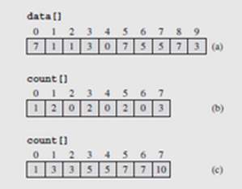
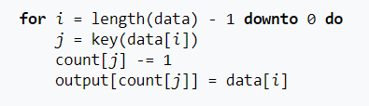


Counting Sort – 2
Array of counters, count[], to track the number of times each value occurs in data[]
The count[] array is indexed with the values from data
Once the count is completed, the counters indicating the values < i are added together and stored in count[i]
Consequently, count[i]-1 indicates the location of i in the data[] array
Input size
$$n$$
$$k$$
Keyspace size
output[]
0
1
2
3
4
5
6
7
8
9
0
1
2
3
4
5
6
7
3
1
3
3
4
5
7
7
10
j=3; count[3]--; output[4]=3;
0
1
2
3
4
5
6
7
8
9
0
1
2
3
4
5
6
7
3
7
1
3
3
4
5
7
7
9
j=7; count[7]--; output[9]=7;
Notes:
Consider the data[] array [7 1 1 3 0 7 5 5 7 3]
The largest value in the array, 7, is determined and used to create the array count[]
Next, we process data[], incrementing count[data[i]]by 1 for each occurrence of data[i], shown in Figure 9.17b
The count[] array is then processed such that each location i contains the accumulated count for values < i
So count[0] accumulate counts for values < 0 (1); count[1] accumulates values < 1 (all 0s plus all 1s = 3), etc.
Once this has been completed, we place the data into the tmp[] array as previously specified, starting with the last item in data[]
data[9] = 3, and count[3] - 1 = 5 – 1 = 4, so tmp[4] = data[9] = 3
After the value is paced, count[3] is decremented by 1
The process is then repeated with the remaining values in data[] until we move the last value, then the contents of tmp[] is transferred back into data[]

Slide 59
Sorting in the STL
There are a number of sorting algorithms in the STL, particularly in the <algorithm> library
Among the algorithms that are implemented in the library are the quicksort, mergesort, and heap sort
These functions are shown in Figure 9.18 on pages 529 – 531
The first group of functions are called partial sorting functions
The first of these picks the k = middle – first smallest elements and orders them in the range [first, middle)
So the code
partial_sort(v1.begin(),v1.begin()+3,v1.end());
takes the three smallest values in vector v1 and puts them in the first three locations

Slide 60
Sorting in the STL (continued)
The default ordering is ascending order, but this can be changed in the fourth parameter of the function
So the call
partial_sort(v2.begin()+1,v2.begin()+4,v2.end(),greater<int>());
takes the largest three values in v2 and puts them into positions two through four in descending order
In both cases, the order of the values outside the destination range is unspecified
A third version takes the first k = last1 - first1 or last2 - first2 elements from the range [first1,last1)
It then overwrites the elements in the range [first2,last2)

Slide 61
Sorting in the STL (continued)
So in this case, the call
partial_sort_copy(v2.begin(),v2.begin()+4,v3.begin(),v3.end());
takes the first four integers of v2 and puts them into the first four locations of v3
In addition, an iterator is returned pointing to the first position following the last copied number
The last variation of the partial sort is similar to this third one, but allows for providing a relation to direct the sort order
The program of Figure 9.18 also demonstrates the partition() function
This function orders two ranges with respect to one another, using a Boolean function to separate the ranges

Slide 62
Sorting in the STL (continued)
Values for which the function is true are placed in the first range; those for which it is false, in the second
The most useful function is probably the one that implements the quicksort, sort()
If we call it as follows:
sort(v1.begin(),v1.end());
it will sort the entire list v1 into ascending order
There is a second version that allows for explicit specification of the sorting relation
Stable sorting functions are also provided in the STL; stable algorithms preserve the original order of equal items

Slide 63
Concluding Remarks
If we order items "one-by-one", we typically get O(n²) algorithms: if length increases 2 times, the runtime grows 4 times.
Counting sort is the fastest among the algorithms, it limits on what are the input data (no big gaps, no negative numbers).
Comparison sort algorithms: Mergesort, Quicksort and Shell sort are fast on typical (random) data. (We did not analyze Shell sort – same as Quicksort, does not have good worst-case behavior.)

