Slide 1
Data Structures Graphs - Introduction
Data Structures and Algorithms
http://linen-tracer-682.appspot.com/data-structures/index.html
Notes:
# Every module has the following content
* Title (1 slide)
* Table of Contents (1 slide) – where are we in the material?
* Motivation (1 slide) – why do we need this module?
* Anchor Task (1x) – introduce the key problem handled by this module
* Objectives (1x)
* Theory Section (1 subtitle + more slides) or Demo Section (1 subtitle + more slides)
* Summary (1x) * References (1x)

Slide 2
Graphs
A graph is a pair (V, E), where
V is a set of nodes, called vertices
E is a collection of pairs of vertices, called edges
Vertices and edges are positions and store elements
Example:
A vertex represents an airport and stores the three-letter airport code
An edge represents a flight route between two airports and stores the mileage of the route
849
PVD
1843
ORD
142
SFO
802
LGA
337
1743
1387
HNL
2555
1099
LAX
1233
DFW
1120
MIA

Slide 3
Edge Types
Undirected edge
unordered pair of vertices (u,v)
e.g., a flight distance
Undirected graph
all the edges are undirected
e.g., flight network
Directed edge
ordered pair of vertices (u,v)
first vertex u is the origin
second vertex v is the destination
For example, a flight
Directed graph
all the edges are directed
For example, (flight) route network
849
miles
ORD
PVD
flight
AA 1206
ORD
PVD

Slide 4
Applications
Electronic circuits
Printed circuit board
Integrated circuit
Transportation networks
Highway network
Flight network
Computer networks
Local area network
Internet
Web
Databases
Entity-relationship diagram

Slide 5
Terminology
End vertices (or endpoints) of an edge
U and V are the endpoints of a
Edges incident on a vertex
a, d, and b are incident on V
Adjacent vertices
U and V are adjacent
Degree of a vertex
X has degree 5
Parallel edges
h and i are parallel edges
Self-loop
j is a self-loop
V
a
b
h
j
U
d
X
Z
c
e
i
W
g
f
Y

Slide 6
Terminology (cont.)
Path
sequence of alternating vertices and edges
begins with a vertex
ends with a vertex
each edge is preceded and followed by its endpoints
Simple path
path such that all its vertices and edges are distinct
Examples
P₁=(V,b,X,h,Z) is a simple path
P₂=(U,c,W,e,X,g,Y,f,W,d,V) is a path that is not simple
V
a
b
P₁
d
U
X
Z
P₂
h
c
e
W
g
f
Y

Slide 7
Terminology (cont.)
Cycle
circular sequence of alternating vertices and edges
each edge is preceded and followed by its endpoints
Simple cycle
cycle such that all its vertices and edges are distinct
Examples
C₁=(V,b,X,g,Y,f,W,c,U,a,↵) is a simple cycle
C₂=(U,c,W,e,X,g,Y,f,W,d,V,a,↵) is a cycle that is not simple
V
a
b
d
U
X
Z
C₂
h
e
C₁
c
W
g
f
Y

Slide 8
Properties
Notation
n number of vertices
m number of edges
deg(v) degree of vertex v
Property 1
Σ_{v} deg(v) = 2m
Proof: each edge is counted twice
Property 2
In an undirected graph with no self-loops and no multiple edges
m ≤ n (n − 1)/2
Proof: each vertex has degree at most (n − 1)
What is the bound for a directed graph?
Example
n = 4
m = 6
deg(v) = 3

Slide 9
Main Methods of the Graph ADT
Accessor methods
e.endVertices(): a list of the two end vertices of e
e.opposite(v): the vertex opposite of v on e
u.isAdjacentTo(v): true iff u and v are adjacent
Update methods
insertVertex(o): insert a vertex storing element o
insertEdge(v, w, o): insert an edge (v,w) storing element o
eraseVertex(v): remove vertex v (and its incident edges)
eraseEdge(e): remove edge e
Iterable collection methods
incidentEdges(v): list of edges incident to v
vertices(): list of all vertices in the graph
edges(): list of all edges in the graph

Slide 10
Edge List Structure
u
Vertex object
element
reference to position in vertex sequence
Edge object
element
origin vertex object
destination vertex object
reference to position in edge sequence
Vertex sequence
sequence of vertex objects
Edge sequence
sequence of edge objects
a
c
b
d
v
w
z
u
v
w
z
a
b
c
d

Slide 11
Adjacency List Structure
a
v
b
Edge list structure
Incidence sequence for each vertex
sequence of references to edge objects of incident edges
Augmented edge objects
references to associated positions in incidence sequences of end vertices
u
w
u
v
w
a
b

Slide 12
Adjacency Matrix Structure
a
v
b
Edge list structure
Augmented vertex objects
Integer key (index) associated with vertex
2D-array adjacency array
Reference to edge object for adjacent vertices
Null for non nonadjacent vertices
The “old fashioned” version just has 0 for no edge and 1 for edge
u
w
0
u
1
v
2
w
 | 0 | 1 | 2
0 | ∅ |  | ∅
1 |  | ∅
2 | ∅ |  | ∅
a
b

Slide 13
Performance
n vertices, m edges no parallel edges no self-loops | Edge List | Adjacency List | Adjacency Matrix
Space | n + m | n + m | n²
v.incidentEdges() | m | deg(v) | n
u.isAdjacentTo (v) | m | min(deg(v), deg(w)) | 1
insertVertex(o) | 1 | 1 | n²
insertEdge(v, w, o) | 1 | 1 | 1
eraseVertex(v) | m | deg(v) | n²
eraseEdge(e) | 1 | 1 | 1

Slide 14
Breadth-First Search
Breadth-first search (BFS) is a general technique for traversing a graph
A BFS traversal of a graph G
Visits all the vertices and edges of G
Determines whether G is connected
Computes the connected components of G
Computes a spanning forest of G
BFS on a graph with n vertices and m edges takes O(n + m ) time
BFS can be further extended to solve other graph problems
Find and report a path with the minimum number of edges between two given vertices
Find a simple cycle, if there is one

Slide 15
BFS Algorithm
Algorithm BFS(G, s)
L₀ ← new empty sequence
L₀.insertBack(s)
s.setLabel(VISITED)
i ← 0
while ¬L_{i}.empty()
L_{i +1} ← new empty sequence
for all v ∈ L_{i}.elements() for all e ∈ v.incidentEdges()
if e.getLabel() = UNEXPLORED
w ← e.opposite(v)
if w.getLabel() = UNEXPLORED
e.setLabel(DISCOVERY)
w.setLabel(VISITED)
L_{i +1}.insertBack(w)
else
e.setLabel(CROSS)
i ← i +1
The algorithm uses a mechanism for setting and getting “labels” of vertices and edges
Algorithm BFS(G)
Input graph G
Output labeling of the edges and partition of the vertices of G
for all u ∈ G.vertices()
u.setLabel(UNEXPLORED)
for all e ∈ G.edges()
e.setLabel(UNEXPLORED)
for all v ∈ G.vertices()
if v.getLabel() = UNEXPLORED
BFS(G, v)

Slide 16
Example
L₀
unexplored vertex
A
A
A
visited vertex
L₁
B
C
D
unexplored edge
discovery edge
E
F
cross edge
L₀
L₀
A
A
L₁
L₁
B
C
D
B
C
D
E
F
E
F

Slide 17
Example (cont.)
L₀
L₀
A
A
L₁
L₁
B
C
D
B
C
D
L₂
E
F
E
F
L₀
L₀
A
A
L₁
L₁
B
C
D
B
C
D
L₂
L₂
E
F
E
F

Slide 18
Example (cont.)
L₀
L₀
A
A
L₁
L₁
B
C
D
B
C
D
L₂
L₂
E
F
E
F
L₀
A
L₁
B
C
D
L₂
E
F

Slide 19
Properties
Notation
G_{s}: connected component of s
Property 1
BFS(G, s) visits all the vertices and edges of G_{s}
Property 2
The discovery edges labeled by BFS(G, s) form a spanning tree T_{s} of G_{s}
Property 3
For each vertex v in L_{i}
The path of T_{s} from s to v has i edges
Every path from s to v in G_{s} has at least i edges
A
B
C
D
E
F
L₀
A
L₁
B
C
D
L₂
E
F

Slide 20
Analysis
Setting/getting a vertex/edge label takes O(1) time
Each vertex is labeled twice
once as UNEXPLORED
once as VISITED
Each edge is labeled twice
once as UNEXPLORED
once as DISCOVERY or CROSS
Each vertex is inserted once into a sequence L_{i}
Method incidentEdges is called once for each vertex
BFS runs in O(n + m) time provided the graph is represented by the adjacency list structure
Recall that Σ_{v} deg(v) = 2m

Slide 21
Applications
Using the template method pattern, we can specialize the BFS traversal of a graph G to solve the following problems in O(n + m) time
Compute the connected components of G
Compute a spanning forest of G
Find a simple cycle in G, or report that G is a forest
Given two vertices of G, find a path in G between them with the minimum number of edges, or report that no such path exists

Slide 22
DFS vs. BFS
Applications | DFS | BFS
Spanning forest, connected components, paths, cycles | √ | √
Shortest paths |  | √
Biconnected components | √
L₀
A
A
L₁
B
C
D
B
C
D
L₂
E
F
E
F
DFS
BFS

Slide 23
DFS vs. BFS (cont.)
Back edge (v,w)
w is an ancestor of v in the tree of discovery edges
Cross edge (v,w)
w is in the same level as v or in the next level
L₀
A
A
L₁
B
C
D
B
C
D
L₂
E
F
E
F
DFS
BFS

Slide 24
Subgraphs
A subgraph S of a graph G is a graph such that
The vertices of S are a subset of the vertices of G
The edges of S are a subset of the edges of G
A spanning subgraph of G is a subgraph that contains all the vertices of G
Subgraph
Spanning subgraph

Slide 25
Connectivity
A graph is connected if there is a path between every pair of vertices
A connected component of a graph G is a maximal connected subgraph of G
Connected graph
Non connected graph with two connected components

Slide 26
Trees and Forests
A (free) tree is an undirected graph T such that
T is connected
T has no cycles
This definition of tree is different from the one of a rooted tree
A forest is an undirected graph without cycles
The connected components of a forest are trees
Tree
Forest

Slide 27
Spanning Trees and Forests
A spanning tree of a connected graph is a spanning subgraph that is a tree
A spanning tree is not unique unless the graph is a tree
Spanning trees have applications to the design of communication networks
A spanning forest of a graph is a spanning subgraph that is a forest
Graph
Spanning tree

Slide 28
Depth-First Search
Depth-first search (DFS) is a general technique for traversing a graph
A DFS traversal of a graph G
Visits all the vertices and edges of G
Determines whether G is connected
Computes the connected components of G
Computes a spanning forest of G
DFS on a graph with n vertices and m edges takes O(n + m ) time
DFS can be further extended to solve other graph problems
Find and report a path between two given vertices
Find a cycle in the graph
Depth-first search is to graphs what Euler tour is to binary trees

Slide 29
DFS Algorithm
The algorithm uses a mechanism for setting and getting “labels” of vertices and edges
Algorithm DFS(G, v)
Input graph G and a start vertex v of G
Output labeling of the edges of G in the connected component of v as discovery edges and back edges
v.setLabel(VISITED)
for all e ∈ G.incidentEdges(v)
if e.getLabel() = UNEXPLORED
w ← e.opposite(v)
if w.getLabel() = UNEXPLORED
e.setLabel(DISCOVERY)
DFS(G, w)
else
e.setLabel(BACK)
Algorithm DFS(G)
Input graph G
Output labeling of the edges of G as discovery edges and back edges
for all u ∈ G.vertices()
u.setLabel(UNEXPLORED)
for all e ∈ G.edges()
e.setLabel(UNEXPLORED)
for all v ∈ G.vertices()
if v.getLabel() = UNEXPLORED
DFS(G, v)

Slide 30
Example
A
unexplored vertex
A
A
visited vertex
B
D
E
unexplored edge
discovery edge
C
back edge
A
A
B
D
E
B
D
E
C
C

Slide 31
Example (cont.)
A
A
B
D
E
B
D
E
C
C
A
A
B
D
E
B
D
E
C
C

Slide 32
DFS and Maze Traversal
The DFS algorithm is similar to a classic strategy for exploring a maze
We mark each intersection, corner and dead end (vertex) visited
We mark each corridor (edge ) traversed
We keep track of the path back to the entrance (start vertex) by means of a rope (recursion stack)

Slide 33
Properties of DFS
Property 1
DFS(G, v) visits all the vertices and edges in the connected component of v
Property 2
The discovery edges labeled by DFS(G, v) form a spanning tree of the connected component of v
A
B
D
E
C

Slide 34
Analysis of DFS
Setting/getting a vertex/edge label takes O(1) time
Each vertex is labeled twice
once as UNEXPLORED
once as VISITED
Each edge is labeled twice
once as UNEXPLORED
once as DISCOVERY or BACK
Method incidentEdges is called once for each vertex
DFS runs in O(n + m) time provided the graph is represented by the adjacency list structure
Recall that Σ_{v} deg(v) = 2m

Slide 35
Path Finding
We can specialize the DFS algorithm to find a path between two given vertices u and z using the template method pattern
We call DFS(G, u) with u as the start vertex
We use a stack S to keep track of the path between the start vertex and the current vertex
As soon as destination vertex z is encountered, we return the path as the contents of the stack
Algorithm pathDFS(G, v, z)
v.setLabel(VISITED)
S.push(v)
if v = z
return S.elements()
for all e ∈ v.incidentEdges()
if e.getLabel() = UNEXPLORED
w ← e.opposite(v)
if w.getLabel() = UNEXPLORED
e.setLabel(DISCOVERY)
S.push(e)
pathDFS(G, w, z)
S.pop(e)
else
e.setLabel(BACK)
S.pop(v)

Slide 36
Cycle Finding
We can specialize the DFS algorithm to find a simple cycle using the template method pattern
We use a stack S to keep track of the path between the start vertex and the current vertex
As soon as a back edge (v, w) is encountered, we return the cycle as the portion of the stack from the top to vertex w
Algorithm cycleDFS(G, v, z)
v.setLabel(VISITED)
S.push(v)
for all e ∈ v.incidentEdges()
if e.getLabel() = UNEXPLORED
w ← e.opposite(v)
S.push(e)
if w.getLabel() = UNEXPLORED
e.setLabel(DISCOVERY)
pathDFS(G, w, z)
S.pop(e)
else
T ← new empty stack
repeat
o ← S.pop()
T.push(o)
until o = w
return T.elements()
S.pop(v)

Slide 37
Digraphs
A digraph is a graph whose edges are all directed
Short for “directed graph”
Applications
one-way streets
flights
task scheduling
E
D
C
B
A

Slide 38
Digraph Properties
A graph G=(V,E) such that
Each edge goes in one direction:
Edge (a,b) goes from a to b, but not b to a
If G is simple, m < n⋅(n − 1)
If we keep in-edges and out-edges in separate adjacency lists, we can perform listing of incoming edges and outgoing edges in time proportional to their size
E
D
C
B
A

Slide 39
Digraph Application
Scheduling: edge (a,b) means task a must be completed before b can be started
ics21
ics22
ics23
ics51
ics53
ics52
ics161
ics131
ics141
ics121
ics171
The good life
ics151

Slide 40
Directed DFS
We can specialize the traversal algorithms (DFS and BFS) to digraphs by traversing edges only along their direction
In the directed DFS algorithm, we have four types of edges
discovery edges
back edges
forward edges
cross edges
A directed DFS starting at a vertex s determines the vertices reachable from s
E
D
C
B
A

Slide 41
Objectives
Looking ahead – in this chapter, we’ll consider
Graph Representation
Graph Traversals
Shortest Paths
Cycle Detection
Spanning Trees
Connectivity

Slide 42
Objectives (continued)
Topological Sort
Networks
Matching
Eulerian and Hamiltonian Graphs
Graph Coloring
NP-Complete Problems in Graph Theory

Slide 43
Introductory Remarks
Although trees are quite flexible, they have an inherent limitation in that they can only express hierarchical structures
Fortunately, we can generalize a tree to form a graph, in which this limitation is removed
Informally, a graph is a collection of nodes and the connections between them
Figure 8.1 illustrates some examples of graphs; notice there is typically no limitation on the number of vertices or edges
Consequently, graphs are extremely versatile and applicable to a wide variety of situations
Graph theory has developed into a sophisticated field of study since its origins in the early 1700s

Slide 44
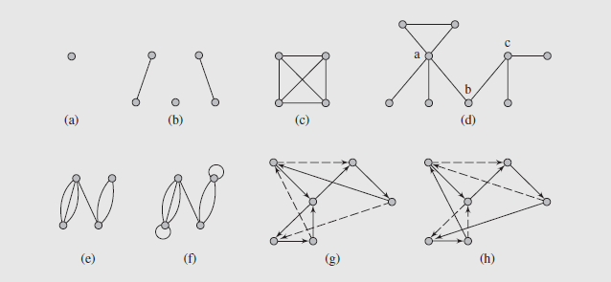
Introductory Remarks (continued)
Fig. 8.1 Examples of graphs: (a–d) simple graphs; (c) a complete graph K₄; (e) a multigraph;
(f) a pseudograph; (g) a circuit in a digraph; (h) a cycle in the digraph

Slide 45
Introductory Remarks (continued)
And, while many results are theoretical, the applications of graphs are numerous and worth consideration
First, though, we need to consider some definitions
A simple graph G = (V, E) consists of a (finite) set denoted by V, and a collection E, of unordered pairs {u, v} of distinct elements from V
Each element of V is called a vertex or a point or a node, and each element of E is called an edge or a line or a link
The number of vertices, the cardinality of V, is called the order of graph and devoted by |V|
The cardinality of E, called the size of graph, is denoted by |E|

Slide 46
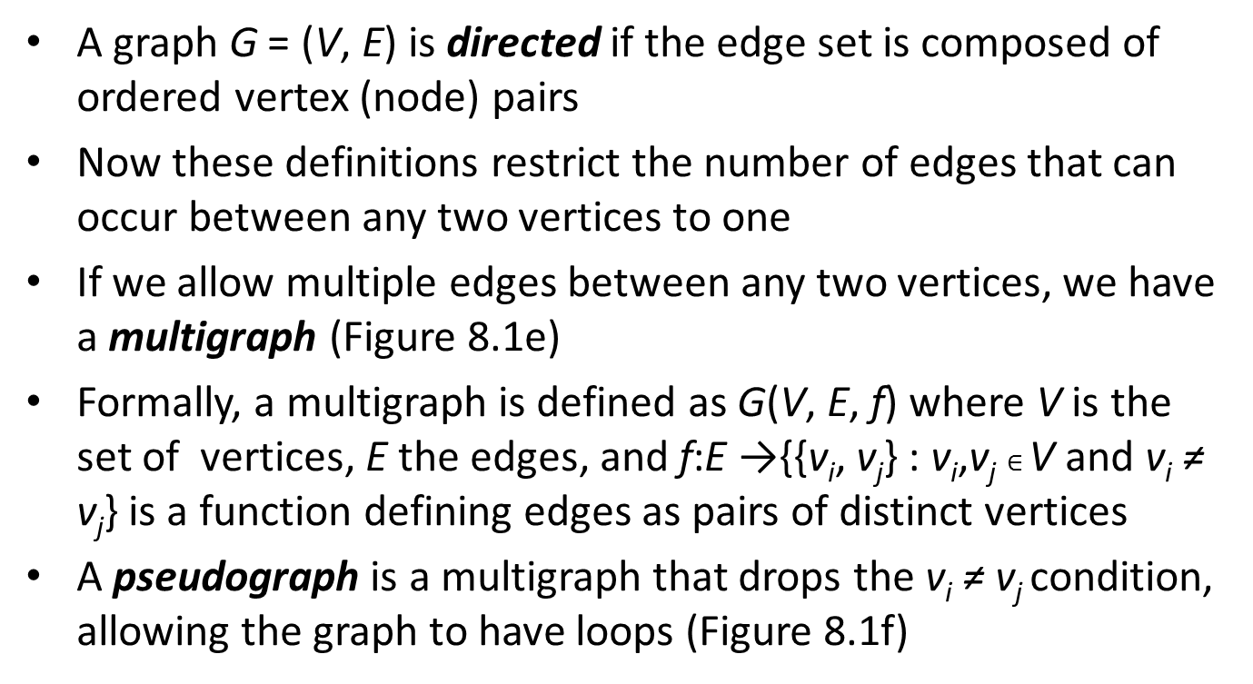
Introductory Remarks (continued)
A graph G = (V, E) is directed if the edge set is composed of ordered vertex (node) pairs
Now these definitions restrict the number of edges that can occur between any two vertices to one
If we allow multiple edges between any two vertices, we have a multigraph (Figure 8.1e)
Formally, a multigraph is defined as G(V, E, f) where V is the set of vertices, E the edges, and f:E →{{v_{i}, v_{j}} : v_{i},v_{j} $∈$ V and v_{i} ≠ v_{j}} is a function defining edges as pairs of distinct vertices
A pseudograph is a multigraph that drops the v_{i} ≠ v_{j} condition, allowing the graph to have loops (Figure 8.1f)

Slide 47
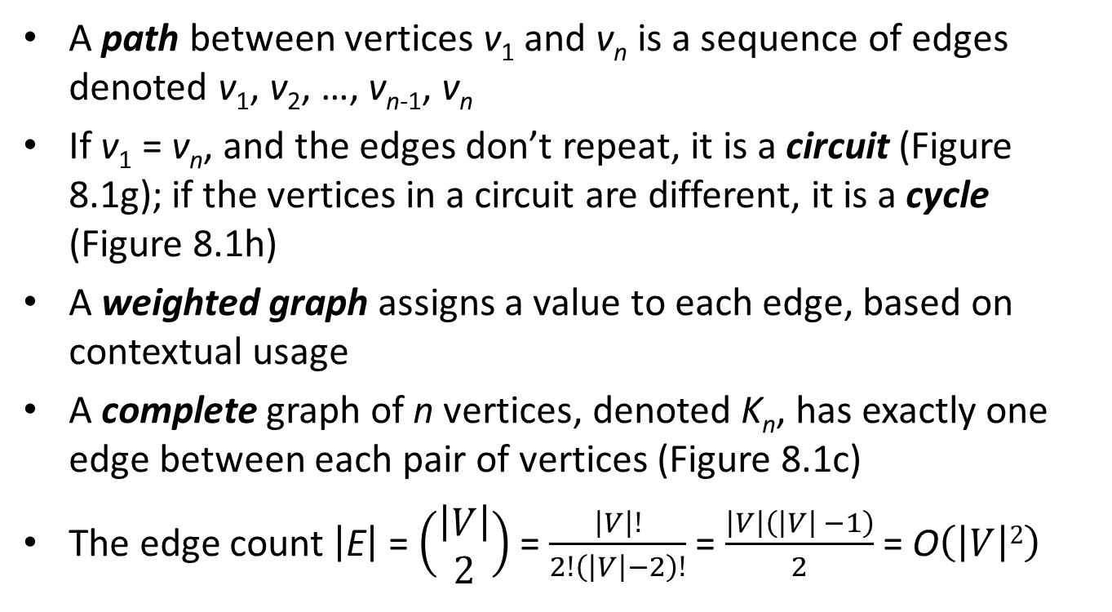
Introductory Remarks (continued)
A path between vertices v₁ and v_{n} is a sequence of edges denoted v₁, v₂, …, v_{n-1}, v_{n}
If v₁ = v_{n}, and the edges don’t repeat, it is a circuit (Figure 8.1g); if the vertices in a circuit are different, it is a cycle (Figure 8.1h)
A weighted graph assigns a value to each edge, based on contextual usage
A complete graph of n vertices, denoted K_{n}, has exactly one edge between each pair of vertices (Figure 8.1c)
The edge count $\left|\text{E}\right|$ = $\left(\begin{matrix}\left|V\right| \\ 2\end{matrix}\right)$ = $\frac{\left|V\right|!}{2!\left(\left|V\right|−2\right)!}$ = $\frac{\left|V\right|\left(\left|V\right| −1\right)}{2}$ = O$\left(\left|V\right|2\right)$

Slide 48
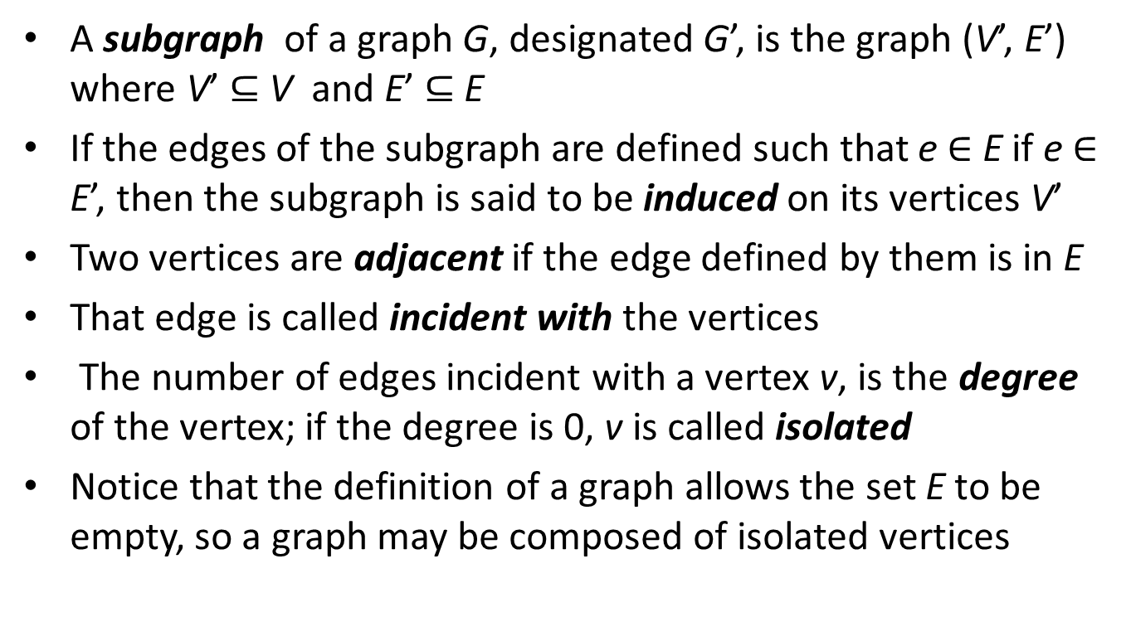
Introductory Remarks (continued)
A subgraph of a graph G, designated G’, is the graph (V’, E’) where V’ $⊆$ V and E’ $⊆$ E
If the edges of the subgraph are defined such that e $∈$ E if e $∈$ E’, then the subgraph is said to be induced on its vertices V’
Two vertices are adjacent if the edge defined by them is in E
That edge is called incident with the vertices
The number of edges incident with a vertex v, is the degree of the vertex; if the degree is 0, v is called isolated
Notice that the definition of a graph allows the set E to be empty, so a graph may be composed of isolated vertices

Slide 49
Graph Representation
Graphs can be represented in a number of ways
One of the simplest is an adjacency list, where each vertex adjacent to a give vertex is listed
This can be designed as a table (known as a star representation) or a linked list, shown in Figure 8.2b-c on page 393
Another representation is as a matrix, which can be designed in two ways
An adjacency matrix is a |V| x |V| binary matrix where:

Slide 50
Graph Representation (continued)
An example of an adjacency matrix is shown in Figure 8.2d
The order of the vertices in the matrix is arbitrary, so there are n! possible matrices for a graph of n vertices
It is also possible to generalize an adjacency matrix definition to handle a multigraph by defining a_{ij} = number of edges between v_{i} and v_{j}
A second matrix representation is based on incidences, hence the name incidence matrix
An incidence matrix is a |V| x |E| binary matrix where:

Slide 51
Graph Representation (continued)
An example of an incidence matrix is shown in Figure 8.2e
For a multigraph, many columns are the same, and a column with a single 1 represents a loop
As far as usage, the proper structure depends to a great extent on the kinds of operations that need to be done

Slide 52
Graph Traversals
Like tree traversals, graph traversals visit each node once
However, we cannot apply tree traversal algorithms to graphs because of cycles and isolated vertices
One algorithm for graph traversal, called the depth-first search, was developed by John Hopcroft and Robert Tarjan in 1974
In this algorithm, each vertex is visited and then all the unvisited vertices adjacent to that vertex are visited
If the vertex has no adjacent vertices, or if they have all been visited, we backtrack to that vertex’s predecessor
This continues until we return to the vertex where the traversal started

Slide 53
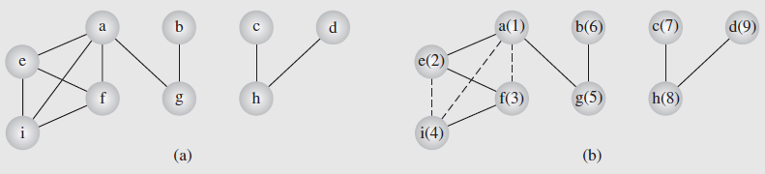
Graph Traversals (continued)
If any vertices remain unvisited at this point, the traversal restarts at one of the unvisited vertices
Although not necessary, the algorithm assigns unique numbers to the vertices, so they are renumbered
Pseudocode for this algorithm is shown on page 395
Figure 8.3 shows an example of this traversal; the numbers indicate the order in which the nodes are visited; the solid lines indicate the edges traversed during the search
Fig. 8.3 An example of application of the depthFirstSearch() algorithm to a graph

Slide 54
Graph Traversals (continued)
The algorithm guarantees that we will create a tree (or a forest, which is a set of trees) including the graph’s vertices
Such a tree is called a spanning tree
The guarantee is based on the algorithm not processing any edge that leads to an already visited node
Consequently, some edges are not included in the tree (marked with dashed lines)
The edges included in the tree are called forward edges; those omitted are called back edges
In Figure 8.4, we can see this algorithm applied to a digraph, which is a graph where the edges have a direction

Slide 55
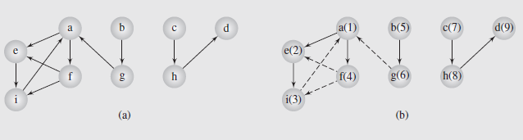
Graph Traversals (continued)
Fig. 8.4 The depthFirstSearch() algorithm applied to a digraph
Notice in this case we end up with a forest of three trees, because the traversal must follow the direction of the edges
There are a number of algorithms based on depth-first searching
However, some are more efficient if the underlying mechanism is breadth-first instead

Slide 56
Graph Traversals (continued)
Recall from our consideration of tree traversals that depth-first traversals used a stack, while breadth-first used queues
This can be extended to graphs, as the pseudocode on page 397 illustrates
Figure 8.4 shows this applied to a graph; Figure 8.5 shows the application to a digraph
In both, the basic operation is to mark all the vertices accessible from a given vertex, placing them in a queue as they are visited
The first vertex in the queue is then removed, and the process repeated
No visited nodes are revisited; if a node has no accessible nodes, the next node in the queue is removed and processed

Slide 57
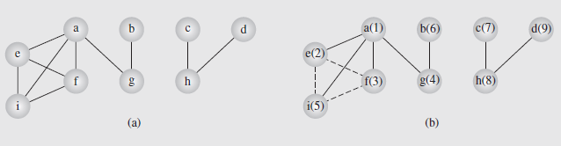
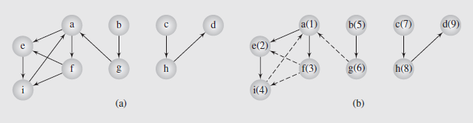
Graph Traversals (continued)
Fig. 8.5 An example of application of the breadthFirstSearch() algorithm to a graph
Fig. 8.6 The breadthFirstSearch() algorithm applied to a digraph

