Slide 1
Traversal-Based Algorithms: Topological Sorting Strong Connectivity
Notes:
# Every module has the following content
* Title (1 slide)
* Table of Contents (1 slide) – where are we in the material?
* Motivation (1 slide) – why do we need this module?
* Anchor Task (1x) – introduce the key problem handled by this module
* Objectives (1x)
* Theory Section (1 subtitle + more slides) or Demo Section (1 subtitle + more slides)
* Summary (1x) * References (1x)

Slide 2
DAGs and Topological Ordering
D
E
A directed acyclic graph (DAG) is a digraph that has no directed cycles
A topological ordering of a digraph is a numbering
v₁ , …, v_{n}
of the vertices such that for every edge (v_{i} , v_{j}), we have i < j
Example: in a task scheduling digraph, a topological ordering a task sequence that satisfies the precedence constraints
Theorem
A digraph admits a topological ordering if and only if it is a DAG
B
C
A
DAG G
v₄
v₅
D
E
v₂
B
v₃
v₁
C
Topological ordering of G
A

Slide 3
Topological Sorting
Number vertices, so that (u,v) in E implies u < v
wake up
1
A typical student day
2
3
eat
study computer sci.
4
5
nap
more c.s.
7
play
8
write c.s. program
6
9
work out
bake cookies
10
sleep
11
dream about graphs

Slide 4
Algorithm for Topological Sorting
Note: This algorithm is different than the one in the book
Running time: O(n + m)
Algorithm TopologicalSort(G)
H ← G // Temporary copy of G
n ← G.numVertices()
while H is not empty do
Let v be a vertex with no outgoing edges
Label v ← n
n ← n − 1
Remove v from H

Slide 5
Implementation with DFS
Simulate the algorithm by using depth-first search
O(n+m) time.
Algorithm topologicalDFS(G, v)
Input graph G and a start vertex v of G
Output labeling of the vertices of G in the connected component of v
v.setLabel(VISITED)
for all e ∈ v.outEdges() { outgoing edges }
w ← e.opposite(v)
if w.getLabel() = UNEXPLORED
{ e is a discovery edge }
topologicalDFS(G, w)
else
{ e is a forward or cross edge }
Label v with topological number n
n ← n - 1
Algorithm topologicalDFS(G)
Input dag G
Output topological ordering of G n ← G.numVertices()
for all u ∈ G.vertices()
u.setLabel(UNEXPLORED)
for all v ∈ G.vertices()
if v.getLabel() = UNEXPLORED
topologicalDFS(G, v)

Slide 6
Topological Sorting Example

Slide 7
Topological Sorting Example
9

Slide 8
Topological Sorting Example
8
9

Slide 9
Topological Sorting Example
7
8
9

Slide 10
Topological Sorting Example
6
7
8
9

Slide 11
Topological Sorting Example
6
5
7
8
9

Slide 12
Topological Sorting Example
4
6
5
7
8
9

Slide 13
Topological Sorting Example
3
4
6
5
7
8
9

Slide 14
Topological Sorting Example
2
3
4
6
5
7
8
9

Slide 15
Topological Sorting Example
2
1
3
4
6
5
7
8
9

Slide 16
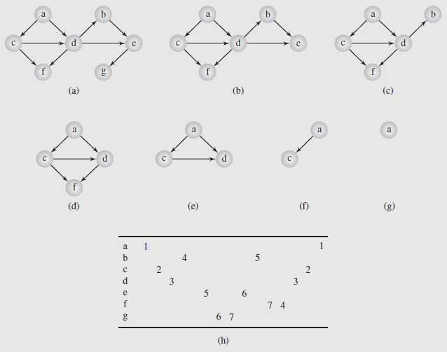
Topological Sort – Brute Force Algorithm
topologicalSort(digraph)
for i = 1 to |V|
find a minimal vertex v;
num(v) = i;
remove from digraph vertex v and all edges incident with v;
As can be seen, we locate a vertex, v with no outgoing edges
Such a vertex is called a minimal vertex or sink
Notes:
We then remove any edges leading from a vertex to v
Figure 8.18 shows this process; the graph in Figure 8.18a goes through a series of deletions (Figure 8.18b-f) to produce the sequence g, e, b, f, d, c, a

Slide 17
Topological Sort (continued)
It is not actually necessary to delete the edges and vertices from a digraph during this processing
If we can determine that all successors of the vertex v have been processed, they can be considered deleted
This is once again handled by applying the depth-first search techniques seen earlier
Basically, if the search backtracks to v, then all its successors can be assumed to have already been searched
The pseudocode for this algorithm is shown on pages 421 and 423
The table (Figure 8.18h) shows how the numbers are assigned for each vertex of the graph of Figure 8.18a

Slide 18
Reachability
DFS tree rooted at v: vertices reachable from v via directed paths
E
D
E
D
C
A
C
F
E
D
A
B
C
F
A
B
Notes:
In many graph problems we want to find a path from a given vertex to any other vertex
In undirected graphs this means there are no separate pieces in the graph (subgraphs)
In a digraph, we may be able to get to some vertices in a particular direction, but not return to the starting vertex
Connectivity is described in terms of degrees; a graph is more or less connected depending on the number of different paths between vertices
An n-connected graph has at least n different paths between any two vertices
This means there are n paths between the vertices that have no vertices in common

Slide 19
Strong Connectivity
Each vertex can reach all other vertices
a
g
c
d
e
b
f

Slide 20
Strong Connectivity Algorithm
Pick a vertex v in G
Perform a (single iteration of) DFS from v in G
If there’s a w not visited, print “no”
Let G’ be G with edges reversed
Perform a DFS from v in G’
If there’s a w not visited, print “no”
Else, print “yes”
Running time: O(n+m)
G:
a
c
g
d
e
f
b
a
G’:
c
g
d
e
f
b

Slide 21
Strongly Connected Components
Maximal subgraphs such that each vertex can reach all other vertices in the subgraph
Can also be done in O(n+m) time using DFS, but is more complicated (similar to biconnectivity). This would be Kosaraju Algorithm (see handout).
a
g
{ a , c , g }
c
d
e
{ f , d , e , b }
f
b

Slide 22
Connectivity (continued)
One special type of graph is the biconnected (or 2-connected) graph, which has at least two non-overlapping paths between two vertices
If we can find a vertex that always has to be included in the path between vertices a and b, then the graph is not biconnected
Removing this vertex, and its incident edges, will split the graph into two subgraphs
These vertices are referred to as cut-vertices or articulation points
If the graph can be split on an edge, the edge is referred to as a cut-edge or bridge
If connected subgraphs have no articulation points or bridges, they are called blocks (if there are at least two vertices, they are biconnected components)

Slide 23
Connectivity (continued)
Connectivity in Undirected Graphs (continued)
We can detect articulation points by extending the depth-first algorithm to create a tree with forward and back edges
A vertex in the resulting tree is an articulation point if it has at least one subtree unconnected with any of its predecessors by a back edge
This is illustrated in Figure 8.16 on page 417
A special case of articulation points occurs when the vertex involved is a root with more than one descendant
In the case of the graph in Figure 8.16, a is the root, and has three incident edges; however, only one becomes a forward edge
This is because the other two are processed by the depth-first search

Slide 24
Connectivity in Undirected Graphs
Consequently, if a is reached again, there will be no untried edge, whereas if a were a cut-vertex there would be at least one such edge
So for a given vertex, v, the vertex is an articulation point if:
v is the root of a depth-first tree and has more than one descendant in the tree OR
at least one of v’s subtrees includes no vertex connected by a back edge with any of v’s predecessors
To find articulation points, a parameter pred(v)is used, defined as the smallest value of the set of vertices connected by a back edge with either v or a predecessor of v
A stack is used to store the currently processed edges; after the cut-vertex is identified, the graph edges comprising the block are output
The pseudocode for the algorithm is on pages 416 and 418

Slide 25
Connectivity (continued)
Connectivity in Directed Graphs (continued)
With directed graphs, defining connectedness depends on whether or not the direction of the edges is considered
A weakly connected digraph is one where the undirected graph with the same edges and vertices is connected
A strongly connected digraph has, for every pair of vertices, a path between them in both directions
A digraph may not be strongly connected, yet contain strongly connected components (SCCs)
These are subsets of vertices in the digraph that of themselves represent a strongly connected digraph

Slide 26
Connectivity (continued)
Connectivity in Directed Graphs (continued)
Depth-first search can also be used in determining SCCs
The root of the SCC is the first vertex of the SCC for which the depth-first search is applied
Because every vertex in the SCC is reachable from this root, the value of the root will be less than the value of any other vertex in the SCC
Only after those vertices are visited will the depth-first search backtrack to the root
At that point the SCC that is accessible from this root can be output
The problem then is how to find these vertices in the digraph, which is a problem similar to finding cut-vertices in an undirected graph

Slide 27
Connectivity (continued)
Connectivity in Directed Graphs (continued)
To do this, the pred(v) parameter is used, which is the lower of num(v) and pred(u), u being a vertex reachable from v and in the same SCC
Of course this leads to the question of how we can determine if two vertices are in the same SCC before we determine if it is an SCC
This can be done using a stack to store the vertices of all SCCs under construction
The topmost vertices will be in the current SCC
This way we know what vertices are already in the SCC even though the construction isn’t finished
The algorithm, attributed to Robert Trajan, is shown on page 419; an example of the execution is shown in Figure 8.17 on page 420

