Slide 1
Graphs: Shortest Paths
Notes:
# Every module has the following content
* Title (1 slide)
* Table of Contents (1 slide) – where are we in the material?
* Motivation (1 slide) – why do we need this module?
* Anchor Task (1x) – introduce the key problem handled by this module
* Objectives (1x)
* Theory Section (1 subtitle + more slides) or Demo Section (1 subtitle + more slides)
* Summary (1x) * References (1x)

Slide 2
Why graph algorithms are so varied and broadly represented?
Graph algorithms illustrate most of the algorithmic thinking patterns. (Much like sorting algorithms).
Many practical tasks are either directly formulated in graph language or are reducible to the graph language.
See 2-Satisfiability https://en.wikipedia.org/wiki/2-satisfiability
Notes:
* For people who want to become professionals = can create systems that others will use
* For people who like to challenge themselves with difficult problems.
* For highly motivated people who also want to sleep; who take normal course-load, but typically do not work full-time yet.

Slide 3
Weighted Graphs
In a weighted graph, each edge has an associated numerical value, called the weight of the edge
Edge weights may represent, distances, costs, etc.
Example:
In a flight route graph, the weight of an edge represents the distance in miles between the endpoint airports
849
PVD
1843
ORD
142
SFO
802
LGA
1743
1205
337
1387
HNL
2555
1099
LAX
1233
DFW
1120
MIA

Slide 4
Shortest Paths
Given a weighted graph and two vertices u and v, we want to find a path of minimum total weight between u and v.
Length of a path is the sum of the weights of its edges.
Example:
Shortest path between Providence and Honolulu
Applications
Internet packet routing
Flight reservations
Driving directions
849
PVD
1843
ORD
142
SFO
802
LGA
1743
1205
337
1387
HNL
2555
1099
LAX
1233
DFW
1120
MIA

Slide 5
Shortest Path Properties
Property 1:
A subpath of a shortest path is itself a shortest path
Property 2:
There is a tree of shortest paths from a start vertex to all the other vertices
Example:
Tree of shortest paths from Providence
849
PVD
1843
ORD
142
SFO
802
LGA
1743
1205
337
1387
HNL
2555
1099
LAX
1233
DFW
1120
MIA

Slide 6
Dijkstra’s Algorithm
The distance of a vertex v from a vertex s is the length of a shortest path between s and v
Dijkstra’s algorithm computes the distances of all the vertices from a given start vertex s
Assumptions:
the graph is connected
the edges are undirected
the edge weights are nonnegative
We grow a “cloud” of vertices, beginning with s and eventually covering all the vertices
We store with each vertex v a label d(v) representing the distance of v from s in the subgraph consisting of the cloud and its adjacent vertices
At each step
We add to the cloud the vertex u outside the cloud with the smallest distance label, d(u)
We update the labels of the vertices adjacent to u

Slide 7
Edge Relaxation
Consider an edge e = (u,z) such that
u is the vertex most recently added to the cloud
z is not in the cloud
The relaxation of edge e updates distance d(z) as follows:
d(z) ← min{d(z),d(u) + weight(e)}
d(u) = 50
10
d(z) = 75
u
e
s
z
d(u) = 50
10
d(z) = 60
u
e
s
z

Slide 8
Example
0
0
8
A
4
8
A
4
2
2
8
7
2
1
4
8
7
2
1
3
B
C
D
B
C
D
∞
3
9
∞
5
3
9
8
2
E
F
5
2
E
F
5
0
0
8
A
4
8
A
4
2
2
8
7
2
1
3
7
7
2
1
3
B
C
D
B
C
D
5
3
9
11
5
3
9
8
2
E
F
5
2
E
F
5

Slide 9
Example (cont.)
0
8
A
4
2
7
7
2
1
3
B
C
D
5
3
9
8
2
E
F
5
0
8
A
4
2
7
7
2
1
3
B
C
D
5
3
9
8
2
E
F
5

Slide 10
Dijkstra’s Algorithm
Algorithm DijkstraDistances(G, s)
Q ← new heap-based priority queue
for all v ∈ G.vertices()
if v = s
v.setDistance(0)
else
v.setDistance(∞)
l ← Q.insert(v.getDistance(), v)
v.setEntry(l)
while ¬Q.empty()
l ← Q.removeMin()
u ← l.getValue()
for all e ∈ u.incidentEdges() { relax e }
z ← e.opposite(u)
r ← u.getDistance() + e.weight()
if r < z.getDistance()
z.setDistance(r) Q.replaceKey(z.getEntry(), r)
A heap-based adaptable priority queue with location-aware entries stores the vertices outside the cloud
Key: distance
Value: vertex
Recall that method replaceKey(l,k) changes the key of entry l
We store two labels with each vertex:
Distance
Entry in priority queue

Slide 11
Analysis of Dijkstra’s Algorithm
Graph operations
Method incidentEdges is called once for each vertex
Label operations
We set/get the distance and locator labels of vertex z O(deg(z)) times
Setting/getting a label takes O(1) time
Priority queue operations
Each vertex is inserted once into and removed once from the priority queue, where each insertion or removal takes O(log n) time
The key of a vertex in the priority queue is modified at most deg(w) times, where each key change takes O(log n) time
Dijkstra’s algorithm runs in O((n + m) log n) time provided the graph is represented by the adjacency list structure
Recall that Σ_{v} deg(v) = 2m
The running time can also be expressed as O(m log n) since the graph is connected

Slide 12
Shortest Paths Tree
Algorithm DijkstraShortestPathsTree(G, s)
…
for all v ∈ G.vertices()
…
v.setParent(∅)
…
for all e ∈ u.incidentEdges()
{ relax edge e }
z ← e.opposite(u)
r ← u.getDistance() + e.weight()
if r < z.getDistance()
z.setDistance(r)
z.setParent(e)
Q.replaceKey(z.getEntry(),r)
Using the template method pattern, we can extend Dijkstra’s algorithm to return a tree of shortest paths from the start vertex to all other vertices
We store with each vertex a third label:
parent edge in the shortest path tree
In the edge relaxation step, we update the parent label

Slide 13
Why Dijkstra’s Algorithm Works
Dijkstra’s algorithm is greedy by increasing distance.
Suppose it didn’t find all shortest distances. Let F be the first wrong vertex the algorithm processed.
When the previous node, D, on the true shortest path was considered, its distance was correct
But the edge (D,F) was relaxed at that time!
Thus, so long as d(F)>d(D), F’s distance cannot be wrong. That is, there is no wrong vertex
0
8
A
4
2
7
7
2
1
3
B
C
D
5
3
9
8
2
E
F
5

Slide 14
Why It Doesn’t Work for Negative-Weight Edges
If a node with a negative incident edge were to be added late to the cloud, it could mess up distances for vertices already in the cloud.
Dijkstra’s algorithm is based on the greedy method. It adds vertices by increasing distance.
Picture: C’s true distance is 1, but it is already in the cloud with d(C)=5!
0
8
A
4
6
7
7
5
1
4
B
C
D
5
0
-8
9
2
E
F
5

Slide 15
Bellman-Ford Algorithm (not in book)
Works even with negative-weight edges
Must assume directed edges (for otherwise we would have negative-weight cycles)
Iteration i finds all shortest paths that use i edges.
Running time: O(nm).
Can be extended to detect a negative-weight cycle if it exists
How?
Algorithm BellmanFord(G, s)
for all v ∈ G.vertices()
if v = s
v.setDistance(0)
else
v.setDistance(∞)
for i ← 1 to n − 1 do
for each e ∈ G.edges()
{ relax edge e }
u ← e.origin()
z ← e.opposite(u)
r ← u.getDistance() + e.weight()
if r < z.getDistance()
z.setDistance(r)

Slide 16
Bellman-Ford Example
Nodes are labeled with their d(v) values
8
0
4
8
0
4
-2
-2
7
1
8
7
-2
1
4
∞
∞
∞
∞
∞
∞
3
9
3
9
-2
∞
∞
5
-2
∞
∞
5
8
0
4
8
0
4
-2
-2
5
8
7
-2
1
4
-1
5
7
-2
1
-1
1
3
9
3
9
-2
6
9
5
-2
4
5
∞
∞
1
9

Slide 17
DAG-based Algorithm (not in book)
Works even with negative-weight edges
Uses topological order
Doesn’t use any fancy data structures
Is much faster than Dijkstra’s algorithm
Running time: O(n+m).
Algorithm DagDistances(G, s)
for all v ∈ G.vertices()
if v = s
v.setDistance(0)
else
v.setDistance(∞)
{ Perform a topological sort of the vertices }
for u ← 1 to n do {in topological order}
for each e ∈ u.outEdges()
{ relax edge e }
z ← e.opposite(u)
r ← u.getDistance() + e.weight()
if r < z.getDistance()
z.setDistance(r)

Slide 18
DAG Example
Nodes are labeled with their d(v) values
1
1
8
0
4
8
0
4
-2
-2
3
7
2
1
4
3
8
7
2
-2
1
4
4
∞
∞
∞
∞
∞
∞
3
9
3
9
-5
∞
∞
5
-5
∞
∞
5
6
5
6
5
1
1
8
0
4
8
0
4
-2
-2
3
5
7
2
1
4
-1
3
7
2
1
4
8
-2
4
5
-2
-1
3
9
3
9
-5
1
7
5
-5
0
4
5
∞
∞
1
7
6
5
6
5
(two steps)

Slide 19
Shortest Paths
A classical problem in graph theory is finding the shortest path between two nodes, with numerous approaches suggested
The edges of the graph are associated with values denoting such things as distance, time, costs, amounts, etc.
If we’re determining the distance between two vertices, say v and u, information about the distance between the intermediate vertices in the path, w, needs to be kept track of
This can be recorded as a label associated with the vertices
The label may simply be the distance between vertices, or the distance along with the current node’s predecessor in the path
Methods for finding shortest paths depend on these labels

Slide 20
Shortest Paths (continued)
Based on how many times the labels are updated, solutions to the shortest path problem fall into two groups
In label-setting methods, one vertex is assigned a value that remains unchanged
This occurs each time we go through the vertices that remain to be processed
The main drawback to this is that we cannot process graphs that have negative weights on any edges
In label-correcting methods, any label can be changed
This means it can be applied to graphs with negative weights as long as they don’t have negative cycles (a cycle where the sum of the edges is a negative value)

Slide 21
Shortest Paths (continued)
However this method guarantees that after processing is complete, for all vertices the current distances indicate the shortest path
Most of these forms (both label-setting and label-correcting) can be looked at as part of the same general process, however
That is the task of finding the shortest paths from one vertex to all the other vertices, the pseudocode being on page 399
In this algorithm, a label is defined as:
label(v) = (currDist(v),predecessor(v))
Two open issues in the code are the design of the set called toBeChecked and the order new values are assigned to v
It is the design of the set that impacts both the choice of v and the efficiency of the algorithm

Slide 22
Shortest Paths (continued)
The distinction between label-setting and label-correcting algorithms is the way the value for vertex v is chosen
This is the vertex in the set toBeChecked with the smallest current distance
In considering label-setting algorithms, one of the first was developed by Edsgar Dijkstra in 1956
In this algorithm, the shortest from among a number of paths from a vertex, v, are tried
This means that a particular path may be extended by adding one more edge to it each time v is checked
However, if the path is longer than any other path from that point, it is dropped, and the other path is expanded

Slide 23
Shortest Paths (continued)
Since the vertices may have more than one outgoing edge, each new edge adds possible paths for exploration
Thus each vertex is visited, the new paths are started, and the vertex is then not used anymore
Once all the vertices are visited, the algorithm is done
Dijkstra’s algorithm is shown on page 400; it is derived from the general algorithm by changing the line
v=a vertex in toBeChecked;
to
v=a vertex in toBeChecked with minimal currDist(v);
It also extends the condition in the if to make permanent the current distance of vertices eliminated from the set

Slide 24
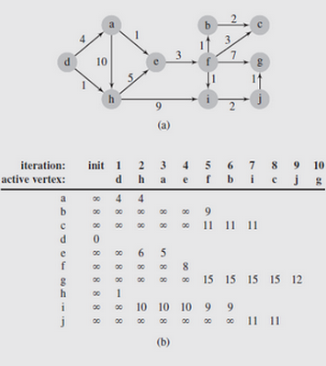
Shortest Paths (continued)
Notice that the set’s structure is not indicated; recall it is the structure that determines efficiency
Figure 8.7 illustrates this for the graph in part (a)
Fig. 8.7 An execution of DijkstraAlgorithm()

Slide 25
Shortest Paths (continued)
As a label-setting algorithm, Dijkstra’s approach may fail when negative weights are used in graphs
To deal with that, a label-correcting algorithm is needed
One of the first label-correcting algorithms was developed by Lester R. Ford, Jr. in the late 1950s
It uses the same technique as Dijkstra’s method to set the current distances, but postpones determining the shortest distance for any vertex until the entire graph is processed
While it is capable of handling graphs with negative weights, it cannot deal with negative cycles
In the algorithm, all edges are watched in an attempt to find an improvement for the current distance of the vertices

Slide 26
Shortest Paths (continued)
The pseudocode for the algorithm is shown on page 402
To facilitate monitoring the vertices, an alphabetic sequence can be used
That way the algorithm can go through the list repeatedly and adjust any vertex’s current distance as needed
Figure 8.8 contains an example of this; note that the graph does include negatively weighted edges
While a vertex may change its current distance during the same iteration, when done each vertex can be reached by the shortest path from the starting vertex

Slide 27
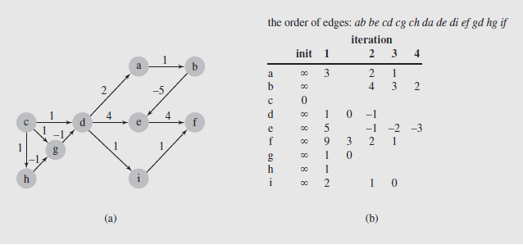
Shortest Paths (continued)
Fig. 8.8 FordAlgorithm() applied to a digraph with negative weights
In the case of Dijkstra’s algorithm, we observed that the efficiency can be improved by the choice of data structure
This in turn impacts the way the edges and vertices are scanned

Slide 28
Shortest Paths (continued)
This observation also holds for label-correcting algorithms; in particular, the FordAlgorithm()specifies no order for edge checking
In the example of Figure 8.8, the approach was to visit all adjacency lists of all vertices in each iteration
However this requires that all the edges are checked every time, which is inefficient
A more sensible organization of the vertices can reduce the number of visits per vertex
The generic algorithm on page 399 suggests an improvement by explicitly accessing toBeChecked
In the FordAlgorithm()this structure is used implicitly, and then only as the set of all vertices

Slide 29
Shortest Paths (continued)
So based on this, we can derive a general label-correcting algorithm, shown in pseudocode on page 403
As indicated before, the efficiency of the algorithm depends directly on the data structure used for toBeChecked
One possibility is a queue, and was the basis for one of the earliest implementations
With a queue, as a vertex, v is removed, the current distance to its neighbors is checked
If any of those distances is updated, the vertex whose distance was changed is added to the queue
While straightforward, it can sometimes reevaluate the same labels excessively

Slide 30
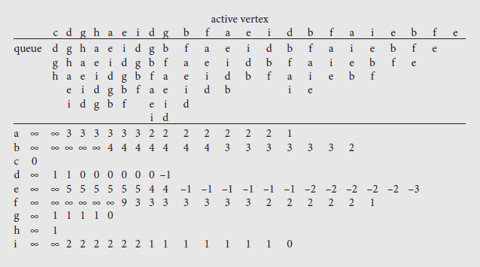
Shortest Paths (continued)
Figure 8.9 illustrates this problem for the graph of Figure 8.8a
As can be seen, a number of vertices are updated multiple times

Slide 31
Shortest Paths (continued)
To avoid this situation, a deque can be used in place of the queue
In this approach, vertices needing to be checked for the first time are added at the end, otherwise they are placed in front
The reasoning behind this is that if a given vertex, v, is included for the first time, the vertices accessible from it have yet to be processed, so they will be processed after v
However, if v has been processed, those vertices are likely still in the list awaiting processing, so putting v in front may avoid unnecessary updates
Figure 8.10 shows the result of using a deque instead of a queue

Slide 32
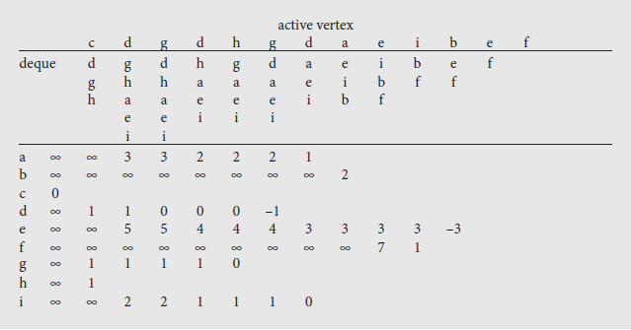
Shortest Paths (continued)
Fig. 8.10 An execution of labelCorrectingAlgorithm(), which applies a deque
The use of a deque does suffer from one problem, however
Its worst case performance is exponential in the number of vertices

Slide 33
Shortest Paths (continued)
However, the average case is about 60% better than the queue version of the same algorithm
A variation of this approach uses two queues separately, rather than combined in a deque
In this variation, vertices enqueued for the first time are placed in the first queue; otherwise they are placed in the second
Vertices are then dequeued from the first queue if it is not empty; otherwise they are taken from the second
The threshold algorithm is another variation of the label-correcting method that uses two lists
Vertices are removed from the first list for processing

Slide 34
Shortest Paths (continued)
A vertex will be added to the end of the first list if the value of its label is below the threshold level
Otherwise it will be added to the second list
If the first list becomes empty, the threshold is modified to a value greater than the minimum label value of all vertices in the second list
Then those vertices whose labels are less than the new threshold are moved from the second list to the first list
Yet another approach is the small label first method
In this method, a vertex is placed at the front of the deque if its label is smaller than the label of the current front of the deque; otherwise it is placed at the rear

Slide 35
Shortest Paths (continued)
All-to-All Shortest Path Problem
Given the issues of finding the shortest path from one vertex to another, the problem of finding all shortest paths between two vertices might seem daunting
However, a method developed by Stephen Warshall in 1962 does it fairly easily, as long as an adjacency matrix that provides edge weights is available
This technique can also handle negative edge weights and the algorithm is shown on page 406
An example of the algorithm’s application, together with the accompanying adjacency matrix, is shown in Figure 8.11 on page 407
The algorithm can also detect cycles if the diagonal of the matrix is initialized to ∞ instead of 0
If any of the diagonal values get changed, the graph contains a cycle

Slide 36
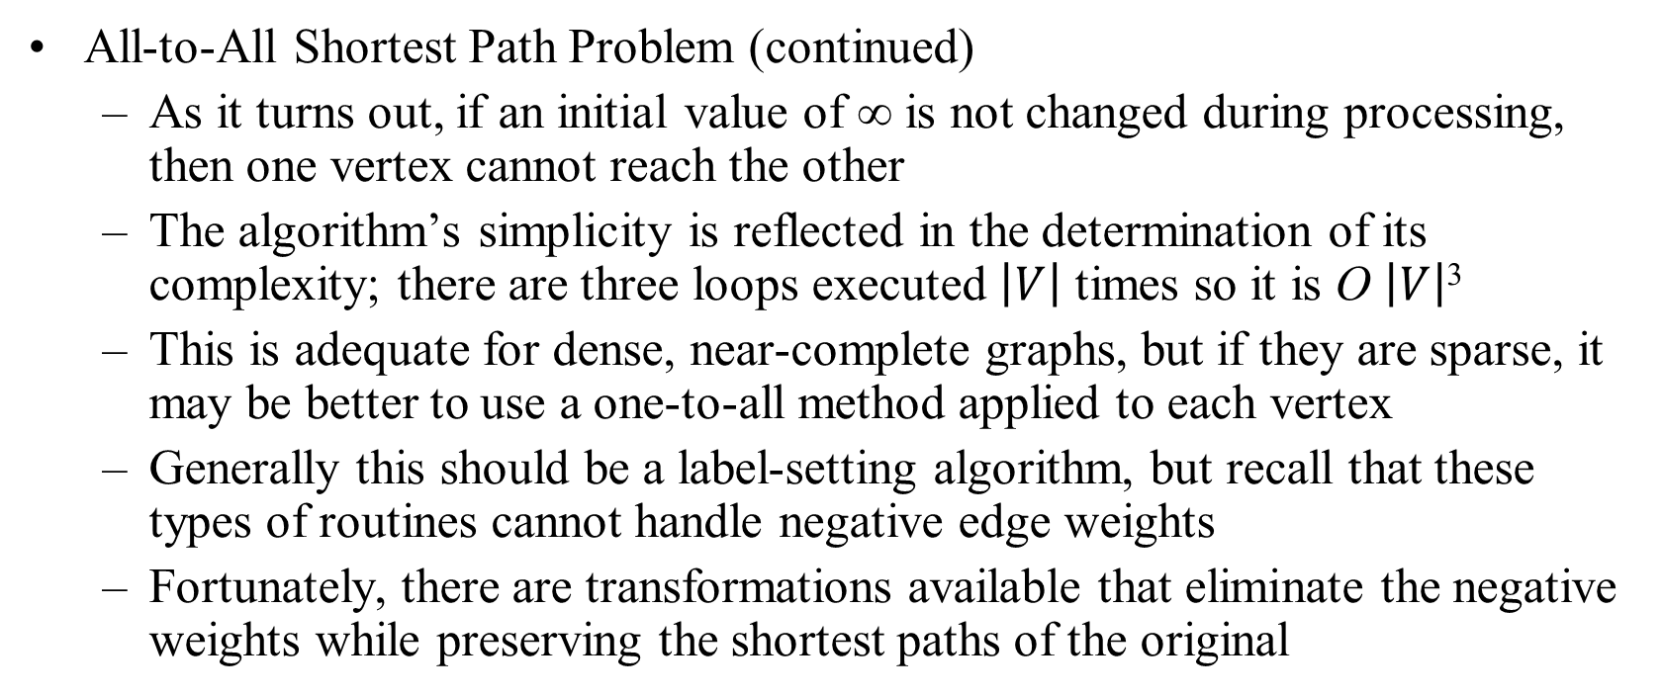
Shortest Paths (continued)
All-to-All Shortest Path Problem (continued)
As it turns out, if an initial value of ∞ is not changed during processing, then one vertex cannot reach the other
The algorithm’s simplicity is reflected in the determination of its complexity; there are three loops executed $\left|V\right|$ times so it is O $\left|V\right|$³
This is adequate for dense, near-complete graphs, but if they are sparse, it may be better to use a one-to-all method applied to each vertex
Generally this should be a label-setting algorithm, but recall that these types of routines cannot handle negative edge weights
Fortunately, there are transformations available that eliminate the negative weights while preserving the shortest paths of the original

Slide 37
Minimum Spanning Trees
Spanning subgraph
Subgraph of a graph G containing all the vertices of G
Spanning tree
Spanning subgraph that is itself a (free) tree
Minimum spanning tree (MST)
Spanning tree of a weighted graph with minimum total edge weight
Applications
Communications networks
Transportation networks
ORD
10
1
PIT
DEN
6
7
9
3
DCA
4
STL
8
5
2
DFW
ATL

Slide 38
Cycle Property
f
8
Cycle Property:
Let T be a minimum spanning tree of a weighted graph G
Let e be an edge of G that is not in T and C let be the cycle formed by e with T
For every edge f of C, weight(f) ≤ weight(e)
Proof:
By contradiction
If weight(f) > weight(e) we can get a spanning tree of smaller weight by replacing e with f
4
C
9
2
6
3
e
8
7
7
Replacing f with e yields a better spanning tree
f
8
4
C
9
2
6
3
e
8
7
7

Slide 39
Partition Property
U
V
f
7
Partition Property:
Consider a partition of the vertices of G into subsets U and V
Let e be an edge of minimum weight across the partition
There is a minimum spanning tree of G containing edge e
Proof:
Let T be an MST of G
If T does not contain e, consider the cycle C formed by e with T and let f be an edge of C across the partition
By the cycle property, weight(f) ≤ weight(e)
Thus, weight(f) = weight(e)
We obtain another MST by replacing f with e
4
9
2
5
8
8
e
3
7
Replacing f with e yields another MST
U
V
f
7
4
9
2
5
8
8
e
3
7

Slide 40
Kruskal’s Algorithm
Partition vertices into clusters
Initially, single-vertex clusters
Keep an MST for each cluster
Merge “closest” clusters and their MSTs
A priority queue stores the edges outside clusters
Key: weight
Element: edge
At the end of the algorithm
One cluster and one MST
Algorithm KruskalMST(G)
for each vertex v in G do
Create a cluster consisting of v
let Q be a priority queue.
Insert all edges into Q
T ← ∅
{T is the union of the MSTs of the clusters}
while T has fewer than n − 1 edges do e ← Q.removeMin().getValue()
[u, v] ← G.endVertices(e)
A ← getCluster(u)
B ← getCluster(v)
if A ≠ B then
Add edge e to T
mergeClusters(A, B)
return T

Slide 41
Example
G
G
B
8
8
4
B
4
9
E
6
9
E
6
1
5
F
1
5
F
C
11
3
C
11
3
2
2
7
D
H
7
H
A
D
10
A
10
G
G
B
8
B
8
4
4
9
E
6
9
E
6
1
5
F
1
5
F
C
11
3
C
11
3
2
2
7
D
H
7
H
D
A
10
A
10

Slide 42
Example (contd.)
G
G
B
8
8
4
B
4
9
E
6
9
E
6
1
5
F
1
5
F
C
11
3
C
11
3
2
2
7
D
H
7
H
D
A
10
A
10
four steps
two steps
G
G
B
8
B
8
4
4
9
E
6
9
E
6
1
5
F
1
5
F
C
11
3
C
11
3
2
2
7
D
H
7
D
H
A
10
A
10

Slide 43
Data Structure for Kruskal’s Algorithm
The algorithm maintains a forest of trees
A priority queue extracts the edges by increasing weight
An edge is accepted it if connects distinct trees
We need a data structure that maintains a partition, i.e., a collection of disjoint sets, with operations:
makeSet(u): create a set consisting of u
find(u): return the set storing u
union(A, B): replace sets A and B with their union

Slide 44
Recall of List-based Partition
Each set is stored in a sequence
Each element has a reference back to the set
operation find(u) takes O(1) time, and returns the set of which u is a member.
in operation union(A,B), we move the elements of the smaller set to the sequence of the larger set and update their references
the time for operation union(A,B) is min(|A|, |B|)
Whenever an element is processed, it goes into a set of size at least double, hence each element is processed at most log n times

Slide 45
Partition-Based Implementation
Partition-based version of Kruskal’s Algorithm
Cluster merges as unions
Cluster locations as finds
Running time O((n + m) log n)
PQ operations O(m log n)
UF operations O(n log n)
Algorithm KruskalMST(G)
Initialize a partition P
for each vertex v in G do
P.makeSet(v)
let Q be a priority queue.
Insert all edges into Q
T ← ∅
{T is the union of the MSTs of the clusters}
while T has fewer than n − 1 edges do e ← Q.removeMin().getValue()
[u, v] ← G.endVertices(e)
A ← P.find(u)
B ← P.find(v)
if A ≠ B then
Add edge e to T
P.union(A, B)
return T

Slide 46
Prim-Jarnik’s Algorithm
Similar to Dijkstra’s algorithm
We pick an arbitrary vertex s and we grow the MST as a cloud of vertices, starting from s
We store with each vertex v label d(v) representing the smallest weight of an edge connecting v to a vertex in the cloud
At each step:
We add to the cloud the vertex u outside the cloud with the smallest distance label
We update the labels of the vertices adjacent to u

Slide 47
Prim-Jarnik’s Algorithm (cont.)
A heap-based adaptable priority queue with location-aware entries stores the vertices outside the cloud
Key: distance
Value: vertex
Recall that method replaceKey(l,k) changes the key of entry l
We store three labels with each vertex:
Distance
Parent edge in MST
Entry in priority queue
Algorithm PrimJarnikMST(G)
Q ← new heap-based priority queue
s ← a vertex of G
for all v ∈ G.vertices()
if v = s
v.setDistance(0)
else
v.setDistance(∞)
v.setParent(∅)
l ← Q.insert(v.getDistance(), v)
v.setLocator(l)
while ¬Q.empty()
l ← Q.removeMin()
u ← l.getValue()
for all e ∈ u.incidentEdges()
z ← e.opposite(u)
r ← e.weight()
if r < z.getDistance()
z.setDistance(r)
z.setParent(e) Q.replaceKey(z.getEntry(), r)

Slide 48
Example
∞
7
2
7
D
2
7
D
B
4
B
4
8
9
∞
5
9
∞
2
5
F
2
5
F
C
8
C
8
8
3
8
3
E
E
A
7
7
A
7
7
0
0
7
7
2
7
D
7
D
B
4
2
B
4
5
9
∞
9
4
2
5
F
5
5
C
2
F
8
C
8
8
3
3
E
8
A
7
E
0
7
A
7
7
0

Slide 49
Example (contd.)
7
2
7
D
B
4
5
9
4
2
5
F
C
8
8
3
E
A
7
3
7
0
7
D
2
B
4
5
9
4
2
5
F
C
8
8
3
E
A
7
3
0

Slide 50
Analysis
Graph operations
Method incidentEdges is called once for each vertex
Label operations
We set/get the distance, parent and locator labels of vertex z O(deg(z)) times
Setting/getting a label takes O(1) time
Priority queue operations
Each vertex is inserted once into and removed once from the priority queue, where each insertion or removal takes O(log n) time
The key of a vertex w in the priority queue is modified at most deg(w) times, where each key change takes O(log n) time
Prim-Jarnik’s algorithm runs in O((n + m) log n) time provided the graph is represented by the adjacency list structure
Recall that Σ_{v} deg(v) = 2m
The running time is O(m log n) since the graph is connected

Slide 51
Graph Assignment
Goals
Learn and implement the adjacency matrix structure an Kruskal’s minimum spanning tree algorithm
Understand and use the decorator pattern and various JDSL classes and interfaces
Your task
Implement the adjacency matrix structure for representing a graph
Implement Kruskal’s MST algorithm
Frontend
Computation and visualization of an approximate traveling salesperson tour

Slide 52
Adjacency Matrix Structure
a
v
b
Edge list structure
Augmented vertex objects
Integer key (index) associated with vertex
2D-array adjacency array
Reference to edge object for adjacent vertices
Null for non nonadjacent vertices
u
w
0
u
1
v
2
w
 | 0 | 1 | 2
0 | ∅ |  | ∅
1 |  | ∅
2 | ∅ |  | ∅
a
b

Slide 53
Kruskal’s Algorithm
The vertices are partitioned into clouds
We start with one cloud per vertex
Clouds are merged during the execution of the algorithm
Partition ADT:
makeSet(o): create set {o} and return a locator for object o
find(l): return the set of the object with locator l
union(A,B): merge sets A and B
Algorithm KruskalMSF(G)
Input weighted graph G
Output labeling of the edges of a minimum spanning forest of G
Q ← new heap-based priority queue
for all v ∈ G.vertices() do
l ← makeSet(v) { elementary cloud }
v.setLocator(l)
for all e ∈ G.edges() do
Q.insert(e.weight(), e)
while ¬Q.empty()
e ← Q.removeMin()
[u,v] ← e.endVertices()
A ← find(u.getLocator())
B ← find(v.getLocator())
if A ≠ B
setMSFedge(e)
{ merge clouds }
union(A, B)

Slide 54
Example
G
G
B
8
8
4
B
4
9
E
6
9
E
6
1
5
F
1
5
F
C
11
3
C
11
3
2
2
7
D
H
7
H
A
D
10
A
10
G
G
B
8
B
8
4
4
9
E
6
9
E
6
1
5
F
1
5
F
C
11
3
C
11
3
2
2
7
D
H
7
H
D
A
10
A
10

Slide 55
Example (contd.)
G
G
B
8
8
4
B
4
9
E
6
9
E
6
1
5
F
1
5
F
C
11
3
C
11
3
2
2
7
D
H
7
H
D
A
10
A
10
four steps
two steps
G
G
B
8
B
8
4
4
9
E
6
9
E
6
1
5
F
1
5
F
C
11
3
C
11
3
2
2
7
D
H
7
D
H
A
10
A
10

Slide 56
Partition Implementation
Partition implementation
A set is represented the sequence of its elements
A position stores a reference back to the sequence itself (for operation find)
The position of an element in the sequence serves as locator for the element in the set
In operation union, we move the elements of the smaller sequence into to the larger sequence
Worst-case running times
makeSet, find: O(1)
union: O(min(n_{A}, n_{B}))
Amortized analysis
Consider a series of k Partiton ADT operations that includes n makeSet operations
Each time we move an element into a new sequence, the size of its set at least doubles
An element is moved at most log₂ n times
Moving an element takes O(1) time
The total time for the series of operations is O(k + n log n)

Slide 57
Analysis of Kruskal’s Algorithm
Graph operations
Methods vertices and edges are called once
Method endVertices is called m times
Priority queue operations
We perform m insert operations and m removeMin operations
Partition operations
We perform n makeSet operations, 2m find operations and no more than n − 1 union operations
Label operations
We set vertex labels n times and get them 2m times
Kruskal’s algorithm runs in time O((n + m) log n) time provided the graph has no parallel edges and is represented by the adjacency list structure

Slide 58
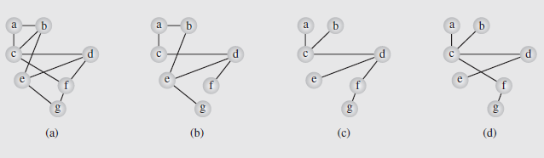
Spanning Trees
Consider an airline that has routes between seven cities represented as the graph in Figure 8.14a
Fig. 8.14 A graph representing (a) the airline connections between
seven cities and (b–d) three possible sets of connections
If economic hardships force the airline to cut routes, which ones should be kept to preserve a route to each city, if only indirectly?
One possibility is shown in Figure 8.14b

Slide 59
Spanning Trees (continued)
However, we want to make sure we have the minimum connections necessary to preserve the routes
To accomplish this, a spanning tree should be used, specifically one created using depthFirstSearch()
There is a possibility of multiple spanning trees (Figure 8.14c-d), but each of these has the minimum number of edges
We don’t know which of these might be optimal, since we haven’t taken distances into account
The airline, wanting to minimize costs, will want to use the shortest distances for the connections
So what we want to find is the minimum spanning tree, where the sum of the edge weights is minimal

Slide 60
Spanning Trees (continued)
The problem we looked at earlier involving finding a spanning tree in a simple graph is a case of this where edge weights = 1
So each spanning tree is a minimum tree in a simple graph
There are a number of solutions to the minimum spanning tree problem, and we will consider two
One popular algorithm is Kruskal’s algorithm, developed by Joseph Kruskal in 1956
It orders the edges by weight, and then checks to see if they can be added to the tree under construction
It will be added if its inclusion doesn’t create a cycle

Slide 61
Spanning Trees (continued)
The algorithm is as follows:
KruskalAlgorithm(weighted connected undirected graph)
tree = null;
edges = sequence of all edges of graph sorted by weight;
for (i = 1; i # |E| and |tree| < |V| – 1; i++)
if e_{i} from edges does not form a cycle with edges in tree
add ei to tree;
A step-by-step example of the application of this algorithm is shown in Figure 8-15ba-bf on page 413
It is not necessary to order the edges in order to build a spanning tree, any order of edges can be used
An algorithm developed by Dijkstra in 1960 (and independently by Robert Kalaba) pursues this approach

Slide 62
Spanning Trees (continued)
This algorithm is shown below:
DijkstraMethod(weighted connected undirected graph)
tree = null;
edges = an unsorted sequence of all edges of graph;
for i = 1 to |E|
add ei to tree;
if there is a cycle in tree
remove an edge with maximum weight from this only cycle;
In this algorithm, edges are added to the tree one-by-one
If a cycle results, the edge in the cycle with maximum weight is removed
The use of this method is shown in Figure 8.15ca-cl on page 414

Slide 63
Decorator Pattern
Labels are commonly used in graph algorithms
Auxiliary data
Output
Examples
DFS: unexplored/visited label for vertices and unexplored/ forward/back labels for edges
Dijkstra and Prim-Jarnik: distance, locator, and parent labels for vertices
Kruskal: locator label for vertices and MSF label for edges
The decorator pattern extends the methods of the Position ADT to support the handling of attributes (labels)
has(a): tests whether the position has attribute a
get(a): returns the value of attribute a
set(a, x): sets to x the value of attribute a
destroy(a): removes attribute a and its associated value (for cleanup purposes)
The decorator pattern can be implemented by storing a dictionary of (attribute, value) items at each position

Slide 64
MST and Traveling Salesperson Problem
A tour of a graph is a spanning cycle (e.g., a cycle that goes through all the vertices)
A traveling salesperson tour of a weighted graph is a tour that is simple (i.e., no repeated vertices or edges) and has has minimum weight
No polynomial-time algorithms are known for computing traveling salesperson tours
The traveling salesperson problem (TSP) is a major open problem in computer science
Find a polynomial-time algorithm computing a traveling salesperson tour or prove that none exists
7
D
B
4
2
2
5
F
C
8
6
3
E
A
1
Example of traveling salesperson tour
(with weight 17)

Slide 65
MST as a TSP Approximation
We can approximate a TSP tour with a tour of at most twice the weight for the case of Euclidean graphs
Vertices are points in the plane
Every pair of vertices is connected by an edge
The weight of an edge is the length of the segment joining the points
Approximation algorithm
Compute a minimum spanning tree
Form an Eulerian circuit around the MST
Transform the circuit into a tour

Slide 66
Transitive Closure
D
E
Given a digraph G, the transitive closure of G is the digraph G* such that
G* has the same vertices as G
if G has a directed path from u to v (u ≠ v), G* has a directed edge from u to v
The transitive closure provides reachability information about a digraph
B
G
C
A
D
E
B
C
A
G*

Slide 67
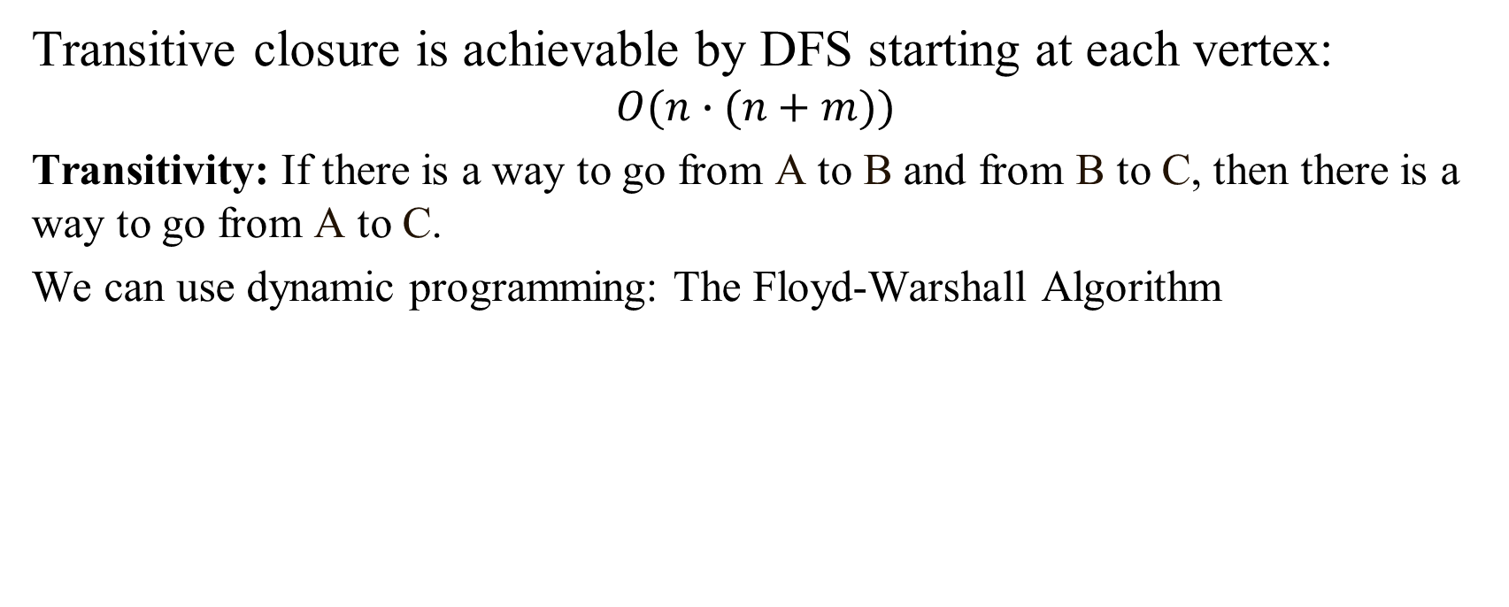
Computing the Transitive Closure
Transitive closure is achievable by DFS starting at each vertex: $$O(n∙(n+m))$$
Transitivity: If there is a way to go from A to B and from B to C, then there is a way to go from A to C.
We can use dynamic programming: The Floyd-Warshall Algorithm

Slide 68
Floyd-Warshall Transitive Closure
Idea #1: Number the vertices 1, 2, …, n.
Idea #2: Consider paths that use only vertices numbered 1, 2, …, k, as intermediate vertices:
Uses only vertices numbered 1,…,k
(add this edge if it’s not already in)
i
j
Uses only vertices
numbered 1,…,k-1
Uses only vertices
numbered 1,…,k-1
k

Slide 69
Floyd-Warshall’s Algorithm
Number vertices v₁ , …, v_{n}
Compute digraphs G₀, …, G_{n}
G₀=G
G_{k} has directed edge (v_{i}, v_{j}) if G has a directed path from v_{i} to v_{j} with intermediate vertices in {v₁ , …, v_{k}}
We have that G_{n} = G*
In phase k, digraph G_{k} is computed from G_{k − 1}
Running time: O(n³), assuming areAdjacent is O(1) (e.g., adjacency matrix)
Algorithm FloydWarshall(G)
Input digraph G
Output transitive closure G* of G
i ← 1
for all v ∈ G.vertices()
denote v as v_{i}
i ← i + 1
G₀ ← G
for k ← 1 to n do
G_{k} ← G_{k − 1}
for i ← 1 to n (i ≠ k) do
for j ← 1 to n (j ≠ i, k) do
if G_{k − 1}.areAdjacent(v_{i}, v_{k}) ∧ G_{k − 1}.areAdjacent(v_{k}, v_{j})
if ¬G_{k}.areAdjacent(v_{i}, v_{j})
G_{k}.insertDirectedEdge(v_{i}, v_{j} , k)
return G_{n}

Slide 70
Floyd-Warshall Example
BOS
ORD
v
4
JFK
v
2
v
6
SFO
DFW
LAX
v
v
3
1
MIA
v
5

Slide 71
Floyd-Warshall, Iteration 1
BOS
ORD
v
4
JFK
v
2
v
6
SFO
DFW
LAX
v
v
3
1
MIA
v
5

Slide 72
Floyd-Warshall, Iteration 2
BOS
ORD
v
4
JFK
v
2
v
6
SFO
DFW
LAX
v
v
3
1
MIA
v
5

Slide 73
Floyd-Warshall, Iteration 3
BOS
ORD
v
4
JFK
v
2
v
6
SFO
DFW
LAX
v
v
3
1
MIA
v
5

Slide 74
Floyd-Warshall, Iteration 4
BOS
ORD
v
4
JFK
v
2
v
6
SFO
DFW
LAX
v
v
3
1
MIA
v
5

Slide 75
Floyd-Warshall, Iteration 5
BOS
ORD
v
4
JFK
v
2
v
6
SFO
DFW
LAX
v
v
3
1
MIA
v
5

Slide 76
Floyd-Warshall, Iteration 6
BOS
ORD
v
4
JFK
v
2
v
6
SFO
DFW
LAX
v
v
3
1
MIA
v
5

Slide 77
Floyd-Warshall, Conclusion
BOS
ORD
v
4
JFK
v
2
v
6
SFO
DFW
LAX
v
v
3
1
MIA
v
5

