Slide 1
Graph Mathcings

Slide 2
Matching
A particular company has a set of jobs {a, b, c, d, e}, and a set of applicants {p, q, r, s, t}
However, applicant p is only qualified for jobs a, b, and c; applicant q is only qualified for jobs b and d; similar restrictions exist for the other applicants
Our problem is how to match the applicants to the jobs such that each applicant has a job and all jobs are assigned
Numerous problems like this exist, and they are conveniently modeled using bipartite graphs
A bipartite graph is one where the vertices can be divided into two sets, such that any edge has one vertex in each set

Slide 3
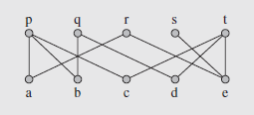
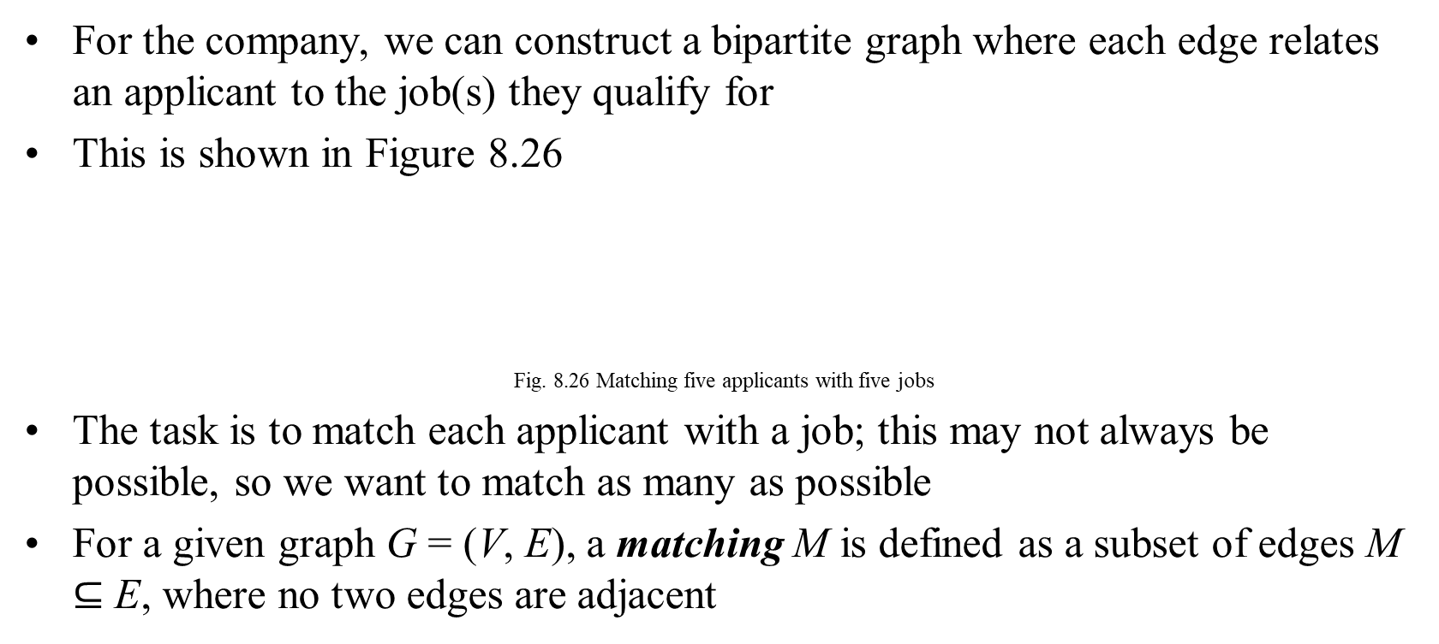
Matching (continued)
For the company, we can construct a bipartite graph where each edge relates an applicant to the job(s) they qualify for
This is shown in Figure 8.26
Fig. 8.26 Matching five applicants with five jobs
The task is to match each applicant with a job; this may not always be possible, so we want to match as many as possible
For a given graph G = (V, E), a matching M is defined as a subset of edges M $⊆$ E, where no two edges are adjacent

Slide 4
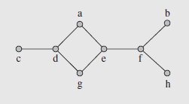
Matching (continued)
A maximum matching is a matching where the number of unmatched vertices is minimal
Consider Figure 8.27
Fig. 8.27 A graph with matchings M1 = {edge(cd), edge(ef)}
and M2 = {edge(cd), edge(ge), edge(fh)}
Sets M₁ = {edge(cd), edge(ef)} and M₂ = {edge(cd), edge(ge), edge(fh)} are matchings, but M₂ is a maximum matching
A perfect matching is one where all vertices in the graph are paired

Slide 5
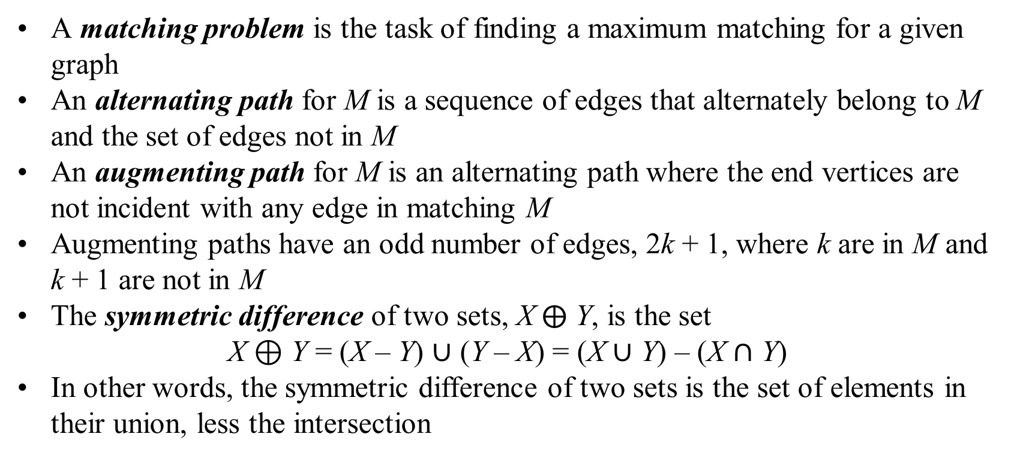
Matching (continued)
A matching problem is the task of finding a maximum matching for a given graph
An alternating path for M is a sequence of edges that alternately belong to M and the set of edges not in M
An augmenting path for M is an alternating path where the end vertices are not incident with any edge in matching M
Augmenting paths have an odd number of edges, 2k + 1, where k are in M and k + 1 are not in M
The symmetric difference of two sets, X $⨁$ Y, is the set
X ⊕ Y = (X – Y) $∪$ (Y – X) = (X $∪$ Y) – (X $∩$ Y)
In other words, the symmetric difference of two sets is the set of elements in their union, less the intersection

Slide 6
Matching (continued)
This leads us to the following lemma, the proof of which is shown on page 439:
Lemma 1. If for two matchings M and N in a graph G = (V,E) we define
a set of edges M ⊕ N ⊆ E, then each connected component of the
subgraph G′ = (V,M ⊕ N) is either (a) a single vertex, (b) a cycle with
an even number of edges alternately in M and N, or (c) a path whose
edges are alternately in M and N and such that each end vertex of the
path is matched only by one of the two matchings M and N (i.e., the
whole path should be considered, not just part, to cover the entire
connected component)
Figure 8.28 shows an example of this
The symmetric difference between matching M (dashed lines) and matching N (dotted lines) contains one path and a cycle (Figure 8.28 b)

Slide 7
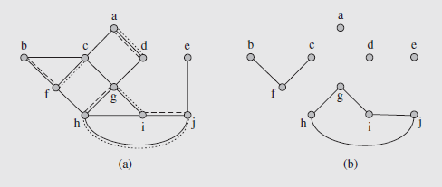
Matching (continued)
Notice that the vertices of the graph G not incident with any edges in the symmetric difference are isolated vertices in G’
Fig. 8.28 (a) Two matchings M and N in a graph G = (V,E)
and (b) the graph G’ = (V, M ⊕ N)
Now consider the next lemma:
Lemma 2. If M is a matching and P is an augmenting path for M, then
M ⊕ P is a matching of cardinality |M| + 1

Slide 8
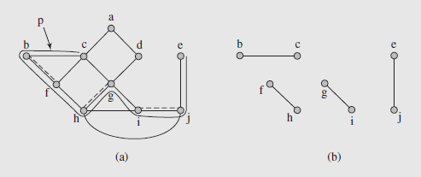
Matching (continued)
The proof of this is on page 440; Figure 8.29 illustrates it
Fig. 8.29 (a) Augmenting path P and a matching M and (b) the matching M ⊕ P
For matching edge M (dashed lines) and augmenting path P for M (c, b, f, h, g, i, j, e), the matching is {edge(bc), edge(ej), edge(fh), edge(gi)}
This includes all the edges from P originally excluded from M

Slide 9
Matching (continued)
These two lemmas can then be used to construct the proof of the following important theorem:
Theorem (Claude Berge 1957). A matching M in a graph G is maximum
iff there is no augmenting path connecting two unmatched vertices in G
The proof of this theorem is shown on page 441
This suggests an approach for finding a maximum path
Starting from an initial matching (possibly empty), it repeatedly finds new augmenting paths to increase the cardinality of the matching until no such path can be found
This means we need an algorithm to determine augmenting paths
Fortunately, this is easier to do for bipartite graphs, so we’ll start with them

Slide 10
Matching (continued)
To find an augmenting path, the breadth-first algorithm is modified to allow for always finding the shortest path
A tree, called a Hungarian tree, is constructed with an unmatched vertex in the root
It consists of alternating paths, and success is determined as soon as another unmatched vertex is found
This indicates the presence of an augmenting path
The augmenting path increases the size of matching; once no such path can be found, the algorithm is finished
The algorithm is shown on pages 441 and 442; an example of this is shown in Figure 8.30 on page 443

Slide 11
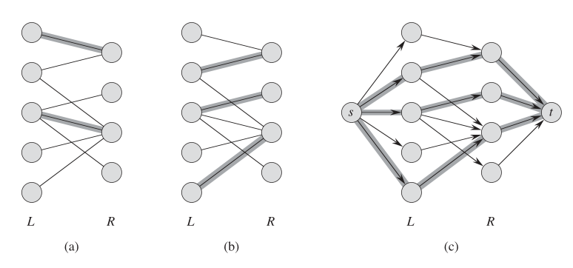
Matchings vs. Max Flow Problems

Slide 12
Matching (continued)
Stable Matching Problem
In the example of matching applicants with jobs, any successful maximum matching was fine
However, this is typically not possible due to preferences for jobs among applicants, and for applicants among employers
The stable matching (also called stable marriage) problem uses two non-overlapping sets with the same cardinality, U and W
The elements of U have a ranking list of elements of W, and those of W have a preference list of elements of U
The ideal matching is to place elements with their highest preference, but because of possible conflicts, a stable matching is sought
A matching is unstable is two elements rank each other higher than those with which they are currently matched; otherwise it is stable

Slide 13
Matching (continued)
Stable Matching Problem (continued)
If we consider the two sets U = {u₁, u₂, u₃, u₄} and W = {w₁, w₂, w₃, w₄}, and the following ranking lists:
u₁: w₂ > w₁ > w₃ > w₄ w₁: u₃ > u₂ > u₁ > u₄
u₂: w₃ > w₂ > w₁ > w₄ w₂: u₁ > u₃ > u₄ > u₂
u₃: w₃ > w₄ > w₁ > w₂ w₃: u₄ > u₂ > u₃ > u₁
u₄: w₂ > w₃ > w₄ > w₁ w₄: u₂ > u₁ > u₃ > u₄
then we can see the matching (u₁, w₁), (u₂, w₂), (u₃, w₄), (u₄, w₃) is unstable because u₁ and w₂ prefer each other over the current match
David Gayle and Lloyd Shapley Designed a matching algorithm in 1962, and also showed that a stable matching always exists
This algorithm is shown in page 444, together with a discussion of its application to the sets and table above

Slide 14
Matching (continued)
Stable Matching Problem (continued)
There is an asymmetry associated with the algorithm based on which rankings are considered more important
As given, the algorithm favors set U
If the roles of the two sets U and W are reversed, then the w’s will have their preferred choices immediately, instead of the u’s

Slide 15
Matching (continued)
Assignment Problem
Finding suitable matches becomes more difficult in a weighted graph
In these cases we want to find a matching with a maximum total weight
This is known as the assignment problem
If we consider complete bipartite graphs with two sets of vertices that are equal in size, then it is known as the optimal assignment problem
An algorithm known as the Hungarian algorithm was developed by Harold Kuhn in 1955, and further investigated by James Munkres in 1957
Kuhn’s original name was in honor of the work done by Dénis Kõnig and Jenõ Egerváry on this problem in 1931

Slide 16
Matching (continued)
Assignment Problem (continued)
The algorithm is shown on pages 445 and 446
An example of its application is shown in Figure 8.31, together with a detailed treatment of its application on pages 446 and 447

Slide 17
Matching (continued)
Matching in Nonbipartite Graphs
The algorithm findMaximumMatching()(pages 441 and 442) is not general enough to correctly handled nonbipartite graphs
Considering the graph in Figure 8.32 and using breadth-first search to construct a tree to determine an augmenting path we run into a problem
Starting at vertex c, d is on an even level, e is odd, and a and f are even
a is then expanded by adding b and f by adding g and then i, creating an augmenting path c, d, e, f, g, i
If i were not in the graph, however, the only augmenting path would not be detected because g, being labeled, blocks access to f and h
A similar problem would occur if we relied on depth-first search instead

Slide 18
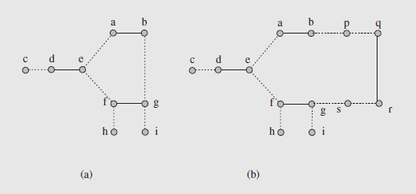
Matching in Nonbipartite Graphs
The problem is caused by certain cycles possessing an odd number of edges
It isn’t the odd number of edges specifically that leads to this

Slide 19
Matching (continued)
Matching in Nonbipartite Graphs (continued)
The type of cycle for which the problems occur is called a blossom
A technique for determining augmenting paths for graphs with blossoms was developed by Jack Edmonds in 1961 and published in 1965
A blossom is an alternating cycle where the first and last edges of the cycle are not in matching
In these cycles, the first vertex is called the base of the blossom
An alternating path of even length is called a stem, so is a path of length zero with a single vertex
If a blossom has a stem whose edge in matching is incident with the base, it is called a flower

Slide 20
Matching (continued)
Matching in Nonbipartite Graphs (continued)
In Figure 8.32a, path c, d, e and path e are stems; cycle e, a, b, g, f, e forms a blossom with base e
Blossoms cause problems when the potential augmenting path leads to a blossom through the base
Depending on the edge chosen to continue the path, an augmenting path may not be derived
If the blossom is entered through any other vertex, however, the problem is averted because only one of the two edges of the vertex can be chosen
So the idea is to detect a blossom is being entered through its base
We can then temporarily remove the blossom by replacing it with a vertex and attach to this all edges connected to the blossom

Slide 21
Matching (continued)
Matching in Nonbipartite Graphs (continued)
At this point the search for an augmenting path continues
If one is found and it includes a vertex representing a blossom, the blossom is re-inserted
The path through it is then determined by going backwards from the edge that led to the blossom to an edge incident with the base
So first, we need to detect that a blossom has been entered through its base
The Hungarian tree in Figure 8.33a was generated using a breadth-first search on the graph of Figure 8.32a
Trying to find neighbors of b leads us to g, because edge(ab) is in matching, so only edges not in matching can be included starting from b

Slide 22
Matching (continued)
Matching in Nonbipartite Graphs (continued)
These edges lead to vertices on an even level in the tree, but g has already been labeled and is on an odd level, signaling a blossom
Thus, we trace paths back in the tree from g and b until we reach a common, root, which is vertex e; this is the base of the blossom
We then replace the blossom with a vertex, A, leading to the graph of Figure 8.33b
The augmenting path search is then resumed, and continues until the path is found, which is c, d, A, h
Then the blossom is expanded, and the path traced through the blossom
This is done by starting from edge(hA) (now edge(hf))

Slide 23
Matching (continued)
Matching in Nonbipartite Graphs (continued)
That edge is not in matching, so from f only edge(fg) can be chosen so the augmenting path remains alternating
By moving through the vertices f, g, b, a, e, the part of the augmenting path corresponding to A is determined, as seen in Figure 8.33c
So the full augmenting path is c, d, e, a, b, g, f, h
Once the path is processed, a new matching is determined, shown in Figure 8.33d

Slide 24
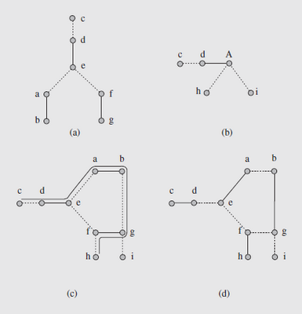
Matching (continued)
Matching in Nonbipartite Graphs (continued)
Fig. 8.33 Processing a graph with a blossom

Slide 25
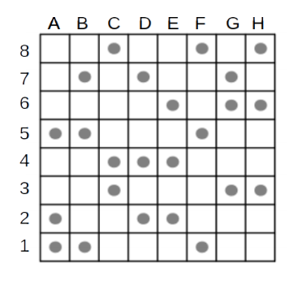
Maximum Matching Problem
In the picture below select the largest number of dots so that no two selected points are on the same horizontal or vertical (they do not threaten each other as chess rooks.

Slide 26
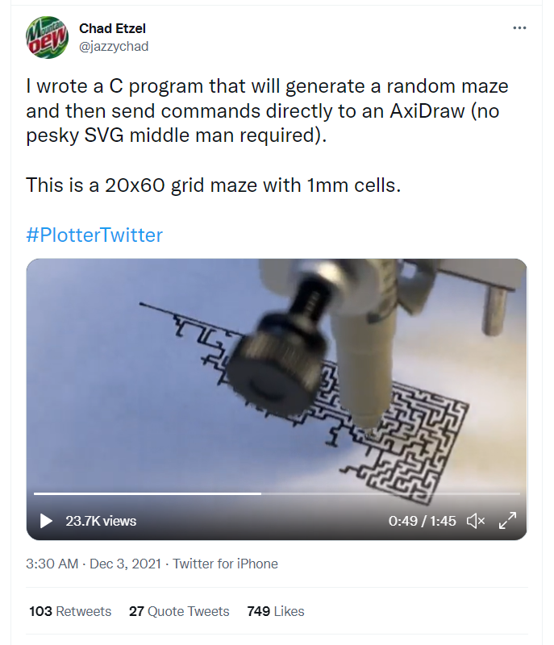
Assume that you have a maze (a graph with vertices and edges drawn on a grid paper; each vertex is a grid point where 1, 3 or 4 lines meet, an edge is a segmented line connected them – it's weight is the total length of it.)
Task: Draw this maze without lifting pen from paper. (I.e. decide the minimum-weight edges to add so that the graph receives Eulerian circuit – every vertex has even degree.)
Notes:
https://twitter.com/jazzychad/status/1466580446481772545

