Slide 1
Chapter 1
An Overview of Computers and Programming Languages

Slide 2
Objectives
In this chapter, you will:
Explore the hardware and software components of a computer system
Learn about the evolution of programming languages
Examine high-level programming languages
Describe what a compiler is and what it does
Examine a C++ program
Explore how a C++ program is processed
Learn what an algorithm is and explore problem-solving techniques
Become aware of Standard C++, C++17, etc.

Slide 3
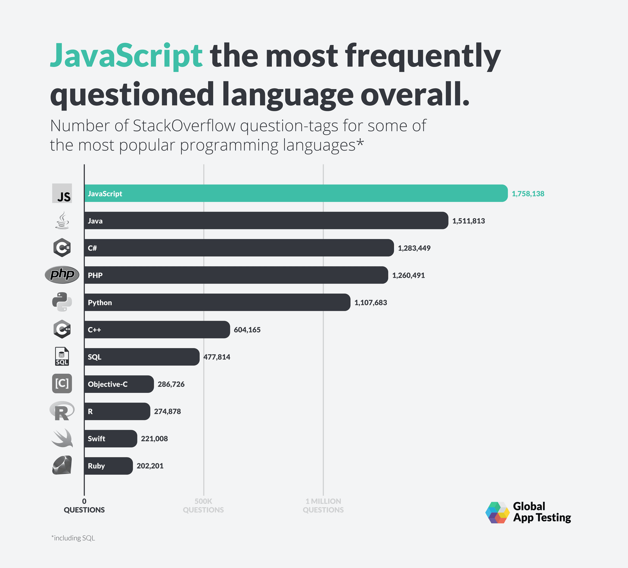
Introduction
Computer has hardware and software.
Without software, a computer is useless
Software is developed with programming languages, including C++

Slide 4
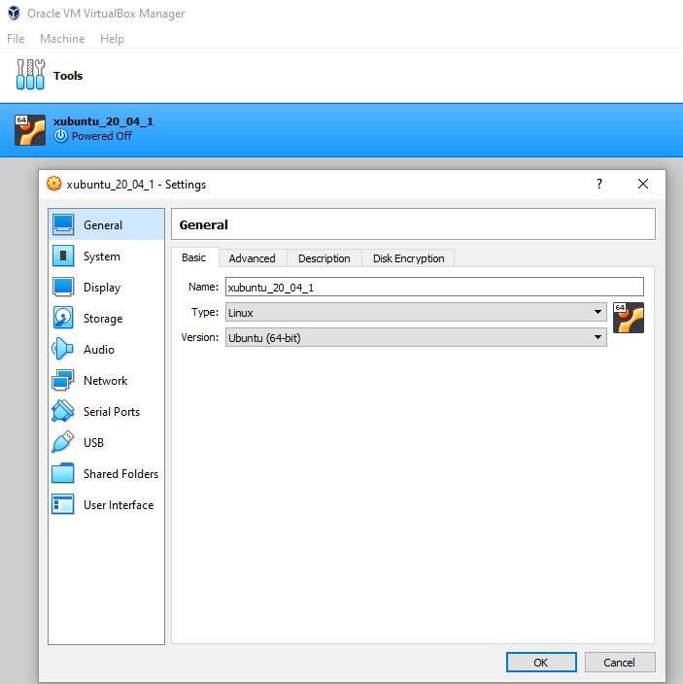
Hardware
Central processing unit (CPU)
Main memory (MM) or random access memory (RAM)
Secondary storage
Input/output devices

Slide 5
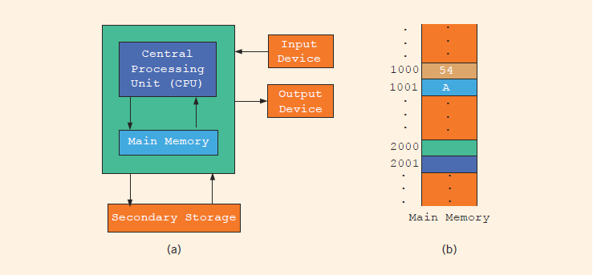
CPU and RAM
Hardware components of a computer and main memory
Notes:
Random access memory (or main memory) is directly connected to the CPU
All programs must be loaded into main memory before they can be executed
All data must be brought into main memory before it can be manipulated
When computer power is turned off, everything in main memory is lost
Main memory is an ordered sequence of memory cells
Each cell has a unique location in main memory, called the address of the cell
Each cell can contain either a programming instruction or data

Slide 6
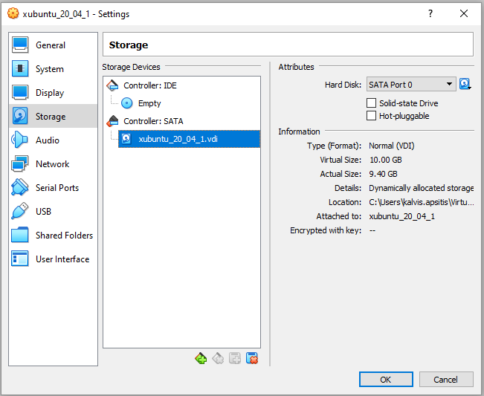
More Hardware: Disks and I/O
Input devices feed data and programs into computers: Keyboard, Mouse, Scanner, Camera
Output devices display results: Monitor, Printer
Secondary storage: device that stores information permanently: Hard disks etc. Secondary storage can be both input and output device.

Slide 7
Software
Software are programs written to perform specific tasks
System programs control the computer
Operating system monitors the overall activity of the computer and provides services such as: Memory management, Input/Output, Hardware drivers.
Application programs perform a specific task. (Unlike OS they are meant to run for a certain time and their resources are managed by the Operating System.)
Some application-type programs are services – they may run continuously and serve clients. (In this course we care about algorithms with finite execution.)

Slide 8
What is in Computer Memory
Byte: a sequence of eight bits
Kilobyte (KB): 2¹⁰ bytes = 1024 bytes. Also – Kibibyte (KiB).
Megabyte (MB): 2²⁰ bytes. Also – Mibibyte (MiB).
ASCII Table
128 characters (only 7 bits are needed).
A is encoded as 1000001 (the 65th character in 0-based counting)
The character 3 is encoded as 0110011 (51st character)
Number systems
The decimal system (base 10) is used in our daily life
The computer uses the binary (or base 2) number system

Slide 9
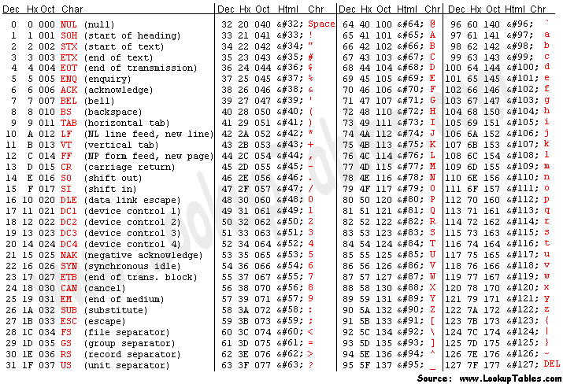

Slide 10
Binary Units
Unit | Symbol | Bits/Bytes
Byte |  | 8 bits
Kilobyte | KB | 2¹⁰ bytes = 1024 bytes
Megabyte | MB | 10²⁴ KB = 2¹⁰ KB = 2²⁰ bytes = 1,048,576 bytes
Gigabyte | GB | 10²⁴MB = 2¹⁰ MB = 2³⁰ bytes = 1,073,741,824 bytes
Terabyte | TB | 10²⁴ GB = 2¹⁰ GB = 2⁴⁰ bytes = 1,099,511,627,776 bytes
Petabyte | PB | 10²⁴ TB = 2¹⁰ TB = 2⁵⁰ bytes = 1,125,899,906,842,624 bytes
Exabyte | EB | 10²⁴ PB = 2¹⁰ PB = 2⁶⁰ bytes = 1,152,921,504,606,846,976 bytes
Zettabyte | ZB | 10²⁴ EB5 2¹⁰ EB = 270 bytes = 1,180,591,620,717,411,303,424 bytes

Slide 11
The Language of a Computer
Unicode is another coding scheme
65,536 characters
Two bytes (16 bits) to store a character. (Ofetn Unicode is encoded using variable length codes for its characters 1-3 bytes per character.)
To interpret physical bytes (in some file) as Unicode you would need to know encoding (such as UTF-8, Cp1257 or Baltic Windows etc.).
In this course we will mostly use ASCII character set to avoid this mess.

Slide 12
Processing a C++ Program
#include <iostream>
using namespace std;
int main()
{
cout << "My first C++ program." << endl;
return 0;
}
Sample Run:
My first C++ program.

Slide 13
Processing a C++ Program (3 of 4)
IDEs are quite user friendly
Compiler identifies the syntax errors and also suggests how to correct them
Build or Rebuild is a simple command that links the object code with the resources used from the IDE

Slide 14
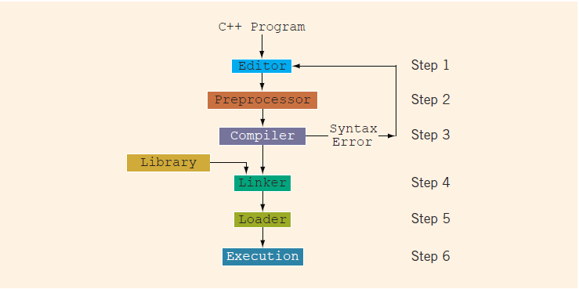
Processing a C++ Program
Notes:
Steps needed to process a C++ program
Use a text editor to create the source code (source program) in C++
Include preprocessor directives
Begin with the symbol # and are processed by the preprocessor
Use the compiler to:
Check that the program obeys the language rules
Translate the program into machine language (object program)
Use an integrated development environment (IDE) to develop programs in a high-level language
Programs such as mathematical functions are available
The library contains prewritten code you can use
A linker combines object program with other programs in the library to create executable code
The loader loads executable program into main memory
The last step is to execute the program

Slide 15
Analysis–Coding–Execution
Once compiled and linked, the loader can place program into main memory for execution
The final step is to execute the program
Compiler guarantees that the program follows the rules of the language
Does not guarantee that the program will run correctly

Slide 16
ANSI/ISO Standard C++
C++ evolved from C
C++ designed by Bjarne Stroustrup at Bell Laboratories in early 1980s.
In mid-1998, ANSI/ISO C++ language standards were approved
C++17, was approved in 2017. (New standard every 3 years).

Slide 17
Quick Review
Computers are electronic devices to do arithmetic and logical operations
A computer system has hardware (CPU, RAM, Storage and various I/O devices) and software components
Compiler: translates high-level language into machine code
Algorithm - Step-by-step problem-solving process, Arrives at a solution in a finite amount of time
Problem-solving process – Analyze, Code, Execute (rinse and repeat).

Slide 18
Chapter 2
Elements of C++ Language

Slide 19
Objectives
In this chapter, you will:
Use basic elements including functions, special symbols, and identifiers
Explore simple data types and arithmetic operators
Introduce string data type
Use assignment statements
Learn about variable declaration
Use Input/Output statements
Use Preprocessor directives.

Slide 20
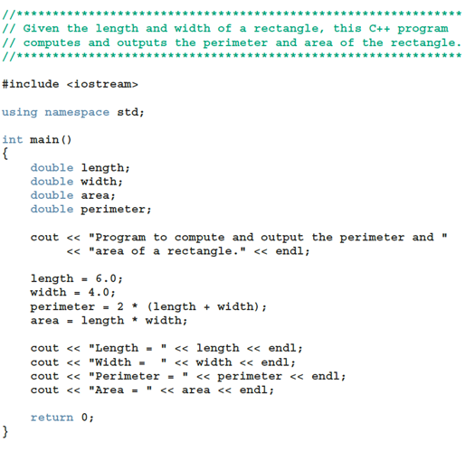
A Quick Look at a C++ Program (1 of 5)
Can have hardcoded variable values.
Declaration differs from Definition.
Should always initialize variables (originally they contain garbage).

Slide 21
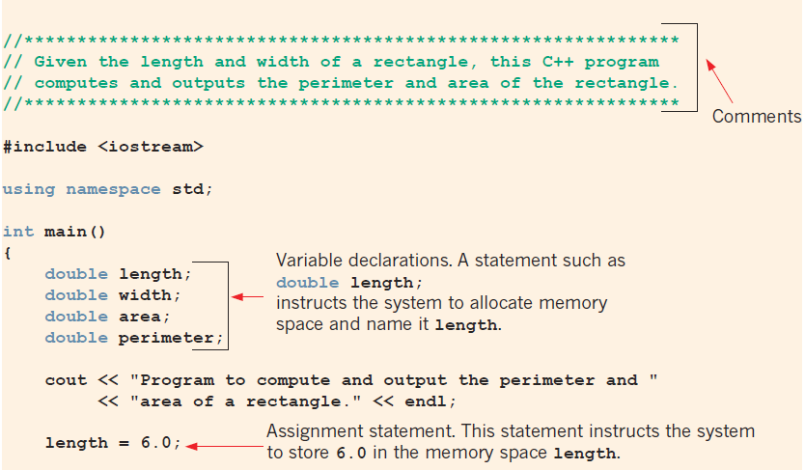
A Quick Look at a C++ Program (3 of 5)

Slide 22

A Quick Look at a C++ Program (4 of 5)

Slide 23
Comments
Comments ignored by the compiler
Two types
Single line: begins with //
//**************************************************************
// Given the length and width of a rectangle, this C++ program
// computes and outputs the perimeter and area of the rectangle.
//**************************************************************
Multiple line: enclosed between /* and */
/*
You can include comments that can
occupy several lines.
*/

Slide 24
Special Symbols
A token is the smallest individual unit of a program written in any language
C++ tokens include special symbols, word symbols, and identifiers
Special symbols in C++ include:
+ - * /
. ; ? ,
<= != == >=

Slide 25
Reserved Words (Keywords)
Reserved word symbols. Cannot be used to name variables.
int
float
double
char
const
void
return

Slide 26
Identifiers (1 of 2)
An identifier is the name of something that appears in a program
Consists of letters, digits, and the underscore character (_)
Must begin with a letter or underscore
C++ is case sensitive
NUMBER is not the same as number
Two predefined identifiers are cout and cin
Unlike reserved words, predefined identifiers may be redefined, but it is not a good idea

Slide 27
Identifiers
Legal identifiers in C++
first
conversion
payRate
pay_rate
__name__
Illegal Identifier | Reason | A Correct Identifier
employee Salary | There can be no space between employee and Salary. | employeeSalary
Hello! | The exclamation mark cannot be used in an identifier. | Hello
one+two | The symbol + cannot be used in an identifier. | onePlusTwo
2nd | An identifier cannot begin with a digit. | second

Slide 28
Whitespaces
Every C++ program contains whitespaces (spaces, tabs, newlines)
Whitespaces separate special symbols, reserved words, and identifiers
Proper utilization of whitespaces is important
Can be used to make the program more readable

Slide 29
Simple Data Types (1 of 2)
Three categories of simple data
Integral: integers (numbers without a decimal)
Can be further categorized: char, short, int, long, bool, unsigned char, unsigned short, unsigned int, unsigned long
Floating-point: decimal numbers
Enumeration: a user-defined data type

Slide 30
Simple Data Types (2 of 2)
Different compilers may allow different ranges of values
Data Type | Values | Storage (in bytes)
int | –147483648 (= –2³¹ ) to 2147483647 (= 2³¹ – 1) | 4
bool | true and false | 1
char | –128 (= –2⁷ ) to 127 (= 2⁷ – 1) | 1
long long | –9223372036854775808 (–2⁶³ ) to 9223372036854775807(2⁶³ – 1) | 64

Slide 31
int Data Type
Examples
-6728
0
78
+763
Positive integers do not require a + sign
A comma cannot be used within an integer
Commas are only used for separating items in a list

Slide 32
bool Data Type
bool type
Two values: true and false
Purpose: to manipulate logical (Boolean) expressions
true and false
Logical values
bool, true, and false
Reserved words

Slide 33
char Data Type
Data type char is the smallest integral data type
It is used for single characters: letters, digits, and special symbols
Each character is enclosed in single quotes
'A', 'a', '0', '*', '+', '$', '&'
A blank space is a character
Written ' ', with a space left between the single quotes

Slide 34
Floating-Point Types – 1
C++ uses scientific notation to represent real numbers (floating-point notation)
Decimal Number | Scientific Notation | C++ Floating-Point Notation
75.924 | 7.5924 * 10¹ | 7.592400E1
0.18 | 1.8 * 10⁻¹ | 1.800000E-1
0.0000453 | 4.53 * 10⁻⁵ | 4.530000E-5
–1.482 | -1.482 * 10⁰ | -1.482000E0
7800.0 | 7.8 * 10³ | 7.800000E3

Slide 35
Floating-Point Types – 2
float: represents any real number
Range: -3.4 * 10³⁸ to 3.4 * 10³⁸ (four bytes)
double: represents any real number
Range: –1.7 * 10³⁰⁸ to 1.7 * 10³⁰⁸ (eight bytes)
Max significant digits (decimal places) for float values: 6 or 7
Max significant digits for double: 15
float values are called single precision
double values are called double precision
(Not universally true. Precision/min/max of data types are system dependent.)

Slide 36
Types, Variables, and Assignments
To declare a variable, must specify its data type
Syntax rule to declare a variable is:
dataType identifier;
Examples include:
int counter;
double interestRate;
char grade;
Assignment statement has the form: variable = expression
Example: interestRate = 0.05;

Slide 37
Order of Precedence
All operations inside () are evaluated first
*, /, and % (remainder) are at the same level of precedence
+ and - have the same level of precedence and are evaluated last
For same precedence - operations are done from left to right (associativity):
3 * 7 - 6 + 2 * 5 % 4 + 6 means (((3 * 7) – 6) + ((2 * 5) % 4 )) + 6

Slide 38
Expressions
Integral expression: all operands are integers
Yields an integral result
Example: 2 + 3 * 5
Floating-point (decimal) expression: all operands are floating-point
Yields a floating-point result
Example: 12.8 * 17.5 - 34.50
Examples of mixed expressions
2 + 3.5
6 / 4 + 3.9
5.4 * 2 – 13.6 + 18 / 2
If operator has both types of operands, integers change to floats.

Slide 39
string Type
Data type string is a programmer-defined type supplied in ANSI/ISO Standard C++ library
A string is a sequence of zero or more characters enclosed in double quotation marks
A null (or empty) string is a string with no characters
Each character has a relative position in the string
Position of first character is 0
The length of a string is the number of characters in it
Example: length of "William Jacob" is 13

Slide 40

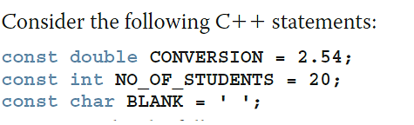
Constants vs. Variables
Named constant: memory location whose content cannot change during execution
Syntax to declare a named constant
In C++, const is a reserved word

Slide 41
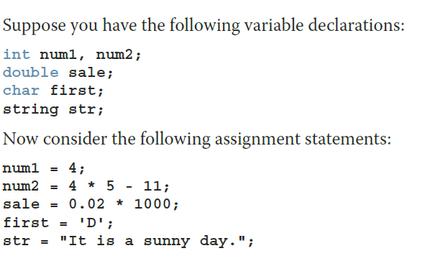
Assignment Statement – 1
A variable is said to be initialized the first time a value is placed into it
In C++, = is called the assignment operator

Slide 42
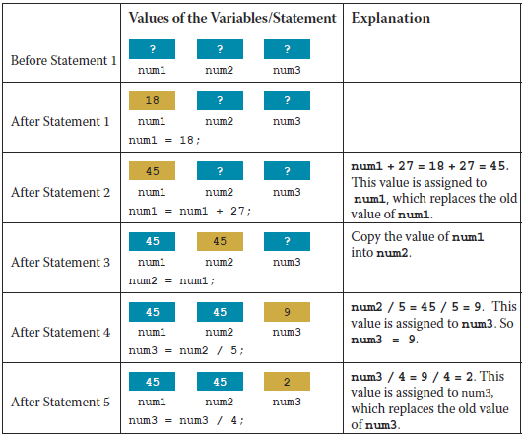
Assignment Statement – 2
Note the uninitialized variables (?).
Integer division does not give float result.
9/4 equals 2 (int)
9.0/4 equals 2.25 (double)

Slide 43
Assignment Statement – 3
Given int variables x, y, and z. How is this legal C++ statement evaluated?
x = y = z
The assignment operator is evaluated from right to left
The associativity of the assignment operator is from right to left

Slide 44
Assignment Statement – 4
Simple and compound assignment operators
Compound operators more concise
Compound operators: +=, -=, *=, /=, %=
Simple assignment operator
x = x * y;
Compound assignment operator
x *= y;

Slide 45
Declaring and Initializing Variables
Not all types of variables are initialized automatically
Variables can be initialized when declared:
int first = 13, second = 10;
char ch = ' ';
double x = 12.6;
All variables must be initialized before they are used
But not necessarily during declaration

Slide 46
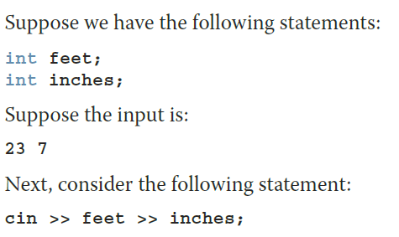

Input (Read) Statement
cin is used with >> to gather one or more inputs
This is called an input (read) statement
The stream extraction operator is >>
For example, if miles is a double variable: cin >> miles;
Causes the computer to get a value of type double and places it in the variable miles

Slide 47
Increment and Decrement Operators
Increment operator (++): increase variable by 1
Pre-increment: ++variable
Post-increment: variable++
Decrement operator: (--) decrease variable by 1
Pre-decrement: --variable
Post-decrement: variable--
What is the difference between the following?
x = 5;
y = ++x;
x = 5;
y = x++;

Slide 48
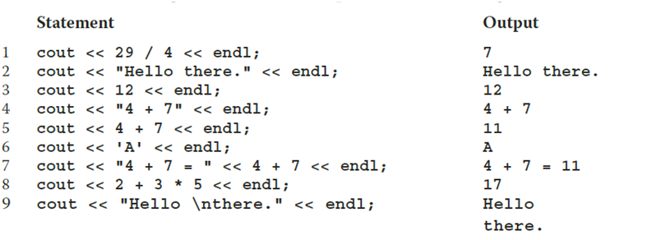
Output – 1
endl causes the insertion point to move to beginning of next line

Slide 49
Output – 2
 | Escape Sequence | Description
\n | Newline | Cursor moves to the beginning of the next line
\t | Tab | Cursor moves to the next tab stop
\b | Backspace | Cursor moves one space to the left
\r | Return | Cursor moves to the beginning of the current line (not the next line)
\\ | Backslash | Backslash is printed
\' | Single quotation | Single quotation mark is printed
\" | Double quotation | Double quotation mark is printed

Slide 50

Preprocessor Directives (2 of 2)
Syntax to include a header file
For example:
#include <iostream>
Causes the preprocessor to include the header file iostream in the program
Preprocessor commands are processed before the program goes through the compiler
Notes:
C++ has a small number of operations
Many functions and symbols needed to run a C++ program are provided as collection of libraries
Every library has a name and is referred to by a header file
Preprocessor directives are processed by the preprocessor program
All preprocessor commands begin with #
No semicolon is placed at the end of these commands

Slide 51
namespace and using cin and cout
cin and cout are declared in the header file iostream, but within std namespace
To use cin and cout in a program, use the following two statements:
#include <iostream>
using namespace std;

Slide 52
Using the string Data Type in a Program
To use the string type, you need to access its definition from the header file string
Include the following preprocessor directive:
#include <string>

Slide 53
Program Style and Form: Syntax
Syntax rules indicate what is legal and what is not legal
Errors in syntax are found in compilation
int x; //Line 1
int y //Line 2
double z; //Line 3
y = w + x; //Line 4
Compilation errors would occur at:
Line 2 (missing semicolon)
Line 4 (identifier w used but not declared)

Slide 54
Use of Semicolons, Brackets, and Commas
All C++ statements end with a semicolon
Also called a statement terminator
("terminators" unlike "separators" are used after the last statement as well).
{ and } are delimiters for code blocks (for variable scope)
Commas separate items in a list
Declaring more than one variable following a data type

Slide 55
Quick Review
A C++ program has functions, one is called main
Identifiers have letters, digits, and underscores, begin with a letter or _
The arithmetic operators in C++ are addition (+), subtraction (-), multiplication (*), division (/), and modulus (%)
Arithmetic expressions use precedence and associativity (from the left, except assignments evaluate from the right)
All variables must be declared before used
Use cin and the stream extraction operator >> to input from the standard input device
Use cout and the stream insertion operator << to output to the standard output device

