Slide 1
What are Efficient Algorithms
The goals, scope and methods of this course
Searching words in a list (or printed dictionary)
Peak finding problem
The concept of an algorithm
Programming Environment
Notes:
These slides correspond to Ch1.7 and Ch1.8 from (Rosen2019).

Slide 2
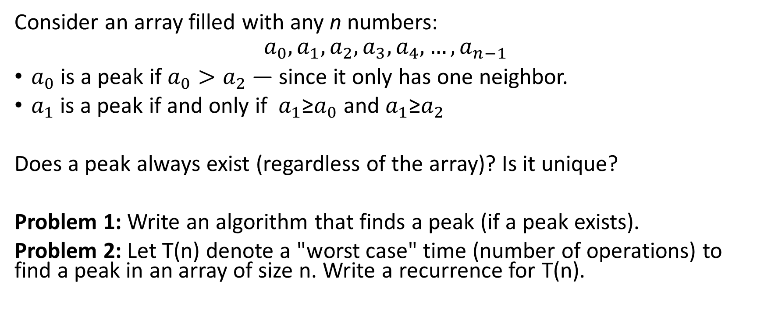
Peak Finding Problem
Consider an array filled with any n numbers:
$$a_{0},a_{1},a_{2},a_{3},a_{4}, …,a_{n−1}$$
$a_{0}$ is a peak if $a_{0}>a_{2}$ — since it only has one neighbor.
$a_{1}$ is a peak if and only if $a_{1}$≥$a_{0}$ and $a_{1}$≥$a_{2}$
Does a peak always exist (regardless of the array)? Is it unique?
Problem 1: Write an algorithm that finds a peak (if a peak exists).
Problem 2: Let T(n) denote a "worst case" time (number of operations) to find a peak in an array of size n. Write a recurrence for T(n).

Slide 3
Write Pseudocode to Do Linear Search
Problem Variant #1:
Human-readable code to find peaks (Python + English sentences?). Use Linear Search – scan the array until you find the peak.
Recurrence for T(n) – how increasing the size of array can be reduced to an array of a smaller size?
Solve the recurrence to find the complexity.

Slide 4
More Efficient algorithm to find Peaks
Problem Variant #2:
Write pseudocode for an algorithm that does not need to scan the whole array linearly.
Recurrence for T(n) – express time used for larger inputs via time used for smaller inputs.
Solve the recurrence for T(n)

Slide 5
Traditional Time Analysis
In textbooks algorithm analysis uses two criteria of the efficiency:
Running time
Used space/memory (usually RAM memory).
Space can be taken by lots of recursive calls OR by creating large data structures on the heap.
Time is analyzed more frequently than space.
Time can sometimes be saved by wasting some extra space – algorithms may have tradeoffs.

Slide 6
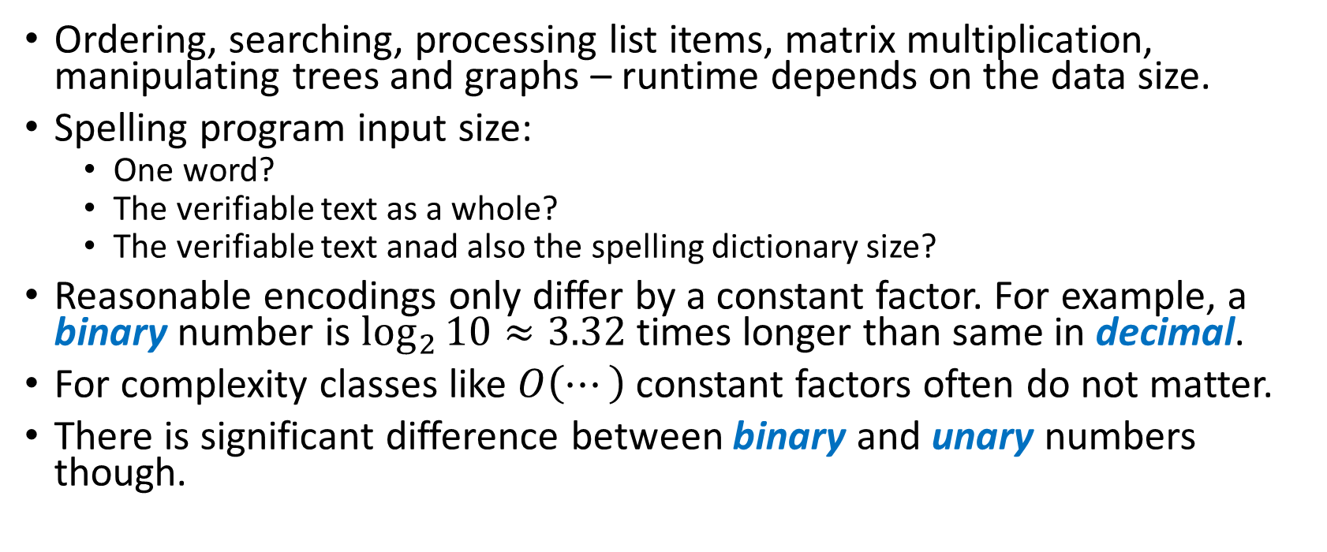
What is Input Data Size?
Ordering, searching, processing list items, matrix multiplication, manipulating trees and graphs – runtime depends on the data size.
Spelling program input size:
One word?
The verifiable text as a whole?
The verifiable text anad also the spelling dictionary size?
Reasonable encodings only differ by a constant factor. For example, a binary number is $\log_{2}{10}≈3.32$ times longer than same in decimal.
For complexity classes like $O\left(⋯\right)$ constant factors often do not matter.
There is significant difference between binary and unary numbers though.

Slide 7
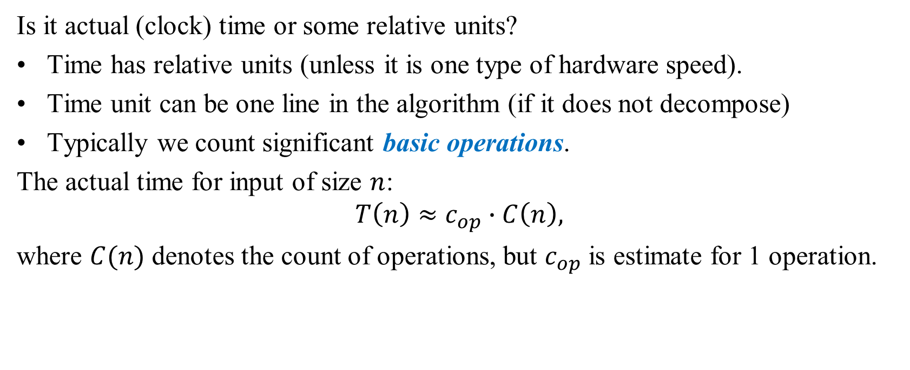
Time Units in Analysis
Is it actual (clock) time or some relative units?
Time has relative units (unless it is one type of hardware speed).
Time unit can be one line in the algorithm (if it does not decompose)
Typically we count significant basic operations.
The actual time for input of size $n$:
$$T\left(n\right)≈c_{op}∙C\left(n\right),$$
where $C(n)$ denotes the count of operations, but $c_{op}$ is estimate for 1 operation.

Slide 8
What can be Counted?
Addition, subtraction
Multiplication, division
Floating point operations
Reading a variable
Updating a variable
Comparison
Boolean (AND, OR, NOT)
I/O operation
Memory allocation
Memory deallocation
Type casting
(Recursive) function call

Slide 9
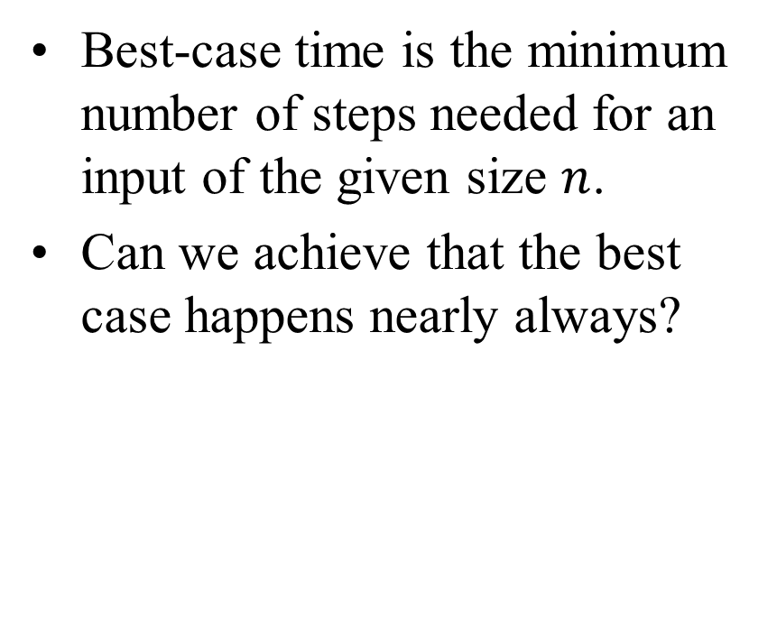
Worst-case and Best-case Analysis
Worst-case time analysis is the max number of steps/operations that may be needed for input data of the given size.
Can investigate, how to avoid these situations (or switch to another algorithm, if they do).
Best-case time is the minimum number of steps needed for an input of the given size $n$.
Can we achieve that the best case happens nearly always?

Slide 10
Best, Average, and Worst Cases
If we want to truly get a handle on the complexity of more complicated algorithms, we need to distinguish three cases:
Worst case – the algorithm takes the maximum number of steps
Best case – the algorithm takes the fewest number of steps
Average case – performance falls between the extremes
For simple situations we can determine the average case by adding together the number of steps required for each input and dividing by the number of inputs
However, this is based on each input occurring with equal probability, which isn’t always likely

Slide 11
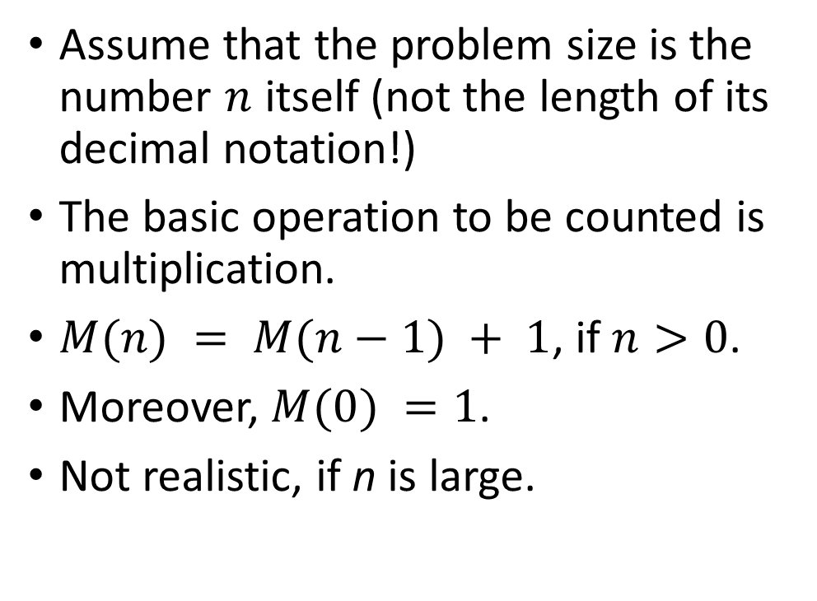
Example: Factorial
Compute factorial n!
Factorial(n):
if n = 0
return 1
else
return Factorial(n-1)*n
Assume that the problem size is the number $n$ itself (not the length of its decimal notation!)
The basic operation to be counted is multiplication.
$M(n) = M(n−1) + 1$, if $n>0$.
Moreover, $M(0) =1$.
Not realistic, if n is large.

Slide 12
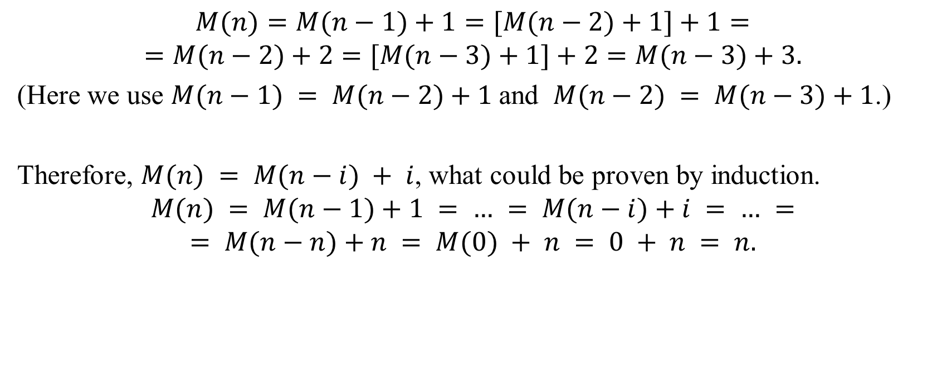
Multiplications in Factorial
$$M(n)=M(n−1)+1=[M(n−2)+1]+1=$$
$$=M(n−2)+2=[M(n−3)+1]+2=M(n−3)+3.$$
(Here we use $M(n−1) = M(n−2)+1$and $M(n−2) = M(n−3)+1$.)
Therefore, $M(n) = M(n−i) + i$, what could be proven by induction.
$$M(n) = M(n−1)+1 = … = M(n−i)+i = … =$$
$$= M(n−n)+n = M(0) + n = 0 + n = n.$$

