Slide 1
Recursion
Recursive Definitions
Function Calls and Recursive Implementation
Anatomy of a Recursive Call
Tail Recursion; Nontail Recursion; Indirect Recursion, Nested Recursion
Excessive Recursion
Backtracking

Slide 2
Recursive Definitions
It is a basic rule in defining new ideas that they not be defined circularly
However, it turns out that many programming constructs are defined in terms of themselves
Fortunately, the formal basis for these definitions is such that no violations of the rules occurs
These definitions are called recursive definitions and are often used to define infinite sets
This is because an exhaustive enumeration of such a set is impossible, so some others means to define it is needed

Slide 3
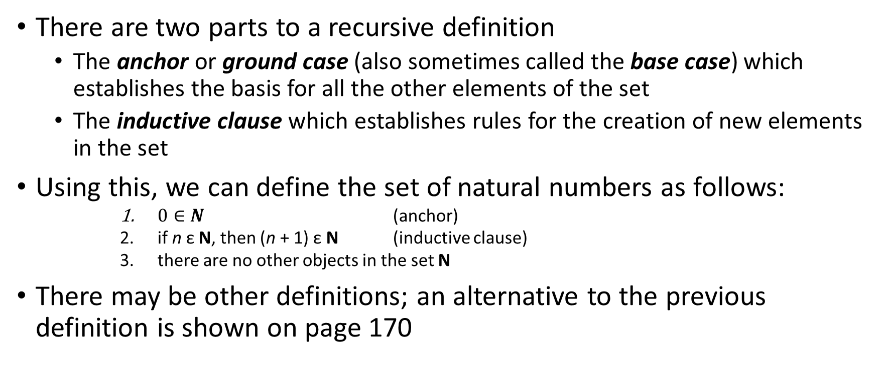
Recursive Definitions (continued)
There are two parts to a recursive definition
The anchor or ground case (also sometimes called the base case) which establishes the basis for all the other elements of the set
The inductive clause which establishes rules for the creation of new elements in the set
Using this, we can define the set of natural numbers as follows:
$0∈N$ (anchor)
if n ε N, then (n + 1) ε N (inductive clause)
there are no other objects in the set N
There may be other definitions; an alternative to the previous definition is shown on page 170

Slide 4
Recursive Definitions (continued)
We can use recursive definitions in two ways:
To define new elements in the set in question
To demonstrate that a particular item belongs in a set
Generally, the second use is demonstrated by repeated application of the inductive clause until the problem is reduced to the base case
This is often the case when we want to define functions and sequences of numbers
However this can have undesirable consequences
For example, to determine 3! (3 factorial) using a recursive definition, we have to work back to 0!

Slide 5
Recursive Definitions (continued)
This results from the recursive definition of the factorial function:
So 3! = 3 ∙ 2! = 3 ∙ 2 ∙ 1! = 3 ∙ 2 ∙ 1 ∙ 0! = 3 ∙ 2 ∙ 1 ∙ 1 = 6
This is cumbersome and computationally inefficient
It would be helpful to find a formula that is equivalent to the recursive one without referring to previous values
For factorials, we can use
In general, however, this is frequently non-trivial and often quite difficult to achieve

Slide 6
Recursive Definitions (continued)
These discussions and examples have been on a theoretical basis
From the standpoint of computer science, recursion occurs frequently in language definitions as well as programming
Fortunately, the translation from specification to code is fairly straightforward; consider a factorial function in C++:
unsigned int factorial (unsigned int n){
if (n == 0)
return 1;
else return n * factorial (n – 1);
}

Slide 7
Recursive Definitions (continued)
Although the code is simple, the underlying ideas supporting its operation are quite involved
Fortunately, most modern programming languages incorporate mechanisms to support the use of recursion, making it transparent to the user
Typically, recursion is supported through use of the runtime stack
So to get a clearer understanding of recursion, we will look at how function calls are processed

Slide 8
Section Summary
Recursive Algorithms
Proving Recursive Algorithms Correct
Recursion and Iteration (not yet included in overheads)
Merge Sort

Slide 9
Recursive Algorithms
Definition: An algorithm is called recursive if it solves a problem by reducing it to an instance of the same problem with smaller input.
For the algorithm to terminate, the instance of the problem must eventually be reduced to some initial case for which the solution is known.

Slide 10
Recursive Factorial Algorithm
Example: Give a recursive algorithm for computing n!, where n is a nonnegative integer.
Solution: Use the recursive definition of the factorial function.
procedure factorial(n: nonnegative integer)
if n = 0 then return 1
else return n∙factorial (n − 1)
{output is n!}

Slide 11
Recursive Exponentiation Algorithm
Example: Give a recursive algorithm for computing a^{n}, where a is a nonzero real number and n is a nonnegative integer.
Solution: Use the recursive definition of a^{n}.
procedure power(a: nonzero real number, n: nonnegative integer)
if n = 0 then return 1
else return a∙ power (a, n − 1)
{output is a^{n}}

Slide 12
Recursive GCD Algorithm
Example: Give a recursive algorithm for computing the greatest common divisor of two nonnegative integers a and b with a < b.
Solution: Use the reduction
gcd(a,b) = gcd(b mod a, a)
and the condition gcd(0,b) = b when b > 0.
procedure gcd(a,b: nonnegative integers
with a < b)
if a = 0 then return b
else return gcd (b mod a, a)
{output is gcd(a, b)}

Slide 13
Recursive Modular Exponentiation Algorithm
Example: Devise a a recursive algorithm for computing b^{n} mod m, where b, n, and m are integers with m ≥ 2, n ≥ 0, and 1≤ b ≤ m.
Solution:
procedure mpower(b,m,n: integers with b > 0 and m ≥ 2, n ≥ 0)
if n = 0 then
return 1
else if n is even then
return mpower(b,n/2,m)² mod m
else
return (mpower(b,⌊n/2⌋,m)² mod m∙ b mod m) mod m
{output is b^{n} mod m}

Slide 14
Recursive Binary Search Algorithm
Example: Construct a recursive version of a binary search algorithm.
Solution: Assume we have a₁,a₂,…, a_{n}, an increasing sequence of integers. Initially i is 1 and j is n. We are searching for x.
procedure binary search(i, j, x : integers, 1≤ i ≤ j ≤n)
m := ⌊(i + j)/2⌋
if x = a_{m} then
return m
else if (x < a_{m} and i < m) then
return binary search(i,m−1,x)
else if (x > a_{m} and j >m) then
return binary search(m+1,j,x)
else return 0
{output is location of x in a₁, a₂,…,a_{n} if it appears, otherwise 0}

Slide 15
Proving Recursive Algorithms Correct
Both mathematical and str0ng induction are useful techniques to show that recursive algorithms always produce the correct output.
Example: Prove that the algorithm for computing the powers of real numbers is correct.
Solution: Use mathematical induction on the exponent n.
BASIS STEP: a⁰ =1 for every nonzero real number a, and power(a,0) = 1.
INDUCTIVE STEP: The inductive hypothesis is that power(a,k) = a^{k}, for all a ≠0. Assuming the inductive hypothesis, the algorithm correctly computes a^{k+1}, since
power(a,k + 1) = a∙ power (a, k) = a∙ a^{k} = a^{k+1} .
procedure power(a: nonzero real number, n: nonnegative integer)
if n = 0 then return 1
else return a∙ power (a, n − 1)
{output is a^{n}}
⁻² .

Slide 16
Merge Sort
Merge Sort works by iteratively splitting a list (with an even number of elements) into two sublists of equal length until each sublist has one element.
Each sublist is represented by a balanced binary tree.
At each step a pair of sublists is successively merged into a list with the elements in increasing order. The process ends when all the sublists have been merged.
The succession of merged lists is represented by a binary tree.

Slide 17
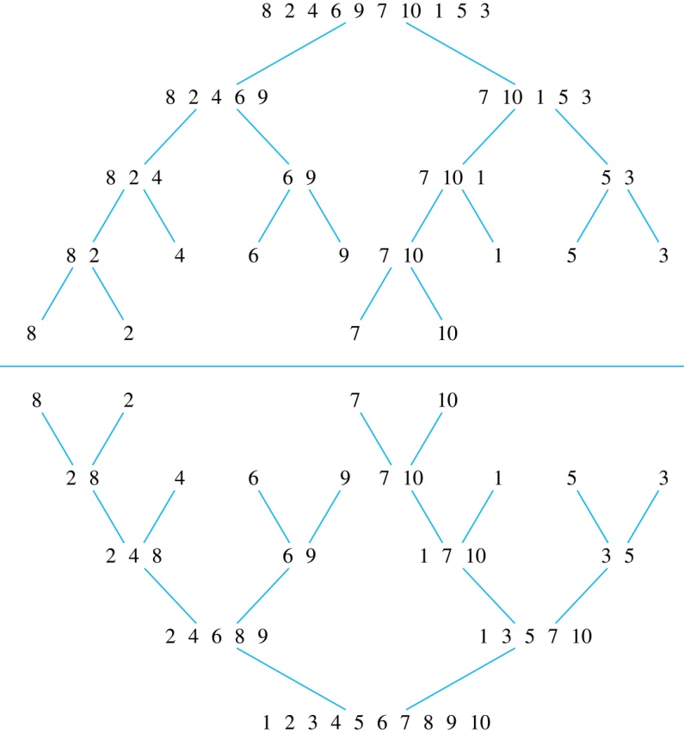
Merge Sort
Example: Use merge sort to put the list
8,2,4,6,9,7,10, 1, 5, 3
into increasing order.
Solution:

Slide 18
Recursive Merge Sort – 1
Example: Construct a recursive merge sort algorithm.
Solution: Begin with the list of n elements L.
procedure mergesort(L = a₁, a₂,…,a_{n} )
if n > 1 then
m := ⌊n/2⌋
L₁ := a₁, a₂,…,a_{m}
L₂ := a_{m+1}, a_{m+2},…,a_{n}
L := merge(mergesort(L₁), mergesort(L₂ ))
{L is now sorted into elements in increasing order}
continued →

Slide 19
Recursive Merge Sort – 2
Subroutine merge, which merges two sorted lists.
Complexity of Merge: Two sorted lists with m elements and n elements can be merged into a sorted list using no more than m + n − 1 comparisons.
procedure merge(L₁, L₂ :sorted lists)
L := empty list
while L₁ and L₂ are both nonempty
remove smaller of first elements of L₁ and L₂ from its list;
put at the right end of L
if this removal makes one list empty
then remove all elements from the other list and append them to L
return L {L is the merged list with the elements in increasing order}

Slide 20
Function Calls and Recursive Implementation
What kind of information must we keep track of when a function is called?
If the function has parameters, they need to be initialized to their corresponding arguments
In addition, we need to know where to resume the calling function once the called function is complete
Since functions can be called from other functions, we also need to keep track of local variables for scope purposes
Because we may not know in advance how many calls will occur, a stack is a more efficient location to save information

Slide 21
Function Calls and Recursive Implementation (continued)
So we can characterize the state of a function by a set of information, called an activation record or stack frame
This is stored on the runtime stack, and contains the following information:
Values of the function’s parameters, addresses of reference variables (including arrays)
Copies of local variables
The return address of the calling function
A dynamic link to the calling function’s activation record
The function’s return value if it is not void
Every time a function is called, its activation record is created and placed on the runtime stack

Slide 22
Function Calls and Recursive Implementation (continued)
So the runtime stack always contains the current state of the function
As an illustration, consider a function f1()called from main()
It in turn calls function f2(), which calls function f3()
The current state of the stack, with function f3()executing, is shown in Figure 5.1
Once f3()completes, its record is popped, and function f2()can resume and access information in its record
If f3()calls another function, the new function has its activation record pushed onto the stack as f3()is suspended

Slide 23
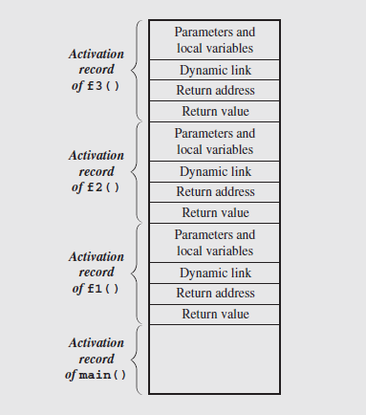
Function Calls and Recursive Implementation (continued)
Fig. 5.1 Contents of the run-time stack when main()
calls function f1(), f1() calls f2(), and f2() calls f3()

Slide 24
Function Calls and Recursive Implementation (continued)
The use of activation records on the runtime stack allows recursion to be implemented and handled correctly
Essentially, when a function calls itself recursively, it pushes a new activation record of itself on the stack
This suspends the calling instance of the function, and allows the new activation to carry on the process
Thus, a recursive call creates a series of activation records for different instances of the same function

Slide 25
Anatomy of a Recursive Call
To gain further insight into the behavior of recursion, let’s dissect a recursive function and analyze its behavior
The function we will look at is defined in the text, and can be used to raise a number x to a non-negative integer power n:
We can also represent this function using C++ code, shown on the next slide

Slide 26
Anatomy of a Recursive Call (continued)
/* 102 */ double power (double x, unsigned int n) {
/* 103 */ if (n == 0)
/* 104 */ return 1.0;
else
/* 105 */ return x * power(x,n-1);
}
Using the definition, the calculation of x⁴ would be calculated as follows: x⁴ = x ∙ x³ = x ∙ (x ∙ x²) = x ∙ (x ∙ (x ∙ x¹)) = x ∙ (x ∙ (x ∙ (x ∙ x⁰))) = x ∙ (x ∙ (x ∙ (x ∙ 1))) = x ∙ (x ∙ (x ∙ (x))) = x ∙ (x ∙ (x ∙ x)) = x ∙ (x ∙ x ∙ x) = x ∙ x ∙ x ∙ x
Notice how repeated application of the inductive step leads to the anchor

Slide 27
Anatomy of a Recursive Call (continued)
This produces the result of x⁰, which is 1, and returns this value to the previous call
That call, which had been suspended, then resumes to calculate x ∙ 1, producing x
Each succeeding return then takes the previous result and uses it in turn to produce the final result
The sequence of recursive calls and returns looks like:
call 1 x⁴ = x ∙ x³ = x ∙ x ∙ x ∙ x
call 2 x³ = x ∙ x² = x ∙ x ∙ x
call 3 x² = x ∙ x¹ = x ∙ x
call 4 x¹ = x ∙ x⁰ = x ∙ 1
call 5 x⁰ = 1

Slide 28
Anatomy of a Recursive Call (continued)
Now, the sequence of calls is kept track of on the runtime stack, which stores the return address of the function call
This is used to remember where to resume execution after the function has completed
The function power()in the earlier slide is called by the following statement:
/* 136 */ y = power(5.6,2);
The sequence of calls and returns generated by this call, along with the address of the calling statement, the return address, and the arguments, are shown in Figure 5.2

Slide 29
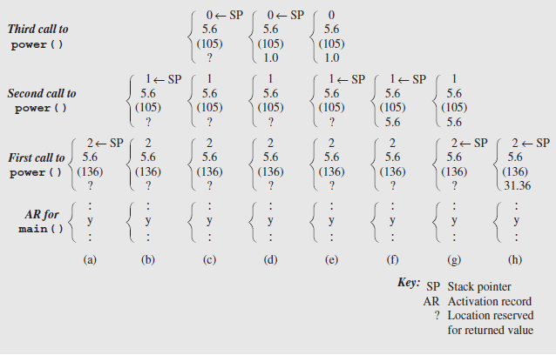
Anatomy of a Recursive Call (continued)
Fig. 5.2 Changes to the run-time stack during execution of power(5.6,2)
Notes:
The initial call (Figure 5.2a) shows the arguments (5.6 and 2), the return address (136), and the space for the return value
The exponent is greater than 0, so the else clause is executed; the function calls itself with arguments (5.6 and 1)
This causes a new activation record to be added to the stack, as shown in Figure 5.2b
Since the exponent is 1, the else clause again calls the function with arguments (5.6 and 0), adding another activation record to the stack (figure 5.2c)
This time, the value of the exponent is 0, so the function returns the value 1 (Figures 5.2d and 5.2e)
This causes the current activation record to be popped from the stack (notice the location of the stack pointer)
The previous call to the function now resumes, and calculates 5.6 * the result of the call, which is 1, resulting in 5.6
This is placed in the activation record, and the call completes, popping the stack again (Figures 5.2f and 5.2g)
Finally, the original call to the function completes by multiplying 5.6 * the call result (5.6), resulting in 31.36
This is placed in the activation record, and when this call completes, the value is returned to the original call in line 136 (Figure 5.2h)

Slide 30
Anatomy of a Recursive Call (continued)
power() as a non-recursive function (for-loop)
double nonRecPower(double x, unsigned int n) {
double result = 1;
for (result = x; n > 1; --n)
result *= x;
return result;
}
Recursive code is often shorter, more intuitive. But it has run-time concerns – see Tail vs. Non-tail recursion story.

Slide 31
Tail Recursion
The nature of a recursive definition is that the function contains a reference to itself
This reference can take on a number of different forms
We’re going to consider a few of these, starting with the simplest, tail recursion
The characteristic implementation of tail recursion is that a single recursive call occurs at the end of the function
No other statements follow the recursive call, and there are no other recursive calls prior to the call at the end of the function

Slide 32
Tail Recursion (continued)
An example of a tail recursive function is the code:
void tail(int i) {
if (i > 0) {
cout << i << '';
tail(i-1);
}
}
Essentially, tail recursion is a loop; it can be replaced by an iterative algorithm to accomplish the same task
In fact, in most cases, languages supporting loops should use this construct rather than recursion

Slide 33
Tail Recursion (continued)
An example of an iterative form of the function is shown below:
void iterativeEquivalentOfTail(int i) {
for ( ; i > 0; i--)
cout << i << '';
}

Slide 34
Nontail Recursion
As an example of another type of recursion, consider the following code from page 178 of the text:
/* 200 */ void reverse() {
char ch;
/* 201 */ cin.get(ch);
/* 202 */ if (ch != '\n') {
/* 203 */ reverse();
/* 204 */ cout.put(ch);
}
}
The function displays a line of input in reverse order

Slide 35
Nontail Recursion (continued)
To accomplish this, the function reverse() uses recursion to repeatedly call itself for each character in the input line
Assuming the input “ABC”, the first time reverse() is called an activation record is created to store the local variable ch and the return address of the call in main()
This is shown in Figure 5.3a
The get() function (line 201) reads in the character “A” from the line and compares it with the end-of-line character
Since they aren’t equal, the function calls itself in line 203, creating a new activation record shown in Figure 5.3b

Slide 36
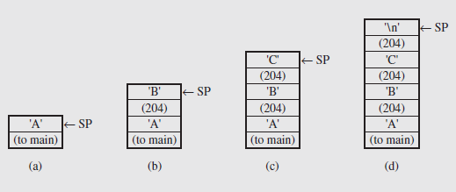
Nontail Recursion (continued)
Fig. 5.3 Changes on the run-time stack during the execution of reverse()
This process continues until the end of line character is read and the stack appears as in Figure 5.3d
At this point, the current call terminates, popping the last activation record off the stack, and resuming the previous call at line 204

Slide 37
Nontail Recursion (continued)
This line outputs the current value of ch, which is contained in the current activation record, and is the value “C”
The current call then ends, causing a repeat of the pop and return action, and once again the output is executed displaying the character “B”
Finally, the original call to reverse() is reached, which will output the character “A”
At that point, control is returned to main(), and the string “CBA” will be displayed
This type of recursion, where the recursive call precedes other code in the function, is called nontail recursion

Slide 38
Nontail Recursion (continued)
Now consider a non-recursive version of the same algorithm:
void simpleIterativeReverse() {
char stack[80];
register int top = 0;
cin.getline(stack,80);
for(top = strlen(stack)-1; top >= 0; cout.put(stack[top--]));
}
This version utilizes functions from the standard C++ library to handle the input and string reversal
So the details of the process are hidden by the functions

Slide 39
Nontail Recursion (continued)
If these functions weren’t available, we’d have to make the processing more explicit, as in the following code:
void iterativeReverse() {
char stack[80];
register int top = 0;
cin.get(stack[top]);
while(stack[top]!='\n')
cin.get(stack[++top]);
for (top -= 2; top >= 0; cout.put(stack[top--]));
}

Slide 40
Nontail Recursion (continued)
In this code, we can see explicitly how the input is handled, using an array to simulate the run-time stack behavior
The first get() retrieves the first character from input, and the loop implements the getline()function operation
When the end-of-line character is detected, the loop terminates, and the array contains the characters entered
The for loop then adjusts the top value to the last character before the end-of-line, and runs backward through the array, outputting the characters in reverse order

Slide 41
Nontail Recursion (continued)
These iterative versions illustrate several important points
First, when implementing nontail recursion iteratively, the stack must be explicitly implemented and handled
Second, the clarity of the algorithm, and often its brevity, are sacrificed as a consequence of the conversion
Therefore, unless compelling reasons are evident during the algorithm design, we typically use the recursive versions

Slide 42
Indirect Recursion
The previous discussions have focused on situations where a function, f(), invokes itself recursively (direct recursion)
However, in some situations, the function may be called not by itself, but by a function that it calls, forming a chain:
f()→ g() → f()
This is known as indirect recursion
The chains of calls may be of arbitrary length, such as:
f() → f₁() → f₂() → ∙∙∙ → f_{n}() → f()
It is also possible that a given function may be a part of multiple chains, based on different calls

Slide 43
Indirect Recursion (continued)
So our previous chain might look like:
f₁() → f₂() → ∙∙∙ → f_{n}()
↗ ↘
f() f()
↘ ↗
g₁() → g₂() → ∙∙∙ → g_{m}()

Slide 44
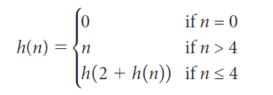
Nested Recursion
Another interesting type of recursion occurs when a function calls itself and is also one of the parameters of the call
Consider the example shown on page 186 of the text:
From this definition, it is given that the function has solutions for n = 0 and n > 4
However, for n = 1, 2, 3, and 4, the function determines a value based on a recursive call that requires evaluating itself
This is called nested recursion

Slide 45
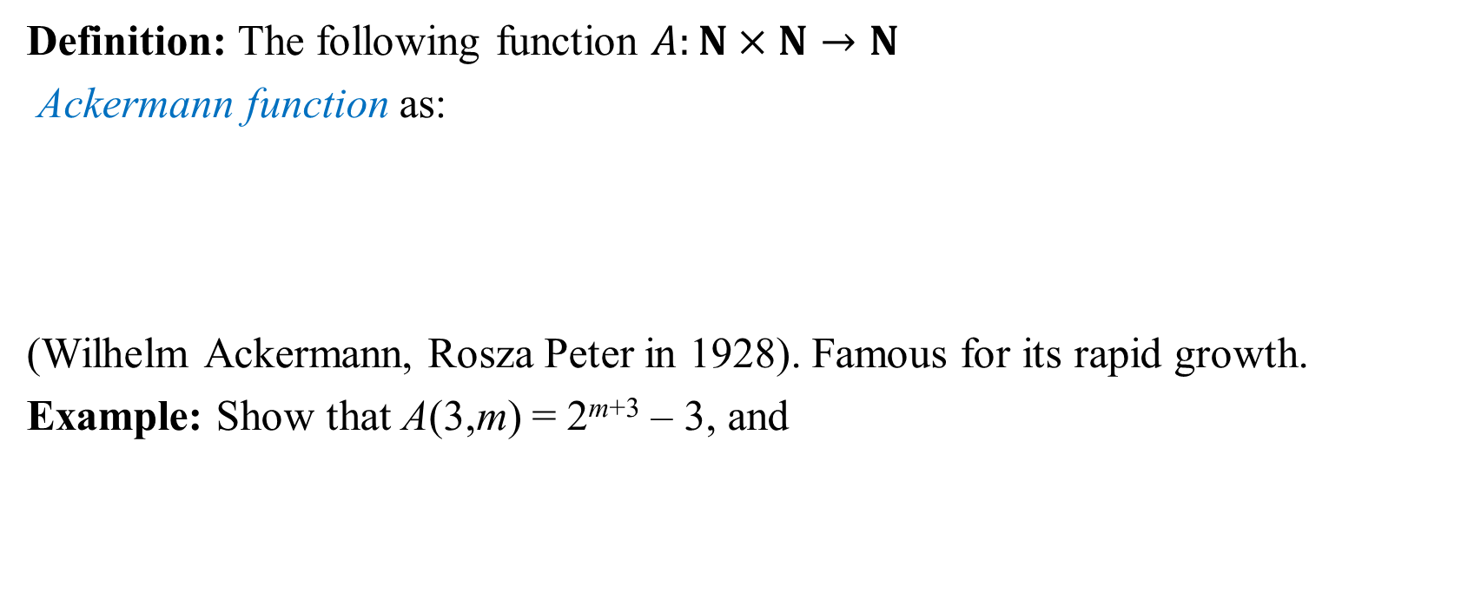
Ackermann Function – 1
Definition: The following function $A:N×N→N$
Ackermann function as:
(Wilhelm Ackermann, Rosza Peter in 1928). Famous for its rapid growth.
Example: Show that A(3,m) = 2^{m+3} – 3, and

Slide 46
Ackermann Function – 2
There are (m – 1) 2s in the exponent, so A(4,1) = 2¹⁶ - 3, which is 65533
However, changing m to 2 has a dramatic impact as the value of has 19,729 digits in its expansion
As can be inferred from this, the function is elegantly expressed recursively, but quite a problem to define iteratively

Slide 47
Excessive Recursion
Recursive algorithms tend to exhibit simplicity in their implementation and are typically easy to read and follow
However, this straightforwardness does have some drawbacks
Generally, as the number of function calls increases, a program suffers from some performance decrease
Also, the amount of stack space required increases dramatically with the amount of recursion that occurs
This can lead to program crashes if the stack runs out of memory
More frequently, though, is the increased execution time leading to poor program performance

Slide 48
Excessive Recursion (continued)
As an example of this, consider the Fibonacci numbers
They are first mentioned in connection with Sanskrit poetry as far back as 200 BCE
Leonardo Pisano Bigollo (also known as Fibonacci), introduced them to the western world in his book Liber Abaci in 1202 CE
The first few terms of the sequence are 0, 1, 1, 2, 3, 5, 8, … and can be generated using the function:

Slide 49
Excessive Recursion (continued)
This tells us that that any Fibonacci number after the first two (0 and 1) is defined as the sum of the two previous numbers
However, as we move further on in the sequence, the amount of calculation necessary to generate successive terms becomes excessive
This is because every calculation ultimately has to rely on the base case for computing the values, since no intermediate values are remembered
The following algorithm implements this definition; again, notice the simplicity of the code that belies the underlying inefficiency

Slide 50
Excessive Recursion (continued)
unsigned long Fib(unsigned long n) {
if (n < 2)
return n;
// else
return Fib(n-2) + Fib(n-1);
}
If we use this to compute Fib(6)(which is 8), the algorithm starts by calculating Fib(4) + Fib(5)
The algorithm then needs to calculate Fib(4) = Fib(2) + Fib(3), and finally the first term of that is Fib(2) = Fib(0) + Fib(1)= 0 + 1 = 1

Slide 51
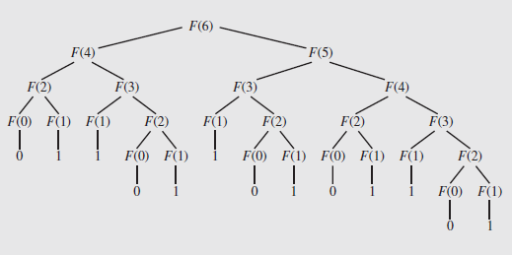
Excessive Recursion (continued)
The entire process can be represented using a tree to show the calculations:
Fig. 5.8 The tree of calls for Fib(6).
Counting the branches, it takes 25 calls to Fib() to calculate Fib(6)

Slide 52
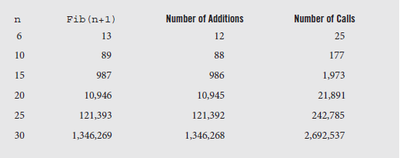
Excessive Recursion (continued)
The total number of additions required to calculate the n^{th} number can be shown to be Fib(n + 1) – 1
With two calls per addition, and the first call taken into account, the total number of calls is 2 ∙ Fib(n + 1) – 1
Values of this are shown in the following table:
Fig. 5.9 Number of addition operations and number of recursive calls to calculate Fibonacci numbers.

Slide 53
Excessive Recursion (continued)
Notice that it takes almost 3 million calls to determine the 31st Fibonacci number
This exponential growth makes the algorithm unsuitable for anything but small values of n
Fortunately there are acceptable iterative algorithms that can be used far more effectively
However, there is an even more useful arithmetic technique, known as Binet’s formula, although first developed by Abraham de Moivre:

Slide 54
Excessive Recursion (continued)
In this formula, and
Since the second term is between -1 and 0, it becomes very small as n grows, so it can be ignored in the formula, which becomes:
This can be rounded to the nearest integer to produce the Fibonacci number
This formula also has a very straightforward implementation in code, using the ceil() function to round the result to the nearest integer

Slide 55
Excessive Recursion (continued)
unsigned long deMoivreFib(unsigned long n) {
return ceil(exp(n*log(1.6180339897)- log(2.2360679775))-0.5);
}

Slide 56
Backtracking
Backtracking is an approach to problem solving that uses a systematic search among possible pathways to a solution
As each path is examined, if it is determined the pathway isn’t viable, it is discarded and the algorithm returns to the prior branch so that a different path can be explored
Thus, the algorithm must be able to return to the previous position, and ensure that all pathways are examined
Backtracking is used in a number of applications, including artificial intelligence, compiling, and optimization problems
One classic application of this technique is known as The Eight Queens Problem

Slide 57
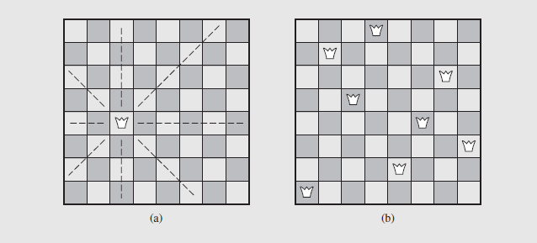
Backtracking (continued)
In this problem, we try to place eight queens on a chessboard in such a way that no two queens attack each other
Fig. 5.11 The eight queens problem

Slide 58
Backtracking (continued)
The approach to solving this is to place one queen at a time, trying to make sure that the queens do not check each other
If at any point a queen cannot be successfully placed, the algorithm backtracks to the placement of the previous queen
This is then moved and the next queen is tried again
If no successful arrangement is found, the algorithm backtracks further, adjusting the previous queen’s predecessor, etc.
A pseudocode representation of the backtracking algorithm is shown in the next slide; the process is described in detail on pages 192 – 197, along with a C++ implementation

Slide 59
Backtracking (continued)
putQueen(row)
for every position col on the same row
if position col is available
place the next queen in position col;
if (row < 8)
putQueen(row+1);
else success;
remove the queen from position col;
This algorithm will find all solutions, although some are symmetrical

Slide 60
Concluding Remarks
The foregoing discussion has provided us with some insight into the use of recursion as a programming tool
While there are no specific rules that require we use or avoid recursion in any particular situation, we can develop some general guidelines
For example, recursion is generally less efficient than the iterative equivalent
However, if the difference in execution times is fairly small, other factors such as clarity, simplicity, and readability may be taken into account
Recursion often is more faithful to the algorithm’s logic

Slide 61
Concluding Remarks (continued)
The task of converting recursive algorithms into their iterative equivalents can often be difficult to perform
As we saw with nontail recursion, we frequently have to explicitly implement stack handling to handle the runtime stack processing incorporated into the recursive form
Again, this may require analysis and judgment by the programmer to determine the best course of action
The text suggests a couple of situations where iterative versions are preferable to recursive ones
First, real-time systems, with their stringent time requirements, benefit by the faster response of iterative code

Slide 62
Concluding Remarks (continued)
Another situation occurs in programs that are repeatedly executed, such as compilers
However, even these cases may be changed if the hardware or operating environment of the algorithm supports processing that speeds the recursive algorithm (consider a hardware supported stack)
Sometimes the best way to decide which version to use relies simply on coding both forms and testing them
This is especially true in cases involving tail recursion, where the recursive version may be faster, and with nontail recursion where use a stack cannot be eliminated

Slide 63
Concluding Remarks (continued)
One place where recursion must be examined carefully is when excessive, repeated calculations occur to obtain results
The discussion of the Fibonacci sequence illustrated this concern
Often, drawing a call tree such as figure 5.8 can be helpful
Trees with a large number of levels can threaten stack overflow problems
On the other hand, shallow, “bushy” trees may indicate a suitable recursive candidate, provided the number of repetitions is reasonable

Slide 64
Time Complexity for Recursive Algorithms
Summations
Master's Theorem
Visualisations with Trees and Fractals

Slide 65
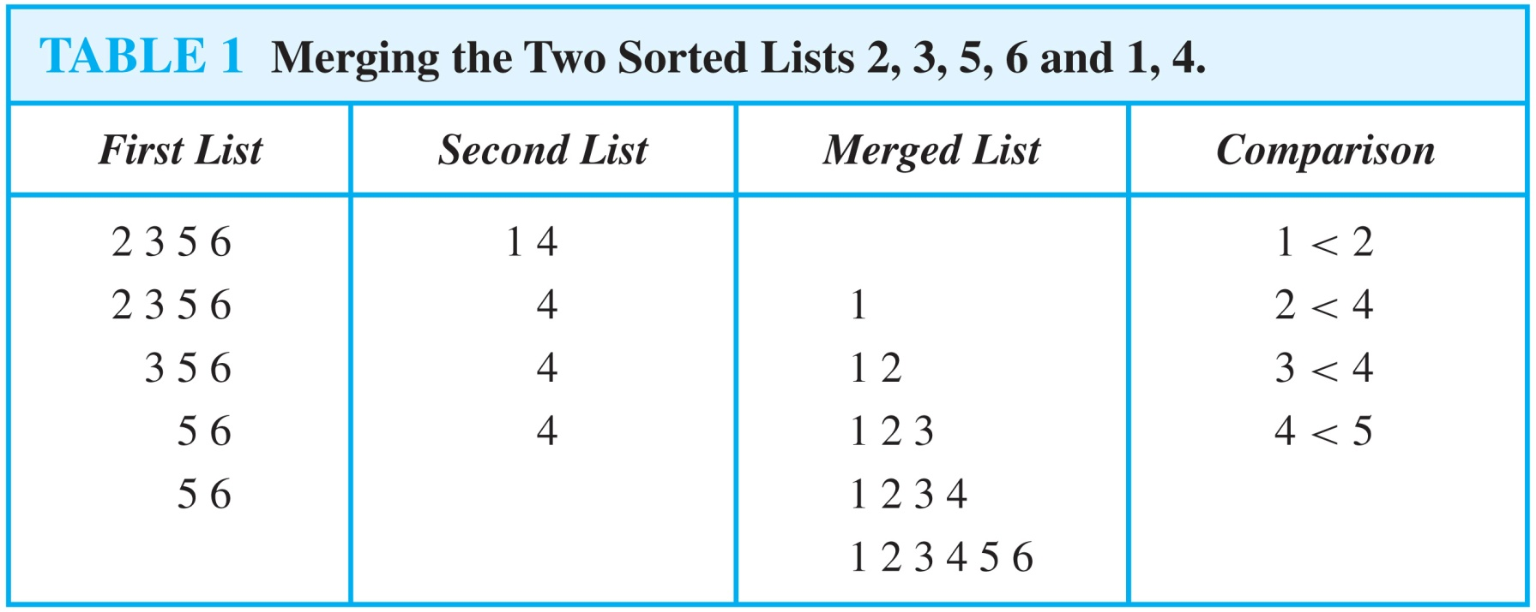
Merging Two Lists
Example: Merge the two lists 2,3,5,6 and 1,4.
Solution:

Slide 66
Complexity of Merge Sort – 1
Complexity of Merge Sort: The number of comparisons needed to merge a list with n elements is O(n log n).
For simplicity, assume that n is a power of 2, say 2^{m}.
At the end of the splitting process, we have a binary tree with m levels, and 2^{m} lists with one element at level m.
The merging process begins at level m with the pairs of 2^{m} lists with one element combined into 2^{m−1} lists of two elements. Each merger takes two one comparison.
The procedure continues , at each level (k = m, m−1, m−1,…,3,2,1) 2^{k} lists with 2^{m−k} elements are merged into 2^{k−1} lists, with 2^{m−k + 1} elements at level k−1.
We know (by the complexity of the merge subroutine) that each merger takes at most 2^{m−k} + 2^{m−k} − 1 = 2^{m−k+ 1} − 1 comparisons.

Slide 67
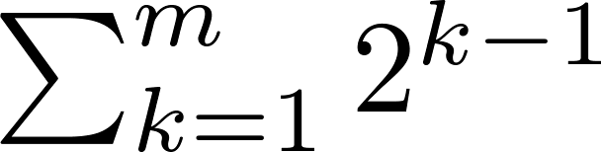
Complexity of Merge Sort – 2
Summing over the number of comparisons at each level, shows that
because m = log n and n = 2^{m}.
(The expression in the formula above is evaluated as 2^{m} − 1 using the formula for the sum of the terms of a geometric progression, from Section 2.4.)
In Chapter 11, we’ll see that the fastest comparison-based sorting algorithms have O(n log n) time complexity. So, merge sort achieves the best possible big-O estimate of time complexity.

Slide 68
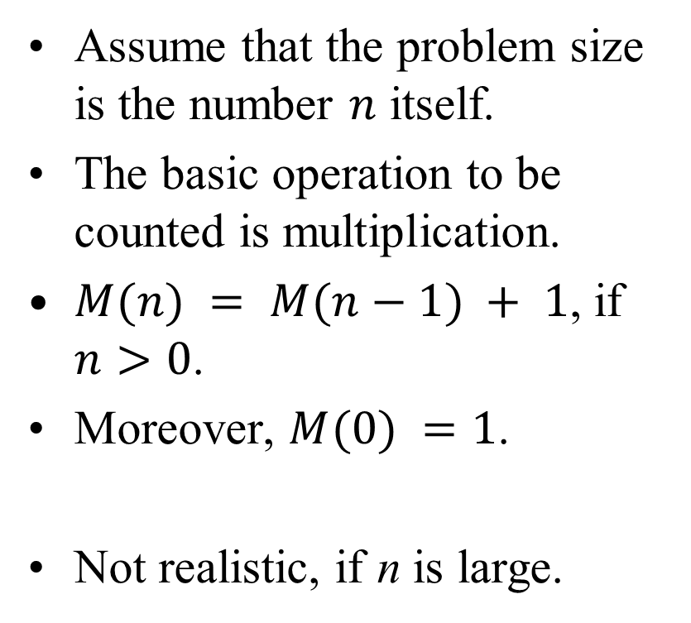
Example: Factorial
Compute factorial n!
Factorial(n):
if n = 0
return 1
else
return Factorial(n-1)*n
Assume that the problem size is the number $n$ itself.
The basic operation to be counted is multiplication.
$M(n) = M(n−1) + 1$, if $n>0$.
Moreover, $M(0) =1$.
Not realistic, if n is large.

Slide 69
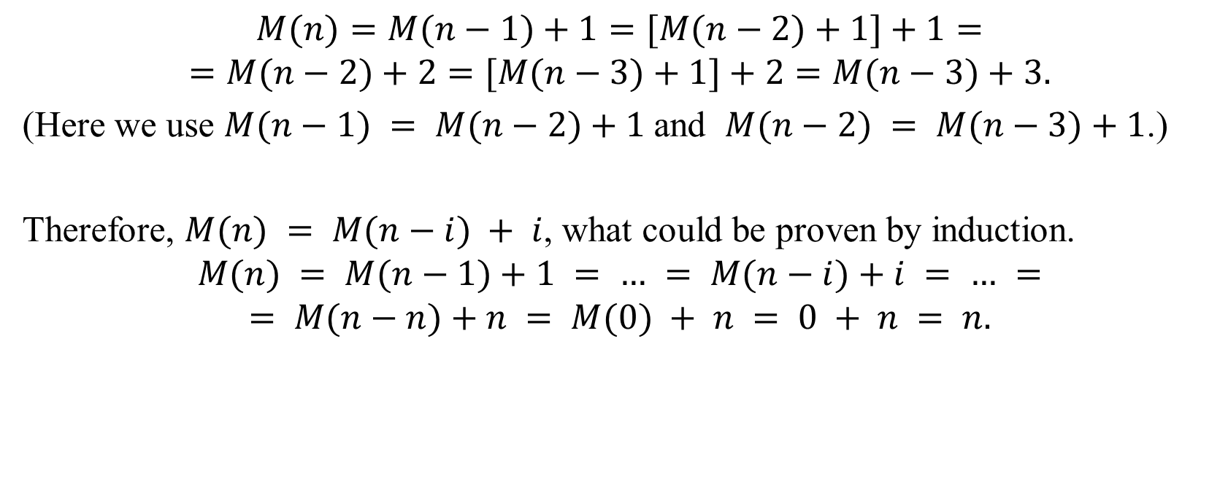
Multiplications in Factorial
$$M(n)=M(n−1)+1=[M(n−2)+1]+1=$$
$$=M(n−2)+2=[M(n−3)+1]+2=M(n−3)+3.$$
(Here we use $M(n−1) = M(n−2)+1$and $M(n−2) = M(n−3)+1$.)
Therefore, $M(n) = M(n−i) + i$, what could be proven by induction.
$$M(n) = M(n−1)+1 = … = M(n−i)+i = … =$$
$$= M(n−n)+n = M(0) + n = 0 + n = n.$$

Slide 70
Analyzing Recursive Algorithm
Determine the parameter for the input data size.
Determine the basic operation of the algorithm.
Check, if the number of basic operations depends only on the input data size.
Write the recurrent equalities to express the count of basic operations.
Try to solve the recurrence – express it with explicit formula.
If solving is difficult, we can use the theorem explained before.

Slide 71
Some simple recurrences
Many algorithms are based on this idea:
Divide the big problem into smaller subproblems
Solve the subproblems and combine them into the larger solution.
Runtime depends on:
The size and the count of subproblems
The time of decomposition (and re-assembly)
We mention 5 examples of recurrences that appear in analysis of real algorithms.

Slide 72
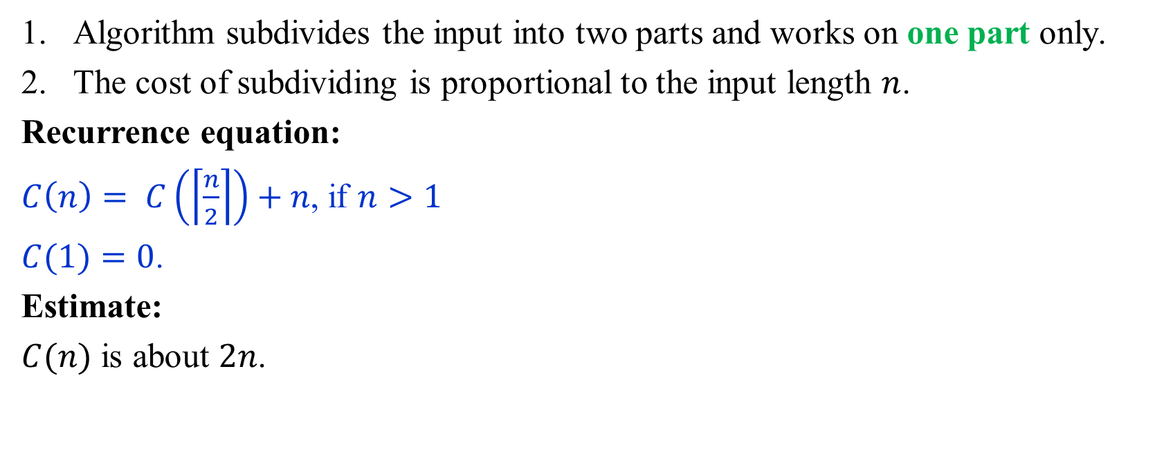
Example 1: Recurrence
Algorithm subdivides the input into two parts and works on one part only.
The cost of subdividing is proportional to the input length $n$.
Recurrence equation:
$C\left(n\right)= C\left(\left\lceil \frac{n}{2}\right\rceil \right)+n$, if $n>1$
$C(1)=0$.
Estimate:
$C(n)$ is about $2n$.

Slide 73
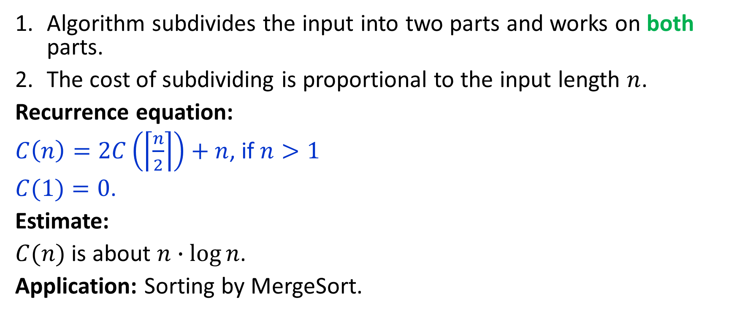
Example 2: Recurrence
Algorithm subdivides the input into two parts and works on both parts.
The cost of subdividing is proportional to the input length $n$.
Recurrence equation:
$C\left(n\right)=2C\left(\left\lceil \frac{n}{2}\right\rceil \right)+n$, if $n>1$
$C(1)=0$.
Estimate:
$C(n)$ is about $n∙\log{n}$.
Application: Sorting by MergeSort.

Slide 74
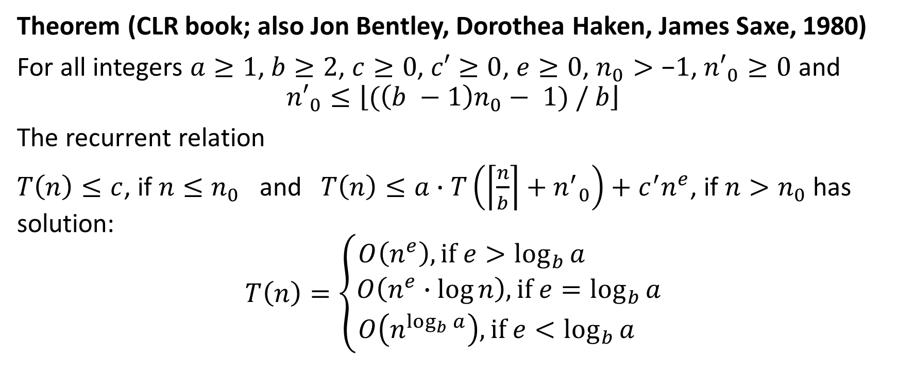
Master Theorem: General Recurrence
Theorem (CLR book; also Jon Bentley, Dorothea Haken, James Saxe, 1980)
For all integers $a≥1$, $b≥2$, $c≥0$, $c′≥0$, $e≥0$, $n_{0}>\text{−}1$, ${n′}_{0}≥0$ and
$${n′}_{0}≤\left\lfloor (\left(b −1\right)n_{0}− 1) / b\right\rfloor$$
The recurrent relation
$T\left(n\right)≤c$, if $n≤n_{0}$ and $T\left(n\right)≤a∙T\left(\left\lceil \frac{n}{b}\right\rceil +{n^{′}}_{0}\right)+c^{′}n^{e}$, if $n>n_{0}$ has solution:
$$T\left(n\right)=\left\{\begin{matrix}O\left(n^{e}\right), if e>\log_{b}{a} \\ O\left(n^{e}∙\log{n}\right), if e=\log_{b}{a} \\ O\left(n^{\log_{b}{a}}\right), if e<\log_{b}{a} \end{matrix}\right.$$

Slide 75
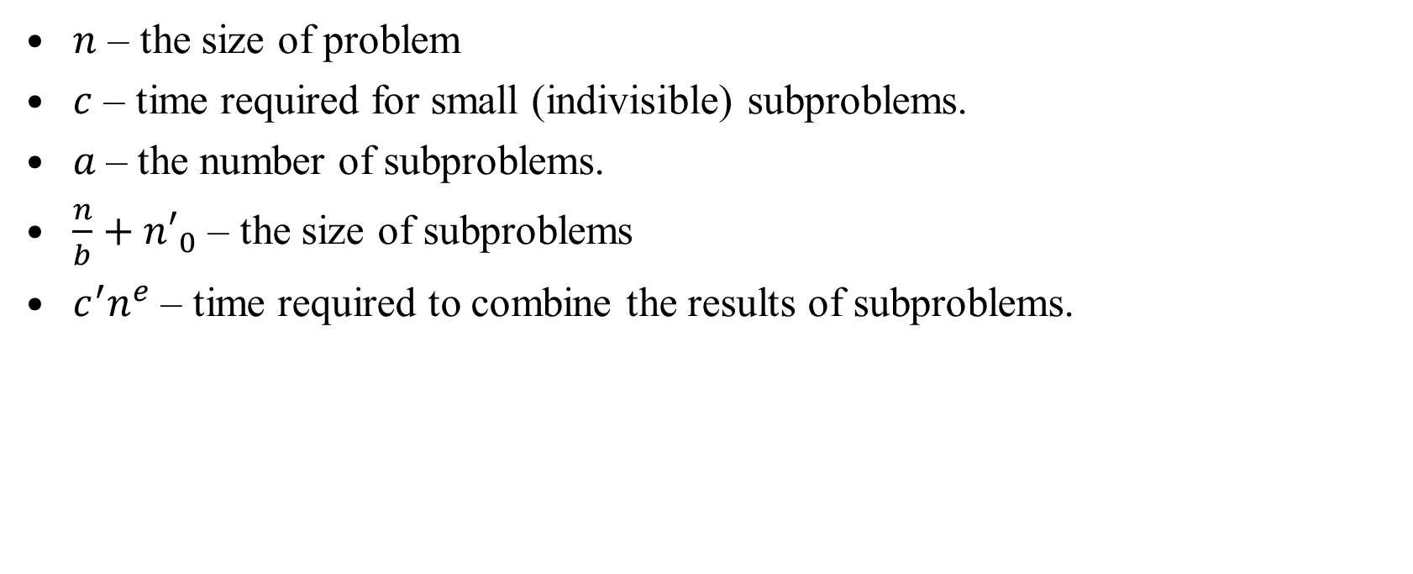
Notation in Master's Theorem
$n$ – the size of problem
$c$ – time required for small (indivisible) subproblems.
$a$– the number of subproblems.
$\frac{n}{b}+{n′}_{0}$ – the size of subproblems
$c^{′}n^{e}$ – time required to combine the results of subproblems.
Notes:
Exercises
Algorithm reduces problem size by 1 at every iteration. The costs of iterations change from n to 1 (or 1 to n).
Given a recurrence, identify what is the Big-O notation for it.

Slide 76
Demo
https://github.com/kapsitis/lu-datastructures-workspace/blob/main/task-bears/README.md

