Slide 1
Abstract Data Types
Abstract Data Types
Encapsulation
Inheritance
Pointers
Polymorphism
Notes:
C++ and Object-Oriented Programming (OOP)
The Standard Template Library (STL)
Vectors in the STL
Data Structures and OOP

Slide 2
Abstract Data Types
Proper planning is essential to successful implementation of programs
Typical design methodologies focus on developing models of solutions before implementing them
These models emphasize structure and function of the algorithms used
Initially our attention is on what needs to be done, not how it is done
So we define program behavior in terms of operations to be performed on data

Slide 3
Abstract Data Types (continued)
The details will emerge as we refine the definitions of the operations
Only then will implementation of those operations be carried out
As part of this implementation, we must choose appropriate data structures
A data structure is a technique of storing and organizing data so it can be used efficiently
In our program models, data structures are described by abstract data types (ADTs)

Slide 4
Abstract Data Types (continued)
ADTs are defined indirectly, in terms of operations to be performed rather than in terms of its inner structure
ADTs can then be implemented through class definitions in an object-oriented language
For example, consider a stack ADT:

Slide 5
Abstract Data Types (continued)
A stack is a last-in first-out (LIFO) linear structure where items can only be added and removed from one end
Operations on this stack ADT might include:
PUSH – add an item to the stack
POP – remove the item at the top of the stack
TOP – return the value of the item at the top of the stack
EMPTY – determine if the stack is empty
CREATE – create a new empty stack
Notice these simply describe the things we can do, not how they are done
These details will be reserved for implementation

Slide 6
Encapsulation
Fundamental to object-oriented programming (OOP) is the notion of an object
An object is a data structure, combined with the operations pertinent to that structure
Most object-oriented languages (OOLs) define objects through the use of a class
A class is a template which implements the ADT defining the objects the class creates
Within a class, the data elements are called data members, and the operations methods, function members, or member functions

Slide 7
Encapsulation (continued)
The combination of data members and methods in a class is referred to as data encapsulation
An object, then, can also be defined as the instantiation of a class, creating an entity that can be used in a program
This concept is a very powerful and useful tool in modern programming
In non-OOLs, the program code itself is responsible for determining the associations between data and functions
In contrast, data encapsulation binds the data structure and its operations together in the class
The program can then focus on the manipulation of these objects through their associated methods

Slide 8
Encapsulation (continued)
This approach has several advantages:
The strong link between data and operations better mimics real-world behavior, on which program models are based
Errors in implementation are confined to the methods of a particular class in which they occur, making them easier to detect and correct
Details of the implementation of the object can be hidden from other objects to prevent side effects from occurring
This last point illustrates the principle of information-hiding
Our use of an object is based on what it does for us, not how it goes about doing it
So an object can be looked at as a black box, with specific user-available methods and a well-defined behavior

Slide 9
Encapsulation (continued)
These user-accessible components comprise an object’s public interface; the remaining methods and data are private

Slide 10
Encapsulation (continued)
Information-hiding also means that every object we use is independent of all other objects, unless we define methods for communicating between objects
Even then, the degree to which the objects interact is precisely defined by the communication methods, known as message passing
This is analogous to function calls in classical programming
An object responds to a message by executing the appropriate method to return information

Slide 11
Encapsulation (continued)
The class as a creator of objects allows great freedom to define objects of the same class with different properties
Default parameters in constructors, combined with well-crafted methods, allow objects to exhibit considerable flexibility
Generic classes offer further flexibility by allowing type parameters to generalize data members and methods
This allows objects to be modified or replaced by other objects that are more efficient or better suited to particular circumstances while the user interface and message passing remains the same

Slide 12
Inheritance
Inheritance is a technique of reusing existing class definitions to derive new classes
These new classes (called derived classes or subclasses or child classes) can inherit the attributes and behavior of the pre-existing classes (called base classes or superclasses or parent classes)
This relationship of classes through inheritance forms a hierarchy, which can be diagrammed
Information hiding can be extended through this hierarchy by the access the base class allows the derived class(es)
Derived classes can then add, delete, & modify methods and data members in their own definitions (known as overriding)

Slide 13
Inheritance (continued)
The amount of access, and level of modifications, are controlled by specifying public, protected, or private in the derived class header
A derived class with public inheritance preserves the access classes of the base class
A derived class with protected inheritance treats public and protected members of the base class as protected; private members remain private
Finally, derived classes with private inheritance treat all members of the base class as private

Slide 14
Inheritance (continued)
Derived classes are also not limited to a single base class for their inherited attributes
Multiple inheritance is the capability provided in some OOLs (like C++) that allows a derived class to inherit from more than one base class
This can create problems if the base classes have a common ancestor in the inheritance hierarchy
In this situation, the derived class could inherit multiple copies of the same member, causing possible errors
This is referred to as the diamond problem, due to the way the inheritance diagram is formed

Slide 15
Inheritance (continued)

Slide 16
Inheritance (continued)
In this figure the two classes B and C inherit from A, and D inherits from B and C
The problem occurs if D uses a method defined in A (and doesn’t override it)
If B and C both override it, D could potentially have two copies with different behaviors, leading to a compiler error
To avoid this, classes B and C inherit class A as “virtual”
This treats A as a direct base class of D, so only one copy of A is available to inherit, eliminating the ambiguity

Slide 17
Polymorphism
Polymorphism is the ability, in many OOLs, to create objects of different types that respond to method calls having the same name
They differ in that they respond according to type-specific behavior
Which method is called depends on the time at which the decision is made about the call
This decision is referred to as binding, and can occur in different ways
Static binding determines the function call at compile time
Dynamic binding delays the decision until run time

Slide 18
Polymorphism (continued)
In C++, dynamic binding can be implemented by declaring the method virtual
This allows the method to be selected based on the value the pointer has instead of its type
With static binding, a method is chosen based on the pointer’s type
This mechanism gives us a very powerful OOP tool
We can send messages to different objects without having to know any of the details of the receiver
It is the receiving object’s responsibility to determine how to handle the message

Slide 19
C++ and Object-Oriented Programming (OOP)
All of our previous concepts are predicated on the idea that C++ is an OOL
While it does implement typical OOL features, C++ does not enforce this approach so it is not a “pure” OOL like Smalltalk
This allows programmers to use procedural aspects of the language and choose which object-oriented features to use
However, the use of these features does provide a powerful object-oriented environment

Slide 20
The Standard Template Library (STL)
While C++ is a powerful language in its own right, recent additions have added even more capabilities
Of these, perhaps the most influential is the Standard Template Library (STL)
It provides three generic entities: containers, iterators, and algorithms, and a set of classes that overload the function operator called function objects
It also has a ready-made set of common classes for C++, such as containers and associative arrays
These can be used with any built-in type and with any user-defined type that supports some elementary operations

Slide 21
The Standard Template Library (continued)
STL algorithms are independent of containers, which significantly reduces the complexity of the library
The results of the STL are achieved through using templates
This allows the use of static binding polymorphism (as opposed to run-time or dynamic binding polymorphism) which is frequently more efficient

Slide 22
The Standard Template Library (continued)
Containers
A container is a data structure that is typically designed to hold objects of the same type
Although the number of possible organizations of this data is unlimited, only a few are practical and implemented in the STL
Containers are implemented as template classes whose methods specify operations on the data in the structures as well as the structures themselves
A number of these methods are common to all containers, while some are more specific to the container they are defined in
The data stored in containers can be of any type and must supply some basic methods and operations
This is especially necessary if pointers are involved

Slide 23
The Standard Template Library (continued)
Iterators
An iterator is an object that accesses the elements of a container
The STL implements five types of iterators
Input iterators, which can read a sequence of values
Output iterators, which can write a sequence of values
Forward iterators, which can be read, written to, or moved forward
Bidirectional iterators, which behave like forward iterators but can also move backwards
Random iterators that can move freely in any direction at one time
Essentially, an iterator is a generalized pointer, and can be dereferenced and manipulated like a pointer
These capabilities make iterators a major feature that allows the generality of the STL

Slide 24
The Standard Template Library (continued)
Algorithms
About 70 generic functions, known as algorithms, are provided in the STL
These perform operations such as searching and sorting
Each is implemented to require a certain level of iterator (and therefore will work on any container that provides an interface by iterators)
Algorithms are in addition to the methods provided by containers, but some algorithms are implemented as member functions for efficiency

Slide 25
The Standard Template Library (continued)
Function Objects
The STL also provides classes that overload the function operator (the operator())
Classes that do this are called function objects
They are useful for maintaining state information in functions that are passed to other functions
Regular function pointers can also be used as function objects
The STL makes heavy use of function objects, since function pointers are inadequate for some manipulations, like those involving built-in operators

Slide 26
Vectors in the STL
A vector is one of the simplest containers in the STL
The elements of vectors are stored contiguously in memory and the entire structure is treated like a dynamic array
Like dynamic arrays, vectors exhibit low memory utilization, good locality of reference, and good data cache utilization
Vectors allow random access, so elements can be referenced using indices
The vector’s structure is able to efficiently allocate the memory needed for data storage
This is useful for storing lists whose length may not be known prior to setting up the list but where removal is rare

Slide 27
Vectors in the STL (continued)
Vectors are incorporated into code by including the vector library:
#include <vector>
The class definition of a vector includes four constructors as well as numerous other functions for manipulating the vector structure and its elements
Adding new elements is quick and easy, unless the vector’s size has reached its capacity
Then, some overhead is required to resize the vector
Otherwise inserting a new element occurs in constant time

Slide 28
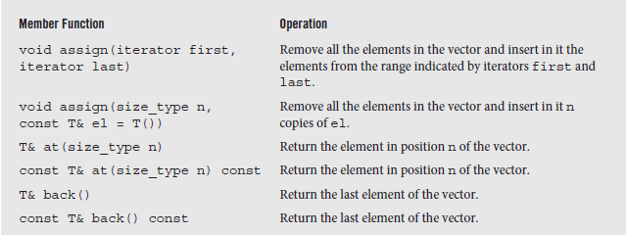
Vectors in the STL (continued)
In addition to the traditional array notation, a vector’s elements can be accessed using iterators
This requires the dereferencing notation used for pointers
A partial list of the member functions of the class vector is shown below; the remainder is on pages 28 and 29.
Fig. 1-3 An alphabetical list of member functions in the class vector (partial)

Slide 29
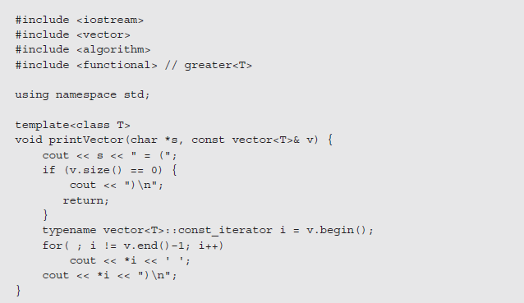
Vectors in the STL (continued)
An example of vector member functions is given in the following program
Fig. 1-4 A program demonstrating the operation of vector member functions

Slide 30
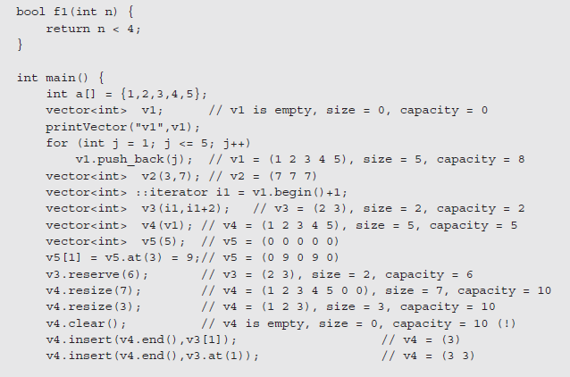
Vectors in the STL (continued)
Fig. 1-4 (continued)

Slide 31
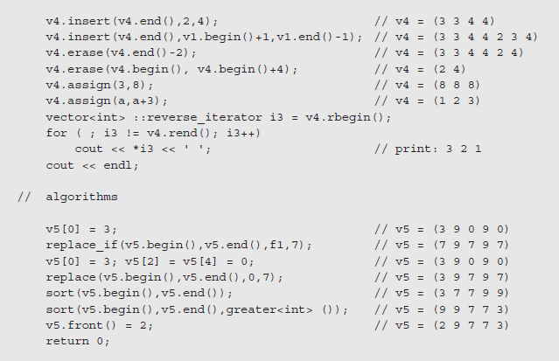
Vectors in the STL (continued)
Fig. 1-4 (concluded)

Slide 32
Data Structures and OOP
The notion of a data type is an abstraction that allows us to hide the details of how the type is implemented
To use effectively, we concern ourselves with the operations that can be performed on it that make it distinctive
While a given programming language may incorporate some data types, the user may have to define their own
These new types typically have a distinct organization that can be exploited to define the type’s behavior
The task then is to study the structure of these types in terms of time and space requirements so we can determine their usefulness

Slide 33
Data Structures and OOP (continued)
This is the opposite of OOP, where we focus on behavior and try to match the data types to the desired operations efficiently
We can look at the field of data structures as a tool building effort that focuses on creating efficient objects that can be incorporated into programs
From this perspective, classes are defined in terms of the mechanisms of the class, typically hidden from the user
By using the features of OOP, the classes can be designed and modified behind the protections afforded by principles of encapsulation and data hiding

Slide 34
Data Structures and OOP (continued)
These protections ensure that the tools that are created are used only in the way that is allowed by the public interface of the class

