Slide 1
Data Structures Stacks and Queues
Stack ADT
Stack-based Algorithms
Queue ADT and Algorithms

Slide 2
Abstract Data Types (ADTs)
An abstract data type (ADT) is an abstraction of a data structure
An ADT specifies:
Data stored
Operations on the data
Error conditions associated with operations
Example: ADT modeling a simple stock trading system
The data stored are buy/sell orders
The operations supported are
order buy(stock, shares, price)
order sell(stock, shares, price)
void cancel(order)
Error conditions:
Buy/sell a nonexistent stock
Cancel a nonexistent order

Slide 3
The Stack ADT
The Stack ADT stores arbitrary objects
Insertions and deletions follow the last-in first-out scheme
Think of a spring-loaded plate dispenser
Main stack operations:
push(object): inserts an element
object pop(): removes the last inserted element
More stack operations:
object top(): returns the last inserted element without removing it
integer size(): returns the number of elements stored
boolean empty(): indicates whether no elements are stored

Slide 4
Stack Interface in C++
C++ interface corresponding to our Stack ADT
Uses an exception class StackEmpty
Different from the built-in C++ STL class stack
template <typename E>
class Stack {
public:
int size() const;
bool empty() const;
const E& top() const throw(StackEmpty);
void push(const E& e);
void pop() throw(StackEmpty); }

Slide 5
Exceptions
Attempting the execution of an operation of ADT may sometimes cause an error condition, called an exception
Exceptions are said to be “thrown” by an operation that cannot be executed
In the Stack ADT, operations pop and top cannot be performed if the stack is empty
Attempting pop or top on an empty stack throws a StackEmpty exception

Slide 6
Applications of Stacks
Direct applications
Page-visited history in a Web browser
Undo sequence in a text editor
Chain of method calls in the C++ run-time system
Indirect applications
Auxiliary data structure for algorithms
Component of other data structures

Slide 7
C++ Run-Time Stack
The C++ run-time system keeps track of the chain of active functions with a stack
When a function is called, the system pushes on the stack a frame containing
Local variables and return value
Program counter, keeping track of the statement being executed
When the function ends, its frame is popped from the stack and control is passed to the function on top of the stack
Allows for recursion
main() { int i = 5; foo(i); }
foo(int j) { int k; k = j+1; bar(k); }
bar(int m) { … }
bar
PC = 1 m = 6
foo
PC = 3 j = 5
k = 6
main
PC = 2 i = 5
https://stackoverflow.com/questions/3899870/print-call-stack-in-c-or-c

Slide 8
Stack as a Linked List
We can implement a stack with a singly linked list
The top element is stored at the first node of the list
The space used is O(n) and each operation of the Stack ADT takes O(1) time
nodes
t
∅
elements

Slide 9
Array-based Stack
A simple way of implementing the Stack ADT uses an array
We add elements from left to right
A variable keeps track of the index of the top element
Algorithm size()
return t + 1
Algorithm pop()
if empty() then
throw StackEmpty
else
t ← t − 1
return S[t + 1]
…
S
0
1
2
t

Slide 10
Array-based Stack (cont.)
The array storing the stack elements may become full
A push operation will then throw a StackFull exception
Limitation of the array-based implementation
Not intrinsic to the Stack ADT
Algorithm push(o)
if t = S.size() − 1 then
throw StackFull
else
t ← t + 1
S[t] ← o
…
S
0
1
2
t

Slide 11
Performance and Limitations
Performance
Let n be the number of elements in the stack
The space used is O(n)
Each operation runs in time O(1)
Limitations
The maximum size of the stack must be defined a priori and cannot be changed
Trying to push a new element into a full stack causes an implementation-specific exception

Slide 12
Array-based Stack in C++
template <typename E> class ArrayStack { private:
E* S; // array holding the stack int cap; // capacity
int t; // index of top element
public:
// constructor given capacity ArrayStack( int c) : S(new E[c]), cap(c), t(-1) { }
void pop() { if (empty()) throw StackEmpty(
"Pop from empty stack"); t--; }
void push(const E& e) {
if (size() == cap) throw
StackFull(
"Push to full stack");
S[++t] = e;
}
//... (other methods of Stack iface)

Slide 13
Example use in C++
* indicates top
ArrayStack<int> A; // A = [ ], size = 0
A.push(7); // A = [7*], size = 1
A.push(13); // A = [7, 13*], size = 2
cout << A.top() << endl; A.pop(); // A = [7*], outputs: 13
A.push(9); // A = [7, 9*], size = 2
cout << A.top() << endl; // A = [7, 9*], outputs: 9
cout << A.top() << endl; A.pop(); // A = [7*], outputs: 9
ArrayStack<string> B(10); // B = [ ], size = 0
B.push("Bob"); // B = [Bob*], size = 1
B.push("Alice"); // B = [Bob, Alice*], size = 2
cout << B.top() << endl; B.pop(); // B = [Bob*], outputs: Alice
B.push("Eve"); // B = [Bob, Eve*], size = 2

Slide 14
Parentheses Matching
Each “(”, “{”, or “[” must be paired with a matching “)”, “}”, or “[”
correct: ( )(( )){([( )])}
correct: ((( )(( )){([( )])}
incorrect: )(( )){([( )])}
incorrect: ({[ ])}
incorrect: (

Slide 15
Parentheses Matching Algorithm
Algorithm ParenMatch(X,n):
Input: An array X of n tokens, each of which is either a grouping symbol, a
variable, an arithmetic operator, or a number
Output: true if and only if all the grouping symbols in X match
Let S be an empty stack
for i=0 to n-1 do
if X[i] is an opening grouping symbol then
S.push(X[i])
else if X[i] is a closing grouping symbol then
if S.empty() then
return false {nothing to match with}
if S.pop() does not match the type of X[i] then
return false {wrong type}
if S.empty() then
return true {every symbol matched}
else return false {some symbols were never matched}

Slide 16
Arithmetic Expressions
14 – 3 * 2 + 7 = (14 – (3 * 2) ) + 7
Operator precedence
* has precedence over +/–
Associativity
operators of the same precedence group
evaluated from left to right
Example: (x – y) + z rather than x – (y + z)
Idea: push each operator on the stack, but first pop and perform higher and equal precedence operations.

Slide 17
Algorithm for Evaluating Expressions
Two stacks:
opStk holds operators valStk holds values
Use $ as special “end of input” token with lowest precedence
Algorithm doOp()
x ← valStk.pop();
y ← valStk.pop();
op ← opStk.pop();
valStk.push( y op x )
Algorithm repeatOps( refOp ):
while ( valStk.size() > 1 and
prec(refOp) ≤ prec(opStk.top())
doOp()
Algorithm EvalExp():
while there’s another token z
if isNumber(z) then
valStk.push(z)
else
repeatOps(z);
opStk.push(z)
repeatOps($);
return valStk.top();

Slide 18
Algorithm on an Example Expression
14 ≤ 4 – 3 * 2 + 7
Operator ≤ has lower precedence than +/–
4
–
14
≤
3
*
$
$
4
–
7
$
14
≤
F
+
-2
+
5
+
14
≤
14
≤
2
2
3
*
3
*
6
4
–
4
–
4
–
-2
+
14
≤
14
≤
14
≤
14
≤

Slide 19
Computing Spans
Using a stack as an auxiliary data structure in an algorithm
Given an an array X, the span S[i] of X[i] is the maximum number of consecutive elements X[j] immediately preceding X[i] and such that X[j] ≤ X[i]
Can analyze "time series"
E.g., find stock at 52-week high
X
6 | 3 | 4 | 5 | 2
1 | 1 | 2 | 3 | 1
S

Slide 20
Quadratic Algorithm
Algorithm spans1(X, n)
Input array X of n integers
Output array S of spans of X
S ← new array of n integers n
for i ← 0 to n − 1 do n
s ← 1 n
while s ≤ i and X[i − s] ≤ X[i] 1 + 2 + …+ (n − 1)
s ← s + 1 1 + 2 + …+ (n − 1)
S[i] ← s n
return S 1
Algorithm spans1 runs in O(n²) time

Slide 21
Computing Spans with a Stack
We keep in a stack the indices of the elements visible when “looking back”
We scan the array from left to right
Let i be the current index
We pop indices from the stack until we find index j such that X[i] < X[j]
We set S[i] ← i − j
We push x onto the stack

Slide 22
Linear Algorithm
Each index of the array
Is pushed into the stack exactly one
Is popped from the stack at most once
The statements in the while-loop are executed at most n times
Algorithm spans2 runs in O(n) time
Algorithm spans2(X, n) #
S ← new array of n integers n
A ← new empty stack 1
for i ← 0 to n − 1 do n
while (not A.empty() and
X[A.top()] ≤ X[i] ) do n
A.pop() n
if A.empty() then n
S[i] ← i + 1 n
else
S[i] ← i − A.top() n
A.push(i) n
return S 1

Slide 23
The Queue ADT
The Queue ADT stores arbitrary objects
Insertions and deletions follow the first-in first-out scheme
Insertions are at the rear of the queue and removals are at the front of the queue
Main queue operations:
enqueue(object): inserts an element at the end of the queue
dequeue(): removes the element at the front of the queue
Auxiliary queue operations:
object front(): returns the element at the front without removing it
integer size(): returns the number of elements stored
boolean empty(): indicates whether no elements are stored
Exceptions
Attempting the execution of dequeue or front on an empty queue throws an QueueEmpty

Slide 24
Example
Operation Output Q
enqueue(5) – (5)
enqueue(3) – (5, 3)
dequeue() – (3)
enqueue(7) – (3, 7)
dequeue() – (7)
front() 7 (7)
dequeue() – ()
dequeue() “error” ()
empty() true ()
enqueue(9) – (9)
enqueue(7) – (9, 7)
size() 2 (9, 7)
enqueue(3) – (9, 7, 3)
enqueue(5) – (9, 7, 3, 5)
dequeue() – (7, 3, 5)

Slide 25
Applications of Queues
Direct applications
Waiting lists, bureaucracy
Access to shared resources (e.g., printer)
Multiprogramming
Indirect applications
Auxiliary data structure for algorithms
Component of other data structures

Slide 26
Array-based Queue
Use an array of size N in a circular fashion
Three variables keep track of the front and rear
f index of the front element
r index immediately past the rear element
n number of items in the queue
normal configuration
Q
0
1
2
f
r
wrapped-around configuration
Q
0
1
2
r
f

Slide 27
Queue Operations
Use n to determine size and emptiness
Algorithm size()
return n
Algorithm empty()
return (n = 0)
Q
0
1
2
f
r
Q
0
1
2
r
f

Slide 28
Queue Operations (cont.)
Operation enqueue throws an exception if the array is full
This exception is implementation-dependent
Algorithm enqueue(o)
if size() = N − 1 then
throw QueueFull
else
Q[r] ← o
r ← (r + 1) mod N
n ← n + 1
Q
0
1
2
f
r
Q
0
1
2
r
f

Slide 29
Queue Operations (cont.)
Operation dequeue throws an exception if the queue is empty
This exception is specified in the queue ADT
Algorithm dequeue()
if empty() then
throw QueueEmpty
else
f ← (f + 1) mod N
n ← n − 1
Q
0
1
2
f
r
Q
0
1
2
r
f

Slide 30
Queue Interface in C++
C++ interface corresponding to our Queue ADT
Requires the def-inition of exception QueueEmpty
No corresponding built-in C++ class
template <typename E>
class Queue {
public:
int size() const;
bool empty() const;
const E& front() const
throw(QueueEmpty);
void enqueue (const E& e);
void dequeue()
throw(QueueEmpty);
};

Slide 31
Application: Round Robin Schedulers
We can implement a round robin scheduler using a queue Q by repeatedly performing the following steps:
e = Q.front(); Q.dequeue()
Service element e
Q.enqueue(e)
Queue
Dequeue
Enqueue
Shared Service

Slide 32
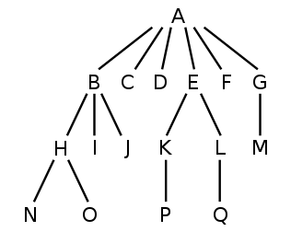
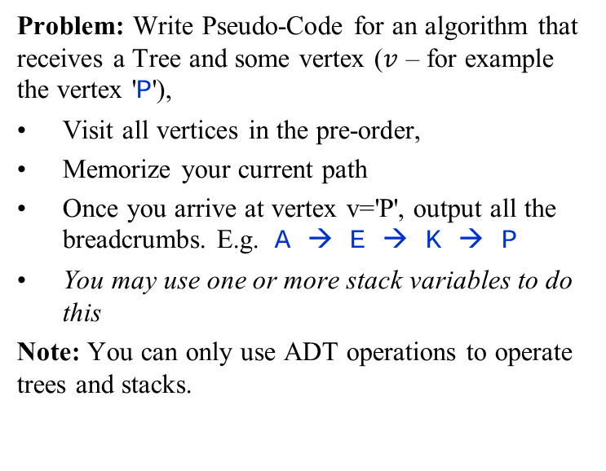
Breadcrumbs in a Stack
Tree ADT
parent(v): Return the parent of vertex v (or Λ, if v is the root).
children(v): Return the list of all children of v (this set is empty, if v is a leaf).
isLeaf(v): Return true, if v is a leaf, false - if v is not a leaf.
Stack ADT
emptyStack(): Return an empty stack
s.push(elt): inserts (pushes) an element
s.pop(): removes the last inserted element
s.top(): returns the last inserted element without removing it
s.size(): returns the number of elements stored
s.empty(): indicates whether the stack is empty
Problem: Write Pseudo-Code for an algorithm that receives a Tree and some vertex ($v$ – for example the vertex 'P'),
Visit all vertices in the pre-order,
Memorize your current path
Once you arrive at vertex v='P', output all the breadcrumbs. E.g. A → E → K → P
You may use one or more stack variables to do this
Note: You can only use ADT operations to operate trees and stacks.

Slide 33
Breadcrumbs in a Stack: Solution
Read the problem carefully. It contains keyword "pre-order".
Find some code to do this:
Preorder(T,v):
Visit(v)
for each child w of v do
Preorder(T,w)
Rewrite this pseudocode using allowed Tree ADT operations.
Every time you "visit" some node, push it to the stack. Every time you return from the "Preorder()", pop that node.
Preorder(v, s):
s.push(v)
foreach child w of v do
Preorder(w)
Main(r,v):
bcs = Stack.empty() // breadcrumb stack
Preorder(r,bcs)

Slide 34
Evaluating Postfix Expression
function PostorderEvaluate(E array[1..n]): integer
stack = emptyStack()
for i from 1 to n do
if isNumber(E[i]) then:
stack.push(E[i])
else:
x1 = stack.pop()
x2 = stack.pop()
res = ApplyOp(E[i], x1, x2)
stack.push(res)
+
×
×
2
−
3
4
17
1
Sample array (post-order traversal of syntax tree)
2 | 17 | 1 | - | * | 3 | 4 | * | +
Problem: Given the pseudocode for PostorderEvaluate(E), write the current state of the stack right after the E[6], i.e. after the number "4" is inserted.

Slide 35
Evaluating Postfix Expression: Solution
2 | 17 | 1 | - | * | 3 | 4 | * | +
Answer: The state of the stack at the point when "4" is pushed is this:
2
2
17
32
3
4
2
17
1
2
16
minus
32
times
32
3

