Slide 1
Data Structures: Trees, Binary Search Trees
Trees (incl. rooted and ordered)
Binary Trees, and Binary Search Trees
Searching a Binary Search Tree
Implementing Binary Trees
Insertion and deletion
Tree Traversal and Expression Trees
Notes:
**Goal:** In this module we manipulate rooted, ordered trees regardless of any specific node ordering or other additional semantics. (Binary Search Trees and similar objects are discussed in subsequent chapter.

Slide 2
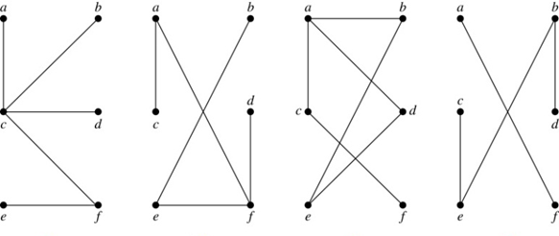
Tree: Definition
Definition: A tree is a connected undirected graph with no simple circuits.
Examples:
G₁ and G₂ are trees.
G₃ is not a tree (contains a circuit)
G₄ is not a tree (not connected)

Slide 3
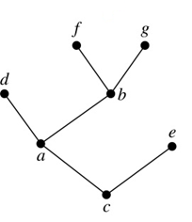
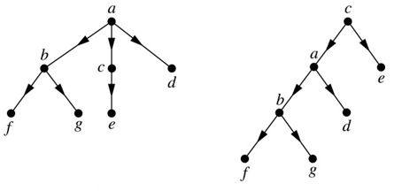
Rooted Trees
If we do not single out any node, the tree is "unrooted" – it is an undirected graph (edges do not have arrows).
Whenever we pick a root, the paths from the root to the other nodes create parent-child relationships (edges become "directed").

Slide 4
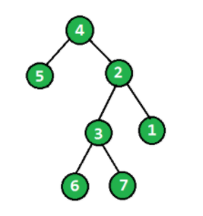

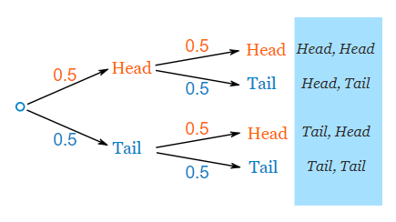
Real-World Trees
Rooted trees are data structures to represent hierarchies – acyclical and transitive relationships among elements. Elements are nodes (also vertices)
C++ class inheritance hierarchy
Probabilistic event hierarchy
Directory tree.
What about "family trees"?
Notes:
Haplogroups showing fathers only, or mothers only. Actual family tree is more messy as everyone has two parents.
Directory tree is a tree only, if you carefully define the letter-drives (in Windows) and symlinks (in Linux).
Linked lists, stacks, queues are linear in form and cannot reflect hierarchically organized data
To overcome these limitations, we’ll consider a new data structure, the tree
Trees consist of two components, nodes and arcs (or edges)
Trees are drawn with the root at the top, and “grow” down
The leaves of the tree (also called terminal nodes) are at the bottom of the tree

Slide 5
Tree for an Arithmetic Expression
Binary tree can reflect arithmetic expression (with binary operators)
Inner nodes: operators
Leaves : numbers or variables
+
×
×
2
−
3
b
a
1
The example shows this arithmetic expression:
(2 * (a - 1) + (3 * b))

Slide 6
Tree Concepts
Tree contains nodes (a.k.a. vertices) and edges.
Definition: A tree is a connected graph with no loops.
A rooted tree is a tree with some root node selected.
In a rooted tree any edge is between a parent and a child.
An ordered tree is a rooted tree with a certain order of child nodes for every parent node.
Root is typically shown at the top, leaves at the bottom.
root
Leaves
Notes:
Some marginal examples:
* Is graph without any nodes still a tree?
* Are there graphs, where the root is a leaf?

Slide 7
Terminology Overview
Node; Edge
Parent; Child
Ancestor; Descendant
Path;
Depth (of a node)
Height (of a tree)
Level (level 0, 1, and so on)
Leaf; internal node
Left/Right subtree
A
B
C
D
E
F
G
H
I
Notes:
**Mezgls** – node (= virsotne/vertex)
**Bērns** - child
**Šķautne** - edge
**Vecāks** - parent
**Priekštecis** - ancestor
**Pēctecis** - descendant
**Sibs**(?) - sibling
**Ceļš** - path
**Dziļums** - depth
**Augstums** - height
**Līmenis** - level
**Lapa** - leaf
**Iekšējs mezgls** - internal node
**Apakškoks** - subtree

Slide 8
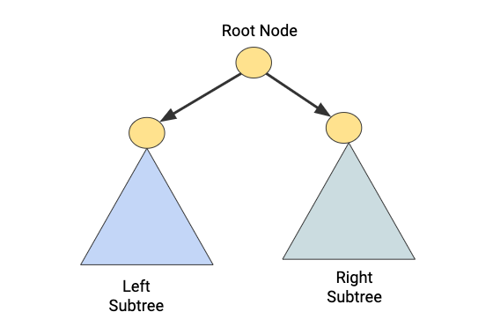
Binary Tree
A binary tree has a finite (possibly empty) set of nodes.
A binary tree is either empty, or it has a root with two child-trees (they are in-turn binary trees; named the left subtree and the right subtree).
The left subtree, the right subtree and the root do not share any nodes.
Notes:
* Why is it convenient to have completely empty binary trees? * Can the left or the right subtree be empty?

Slide 9
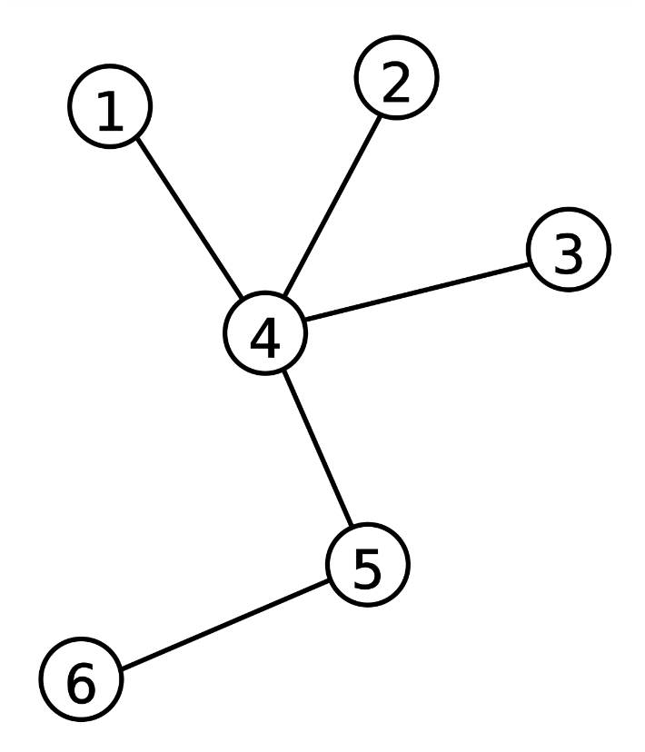
What is a node?
Non-rooted trees:
Trees without a root can have nodes of various degrees.
Rooted trees:
Every node has an "upward" edge connecting it with the root.
Additionally, internal nodes can have certain number of children.
A
B
C
D
E
F
G
H
I

Slide 10
Edges in Unrooted and Rooted Trees
Edges
In a general tree an edge is undirected (2-way) link between two nodes. In a rooted tree any edge is on a downward path from the root to some other node.
A
B
C
D
E
F
G
H
I

Slide 11
Parents and Children
Questions:
What are the children of node A?
List the children of nodes B and C.
What are the parents of E and H?
Do your answers change, if the root of the tree moves from A to E?
A
B
C
D
E
F
G
H
I
A
B
C
D
E
F
G
H
I
Notes:
As soon as the root is selected, we imagine that tree *hangs* from that root vertex; therefore all the parent-child relationships become defined.

Slide 12
Recursive Definition of a Rooted Tree
Definition: Trees can be defined recursively as follows:
A structure consisting of just one node (and no edges) is a tree
If we have a set t₁… t_{k} of disjoint trees, the tree whose root has the roots of t₁… t_{k} as its children is a tree.
Only structures generated by rules 1 and 2 are trees
Theorem: A tree with n nodes has n-1 edges.
Theorem: Every node in a rooted tree is accessible from the root through a unique sequence of arcs, called a path
Definition: A node’s level is the length of the path to that node

Slide 13
Counting Rooted Trees
n | 1 | 2 | 3 | 4 | 5 | 6 | 7 | 8 | 9 | 10 | 11 | 12
T(n) | 1 | 1 | 2 | 4 | 9 | 20 | 48 | 115 | 286 | 719 | 1842 | 4766
https://mathworld.wolfram.com/RootedTree.html
Parenthesized (prefix) notation:
If n=3, the two trees are: (A (B C)) vs. (A B C)
If n=4, the four trees are:
(A (B (C D))) ....
Does this count rooted unordered or rooted ordered trees?
What is graph isomorphism
Notes:
https://mathworld.wolfram.com/RootedTree.html
The number of nonisomorphic rooted trees on n nodes.

Slide 14
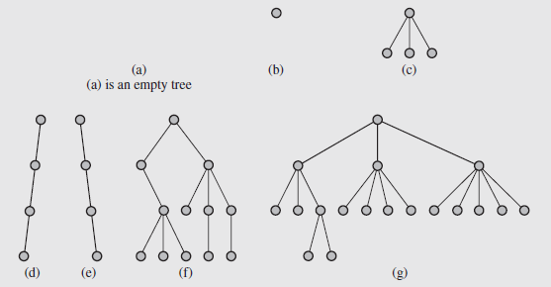
Depth and Height of a Node
Definition: The depth of a node is the number of edges from the node to the tree's root node. A root node will have a depth of 0.
Definition: The height of a node is the number of edges on the longest path from the node to a leaf. A leaf node will have a height of 0.
Notes:
Again, notice from this Figure that nodes can have any number of children.
Several algorithms exist that are based on trees that have specific numbers of leaves. In this discussion, however, we are going to focus on binary trees.
The number of children of a given node can be arbitrary
Using trees may also to improve the process of searching for elements
In order to find a particular element in a list of n elements, we have to examine all those before that element in the list
This holds even if the list is ordered
On the other hand, if the elements of a list are stored in a tree that is organized in a predetermined fashion, the number of elements that must be looked at can be substantially reduced

Slide 15
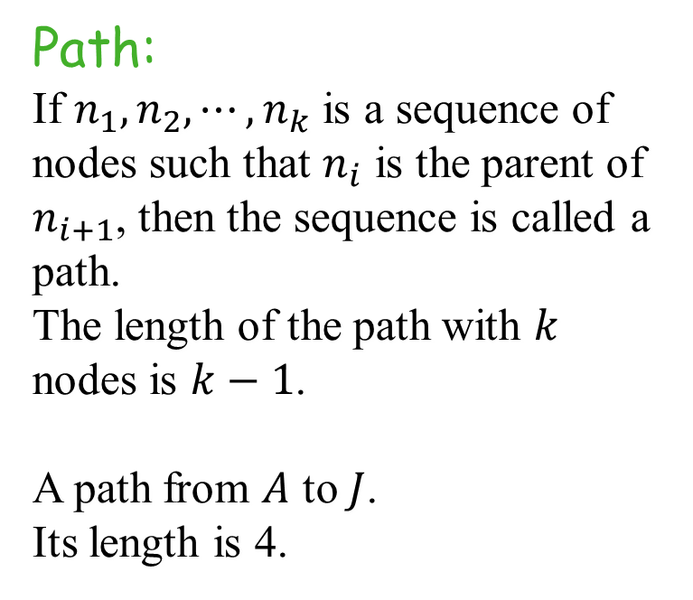
Concept:Path
Path:
If $n_{1},n_{2},⋯,n_{k}$ is a sequence of nodes such that $n_{i}$ is the parent of $n_{i+1}$, then the sequence is called a path. The length of the path with $k$ nodes is $k−1$.
A path from $A$ to $J$.
Its length is 4.
A
B
C
D
E
F
G
H
I
J

Slide 16
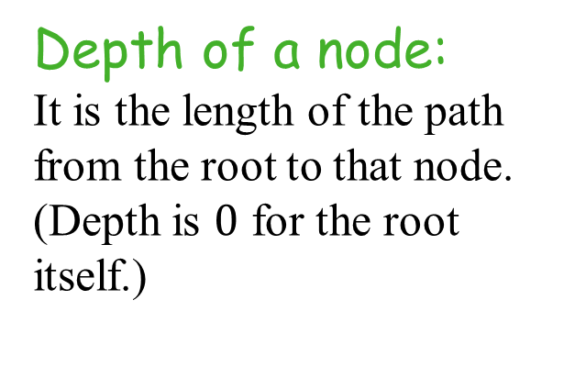
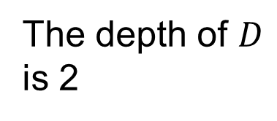
Concept: Depth
Depth of a node:
It is the length of the path from the root to that node.
(Depth is $0$ for the root itself.)
A
B
C
D
E
F
The depth of $D$
is 2
G
H
I

Slide 17
Concept: The height of a node
Height (for a node):
The largest possible length of the downward path from this node to some leaf node.
Height (for the tree):
The largest possible depth of some leaf node (=path from the root to the deepest leaf).
(In this example it is 3)
A
B
C
D
E
F
G
H
I

Slide 18
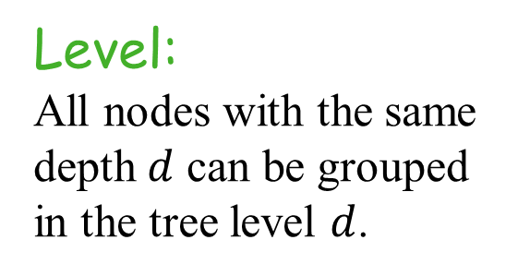
Concept: Level
0
A
Level:
All nodes with the same depth $d$ can be grouped in the tree level $d$.
1
B
C
2
D
E
F
3
G
H
I

Slide 19
Successors and Predecessors
Successors:
Successors of node C?
Predecessors:
What are the predecessors of node D?
Or of node H?
A
A
B
C
B
C
D
E
F
D
E
F
G
H
I
G
H
I
Notes:
Successors typically do not include the node itself.

Slide 20
Leafs and Internal Nodes
Leaf:
Any node with all empty subtrees/children.
Internal Node:
Any node with some non-empty child.
A
A
B
C
B
C
D
E
F
D
E
F
G
H
I
G
H
I

Slide 21
Cultural Reference: CSS Selectors
Example | Example description
div p | Selects all <p> elements inside <div> elements
div > p | Selects all <p> elements where the parent is a <div> element
div + p | Selects all <p> elements that are placed immediately after <div> elements
p ~ ul | Selects all <ul> elements that are siblings of a <p> element

Slide 22
Tree Terminology: Summary
Root: node without parent (A)
Internal node: node with at least one child (A, B, C, F)
External node (a.k.a. leaf ): node without children (E, I, J, K, G, H, D)
Ancestors of a node: parent, grandparent, grand-grandparent, etc.
Depth of a node: number of ancestors
Height of a tree: maximum depth of any node (3)
Descendant of a node: child, grandchild, grand-grandchild, etc.
Subtree: tree consisting of a node and its descendants
A
subtree
B
C
D
E
F
G
H
I
J
K

Slide 23
Surroundings of a Node
A
Item Name | Count/Value
Parent of F | Node
Children of F | List of nodes
Ancestors of F (parent to root) | List of nodes
Successors of F | count
Depth of F | value
Height of F | value
Nodes visited before F in preorder/inorder/postorder | 3 values
Nodes visited after F in preorder/inorder/postorder | 3 values
Level of F | value
Siblings of F | List of nodes
Siblings to the left of F | count
B
C
D
E
F
G
I
J
Note: Please pay attention to the type requested in the answer
node,
list of nodes,
integer value,
multiple integer values

Slide 24
Surroundings of a Node: Solution
Item Name | Count/Value
Parent of F | C
Children of F | [ ]
Ancestors of F (parent to root) | [C,A]
Successors of F | 0
Depth of F | 2
Height of F | 0
Nodes visited before F in preorder/inorder/postorder | (5,4,3)
Nodes visited after F in preorder/inorder/postorder | (3,4,5)
Level of F | 2
Siblings of F | [ ]
Siblings to the left of F | 0
A
B
C
D
E
F
G
I
J

Slide 25
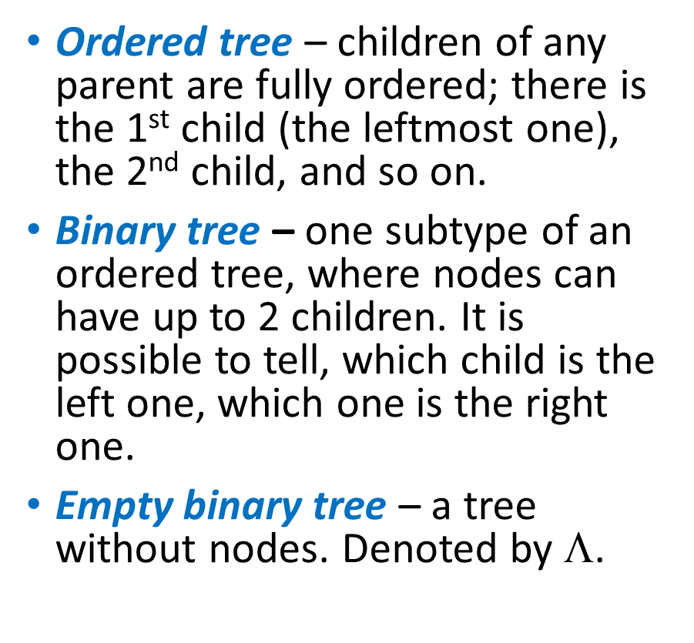
Subclasses of Trees – 1
Ordered tree – children of any parent are fully ordered; there is the 1st child (the leftmost one), the 2nd child, and so on.
Binary tree – one subtype of an ordered tree, where nodes can have up to 2 children. It is possible to tell, which child is the left one, which one is the right one.
Empty binary tree – a tree without nodes. Denoted by $☹$.
A
B
C
D
E
F
G
H
I
A
B
C
D
E
F
G
H
I
Notes:
The two trees are equivalent in many senses:
* As isomorphic graphs (and unrooted trees)
* As equal rooted unordered trees
* As equal rooted ordered trees
But they are not equivalent as binary trees, because sometimes the only child is the left child (and sometimes it is the right child).

Slide 26
Arithmetic Expression Tree
Binary tree associated with an arithmetic expression
internal nodes: operators
external nodes: operands
Example: arithmetic expression tree for the expression (2 × (a − 1) + (3 × b))
+
×
×
2
−
3
b
a
1

Slide 27
Subclasses of Trees – 2
Full binary tree – any vertex either has two children or none at all.
Perfect binary tree – a full binary tree having all leaves of the same depth.
Complete binary tree – can be obtained from a perfect binary tree by removing some adjacent leaves from the end.
Notes:
Concepts:
**Pilns binārs koks** - Full binary tree.
**Pilnīgs bināŗs koks** - Complete binary tree.
**Perfekts binārs koks** - Perfect binary tree.

Slide 28
Full Binary Tree
In a full binary tree:
Every node is either (1) Inner node with two children OR
(2) A leaf without any children
A
B
C
D
E
F
G
H

Slide 29
Recognizing Full Binary Trees
Are these full binary trees?
A
A
B
C
B
C
D
E
F
G
D
E
F
G
I
J
H
I
J
Notes:
On the left side there is a full binary tree (just leaves and f

Slide 30
Complete and Perfect Binary Trees
1
In general, there would be 2^{i} nodes at level i
A tree that exhibits this is called a complete binary tree
In such a tree, all nonterminal nodes have both children, and all leaves are on the same level.
2
3
4
5
6
7
8
9
10
11
12
13
14
15

Slide 31
Binary Search Trees
Because leaves can occur throughout this tree (except at level 1), there is no general formula to calculate the number of nodes
However, it can be approximated:
For all the nonempty binary trees whose nonterminal nodes have exactly two nonempty children, This holds trivially for the tree consisting of only the root

Slide 32
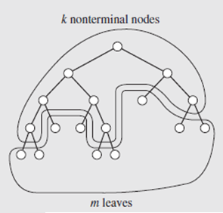
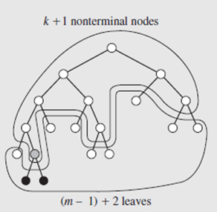
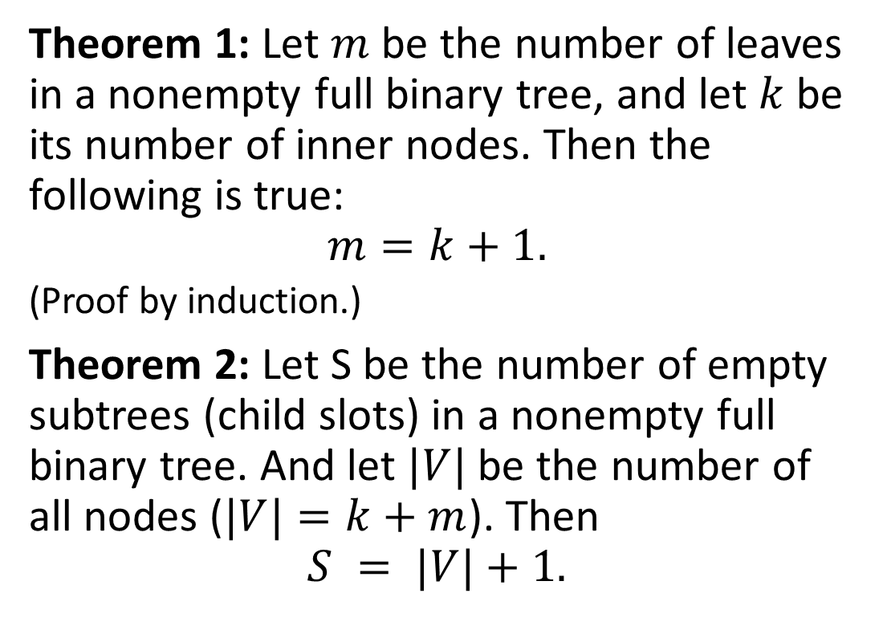
Invariants in a Full Binary Tree
Theorem 1: Let $m$ be the number of leaves in a nonempty full binary tree, and let $k$ be its number of inner nodes. Then the following is true:
$$m=k+1.$$
(Proof by induction.)
Theorem 2: Let S be the number of empty subtrees (child slots) in a nonempty full binary tree. And let $|V|$ be the number of all nodes ($|V|=k+m$). Then
$$S = |V|+1.$$

Slide 33
More Invariants in Binary Trees
Properties:
E = 2I
H ≤ I
H ≤ (N − 1)/2
L ≤ 2^{H}
H ≥ log₂ L
H ≥ log₂ (N + 1) − 1
Notation
N number of nodes
L number of external nodes
I number of internal nodes
E number of edges
H height

Slide 34
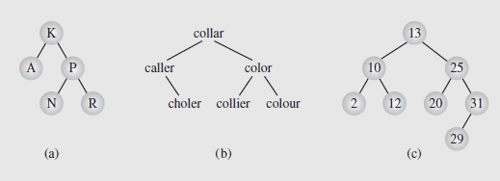
Trees, Binary Trees, and Binary Search Trees (continued)
In a binary search tree (or ordered binary tree), values stored in the left subtree of a given node are less than the value stored in that node, and values stored in the right subtree of a given node are greater than the value stored in that node
The values stored are considered unique; attempts to store duplicate values can be treated as an error
The meanings of the expressions “less than” and “greater than” will depend on the types of values stored
Fig. 6.6 Examples of binary search trees
Notes:
Figure 6.6 shows examples of binary search trees; notice figure 6.6c is the tree from figure 6.3a, optimized.

Slide 35
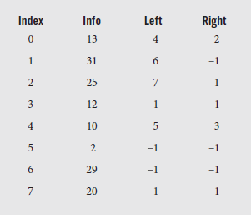
Implementing Binary Trees
We can use arrays or linked structures to implement binary trees
If using an array, each element stores a structure that has an information field and two “pointer” fields containing the indexes of the array locations of the left and right children
The root of the tree is always in the first cell of the array, and a value of -1 indicates an empty child
Notes:
Using this implementation, the tree from figure 6.6c can be implemented using the array shown in figure 6.7.

Slide 36
Implementing Binary Trees (continued)
Implementing binary tree arrays does have drawbacks
We need to keep track of the locations of each node, and these have to be located sequentially
Deletions are also awkward, requiring tags to mark empty cells, or moving elements around, requiring updating values
Consequently, while arrays are convenient, we’ll usually use a linked implementation
In a linked implementation, the node is defined by a class, and consists of an information data member and two pointer data members
The node is manipulated by methods defined in another class that represents the tree
The code for this is shown in Figure 6.8 on pages 220-222

Slide 37
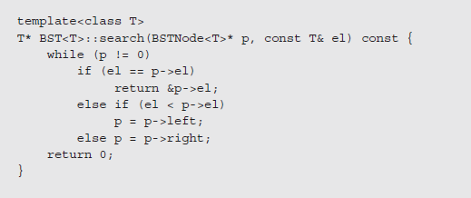
Locating a specific value in a binary tree
If the target is smaller, we branch to the left subtree; if larger, we branch to the right
If at any point we cannot proceed further, then the search has failed and the target isn’t in the tree
Notes:
The number of comparisons performed during the search determines the complexity of the search
This in turn depends on the number of nodes encountered on the path from the root to the target node
So the complexity is the length of the path plus 1, and is influenced by the shape of the tree and location of the target
Searching in a binary tree is quite efficient, even if it isn’t balanced
However, this only holds for randomly created trees, as those that are highly unbalanced or elongated and resemble linear linked lists approach sequential search times

Slide 38
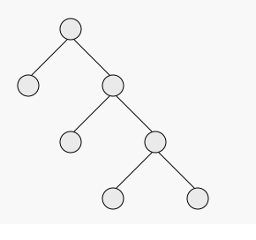

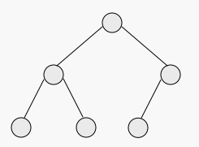
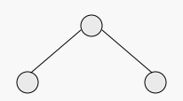
N-ary Trees
(A)
(B)
Property | (A) | (B) | (C) | (D)
Tree is n-ary for some n
Tree is full
Tree is complete
Tree is perfect
Note: All answers are Yes or No.
(C)
(D)

Slide 39
N-ary Trees: Solution
(A)
(B)
Property | (A) | (B) | (C) | (D)
Tree is n-ary for some n | Yes | Yes | Yes | Yes
Tree is full | Yes | No | No | Yes
Tree is complete | No | No | Yes | Yes
Tree is perfect | No | No | No | Yes
(C)
(D)

Slide 40
Tree ADT
T.size(): integer
T.isEmpty(): bool
T.root(): position
T.positions(): list<position>
p.parent(): position
p.children(): list<position>
p.isRoot(): bool
p.isInternal(): bool (iff p is internal, not a leaf)
p.isLeaf(): Return true, iff p is a leaf.
p.firstChild(): return the leftmost child (or Λ for leaf).
p.rightSibling(): sibiling to the right of the node v (or Λ, if does not exist).
p.leftSibling(): similar.
Binary trees only: p.leftChild(), p.rightChild():

Slide 41
Depth of a node using Tree ADT
Some functions can be computed:
Depth(v): Return the depth of the node v in this tree.
Height(v): Return the height of the node v in this tree.
Algorithm depth(T,v)
if T.isRoot(v) then
return 0
else
return 1 + depth(T,T.parent(v))

Slide 42
Height of the (sub)tree using Tree ADT
Algorithm height(T,v)
if T.isExternal(v) then
return 0
else
h = 0
for each w in T.children(v) do
h = max(h, height(T,w))
return 1 + h

Slide 43
Inorder Traversal
Algorithm inOrder(v)
if ¬ v.isExternal()
inOrder(v.leftChild())
visit(v)
if ¬ v.isExternal()
inOrder(v.rightChild())
In an inorder traversal a node is visited after its left subtree and before its right subtree
Application: draw a binary tree
x(v) = inorder rank of v
y(v) = depth of v
6
2
8
1
4
7
9
3
5

Slide 44
Print Arithmetic Expressions
Algorithm printExpression(v)
if ¬v.isExternal() print(“(’’)
inOrder(v.leftChild())
print(v.element())
if ¬v.isExternal()
inOrder(v.rightChild())
print (“)’’)
Specialization of an inorder traversal
print operand or operator when visiting node
print “(“ before traversing left subtree
print “)“ after traversing right subtree
+
×
×
2
−
3
b
((2 × (a − 1)) + (3 × b))
a
1

Slide 45
Evaluate Arithmetic Expressions
Specialization of a postorder traversal
recursive method returning the value of a subtree
when visiting an internal node, combine the values of the subtrees
Algorithm evalExpr(v)
if v.isExternal()
return v.element()
else
x ← evalExpr(v.left())
y ← evalExpr(v.right())
◊ ← operator stored at v
return x ◊ y
+
×
×
2
−
3
2
5
1

Slide 46
DFS Preorder Traversal
Use-Case: Print an outline of a structured document (text snippets or the table of contents).
In a preorder traversal, a node is visited before its descendants
Algorithm preOrder(v)
visit(v)
for each child w of v
preorder (w)
1
Make Money Fast!
2
5
9
1. Motivations
2. Methods
References
3
4
6
7
8
1.1 Greed
1.2 Avidity
2.1 Stock Fraud
2.2 Ponzi Scheme
2.3 Bank Robbery
Notes:
Tree traversal is the process of visiting each node in a tree data structure exactly one time
This definition only specifies that each node is visited, but does not indicate the order of the process
Hence, there are numerous possible traversals; in a tree of n nodes there are n! traversals
Two especially useful traversals are depth-first traversals and breadth-first traversals

Slide 47
DFS Postorder Traversal
Algorithm postOrder(v)
for each child w of v
postOrder (w)
visit(v)
In a postorder traversal, a node is visited after its descendants
Application: compute space used by files in a directory and its subdirectories
9
cs16/
8
3
7
homeworks/
programs/
todo.txt 1K
1
2
4
5
6
h1c.doc 3K
h1nc.doc 2K
DDR.cpp 10K
Stocks.cpp 25K
Robot.cpp 20K

Slide 48
DFS: Inorder Traversal
This makes sense only for binary trees. The top node is visited just after the left subtree, but just before the right subtree.
procedure Inorder(pointer P):
// P points to the root node
if P=Λ then
return
else
Inorder(LeftChild(P))
Visit(P)
Inorder(RightChild(P))
6
2
8
1
4
7
9
3
5

Slide 49
"Universal" DFS Traversal
function Traverse(pointer P):
// P points to the root node
if P ≠ Λ then
PreVisit(P)
Traverse(LC(P))
InVisit(P)
Traverse(RC(P))
PostVisit(P)
+
PreVisit
×
PostVisit
×
InVisit
2
−
3
2
5
1

Slide 50
Implementing DFS Traversal
Depth-First Traversal
Depth-first traversal proceeds by following left- (or right-) hand branches as far as possible
The algorithm then backtracks to the most recent fork and takes the right- (or left-) hand branch to the next node
It then follows branches to the left (or right) again as far as possible
This process continues until all nodes have been visited
While this process is straightforward, it doesn’t indicate at what point the nodes are visited; there are variations that can be used
We are interested in three activities: traversing to the left, traversing to the right, and visiting a node
These activities are labeled L, R, and V, for ease of representation

Slide 51
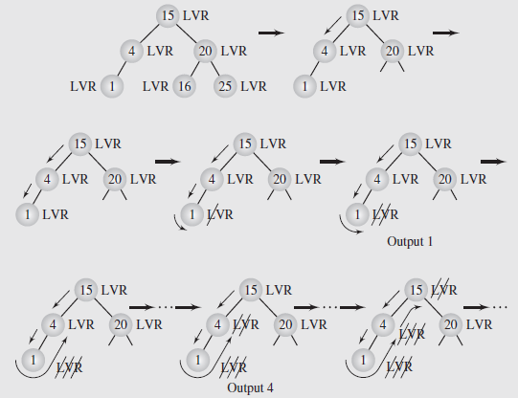
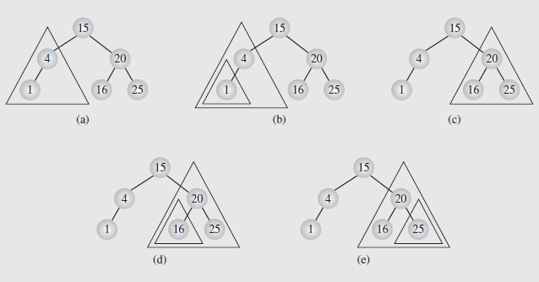
DFS Traversal – Recursive Implementation
Example of Inorder traversal via recursive calls
Notes:
The output from the inorder traversal can be seen in figure 6.12. The individual steps labeled in the figure are described in detail on pages 226 and 227.
Depth-First Traversal (continued)
Because of the order of the recursion in the code, the V and R steps are held pending until the L step completes
This is the function of the stack, to “remember” the backtrack point, so that after a left traversal ends, the routine can back up to visit the branch point node, and then proceed to the right
Depth-First Traversal (continued)
Based on earlier discussions, we want to perform the traversal in an orderly manner, so there are six possible arrangements:
VLR, VRL, LVR, LRV, RVL, and RLV
Generally, we follow the convention of traversing from left to right, which narrows this down to three traversals:
VLR – known as preorder traversal
LVR – known as inorder traversal
LRV – known as postorder traversal
These can be implemented straightforwardly, as seen in Figure 6.11
Depth-First Traversal (continued)
Now let’s consider nonrecursive implementations of the traversal algorithms
As we’ve learned, recursive algorithms tend to be less efficient than their nonrecursive versions
So we need to determine if it is useful to pursue nonrecursive versions of the traversal algorithms

Slide 52
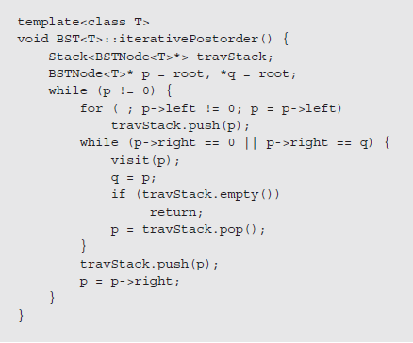
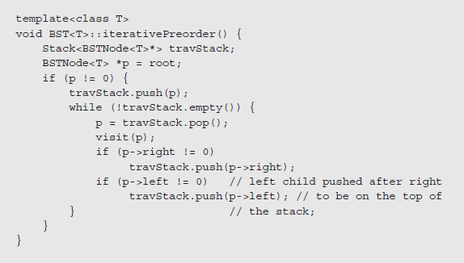
DFS Traversal – Explicit Stack Implementation
Examples of Preorder and Postorder traversals (both need Stack data structure)

Slide 53
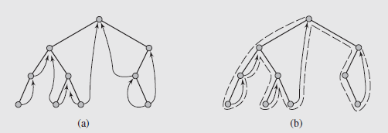
DFS Traversal – Threaded Trees
Stackless Depth-First Traversal: Threaded Trees (inorder traversal order pointers between nodes).
Notes:
Stackless Depth-First Traversal: Threaded Trees
The previous algorithms were all characterized by the use of a stack, either implicitly through the system, or explicitly in code
In both cases, additional processing time is required to handle stack operations, and memory has to be allocated for the stack
In extreme cases where the tree is highly skewed, this can be a serious processing concern
A more efficient implementation can be achieved if the stack is incorporated into the design of the tree itself
This is done by using threads, pointers to the predecessor and successor of a node based on an inorder traversal
Trees using threads are called threaded trees

Slide 54
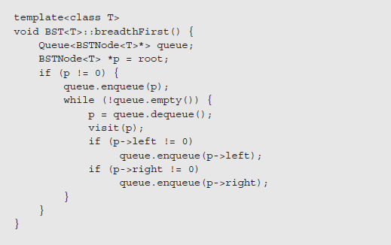
BFS Traversal needs a Queue
Notes:
Breadth-First Traversal
Breadth-first traversal proceeds level-by-level from top-down or bottom-up visiting each level’s nodes left-to-right or right-to-left
This gives us four possibilities; a top-down, left-to-right breadth-first traversal of Figure 6.6c yields 13, 10, 25, 2, 12, 20, 31, 29
This can be easily implemented using a queue
If we consider a top-down, left-to-right breadth-first traversal, we start by placing the root node in the queue
We then remove the node at the front of the queue, and after visiting it, we place its children (if any) in the queue
This is repeated until the queue is empty

Slide 55
BFS Traversal Example

Slide 56
An example of a tree traversal
Every arithmetic expression can be expressed as a tree.
Arithmetic expression can be computed with Evaluate.
function Evaluate(pointer P): integer
if IsLeaf(P) then
return Label(P)
else
xL = Evaluate(LeftChild(P))
xR = Evaluate(RightChild(P))
op = Label(P)
return ApplyOp(op, xL, xR)
Notes:
* Function `Label(v)` returns the information stored in the node `v`.
* Function `ApplyOp(op, x, y)` returns the result when applying operation `op` to the arguments `x` and `y`.

Slide 57
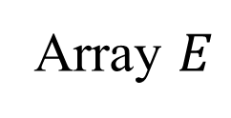
Evaluating Postfix Expression
function PostorderEvaluate(E array[1..n]): integer
stack = emptyStack()
for i from 1 to n do
if isNumber(E[i]) then:
stack.push(E[i])
else:
x1 = stack.pop()
x2 = stack.pop()
res = ApplyOp(E[i], x1, x2)
stack.push(res)
+
×
×
2
−
3
4
7
1
Array $E$
2 | 7 | 1 | - | * | 3 | 4 | * | +

Slide 58
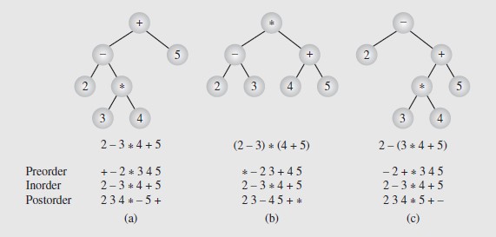
Polish Notation and Expression Trees
Polish notation, developed by Jan Lukasiewicz in the 1920s, is a special notation for symbolic logic that allows us to eliminate all parentheses from formulas
For the sake of readability we use parentheses. However, if we are only concerned with ambiguity, as in a compiler, we can omit most extra symbols.
Notes:
Preorder traversals produce prefix notation, where the operator precedes the operands it works on, such as in LISP
Postorder traversals generate postfix notation, where the operator follows the operands it works on, such as in Forth
Inorder traversals create infix notation, where the operator is in between its operands. It is the infix notation form that we are most familiar with in reading and creating expressions

Slide 59
Polish Notation and Expression Trees
Notice no parentheses are used, but there is no ambiguity
This structure can be retained even when the tree is linearized by traversing the tree and output the symbols based on the traversal order
Notice that traversing using inorder produces the same expression (regardless of the tree), implying inorder isn’t useful to us
The other two are however, so we can use them to create unambiguous expressions

Slide 60
Polish Notation and Expression Trees (continued)
Operations on Expression Trees (continued)
class ExprTreeNode {
public:
ExprTreeNode (char *k, ExprTreeNode *l, ExprTreeNode *r) {
key = new char[strlen(k) +1];
strcpy (key, k);
left = l; right = r;
}
…
private:
char *key;
ExprTreeNode *left, *right;
}

Slide 61
Tree implementation
Implementation alternatives:
Implementing a binary tree
Implementing an ordered tree
For a fixed (or limited) number of children?
For an arbitrary number of children – can map to a binary tree.

Slide 62
Binary Tree as Array – 1
1
The index of the node – its position in a perfect binary tree.
The node information is stored in that array position.
a
2
3
b
c
4
5
6
7
d
e
f
g
8
9
10
h
i
j
tree[]
a
b
c
d
e
f
g
h
i
j
0
5
10
Notes:
Is there any advantage of leaving the first element empty? (Some arithmetic of parent/children finding is a bit easier, but it only affects very few C++ methods.)
If the height of the tree changes, it has to allocate twice as many slots in an array.
* For near-perfect (or simply naturally growing) trees this happens infrequently, and occasionally we can spend linear time on copying arrays.
* For very skinny trees, new levels may appear very frequently (and eventually lead to exponential waste of memory). In such cases arrays are clearly inefficient (and pointers are preferred).

Slide 63
Implementing a Complete Binary Tree
Arrays – the Favorite Implementation
Nodes are enumerated level by level
The node level-based number determines its index in an array.
Complete trees can be stored very compactly
All ADT operations are doable in constant time.

Slide 64
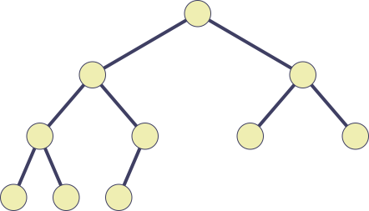

Complete Binary Tree as an Array
Finding Parents/Children arithmetically:
parent(i) = (i - 1) / 2
left(i) = 2i + 1
right(i) = 2i + 2
0
h
1
j
2
f
3
d
4
b
5
a
6
e
i
c
g
7
8
9
h
j
f
d
b
a
e
i
c
g

Slide 65
Array-Based Representation of Binary Trees
Nodes are stored in an array A
Node v is stored at A[rank(v)]
rank(root) = 1
if node is the left child of parent(node), rank(node) = 2 ⋅ rank(parent(node))
if node is the right child of parent(node),
rank(node) = 2 ⋅ rank(parent(node)) + 1
A
B
D
…
G
H
…
0
1
2
3
10
11
1
A
2
3
B
D
4
5
6
7
E
F
C
J
10
11
G
H

Slide 66
Binary Tree as Array – 2
1
a
b
3
7
c
15
d
tree[]
a
-
b
-
-
-
c
-
-
-
-
-
-
-
d
0
5
10
15
Notes:
This picture shows storing a skinny tree in an array (gaps between the nodes grow exponentially).

Slide 67
ADT Implementations in an Array
IsLeaf(i): 2 * i + 1 >= n
LeftChild(i): 2 * i + 1 (null, if 2 * i + 1 >= n)
RightChild(i): 2 * i + 2 (null, if 2 * i + 2 >= n)
LeftSibling(i): i - 1 (null, if i = 0 or i is odd)
RightSibling(i): i + 1 (null, if i = n - 1 or i is even)
Parent(i): ⎣(i - 1) / 2⎦ (null, if i = 0)
Depth: ⎣log₂(i + 1) ⎦
Height: ⎡log₂ ((n + 1) / (i + 1))⎤ - 1

Slide 68
Binary Trees Consist of Identical Nodes
A node is represented by an object storing
Element
Parent node
Left child node
Right child node
Node objects implement the Position ADT
∅
B
∅
∅
A
D
B
A
D
∅
∅
∅
∅
C
E
C
E

Slide 69
Non-Binary Trees need Lists of Children: More Complicated
A node is represented by an object storing
Element
Parent node
Sequence of children nodes
Node objects implement the Position ADT
B
∅
A
∅
D
F
∅
B
A
D
F
C
E
C
∅
E
∅

Slide 70
Binary Tree with Pointers
root
a
b
c
e
d
g
f
leftChild
element
h
rightChild

Slide 71

Ordered Tree Storage (Limit on Children)
If we know that the number of children is limited by $N$:
For $N=2$, then it is a traditional binary tree implementation.
For $N>2$, store any node as an info field followed by N pointers to its children.
Info | C1 | C2 | C3 | ... | CN

Slide 72
Encoding Between Binary and Non-Binary
B.root ⇔ S.root
LeftChild(B.node) ⇔ FirstChild(S.node)
RightChild(B.node) ⇔ RightSibling(S.node)

Slide 73
Encoding: General Ordered to Binary
A
A
A
B
B
C
D
B
C
D
E
C
E
F
G
H
I
E
F
G
H
I
F
D
J
K
L
M
J
K
L
M
J
G
N
N
K
H
L
I
N
M

Slide 74

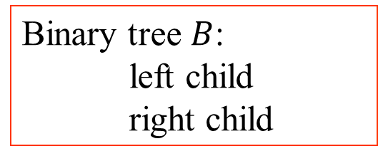
Decoding: Binary to General Ordered
A
A
A
B
B
C
D
B
C
D
E
C
E
F
G
H
I
J
E
F
G
H
I
J
F
D
Ordered Tree $S$
Binary tree $B$: left child right child
G
H
I
J

