Slide 1
Search Trees and Balancing
Notes:
# Every module has the following content
* Title (1 slide)
* Table of Contents (1 slide) – where are we in the material?
* Motivation (1 slide) – why do we need this module?
* Anchor Task (1x) – introduce the key problem handled by this module
* Objectives (1x)
* Theory Section (1 subtitle + more slides) or Demo Section (1 subtitle + more slides)
* Summary (1x) * References (1x)
Binary Search Trees – node order invariant.
Performance Issues – Skinny vs. Bushy trees
Balancing techniques.

Slide 2
Ordered Maps
Keys come from a total order
New operations:
Each returns an iterator to an entry:
firstEntry(): smallest key in the map
lastEntry(): largest key in the map
floorEntry(k): largest key ≤ k
ceilingEntry(k): smallest key ≥ k
All return end if the map is empty

Slide 3
Binary Search
Binary search can perform operations get, floorEntry and ceilingEntry on an ordered map implemented by means of an array-based sequence, sorted by key
similar to the high-low game
at each step, the number of candidate items is halved
terminates after O(log n) steps
Example: find(7)
0
1
3
4
5
7
8
9
11
14
16
18
19
l
m
h
0
1
3
4
5
7
8
9
11
14
16
18
19
l
m
h
0
1
3
4
5
7
8
9
11
14
16
18
19
l
m
h
0
1
3
4
5
7
8
9
11
14
16
18
19
l=m =h

Slide 4
Search Tables
A search table is an ordered map implemented by means of a sorted sequence
We store the items in an array-based sequence, sorted by key
We use an external comparator for the keys
Performance:
get, floorEntry and ceilingEntry take O(log n) time, using binary search
get takes O(n) time since in the worst case we have to shift n/2 items to make room for the new item
erase take O(n) time since in the worst case we have to shift n/2 items to compact the items after the removal
The lookup table is effective only for dictionaries of small size or for dictionaries on which searches are the most common operations, while insertions and removals are rarely performed (e.g., credit card authorizations)

Slide 5
Binary Search Trees
A binary search tree is a binary tree storing keys (or key-value entries) at its internal nodes and satisfying the following property:
Let u, v, and w be three nodes such that u is in the left subtree of v and w is in the right subtree of v. We have key(u) ≤ key(v) ≤ key(w)
External nodes do not store items
An inorder traversal of a binary search trees visits the keys in increasing order
6
2
9
1
4
8

Slide 6
Search
Algorithm TreeSearch(k, v)
if v.isExternal ()
return v
if k < v.key()
return TreeSearch(k, v.left())
else if k = v.key()
return v
else { k > v.key() }
return TreeSearch(k, v.right())
To search for a key k, we trace a downward path starting at the root
The next node visited depends on the comparison of k with the key of the current node
If we reach a leaf, the key is not found
Example: get(4):
Call TreeSearch(4,root)
The algorithms for floorEntry and ceilingEntry are similar
<
6
2
>
9
1
4
=
8

Slide 7
Insertion – 1
<
6
Insertion should preserve the Binary Search Tree (BST) ordering property. Also should be fast.
To perform operation put(k, o), we search for key k (using TreeSearch)
Assume k is not already in the tree, and let w be the leaf reached by the search
We insert k at node w and expand w into an internal node
Example: insert 5
2
>
9
1
4
>
8
w
6
2
9
1
4
8
w
5

Slide 8
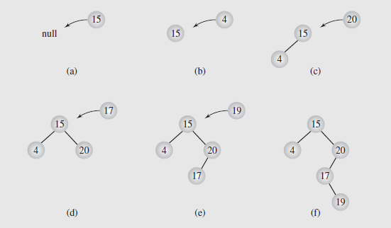
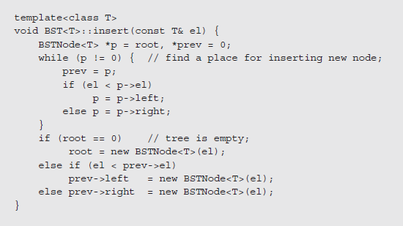
Insertion – 2
Notes:
Searching a binary tree does not modify the tree
Traversals may temporarily modify the tree, but it is usually left in its original form when the traversal is done
Operations like insertions, deletions, modifying values, merging trees, and balancing trees do alter the tree structure
We’ll look at how insertions are managed in binary search trees first
In order to insert a new node in a binary tree, we have to be at a node with a vacant left or right child
This is performed in the same way as searching:
1. Compare the value of the node to be inserted to the current node
2. If the value to be inserted is smaller, follow the left subtree; if it is larger, follow the right subtree
3. If the branch we are to follow is empty, we stop the search and insert the new node as that child
In looking at tree traversal, we considered three approaches: stack-based, thread-based, and via transformations
Stack based traversals don’t change the trees; transformations change the tree but restore it when done
Threaded approaches, though, do modify the tree by adding threads to the structure
While it may be possible to add and remove the threads as needed, if the tree is processed frequently, we might want to make the threads a permanent part of the tree
This requires incorporating threads into the insertion process

Slide 9
Deletion – 1
<
6
To perform operation erase(k), we search for key k
Assume key k is in the tree, and let let v be the node storing k
If node v has a leaf child w, we remove v and w from the tree with operation removeExternal(w), which removes w and its parent
Example: remove 4
2
>
9
1
4
v
8
w
5
6
2
9
1
5
8
Notes:
1. The main approach to handling deleting is called deletion by copying and was proposed by Thomas Hibbard and Donald Knuth in the 1960s
2. Initially, this works much like the merging process
3. We locate the node’s predecessor by searching for the rightmost node in the left subtree
4. The key of this node replaces the key of the node to be deleted
5. We then recall the two simple cases of deletion: if the rightmost node was a leaf, we delete it; if it has one child, we set the parent’s pointer to the node to point to the node’s child
6. This way, we delete a key k₁ by overwriting it by a key k₂ and then deleting the node holding k₂

Slide 10
Deletion – 2
1
v
We consider the case where the key k to be removed is stored at a node v whose children are both internal
we find the internal node w that follows v in an inorder traversal
we copy key(w) into node v
we remove node w and its left child z (which must be a leaf) by means of operation removeExternal(z)
Example: remove 3
3
2
8
6
9
w
5
z
1
v
5
2
8
6
9

Slide 11
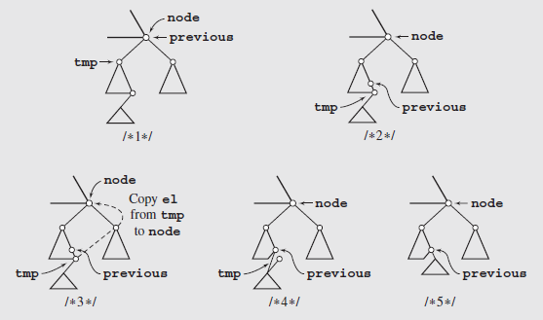
Deletion – 3
Algorithm always deletes the immediate predecessor of the key being replaced, the left subtree can shrink while the right subtree is unchanged, making the algorithm asymmetric.
Eventually the tree becomes unbalanced to the right, and the right subtree is bushier and larger than the left
A simple improvement can make this symmetric; we alternately delete the node’s predecessor from the left subtree and its successor from the right subtree.

Slide 12
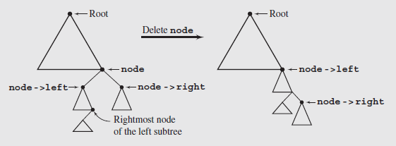
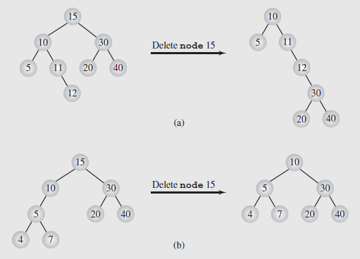
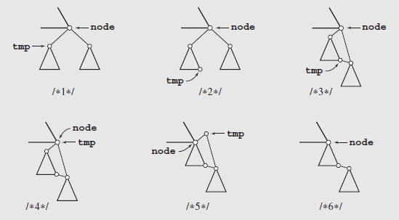
Deletion by Merging (More Asymmetric)
Alternative algorithm to delete nodes.

Slide 13
Performance
Consider an ordered map with n items implemented by means of a binary search tree of height h
the space used is O(n)
methods get, floorEntry, ceilingEntry, put and erase take O(h) time
The height h is O(n) in the worst case and O(log n) in the best case

Slide 14
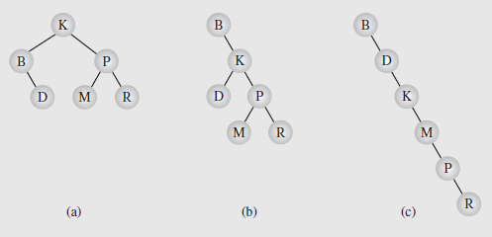
Balancing a Tree
A binary tree is height balanced (or simply, balanced) if the difference in height of the subtrees of any node in the tree is zero or one
It is perfectly balanced if it is balanced and all leaves are on one or two levels
Notes:
Two arguments have been presented in favor of trees:
They represent hierarchical data particularly well
Searching trees is much faster than searching lists
However, this second point depends on the structure of the tree
As we’ve seen, skewed trees search no better than linear lists

Slide 15
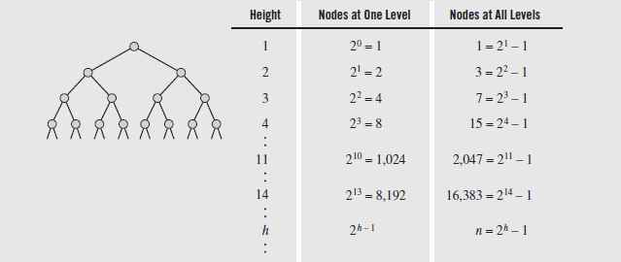

Balancing a Tree (continued)
The number of nodes that can be stored in binary trees of different heights
We see that storing n elements in a perfect tree, the height is $\left\lceil \text{lg}\left(n+1\right)\right\rceil$

Slide 16
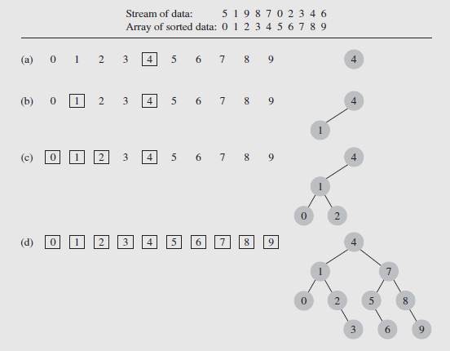
Convert Array To a Balanced Tree
Inspired by the binary search technique on an array: Arriving data is stored in an array, then sorted.
The element in the middle of the array is designated as the root
The elements in the middle of the left and right subarrays become the roots of the left and right subtrees, etc.
Notes:
This algorithm does suffer from one significant drawback
All the data needs to be in the array before the tree can be created
So it can be unsuitable for a tree that needs to be used while it is being constructed
On the other hand, an unbalanced tree can be balanced easily by carrying out an inorder traversal and writing the output to an array
This array can then be used to create a balanced version of the tree

Slide 17
Day-Stout-Warren (DSW) Algorithm
Make tree well-balanced, edit in place (no external sorting, etc.)
One such algorithm by Colin Day and modified by Quentin F. Stout and Bette L. Warren; it is called the DSW algorithm
Idea of rotation, introduced by Adel’son-Vel’skii and Landis in 1962
Two types of rotation can occur, left and right, which are symmetric
rotateRight(Gr, Par, Ch)
if Par is not the root of the tree //i.e.,if Gr is not null
grandparent Gr of child Ch becomes Ch’s parent;
right subtree of Ch becomes left subtree of Ch’s parent Par;
node Ch acquires Par as its right child;
The heart of this process is the third step, when parent and child swap roles
The first and second steps ensure that the tree remains a search tree after the rotation is completed

Slide 18
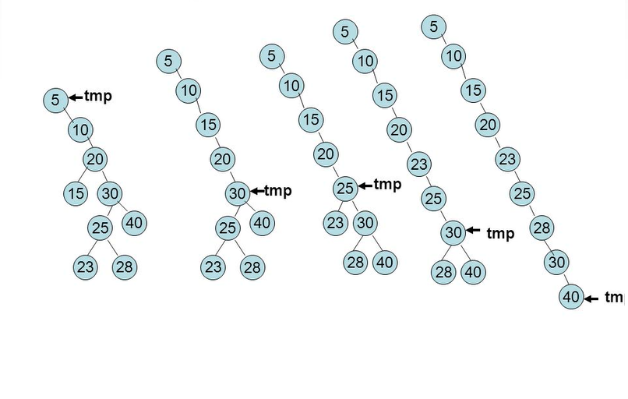
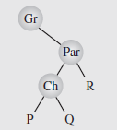
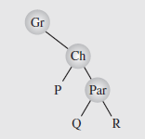
Transform BST into a Backbone
Rotation of Ch around Par
Notes:
The algorithm to create the backbone, which is the first step of the process, is as follows:
createBackbone(root)
tmp = root;
while (tmp != 0)
if tmp has a left child
rotate this child about tmp; // hence the left child
// becomes parent of tmp
set tmp to the child that just became parent;
else set tmp to its right child;

Slide 19
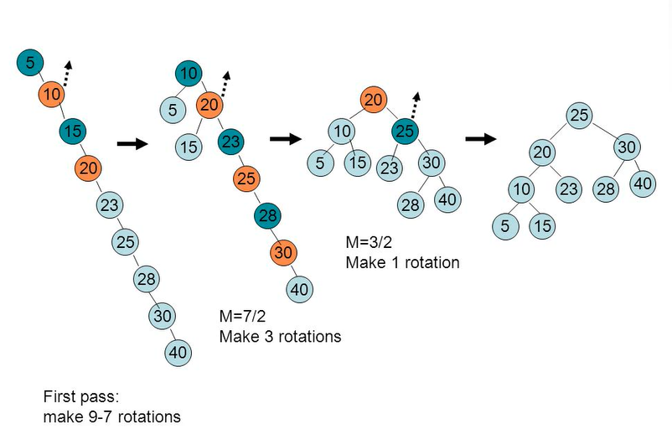
Transform Backbone into a Balanced BST
Do various numbers of rotations to achieve balanced form.
Notes:
In the second step of the transformation, the backbone is transformed into a perfectly balanced tree
In each pass down the backbone, every second node is rotated about its parent
The first pass handles the difference between the number of nodes in the backbone and the number of nodes in the closest complete binary tree
Overflowing nodes are treated separately

Slide 20
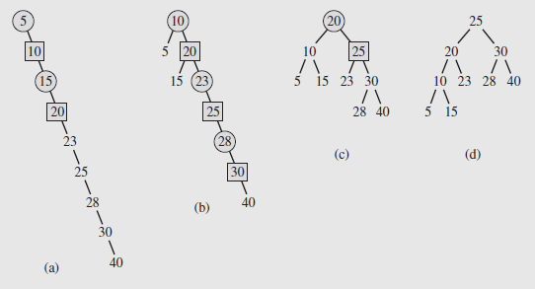
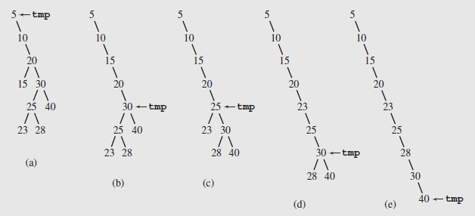
Balancing a Tree (continued)
In these diagrams, the nodes being promoted one level by left rotations are shown as squares
The circles are the parents about which they are rotated

Slide 21
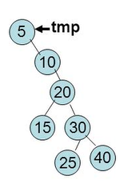
Exercise on DSW Algorithm
Transform this into a backbone.
Then create a perfect, balanced Binary Search Tree.

Slide 22
AVL Tree Definition
Georgij Adelson-Velski + Evgeny Landis (1962)
AVL trees are balanced
An AVL Tree is a binary search tree such that for every internal node v of T, the heights of the children of v can differ by at most 1
An example of an AVL tree where the heights are shown next to the nodes:

Slide 23
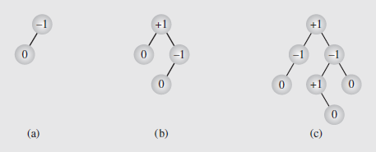
AVL Trees (Adjust when Editing)
An AVL tree (also called an admissible tree) is one where the height of the left and right subtrees of every node differ by at most one
Numbers in the nodes are the balance factors, which is the difference between the height of the right and left subtrees and should be +1, 0, or -1 for AVL trees
In addition, the process of balancing an AVL tree does not guarantee a perfectly balanced tree

Slide 24
Height of an AVL Tree
Fact: The height of an AVL tree storing n keys is O(log n).
Proof: Let us bound n(h): the minimum number of internal nodes of an AVL tree of height h.
We easily see that n(1) = 1 and n(2) = 2
For n > 2, an AVL tree of height h contains the root node, one AVL subtree of height n-1 and another of height n-2.
That is, n(h) = 1 + n(h-1) + n(h-2)
Knowing n(h-1) > n(h-2), we get n(h) > 2n(h-2). So
n(h) > 2n(h-2), n(h) > 4n(h-4), n(h) > 8n(n-6), … (by induction),
n(h) > 2^{i}n(h-2i)
Solving the base case we get: n(h) > 2 ^{h/2-1}
Taking logarithms: h < 2log n(h) +2
Thus the height of an AVL tree is O(log n)
n(2)
3
4
n(1)

Slide 25
Restructuring (as Single Rotations)
Single Rotations:

Slide 26
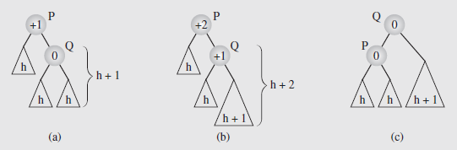
Balancing an unbalanced AVL Tree – 1
Balancing a tree after insertion of a node in the right subtree of node Q
The subtrees involved in the rotation have their heights indicated
After a new node is inserted somewhere in the right subtree of Q to unbalance the tree, Q rotates around is parent P to rebalance the tree

Slide 27
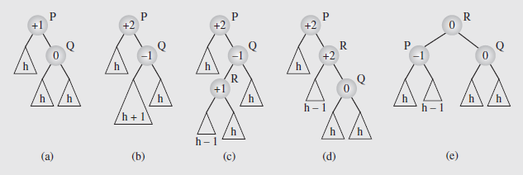
Balancing an unbalanced AVL Tree – 2
The imbalance is solved by a double rotation:
first R around Q (Fig (d)),
then R around P (Fig (e))

Slide 28
Restructuring (as Double Rotations)
double rotations:

Slide 29
Balancing an AVL Tree after Insert – 1
unbalanced...
T
4
1
44
2
3
x
17
y
62
z
1
2
2
32
50
78
1
1
1
...balanced
48
54
88
T
2
T
0
T
1
T
3

Slide 30
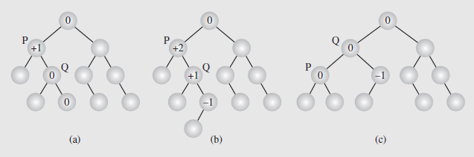
Balancing an AVL Tree after Insert – 2
A node is inserted and the resulting updates cause a node to become imbalanced

Slide 31
Show Delete Step by Step
Let z be the first unbalanced node encountered while travelling up the tree from w. Also, let y be the child of z with the larger height, and let x be the child of y with the larger height
We perform restructure(x) to restore balance at z
As this restructuring may upset the balance of another node higher in the tree, we must continue checking for balance until the root of T is reached
62
a=z
44
w
b=y
44
78
17
62
c=x
17
50
88
50
78
48
54
48
54
88

Slide 32
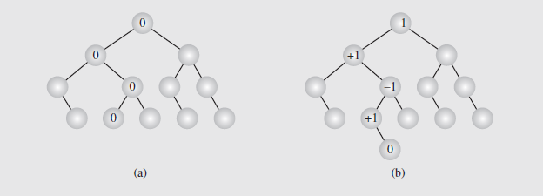
Balancing an AVL Tree after Delete – 1
Deleting a node may require more work
The deleteByCopying()algorithm is applied to delete the node
The balance factors of all nodes from the parent of the deleted node to the root are then updated
Each node whose balance factor becomes ± 2 will be rebalanced

Slide 33
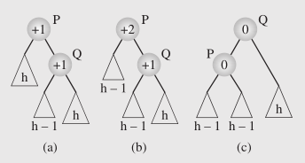
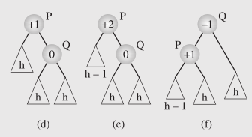
Balancing an AVL Tree after Delete – 2
In the first case, P’s balance factor is +1, and its right child, Q, is also at +1; this is shown in (a). Deleting a node from P’s left child leads to the tree in Figure (b), with P at +2; this is rebalanced by rotating P around Q, Figure (c)
In the second case, P’s balance factor is +1, and its right child, Q, is 0; Figure (d). Deleting a node from P’s left child leads to the tree in Figure (e), with P at +2; this is rebalanced as in the first case by rotating P around Q, Figure (f).

Slide 34
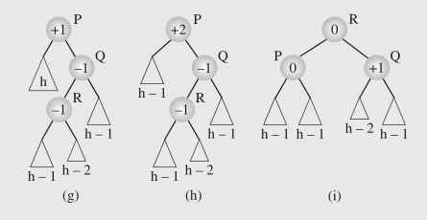
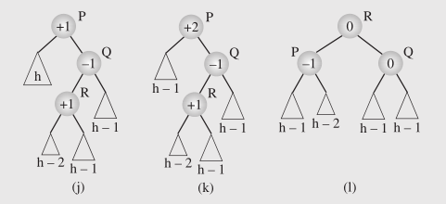
Balancing an AVL Tree after Delete – 3
The third case arises when the left subtree of Q, rooted at R, has a balance factor of -1 (g). Rebalancing after deletion requires a double rotation; first of R about Q and then of R about P, Figures (h) and (i).
The fourth case is similar to the third, but differs in that the balance factor of R is +1, rather than -1. However, rebalancing can be done with the same two rotations as the third case.

Slide 35
AVL Tree Performance
a single restructure takes O(1) time
using a linked-structure binary tree
find takes O(log n) time
height of tree is O(log n), no restructures needed
put takes O(log n) time
initial find is O(log n)
Restructuring up the tree, maintaining heights is O(log n)
erase takes O(log n) time
initial find is O(log n)
Restructuring up the tree, maintaining heights is O(log n)
6
v
3
8
z
4

Slide 36
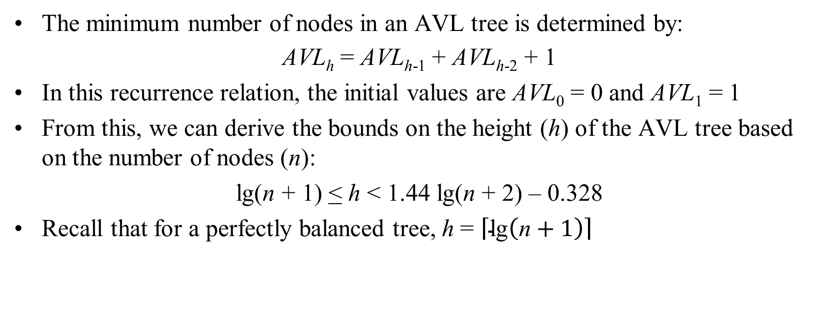
Balancing a Tree (continued)
The minimum number of nodes in an AVL tree is determined by:
AVL_{h} = AVL_{h-1} + AVL_{h-2} + 1
In this recurrence relation, the initial values are AVL₀ = 0 and AVL₁ = 1
From this, we can derive the bounds on the height (h) of the AVL tree based on the number of nodes (n):
lg(n + 1) < h < 1.44 lg(n + 2) – 0.328
Recall that for a perfectly balanced tree, h = $\left\lceil \text{lg}\left(\text{n}+1\right)\right\rceil$

