Slide 1
Data Structures Self-Adjusting BSTs
Data Structures and Algorithms
Notes:
# Every module has the following content
* Title (1 slide)
* Table of Contents (1 slide) – where are we in the material?
* Motivation (1 slide) – why do we need this module?
* Anchor Task (1x) – introduce the key problem handled by this module
* Objectives (1x)
* Theory Section (1 subtitle + more slides) or Demo Section (1 subtitle + more slides)
* Summary (1x) * References (1x)

Slide 2
Multi-Way Search Tree
A multi-way search tree is an ordered tree such that
Each internal node has at least two children and stores d −1 key-element items (k_{i}, o_{i}), where d is the number of children
For a node with children v₁ v₂ … v_{d} storing keys k₁ k₂ … k_{d−1}
keys in the subtree of v₁ are less than k₁
keys in the subtree of v_{i} are between k_{i−1} and k_{i} (i = 2, …, d − 1)
keys in the subtree of v_{d} are greater than k_{d−1}
The leaves store no items and serve as placeholders
11 24
2 6 8
15
27 32
30

Slide 3
Multi-Way Inorder Traversal
We can extend the notion of inorder traversal from binary trees to multi-way search trees
Namely, we visit item (k_{i}, o_{i}) of node v between the recursive traversals of the subtrees of v rooted at children v_{i} and v_{i} ₊ ₁
An inorder traversal of a multi-way search tree visits the keys in increasing order
11 24
8
12
2 6 8
15
27 32
2
4
6
10
14
18
30
1
3
5
7
9
11
13
16
19
Leaves are visited, but produce no output during inorder traversal.
15
17

Slide 4
Multi-Way Searching
Similar to search in a binary search tree
A each internal node with children v₁ v₂ … v_{d} and keys k₁ k₂ … k_{d−1}
k = k_{i} (i = 1, …, d − 1): the search terminates successfully
k < k₁: we continue the search in child v₁
k_{i−1} < k < k_{i} (i = 2, …, d − 1): we continue the search in child v_{i}
k > k_{d−1}: we continue the search in child v_{d}
Reaching an external node terminates the search unsuccessfully
Example: search for 30
11 24
2 6 8
15
27 32
30

Slide 5
(2,4) Trees
A (2,4) tree (also called 2-4 tree or 2-3-4 tree) is a multi-way search with the following properties
Node-Size Property: every internal node has at most four children
Depth Property: all the external nodes have the same depth
Depending on the number of children, an internal node of a (2,4) tree is called a 2-node, 3-node or 4-node
10 15 24
2 8
12
18
27 32

Slide 6
Height of a (2,4) Tree
Theorem: A (2,4) tree storing n items has height O(log n)
Proof:
Let h be the height of a (2,4) tree with n items
Since there are at least 2^{i} items at depth i = 0, … , h − 1 and no items at depth h, we have n ≥ 1 + 2 + 4 + … + 2^{h−1} = 2^{h} − 1
Thus, h ≤ log (n + 1)
Searching in a (2,4) tree with n items takes O(log n) time
depth
items
0
1
1
2
h−1
2^{h−1}
h
0

Slide 7
Insertion
We insert a new item (k, o) at the parent v of the leaf reached by searching for k
We preserve the depth property but
We may cause an overflow (i.e., node v may become a 5-node)
Example: inserting key 30 causes an overflow
10 15 24
v
2 8
12
18
27 32 35
10 15 24
v
2 8
12
18
27 30 32 35

Slide 8
Overflow and Split
We handle an overflow at a 5-node v with a split operation:
let v₁ … v₅ be the children of v and k₁ … k₄ be the keys of v
node v is replaced nodes v' and v"
v' is a 3-node with keys k₁ k₂ and children v₁ v₂ v₃
v" is a 2-node with key k₄ and children v₄ v₅
key k₃ is inserted into the parent u of v (a new root may be created)
The overflow may propagate to the parent node u
u
u
15 24
15 24 32
v
v'
v"
12
18
27 30 32 35
12
18
27 30
35
v₁
v₂
v₃
v₄
v₅
v₁
v₂
v₃
v₄
v₅

Slide 9
Analysis of Insertion
Algorithm put(k, o)
1. We search for key k to locate the insertion node v
2. We add the new entry (k, o) at node v
3. while overflow(v)
if isRoot(v)
create a new empty root above v
v ← split(v)
Let T be a (2,4) tree with n items
Tree T has O(log n) height
Step 1 takes O(log n) time because we visit O(log n) nodes
Step 2 takes O(1) time
Step 3 takes O(log n) time because each split takes O(1) time and we perform O(log n) splits
Thus, an insertion in a (2,4) tree takes O(log n) time

Slide 10
Deletion
We reduce deletion of an entry to the case where the item is at the node with leaf children
Otherwise, we replace the entry with its inorder successor (or, equivalently, with its inorder predecessor) and delete the latter entry
Example: to delete key 24, we replace it with 27 (inorder successor)
10 15 24
2 8
12
18
27 32 35
10 15 27
2 8
12
18
32 35

Slide 11
Underflow and Fusion
Deleting an entry from a node v may cause an underflow, where node v becomes a 1-node with one child and no keys
To handle an underflow at node v with parent u, we consider two cases
Case 1: the adjacent siblings of v are 2-nodes
Fusion operation: we merge v with an adjacent sibling w and move an entry from u to the merged node v'
After a fusion, the underflow may propagate to the parent u
u
u
9 14
9
w
v
v'
2 5 7
10
2 5 7
10 14

Slide 12
Underflow and Transfer
To handle an underflow at node v with parent u, we consider two cases
Case 2: an adjacent sibling w of v is a 3-node or a 4-node
Transfer operation:
1. we move a child of w to v
2. we move an item from u to v
3. we move an item from w to u
After a transfer, no underflow occurs
u
u
4 9
4 8
w
v
w
v
2
6 8
2
6
9

Slide 13
Analysis of Deletion
Let T be a (2,4) tree with n items
Tree T has O(log n) height
In a deletion operation
We visit O(log n) nodes to locate the node from which to delete the entry
We handle an underflow with a series of O(log n) fusions, followed by at most one transfer
Each fusion and transfer takes O(1) time
Thus, deleting an item from a (2,4) tree takes O(log n) time

Slide 14
Comparison of Map Implementations
 | Find | Put | Erase | Notes
Hash Table | 1 expected | 1 expected | 1 expected | no ordered map methods simple to implement
Skip List | log n high prob. | log n high prob. | log n high prob. | randomized insertion simple to implement
AVL and (2,4) Tree | log n worst-case | log n worst-case | log n worst-case | complex to implement

Slide 15
From (2,4) to Red-Black Trees
A red-black tree is a representation of a (2,4) tree by means of a binary tree whose nodes are colored red or black
In comparison with its associated (2,4) tree, a red-black tree has
same logarithmic time performance
simpler implementation with a single node type
4
3 5
2 6 7
4
5
3
6
OR
3
5
2
7

Slide 16
Red-Black Trees
A red-black tree can also be defined as a binary search tree that satisfies the following properties:
Root Property: the root is black
External Property: every leaf is black
Internal Property: the children of a red node are black
Depth Property: all the leaves have the same black depth
9
4 9
4
15
2
6 7
12 15 21
2
6
12
21
7

Slide 17
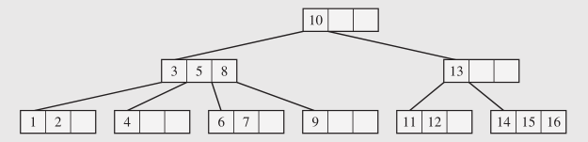
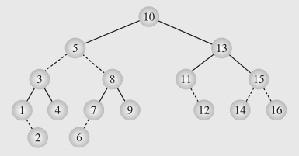
Another View on Red-Black Trees
Convert (2,4)-tree into a binary tree.
Continuous edge – between two (2,4)-nodes.
Dashed edge – inside the same (2,4)-node.
A node is red iff it connects to its parent with a dashed edge. (Drozdek p.341)

Slide 18
Height of a Red-Black Tree
Theorem: A red-black tree storing n entries has height O(log n)
Proof:
The height of a red-black tree is at most twice the height of its associated (2,4) tree, which is O(log n)
The search algorithm for a binary search tree is the same as that for a binary search tree
By the above theorem, searching in a red-black tree takes O(log n) time

Slide 19
Insertion
To perform operation put(k, o), we execute the insertion algorithm for binary search trees and color red the newly inserted node z unless it is the root
We preserve the root, external, and depth properties
If the parent v of z is black, we also preserve the internal property and we are done
Else (v is red ) we have a double red (i.e., a violation of the internal property), which requires a reorganization of the tree
Example where the insertion of 4 causes a double red:
6
6
v
v
3
8
3
8
z
z
4

Slide 20
Remedying a Double Red
Consider a double red with child z and parent v, and let y be the sibling of v
Case 1: y is black
The double red is an incorrect replacement of a 4-node
Restructuring: we change the 4-node replacement
Case 2: y is red
The double red corresponds to an overflow
Recoloring: we perform the equivalent of a split
w
4
v
w
4
v
2
z
7
2
z
7
6
6
4 6 7
2 4 6 7
.. 2 ..

Slide 21
Restructuring – 1
A restructuring remedies a child-parent double red when the parent red node has a black sibling
It is equivalent to restoring the correct replacement of a 4-node
The internal property is restored and the other properties are preserved
z
4
6
w
v
v
2
7
4
7
z
w
6
2
4 6 7
4 6 7
.. 2 ..
.. 2 ..

Slide 22
Restructuring – 2
There are four restructuring configurations depending on whether the double red nodes are left or right children
2
6
6
2
6
2
4
4
4
4
2
6
4
2
6

Slide 23
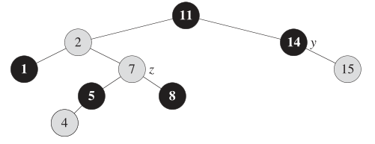
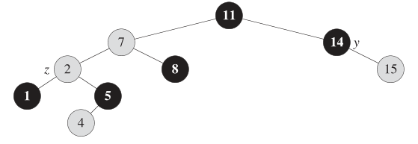
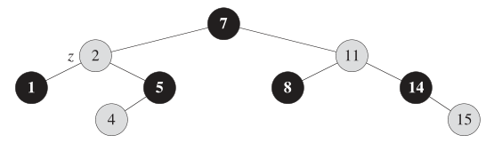
Restructuring Example

Slide 24
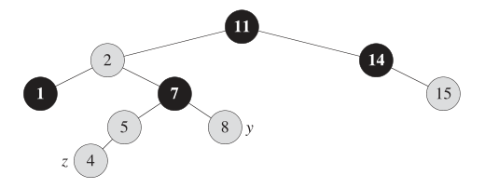
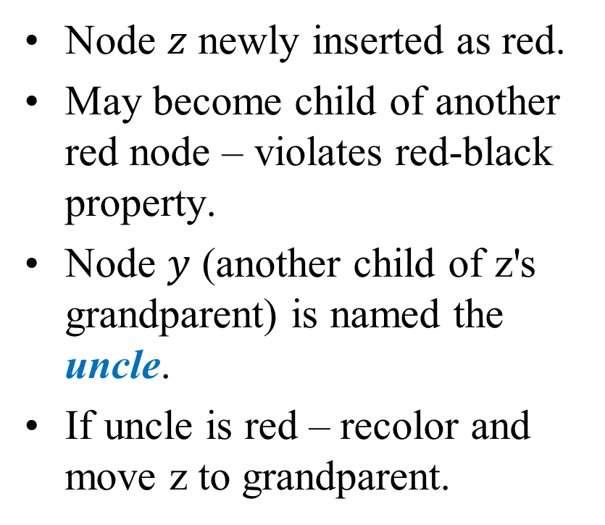
Recoloring Below the Root
Node $z$ newly inserted as red.
May become child of another red node – violates red-black property.
Node $y$ (another child of z's grandparent) is named the uncle.
If uncle is red – recolor and move z to grandparent.

Slide 25
Recoloring at the Root
A recoloring remedies a child-parent double red when the parent red node has a red sibling
The parent v and its sibling w become black and the grandparent u becomes red, unless it is the root
It is equivalent to performing a split on a 5-node
The double red violation may propagate to the grandparent u
w
4
v
w
4
v
2
z
7
2
z
7
6
6
4
2 4 6 7
2
6 7

Slide 26
Analysis of Insertion
Algorithm put(k, o)
1. We search for key k to locate the insertion node z
2. We add the new entry (k, o) at node z and color z red
3. while doubleRed(z)
if isBlack(sibling(parent(z)))
z ← restructure(z)
return
else { sibling(parent(z) is red }
z ← recolor(z)
Recall that a red-black tree has O(log n) height
Step 1 takes O(log n) time because we visit O(log n) nodes
Step 2 takes O(1) time
Step 3 takes O(log n) time because we perform
O(log n) recolorings, each taking O(1) time, and
at most one restructuring taking O(1) time
Thus, an insertion in a red-black tree takes O(log n) time

Slide 27
Deletion
To perform operation erase(k), we first execute the deletion algorithm for binary search trees
Let v be the internal node removed, w the external node removed, and r the sibling of w
If either v of r was red, we color r black and we are done
Else (v and r were both black) we color r double black, which is a violation of the internal property requiring a reorganization of the tree
Example where the deletion of 8 causes a double black:
6
6
v
r
3
8
3
r
w
4
4

Slide 28
Remedying a Double Black
The algorithm for remedying a double black node w with sibling y considers three cases
Case 1: y is black and has a red child
We perform a restructuring, equivalent to a transfer , and we are done
Case 2: y is black and its children are both black
We perform a recoloring, equivalent to a fusion, which may propagate up the double black violation
Case 3: y is red
We perform an adjustment, equivalent to choosing a different representation of a 3-node, after which either Case 1 or Case 2 applies
Deletion in a red-black tree takes O(log n) time

Slide 29
Red-Black Tree Reorganization
Insertion | remedy double red
Red-black tree action | (2,4) tree action | result
restructuring | change of 4-node representation | double red removed
recoloring | split | double red removed or propagated up
Deletion | remedy double black
Red-black tree action | (2,4) tree action | result
restructuring | transfer | double black removed
recoloring | fusion | double black removed or propagated up
adjustment | change of 3-node representation | restructuring or recoloring follows

Slide 30
Self-Adjusting Trees (continued)
Since trees are used to handle items quickly, it is the speed of operations and not the tree’s structure that is critical
Not all items in a tree are likely to be used with equal frequency
Improving access to frequently searched items can improve the average-case time complexity. This is the basis for self-adjusting trees
Each node could count # of accesses. Or the assumption that an item that has been accessed will be accessed soon again.

Slide 31
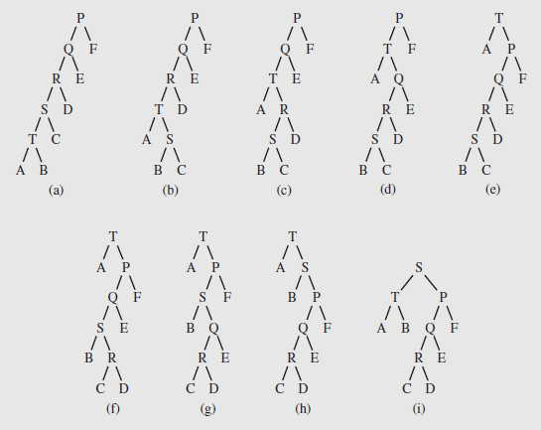
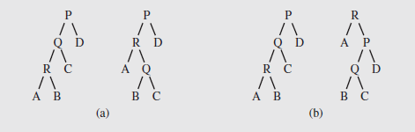
"Rotate to Root" – Approach #1
Brian Allen, Ian Munroe [1978], and James Bitner [1979] proposed two strategies:
Single rotation – if an element in a child is accessed, rotate the child around the parent, unless it is the root
Moving to the root – the parent-child rotation is repeated until the element that was accessed is the root.
These strategies don’t work well in the case of skewed trees; tree might slowly improve its structure:
T to root
S to root
Notes:
Still has the worst-case amortized cost O(n) per operation (because the tree can become, and remain, very unbalanced)

Slide 32
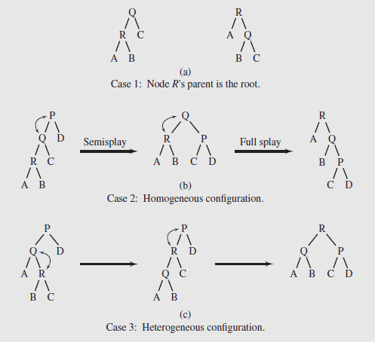
"Splaying" – Approach #2
Robert Tarjan and Daniel Sleator, 1985
Splaying applies single rotations in pairs; using an order determined by the links between child, parent, and grandparent
3 cases based on relationships between a node R, its parent Q, and grandparent P (if exists)
Case 1 – The root node is R’s parent
Case 2 – Called the homogeneous configuration, R is the left child of Q, and Q is the left child of P (or, R and Q are right children)
Case 3 – Called the heterogeneous configuration, R is the right child of Q and Q is the left child of P (or R is the left child of Q and Q is the right child of P)

Slide 33
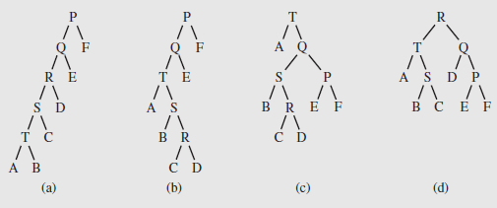
Splaying to Improve Tree Structure
In accessing the node T in the fifth level of the tree, the shape is improved: After accessing R, the height is considerably smaller.
Notes:
Even though splaying is a combination of two rotations (except when next to the root), they are not necessarily bottom-up
For homogeneous cases (left-right or right-right), the parent and grandparent node are rotated, then the node and its parent
The effect of this is both to move the node towards the root and to flatten the tree, which improves access
Splaying focuses on the elements rather than tree shape, so typically it performs better when some elements are used more frequently
If all the elements are accessed with about the same frequency, it will not be as useful
In those cases an alternative approach that focuses on balancing the tree is better
A modification called semisplaying is illustrated in Figure 6.48b
It requires one rotation for a homogeneous splay, and continue splaying with the parent of the node, rather than the node itself

Slide 34
BST Example (w/ repetitive keys)
BST (Binary Search Trees):
entries stored only at internal nodes
keys stored at nodes in the left subtree of v are less than or equal to the key stored at v
keys stored at nodes in the right subtree of v are greater than or equal to the key stored at v
An inorder traversal will return the keys in order
(20,Z)
(10,A)
(35,R)
(7,T)
(14,J)
(21,O)
(37,P)
(1,Q)
(40,X)
(8,N)
(36,L)
(1,C)
(5,H)
(7,P)
(10,U)
(2,R)
(5,G)
(5,I)
(6,Y)

Slide 35
Same BST as a Splay Tree – 1
Starts same as in a general BST
Search proceeds down the tree to found item or an external node.
Example: Search with key 11.
Example: Search with key 5 or 7. (Repetitive nodes).
(20,Z)
(10,A)
(35,R)
(7,T)
(14,J)
(21,O)
(37,P)
(1,Q)
(40,X)
(8,N)
(36,L)
(1,C)
(5,H)
(7,P)
(10,U)
(2,R)
(5,G)
(5,I)
(6,Y)

Slide 36
Same BST as a Splay Tree – 2
Search for key 8, ends at an internal node.
(20,Z)
(10,A)
(35,R)
(7,T)
(14,J)
(21,O)
(37,P)
(1,Q)
(40,X)
(8,N)
(36,L)
(1,C)
(5,H)
(7,P)
(10,U)
(2,R)
(5,G)
(5,I)
(6,Y)

Slide 37
Splay Trees do Rotations after Every Operation (Even Search)
new operation: splay
splaying moves a node to the root using rotations
right rotation
makes the left child x of a node y into y’s parent; y becomes the right child of x
left rotation
makes the right child y of a node x into x’s parent; x becomes the left child of y
y
x
a right rotation about y
a left rotation about x
x
T₃
T₁
y
x
y
T₁
T₂
T₁
y
T₂
T₃
x
T₃
T₂
T₃
T₁
T₂
(structure of tree above y is not modified)
(structure of tree above x is not modified)

Slide 38
Splaying
“x is a left-left grandchild” means x is a left child of its parent, which is itself a left child of its parent
p is x’s parent; g is p’s parent
start with node x
is x a left-left grandchild?
is x the root?
yes
zig-zig
stop
yes
right-rotate about g, right-rotate about p
no
is x a right-right grandchild?
is x a child of the root?
zig-zig
no
yes
left-rotate about g, left-rotate about p
yes
is x a right-left grandchild?
is x the left child of the root?
zig-zag
no
yes
left-rotate about p, right-rotate about g
is x a left-right grandchild?
zig
zig
zig-zag
yes
right-rotate about the root
left-rotate about the root
yes
right-rotate about p, left-rotate about g

Slide 39
Visualizing the Splaying Cases
zig-zag
x
z
z
y
z
y
y
T₄
T₁
x
T₄
T₁
T₂
T₃
T₄
x
T₃
T₂
T₃
T₁
T₂
zig-zig
x
y
zig
T₁
y
x
T₄
x
T₂
z
w
w
y
T₃
T₃
T₄
T₁
T₂
T₃
T₄
T₁
T₂

Slide 40
Splaying node "8": Zig-Zag Part 1
let x = (8,N)
x is the right child of its parent, which is the left child of the grandparent
left-rotate around p, then right-rotate around g
(20,Z)
(20,Z)
g
(10,A)
(35,R)
(10,A)
(35,R)
p
(7,T)
(14,J)
(21,O)
(37,P)
(8,N)
(14,J)
(21,O)
(37,P)
(1,Q)
(8,N)
x
(36,L)
(40,X)
(7,T)
(10,U)
(36,L)
(40,X)
(1,Q)
(7,P)
(1,C)
(5,H)
(7,P)
(10,U)
(1,C)
(5,H)
(2,R)
(5,G)
(5,I)
(6,Y)
(2,R)
(5,G)
(5,I)
(6,Y)

Slide 41
Splaying node "8": Zig-Zag Part 2
(20,Z)
(20,Z)
(10,A)
(35,R)
x
(8,N)
(35,R)
(8,N)
(14,J)
(21,O)
(37,P)
g
p
(7,T)
(10,A)
(21,O)
(37,P)
(7,T)
(10,U)
(36,L)
(40,X)
(1,Q)
(7,P)
(14,J)
(36,L)
(40,X)
(1,Q)
(7,P)
(5,H)
(1,C)
(5,H)
(10,U)
(1,C)
(2,R)
(5,G)
(2,R)
(5,G)
(5,I)
(6,Y)
(5,I)
(6,Y)

Slide 42
Splaying node "8": Zig
now x is the left child of the root
right-rotate around root.
x
(8,N)
p
(20,Z)
(7,T)
(20,Z)
p
x
(8,N)
(35,R)
(1,Q)
(7,P)
(10,A)
(35,R)
(7,T)
(10,A)
(21,O)
(37,P)
(1,C)
(5,H)
(14,J)
(21,O)
(37,P)
(1,Q)
(7,P)
(14,J)
(36,L)
(40,X)
(2,R)
(5,G)
(10,U)
(36,L)
(40,X)
(1,C)
(5,H)
(10,U)
(5,I)
(6,Y)
(2,R)
(5,G)
(5,I)
(6,Y)

Slide 43
Tree may not become more balanced
For example, splay (40,X)
before, the depth of the shallowest leaf is 3 and the deepest is 7
after, the depth of shallowest leaf is 1 and deepest is 7.
(40,X)
(20,Z)
(20,Z)
(20,Z)
(10,A)
(35,R)
(10,A)
(40,X)
(10,A)
(37,P)
(14,J)
(7,T)
(14,J)
(37,P)
(14,J)
(7,T)
(21,O)
(37,P)
(7,T)
(35,R)
(1,Q)
(8,N)
(35,R)
(1,Q)
(8,N)
(36,L)
(40,X)
(1,Q)
(8,N)
(21,O)
(36,L)
(1,C)
(5,H)
(7,P)
(10,U)
(21,O)
(36,L)
(1,C)
(5,H)
(7,P)
(10,U)
(1,C)
(5,H)
(7,P)
(10,U)
(2,R)
(5,G)
(2,R)
(5,G)
(2,R)
(5,G)
(5,I)
(6,Y)
(5,I)
(6,Y)
(5,I)
(6,Y)

Slide 44
Splay Tree Definition
a splay tree is a binary search tree where a node is splayed after it is accessed (for a search or update)
deepest internal node accessed is splayed
splaying costs O(h), where h is height of the tree – which is still O(n) worst-case
O(h) rotations, each of which is O(1)

Slide 45
Splay Trees & Ordered Dictionaries
which nodes are splayed after each operation?
method
splay node
if key found, use that node
if key not found, use parent of ending external node
get(k)
put(k,v)
use the new node containing the entry inserted
use the parent of the internal node that was actually removed from the tree (the parent of the node that the removed item was swapped with)
erase(k)

Slide 46
Amortized Analysis of Splay Trees
Running time of each operation is proportional to time for splaying.
Define rank(v) as the logarithm (base 2) of the number of nodes in subtree rooted at v.
Costs: zig = $1, zig-zig = $2, zig-zag = $2.
Thus, cost for playing a node at depth d = $d.
Imagine that we store rank(v) cyber-dollars at each node v of the splay tree (just for the sake of analysis).

Slide 47
Cost per zig
Doing a zig at x costs at most rank’(x) - rank(x):
cost = rank’(x) + rank’(y) - rank(y) - rank(x) < rank’(x) - rank(x).
y
zig
x
T₄
x
w
T₃
w
y
T₁
T₂
T₃
T₄
T₁
T₂

Slide 48
Cost per zig-zig and zig-zag
Doing a zig-zig or zig-zag at x costs at most 3(rank’(x) - rank(x)) - 2
z
x
y
T₄
zig-zig
T₁
y
x
T₃
T₂
z
T₁
T₂
T₃
T₄
z
zig-zag
x
y
z
y
T₁
x
T₄
T₁
T₂
T₃
T₄
T₂
T₃

Slide 49
Cost of Splaying
Cost of splaying a node x at depth d of a tree rooted at r:
at most 3(rank(r) - rank(x)) - d + 2:
Proof: Splaying x takes d/2 splaying substeps:

Slide 50
Performance of Splay Trees
Recall: rank of a node is logarithm of its size.
Thus, amortized cost of any splay operation is O(log n)
In fact, the analysis goes through for any reasonable definition of rank(x)
This implies that splay trees can actually adapt to perform searches on frequently-requested items much faster than O(log n) in some cases

Slide 51
Self-Adjusting Trees (continued)
Since trees are used to handle items quickly, it is the speed of operations and not the tree’s structure that is critical
Not all items in a tree are likely to be used with equal frequency
Improving access to frequently searched items can improve the average-case time complexity. This is the basis for self-adjusting trees
Each node could count # of accesses. Or the assumption that an item that has been accessed will be accessed soon again.

Slide 52
"Rotate to Root" – Approach #1
Brian Allen, Ian Munroe [1978], and James Bitner [1979] proposed two strategies:
Single rotation – if an element in a child is accessed, rotate the child around the parent, unless it is the root
Moving to the root – the parent-child rotation is repeated until the element that was accessed is the root.
These strategies don’t work well in the case of skewed trees; tree might slowly improve its structure:
T to root
S to root
Notes:
Still has the worst-case amortized cost O(n) per operation (because the tree can become, and remain, very unbalanced)

Slide 53
"Splaying" – Approach #2
Robert Tarjan and Daniel Sleator, 1985
Splaying applies single rotations in pairs; using an order determined by the links between child, parent, and grandparent
3 cases based on relationships between a node R, its parent Q, and grandparent P (if exists)
Case 1 – The root node is R’s parent
Case 2 – Called the homogeneous configuration, R is the left child of Q, and Q is the left child of P (or, R and Q are right children)
Case 3 – Called the heterogeneous configuration, R is the right child of Q and Q is the left child of P (or R is the left child of Q and Q is the right child of P)

Slide 54
Self-Adjusting Trees (continued)
In accessing the node T in the fifth level of the tree, the shape is improved a great deal; after accessing R, the improvement is dramatic
Notes:
Even though splaying is a combination of two rotations (except when next to the root), they are not necessarily bottom-up
For homogeneous cases (left-right or right-right), the parent and grandparent node are rotated, then the node and its parent
The effect of this is both to move the node towards the root and to flatten the tree, which improves access
Splaying focuses on the elements rather than tree shape, so typically it performs better when some elements are used more frequently
If all the elements are accessed with about the same frequency, it will not be as useful
In those cases an alternative approach that focuses on balancing the tree is better
A modification called semisplaying is illustrated in Figure 6.48b
It requires one rotation for a homogeneous splay, and continue splaying with the parent of the node, rather than the node itself

