Slide 1
Data Structures Sorting Algorithms
Notes:
# Every module has the following content
* Title (1 slide)
* Table of Contents (1 slide) – where are we in the material?
* Motivation (1 slide) – why do we need this module?
* Anchor Task (1x) – introduce the key problem handled by this module
* Objectives (1x)
* Theory Section (1 subtitle + more slides) or Demo Section (1 subtitle + more slides)
* Summary (1x) * References (1x)

Slide 2
Objectives
Looking ahead – in this chapter, we’ll consider
Elementary Sorting Algorithms
Decision Trees
Efficient Sorting Algorithms
Sorting in the Standard Template Library

Slide 3
Classifying Sorting Methods
Internal and external sorting
Sorting "in place" and sorting, using additional data structures.
The worst case and the average case complexity.
Sorting with comparisons and sorting "digitally"
Stable and unstable algorithms
"inefficient, but easy" and “efficient, but hard” (also hard to memorize) algorithms.

Slide 4
The behavior of algorithms
Some may differ depending on the original state of the data set (sorted, unsorted, partially sorted)
Others may behave the same way regardless of the data
Typically, we obtain a best case, worst case, and average case
We may also find that the number of comparisons and number of data movements don’t apparently coincide
An algorithm maybe very efficient in one case, and perform poorly on the other
Yet another consideration is the complexity of the algorithms themselves
Some methods are considerably less efficient than others
However, for smaller data sets, they may prove to be faster, because their coding is simpler and executes faster

Slide 5

Sorting data in an array
Assume that the data table is A[0..n-1]
We can compare any pair of elements directly: For any two elements in the array, we have either $x<y$, or $x=y$, or $x>y$.
We want to sort the table in non-decreasing order:
$$A[0]≤A[1]≤A[2]≤⋯≤A[n−1]$$

Slide 6
Typical States in Tables
Many simple algorithms allow to illustrate the sortable array – its division in regions.
Ordered part | Unordered part

Slide 7
Insertion Sort
Any element in the unordred part is inserted into its right place.
5 | 7 | 10 | 15 | 8 | 1 | 20 | 9 | 4
5 | 7 | 8 | 10 | 15 | 1 | 20 | 9 | 4
1 | 5 | 7 | 8 | 10 | 15 | 20 | 9 | 4
1 | 5 | 7 | 8 | 10 | 15 | 20 | 9 | 4
1 | 5 | 7 | 8 | 9 | 10 | 15 | 20 | 4
1 | 4 | 5 | 7 | 8 | 9 | 10 | 15 | 20

Slide 8
Insertion Sort
function InsertionSort(table A[0..n-1])
{Order by inserting every element somewhere in the left part}
for i from 1 to n-1 do
j = i { j goes leftwards until it finds the place for A[i]}
x = A[i]
while j >= 1 and A[j-1] > x do
A[j] = A[j-1]
j = j-1
A[j] = x

Slide 9
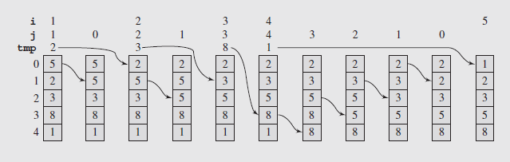
Insertion Sort
The sort can be implemented with the following code:
insertionsort(arr[],n)
for i = 1 to n-1:
move all arr[j] greater than arr[i] by one position;
place data[i] in its proper position;
Notes:
template<class T>
void insertionSort(T data[], int n) {
for (int i = 1, j; i < n; i++) {
T tmp = data[i];
for (j = i; j > 0 && tmp < data[j – 1]; j--)
data[j] = data[j – 1];
data[j] = tmp; } }

Slide 10
Selection Sort
At every step find the smallest element in the unsorted part to place it at the beginning of the unsorted part.
2 | 3 | 5 | 7 | 10 | 15 | 9 | 20 | 11
2 | 3 | 5 | 7 | 9 | 15 | 10 | 20 | 11
2 | 3 | 5 | 7 | 9 | 10 | 15 | 20 | 11
2 | 3 | 5 | 7 | 9 | 10 | 11 | 20 | 15
2 | 3 | 5 | 7 | 9 | 10 | 11 | 15 | 20

Slide 11
Selection Sort
function SelectionSort(table A[0..n-1]):
{Order the table A by repeated selection of the smallest element.}
for i from 0 to n-2 do
j = i {j is the index of the smallest element in A[0..n-1] }
for k from i+1 to n-1 do
if A[k] < A[j] then
j = k
A[i]↔A[j]

Slide 12
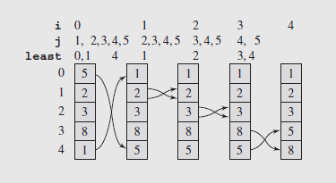
Selection Sort
Selection Sort (continued)
The pseudocode for the algorithm reflects its simplicity:
selectionsort(data[],n)
for i = 0 to n-2
select the smallest element among data[i], . . . , data[n-1];
swap it with data[i];
The last value for i is n – 2 since if all items have been looked at and placed except for the last, then the n^{th} element has to be the largest
Fig. 9.2 The array [5 2 3 8 1] sorted by selection sort
Notes:
template<class T>
void selectionsort(T data[], int n) {
for (int i = 0,j,least; i < n-1; i++) {
for (j = i+1, least = i; j < n; j++)
if (data[j] < data[least])
least = j;
swap(data[least],data[i]);
}}

Slide 13
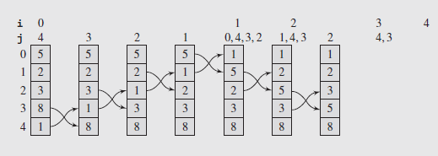
Bubble Sort
The pseudocode for this algorithm appears below:
bubblesort(data[],n)
for i = 0 to n-2
for j = n-1 down to i+1
swap items in positions j and j-1 if they are out of order;
The main disadvantage to bubble sort is the "bubbling" process - each item gradually moves step by step to the appropriate end of the list.
Turtles – small values near the end of the list slow the sorting down tremendously.
Notes:
template<class T>
void bubblesort(T data[], int n) {
for (int i = 0; i < n-1; i++)
for (int j = n-1; j > i; --j)
if (data[j] < data[j-1])
swap(data[j],data[j-1]);
}

Slide 14
Heap Sort
Unordered part has the heap (reverse order).
Exchange the heap minimum with its end.
Restore the heap property.
Ordered part | Unordered part
 | Heap (root at the right)
 |  | ... | Remaining heap
 | Restored heap

Slide 15
Heap Sort
procedure HeapSort (table A[0 .. n-1]):
{Sort by converting A into a heap and then selecting smallest elements.}
InitializeHeap(A[0 .. n-1])
for i from 0 to n-2 do
A[i]↔A[n-1]
Heapify(A[i+1 .. n-1])

Slide 16
Heap Sort
function InitializeHeap (table A[0 .. n-1]):
{Make A into a Heap.}
for i from 1 to n-1 do Heapify(A[0 .. i])

Slide 17
Heap Sort
function Heapify(table A[i .. j]):
{ Initially A[i .. j - 1] is partially ordered}
{ At the end A[i .. J] is partially ordered}
if RC(j) >= i and A[RC(j)] <= A[LC(j)] and A[RC(j)] < A[j] then
A[j]↔A[RC(j)]
Heapify(A[i .. RC(j)])
else if LC(j) >= i and A[LC(j)] < A[j] then
A[j]↔A[LC(j)]
Heapify(A[i .. LC(j)])

Slide 18

Heap Sort complexity
Heapify – $O(log⁡n)$
InitializeHeap – n times $O(log⁡n)$ => $O(n∙log⁡n)$
HeapSort - $O(n log⁡n)$ + $n$ times $O(log⁡n)$=> $O(n∙log⁡n)$

Slide 19
Merge Sort
Algorithm uses "divide and conquer"
Table is divided in half and on every part the same algorithm is called.
After these calls both parts are assumed to be ordered.
The function Merge() merges two sorted arrays into a single table by comparing the currently selected elements from either part.

Slide 20
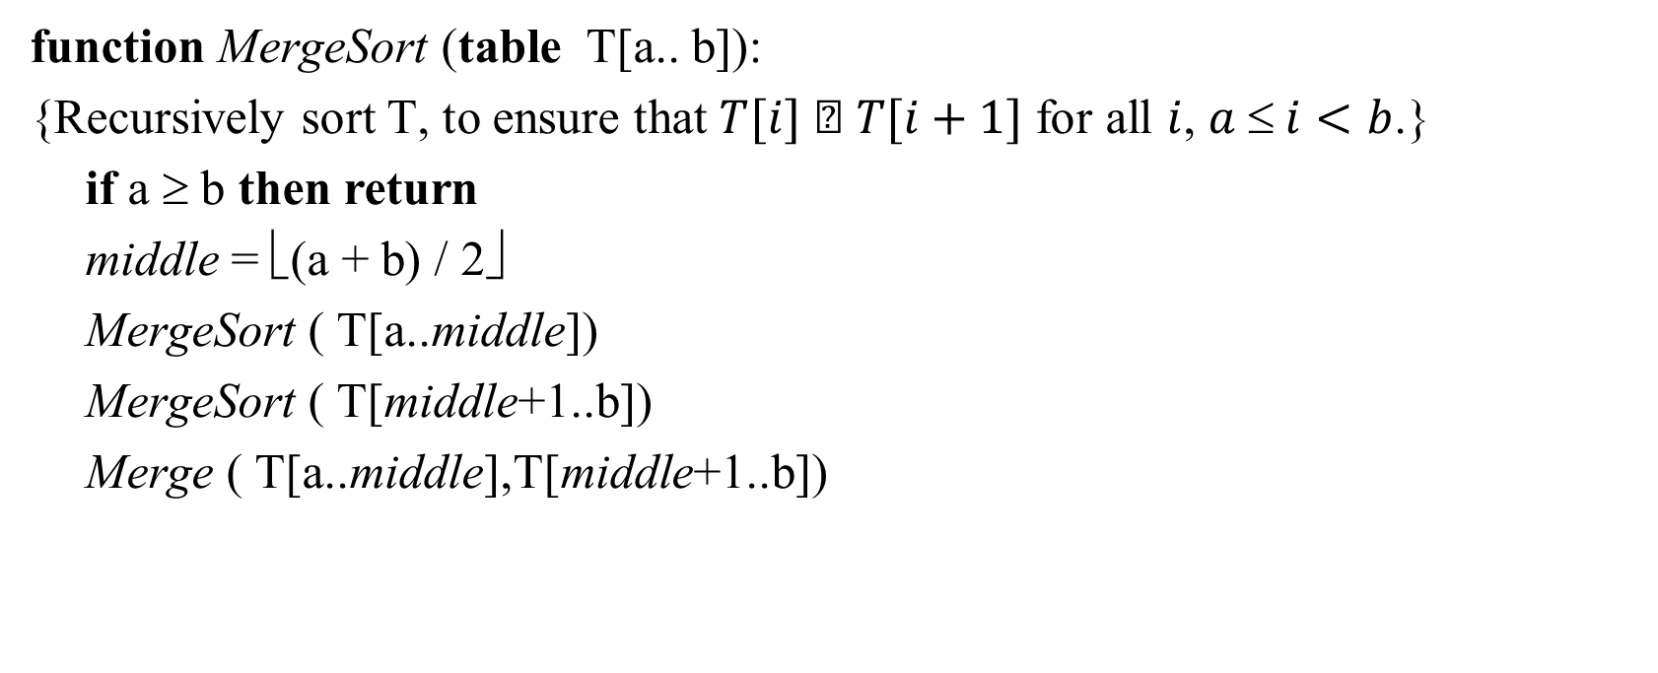
MergeSort
function MergeSort (table T[a.. b]):
{Recursively sort T, to ensure that $T[i]  T[i+1]$ for all $i$, $a  i<b$.}
if a ≥ b then return
middle = ⎣(a + b) / 2⎦
MergeSort ( T[a..middle])
MergeSort ( T[middle+1..b])
Merge ( T[a..middle],T[middle+1..b])

Slide 21
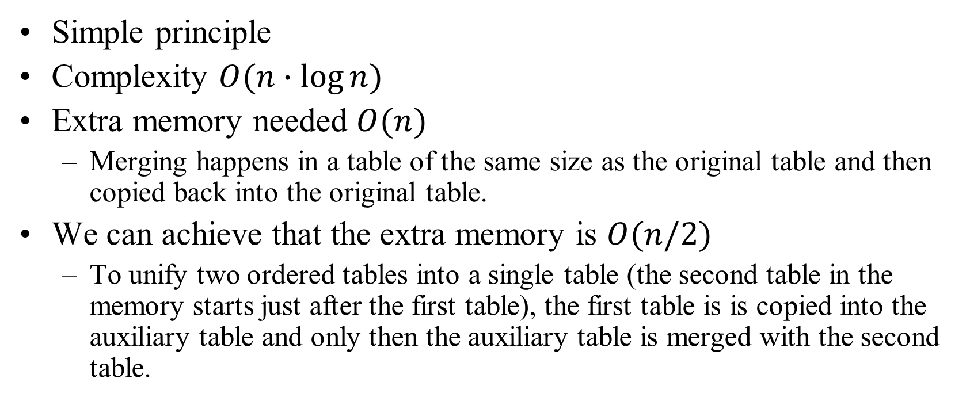
Analysis of MergeSort
Simple principle
Complexity $O(n∙log⁡n)$
Extra memory needed $O(n)$
Merging happens in a table of the same size as the original table and then copied back into the original table.
We can achieve that the extra memory is $O(n/2)$
To unify two ordered tables into a single table (the second table in the memory starts just after the first table), the first table is is copied into the auxiliary table and only then the auxiliary table is merged with the second table.

Slide 22
Divide-and-Conquer Paradigm
Divide-and conquer is a general algorithm design paradigm:
Divide: divide the input data S in two disjoint subsets S₁ and S₂
Recur: solve the subproblems associated with S₁ and S₂
Conquer: combine the solutions for S₁ and S₂ into a solution for S
The base case for the recursion are subproblems of size 0 or 1
Merge-sort is a sorting algorithm based on the divide-and-conquer paradigm
Like heap-sort
It uses a comparator
It has O(n log n) running time
Unlike heap-sort
It does not use an auxiliary priority queue
It accesses data in a sequential manner (suitable to sort data on a disk)

Slide 23
Merge-Sort
Merge-sort on an input sequence S with n elements consists of three steps:
Divide: partition S into two sequences S₁ and S₂ of about n/2 elements each
Recur: recursively sort S₁ and S₂
Conquer: merge S₁ and S₂ into a unique sorted sequence
Algorithm mergeSort(S, C)
Input sequence S with n elements, comparator C
Output sequence S sorted
according to C
if S.size() > 1
(S₁, S₂) ← partition(S, n/2)
mergeSort(S₁, C)
mergeSort(S₂, C)
S ← merge(S₁, S₂)

Slide 24
Merging Two Sorted Sequences
The conquer step of merge-sort consists of merging two sorted sequences A and B into a sorted sequence S containing the union of the elements of A and B
Merging two sorted sequences, each with n/2 elements and implemented by means of a doubly linked list, takes O(n) time
Algorithm merge(A, B)
Input sequences A and B with n/2 elements each
Output sorted sequence of A ∪ B
S ← empty sequence
while ¬A.empty() ∧ ¬B.empty()
if A.front() < B.front()
S.addBack(A.front()); A.eraseFront();
else
S.addBack(B.front()); B.eraseFront();
while ¬A.empty()
S.addBack(A.front()); A.eraseFront();
while ¬B.empty()
S.addBack(B.front()); B.eraseFront();
return S

Slide 25
How to Merge? (Temp. Array)
If it is run on a single array split in half, the array looks like this: array1 = [1 4 6 8 10 2 3 5 22]
Normally, a temporary array is needed during the merging process
We can pass indexes to the beginning and end of array1
Once the merge is complete, the temporary array can be transferred back into array1

Slide 26
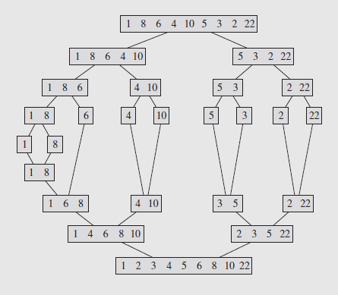
MergeSort Visualized
How many comparisons?
In which order we create the sorted subarrays?
How the chunks are physically represented?
In what order are they created?

Slide 27
Analysis of Merge-Sort
The height h of the merge-sort tree is O(log n)
at each recursive call we divide in half the sequence,
The overall amount or work done at the nodes of depth i is O(n)
we partition and merge 2^{i} sequences of size n/2^{i}
we make 2^{i+1} recursive calls
Thus, the total running time of merge-sort is O(n log n)
depth | #seqs | size
0 | 1 | n
1 | 2 | n/2
i | 2^{i} | n/2^{i}
… | … | …

Slide 28
Summary of Sorting Algorithms
Algorithm | Time | Notes
selection-sort | O(n²) | slow in-place for small data sets (< 1K)
insertion-sort | O(n²) | slow in-place for small data sets (< 1K)
heap-sort | O(n log n) | fast in-place for large data sets (1K — 1M)
merge-sort | O(n log n) | fast sequential data access for huge data sets (> 1M)

Slide 29
Quicksort: Intro
Quicksort is similar to Merge Sort.
An essential improvement – no need for extra space to store intermediate results.
Ordering happens in the same table where the elements are stored.
Quicksort uses a few external variables (not large arrays).
Quicksort algorithm ensures that the table is split into two (unequal) parts (and any element in the first part does not exceed any element in the second part).
Apply this recursively by subdividing the tables again, and so on.
Ideally want to pivot on median, but it usually do not search for it.
Notes:
The data preprocessing before the recursive call should be linear time and should not use extra memory.
It is desirable to split the table in two nearly equal parts – to reduce the number of recursive calls.
Ideally we could wish to use the median element. But searching for the median would require linear time; so we try to use something close to median.

Slide 30
Quicksort: Use of Pivot
The element that divides table at every step is named pivot. The simplest flavor – the pivot is always the leftmost element of an unsorted array.
If we assume that the input table is randomly shuffled, we can expect that the pivot would usually divide the table in a reasontably balanced way.
Scan the table from the left to the right and find element that is larger than the pivot.
Also scan the table from right to left and search for an element that is less or equal to the pivot.
When both such elements are found, swap them and continue scanning.
Finding and swapping stops, when both scans meet somewhere. Finally swap the pivot to the last element less or equal to the pivot.

Slide 31
Quicksort
QuickSort is a randomized sorting algorithm based on the divide-and-conquer paradigm:
Divide: pick a random element x (called pivot) and partition S into
L elements less or equal than x
E – pivot x itself
G – elements greater than x
Recursion: sort L and G using the same QuickSort
Conquer: join L, E and G (simple concatenation in place – zero time.)
x
x
L
G
E
x

Slide 32
Quick Sort Example
9 | 1 | 11 | 17 | 13 | 18 | 4 | 12 | 14 | 5
9 | 1 | 11 | 17 | 13 | 18 | 4 | 12 | 14 | 5
 | ⇒ | ⇒ |  |  |  |  |  |  | ⇐
9 | 1 | 5 | 17 | 13 | 18 | 4 | 12 | 14 | 11
 |  |  | ⇒ |  |  | ⇐ | ⇐ | ⇐
9 | 1 | 5 | 4 | 13 | 18 | 17 | 12 | 14 | 11
 |  |  | ⇐ | ⇐ ⇒ | ⇐

Slide 33
Quick Sort Example
9 | 1 | 5 | 4 | 13 | 18 | 17 | 12 | 14 | 11
 |  |  | ⇐ | ⇐ ⇒ | ⇐
9 | 1 | 5 | 13 | 4 | 18 | 17 | 12 | 14 | 11
9 | 1 | 5 | 4 | 13 | 18 | 17 | 12 | 14 | 11
4 | 1 | 5 | 9 | 13 | 18 | 17 | 12 | 14 | 11

Slide 34

Quick Sort
function QuickSort(table A[l.. r]):
if l<r then
i = l {$i$ goes from left to right, searching elements ≥ than the center.}
j = r+1 {$j$ goes from the right, searching elements ≤ than the center.}
v = A[l] {$v$ is the center element.}
while i<j do
i←i+1
while i≤r and A[i]<v do
i = i+1
j = j-1
while j≥l and A[j]>v do
j = j-1
A[i]↔A[j]
A[i]↔A[j] {fix the extra exchange at the end of the previous loop.}
A[j]↔A[l] {move the center element to a fitting place.}
QuickSort (A[l..j-1])
QuickSort (A[j+1..r])

Slide 35

QuickSort analysis
The expected sorting time $O(n∙log⁡n)$
Worst case happens, if everything is already sorted – $O(n^{2})$
The algorithm works best, if data is randomly shuffled
The necessary memory for recursions (up to $O(n)$)
Very many recursive calls

Slide 36
Quicksort: Time Complexity
We partition an input sequence as follows:
We remove, in turn, each element y from S and
We insert y into L, E or G, depending on the result of the comparison with the pivot x
Each insertion and removal is at the beginning or at the end of a sequence, and hence takes O(1) time
Thus, the partition step of quick-sort takes O(n) time. (Also – on all the sub-arrays created later at every stage.)
Question: How many stages do we need? (May be unequal in separate branches)
Notes:
quicksort(array[])
if length(array) > 1
choose bound; // partition array into subarray1 and subarray2
while there are elements left in array
include element either in subarray1 = {el: el ≤ bound}
or in subarray2 = {el: el ≥ bound};
quicksort(subarray1);
quicksort(subarray2);

Slide 37
Worst-case Running Time
The worst case for quick-sort occurs when the pivot is the unique minimum or maximum element
One of L and G has size n − 1 and the other has size 0
The running time is proportional to the sum
n + (n − 1) + … + 2 + 1
Thus, the worst-case running time of quick-sort is O(n²)
depth | time
0 | n
1 | n − 1
… | …
n − 1 | 1
…

Slide 38
Expected Running Time
Consider a recursive call of quick-sort on a sequence of size s
Good call: the sizes of L and G are each less than 3s/4
Bad call: one of L and G has size greater than 3s/4
A call is good with probability 1/2
1/2 of the possible pivots cause good calls:
7 2 9 4 3 7 6 1 9
7 2 9 4 3 7 6 1
2 4 3 1
7 9 7 1 → 1
1
7 2 9 4 3 7 6
Good call
Bad call
1 2 3 4 5 6 7 8 9 10 11 12 13 14 15 16
Bad pivots
Good pivots
Bad pivots

Slide 39
Expected Running Time, Part 2
Probabilistic Fact: The expected number of coin tosses required in order to get k heads is 2k
For a node of depth i, we expect
i/2 ancestors are good calls
The size of the input sequence for the current call is at most (3/4)^{i/2}n
Therefore, we have
For a node of depth 2log_{4/3}n, the expected input size is one
The expected height of the quick-sort tree is O(log n)
The amount or work done at the nodes of the same depth is O(n)
Thus, the expected running time of quick-sort is O(n log n)

Slide 40
Summary of Sorting Algorithms
Algorithm | Time | Notes
selection-sort | O(n²) | in-place slow (good for small inputs)
insertion-sort | O(n²) | in-place slow (good for small inputs)
quick-sort | O(n log n) expected | in-place, randomized fastest (good for large inputs)
heap-sort | O(n log n) | in-place fast (good for large inputs)
merge-sort | O(n log n) | sequential data access fast (good for huge inputs)

Slide 41
Lower-Bound on Sorting
Algorithm compares n elements, x₁, x₂, …, x_{n}.
How many comparisons to sort a list of length n ?
Sorting algorithms are binary trees with arcs yes (Y) or no (N)
The nonterminal nodes represent comparisons; terminal nodes represent orderings of the list.
This type of tree is referred to as a decision tree
Is x_{i} < x_{j}?
yes
no
Notes:
The height of the decision tree is a lower bound on the running time
Every input permutation must lead to a separate leaf output
If not, some input …4…5… would have same output ordering as …5…4…, which would be wrong
Since there are n!=1⋅2 ⋅ … ⋅n leaves, the height is at least log (n!)

Slide 42
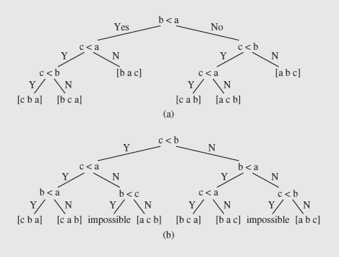
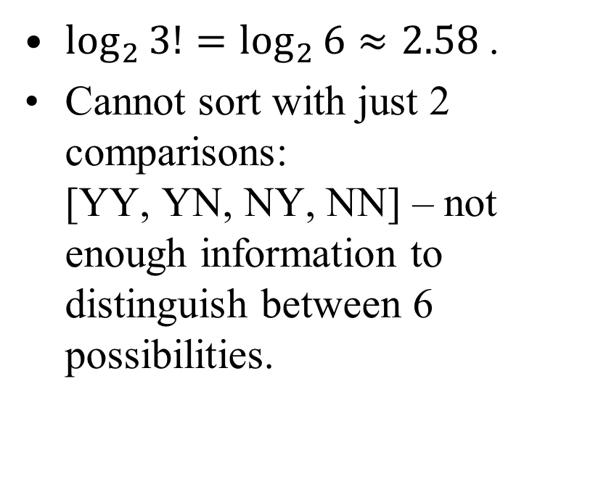
Three Comparisons for n=3
$\log_{2}{3!=\log_{2}{6≈2.58 }}$.
Cannot sort with just 2 comparisons: [YY, YN, NY, NN] – not enough information to distinguish between 6 possibilities.

Slide 43
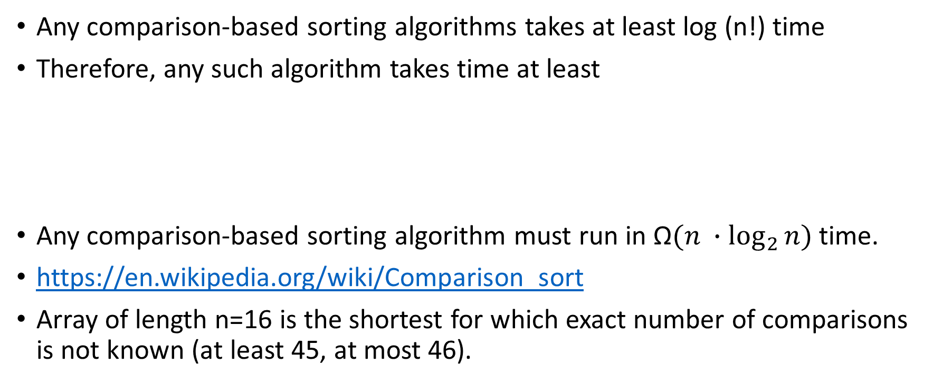
The Lower Bound
Any comparison-based sorting algorithms takes at least log (n!) time
Therefore, any such algorithm takes time at least
Any comparison-based sorting algorithm must run in $\text{Ω}(n ∙\log_{2}{n})$ time.
https://en.wikipedia.org/wiki/Comparison_sort
Array of length n=16 is the shortest for which exact number of comparisons is not known (at least 45, at most 46).

Slide 44
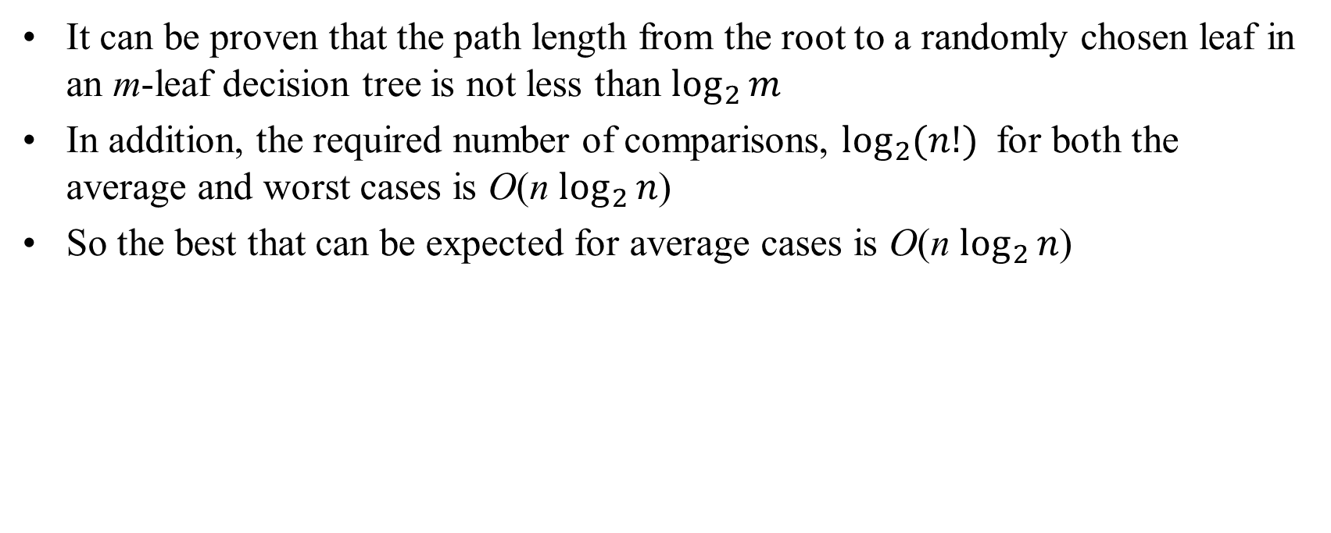
Decision Trees (continued)
It can be proven that the path length from the root to a randomly chosen leaf in an m-leaf decision tree is not less than $\log_{2}{m}$
In addition, the required number of comparisons, $\log_{2}{(n!) }$ for both the average and worst cases is O(n $\log_{2}{n}$)
So the best that can be expected for average cases is O(n $\log_{2}{n}$)

