Slide 1
Data Structures Sorting Algorithms in Special Cases
Notes:
# Every module has the following content
* Title (1 slide)
* Table of Contents (1 slide) – where are we in the material?
* Motivation (1 slide) – why do we need this module?
* Anchor Task (1x) – introduce the key problem handled by this module
* Objectives (1x)
* Theory Section (1 subtitle + more slides) or Demo Section (1 subtitle + more slides)
* Summary (1x) * References (1x)

Slide 2
Comparisons to find Maximum or Minimum
Problem: Find a precise estimate of the necessary comparisons to determine a maximum of the given array.
Consider the "brute force" search.
How many comparisons are needed?
Can we hope to do better?

Slide 3
Comparisons to find Maximum and Minimum
Comparisons to find Max and Min simultaneously.
Brute force approach – first find maximum, then find minimum.
Which comparisons are redundant?
Optimal algorithm that runs in 2 phases:
Phase #1: Out of 2n numbers compare n separate pairs.
Phase #2: Find maximum among the greatest numbers in each pair.
Phase #3: Find minimum among the smallest numbers in each pair.

Slide 4
Find 2nd Largest; Find the Median
How many comparisons to find the 2nd largest number among n?
How many comparisons to find the median among n?

Slide 5
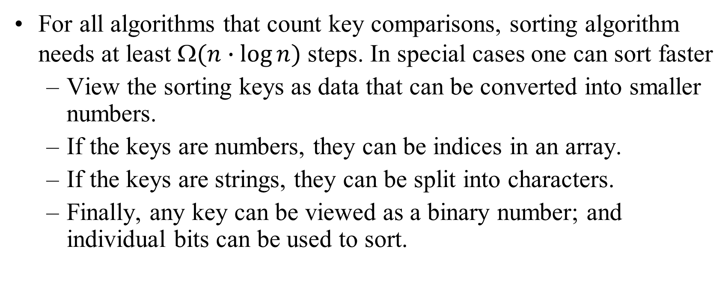
Digital Sorting – General Approach
For all algorithms that count key comparisons, sorting algorithm needs at least $(n∙log⁡n)$ steps. In special cases one can sort faster
View the sorting keys as data that can be converted into smaller numbers.
If the keys are numbers, they can be indices in an array.
If the keys are strings, they can be split into characters.
Finally, any key can be viewed as a binary number; and individual bits can be used to sort.

Slide 6
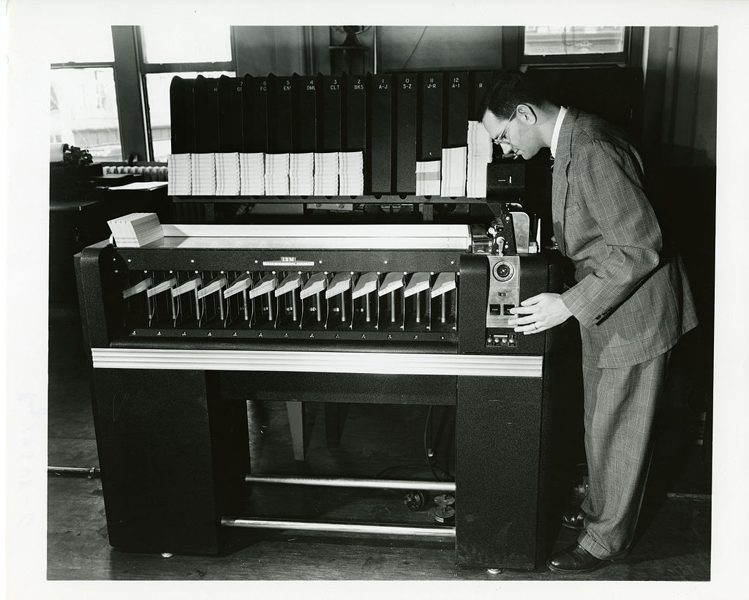
Classical Sorting Approach
Puched cards: Keys (such as postal indices, etc.) take fixed number of positions.
Typically starts from the last position (then moves backwards).
Sorts into buckets. Collect them from the buckets, stack them on top of each other and sort by the next position.
And so on...
IBM, US Census (since 1923)

Slide 7
RadixSort
CX | AX | BZ | BY | AZ | BX | AY
CX | AX | BX | BY | AY | BZ | AZ
X |  |  | Y |  | Z
AX | AY | AZ | BX | BY | BZ | CX
A |  |  | B |  |  | C
AX | AY | AZ | BX | BY | BZ | CX

Slide 8
RadixSort algorithm
function RadixSort (table A[0..n-1]):
{A is the array of pointers to be ordered.}
{S[0..N-1] is a table of queues.}
for i from 0 to K-1do S[i] = MakeEmptyQueue()
for k from 0 to K-1do
for j from 0 to n-1do
Enqueue(A[j], S[Keyk(A[j])])
j = 0
for i from 0 to N-1do
until IsEmptySet(S[i]) do
A[j] = Dequeue(S[i])
j = j+1

Slide 9
Bucket-Sort: Revisited
Algorithm bucketSort(S, N)
Input sequence S of (key, element) items with keys in the range [0, N − 1] Output sequence S sorted by increasing keys
B ← array of N empty sequences
while ¬S.empty()
(k, o) ← S.front()
S.eraseFront()
B[k].insertBack((k, o))
for i ← 0 to N − 1
while ¬B[i].empty()
(k, o) ← B[i].front()
B[i].eraseFront()
S.insertBack((k, o))
Let be S be a sequence of n (key, element) entries with keys in the range [0, N − 1]
Bucket-sort uses the keys as indices into an auxiliary array B of sequences (buckets)
Phase 1: Empty sequence S by moving each entry (k, o) into its bucket B[k]
Phase 2: For i = 0, …, N − 1, move the entries of bucket B[i] to the end of sequence S
Analysis:
Phase 1 takes O(n) time
Phase 2 takes O(n + N) time
Bucket-sort takes O(n + N) time

Slide 10
Example
Key range [0, 9]
7, d
1, c
3, a
7, g
3, b
7, e
Phase 1
1, c
3, a
3, b
7, d
7, g
7, e
B
0
1
2
3
4
5
6
7
8
9
∅
∅
∅
∅
∅
∅
∅
Phase 2
1, c
3, a
3, b
7, d
7, g
7, e

Slide 11
Properties and Extensions
Key-type Property
The keys are used as indices into an array and cannot be arbitrary objects
No external comparator
Stable Sort Property
The relative order of any two items with the same key is preserved after the execution of the algorithm
Extensions
Integer keys in the range [a, b]
Put entry (k, o) into bucket B[k − a]
String keys from a set D of possible strings, where D has constant size (e.g., names of the 50 U.S. states)
Sort D and compute the rank r(k) of each string k of D in the sorted sequence
Put entry (k, o) into bucket B[r(k)]

Slide 12
Radix-Sort
Radix-sort is a specialization of lexicographic-sort that uses bucket-sort as the stable sorting algorithm in each dimension
Radix-sort is applicable to tuples where the keys in each dimension i are integers in the range [0, N − 1]
Radix-sort runs in time O(d( n + N))
Algorithm radixSort(S, N)
Input sequence S of d-tuples such
that (0, …, 0) ≤ (x₁, …, x_{d}) and (x₁, …, x_{d}) ≤ (N − 1, …, N − 1) for each tuple (x₁, …, x_{d}) in S Output sequence S sorted in lexicographic order
for i ← d downto 1
bucketSort(S, N)

Slide 13
Radix-Sort for Binary Numbers
Consider a sequence of n b-bit integers x = x_{b − 1} … x₁x₀
We represent each element as a b-tuple of integers in the range [0, 1] and apply radix-sort with N = 2
This application of the radix-sort algorithm runs in O(bn) time
For example, we can sort a sequence of 32-bit integers in linear time
Algorithm binaryRadixSort(S)
Input sequence S of b-bit integers Output sequence S sorted
replace each element x of S with the item (0, x)
for i ← 0 to b − 1
replace the key k of each item (k, x) of S with bit x_{i} of x
bucketSort(S, 2)

Slide 14
Example
Sorting a sequence of 4-bit integers
1001
0010
1001
1001
0001
0010
1110
1101
0001
0010
1101
1001
0001
0010
1001
0001
1101
0010
1101
1101
1110
0001
1110
1110
1110

Slide 15
Lexicographic Order
A d-tuple is a sequence of d keys (k₁, k₂, …, k_{d}), where key k_{i} is said to be the i-th dimension of the tuple
Example:
The Cartesian coordinates of a point in space are a 3-tuple
The lexicographic order of two d-tuples is recursively defined as follows
(x₁, x₂, …, x_{d}) < (y₁, y₂, …, y_{d}) ⇔ x₁ < y₁ ∨ x₁ = y₁ ∧ (x₂, …, x_{d}) < (y₂, …, y_{d})
I.e., the tuples are compared by the first dimension, then by the second dimension, etc.

Slide 16
Lexicographic-Sort
Algorithm lexicographicSort(S)
Input sequence S of d-tuples Output sequence S sorted in lexicographic order
for i ← d downto 1
stableSort(S, C_{i})
Let C_{i} be the comparator that compares two tuples by their i-th dimension
Let stableSort(S, C) be a stable sorting algorithm that uses comparator C
Lexicographic-sort sorts a sequence of d-tuples in lexicographic order by executing d times algorithm stableSort, one per dimension
Lexicographic-sort runs in O(dT(n)) time, where T(n) is the running time of stableSort
Example:
(7,4,6) (5,1,5) (2,4,6) (2, 1, 4) (3, 2, 4)
(2, 1, 4) (3, 2, 4) (5,1,5) (7,4,6) (2,4,6)
(2, 1, 4) (5,1,5) (3, 2, 4) (7,4,6) (2,4,6)
(2, 1, 4) (2,4,6) (3, 2, 4) (5,1,5) (7,4,6)

Slide 17
Counting Sort
Counting sort is an algorithm for sorting a collection of objects according to keys that are small integers
It operates by counting the number of objects that have distinct key values
It then uses arithmetic on those counts to determine the positions of each key value in the output sequence
Its running time is linear in the number of items and the maximum key value
So it is only suitable for use in situations where the keys are not significantly larger than the number of items
However, it is often used as a subroutine in another sorting algorithm, radix sort, that can handle larger keys more efficiently

Slide 18
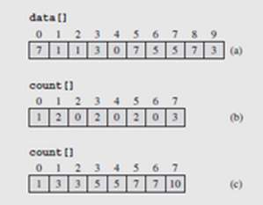
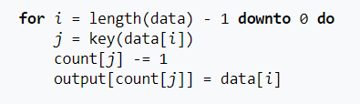


Counting Sort – 2
Array of counters, count[], to track the number of times each value occurs in data[]
The count[] array is indexed with the values from data
Once the count is completed, the counters indicating the values < i are added together and stored in count[i]
Consequently, count[i]-1 indicates the location of i in the data[] array
Input size
$$n$$
$$k$$
Keyspace size
output[]
0
1
2
3
4
5
6
7
8
9
0
1
2
3
4
5
6
7
3
1
3
3
4
5
7
7
10
j=3; count[3]--; output[4]=3;
0
1
2
3
4
5
6
7
8
9
0
1
2
3
4
5
6
7
3
7
1
3
3
4
5
7
7
9
j=7; count[7]--; output[9]=7;
Notes:
Consider the data[] array [7 1 1 3 0 7 5 5 7 3]
The largest value in the array, 7, is determined and used to create the array count[]
Next, we process data[], incrementing count[data[i]]by 1 for each occurrence of data[i], shown in Figure 9.17b
The count[] array is then processed such that each location i contains the accumulated count for values < i
So count[0] accumulate counts for values < 0 (1); count[1] accumulates values < 1 (all 0s plus all 1s = 3), etc.
Once this has been completed, we place the data into the tmp[] array as previously specified, starting with the last item in data[]
data[9] = 3, and count[3] - 1 = 5 – 1 = 4, so tmp[4] = data[9] = 3
After the value is paced, count[3] is decremented by 1
The process is then repeated with the remaining values in data[] until we move the last value, then the contents of tmp[] is transferred back into data[]

Slide 19
Sorting in the STL
There are a number of sorting algorithms in the STL, particularly in the <algorithm> library
Among the algorithms that are implemented in the library are the quicksort, mergesort, and heap sort
The first group of functions are called partial sorting functions
The first of these picks the k = middle – first smallest elements and orders them in the range [first, middle)
So the code
partial_sort(v1.begin(),v1.begin()+3,v1.end());
takes the three smallest values in vector v1 and puts them in the first three locations
Notes:
These functions are shown in Figure 9.18 on pages 529 – 531

Slide 20
Sorting in the STL (continued)
The default ordering is ascending order, but this can be changed in the fourth parameter of the function
So the call
partial_sort(v2.begin()+1,v2.begin()+4,v2.end(),greater<int>());
takes the largest three values in v2 and puts them into positions two through four in descending order
In both cases, the order of the values outside the destination range is unspecified
A third version takes the first k = last1 - first1 or last2 - first2 elements from the range [first1,last1)
It then overwrites the elements in the range [first2,last2)

Slide 21
Sorting in the STL (continued)
So in this case, the call
partial_sort_copy(v2.begin(),v2.begin()+4,v3.begin(),v3.end());
takes the first four integers of v2 and puts them into the first four locations of v3
In addition, an iterator is returned pointing to the first position following the last copied number
The last variation of the partial sort is similar to this third one, but allows for providing a relation to direct the sort order
The program of Figure 9.18 also demonstrates the partition() function
This function orders two ranges with respect to one another, using a Boolean function to separate the ranges

Slide 22
Sorting in the STL (continued)
Values for which the function is true are placed in the first range; those for which it is false, in the second
The most useful function is probably the one that implements the quicksort, sort()
If we call it as follows:
sort(v1.begin(),v1.end());
it will sort the entire list v1 into ascending order
There is a second version that allows for explicit specification of the sorting relation
Stable sorting functions are also provided in the STL; stable algorithms preserve the original order of equal items

Slide 23
Concluding Remarks
If we order items "one-by-one", we typically get O(n²) algorithms: if length increases 2 times, the runtime grows 4 times.
Counting sort is the fastest among the algorithms, it limits on what are the input data (no big gaps, no negative numbers).
Comparison sort algorithms: Mergesort, Quicksort and Shell sort are fast on typical (random) data. (We did not analyze Shell sort – same as Quicksort, does not have good worst-case behavior.)

