Slide 1
Graph Algorithms: Shortest Paths, MSTs, Transitive Closures
Notes:
Graph algorithms illustrate most of the algorithmic thinking patterns. (Much like sorting algorithms).
Many practical tasks are either directly formulated in graph language or are reducible to the graph language.
See 2-Satisfiability https://en.wikipedia.org/wiki/2-satisfiability

Slide 2
Weighted Graphs
In a weighted graph, each edge has an associated numerical value, called the weight of the edge
Edge weights may represent, distances, costs, etc.
Example:
In a flight route graph, the weight of an edge represents the distance in miles between the endpoint airports
849
PVD
1843
ORD
142
SFO
802
LGA
1743
1205
337
1387
HNL
2555
1099
LAX
1233
DFW
1120
MIA

Slide 3
Shortest Paths
Given a weighted graph and two vertices u and v, we want to find a path of minimum total weight between u and v.
Length of a path is the sum of the weights of its edges.
Example:
Shortest path between Providence and Honolulu
Applications
Internet packet routing
Flight reservations
Driving directions
849
PVD
1843
ORD
142
SFO
802
LGA
1743
1205
337
1387
HNL
2555
1099
LAX
1233
DFW
1120
MIA

Slide 4
Shortest Path Properties
Property 1:
A subpath of a shortest path is itself a shortest path
Property 2:
There is a tree of shortest paths from a start vertex to all the other vertices
Example:
Tree of shortest paths from Providence
849
PVD
1843
ORD
142
SFO
802
LGA
1743
1205
337
1387
HNL
2555
1099
LAX
1233
DFW
1120
MIA

Slide 5
Dijkstra’s Algorithm
The distance of a vertex v from a vertex s is the length of a shortest path between s and v
Dijkstra’s algorithm computes the distances of all the vertices from a given start vertex s
Assumptions:
the graph is connected
the edges are undirected
the edge weights are nonnegative
We grow a “cloud” of vertices, beginning with s and eventually covering all the vertices
We store with each vertex v a label d(v) representing the distance of v from s in the subgraph consisting of the cloud and its adjacent vertices
At each step
We add to the cloud the vertex u outside the cloud with the smallest distance label, d(u)
We update the labels of the vertices adjacent to u

Slide 6
Edge Relaxation
Consider an edge e = (u,z) such that
u is the vertex most recently added to the cloud
z is not in the cloud
The relaxation of edge e updates distance d(z) as follows:
d(z) ← min{d(z),d(u) + weight(e)}
d(u) = 50
10
d(z) = 75
u
e
s
z
d(u) = 50
10
d(z) = 60
u
e
s
z

Slide 7
Example
0
0
8
A
4
8
A
4
2
2
8
7
2
1
4
8
7
2
1
3
B
C
D
B
C
D
∞
3
9
∞
5
3
9
8
2
E
F
5
2
E
F
5
0
0
8
A
4
8
A
4
2
2
8
7
2
1
3
7
7
2
1
3
B
C
D
B
C
D
5
3
9
11
5
3
9
8
2
E
F
5
2
E
F
5

Slide 8
Example (cont.)
0
8
A
4
2
7
7
2
1
3
B
C
D
5
3
9
8
2
E
F
5
0
8
A
4
2
7
7
2
1
3
B
C
D
5
3
9
8
2
E
F
5

Slide 9
Dijkstra’s Algorithm
Algorithm DijkstraDistances(G, s)
Q ← new heap-based priority queue
for all v ∈ G.vertices()
if v = s
v.setDistance(0)
else
v.setDistance(∞)
l ← Q.insert(v.getDistance(), v)
v.setEntry(l)
while ¬Q.empty()
l ← Q.removeMin()
u ← l.getValue()
for all e ∈ u.incidentEdges() { relax e }
z ← e.opposite(u)
r ← u.getDistance() + e.weight()
if r < z.getDistance()
z.setDistance(r) Q.replaceKey(z.getEntry(), r)
A heap-based adaptable priority queue with location-aware entries stores the vertices outside the cloud
Key: distance
Value: vertex
Recall that method replaceKey(l,k) changes the key of entry l
We store two labels with each vertex:
Distance
Entry in priority queue

Slide 10
Analysis of Dijkstra’s Algorithm
Graph operations
Method incidentEdges is called once for each vertex
Label operations
We set/get the distance and locator labels of vertex z O(deg(z)) times
Setting/getting a label takes O(1) time
Priority queue operations
Each vertex is inserted once into and removed once from the priority queue, where each insertion or removal takes O(log n) time
The key of a vertex in the priority queue is modified at most deg(w) times, where each key change takes O(log n) time
Dijkstra’s algorithm runs in O((n + m) log n) time provided the graph is represented by the adjacency list structure
Recall that Σ_{v} deg(v) = 2m
The running time can also be expressed as O(m log n) since the graph is connected

Slide 11
Shortest Paths Tree
Algorithm DijkstraShortestPathsTree(G, s)
…
for all v ∈ G.vertices()
…
v.setParent(∅)
…
for all e ∈ u.incidentEdges()
{ relax edge e }
z ← e.opposite(u)
r ← u.getDistance() + e.weight()
if r < z.getDistance()
z.setDistance(r)
z.setParent(e)
Q.replaceKey(z.getEntry(),r)
Using the template method pattern, we can extend Dijkstra’s algorithm to return a tree of shortest paths from the start vertex to all other vertices
We store with each vertex a third label:
parent edge in the shortest path tree
In the edge relaxation step, we update the parent label

Slide 12
Why Dijkstra’s Algorithm Works
Dijkstra’s algorithm is greedy by increasing distance.
Suppose it didn’t find all shortest distances. Let F be the first wrong vertex the algorithm processed.
When the previous node, D, on the true shortest path was considered, its distance was correct
But the edge (D,F) was relaxed at that time!
Thus, so long as d(F)>d(D), F’s distance cannot be wrong. That is, there is no wrong vertex
0
8
A
4
2
7
7
2
1
3
B
C
D
5
3
9
8
2
E
F
5

Slide 13
Why It Doesn’t Work for Negative-Weight Edges
If a node with a negative incident edge were to be added late to the cloud, it could mess up distances for vertices already in the cloud.
Dijkstra’s algorithm is based on the greedy method. It adds vertices by increasing distance.
Picture: C’s true distance is 1, but it is already in the cloud with d(C)=5!
0
8
A
4
6
7
7
5
1
4
B
C
D
5
0
-8
9
2
E
F
5

Slide 14
Bellman-Ford Algorithm (not in book)
Works even with negative-weight edges
Must assume directed edges (for otherwise we would have negative-weight cycles)
Iteration i finds all shortest paths that use i edges.
Running time: O(nm).
Can be extended to detect a negative-weight cycle if it exists
How?
Algorithm BellmanFord(G, s)
for all v ∈ G.vertices()
if v = s
v.setDistance(0)
else
v.setDistance(∞)
for i ← 1 to n − 1 do
for each e ∈ G.edges()
{ relax edge e }
u ← e.origin()
z ← e.opposite(u)
r ← u.getDistance() + e.weight()
if r < z.getDistance()
z.setDistance(r)

Slide 15
Bellman-Ford Example
Nodes are labeled with their d(v) values
8
0
4
8
0
4
-2
-2
7
1
8
7
-2
1
4
∞
∞
∞
∞
∞
∞
3
9
3
9
-2
∞
∞
5
-2
∞
∞
5
8
0
4
8
0
4
-2
-2
5
8
7
-2
1
4
-1
5
7
-2
1
-1
1
3
9
3
9
-2
6
9
5
-2
4
5
∞
∞
1
9

Slide 16
DAG-based Algorithm (not in book)
Works even with negative-weight edges
Uses topological order
Doesn’t use any fancy data structures
Is much faster than Dijkstra’s algorithm
Running time: O(n+m).
Algorithm DagDistances(G, s)
for all v ∈ G.vertices()
if v = s
v.setDistance(0)
else
v.setDistance(∞)
{ Perform a topological sort of the vertices }
for u ← 1 to n do {in topological order}
for each e ∈ u.outEdges()
{ relax edge e }
z ← e.opposite(u)
r ← u.getDistance() + e.weight()
if r < z.getDistance()
z.setDistance(r)

Slide 17
DAG Example
Nodes are labeled with their d(v) values
1
1
8
0
4
8
0
4
-2
-2
3
7
2
1
4
3
8
7
2
-2
1
4
4
∞
∞
∞
∞
∞
∞
3
9
3
9
-5
∞
∞
5
-5
∞
∞
5
6
5
6
5
1
1
8
0
4
8
0
4
-2
-2
3
5
7
2
1
4
-1
3
7
2
1
4
8
-2
4
5
-2
-1
3
9
3
9
-5
1
7
5
-5
0
4
5
∞
∞
1
7
6
5
6
5
(two steps)

Slide 18
Minimum Spanning Trees
Spanning subgraph
Subgraph of a graph G containing all the vertices of G
Spanning tree
Spanning subgraph that is itself a (free) tree
Minimum spanning tree (MST)
Spanning tree of a weighted graph with minimum total edge weight
Applications
Communications networks
Transportation networks
ORD
10
1
PIT
DEN
6
7
9
3
DCA
4
STL
8
5
2
DFW
ATL

Slide 19
Cycle Property
f
8
Cycle Property:
Let T be a minimum spanning tree of a weighted graph G
Let e be an edge of G that is not in T and C let be the cycle formed by e with T
For every edge f of C, weight(f) ≤ weight(e)
Proof:
By contradiction
If weight(f) > weight(e) we can get a spanning tree of smaller weight by replacing e with f
4
C
9
2
6
3
e
8
7
7
Replacing f with e yields a better spanning tree
f
8
4
C
9
2
6
3
e
8
7
7

Slide 20
Partition Property
U
V
f
7
4
Partition Property:
Consider a partition of the vertices of G into subsets U and V
Let e be an edge of minimum weight across the partition
There is a minimum spanning tree of G containing edge e
Proof:
Let T be an MST of G
If T does not contain e, consider the cycle C formed by e with T and let f be an edge of C across the partition
By the cycle property, weight(f) ≤ weight(e)
Thus, weight(f) = weight(e)
We obtain another MST by replacing f with e
9
2
5
8
8
e
3
7
Replacing f with e yields another MST
U
V
f
7
4
9
2
5
8
8
e
3
7

Slide 21
Kruskal’s Algorithm
Partition vertices into clusters
Initially, single-vertex clusters
Keep an MST for each cluster
Merge “closest” clusters and their MSTs
A priority queue stores the edges outside clusters
Key: weight
Element: edge
At the end of the algorithm
One cluster and one MST
Algorithm KruskalMST(G)
for each vertex v in G do
Create a cluster consisting of v
let Q be a priority queue.
Insert all edges into Q
T ← ∅
{T is the union of the MSTs of the clusters}
while T has fewer than n − 1 edges do e ← Q.removeMin().getValue()
[u, v] ← G.endVertices(e)
A ← getCluster(u)
B ← getCluster(v)
if A ≠ B then
Add edge e to T
mergeClusters(A, B)
return T

Slide 22
Example
G
G
B
8
8
4
B
4
9
E
6
9
E
6
1
5
F
1
5
F
C
11
3
C
11
3
2
2
7
D
H
7
H
A
D
10
A
10
G
G
B
8
B
8
4
4
9
E
6
9
E
6
1
5
F
1
5
F
C
11
3
C
11
3
2
2
7
D
H
7
H
D
A
10
A
10

Slide 23
Example (contd.)
G
G
B
8
8
4
B
4
9
E
6
9
E
6
1
5
F
1
5
F
C
11
3
C
11
3
2
2
7
D
H
7
H
D
A
10
A
10
four steps
two steps
G
G
B
8
B
8
4
4
9
E
6
9
E
6
1
5
F
1
5
F
C
11
3
C
11
3
2
2
7
D
H
7
D
H
A
10
A
10

Slide 24
Data Structure for Kruskal’s Algorithm
The algorithm maintains a forest of trees
A priority queue extracts the edges by increasing weight
An edge is accepted it if connects distinct trees
We need a data structure that maintains a partition, i.e., a collection of disjoint sets, with operations:
makeSet(u): create a set consisting of u
find(u): return the set storing u
union(A, B): replace sets A and B with their union

Slide 25
Recall of List-based Partition
Each set is stored in a sequence
Each element has a reference back to the set
operation find(u) takes O(1) time, and returns the set of which u is a member.
in operation union(A,B), we move the elements of the smaller set to the sequence of the larger set and update their references
the time for operation union(A,B) is min(|A|, |B|)
Whenever an element is processed, it goes into a set of size at least double, hence each element is processed at most log n times
Notes:
Any of the set operations can be implemented using a generic merge
For example:
For intersection: only copy elements that are duplicated in both list
For union: copy every element from both lists except for the duplicates
All methods run in linear time

Slide 26
Partition-Based Implementation
Algorithm KruskalMST(G)
Initialize a partition P
for each vertex v in G do
P.makeSet(v)
let Q be a priority queue.
Insert all edges into Q
T ← ∅
{T is the union of the MSTs of the clusters}
while T has fewer than n − 1 edges do e ← Q.removeMin().getValue()
[u, v] ← G.endVertices(e)
A ← P.find(u)
B ← P.find(v)
if A ≠ B then
Add edge e to T
P.union(A, B)
return T
Partition-based version of Kruskal’s Algorithm
Cluster merges as unions
Cluster locations as finds
Running time O((n + m) log n)
PQ operations O(m log n)
UF operations O(n log n)

Slide 27
Analysis of List-based Representation
When doing a union, always move elements from the smaller set to the larger set
Each time an element is moved it goes to a set of size at least double its old set
Thus, an element can be moved at most O(log n) times
Total time needed to do n unions and finds is O(n log n).

Slide 28
Tree-based Implementation
Each element is stored in a node, which contains a pointer to a set name
A node v whose set pointer points back to v is also a set name
Each set is a tree, rooted at a node with a self-referencing set pointer
For example: The sets “1”, “2”, and “5”:
1
2
5
4
7
3
6
8
10
9
11
12

Slide 29
Union-Find Operations
To do a union, simply make the root of one tree point to the root of the other
To do a find, follow set-name pointers from the starting node until reaching a node whose set-name pointer refers back to itself
5
2
8
10
3
6
11
9
12
5
2
8
10
3
6
11
9
12

Slide 30
Union-Find Heuristic 1
Union by size:
When performing a union, make the root of smaller tree point to the root of the larger
Implies O(n log n) time for performing n union-find operations:
Each time we follow a pointer, we are going to a subtree of size at least double the size of the previous subtree
Thus, we will follow at most O(log n) pointers for any find.
5
2
8
10
3
6
11
9
12

Slide 31
Union-Find Heuristic 2
Path compression:
After performing a find, compress all the pointers on the path just traversed so that they all point to the root
Implies O(n log* n) time for performing n union-find operations:
Proof is somewhat involved… (and not in the book)
5
5
8
10
8
10
11
11
2
12
2
12
3
6
3
6
9
9

Slide 32
Proof of log* n Amortized Time
For each node v that is a root
define n(v) to be the size of the subtree rooted at v (including v)
identified a set with the root of its associated tree.
We update the size field of v each time a set is unioned into v. Thus, if v is not a root, then n(v) is the largest the subtree rooted at v can be, which occurs just before we union v into some other node whose size is at least as large as v ’s.
For any node v, then, define the rank of v, which we denote as r (v), as r (v) = [log n(v)]:
Thus, n(v) ≥ 2^{r(v)}.
Also, since there are at most n nodes in the tree of v, r (v) = [log n], for each node v.

Slide 33
Proof of log* n Amortized Time (2)
For each node v with parent w:
r (v ) > r (w )
Claim: There are at most n/ 2^{s} nodes of rank s.
Proof:
Since r (v) < r (w), for any node v with parent w, ranks are monotonically increasing as we follow parent pointers up any tree.
Thus, if r (v) = r (w) for two nodes v and w, then the nodes counted in n(v) must be separate and distinct from the nodes counted in n(w).
If a node v is of rank s, then n(v) ≥ 2^{s}.
Therefore, since there are at most n nodes total, there can be at most n/ 2^{s} that are of rank s.

Slide 34
Proof of log* n Amortized Time (3)
Definition: Tower of two’s function:
t(i) = 2^{t(i-1)}
Nodes v and u are in the same rank group g if
g = log*(r(v)) = log*(r(u)):
Since the largest rank is log n, the largest rank group is
log*(log n) = (log* n) - 1

Slide 35
Proof of log* n Amortized Time (4)
Charge 1 cyber-dollar per pointer hop during a find:
If w is the root or if w is in a different rank group than v, then charge the find operation one cyber-dollar.
Otherwise (w is not a root and v and w are in the same rank group), charge the node v one cyber-dollar.
Since there are most (log* n)-1 rank groups, this rule guarantees that any find operation is charged at most log* n cyber-dollars.

Slide 36
Proof of log* n Amortized Time (5)
After we charge a node v then v will get a new parent, which is a node higher up in v ’s tree.
The rank of v ’s new parent will be greater than the rank of v ’s old parent w.
Thus, any node v can be charged at most the number of different ranks that are in v ’s rank group.
If v is in rank group g > 0, then v can be charged at most t(g)-t(g-1) times before v has a parent in a higher rank group (and from that point on, v will never be charged again). In other words, the total number, C, of cyber-dollars that can ever be charged to nodes is bounded.

Slide 37
Proof of log* n Amortized Time (end)
Bounding n(g):
Returning to C:

Slide 38
Prim-Jarnik’s Algorithm
Similar to Dijkstra’s algorithm
We pick an arbitrary vertex s and we grow the MST as a cloud of vertices, starting from s
We store with each vertex v label d(v) representing the smallest weight of an edge connecting v to a vertex in the cloud
At each step:
We add to the cloud the vertex u outside the cloud with the smallest distance label
We update the labels of the vertices adjacent to u

Slide 39
Prim-Jarnik’s Algorithm (cont.)
A heap-based adaptable priority queue with location-aware entries stores the vertices outside the cloud
Key: distance
Value: vertex
Recall that method replaceKey(l,k) changes the key of entry l
We store three labels with each vertex:
Distance
Parent edge in MST
Entry in priority queue
Algorithm PrimJarnikMST(G)
Q ← new heap-based priority queue
s ← a vertex of G
for all v ∈ G.vertices()
if v = s
v.setDistance(0)
else
v.setDistance(∞)
v.setParent(∅)
l ← Q.insert(v.getDistance(), v)
v.setLocator(l)
while ¬Q.empty()
l ← Q.removeMin()
u ← l.getValue()
for all e ∈ u.incidentEdges()
z ← e.opposite(u)
r ← e.weight()
if r < z.getDistance()
z.setDistance(r)
z.setParent(e) Q.replaceKey(z.getEntry(), r)

Slide 40
Example
∞
7
2
7
D
2
7
D
B
4
B
4
8
9
∞
5
9
∞
2
5
F
2
5
F
C
8
C
8
8
3
8
3
E
E
A
7
7
A
7
7
0
0
7
7
2
7
D
7
D
B
4
2
B
4
5
9
∞
9
4
2
5
F
5
5
C
2
F
8
C
8
8
3
3
E
8
A
7
E
0
7
A
7
7
0

Slide 41
Example (contd.)
7
2
7
D
B
4
5
9
4
2
5
F
C
8
8
3
E
A
7
3
7
0
7
D
2
B
4
5
9
4
2
5
F
C
8
8
3
E
A
7
3
0

Slide 42
Analysis
Graph operations
Method incidentEdges is called once for each vertex
Label operations
We set/get the distance, parent and locator labels of vertex z O(deg(z)) times
Setting/getting a label takes O(1) time
Priority queue operations
Each vertex is inserted once into and removed once from the priority queue, where each insertion or removal takes O(log n) time
The key of a vertex w in the priority queue is modified at most deg(w) times, where each key change takes O(log n) time
Prim-Jarnik’s algorithm runs in O((n + m) log n) time provided the graph is represented by the adjacency list structure
Recall that Σ_{v} deg(v) = 2m
The running time is O(m log n) since the graph is connected

Slide 43
Kruskal’s Algorithm
Algorithm KruskalMSF(G)
Input weighted graph G
Output labeling of the edges of a minimum spanning forest of G
Q ← new heap-based priority queue
for all v ∈ G.vertices() do
l ← makeSet(v) { elementary cloud }
v.setLocator(l)
for all e ∈ G.edges() do
Q.insert(e.weight(), e)
while ¬Q.empty()
e ← Q.removeMin()
[u,v] ← e.endVertices()
A ← find(u.getLocator())
B ← find(v.getLocator())
if A ≠ B
setMSFedge(e)
{ merge clouds }
union(A, B)
The vertices are partitioned into clouds
We start with one cloud per vertex
Clouds are merged during the execution of the algorithm
Partition ADT:
makeSet(o): create set {o} and return a locator for object o
find(l): return the set of the object with locator l
union(A,B): merge sets A and B

Slide 44
Example
G
G
B
8
8
4
B
4
9
E
6
9
E
6
1
5
F
1
5
F
C
11
3
C
11
3
2
2
7
D
H
7
H
A
D
10
A
10
G
G
B
8
B
8
4
4
9
E
6
9
E
6
1
5
F
1
5
F
C
11
3
C
11
3
2
2
7
D
H
7
H
D
A
10
A
10

Slide 45
Example (contd.)
G
G
B
8
8
4
B
4
9
E
6
9
E
6
1
5
F
1
5
F
C
11
3
C
11
3
2
2
7
D
H
7
H
D
A
10
A
10
four steps
two steps
G
G
B
8
B
8
4
4
9
E
6
9
E
6
1
5
F
1
5
F
C
11
3
C
11
3
2
2
7
D
H
7
D
H
A
10
A
10

Slide 46
Partition Implementation
Partition implementation
A set is represented the sequence of its elements
A position stores a reference back to the sequence itself (for operation find)
The position of an element in the sequence serves as locator for the element in the set
In operation union, we move the elements of the smaller sequence into to the larger sequence
Worst-case running times
makeSet, find: O(1)
union: O(min(n_{A}, n_{B}))
Amortized analysis
Consider a series of k Partiton ADT operations that includes n makeSet operations
Each time we move an element into a new sequence, the size of its set at least doubles
An element is moved at most log₂ n times
Moving an element takes O(1) time
The total time for the series of operations is O(k + n log n)

Slide 47
Analysis of Kruskal’s Algorithm
Graph operations
Methods vertices and edges are called once
Method endVertices is called m times
Priority queue operations
We perform m insert operations and m removeMin operations
Partition operations
We perform n makeSet operations, 2m find operations and no more than n − 1 union operations
Label operations
We set vertex labels n times and get them 2m times
Kruskal’s algorithm runs in time O((n + m) log n) time provided the graph has no parallel edges and is represented by the adjacency list structure

Slide 48
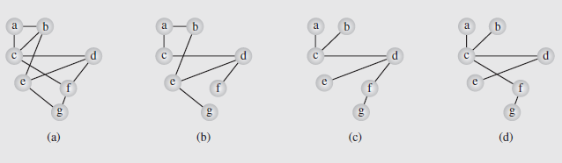
Spanning Trees
Consider an airline that has routes between seven cities as in the figure:
If economic hardships force the airline to cut routes, which ones should be kept to preserve a route to each city, if only indirectly?
Notes:
Fig. 8.14 A graph representing (a) the airline connections between
seven cities and (b–d) three possible sets of connections
One possibility is shown in Figure 8.14b

Slide 49
Spanning Trees (continued)
However, we want to make sure we have the minimum connections necessary to preserve the routes
To accomplish this, a spanning tree should be used, specifically one created using depthFirstSearch()
There is a possibility of multiple spanning trees (Figure 8.14c-d), but each of these has the minimum number of edges
We don’t know which of these might be optimal, since we haven’t taken distances into account
The airline, wanting to minimize costs, will want to use the shortest distances for the connections
So what we want to find is the minimum spanning tree, where the sum of the edge weights is minimal

Slide 50
Spanning Trees (continued)
The problem we looked at earlier involving finding a spanning tree in a simple graph is a case of this where edge weights = 1
So each spanning tree is a minimum tree in a simple graph
There are a number of solutions to the minimum spanning tree problem, and we will consider two
One popular algorithm is Kruskal’s algorithm, developed by Joseph Kruskal in 1956
It orders the edges by weight, and then checks to see if they can be added to the tree under construction
It will be added if its inclusion doesn’t create a cycle

Slide 51
Spanning Trees (continued)
The algorithm is as follows:
KruskalAlgorithm(weighted connected undirected graph)
tree = null;
edges = sequence of all edges of graph sorted by weight;
for (i = 1; i # |E| and |tree| < |V| – 1; i++)
if e_{i} from edges does not form a cycle with edges in tree
add ei to tree;
A step-by-step example of the application of this algorithm is shown in Figure 8-15ba-bf on page 413
It is not necessary to order the edges in order to build a spanning tree, any order of edges can be used
An algorithm developed by Dijkstra in 1960 (and independently by Robert Kalaba) pursues this approach

Slide 52
Spanning Trees (continued)
This algorithm is shown below:
DijkstraMethod(weighted connected undirected graph)
tree = null;
edges = an unsorted sequence of all edges of graph;
for i = 1 to |E|
add ei to tree;
if there is a cycle in tree
remove an edge with maximum weight from this only cycle;
In this algorithm, edges are added to the tree one-by-one
If a cycle results, the edge in the cycle with maximum weight is removed
The use of this method is shown in Figure 8.15ca-cl on page 414

Slide 53
Decorator Pattern
Labels are commonly used in graph algorithms
Auxiliary data
Output
Examples
DFS: unexplored/visited label for vertices and unexplored/ forward/back labels for edges
Dijkstra and Prim-Jarnik: distance, locator, and parent labels for vertices
Kruskal: locator label for vertices and MSF label for edges
The decorator pattern extends the methods of the Position ADT to support the handling of attributes (labels)
has(a): tests whether the position has attribute a
get(a): returns the value of attribute a
set(a, x): sets to x the value of attribute a
destroy(a): removes attribute a and its associated value (for cleanup purposes)
The decorator pattern can be implemented by storing a dictionary of (attribute, value) items at each position

Slide 54
MST and Traveling Salesperson Problem
A tour of a graph is a spanning cycle (e.g., a cycle that goes through all the vertices)
A traveling salesperson tour of a weighted graph is a tour that is simple (i.e., no repeated vertices or edges) and has has minimum weight
No polynomial-time algorithms are known for computing traveling salesperson tours
The traveling salesperson problem (TSP) is a major open problem in computer science
Find a polynomial-time algorithm computing a traveling salesperson tour or prove that none exists
7
D
B
4
2
2
5
F
C
8
6
3
E
A
1
Example of traveling salesperson tour
(with weight 17)

Slide 55
MST as a TSP Approximation
We can approximate a TSP tour with a tour of at most twice the weight for the case of Euclidean graphs
Vertices are points in the plane
Every pair of vertices is connected by an edge
The weight of an edge is the length of the segment joining the points
Approximation algorithm
Compute a minimum spanning tree
Form an Eulerian circuit around the MST
Transform the circuit into a tour

Slide 56
Transitive Closure
D
E
Given a digraph G, the transitive closure of G is the digraph G* such that
G* has the same vertices as G
if G has a directed path from u to v (u ≠ v), G* has a directed edge from u to v
The transitive closure provides reachability information about a digraph
B
G
C
A
D
E
B
C
A
G*

Slide 57
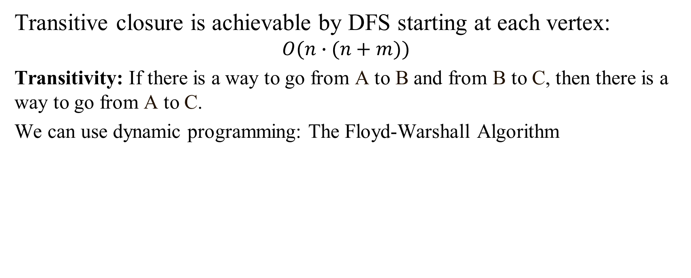
Computing the Transitive Closure
Transitive closure is achievable by DFS starting at each vertex: $$O(n∙(n+m))$$
Transitivity: If there is a way to go from A to B and from B to C, then there is a way to go from A to C.
We can use dynamic programming: The Floyd-Warshall Algorithm

Slide 58
Floyd-Warshall Transitive Closure
Idea #1: Number the vertices 1, 2, …, n.
Idea #2: Consider paths that use only vertices numbered 1, 2, …, k, as intermediate vertices:
Uses only vertices numbered 1,…,k
(add this edge if it’s not already in)
i
j
Uses only vertices
numbered 1,…,k-1
Uses only vertices
numbered 1,…,k-1
k

Slide 59
Example of the Powers of a Relation
R
R²
b
a
b
a
d
c
d
c
R⁴
R³
a
b
a
b
d
c
d
c
The pair (x,y) is in R^{n} if there is a path of length =n from x to y in R (following the direction of the arrows).

Slide 60


Transitive Closure in a Directed Graph
$$R$$
$$R^{t}$$
a
b
a
b
d
c
d
c
Find the transitive closure of R.
Transitive closure can add some loops (if the path ever returns back to the same vertex.

Slide 61

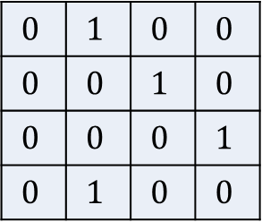
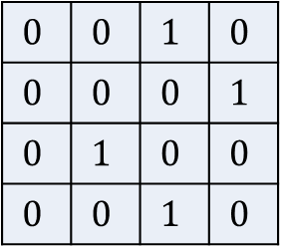
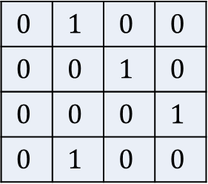
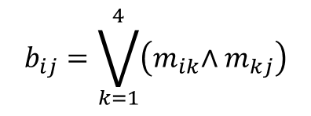
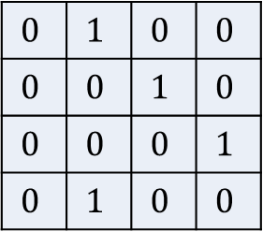



Matrix "Multiplication" – for Relations
R
R²
b
a
b
$$b_{ij}=\bigvee_{k=1}^{4}{\left({m_{ik}\text{∧ }m}_{kj}\right)}$$
a
d
c
d
c
$$0$$ | $$1$$ | $$0$$ | $$0$$
$$0$$ | $$0$$ | $$1$$ | $$0$$
$$0$$ | $$0$$ | $$0$$ | $$1$$
$$0$$ | $$1$$ | $$0$$ | $$0$$
$$0$$ | $$1$$ | $$0$$ | $$0$$
$$0$$ | $$0$$ | $$1$$ | $$0$$
$$0$$ | $$0$$ | $$0$$ | $$1$$
$$0$$ | $$1$$ | $$0$$ | $$0$$
$$0$$ | $$1$$ | $$0$$ | $$0$$
$$0$$ | $$0$$ | $$1$$ | $$0$$
$$0$$ | $$0$$ | $$0$$ | $$1$$
$$0$$ | $$1$$ | $$0$$ | $$0$$
$$0$$ | $$0$$ | $$1$$ | $$0$$
$$0$$ | $$0$$ | $$0$$ | $$1$$
$$0$$ | $$1$$ | $$0$$ | $$0$$
$$0$$ | $$0$$ | $$1$$ | $$0$$
$$M_{R}=$$
$$M_{R}^{[2]}=$$
$$×$$
$$=$$

Slide 62
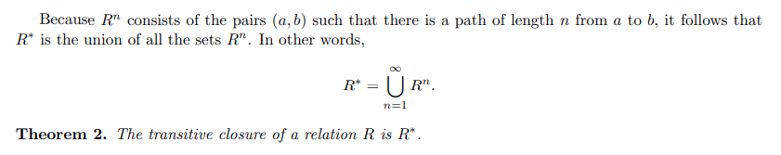

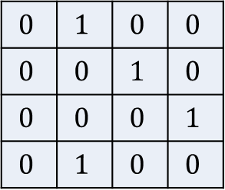

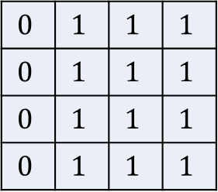
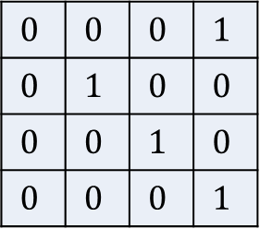

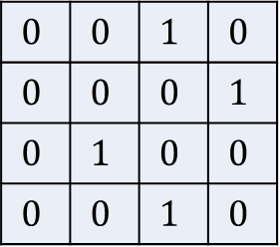

Computing Transitive Closure
$$R^{t}$$
a
b
$$0$$ | $$1$$ | $$0$$ | $$0$$
$$0$$ | $$0$$ | $$1$$ | $$0$$
$$0$$ | $$0$$ | $$0$$ | $$1$$
$$0$$ | $$1$$ | $$0$$ | $$0$$
$$0$$ | $$0$$ | $$1$$ | $$0$$
$$0$$ | $$0$$ | $$0$$ | $$1$$
$$0$$ | $$1$$ | $$0$$ | $$0$$
$$0$$ | $$0$$ | $$1$$ | $$0$$
$$0$$ | $$0$$ | $$0$$ | $$1$$
$$0$$ | $$1$$ | $$0$$ | $$0$$
$$0$$ | $$0$$ | $$1$$ | $$0$$
$$0$$ | $$0$$ | $$0$$ | $$1$$
$$0$$ | $$1$$ | $$1$$ | $$1$$
$$0$$ | $$1$$ | $$1$$ | $$1$$
$$0$$ | $$1$$ | $$1$$ | $$1$$
$$0$$ | $$1$$ | $$1$$ | $$1$$
c
d
$$∪$$
$$∪$$
$$=$$
Time complexity: $(n−1)$ times multiply, spend $n^{3}$ every time.

Slide 63
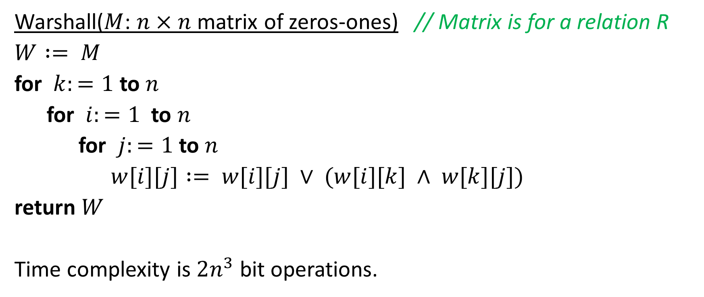
More Efficient: Warshall Algorithm
Warshall($M$: $n×n$ matrix of zeros-ones) // Matrix is for a relation R
$W := M$
for $k:=1$ to $n$
for $i:=1$ to $n$
for $j:=1$ to $n$
$w[i][j] := w[i][j] ∨ (w[i][k] ∧ w[k][j])$
return $W$
Time complexity is $2n^{3}$ bit operations.

Slide 64
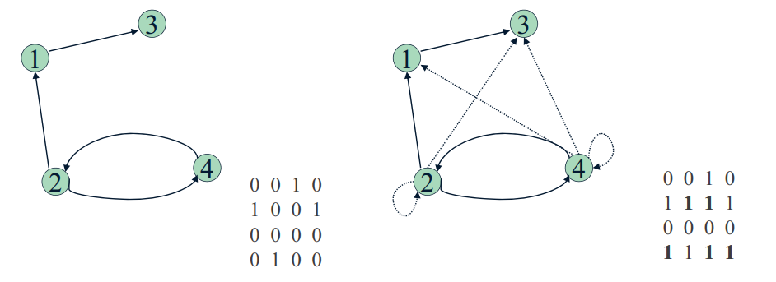
Example of Warshall's Algorithm
Relation to the left is given by a matrix. Find its transitive closure.

Slide 65
How it is supposed to work
Main idea: A path exists between two vertices i, j, iff
there is an edge from i to j; or
there is a path from i to j going through vertex 1; or
there is a path from i to j going through vertex 1 and/or 2; or
there is a path from i to j going through vertex 1, 2, and/or 3; or
... and so on…

Slide 66
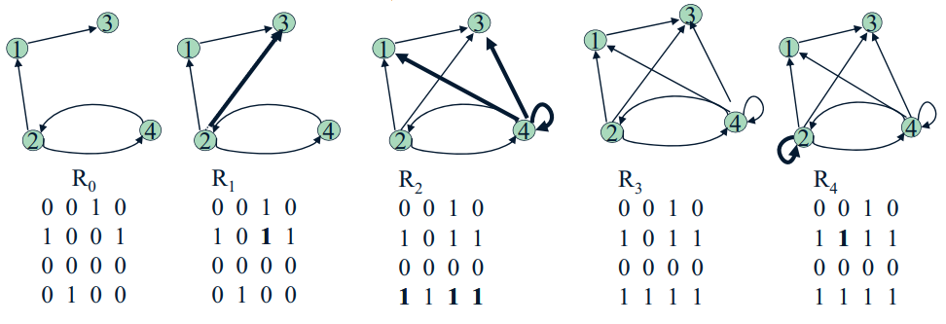
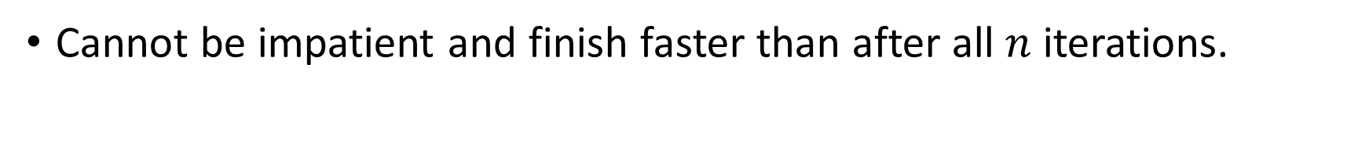
Warshall Algorithm on a Real Graph
Cannot be impatient and finish faster than after all $n$ iterations.

