Slide 1
Maps, Dictionaries, Hashing
Notes:
Why storing maps and dictionaries differs from array and list structures?
Searching by a key (where keys do not follow each other directly)
Set is a particular case of a map (no info field is stored, just the key)

Slide 2
Objectives
Define Maps, Sets and Dictionaries as ADTs
Consider some implementations that do not use hashing
Introduce basics of hashing
Compare several familes of hash functions
Resolve collisions – separate chaining, open addressing
Perfect Hash Functions
Rehashing and Dynamic Rehashing for Extendible Files

Slide 3
Maps
A map models a searchable collection of key-value entries
The main operations of a map are for searching, inserting, and deleting items
Multiple entries with the same key are not allowed
Applications:
address book
student-record database

Slide 4
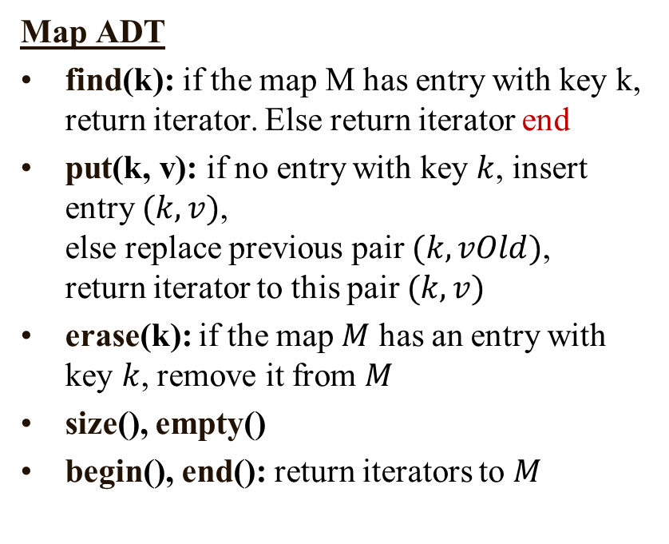
Entry and Map ADT
Entry ADT
An entry stores a key-value pair (k,v)
Methods:
key(): return the associated key
value(): return the associated value
setKey(k): set the key to k
setValue(v): set the value to v
Map ADT
find(k): if the map M has entry with key k, return iterator. Else return iterator end
put(k, v): if no entry with key $k$, insert entry $(k, v)$, else replace previous pair $(k, vOld)$, return iterator to this pair $(k,v)$
erase(k): if the map $M$ has an entry with key $k$, remove it from $M$
size(), empty()
begin(), end(): return iterators to $M$
Notes:
find(k): if the map M has an entry with key k, return its associated value; else, return null
put(k, v): insert entry (k, v) into the map M; if key k is not already in M, then return null; else, return old value associated with k
erase(k): if the map M has an entry with key k, remove it from M and return its associated value; else, return null
size(), empty()
entrySet(): return a list of the entries in M
keySet(): return a list of the keys in M
values(): return a list of the values in M

Slide 5
Map ADT Example
Operation Output Map
empty() true Ø
put(5,A) [(5,A)] (5,A)
put(7,B) [(7,B)] (5,A),(7,B)
put(2,C) [(2,C)] (5,A),(7,B),(2,C)
put(8,D) [(8,D)] (5,A),(7,B),(2,C),(8,D)
put(2,E) [(2,E)] (5,A),(7,B),(2,E),(8,D)
find(7) [(7,B)] (5,A),(7,B),(2,E),(8,D)
find(4) end (5,A),(7,B),(2,E),(8,D)
find(2) [(2,E)] (5,A),(7,B),(2,E),(8,D)
size() 4 (5,A),(7,B),(2,E),(8,D)
erase(5) — (7,B),(2,E),(8,D)
erase(2) — (7,B),(8,D)
find(2) end (7,B),(8,D)
empty() false (7,B),(8,D)

Slide 6
Set ADT
find(k): if the map M has an entry with key k: return and iterator to it; else: return special iterator end
put(k, v): if there is no entry with key k, insert entry (k, v), else replace previous pair (k, vOld) with (k,v) return iterator to this pair (k,v)
erase(k): if the map M has an entry with key k, remove it from M
size(), empty()
begin(), end(): return iterators to beginning and end of M

Slide 7
Dictionary
The dictionary ADT models a searchable collection of key-element entries
The main operations of a dictionary are searching, inserting, and deleting items
Multiple items with the same key are allowed
Applications:
word-definition pairs
credit card authorizations
DNS mapping of host names (e.g., datastructures.net) to internet IP addresses (e.g., 128.148.34.101)

Slide 8
Dictionary ADT
find(k): if there is an entry with key k, return an iterator to it, else return the special iterator end
findAll(k): return iterators b and e such that all entries with key k are in the iterator range [b, e) starting at b and ending just prior to e
put(k, o): inserts and returns an iterator to it
erase(k): remove an entry with key k
begin(), end(): return iterators to the beginning and end of the dictionary
size(), empty()

Slide 9
Dictionary Example
Operation Output Dictionary
put(5,A) (5,A) (5,A)
put(7,B) (7,B) (5,A),(7,B)
put(2,C) (2,C) (5,A),(7,B),(2,C)
put(8,D) (8,D) (5,A),(7,B),(2,C),(8,D)
put(2,E) (2,E) (5,A),(7,B),(2,C),(8,D),(2,E)
find(7) (7,B) (5,A),(7,B),(2,C),(8,D),(2,E)
find(4) end (5,A),(7,B),(2,C),(8,D),(2,E)
find(2) (2,C) (5,A),(7,B),(2,C),(8,D),(2,E)
findAll(2) {(2,C),(2,E)} (5,A),(7,B),(2,C),(8,D),(2,E)
size() 5 (5,A),(7,B),(2,C),(8,D),(2,E)
erase(5) — (7,B),(2,C),(8,D),(2,E)
find(5) end (7,B),(2,C),(8,D),(2,E)

Slide 10
Unsorted List as a Map
We can efficiently implement a map using an unsorted list
We store the items of the map in a list S (based on a doubly-linked list), in arbitrary order
header
nodes/positions
trailer
9
c
6
c
5
c
8
c
entries

Slide 11
The find Algorithm
Algorithm find(k):
for each p in [S.begin(), S.end()) do
if p→key() = k then
return p
return S.end() {there is no entry with key equal to k}
We use p→key() as a shortcut for (*p).key()

Slide 12
The put Algorithm
Algorithm put(k,v):
for each p in [S.begin(), S.end()) do
if p→key() = k then
p→setValue(v)
return p
p = S.insertBack((k,v)) {there is no entry with key k}
n = n + 1 {increment number of entries}
return p

Slide 13
The erase Algorithm
Algorithm erase(k):
for each p in [S.begin(), S.end()) do
if p.key() = k then
S.erase(p)
n = n – 1 {decrement number of entries}

Slide 14
Performance of a List-Based Map
Performance:
put takes O(n) time since we need to determine whether it is already in the sequence
find and erase take O(n) time since in the worst case (the item is not found) we traverse the entire sequence to look for an item with the given key
The unsorted list implementation is effective only for maps of small size or for maps in which puts are the most common operations, while searches and removals are rarely performed (e.g., historical record of logins to a workstation)

Slide 15
A List-Based Dictionary
A log file or audit trail is a dictionary implemented by means of an unsorted sequence
We store the items of the dictionary in a sequence (based on a doubly-linked list or array), in arbitrary order
Performance:
put takes O(1) time since we can insert the new item at the beginning or at the end of the sequence
find and erase take O(n) time since in the worst case (the item is not found) we traverse the entire sequence to look for an item with the given key
The log file is effective only for dictionaries of small size or for dictionaries on which insertions are the most common operations, while searches and removals are rarely performed (e.g., historical record of logins to a workstation)

Slide 16
The find, put, erase Algorithms
Algorithm find(k)
for each p in [S.begin(), S.end()) do
if p.key() = k then
return p
Algorithm put(k, v)
Create a new entry e = (k, v)
p = S.insertBack(e) {S is unordered}
return p
Algorithm erase(k):
for each p in [S.begin(), S.end()) do
if p.key() = k then
S.erase(p)

Slide 17
Sorted Array or Sorted List Implementation
A search table is a dictionary implemented by means of a sorted array
We store the items of the dictionary in an array-based sequence, sorted by key
We use an external comparator for the keys
Performance:
find takes O(log n) time, using binary search
put takes O(n) time since in the worst case we have to shift n/2 items to make room for the new item
erase takes O(n) time since in the worst case we have to shift n/2 items to compact the items after the removal
A search table is effective only for dictionaries of small size or for dictionaries on which searches are the most common operations, while insertions and removals are rarely performed (e.g., credit card authorizations)

Slide 18
Binary Search
Binary search performs operation find(k) on a dictionary implemented by means of an array-based sequence, sorted by key
similar to the high-low game
at each step, the number of candidate items is halved
terminates after a logarithmic number of steps
Example: find(7)
0
1
3
4
5
7
8
9
11
14
16
18
19
l
m
h
0
1
3
4
5
7
8
9
11
14
16
18
19
l
m
h
0
1
3
4
5
7
8
9
11
14
16
18
19
l
m
h
0
1
3
4
5
7
8
9
11
14
16
18
19
l=m =h

Slide 19
SortedMap, SortedSet Implementations
An important subcase for Maps and Sets are SortedSets and SortedMaps – iterator can return entries in a sorted order.
Typically implemented as Binary Search Trees or k-ary Search Trees.

Slide 20
What is Hashing?
Hash tables reduce the search time from O(n) or O(log n) to 1 or at least O(1)
No matter how many elements there are, the run time is the same
In real applications it might be more complicated (time/space tradeoff)
The task is to develop a function, h, that can transform a key, K, into an index for a table used to store items of the same type as K
The function h is called a hash function

Slide 21
Typically Hash Functions are not Perfect
If h is able to transform different key values into different hash values, it is called a perfect hash function
For the hash function to be perfect, the table must have as many positions as there are items to be hashed
Consider a symbol table for a compiler, to store all the variable names
Given the nature of the variable names typically used, a table with 1000 positions may be more than adequate
However, even if we wanted to handle all possible variable names, we still need to design an appropriate h

Slide 22
Collisions
For example, we could define h to be the sum of the ASCII values of the letters in the variable name
If we restrict variables to 31 letters, we will need 3782 positions, since a variable with of 31 characters all “z” would sum to 31 ∙ 122 (the ASCII code for “z”) = 3782
Even then, the function will not produce unique values, for h(“abc”) = 97 + 98 + 99 = 294, and h(“acb”) = 97 + 99 + 98 = 294
This is called a collision, and is a measure of the usefulness of a hash function
Avoiding collisions can be achieved by making h more complex, but complexity and speed must be balanced

Slide 23
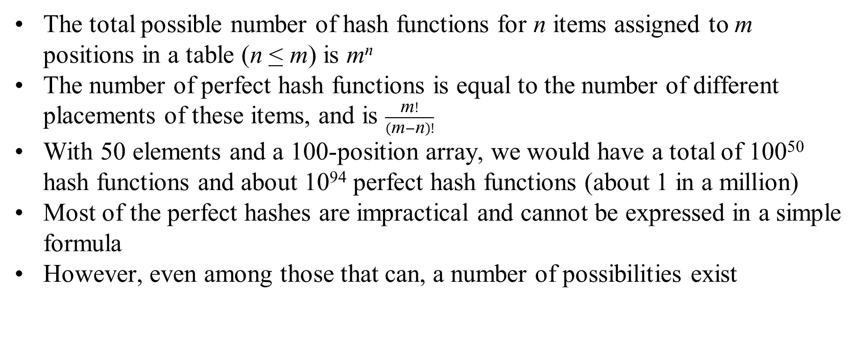
Hash Functions
The total possible number of hash functions for n items assigned to m positions in a table (n < m) is m^{n}
The number of perfect hash functions is equal to the number of different placements of these items, and is $\frac{\text{m}!}{\left(\text{m}−\text{n}\right)!}$
With 50 elements and a 100-position array, we would have a total of 100⁵⁰ hash functions and about 10⁹⁴ perfect hash functions (about 1 in a million)
Most of the perfect hashes are impractical and cannot be expressed in a simple formula
However, even among those that can, a number of possibilities exist

Slide 24
Hash Functions and Hash Tables
A hash function h maps keys of a given type to integers in a fixed interval [0, N - 1]
Example: h(x) = x mod N is a hash function for integer keys
The integer h(x) is called the hash value of key x
A hash table for a given key type consists of
Hash function h
Array (called table) of size N
When implementing a map with a hash table, the goal is to store item (k, o) at index i = h(k)

Slide 25
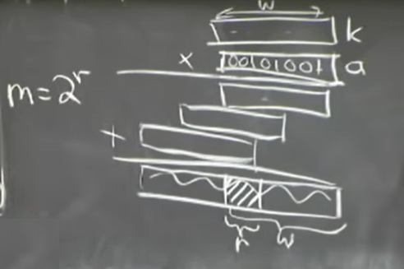
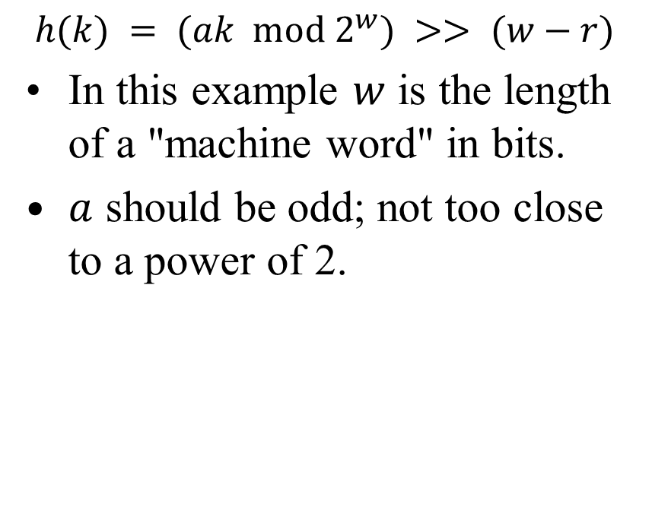
Hash Functions: Multiplication Method
$$h(k) = (ak mod 2^{w}) >> (w−r)$$
In this example $w$ is the length of a "machine word" in bits.
$a$ should be odd; not too close to a power of 2.

Slide 26
Example
We design a hash table for a map storing entries as (SSN, Name), where SSN (social security number) is a nine-digit positive integer
Our hash table uses an array of size N = 10,000 and the hash function h(x) = last four digits of x
0
∅
1
025-612-0001
2
981-101-0002
3
∅
4
451-229-0004
…
9997
∅
9998
200-751-9998
9999
∅

Slide 27
Hash Functions
A hash function is usually specified as the composition of two functions:
Hash code: h₁: keys → integers
Compression function: h₂: integers → [0, N − 1]
The hash code is applied first, and the compression function is applied next on the result, i.e., h(x) = h₂(h₁(x))
The goal of the hash function is to “disperse” the keys in an apparently random way

Slide 28
Hash Codes
Memory address:
We reinterpret the memory address of the key object as an integer
Good in general, except for numeric and string keys
Integer cast:
We reinterpret the bits of the key as an integer
Suitable for keys of length less than or equal to the number of bits of the integer type (e.g., byte, short, int and float in C++)
Component sum:
We partition the bits of the key into components of fixed length (e.g., 16 or 32 bits) and we sum the components (ignoring overflows)
Suitable for numeric keys of fixed length greater than or equal to the number of bits of the integer type (e.g., long and double in C++)

Slide 29
Hash Codes (cont.)
Polynomial accumulation:
We partition the bits of the key into a sequence of components of fixed length (e.g., 8, 16 or 32 bits) a₀ a₁ … a_{n−1}
We evaluate the polynomial
p(z) = a₀ + a₁ z + a₂ z² + … … + a_{n−1}z^{n−1}
at a fixed value z, ignoring overflows
Especially suitable for strings (e.g., the choice z = 33 gives at most 6 collisions on a set of 50,000 English words)
Polynomial p(z) can be evaluated in O(n) time using Horner’s rule:
The following polynomials are successively computed, each from the previous one in O(1) time
p₀(z) = a_{n−1}
p_{i} (z) = a_{n−i−1} + zp_{i−1}(z) (i = 1, 2, …, n −1)
We have p(z) = p_{n−1}(z)

Slide 30
Compression Functions
Division:
h₂ (y) = y mod N
The size N of the hash table is usually chosen to be a prime
The reason has to do with number theory and is beyond the scope of this course
Multiply, Add and Divide (MAD):
h₂ (y) = (ay + b) mod N
a and b are nonnegative integers such that a mod N ≠ 0
Otherwise, every integer would map to the same value b

Slide 31
Hash Tables for Dictionary ADTs
We can also create a hash-table dictionary implementation.
If we use separate chaining to handle collisions, then each operation can be delegated to a list-based dictionary stored at each hash table cell.

Slide 32
Mod-Division in Hash Functions
Hash functions must guarantee that the value they produce is a valid index to the table
A fairly easy way to ensure this is to use modular division, and divide the keys by the size of the table, so h(K) = K mod TSize where TSize = sizeof(table)
This works best if the table size is a prime number, but if not, we can use h(K) = (K mod p) mod TSize for a prime p > TSize
However, nonprimes work well for the divisor provided they do not have any prime factors less than 20
The division method is frequently used when little is known about the keys

Slide 33
Folding in Hash Functions – 1
In folding, the keys are divided into parts which are then combined (or “folded”) together and often transformed into the address
Two types of folding are used, shift folding and boundary folding
In shift folding, the parts are placed underneath each other and then processed (for example, by adding)
Using a Social Security number, say 123-45-6789, we can divide it into three parts - 123, 456, and 789 – and add them to get 1368
This can then be divided modulo TSize to get the address
With boundary folding, the key is visualized as being written on a piece of paper and folded on the boundaries between the parts

Slide 34
Folding in Hash Functions – 2
The result is that alternating parts of the key are reversed, so the Social Security number part would be 123, 654, 789, totaling 1566
As can be seen, in both versions, the key is divided into even length parts of some fixed size, plus any leftover digits
Then these are added together and the result is divided modulo the table size
Consequently this is very fast and efficient, especially if bit strings are used instead of numbers
With character strings, one approach is to exclusively-or the individual character together and use the result
In this way, h(“abcd”) = “a” ⋁ “b” ⋁ “c” ⋁ “d”

Slide 35
Folding in Hash Functions – 3
However, this is limited, because it will only generate values between 0 and 127
A better approach is to use chunks of characters, where each chunk has as many characters as bytes in an integer
On the IBM PC, integers are often 2 bytes long, so h(“abcd”) = “ab” ⋁ “cd”, which would then be divided modulo TSize

Slide 36
Mid-Square Approach
In the mid-square approach, the numeric value of the key is squared and the middle part is extracted to serve as the address
If the key is non-numeric, some type of preprocessing needs to be done to create a numeric value, such as folding
Since the entire key participates in generating the address, there is a better chance of generating different addresses for different keys
So if the key is 3121, 3121² = 9,740,641, and if the table has 1000 locations, h(3121) = 406, which is the middle part of 3121²
In application, powers of two are more efficient for the table size and the middle of the bit string of the square of the key is used
Assuming a table size of 1024, 3121² is represented by the bit string 1001010 0101000010 1100001, and the key, 322, is in italics

Slide 37
Extraction Approach
In the extraction approach, the address is derived by using a portion of the key
Using the SSN 123-45-6789, we could use the first four digits, 1234, the last four 6789, or the first two combined with the last two 1289
Other combinations are also possible, but each time only a portion of the key is used
With careful choice of digits, this may be sufficient for address generation
For example, some universities give international students ID numbers beginning with 999; ISBNs start with digits representing the publisher
So these could be excluded from the address generation if the nature of the data is appropriately limited

Slide 38
Radix Transformation Approach
With radix transformation, the key is transformed into a different base
For instance, if K is 345 in decimal, its value in base 9 is 423
This result is then divided modulo TSize, and the resulting value becomes the address top which K is hashed
The drawback to this approach is collisions cannot be avoided
For example, if TSize is 100, then although 345 and 245 in decimal will not collide, 345 and 264 will because 264 is 323 in base nine
Since 345 is 423, these two values will collide when divided modulo 100

Slide 39
Universal Hash Functions – 1
When little is known about the keys, a universal class of hash functions can be used
Functions are universal when a randomly chosen member of the class will be expected to distribute a sample evenly, guaranteeing low collisions
This idea was first considered by Larry Carter and Mark Wegman in 1979
We define H as a class of functions from a set of keys to a hash table of size TSize
H is called universal if no distinct pair of keys are mapped to the same position in the table by a function chosen at random from h with a probability of 1 / TSize
This basically means there is one chance in TSize that two randomly chosen keys collide when hashed with a randomly chosen function

Slide 40
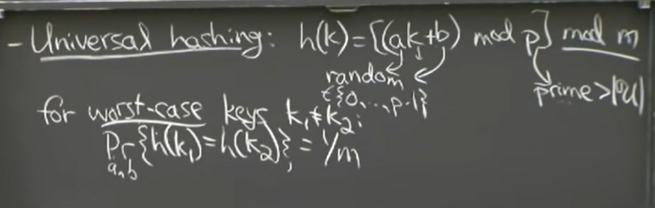
Universal Hash Funnctions – 2
If you pick worst-case keys (and then pick a,b,p randomly) – it has nice properties.

Slide 41
Universal Hash Functions – 3
Universal Hash Functions (continued)
One example of such a class of functions is defined for a prime number p > |keys| and random numbers a and b
H = {h_{a,b}(K): h_{a,b}(K) = ((aK+b) mod p) mod TSize and 0 ≤ a, b < p}
Another class of functions is for keys considered as sequences of bytes, K = K₀K₁ … K_{r-1}
For a prime p > 2⁸ = 256 and a sequence a = a₀ , a₁ , …, a_{r-1} ,

Slide 42
Cryptographic Hash Functions
Maps data of an arbitrary size to a bit array of a fixed size (the "hash value" or "message digest").
It is a one-way function: it is practically infeasible to invert the computation.
Relatively fast to compute (but slower than non-cryptographic hash functions)
Cannot reverse hash computation (except by exhaustive list of values)
Cannot get a collision in practice (in theory collisions are unavoidable)
A small change to a message typically changes about 1/2 of the bits
SHA-2 family of hash functions (SHA-256, SHA-384, SHA-512).
Authenticate Debian Linux packages, DKIM email authentication (anti-spoofing mechanism), blockchains used in cryptocurrency transactions.
All of this is not in the scope of our course.

