Slide 1
Collision Handling
Perfect Hash Functions
Separate Chaining
Linear Probing
Double Hashing

Slide 2
Naive Algorithm
NaiveStringMatcher(T, P)
1. n=T.length
2. m=P.length
3. for i=0 to n−m
4. if (P[0],…,P[m−1])==(T[i],…,T[i+m−1]])
5. print "Found pattern, offset = {i}"
Worst-case input? Worst-case running time?

Slide 3
Faster String Search by Hashing
Text T, pattern P are just (huge) inegers.
Assume that their letters are used as "digits"
If your alphabet is S={0,1,2,…,9}, then they can be interpreted as regular digits.
Otherwise, just use a different base of the number notation.
Example: Consider string "pt". The ASCII values of "p" and "t" are x70 and x74 (or 112 and 116 in decimal).
If ASCII has 128 symbols, compute "pt" for base "128": 112⋅128+116=14452.

Slide 4
Rolling Hash ADT
"r" – data structure that maintains a string (and also rolling hash computations)
r.append(c) – add one more character to the end of the rolling hash
r.skip(c) – delete the first character.
r() – get the current has value.

Slide 5
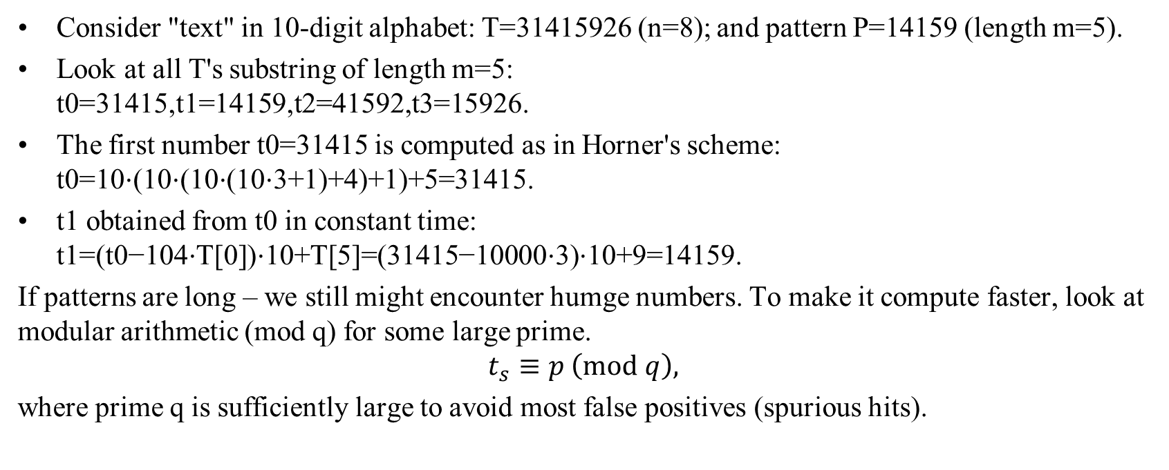
Concrete rolling hashes
Consider "text" in 10-digit alphabet: T=31415926 (n=8); and pattern P=14159 (length m=5).
Look at all T's substring of length m=5: t0=31415,t1=14159,t2=41592,t3=15926.
The first number t0=31415 is computed as in Horner's scheme: t0=10⋅(10⋅(10⋅(10⋅3+1)+4)+1)+5=31415.
t1 obtained from t0 in constant time: t1=(t0−104⋅T[0])⋅10+T[5]=(31415−10000⋅3)⋅10+9=14159.
If patterns are long – we still might encounter humge numbers. To make it compute faster, look at modular arithmetic (mod q) for some large prime.
$$t_{s}≡p \left(mod q\right),$$
where prime q is sufficiently large to avoid most false positives (spurious hits).

Slide 6

Rabin-Karp Pseudocode
RabinKarpMatcher(T, P,d,q)
1. n=T.length
2. m=P.length
3. $h=d^{m−1} mod q$
4. p=0
5. t0=0
6. for i=0 to m−1 // add using Horner's scheme
7. p=(d⋅p+P[i]) mod q
8. t0=(d⋅t0+T[i]) mod q
9. for s=0 to n−m
10 if $p$==$t_{s}$
11 if (P[0],…,P[m−1])==(T[s],…,T[s+m−1])
12 print "Pattern occurs with a shift" s
13. if $s<n−m$
14 ts+1=(d(ts−T[s]⋅h)+T[s+m])modq

Slide 7
Collision Resolution – Overview
Multiple keys can hash to the same location in the table
Example: Consider a function that places names in a table based on hashing the ASCII code of the first letter of the name. All names beginning with the same letter would hash to the same position
If the hash value depends on the first two letters, fewer collisions, but problems don't go away.
If the computation depends on all the letters in the name, there is still a possibility of collisions (if the table only has limited # of positions)
In addition to using more efficient functions, we also need to consider the size of the table being hashed into.

Slide 8
Perfect Hash Functions
Typically a hash function is developed first and then the data is processed into the table
In a number of cases, though, the data is known in advance, and the hash function can be derived after the fact
This function may turn out to be a perfect hash if items hash on the first try
Additionally, if the function uses only as many cells as are available in the table with no empty cells left after the hash, it is called a minimal perfect hash function
Minimal perfect hash functions avoid the need for collision resolution and also avoid wasting table space
Notes:
Processing fixed bodies of data occurs frequently in a variety of applications
Dictionaries and tables of reserved words in compilers are among several examples
Creating perfect hash functions requires a great deal of work
Such functions are rare; as we saw earlier, for 50 elements in a 100-position array, only 1 function in a million is perfect
All the other functions will lead to collisions

Slide 9
Open Addressing in General
In open addressing, collisions are resolved by finding an available table position other than the one to which the key hashed
If the position h(K) is already occupied, positions are tried in the probing sequence norm(h(K) + p(1)), norm(h(K) + p(2)), . . . , norm(h(K) + p(i)), . . . until an open location is found, the same positions are tried again, or the table is full
The function p is called a probing function, i is the probe, and norm is a normalization function, often division modulo the table size
The simplest realization of this is linear probing, where the search proceeds sequentially from the point of the collision
If the end of the table is reached before finding an empty cell, it continued from the beginning of the table
If it reaches the cell before the one causing the collision, it then stops

Slide 10
Linear Probing
Open addressing: Opposed to "separate chaining" – the colliding item is placed in a different cell of the table
Linear probing: handles collisions by placing the colliding item in the next (circularly) available table cell
Each table cell inspected is referred to as a “probe”
Colliding items lump together, causing future collisions to cause a longer sequence of probes
Example:
h(x) = x mod 13
Insert keys 18, 41, 22, 44, 59, 32, 31, 73, in this order
0
1
2
3
4
5
6
7
8
9
10
11
12
41
18
44
59
32
22
31
73
0
1
2
3
4
5
6
7
8
9
10
11
12

Slide 11
Search with Linear Probing
Algorithm find(k)
i ← h(k)
p ← 0
repeat
c ← A[i]
if c = ∅
return null
else if c.key () = k
return c.value()
else
i ← (i + 1) mod N
p ← p + 1
until p = N
return null
Consider a hash table A that uses linear probing
find(k)
We start at cell h(k)
We probe consecutive locations until one of the following occurs
An item with key k is found, or
An empty cell is found, or
N cells have been unsuccessfully probed

Slide 12
Updates with Linear Probing
To handle insertions and deletions, we introduce a special object, called AVAILABLE, which replaces deleted elements
erase(k)
We search for an entry with key k
If such an entry (k, o) is found, we replace it with the special item AVAILABLE and we return element o
Else, we return null
put(k, o)
We throw an exception if the table is full
We start at cell h(k)
We probe consecutive cells until one of the following occurs
A cell i is found that is either empty or stores AVAILABLE, or
N cells have been unsuccessfully probed
We store (k, o) in cell i

Slide 13
Deletion for Linear Probing
How can data be removed from a hash table?
If chaining is used, the deletion of an element entails deleting the node from the linked list holding the element
For the other techniques we’ve considered, deletion usually involves more careful handling of collision issues, unless a perfect hash function is used

Slide 14
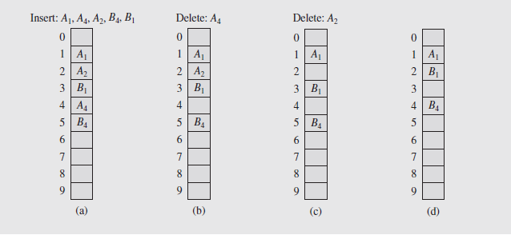
Deletion (continued)
A solution to this is to leave the deleted keys in the table with some type of indicator that the keys are not valid
This way, searches for elements won’t terminate prematurely
When new keys are inserted, they can overwrite the marked keys
The drawback to this is that of the table has far more deletions than insertions
It will become overloaded with deleted records, slowing down search times

Slide 15
Quadratic Probing – 1
As can be seen from the figure, empty cells immediately following clusters tend to be filled more quickly than other locations
So if a cluster is created, it tends to grow, and as it grows, it increases the likelihood of growing even larger
This behavior significantly reduces the efficiency of the hash table for processing data
So to avoid cluster creation and buildup, a better choice of the probing function, p, needs to be found
One possibility is to use a quadratic function producing the formula
p(i) = h(K) + (–1)^{i–1}((i + 1)/2)² for i = 1, 2, . . . , TSize – 1
Expressed as a sequence of probes, this is
h(K) + i², h(K) – i² for i = 1, 2, . . . , (TSize – 1)/2
Notes:
Notice that though we obtain better results with this approach, we don’t avoid clustering entirely
This is because the same probe sequence is used for any collision, creating secondary clusters

Slide 16
Quadratic Probing – 2
Starting with the first hash, this produces the sequence
h(K), h(K) + 1, h(K) – 1, h(K) + 4, h(K) – 4, . . . , h(K) + (TSize – 1)²/4,
h(K) – (TSize – 1)²/4
Each of these values is divided modulo TSize
Because the value of h(K) tries only the even or odd positions in the table, the size of the table should not be an even number
The ideal value for the table size is a prime of the form 4j + 3, which j is an integer
This will guarantee that all the table locations will be checked in the probing process

Slide 17
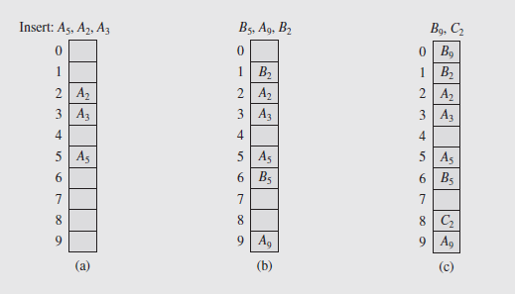
Quadratic Probing – 3

Slide 18
Double Hashing
Double hashing uses a secondary hash function d(k) and handles collisions by placing an item in the first available cell of the series (i + jd(k)) mod N for j = 0, 1, … , N − 1
The secondary hash function d(k) cannot have zero values
The table size N must be a prime to allow probing of all the cells
Common choice of compression function for the secondary hash function:
d₂(k) = q − k mod q
where
q < N
q is a prime
The possible values for d₂(k) are 1, 2, … , q

Slide 19
Example of Double Hashing
Consider a hash table storing integer keys that handles collision with double hashing
N = 13
h(k) = k mod 13
d(k) = 7 − k mod 7
Insert keys 18, 41, 22, 44, 59, 32, 31, 73, in this order
0
1
2
3
4
5
6
7
8
9
10
11
12
31
41
18
32
59
73
22
44
0
1
2
3
4
5
6
7
8
9
10
11
12

Slide 20
Collision Resolution (continued)
The best approach to secondary clustering is through the technique of double hashing
This utilizes two hashing functions, one for the primary hash and the other to resolve collisions
In this way the probing sequence becomes h(K), h(K) + h_{p}(K), . . . , h(K) + i · h_{p}(K), . . .
Here, h is the primary hashing function and h_{p} is the secondary hash
The table size should be a prime number so every location is included in the sequence, since the values above are divided modulo TSize
Empirical evidence shows that this approach works well to eliminate secondary clustering, since the probe sequence is based on h_{p}

Slide 21
Collision Resolution (continued)
This is because the probing sequence for key K₁ hashed to location j is j, j + h_{p}(K₁), j + 2 · h_{p}(K₁), . . .
And if another key hashes to j + h_{p}(K₁), the next location to be checked is j + h_{p}(K₁) + h_{p}(K₂), not j + 2 · h_{p}(K₁)
This avoids secondary clustering, as long as h_{p} is well chosen
So even if two keys hash to the same position initially, the probing sequences can be different for each key
The use of two different hash functions can be time-consuming, so it is possible to define the second hash in terms of the first
For example, the function could be h_{p}(K) = i · h(K) + 1; for key K₁ the probe sequence is j, 2j + 1, 5j + 2, . . . ; if K₂ hashes to 2j + 1, the sequence is 2j + 1, 4j + 3, 10j + 11, . . .

Slide 22
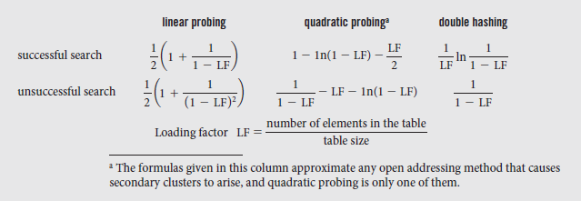
Efficiency of Probing
The efficiency of these techniques depends on the size of the table and number of elements in the table
There are formulas, developed by Donald Knuth, that approximate the number of times for successful and unsuccessful searches:

Slide 23
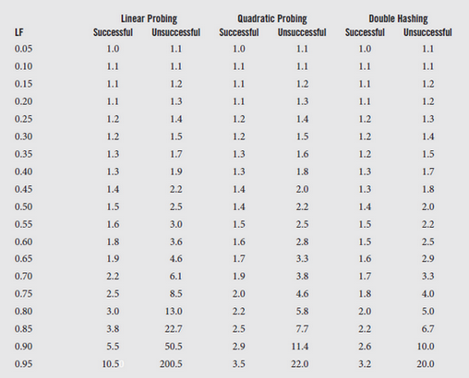
Successful, Unsuccessful Searches

Slide 24
Performance of Hashing
In the worst case, searches, insertions and removals on a hash table take O(n) time
The worst case occurs when all the keys inserted into the map collide
The load factor α = n/N affects the performance of a hash table
Assuming that the hash values are like random numbers, it can be shown that the expected number of probes for an insertion with open addressing is 1 / (1 − α)
The expected running time of all the dictionary ADT operations in a hash table is O(1)
In practice, hashing is very fast provided the load factor is not close to 100%
Applications of hash tables:
small databases
compilers
browser caches

Slide 25
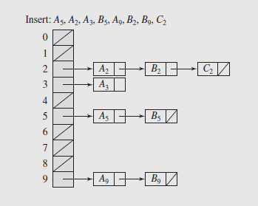
Chaining: Introduction
In chaining, the keys are not stored in the table, but in the info portion of a linked list of nodes associated with each table position
This is called separate chaining, and the table is called a scatter table
This is very fast for short lists, but as they increase in size, performance can degrade sharply
Gains in performance can be made if the lists are ordered so unsuccessful searches don’t traverse the entire list, or by using self-organizing linked lists
This approach requires additional space for the pointers, so if there are a large number of keys involved, space requirements can be high

Slide 26
Collision Handling
Separate Chaining: Let each cell in the table point to a linked list of entries that map there.
Separate chaining is simple, but requires additional memory outside the table
An example with phone numbers:
0
∅
1
025-612-0001
2
∅
3
∅
4
451-229-0004
981-101-0004

Slide 27
Map with Separate Chaining
Delegate operations to a list-based map at each cell:
Algorithm find(k):
return A[h(k)].find(k)
Algorithm put(k,v):
t = A[h(k)].put(k,v)
if t = null then {k is a new key}
n = n + 1
return t
Algorithm erase(k):
t = A[h(k)].erase(k)
if t ≠ null then {k was found}
n = n - 1
return t

Slide 28
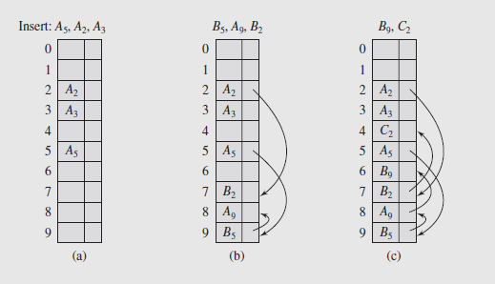
Coalesced Chaining
Coalesced chaining combines chaining and linear probing
The first available position is found for the colliding key, and its index is stored with the stored key
The next element in the list can be accessed without sequential search.
Each position in the table is an object that consists of two elements, info for the key and next which is the index of the key that collided with this position
Figure shows an example of coalesced hashing where a key ends up in the last position in the table

Slide 29
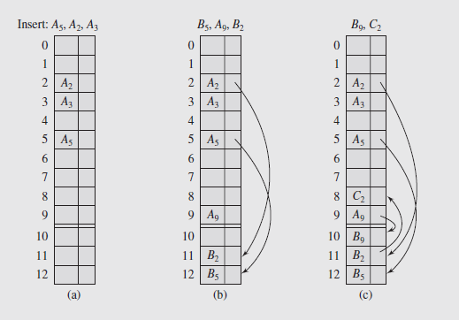
Collision Resolution (continued)
For keys for which there is no room in the table, an overflow area known as the cellar can be dynamically located in the arrays
Keys that hash without colliding are stored in their home locations, as can be seen in (a)
Keys that collide are put in the last available position in the cellar and linked back to their home position as in (b)
If the cellar is filled, available cells are used in the table, as seen in (c)

Slide 30
Cuckoo hashing – 1
Two tables, T₁ and T₂, and two hash tables, h₁ and h₂, are used in the cuckoo hash
Inserting a key K₁ into table T₁ uses hash function h₁, and if T₁[h₁(K₁)] is open, the key is inserted there
If the location is occupied by a key, say K₂, this key is removed to allow K₁ to be placed, and K₂ is placed in the second table at T₂[h₂(K₂)]
If this location is occupied by key K₃, it is moved to make room for K₂, and an attempt is made to place K₃ at T₁[h₁(K₃)]
So the key that is being placed in or moved to the table has priority over a key that is already there
There is a possibility that a sequence like this could lead to an infinite loop if it ends up back at the first position that was tried
Notes:
One method in particular for which rehashing is important is cuckoo hashing, first described by Rasmus Pagh and Flemming Rodler in 2001

Slide 31
Cuckoo hashing – 2
It is also possible the search will fail because both tables are full
To circumvent this, a limit is set on tries which if exceeded causes rehashing to take place with two new, larger tables and new hash functions
Then the keys from the old tables are rehashed to the new ones
If during this the limit on number of tries is exceeded, rehashing is performed again with yet larger tables and new hash functions
The pseudocode for this process is shown on the next slide
Execution of this algorithm is illustrated in Figure 10.13

Slide 32
Cuckoo hashing – 3
insert(K)
if K is already in T1[h1(K)] or in T2[h2(K)]
do nothing;
for i = 0 to maxLoop-1
swap(K,T1[h1(K)]);
if K is null
return;
swap(K,T2[h2(K)]);
if K is null
return;
rehash();
insert(K);

Slide 33
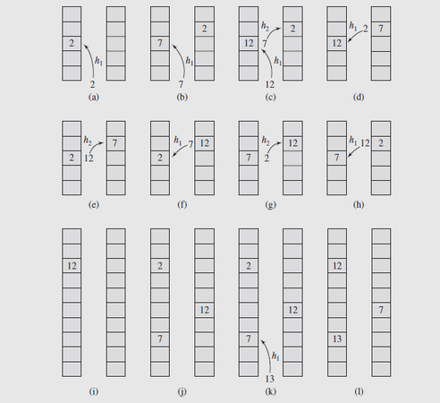
Cuckoo hashing – 4
Fig. 10.13 An example of the application of cuckoo hashing

Slide 34
Cuckoo Hashing – 5
Initially, key 2 is inserted in T₁[h₁(2)], as shown in Figure 10.13a
When key 7 is inserted, h₁(7) = h₁(2) so 2 is moved out to make room for 7 in T₁, and 2 is placed in T₂[h₂(2)], shown in Figure 10.13b
Then key 12 attempts to be inserted, but h₁(12) = h₁(7), so 12 replaces 7 in T₁; in transferring 7 to T₂, h₂(7) = h₂(2), so 2 is moved out (Figure 10.13c-d)
This process continues in Figure 10-13e-h, so the potential loop is broken by exceeding the value of maxloop, and rehashing occurs
Figure 10.13i-l illustrates this, including the addition of key 13
Searching for a key in this scheme requires at most two tests to check both T₁[h₁(K)] and T₂[h₂(K)]

Slide 35
Cuckoo Hashing – 6
One point to note is that rehashing may be limited, so that instead of creating tables, only new hash functions are created and keys reprocessed
However, this would be a global operation requiring both tables be completely processed

Slide 36
Dynamic Resizing (Rehashing)

Slide 37
Hash Table Growing
Want constant time (load factor should be smaller than 1 – otherwise we have too many collisions).
Want O(n) space – the table size "m" should not exceed "n" by much.
Rehashing:
Increase m
Come up with a new hash function
Rehash all the items.

Slide 38
Amortized analysis: Operation takes "T(n) amortized" if k operations take no more than k*T(n) time.
Amortized means "the average over all operations" (it is not "the expected time" in probabilistic sense – as the algorithms are not probabilistic). But it is averaged over a longer chain of operations.
For example, k inserts take Theta(k) time → O(1) amortized per insertion.
Notes:
https://courses.csail.mit.edu/6.006/fall09/lecture_notes/lecture01.pdf

Slide 39
Shrinking on Deletion
For long-living hashes also need to shrink tables – to keep it efficient.
When do you trigger the shrinking in half?
Notes:
Hysteresis Effect: Growing the table does not follow the same path as shrinking the table.

Slide 40
Rehashing
When hash tables become full, no more items can be added
As they fill up and reach certain levels of occupancy (saturation), their efficiency falls due to increased searching needed to place items
A solution to these problems is rehashing, allocating a new, larger table, possibly modifying the hash function (and at least TSize), and hashing all the items from the old table to the new
The old table is then discarded and all further hashes are done to the new table with the new function
The size of the new table can be determined in a number of ways: doubled, a prime closest to doubled, etc.

Slide 41
Hash Functions for Extendible Files
While rehashing adds flexibility to hashing by allowing for dynamic expansion of the has table, it has drawbacks
In particular, the entire process comes to a halt while the new table(s) are created and the values rehashed to the new table
The time required for this may be unacceptable in many cases
An alternative approach is to expand the table rather than replace it, and only allow for local rehashing and local changes
This approach won’t work with arrays, because expanding an array can’t be done by simply adding locations to the end
However, it can be managed if the data is kept in a file

Slide 42
Hash Functions for Extendible Files (continued)
There are some hashing techniques that take into account variable sizes of tables or files
These fall into two groups: directory and directoryless
In directory schemes, a directory or index of keys controls access to the keys themselves
There are a number of techniques that fall into this category
Expandable hashing, developed by Gary D. Knott in 1971
Dynamic hashing, developed by Per-Âke Larson in 1978
Extendible hashing, developed by Ronald Fagin and others in 1979
All of these distribute keys among buckets in similar ways
The structure of the directory or index is the main difference

Slide 43
Hash Functions for Extendible Files (continued)
A binary tree is used as the bucket index in expandable and dynamic hashing; extendible hashing uses a table
Virtual hashing, developed in 1978, is a directoryless technique, defined as “any hashing which may dynamically change its hashing function” by its developer, Witold Litwin
One example of this technique is linear hashing, developed by Litwin in 1980

Slide 44
Hash Functions for Extendible Files (continued)
Extendible Hashing
Consider a dynamically changing file with fixed-size buckets to which a hashing method has been applied
The data stored in the buckets is indirectly accessed through an index that is dynamically adjusted to reflect file changes
The index, which is an expandable table, is the characteristic feature of extendible hashing
When certain keys are hashed, they indicate a position in the index, not the file
The values the hash function return are called pseudokeys
This way, the file doesn’t need reorganization as data are added or deleted, because the changes are recorded in the index

Slide 45
Hash Functions for Extendible Files (continued)
Extendible Hashing (continued)
Only one hash function can be used, but depending on the size of the table, only a portion of the address h(K) is used
An easy way to do this is to look at the address as a string of bits from which only the leftmost i bits can be used
This number i is called the depth of the directory; a directory of depth two is shown in Figure 10.14a
As an example, assume h generates a pattern of five bits with a value of 01011
With a depth of two, the two leftmost bits are 01, and this is the position in the directory containing a pointer to the bucket where the key can be found or inserted
Figure 10.14 shows the h values in the buckets, which represent the keys actually stored in the buckets

Slide 46
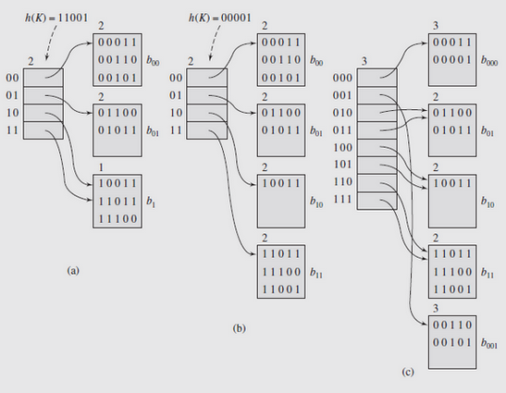
Hash Functions for Extendible Files (continued)
Fig. 10.14 An example of extendible hashing

Slide 47
Hash Functions for Extendible Files (continued)
Extendible Hashing (continued)
There is a local depth associated with each bucket that indicates the number of leftmost bits in h(K); these bits are the same for all keys in the bucket
These local depths are shown at the top of each bucket in Figure 10.14; for example, bucket b₀₀ holds all keys for which h(K) starts with 00
Importantly, the local depth indicates whether the bucket can be accessed from only one location in the directory or at least two
If the local depth is equal to the depth of the directory, the size of the directory must be changed after the bucket is split in case of overflow
If the local depth is smaller than the directory depth, only half the pointers pointing to the bucket need to be changed to point to the new one

Slide 48
Hash Functions for Extendible Files (continued)
Extendible Hashing (continued)
This is illustrated in Figure 10.14b; when a key with h value 11001 arrives, the first two bits send it to the fourth directory position
From there it goes to bucket b₁, where keys whose h-values start with 1 are stored
This causes an overflow, splitting bucket b₁ into b₁₀, which is the new name for b₁, and b₁₁; their local depths are set to two
Bucket b₁₁ is now pointed at by the pointer in position 11, and b₁’s keys are split between b₁₀ and b₁₁
Things are more complicated if a bucket whose local depth is equal to the depth of the directory overflows
Consider what happens when a key with h-value 0001 arrives at the table in Figure 10.14b

Slide 49
Hash Functions for Extendible Files (continued)
Extendible Hashing (continued)
It is hashed through position 00 to bucket b₀₀
This causes a split, but there is no room in the directory for a pointer to the new bucket
As a consequence, the directory size is doubled, making its depth three, b₀₀ becomes b₀₀₀, and b₀₀₁ is the new bucket
The keys are divided between these two buckets; the ones with an h-value starting with 000 go in b₀₀₀, and remaining ones go in b₀₀₁
In addition, all the slots of the new directory have to have their proper values set by having newdirectory[2 · i] = olddirectory[i] and newdirectory[2 ·i + 1] = olddirectory[i]
This is done for the is that range over positions of olddirectory, except for the position referring to the bucket that was just split

Slide 50
Hash Functions for Extendible Files (continued)
Extendible Hashing (continued)
The algorithm for inserting a record into a file using extendible hashing is shown on page 573
The main advantage of extendible hashing is that it avoids file reorganization on directory overflow; only the directory is impacted
Since the directory is most often kept in main memory, costs associated with expanding and updating it are small
On the other hand, if we have a large file of small buckets, the directory can become so large as to require virtual memory or a file
This can slow down processing significantly
The size of the directory doesn’t grow uniformly, since it doubles if a bucket with local depth equal to the directory depth is split

Slide 51
Hash Functions for Extendible Files (continued)
Extendible Hashing (continued)
This means a large directory will have many redundant entries in it
To address this problem, a proposal by David Lomet in 1983 suggested using extendible hashing until the directory was too large for main memory
At that point, the buckets are doubled instead of the directories, and the bits that come after the first depth bits in h(K) are used to distinguish different parts of the bucket
So if depth = 3 and bucket b₁₀ has been quadrupled, we use bit strings 00, 01, 10, and 11 to distinguish the parts
Then, if h(K) = 10101101, we look for K in the second portion (01) of bucket b₁₀₁

Slide 52
Hash Functions for Extendible Files (continued)
Linear hashing
While extendible hashing allows a file to expand without reorganization, it does require storage space for an index
In Litwin’s method, there is no need for an index because new buckets resulting from splitting existing buckets are added in the same linear way, so indexes don’t need to be retained
To facilitate this, a pointer split is used to indicate which bucket should be split next
After that bucket is split, the keys in the bucket are divided between that bucket and the new one, which is added to the end of the table
Figure 10.15 illustrates a series of initial splits where TSize = 3
To begin with, the pointer split is 0

Slide 53
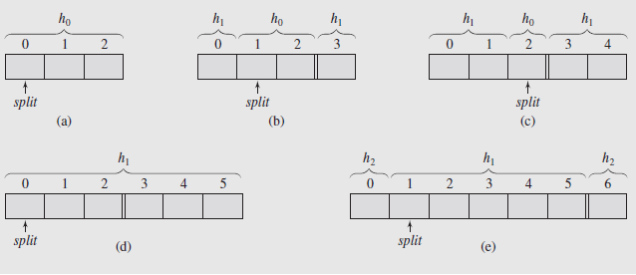
Hash Functions for Extendible Files (continued)
Linear hashing (continued)
Fig. 10.15 Splitting buckets in the linear hashing technique
If the loading factor exceeds a threshold, a new bucket is made, keys from bucket zero are distributed between buckets zero and three, and split is incremented

Slide 54
Hash Functions for Extendible Files (continued)
Linear hashing (continued)
The question is, how to perform this distribution?
With only one hash function, keys from bucket zero are hashed to bucket zero before and after splitting
So one function isn’t adequate to perform this
Linear hashing maintains two hash functions at each level of splitting, h_{level} and h_{level+1} with h_{level} (K) = K mod (TSize ∙ 2^{level})
The first function hashes keys to buckets on the current level that have not yet been split; the second hashes keys to already split buckets
The algorithm for linear hashing is shown on pages 574 and 575

Slide 55
Hash Functions for Extendible Files (continued)
Linear hashing (continued)
It may not be clear when a bucket should be split; as the algorithm assumes, a threshold value of the loading factor is used to decide
This threshold has to be determined in advance, usually by the designer of the program
To illustrate, assume keys can be hashed to buckets in a file, and if a bucket is full, overflowing keys are put on a linked list in an overflow area
This situation is shown in Figure 10.16a, with TSize = 3, h₀(K) = K mod TSize, and h₁(K) = K mod 2 ∙ TSize
We’ll let the overflow are size OSize = 3, and the highest acceptable loading factor be 80 percent
The loading factor is defined as the number of elements divided by the number of slots in the file and overflow area

Slide 56
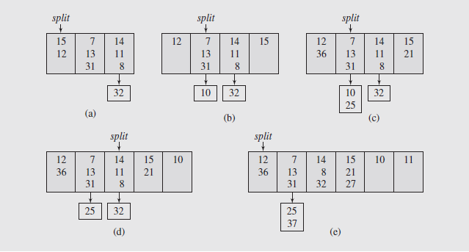
Hash Functions for Extendible Files (continued)
Fig. 10.16 Inserting keys to buckets and overflow areas with the linear hashing technique

Slide 57
Hash Functions for Extendible Files (continued)
Linear hashing (continued)
Current loading in Figure 10.16a is 75%, but when key 10 arrives it is hashed to position 1 and loading increases to 83%
The first bucket splits and keys are distributed using function h₁, shown in Figure 10.16b
Of note is the fact that the first bucket has the lowest load, but was the first one that split
Now assume 21 and 36 are hashed to the table, and 25 arrives as seen in Figure 10.16c
The loading factor rises to 87%, so another split, this time the second bucket, gives rise to the configuration in Figure 10.16d
After hashing 27 and 37 another split occurs, and this new situation is shown in Figure 10.16e

Slide 58
Hash Functions for Extendible Files (continued)
Linear hashing (continued)
In this case, split reached the last allowed value on this level, so it is assigned the value zero, and h₁ is retained for use in further hashing
In addition, a new function, h₂ is defined as K mod 4 ∙ TSize
These steps are presented in a table on the next slide
Note that since the order of splitting is predetermined, some overflow area is needed with linear hashing
If files are used, this may lead to more than one file access
The area can be distinct from buckets, but can also work in the fashion of coalesced hashing by using empty space in buckets, as suggested by James Mullin in 1981
Overflow areas are not necessary in a directory scheme, but can be used

Slide 59
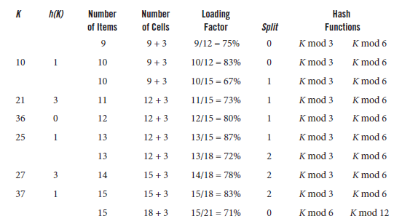
Hash Functions for Extendible Files (continued)
Table 10-1 Steps in carrying out the hashing and splitting of Figure 10.16

Slide 60
Hash Functions for Extendible Files (continued)
Linear hashing (continued)
As with directory schemes, linear hashing increases the address space by splitting buckets
Keys from the split bucket are also redistributed between the resulting buckets
Since no indexes need to be maintained, linear hashing is faster and requires less space than previous methods
This increase in efficiency is especially noticeable for large files

