Slide 1
List ADT
begin(): Return an iterator referring to the first element
end(): Return an iterator referring to a location just after the last element
insertFront(e): Insert a new element e into L as the first element
insertBack(e): Insert as the last element.
insert(p,e): Insert at position p.
eraseFront(): Erase the first one
eraseBack(): Erase the last one
erase(p): Erase at position p
moveNext(p): Move the position to the next one

Slide 2
The Array List ADT
The Vector or Array List ADT extends the notion of array by storing a sequence of objects
An element can be accessed, inserted or removed by specifying its index (number of elements preceding it)
An exception is thrown if an incorrect index is given (e.g., a negative index)
Main methods:
at(integer i): returns the element at index i without removing it
set(integer i, object o): replace the element at index i with o
insert(integer i, object o): insert a new element o to have index i
erase(integer i): removes element at index i
Additional methods:
size()
empty()

Slide 3
Containers and Iterators
An iterator abstracts the process of scanning through a collection of elements
A container is an abstract data structure that supports element access through iterators
begin(): returns an iterator to the first element
end(): return an iterator to an imaginary position just after the last element
An iterator behaves like a pointer to an element
*p: returns the element referenced by this iterator
++p: advances to the next element
Extends the concept of position by adding a traversal capability

Slide 4
Containers
Data structures that support iterators are called containers
Examples include Stack, Queue, Vector, List
Various notions of iterator:
(standard) iterator: allows read-write access to elements
const iterator: provides read-only access to elements
bidirectional iterator: supports both ++p and –p
random-access iterator: supports both p+i and p-i

Slide 5
Iterating through a Container
Let C be an array-type container and p be an iterator for C
for (p = C.begin(); p != C.end(); ++p)
loop_body
Example: (with an STL vector)
typedef vector<int>::iterator Iterator;
int sum = 0;
for (Iterator p = V.begin(); p != V.end(); ++p)
sum += *p;
return sum;

Slide 6
Implementing Iterators
Array-based
array A of the n elements
index i that keeps track of the cursor
begin() = 0
end() = n (index following the last element)
Linked list-based
doubly-linked list L storing the elements, with sentinels for header and trailer
pointer to node containing the current element
begin() = front node
end() = trailer node (just after last node)

Slide 7
STL Iterators in C++
Each STL container type C supports iterators:
C::iterator – read/write iterator type
C::const_iterator – read-only iterator type
C.begin(), C.end() – return start/end iterators
This iterator-based operators and methods:
*p: access current element
++p, --p: advance to next/previous element
C.assign(p, q): replace C with contents referenced by the iterator range [p, q) (from p up to, but not including, q)
insert(p, e): insert e prior to position p
erase(p): remove element at position p
erase(p, q): remove elements in the iterator range [p, q)

Slide 8
Sequence ADT
List-based methods:
begin(), end()
insertFront(o), insertBack(o)
eraseFront(), eraseBack()
insert (p, o), erase(p)
Bridge methods:
atIndex(i), indexOf(p)
The Sequence ADT is the union of the Array List and Node List ADTs
Elements accessed by
Index, or
Position
Generic methods:
size(), empty()
ArrayList-based methods:
at(i), set(i, o), insert(i, o), erase(i)

Slide 9
Applications of Sequences
The Sequence ADT is a basic, general-purpose, data structure for storing an ordered collection of elements
Direct applications:
Generic replacement for stack, queue, vector, or list
small database (e.g., address book)
Indirect applications:
Building block of more complex data structures

Slide 10
Linked List Implementation
Position-based methods run in constant time
Index-based methods require searching from header or trailer while keeping track of indices; hence, run in linear time
A doubly linked list provides a reasonable implementation of the Sequence ADT
Nodes implement Position and store:
element
link to the previous node
link to the next node
Special trailer and header nodes
header
nodes/positions
trailer
elements

Slide 11
Array-based Implementation
elements
We use a circular array storing positions
A position object stores:
Element
Index
Indices f and l keep track of first and last positions
0
1
2
3
positions
S
f
l

Slide 12
Comparing Sequence Implementations
Operation | Array | List
size, empty | 1 | 1
atIndex, indexOf, at | 1 | n
begin, end | 1 | 1
set(p,e) | 1 | 1
set(i,e) | 1 | n
insert(i,e), erase(i) | n | n
insertBack, eraseBack | 1 | 1
insertFront, eraseFront | n | 1
insert(p,e), erase(p) | n | 1

Slide 13
Position ADT
The Position ADT models the notion of place within a data structure where a single object is stored
It gives a unified view of diverse ways of storing data, such as
a cell of an array
a node of a linked list
Just one method:
object p.element(): returns the element at position
In C++ it is convenient to implement this as *p

Slide 14
Node List ADT
The Node List ADT models a sequence of positions storing arbitrary objects
It establishes a before/after relation between positions
Generic methods:
size(), empty()
Iterators:
begin(), end()
Update methods:
insertFront(e), insertBack(e)
removeFront(), removeBack()
Iterator-based update:
insert(p, e)
remove(p)

Slide 15
Doubly Linked List
A doubly linked list provides a natural implementation of the Node List ADT
Nodes implement Position and store:
element
link to the previous node
link to the next node
Special trailer and header nodes
prev
next
elem
node
header
nodes/positions
trailer
elements

Slide 16
Insertion
We visualize operation insert(p, x), which inserts x before p
p
a
b
c
p
a
b
c
q
x
q
p
a
b
x
c

Slide 17
Insertion Algorithm
Algorithm insert(p, e): {insert e before p}
Create a new node v
v→element = e
u = p→prev
v→next = p; p→prev = v {link in v before p}
v→prev = u; u→next = v {link in v after u}

Slide 18
Deletion
p
We visualize remove(p)
a
b
c
d
a
b
c
p
d
a
b
c

Slide 19
Deletion Algorithm
Algorithm remove(p):
u = p→prev
w = p→next
u→next = w {linking out p}
w→prev = u

Slide 20
Performance
In the implementation of the List ADT by means of a doubly linked list
The space used by a list with n elements is O(n)
The space used by each position of the list is O(1)
All the operations of the List ADT run in O(1) time
Operation element() of the Position ADT runs in O(1) time

Slide 21
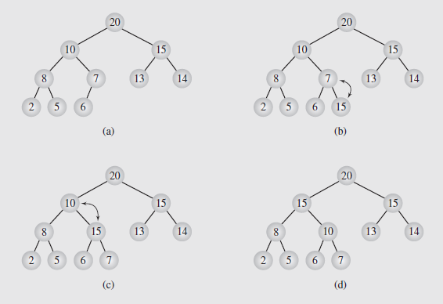
After Insert – Upheap
After the insertion of a new key k, the heap-order property may be violated
Algorithm upheap restores the heap-order property by swapping k along an upward path from the insertion node
Upheap terminates when the key k reaches the root or a node whose parent has a key smaller than or equal to k
Since a heap has height O(log n), upheap runs in O(log n) time

Slide 22
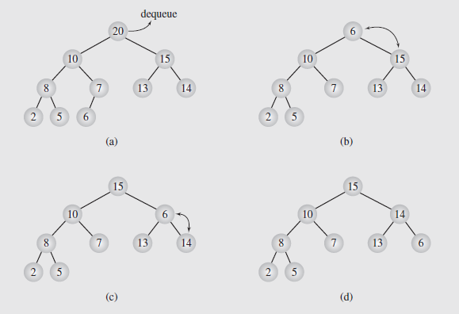
After Removal – Downheap
After replacing the root key with the key k of the last node, the heap-order property may be violated
Algorithm downheap restores the heap-order property by swapping key k along a downward path from the root
Upheap terminates when key k reaches a leaf or a node whose children have keys greater than or equal to k
Since a heap has height O(log n), downheap runs in O(log n) time

Slide 23
Objectives
Looking ahead – in this chapter, we’ll consider
Graph Representation
Graph Traversals
Shortest Paths
Cycle Detection
Spanning Trees
Connectivity

Slide 24
Objectives (continued)
Topological Sort
Networks
Matching
Eulerian and Hamiltonian Graphs
Graph Coloring
NP-Complete Problems in Graph Theory

Slide 25
Introductory Remarks
Although trees are quite flexible, they have an inherent limitation in that they can only express hierarchical structures
Fortunately, we can generalize a tree to form a graph, in which this limitation is removed
Informally, a graph is a collection of nodes and the connections between them
Figure 8.1 illustrates some examples of graphs; notice there is typically no limitation on the number of vertices or edges
Consequently, graphs are extremely versatile and applicable to a wide variety of situations
Graph theory has developed into a sophisticated field of study since its origins in the early 1700s

Slide 26
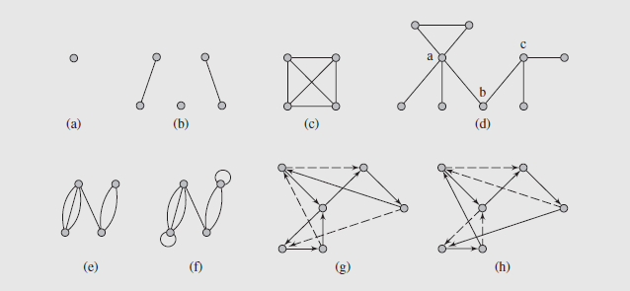
Introductory Remarks (continued)
Notes:
Fig. 8.1 Examples of graphs: (a–d) simple graphs; (c) a complete graph K₄; (e) a multigraph;
(f) a pseudograph; (g) a circuit in a digraph; (h) a cycle in the digraph

Slide 27
Introductory Remarks (continued)
And, while many results are theoretical, the applications of graphs are numerous and worth consideration
First, though, we need to consider some definitions
A simple graph G = (V, E) consists of a (finite) set denoted by V, and a collection E, of unordered pairs {u, v} of distinct elements from V
Each element of V is called a vertex or a point or a node, and each element of E is called an edge or a line or a link
The number of vertices, the cardinality of V, is called the order of graph and devoted by |V|
The cardinality of E, called the size of graph, is denoted by |E|

Slide 28
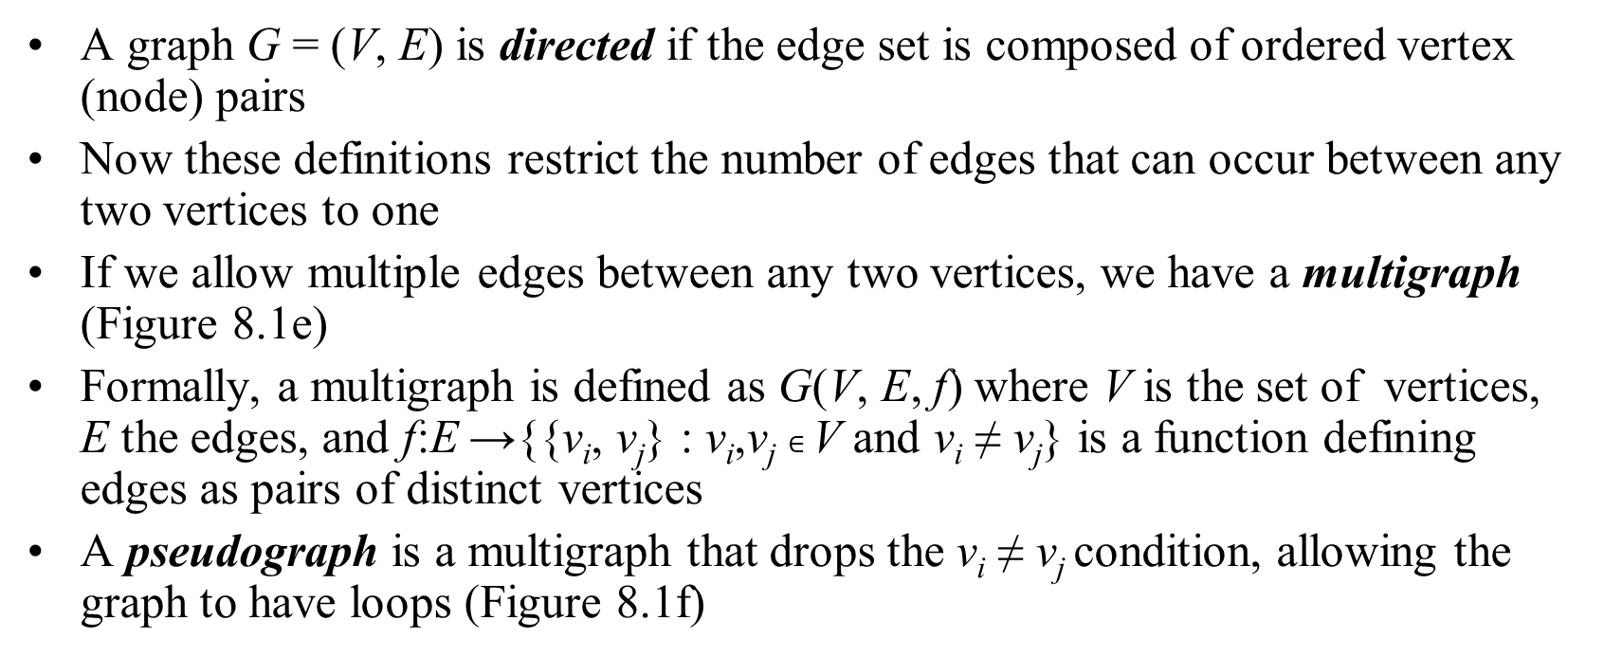
Introductory Remarks (continued)
A graph G = (V, E) is directed if the edge set is composed of ordered vertex (node) pairs
Now these definitions restrict the number of edges that can occur between any two vertices to one
If we allow multiple edges between any two vertices, we have a multigraph (Figure 8.1e)
Formally, a multigraph is defined as G(V, E, f) where V is the set of vertices, E the edges, and f:E →{{v_{i}, v_{j}} : v_{i},v_{j} $∈$ V and v_{i} ≠ v_{j}} is a function defining edges as pairs of distinct vertices
A pseudograph is a multigraph that drops the v_{i} ≠ v_{j} condition, allowing the graph to have loops (Figure 8.1f)

Slide 29
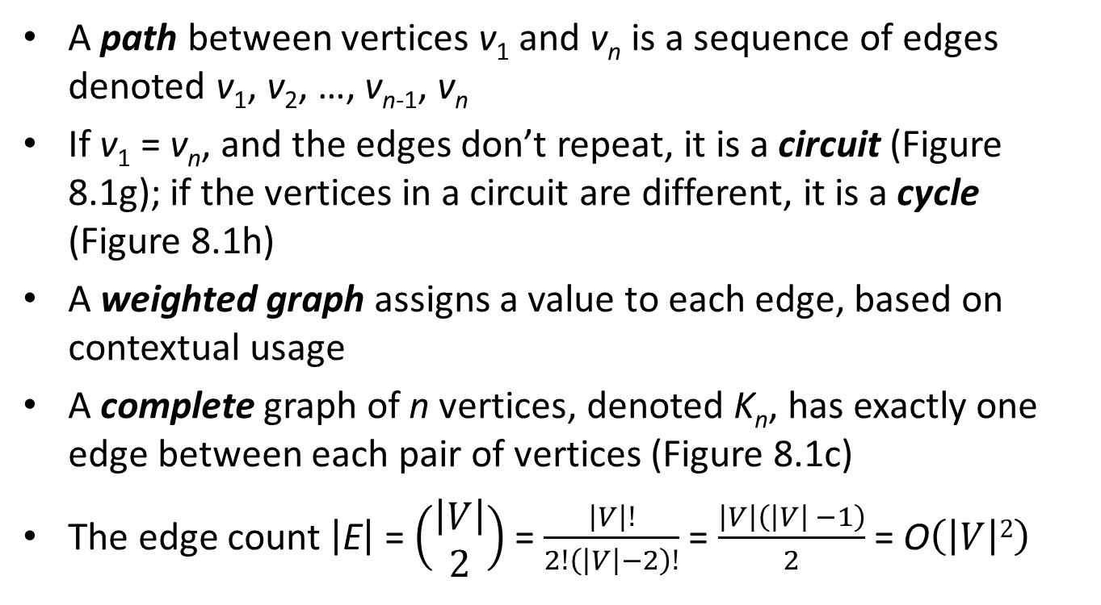
Introductory Remarks (continued)
A path between vertices v₁ and v_{n} is a sequence of edges denoted v₁, v₂, …, v_{n-1}, v_{n}
If v₁ = v_{n}, and the edges don’t repeat, it is a circuit (Figure 8.1g); if the vertices in a circuit are different, it is a cycle (Figure 8.1h)
A weighted graph assigns a value to each edge, based on contextual usage
A complete graph of n vertices, denoted K_{n}, has exactly one edge between each pair of vertices (Figure 8.1c)
The edge count $\left|\text{E}\right|$ = $\left(\begin{matrix}\left|V\right| \\ 2\end{matrix}\right)$ = $\frac{\left|V\right|!}{2!\left(\left|V\right|−2\right)!}$ = $\frac{\left|V\right|\left(\left|V\right| −1\right)}{2}$ = O$\left(\left|V\right|2\right)$

Slide 30
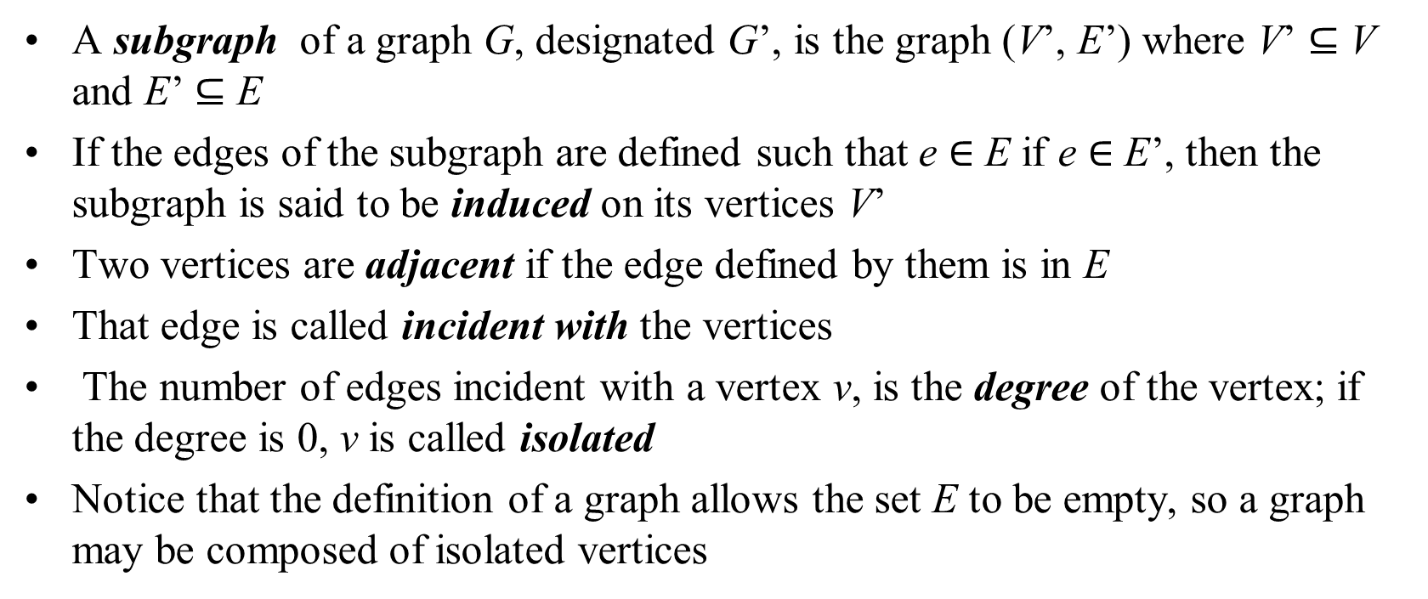
Introductory Remarks (continued)
A subgraph of a graph G, designated G’, is the graph (V’, E’) where V’ $⊆$ V and E’ $⊆$ E
If the edges of the subgraph are defined such that e $∈$ E if e $∈$ E’, then the subgraph is said to be induced on its vertices V’
Two vertices are adjacent if the edge defined by them is in E
That edge is called incident with the vertices
The number of edges incident with a vertex v, is the degree of the vertex; if the degree is 0, v is called isolated
Notice that the definition of a graph allows the set E to be empty, so a graph may be composed of isolated vertices

Slide 31
Graph Representation
Graphs can be represented in a number of ways
One of the simplest is an adjacency list, where each vertex adjacent to a give vertex is listed
This can be designed as a table (known as a star representation) or a linked list, shown in Figure 8.2b-c on page 393
Another representation is as a matrix, which can be designed in two ways
An adjacency matrix is a |V| x |V| binary matrix where:

Slide 32
Graph Representation (continued)
An example of an adjacency matrix is shown in Figure 8.2d
The order of the vertices in the matrix is arbitrary, so there are n! possible matrices for a graph of n vertices
It is also possible to generalize an adjacency matrix definition to handle a multigraph by defining a_{ij} = number of edges between v_{i} and v_{j}
A second matrix representation is based on incidences, hence the name incidence matrix
An incidence matrix is a |V| x |E| binary matrix where:

Slide 33
Graph Representation (continued)
An example of an incidence matrix is shown in Figure 8.2e
For a multigraph, many columns are the same, and a column with a single 1 represents a loop
As far as usage, the proper structure depends to a great extent on the kinds of operations that need to be done

Slide 34
Graph Traversals
Like tree traversals, graph traversals visit each node once
However, we cannot apply tree traversal algorithms to graphs because of cycles and isolated vertices
One algorithm for graph traversal, called the depth-first search, was developed by John Hopcroft and Robert Tarjan in 1974
In this algorithm, each vertex is visited and then all the unvisited vertices adjacent to that vertex are visited
If the vertex has no adjacent vertices, or if they have all been visited, we backtrack to that vertex’s predecessor
This continues until we return to the vertex where the traversal started

Slide 35
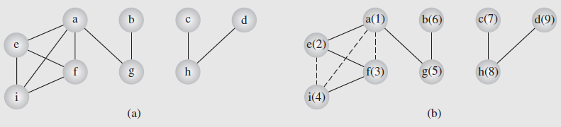
Graph Traversals (continued)
If any vertices remain unvisited at this point, the traversal restarts at one of the unvisited vertices
Although not necessary, the algorithm assigns unique numbers to the vertices, so they are renumbered
The numbers indicate the order in which the nodes are visited; the solid lines indicate the edges traversed during the search
Notes:
Figure 8.3 shows an example of this traversal; t
Fig. 8.3 An example of application of the depthFirstSearch() algorithm to a graph

Slide 36
Graph Traversals (continued)
The algorithm guarantees that we will create a tree (or a forest, which is a set of trees) including the graph’s vertices
Such a tree is called a spanning tree
The guarantee is based on the algorithm not processing any edge that leads to an already visited node
Consequently, some edges are not included in the tree (marked with dashed lines)
The edges included in the tree are called forward edges; those omitted are called back edges
In Figure 8.4, we can see this algorithm applied to a digraph, which is a graph where the edges have a direction

Slide 37
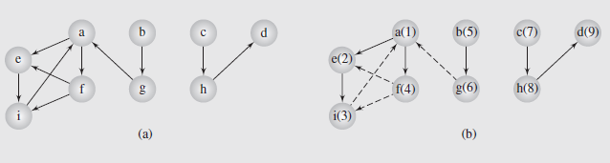
Graph Traversals (continued)
Fig. 8.4 The depthFirstSearch() algorithm applied to a digraph
Notice in this case we end up with a forest of three trees, because the traversal must follow the direction of the edges
There are a number of algorithms based on depth-first searching
However, some are more efficient if the underlying mechanism is breadth-first instead

Slide 38
Graph Traversals (continued)
Recall from our consideration of tree traversals that depth-first traversals used a stack, while breadth-first used queues
This can be extended to graphs, as the pseudocode on page 397 illustrates
Figure 8.4 shows this applied to a graph; Figure 8.5 shows the application to a digraph
In both, the basic operation is to mark all the vertices accessible from a given vertex, placing them in a queue as they are visited
The first vertex in the queue is then removed, and the process repeated
No visited nodes are revisited; if a node has no accessible nodes, the next node in the queue is removed and processed

Slide 39
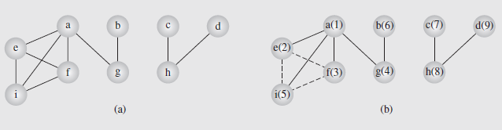
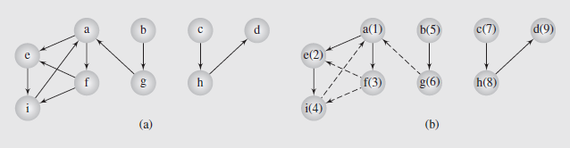
Graph Traversals (continued)
Fig. 8.5 An example of application of the breadthFirstSearch() algorithm to a graph
Fig. 8.6 The breadthFirstSearch() algorithm applied to a digraph

Slide 40
Shortest Paths
A classical problem in graph theory is finding the shortest path between two nodes, with numerous approaches suggested
The edges of the graph are associated with values denoting such things as distance, time, costs, amounts, etc.
If we’re determining the distance between two vertices, say v and u, information about the distance between the intermediate vertices in the path, w, needs to be kept track of
This can be recorded as a label associated with the vertices
The label may simply be the distance between vertices, or the distance along with the current node’s predecessor in the path
Methods for finding shortest paths depend on these labels

Slide 41
Shortest Paths (continued)
Based on how many times the labels are updated, solutions to the shortest path problem fall into two groups
In label-setting methods, one vertex is assigned a value that remains unchanged
This occurs each time we go through the vertices that remain to be processed
The main drawback to this is that we cannot process graphs that have negative weights on any edges
In label-correcting methods, any label can be changed
This means it can be applied to graphs with negative weights as long as they don’t have negative cycles (a cycle where the sum of the edges is a negative value)

Slide 42
Shortest Paths (continued)
However this method guarantees that after processing is complete, for all vertices the current distances indicate the shortest path
Most of these forms (both label-setting and label-correcting) can be looked at as part of the same general process, however
That is the task of finding the shortest paths from one vertex to all the other vertices, the pseudocode being on page 399
In this algorithm, a label is defined as:
label(v) = (currDist(v),predecessor(v))
Two open issues in the code are the design of the set called toBeChecked and the order new values are assigned to v
It is the design of the set that impacts both the choice of v and the efficiency of the algorithm

Slide 43
Shortest Paths (continued)
The distinction between label-setting and label-correcting algorithms is the way the value for vertex v is chosen
This is the vertex in the set toBeChecked with the smallest current distance
In considering label-setting algorithms, one of the first was developed by Edsgar Dijkstra in 1956
In this algorithm, the shortest from among a number of paths from a vertex, v, are tried
This means that a particular path may be extended by adding one more edge to it each time v is checked
However, if the path is longer than any other path from that point, it is dropped, and the other path is expanded

Slide 44
Shortest Paths (continued)
Since the vertices may have more than one outgoing edge, each new edge adds possible paths for exploration
Thus each vertex is visited, the new paths are started, and the vertex is then not used anymore
Once all the vertices are visited, the algorithm is done
Dijkstra’s algorithm is shown on page 400; it is derived from the general algorithm by changing the line
v=a vertex in toBeChecked;
to
v=a vertex in toBeChecked with minimal currDist(v);
It also extends the condition in the if to make permanent the current distance of vertices eliminated from the set

Slide 45
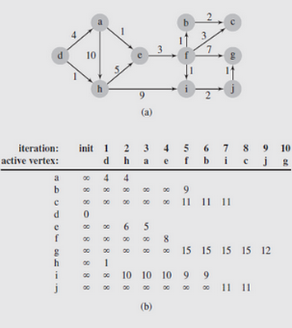
Shortest Paths (continued)
Notice that the set’s structure is not indicated; recall it is the structure that determines efficiency
Figure 8.7 illustrates this for the graph in part (a)
Fig. 8.7 An execution of DijkstraAlgorithm()

Slide 46
Shortest Paths (continued)
As a label-setting algorithm, Dijkstra’s approach may fail when negative weights are used in graphs
To deal with that, a label-correcting algorithm is needed
One of the first label-correcting algorithms was developed by Lester R. Ford, Jr. in the late 1950s
It uses the same technique as Dijkstra’s method to set the current distances, but postpones determining the shortest distance for any vertex until the entire graph is processed
While it is capable of handling graphs with negative weights, it cannot deal with negative cycles
In the algorithm, all edges are watched in an attempt to find an improvement for the current distance of the vertices

Slide 47
Shortest Paths (continued)
The pseudocode for the algorithm is shown on page 402
To facilitate monitoring the vertices, an alphabetic sequence can be used
That way the algorithm can go through the list repeatedly and adjust any vertex’s current distance as needed
Figure 8.8 contains an example of this; note that the graph does include negatively weighted edges
While a vertex may change its current distance during the same iteration, when done each vertex can be reached by the shortest path from the starting vertex

Slide 48
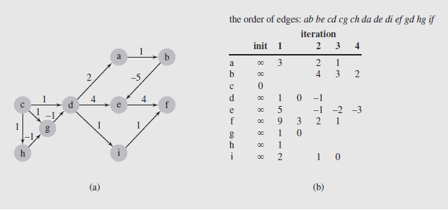
Shortest Paths (continued)
Fig. 8.8 FordAlgorithm() applied to a digraph with negative weights
In the case of Dijkstra’s algorithm, we observed that the efficiency can be improved by the choice of data structure
This in turn impacts the way the edges and vertices are scanned

Slide 49
Shortest Paths (continued)
This observation also holds for label-correcting algorithms; in particular, the FordAlgorithm()specifies no order for edge checking
In the example of Figure 8.8, the approach was to visit all adjacency lists of all vertices in each iteration
However this requires that all the edges are checked every time, which is inefficient
A more sensible organization of the vertices can reduce the number of visits per vertex
The generic algorithm on page 399 suggests an improvement by explicitly accessing toBeChecked
In the FordAlgorithm()this structure is used implicitly, and then only as the set of all vertices

Slide 50
Shortest Paths (continued)
So based on this, we can derive a general label-correcting algorithm, shown in pseudocode on page 403
As indicated before, the efficiency of the algorithm depends directly on the data structure used for toBeChecked
One possibility is a queue, and was the basis for one of the earliest implementations
With a queue, as a vertex, v is removed, the current distance to its neighbors is checked
If any of those distances is updated, the vertex whose distance was changed is added to the queue
While straightforward, it can sometimes reevaluate the same labels excessively

Slide 51
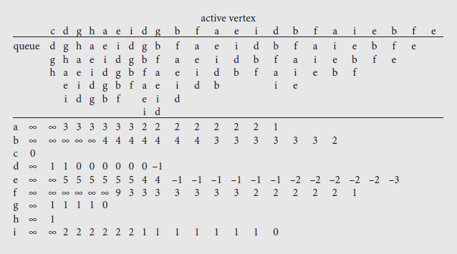
Shortest Paths (continued)
Figure 8.9 illustrates this problem for the graph of Figure 8.8a
As can be seen, a number of vertices are updated multiple times

Slide 52
Shortest Paths (continued)
To avoid this situation, a deque can be used in place of the queue
In this approach, vertices needing to be checked for the first time are added at the end, otherwise they are placed in front
The reasoning behind this is that if a given vertex, v, is included for the first time, the vertices accessible from it have yet to be processed, so they will be processed after v
However, if v has been processed, those vertices are likely still in the list awaiting processing, so putting v in front may avoid unnecessary updates
Figure 8.10 shows the result of using a deque instead of a queue

Slide 53
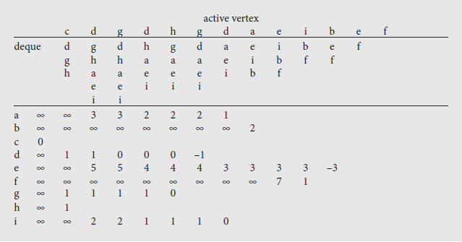
Shortest Paths (continued)
Fig. 8.10 An execution of labelCorrectingAlgorithm(), which applies a deque
The use of a deque does suffer from one problem, however
Its worst case performance is exponential in the number of vertices

Slide 54
Shortest Paths (continued)
However, the average case is about 60% better than the queue version of the same algorithm
A variation of this approach uses two queues separately, rather than combined in a deque
In this variation, vertices enqueued for the first time are placed in the first queue; otherwise they are placed in the second
Vertices are then dequeued from the first queue if it is not empty; otherwise they are taken from the second
The threshold algorithm is another variation of the label-correcting method that uses two lists
Vertices are removed from the first list for processing

Slide 55
Shortest Paths (continued)
A vertex will be added to the end of the first list if the value of its label is below the threshold level
Otherwise it will be added to the second list
If the first list becomes empty, the threshold is modified to a value greater than the minimum label value of all vertices in the second list
Then those vertices whose labels are less than the new threshold are moved from the second list to the first list
Yet another approach is the small label first method
In this method, a vertex is placed at the front of the deque if its label is smaller than the label of the current front of the deque; otherwise it is placed at the rear

Slide 56
Shortest Paths (continued)
All-to-All Shortest Path Problem
Given the issues of finding the shortest path from one vertex to another, the problem of finding all shortest paths between two vertices might seem daunting
However, a method developed by Stephen Warshall in 1962 does it fairly easily, as long as an adjacency matrix that provides edge weights is available
This technique can also handle negative edge weights and the algorithm is shown on page 406
An example of the algorithm’s application, together with the accompanying adjacency matrix, is shown in Figure 8.11 on page 407
The algorithm can also detect cycles if the diagonal of the matrix is initialized to ∞ instead of 0
If any of the diagonal values get changed, the graph contains a cycle

Slide 57
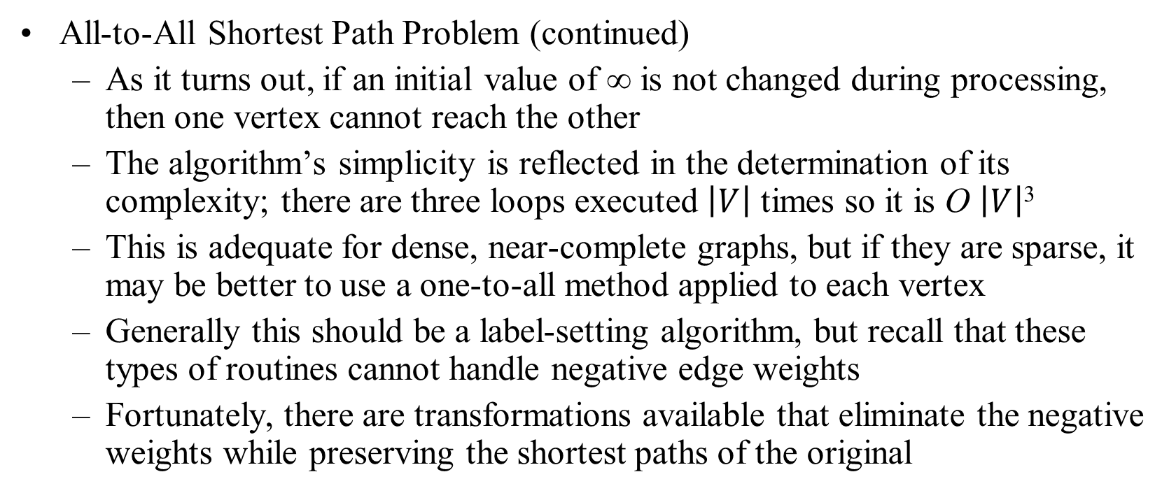
Shortest Paths (continued)
All-to-All Shortest Path Problem (continued)
As it turns out, if an initial value of ∞ is not changed during processing, then one vertex cannot reach the other
The algorithm’s simplicity is reflected in the determination of its complexity; there are three loops executed $\left|V\right|$ times so it is O $\left|V\right|$³
This is adequate for dense, near-complete graphs, but if they are sparse, it may be better to use a one-to-all method applied to each vertex
Generally this should be a label-setting algorithm, but recall that these types of routines cannot handle negative edge weights
Fortunately, there are transformations available that eliminate the negative weights while preserving the shortest paths of the original

Slide 58
Floyd-Warshall’s Algorithm
Number vertices v₁ , …, v_{n}
Compute digraphs G₀, …, G_{n}
G₀=G
G_{k} has directed edge (v_{i}, v_{j}) if G has a directed path from v_{i} to v_{j} with intermediate vertices in {v₁ , …, v_{k}}
We have that G_{n} = G*
In phase k, digraph G_{k} is computed from G_{k − 1}
Running time: O(n³), assuming areAdjacent is O(1) (e.g., adjacency matrix)
Algorithm FloydWarshall(G)
Input digraph G
Output transitive closure G* of G
i ← 1
for all v ∈ G.vertices()
denote v as v_{i}
i ← i + 1
G₀ ← G
for k ← 1 to n do
G_{k} ← G_{k − 1}
for i ← 1 to n (i ≠ k) do
for j ← 1 to n (j ≠ i, k) do
if G_{k − 1}.areAdjacent(v_{i}, v_{k}) ∧ G_{k − 1}.areAdjacent(v_{k}, v_{j})
if ¬G_{k}.areAdjacent(v_{i}, v_{j})
G_{k}.insertDirectedEdge(v_{i}, v_{j} , k)
return G_{n}

Slide 59
Floyd-Warshall Example
BOS
ORD
v
4
JFK
v
2
v
6
SFO
DFW
LAX
v
v
3
1
MIA
v
5

Slide 60
Floyd-Warshall, Iteration 1
BOS
ORD
v
4
JFK
v
2
v
6
SFO
DFW
LAX
v
v
3
1
MIA
v
5

Slide 61
Floyd-Warshall, Iteration 2
BOS
ORD
v
4
JFK
v
2
v
6
SFO
DFW
LAX
v
v
3
1
MIA
v
5

Slide 62
Floyd-Warshall, Iteration 3
BOS
ORD
v
4
JFK
v
2
v
6
SFO
DFW
LAX
v
v
3
1
MIA
v
5

Slide 63
Floyd-Warshall, Iteration 4
BOS
ORD
v
4
JFK
v
2
v
6
SFO
DFW
LAX
v
v
3
1
MIA
v
5

Slide 64
Floyd-Warshall, Iteration 5
BOS
ORD
v
4
JFK
v
2
v
6
SFO
DFW
LAX
v
v
3
1
MIA
v
5

Slide 65
Floyd-Warshall, Iteration 6
BOS
ORD
v
4
JFK
v
2
v
6
SFO
DFW
LAX
v
v
3
1
MIA
v
5

Slide 66
Floyd-Warshall, Conclusion
BOS
ORD
v
4
JFK
v
2
v
6
SFO
DFW
LAX
v
v
3
1
MIA
v
5

Slide 67
Graph Assignment
Goals
Learn and implement the adjacency matrix structure an Kruskal’s minimum spanning tree algorithm
Understand and use the decorator pattern and various JDSL classes and interfaces
Your task
Implement the adjacency matrix structure for representing a graph
Implement Kruskal’s MST algorithm
Frontend
Computation and visualization of an approximate traveling salesperson tour

Slide 68
Adjacency Matrix Structure
a
v
b
Edge list structure
Augmented vertex objects
Integer key (index) associated with vertex
2D-array adjacency array
Reference to edge object for adjacent vertices
Null for non nonadjacent vertices
u
w
0
u
1
v
2
w
 | 0 | 1 | 2
0 | ∅ |  | ∅
1 |  | ∅
2 | ∅ |  | ∅
a
b

