Slide 1
Rolling Hashes
String Search algorithm

Slide 2
Naive Algorithm
NaiveStringMatcher(T, P)
1. n=T.length
2. m=P.length
3. for i=0 to n−m
4. if (P[0],…,P[m−1])==(T[i],…,T[i+m−1]])
5. print "Found pattern, offset = {i}"
Worst-case input? Worst-case running time?

Slide 3
Faster String Search by Hashing
Text T, pattern P are just (huge) inegers.
Assume that their letters are used as "digits"
If your alphabet is S={0,1,2,…,9}, then they can be interpreted as regular digits.
Otherwise, just use a different base of the number notation.
Example: Consider string "pt". The ASCII values of "p" and "t" are x70 and x74 (or 112 and 116 in decimal).
If ASCII has 128 symbols, compute "pt" for base "128": 112⋅128+116=14452.

Slide 4
Rolling Hash ADT
"r" – data structure that maintains a string (and also rolling hash computations)
r.append(c) – add one more character to the end of the rolling hash
r.skip(c) – delete the first character.
r() – get the current has value.

Slide 5
Abstract Rabin-Karp Algorithm

Slide 6
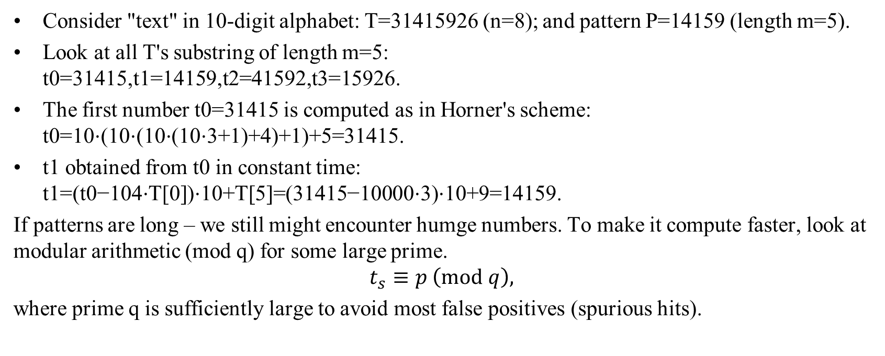
Concrete rolling hashes
Consider "text" in 10-digit alphabet: T=31415926 (n=8); and pattern P=14159 (length m=5).
Look at all T's substring of length m=5: t0=31415,t1=14159,t2=41592,t3=15926.
The first number t0=31415 is computed as in Horner's scheme: t0=10⋅(10⋅(10⋅(10⋅3+1)+4)+1)+5=31415.
t1 obtained from t0 in constant time: t1=(t0−104⋅T[0])⋅10+T[5]=(31415−10000⋅3)⋅10+9=14159.
If patterns are long – we still might encounter humge numbers. To make it compute faster, look at modular arithmetic (mod q) for some large prime.
$$t_{s}≡p \left(mod q\right),$$
where prime q is sufficiently large to avoid most false positives (spurious hits).

Slide 7
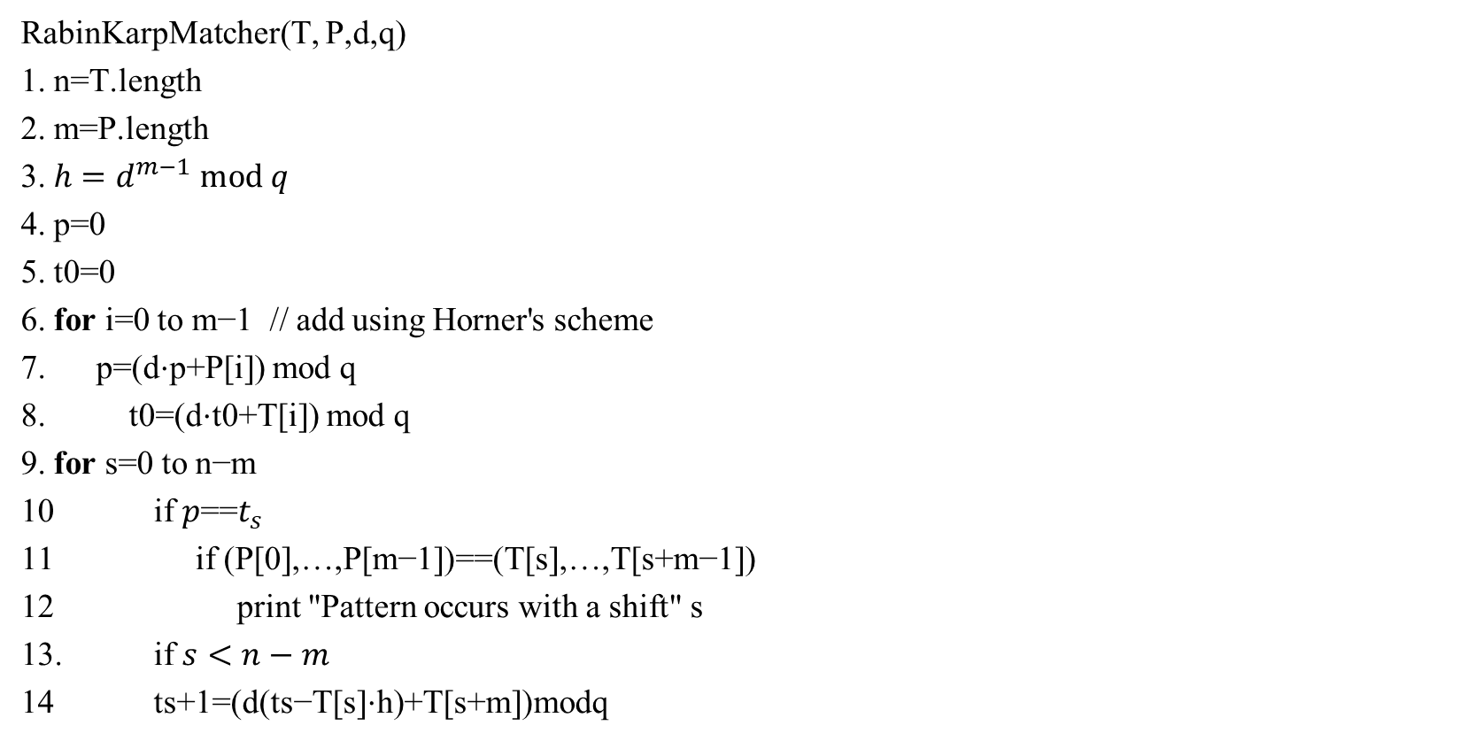
Rabin-Karp Pseudocode
RabinKarpMatcher(T, P,d,q)
1. n=T.length
2. m=P.length
3. $h=d^{m−1} mod q$
4. p=0
5. t0=0
6. for i=0 to m−1 // add using Horner's scheme
7. p=(d⋅p+P[i]) mod q
8. t0=(d⋅t0+T[i]) mod q
9. for s=0 to n−m
10 if $p$==$t_{s}$
11 if (P[0],…,P[m−1])==(T[s],…,T[s+m−1])
12 print "Pattern occurs with a shift" s
13. if $s<n−m$
14 ts+1=(d(ts−T[s]⋅h)+T[s+m])modq

