Slide 1
BoLA MHC Genotyping Pipeline
from Oxford Nanopore amplicon sequencing
A two-class pipeline Class I (multi-copy, hard) vs Class II / DRB3 (DQA/DQB pending) (single-copy, clean)
Kapur Lab · analysis on WGS3

Slide 2
CONTEXT
Why are we genotyping the bovine MHC (BoLA)?
1
Immune recognition
MHC molecules display pathogen fragments to T cells. An animal's MHC genotype shapes which infections its immune system can “see” and respond to.
2
Disease resistance & breeding
BoLA type is linked to resistance and susceptibility to key cattle diseases and a genetic marker for health-informed selection.
3
Diagnostics and Vaccine immunology
Knowing each animal's MHC type is needed to detect, interpret and design peptide-based markers of immune responses for the collaborators using these data.

Slide 3
THE BOVINE MHC
What the BoLA complex is — and why it matters
1
A polymorphic immune region
BoLA is the cattle MHC on chromosome 23. Class I presents peptides to CD8+ T cells, Class II to CD4+ — the genotype sets what an animal can immunologically “see”.
2
A fluid, multi-copy gene family
Classical genes BoLA-1/2/3/4/6 (plus non-classical); DRB3 is the Class II workhorse. Unlike human, haplotypes vary in the number and composition of expressed Class I genes — none is on every haplotype (Ellis et al.).
3
Why we type it — including bovine TB
DRB3 alleles track mastitis, tick burden and trypanosomiasis. BoLA is a leading candidate for bovine-TB susceptibility, but the genetic evidence is still mixed — accurate typing, especially at Class I, is the missing prerequisite.

Slide 4
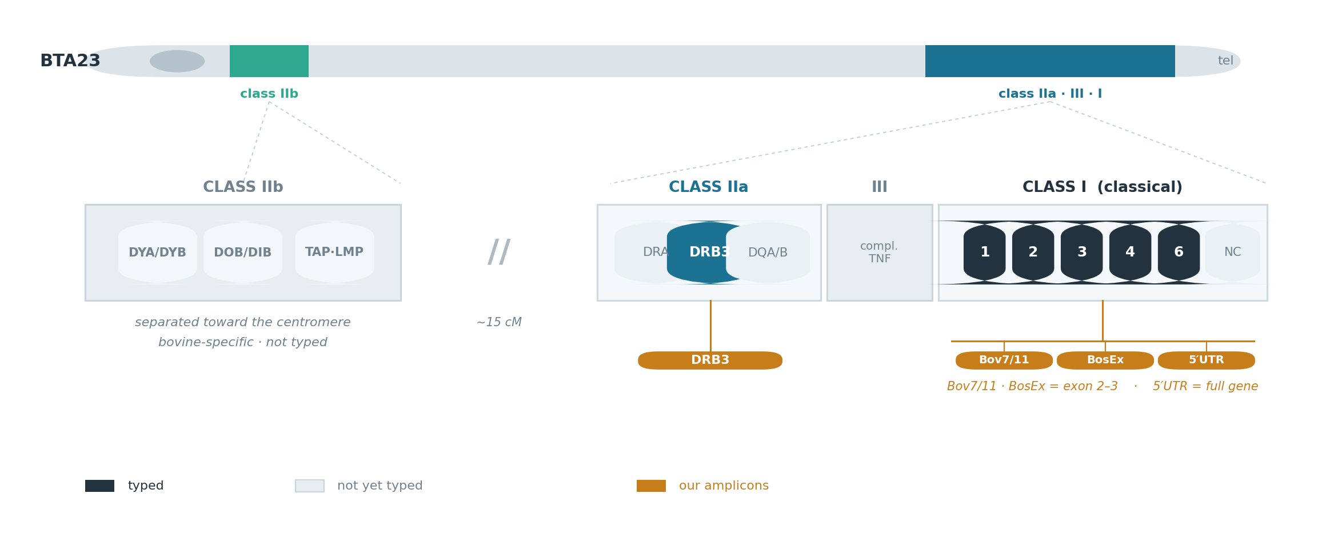
WHERE IT LIVES
The BoLA region on chromosome 23

Slide 5
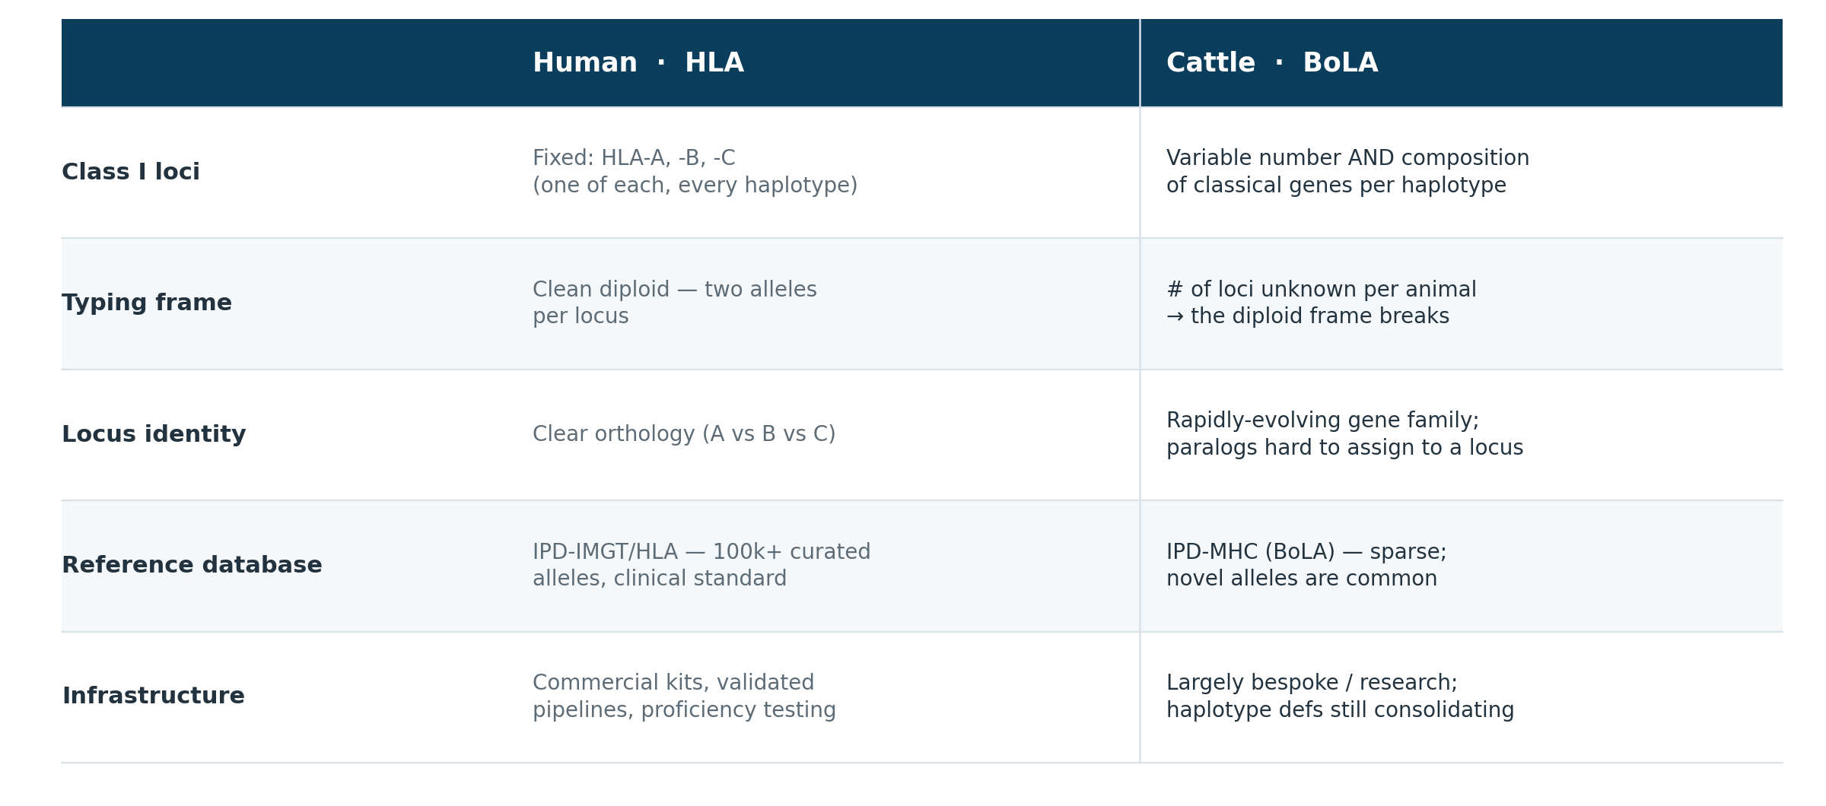
CATTLE ≠ HUMAN
Why human HLA methods don't transfer

Slide 6
THE HARD PART
Why MHC typing is technically hard
Six problems the pipeline must solve — several unique to multi-copy Class I.
1
Extreme polymorphism — the MHC is the most variable region of the genome; new alleles keep appearing
2
Paralog knife-edge — over ~600 bp, read error ≈ paralog divergence, so genome-mapping collapses the copies onto one locus
3
Unknown copy number — can't assume two alleles per locus when the gene count varies between haplotypes
4
Amplicon trade-off — short amplicons sequence deep but can't say which gene a variant is from; long-range resolves copies but is hard to sequence
5
Basecalling accuracy — read error must sit below allele divergence; FAST/HAC isn't enough, SUP is required (our cohort was FAST)
6
Database gaps — a true novel allele vs a sequencing artifact can't be told from IPD alone → orthogonal confirmation (Arm B)

Slide 7
THE CENTRAL STORY
One method, two very different problems
CLASS I
CLASS II · DRB3 (pending DQA/DQB)
Multi-gene, copy-number-variable
Single locus, two alleles
Several BoLA-1/2/3/4/6 genes per haplotype, and the number varies between animals.
→ HARD: paralogs are too similar to separate and too divergent to be one locus. Calls are unstable.
One gene, one pair of alleles per animal — exactly what a diploid model expects.
→ CLEAN: reproducible genotype, ready to report.
This biological difference drives the entire pipeline design — and every result.

Slide 8
WHAT HAVE WE SEQUENCED
Four amplicons on Nanopore MinION
Amplicon
Product
Class
Role
Bov7/11
~610 bp gDNA
Class I
Classical exon 2–3 · primary
BosEx
~690 bp gDNA
Class I
Classical exon 2–3 · orthogonal cross-check
5′UTR
~3.5–5 kb gDNA
Class I
Full gene (exon 1→4) · resolves gene copies
DRB3
~594 bp gDNA
Class II
Single-locus typing
R10.4.1 · SQK-NBD114-96 · dorado SUP v5.2.0 · 24 Dairy Complex animals · ARS-UCD2.0 + IPD-MHC · DQA/DQB pending for full MHC-II

Slide 9
01
The Workflows
The pipeline, end to end, for each MHC class

Slide 10
CLASS I PIPELINE · BOV7/11 · BOSEX · 5′UTR
Class I — cluster-first
Reference mapping collapses paralogs, so we separate genes by sequence, not position.
1
Merge + QC filter — nanoq; short 400–950 bp Q10, 5′UTR 2500–6000 bp Q8
2
On-target reads — minimap2 → ARS-UCD2.0 chr23 MHC window; ref-oriented
3
Cluster (reference-free) — vsearch, id 0.88 short / 0.85 long — separates the genes
4
Consensus per cluster — spoa draft → medaka polish (R10.4.1 SUP)
5
Diploid split — bcftools ploidy-2: allele-1 = majority, allele-2 = het-ALT
6
Assign + tier — BLAST → IPD BoLA_nuc+gen: CONFIRMED / candidate→ArmB / NC / review
7
Cross-amplicon reconcile — Bov7/11 + BosEx + 5′UTR — concordance = confidence
8
Haplotype call — confident alleles → Tim's MHCI workbook → HP1.* pair

Slide 11
CLASS II PIPELINE · DRB3
Class II (DRB3) — direct
Single locus with two alleles — no clustering or phasing needed.
1
Merge + QC filter — nanoq; 400–850 bp Q10
2
BLAST reads → IPD BoLA_nuc (DRB3) — best hit per read
3
Call genotype — top-2 distinct allele groups = the diploid pair (het / hom)
4
MHCII haplotype (optional) — DRB3 allele → Tim's MHCII workbook
Result: 23/24 clean DRB3 genotypes (1 PCR failure). Pending: DQA/DQB amplicons — will complete the MHC-II (HP2) haplotype beyond DRB3.

Slide 12
THE CRITICAL FINDING
Short-amplicon Class I doesn't reproduce
Same animal (3300), two independent class-I primer sets, calls at gene level:
Bov7/11
BosEx
BoLA-1*009/*019 · BoLA-2*008/*025 · BoLA-4*024
≠
BoLA-1*031 · BoLA-2*018/*071 · BoLA-3*033
overlap: none — only ~3 of ~40 class-I alleles agree across the two amplicons cohort-wide
Why: multi-copy collapse (or genuinely >2 gene copies) means each primer set samples a different slice of a large gene family — so the calls don't replicate.
Consequence: class-I allele calls and MHCI haplotypes are provisional leads, not final genotypes — they need the long-range 5′UTR (adequate depth) or orthogonal Arm B (independent Sanger or MiSeq) confirmation. DRB3 (single-copy) reproduces perfectly, which proves the pipeline is sound; the class-I difficulty is the biology.

Slide 13
THE DELIVERABLE
Per-animal report + browsable HTML sheet
One row per animal: class-I alleles by gene · haplotype · DRB3 · reflex flags · per-amplicon QC.
3209
BoLA-1*019:01 | BoLA-2*012:01 + *008:03 | BoLA-3*086:01N | – | –
class-I haplotype: HP1.A10.1 / HP1.A12* DRB3: *010:01 / *015:01
flags: NC1, NC9 detected · 3 candidates → Arm B
QC: Bov7/11 52k ✓ BosEx 77 ⚠ 5′UTR 205 ✓
green = confirmed / concordant amber = single-amplicon candidate → Arm B QC ✓ / ⚠ = per-amplicon depth
Deliverable files · Desktop/BoLA/results/
per_animal_report.html — color-coded, browsable, self-contained (opens in any browser)
per_animal_report.txt · reconciled_alleles.tsv · drb3_typed.tsv · per-amplicon TSVs (Bov7/11, BosEx, 5′UTR)

Slide 14
02
Technical Detail
Tools, references, parameters, and the design rationale

Slide 15
FOR THE BIOINFORMATICIAN
Class I — tools, references, parameters
Aligner
minimap2 -x map-ont --secondary=no --MD
Reference
ARS-UCD2.0 chr23 MHC window (NC_037350.1 : 27.8–28.7 Mb)
Clustering
vsearch --cluster_size, id 0.88 short / 0.85 long, --strand plus on ref-oriented reads (pysam query_sequence)
Consensus
spoa draft → medaka r1041_e82_400bps_sup_v5.2.0
Variants / phasing
bcftools mpileup+call --ploidy 2; allele-2 via -H2 het-ALT (HapCUT2 read-backed phasing also validated)
Assignment
BLASTN vs IPD-MHC BoLA_nuc + BoLA_gen (genomic ref essential: gDNA amplicons span introns)
Tiers
100% exact = CONFIRMED · <100% no-indel = CANDIDATE_NOVEL→ArmB · NC*→diagnostic · indel/no-hit→review
Why cluster-first: over 600 bp, ONT error (~5%) ≈ paralog divergence, so genomic-position mapping collapses paralogs onto one “locus” (54 variants, tri-allelic sites, VAF smear). Long 5′UTR reads carry enough unique sequence to separate them.

Slide 16
FOR THE BIOINFORMATICIAN
Class II, reconciliation & haplotypes
DRB3 typing
BLASTN reads → IPD BoLA_nuc; top-2 distinct allele groups = genotype. Validated against a full minimap2 → bcftools → HapCUT2 phasing run — identical two alleles at 99.6–100%.
Cross-amplicon reconciliation
Join amplicons per animal. HIGH = ≥2 amplicons concordant · CONFIRMED = single 100% · PROVISIONAL = single candidate. Concordance is the confidence metric.
Haplotype calling
Specificity-weighted match to Tim's workbook (487 MHCI, 271 MHCII haplotypes); require ≥1 discriminating allele so common alleles don't over-call. MHCII under-determined from DRB3 alone — DQA/DQB pending to complete HP2.

Slide 17
PROVENANCE · SHARING BACK
Built on Istvan Albert's pipeline
The genome-coordinate backbone — minimap2 → bcftools → HapCUT2 → consensus → peptides — is his. We validated it, and extended it for multi-copy Class I.
ADOPTED FROM ISTVAN
OUR MODIFICATIONS
minimap2 map-ont genome alignment
bcftools mpileup + call diploid variant calling (flags, AD/ADF/ADR)
HapCUT2 read-backed phasing (extractHAIRS → HAPCUT2)
bcftools consensus -H1/-H2 haplotype reconstruction
MIN_FRAC on-target alignment filter
bam2pep.py peptide translation (for the immunology layer)
Cluster-first (vsearch) before phasing — his single-region diploid model collapses multi-copy Class-I paralogs (54 vars, tri-allelic, VAF smear); works as-is for single-copy DRB3
medaka SUP polishing for consensus accuracy
IPD-MHC BLAST assignment + confidence tiers + novelty flagging
cross-amplicon reconciliation + haplotype calling (Tim's workbook)
per-barcode driver + 128-core parallelization
Sharing the modifications back — the phasing backbone is his; the multi-copy handling is our delta.

Slide 18
HANDOVER
Open problems & next steps
1
Deeper 5′UTR coverage
The real class-I resolver — this run's long-range library sequenced mostly short fragments (median 805 bp). Long full-length reads separate the gene copies.
2
Arm B orthogonal confirmation
Sanger / MiSeq for candidate alleles and second alleles — required to promote any class-I call from provisional.
3
Resolve the copy-number question
Is class I truly diploid per gene, or >2 copies? Determines whether “diploid typing” is even the right frame.
4
BosEx ~2-SNP offset
Classical hits land ~99.2% vs IPD — basecaller artifact or a real cohort-vs-reference difference?
5
DQA/DQB (pending)
Amplicons in progress — will complete MHC-II (HP2) haplotypes beyond DRB3.
All pipelines parallelized on WGS3 (128-core) · scripts in /home/vxk1/BoLA_MHC/scripts

