Slide 1
Sequencing the Bovine MHC on Oxford Nanopore
Amplicon PCR, native barcoding, and what it means for the analysis
gDNA → locus PCR → native barcoding → MinKNOW → typing · R10.4.1 · SQK-NBD114 · dorado SUP
Kapur Lab · Penn State · Animal Science

Slide 2
WHY NANOPORE
Why Oxford Nanopore for this problem
Long reads + native multiplexing make allele-level MHC typing tractable, and cheap.
1
Long reads — span full genes (the 3.6 kb 5′UTR amplicon) and phase paralogs; short reads can't
2
Native multiplexing — up to 96 barcoded samples pooled on a single flow cell
3
Low cost & portable — modest capital, real-time data, runs in-house on a MinION
4
Accuracy is now sufficient — R10.4.1 + SUP basecalling reaches the per-read accuracy allele typing needs
5
Validated for HLA typing — multiplexed-PCR MinION reaches 99.5–100% concordance [Liu 2021; Matern 2020]; proven for multi-copy MHC/KIR incl. macaque MHC [Bruijnesteijn 2021; de Groot 2024]

Slide 3
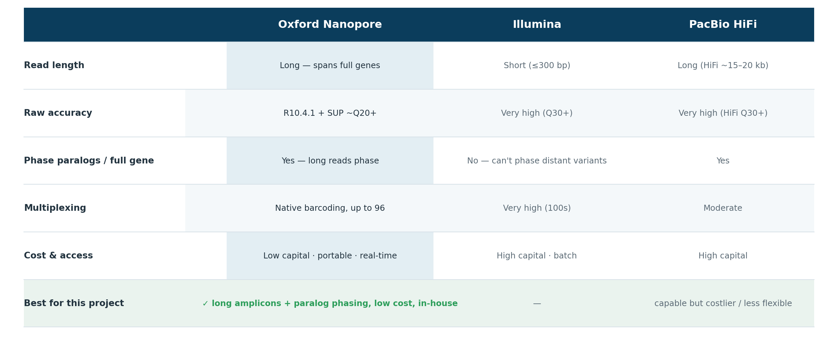
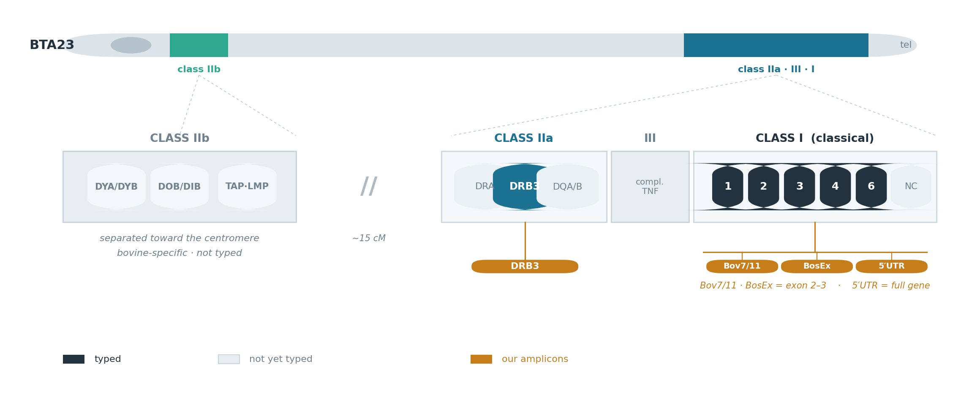

Slide 4
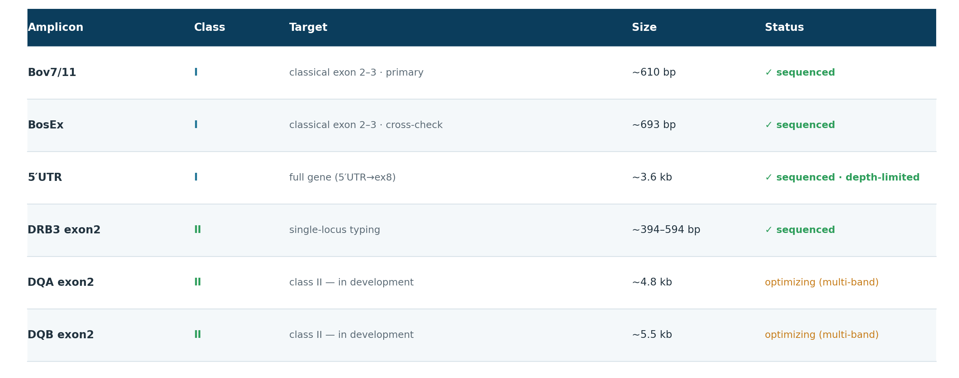

Slide 5
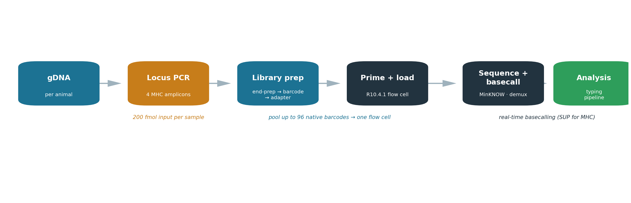

Slide 6
LIBRARY PREP · SQK-NBD114 NATIVE BARCODING
Four stages to a loadable library
~140 min bench time; each stage can pause overnight at 4 °C.
1
End-prep — repair ends + dA-tail; 200 fmol amplicon input per sample (NEBNext Ultra II)
2
Native barcode ligation — one unique barcode per sample (NB01–96), then pool all samples into one tube
3
Adapter ligation — ligate the sequencing (motor-protein) adapter; clean up at 0.4× beads
4
Size-selection lever — LFB enriches ≥3 kb (for the 5′UTR long-range); SFB keeps all sizes (amplicon panel) — never ethanol, it denatures the motor
5
Prime & load — check ≥800 active pores; load by fragment length, dropwise onto the SpotON port

Slide 7
SEQUENCING & BASECALLING
Running the flow cell — signal to reads
R10.4.1 flow cell; MinKNOW acquires, basecalls and demultiplexes in real time.
1
Flow cell check — warm to RT, run a pore check; don't start below 800 active pores (SOP-016)
2
Prime carefully — air in the sensor array is irreversible; the top cause of a low starting pore count
3
Watch the first 30 min — the window that reveals a priming or loading problem
4
Basecall + demux — MinKNOW real-time by barcode; but its default is FAST/HAC — MHC needs SUP re-basecalling

Slide 8
IMPLICATIONS
What the chemistry forces on the analysis
The wet-lab choices above set the constraints the pipeline has to handle.
1
Error ≈ paralog divergence — → SUP basecalling + cluster-first (not genome-mapping) for multi-copy Class I
2
Barcode demux is imperfect — → misassignment risk; use barcode-both-ends and a per-barcode depth gate
3
PCR chimeras — paralogs recombine in PCR → false alleles; consensus + filters guard (enrichment avoids it, [Bruijnesteijn 2021])
4
Amplicon length is real — the 5′UTR long-range must actually yield long fragments (LFB), or it stays undersampled
5
Amplicon ≠ copy number — PCR panels can't count gene copies → Class I stays provisional
6
Basecalling model matters — real-time FAST/HAC isn't enough; re-basecall SUP (our cohort was FAST)

Slide 9
TAKEAWAYS
What to remember
1
Long reads, cheaply multiplexed
Native barcoding pools up to 96 samples on one MinION flow cell; long reads phase paralogs and span full genes — validated for HLA and multi-copy immune regions.
2
Buffer choice is the biggest lever
LFB vs SFB (and bead ratio) set size-selection and yield — exactly what the 5′UTR long-range amplicon needs to sequence at length.
3
Basecalling model is not a detail
MinKNOW's real-time default is FAST/HAC; multi-copy Class I needs SUP — the reason we re-basecall on the GB10.

