Slide 1
Collaborative Filtering
CMSC498K Survey Paper
Presented by Hyoungtae Cho

Slide 2
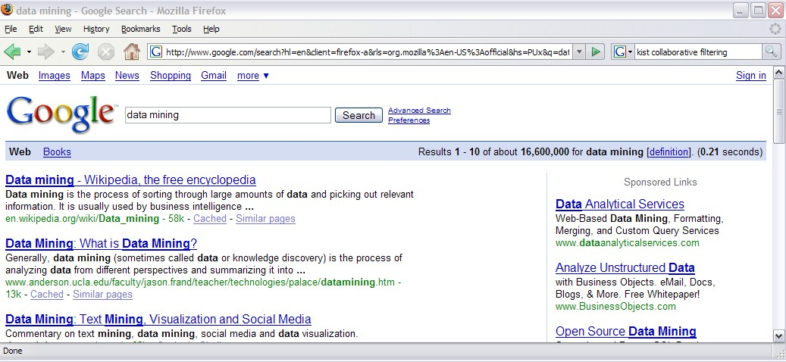
Collaborative Filtering in our life

Slide 3
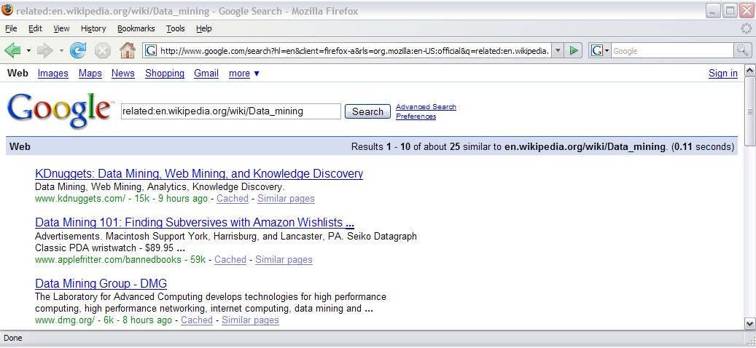
Collaborative Filtering in our life

Slide 4
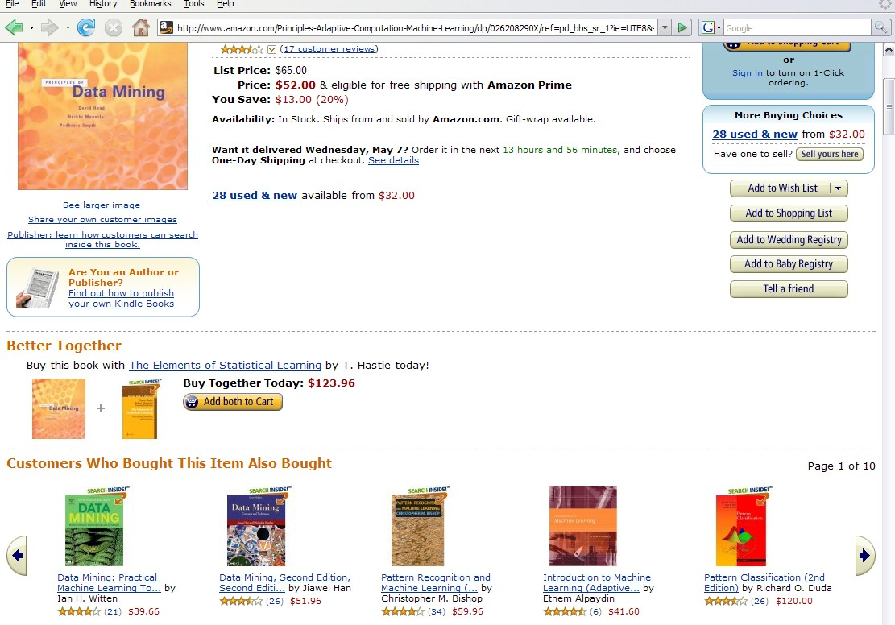
Collaborative Filtering in our life

Slide 5
Motivation of
Collaborative Filtering (CF)
Need to develop multiple products that meet the multiple needs of multiple consumers
One of recommender systems used by E-commerce
Laptop -> Laptop Backpack
Personal tastes are correlated

Slide 6
Basic Strategies
Predict the opinion the user will have on the different items
Recommend the ‘best’ items based on the user’s previous likings and the opinions of like-minded users whose ratings are similar

Slide 7
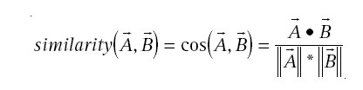
Traditional Collaborative Filtering
Nearest-Neighbor CF algorithm
Cosine distance
  For N-dimensional vector of items, measure two customers A and B

Slide 8
Traditional Collaborative Filtering
If we have M customers, the complexity will be O(MN)
Reduce M by randomly sampling the customers
Reduce N by discarding very popular or unpopular items
Can be O(M+N), but …

Slide 9
Clustering Techniques
Work by identifying groups of consumers who appear to have similar preferences
Performance can be good with smaller size of group
May hurt accuracy while dividing the population into clusters

Slide 10
Search or Content based Method
Given the user’s purchased and rated items, constructs a search query to find other popular items
For example, same author, artist, director, or similar keywords/subjects
Impractical to base a query on all the items

Slide 11
User-Based Collaborative Filtering
Algorithms we looked into so far
Complexity grows linearly with the number of customers and items
The sparsity of recommendations on the data set
  Even active customers may have purchased well under 1% of the products

Slide 12
Item-to-Item
Collaborative Filtering
Rather than matching the user to similar customers, build a similar-items table by finding that customers tend to purchase together
Amazon.com used this method
Scales independently of the catalog size or the total number of customers
Acceptable performance by creating the expensive similar-item table offline

Slide 13
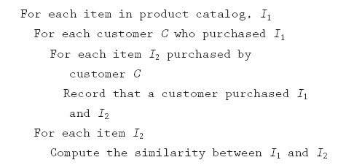
Item-to-Item CF Algorithm
O(N^2M) as worst case, O(NM) in practical

Slide 14
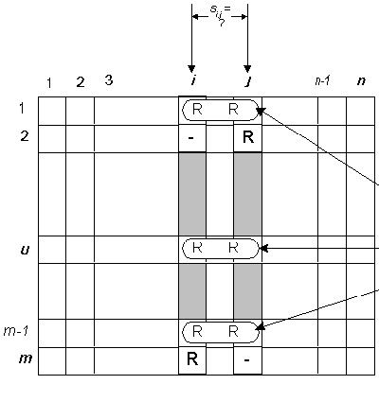
Item-to-Item CF Algorithm
Similarity Calculation
Computed by looking into
co-rated items only. These co-rated pairs are obtained from different users.

Slide 15

Item-to-Item CF Algorithm
Similarity Calculation
For similarity between two items i and j,

Slide 16
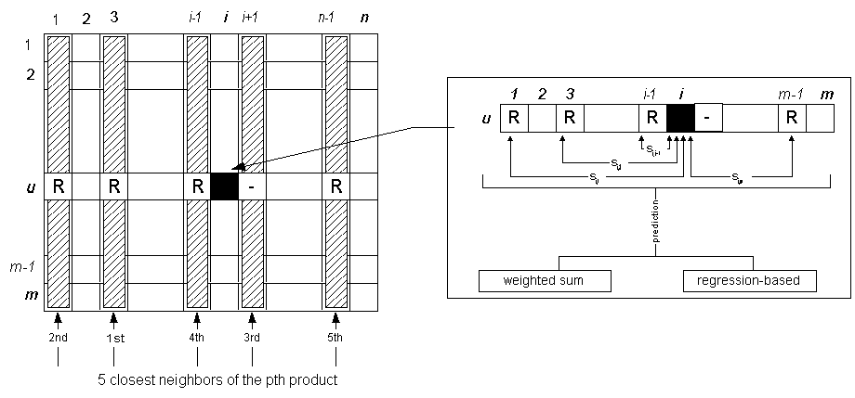
Item-to-Item CF Algorithm
Prediction Computation
Recommend items with high-ranking based on similarity

Slide 17

Item-to-Item CF Algorithm
Prediction Computation
Weighted Sum to capture how the active user rates the similar items
Regression to avoid misleading in the sense that two similarities may be distant yet may have very high similarities

Slide 18
References
E-Commerce Recommendation Applications: http://citeseer.ist.psu.edu/cache/papers/cs/14532/http:zSzzSzwww.cs.umn.eduzSzResearchzSzGroupLenszSzECRA.pdf/schafer01ecommerce.pdf
Amazon.com Recommendations: Item-to-Item Collaborative Filtering http://www.win.tue.nl/~laroyo/2L340/resources/Amazon-Recommendations.pdf
Item-based Collaborative Filtering Recommendation Algorithms
http://www.grouplens.org/papers/pdf/www10_sarwar.pdf

