Slide 1

Team Red
Software Assignment and License Tracking System
(S.A.L.T.S.)
Tyson Lucas, Noelle Stark, Frederick Bumgarner, Kara Lynch, Oluwasegun Durosinmi
Notes:
Introduction dialogue: Hello, I’m [introduce myself], [Fred introduces himself]. And We are Team Red, meeting with you all today on behalf of Rocket Software. We are here because the Buzzword Software Solutions Compliance Department had come to us with a contract to create a software that assists in the management of licensed external software. Which, we have come to show you. Team Red has created the Software License Tracking System. → pivot to mission statement.

Slide 2
Product Overview & Mission
Notes:
SALTS is a program built for tracking software licenses. Using software with an expired license can incur legal consequences, and paying for software that the organization isn't using is just wasted money, both of which SALTS is intended to prevent.

Slide 3




TOOLS Used
Programming Language: Python 3.13.7
Web Server Framework: Flask 3.1.2
Database: MySQL 8.0.43
Database Configuration: MySQL Workbench 8.0.36
Documentation: Sphinx 7.2.6
Automated Testing: Pytest 8.4.2
Notes:
Project made using Python, Web Server will be Flask, DB is MySQL.
For our branching strategy, we use dev branches. We each have our own branch we push changes to, then when we were ready for integration we merged our branches into the Integration branch. Once the Integration branch was in a function state, we merged it with Main to indicate a new release.

Slide 4
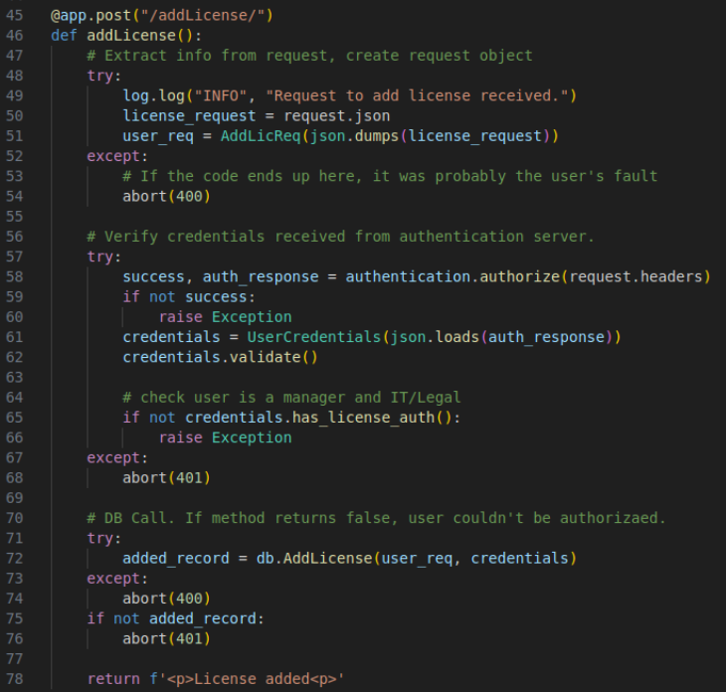
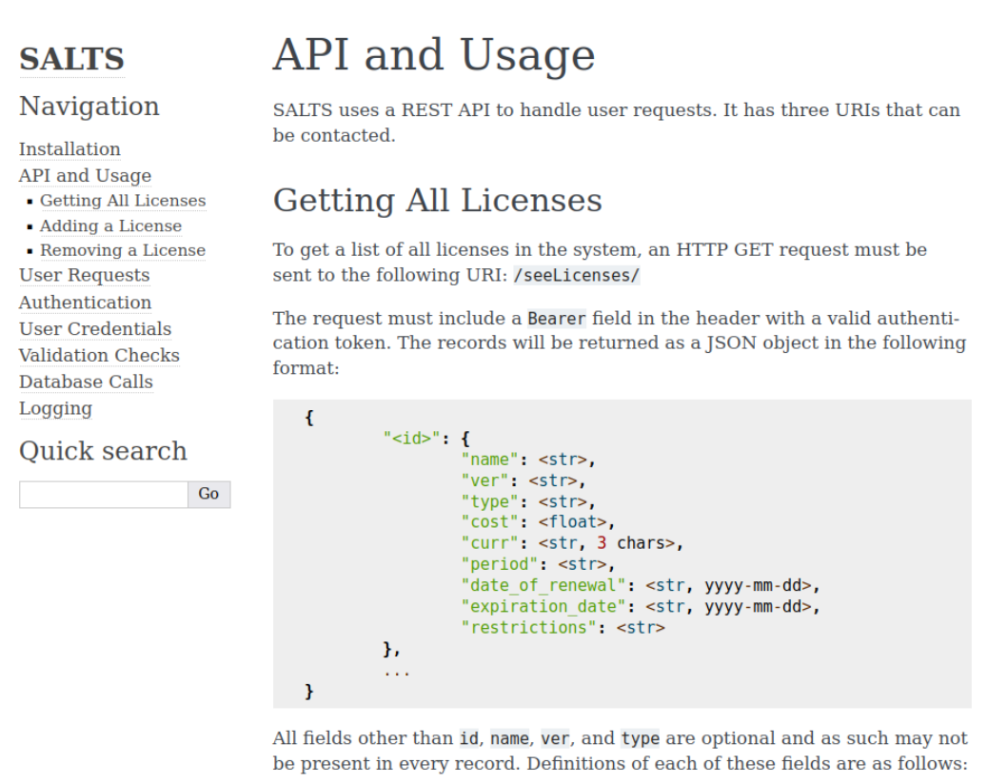
Flask webserver
Notes:
Our codebase is designed to be as modular as possible, so anyone else can modify their section of the code and things will still work so long as they return the same formatted data. Most of the logging is also within the modules, including high-priority error messages and warnings for things like incomplete fields or failed authentication.
API is designed to deal with errors gracefully, so if any piece of the request is missing then the API will return a 400, but if the issue is instead with their token it will return a 401 error.
We want to check that the user request is in the right format before contacting the auth server, so we create an object for this specific request type, adding a license, which will be automatically validated to make sure it follows the right format. If it doesn't, 400 error.
We then contact the authorization server. If the token can't be authenticated, the returned user credentials are wrong, or the user is employee-level, 401 error.
Then we send the credentials and request objects to the DB module which re-validates that the user has the right permissions, then it adds the license using the data from the UserRequest object.
If the DB returns that it couldn't add the record, an issue with the user credentials has occurred, so 401 error. If any other exception occurs we give a 400 error, and otherwise we return a message to the user telling them the new record was added.
You can see we do logging throughout, especially in the entity classes and modules called by the API, so we can track

Slide 5
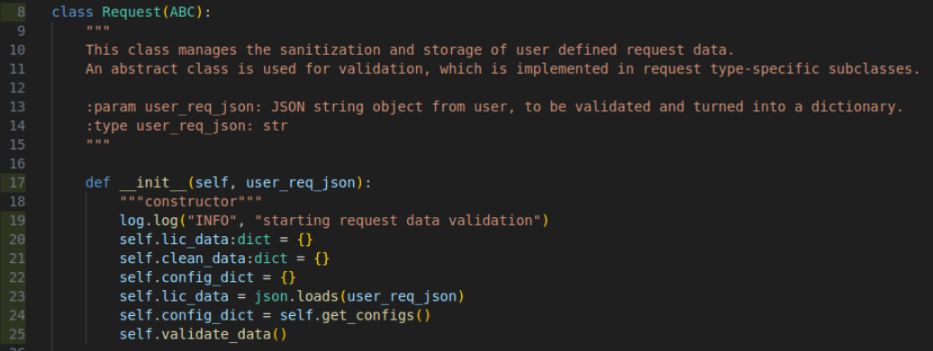
REQUEST CLASS

Slide 6
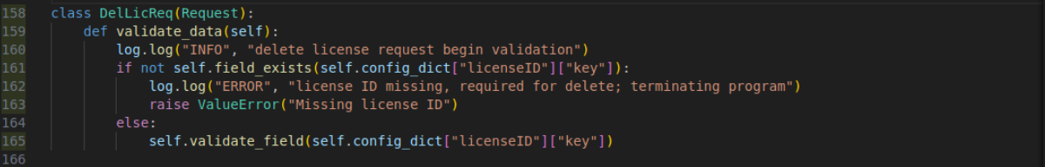
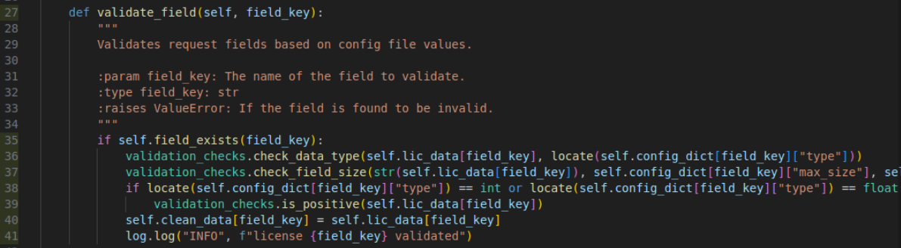
REQUEST VALIDATION

Slide 7
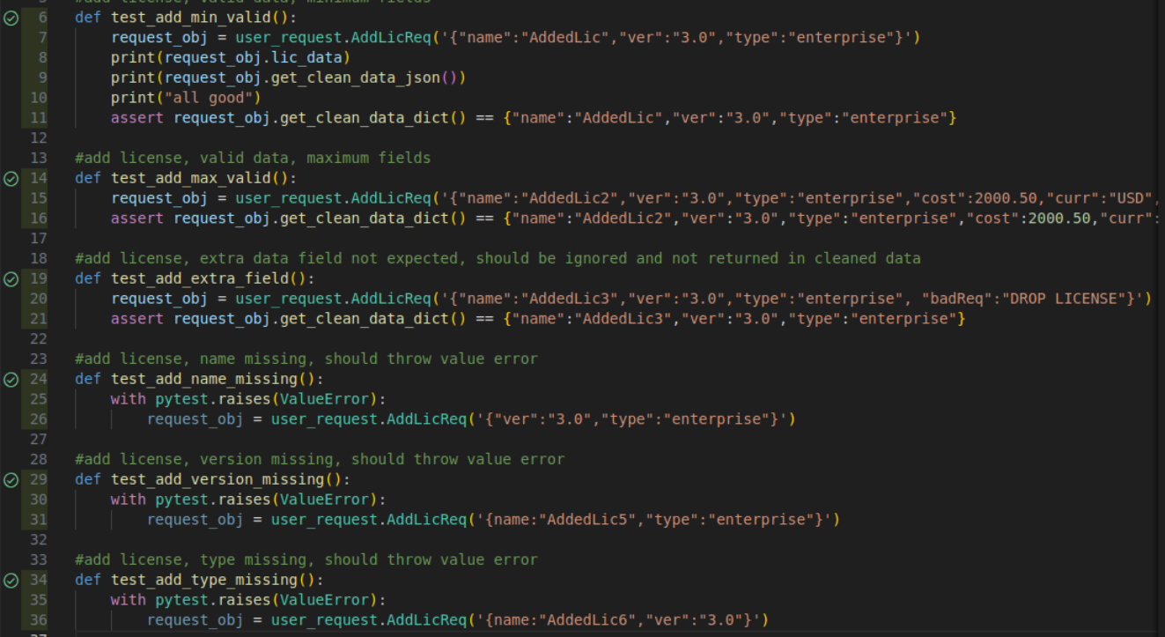
AUTOMATED TESTING

Slide 8
DOCUMENTATION - Sphinx

Slide 9
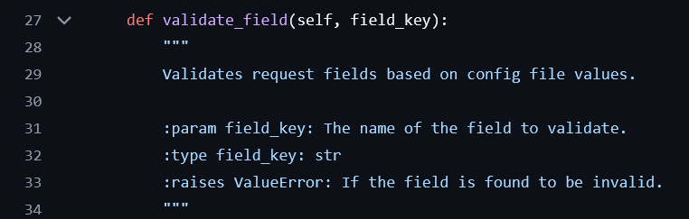
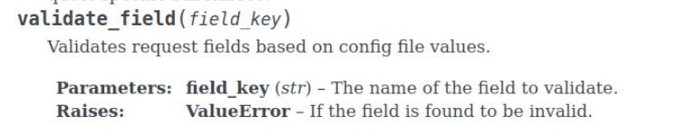
DOCUMENTATION - Sphinx

Slide 10

DATABASE
DATABASE
🔐 User Access
  Created different user accounts with limited access.
  Regular employees can only view data.
  Managers have full access to add, update, and delete.
🧹 Clean Data Handling
  Set up the database so that when a license ID is deleted, related data in other tables is also removed automatically.
🛠️ Tools Used
  Used MySQL for building and managing the database.
📜 Setup Scripts
  Wrote two SQL scripts:
    One to create tables and set rules.
    One to insert sample data for testing.

Slide 11
License DAO
Architecture & Functionality
DAO interaction with other modules
Purpose of DAO: Acts as an abstraction layer between the application and the database. It encapsulates all the logic for accessing data, so other parts of the system don’t need to know how the data is stored or retrieved.
Data Operations:
  AddLicense: Inserts license data and optional metadata into multiple tables.
  DeleteLicense: Removes license records from database tables.
  SeeLicenses: Retrieves and compiles license data from multiple joined tables.
Credentials Manager Module: Ensures only authorized users can perform certain actions by checking permissions before executing queries.
User Request Module: Provides cleaned and validated input data to the DAO. It abstracts away raw user input and ensures data integrity.
Logger Module: Captures errors and important events during DAO operations, aiding in debugging and monitoring.
Settings Module: Supplies configuration details like database credentials, keeping sensitive info out of the codebase.
Notes:
Separation of Concerns: DAO keeps database logic separate from business logic, improving modularity and maintainability.
Connection Management: Initializes and manages the database
Authorization Checks: Validates user credentials before performing sensitive operations like adding or deleting records.
Benefits of using a DAO:
Improved testability: You can mock DAO methods in unit tests without touching the actual database.
Scalability: Easy to extend with new methods or switch to a different database backend.
Security: Centralized access control and validation reduce the risk of unauthorized access or SQL Injection.

Slide 12
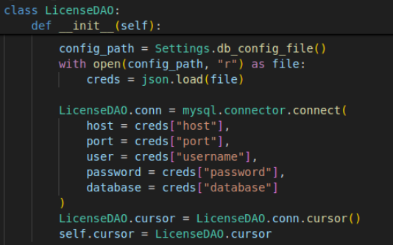
DAO Initialization
Purpose: The __init__ method is responsible for securely establishing a connection to the MySQL database when the LicenseDAO class is instantiated.
Configuration-Driven: It reads database credentials from a centralized configuration file, which promotes security and flexibility. This means credentials aren’t hardcoded, making it easier to manage across environments (e.g., dev, test, prod).
Shared Resources: The method sets up a shared connection and cursor at the class level, ensuring consistent access to the database across all DAO methods.
Error Handling: It includes safeguards to catch issues like missing config files, invalid JSON, or connection failures — helping prevent runtime crashes and making debugging easier.
Notes:
Why It Matters: This setup ensures that all license-related operations (add, delete, search) have reliable access to the database, and it enforces a clean separation between configuration, connection logic, and business functionality.

Slide 13
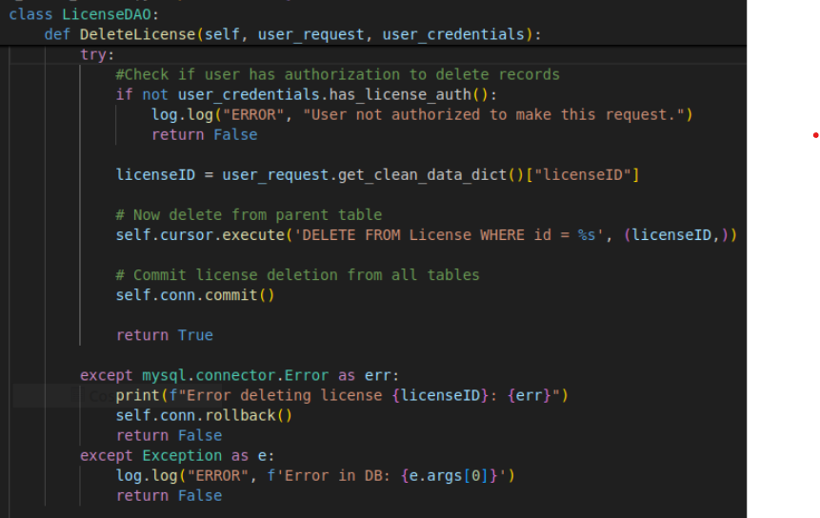
DAO DeleteLicense
Authorization Check: Before any deletion occurs, the method verifies whether the user has the necessary permissions using user_credentials.has_license_auth(). If the user is not authorized, the operation is aborted and an error is logged.
License ID Extraction: The method retrieves the licenseID from the cleaned user request data using user_request.get_clean_data_dict().
Deletion Execution: A SQL DELETE statement is executed to remove the license record from the License table using the provided ID. If the database schema is configured with ON DELETE CASCADE, related records in child tables (e.g., Cost, ExpirationDate, GeogRestriction) will be automatically removed.
Transaction Management: If the deletion is successful, the changes are committed to the database. If an error occurs (either a MySQL-specific error or a general code exception), the transaction is rolled back to maintain data integrity, and the error is logged.
Notes:
Parameters:
- user_request: An object containing the cleaned license data, including the license ID.
- user_credentials: An object representing the user's identity and permissions.
Business Value & Importance
Access Control: Ensures only authorized personnel can delete sensitive license data, protecting against accidental or malicious data loss.
Data Integrity: Uses transaction management to prevent partial deletions or corruption in case of failure.
Scalability: Designed to work seamlessly with cascading deletes, reducing the need for manual cleanup of related records.
Auditability: Logs errors and unauthorized access attempts, supporting traceability and compliance.

Slide 14
Takeaways

Slide 15
Q & A

