Slide 1
Application Servers
Tomcat, GlassFish & WildFly
Three Java servers, three personalities
Notes:
Welcome. Today: three servers, three personalities.

Slide 2

Why do we need them?
Real apps need more than a page that says "Hello"
Today: three Java servers, three personalities.
2
Notes:
Hello World is cute, real apps need more.

Slide 3
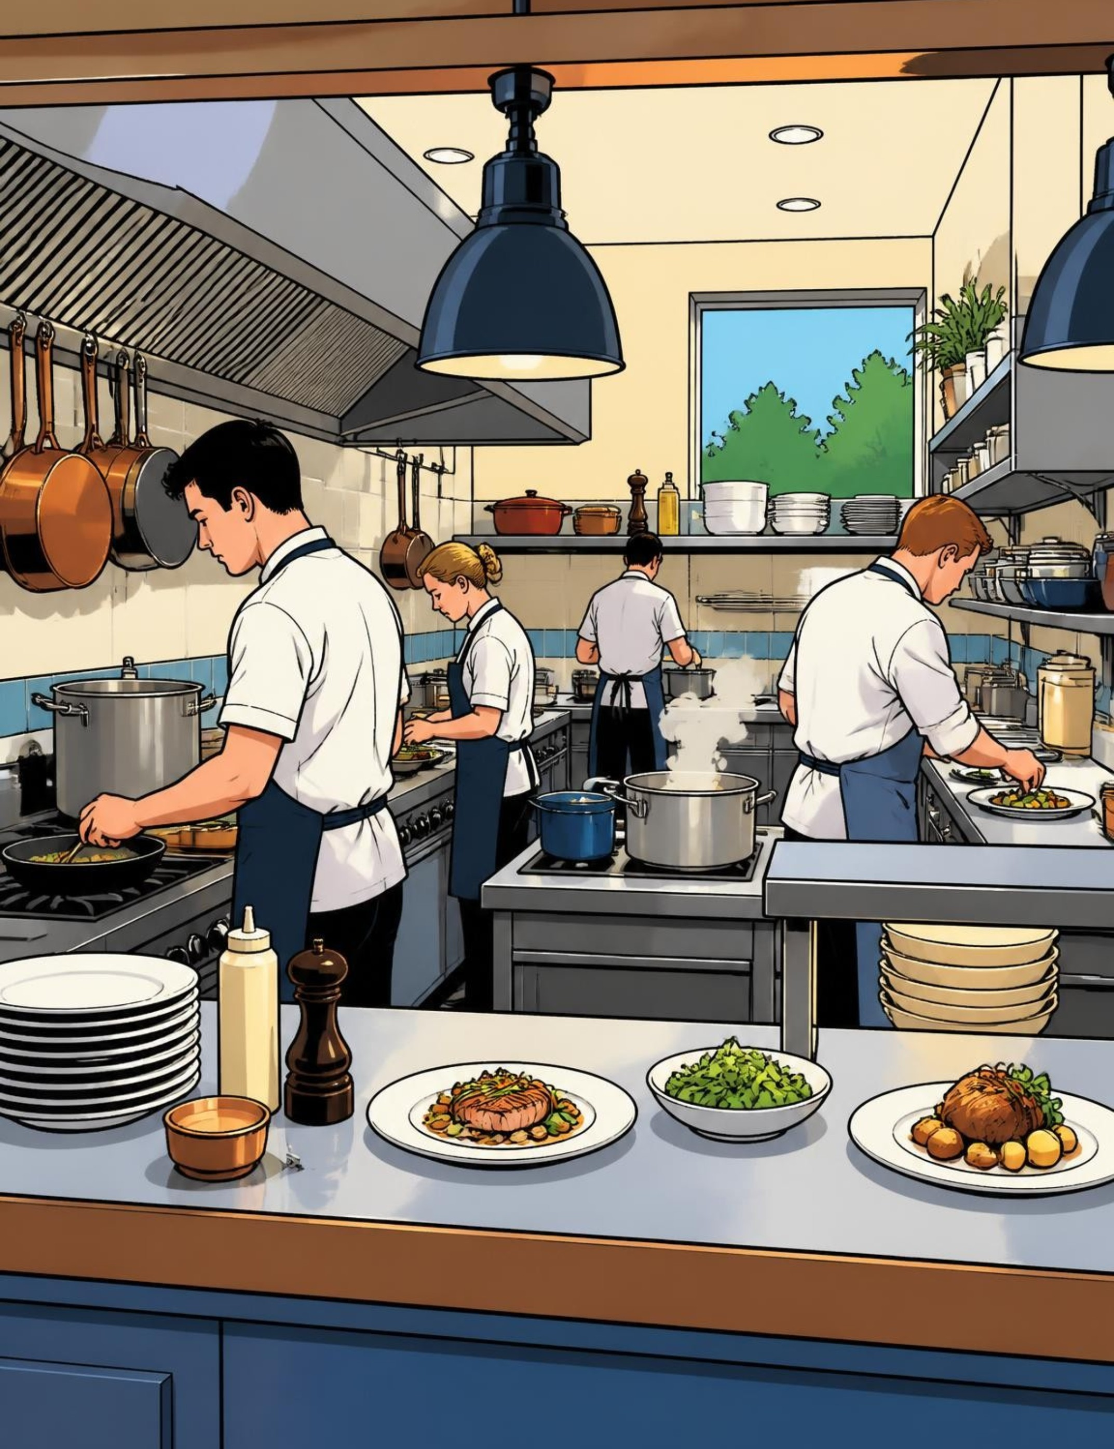
An application server runs your business logic
Hosts Java applications and runs the code behind the screen
Handles security, transactions, database connections
Think: the kitchen of a restaurant
3
Notes:
The kitchen of a restaurant.

Slide 4

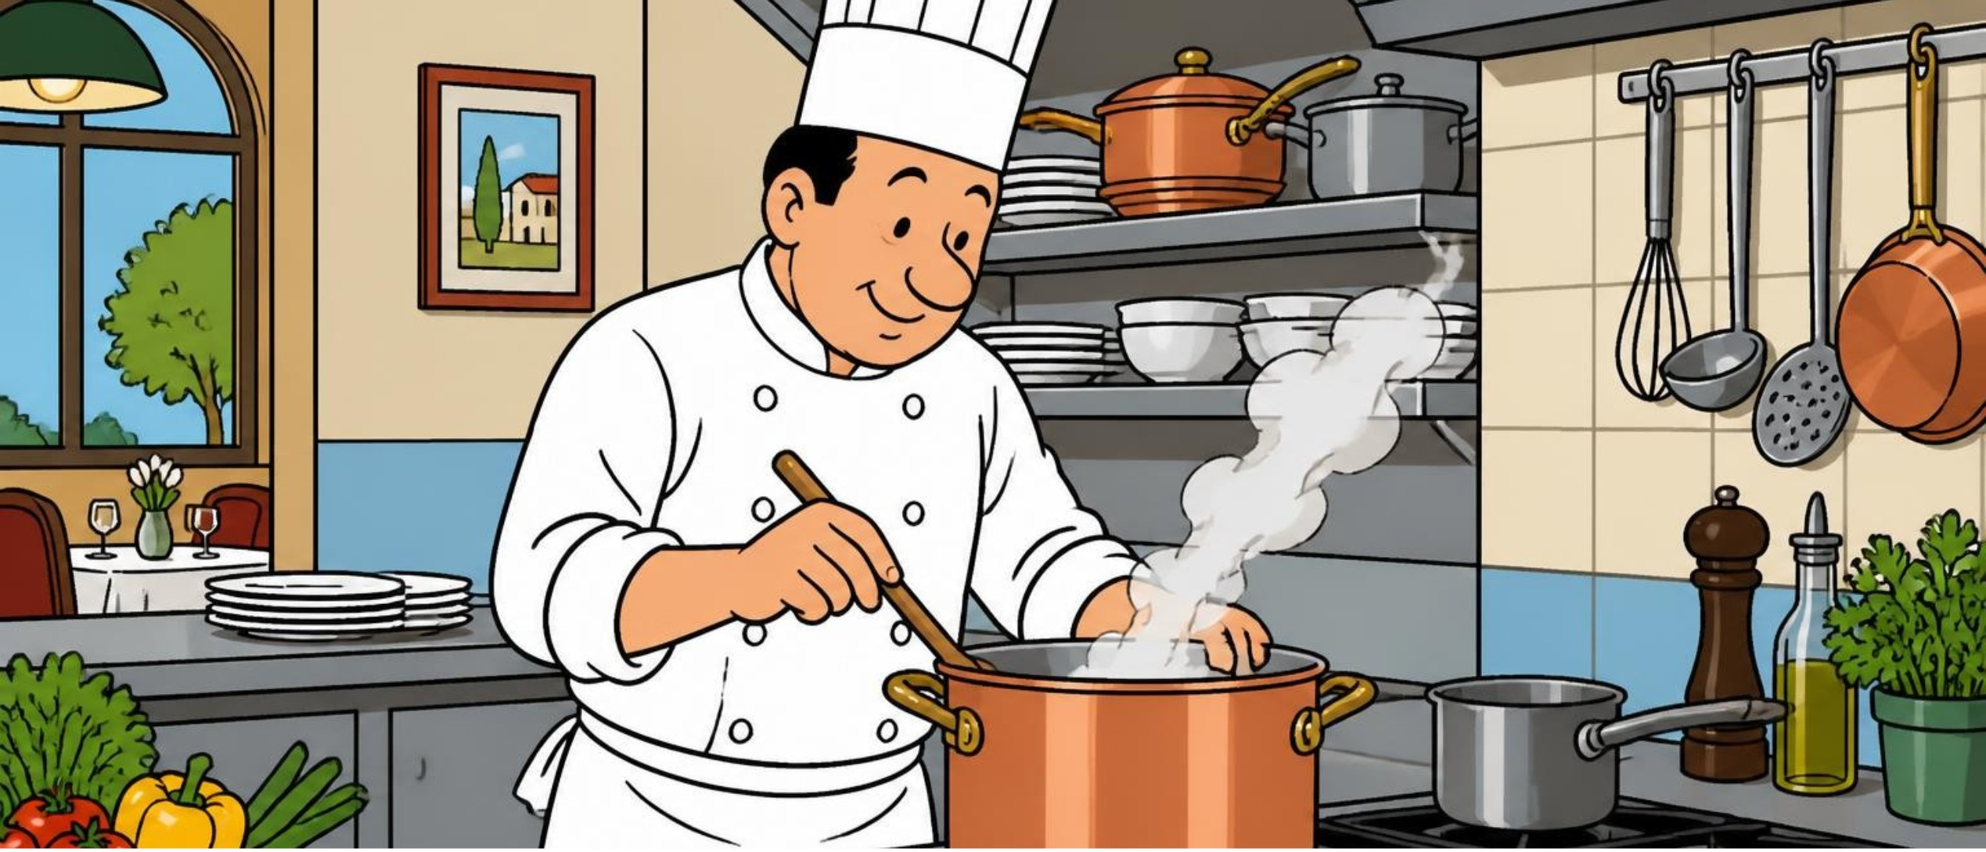
Web server serves pages; app server cooks them
Web server: the waiter
App server: the chef
Delivers static files (HTML, images).
Runs code and talks to databases.
The waiter never burns the food, because he never cooks.
4
Notes:
Pause for the joke.

Slide 5
TODAY
Meet the contenders
Tomcat, GlassFish, WildFly.
Notes:
Three paths ahead.

Slide 6
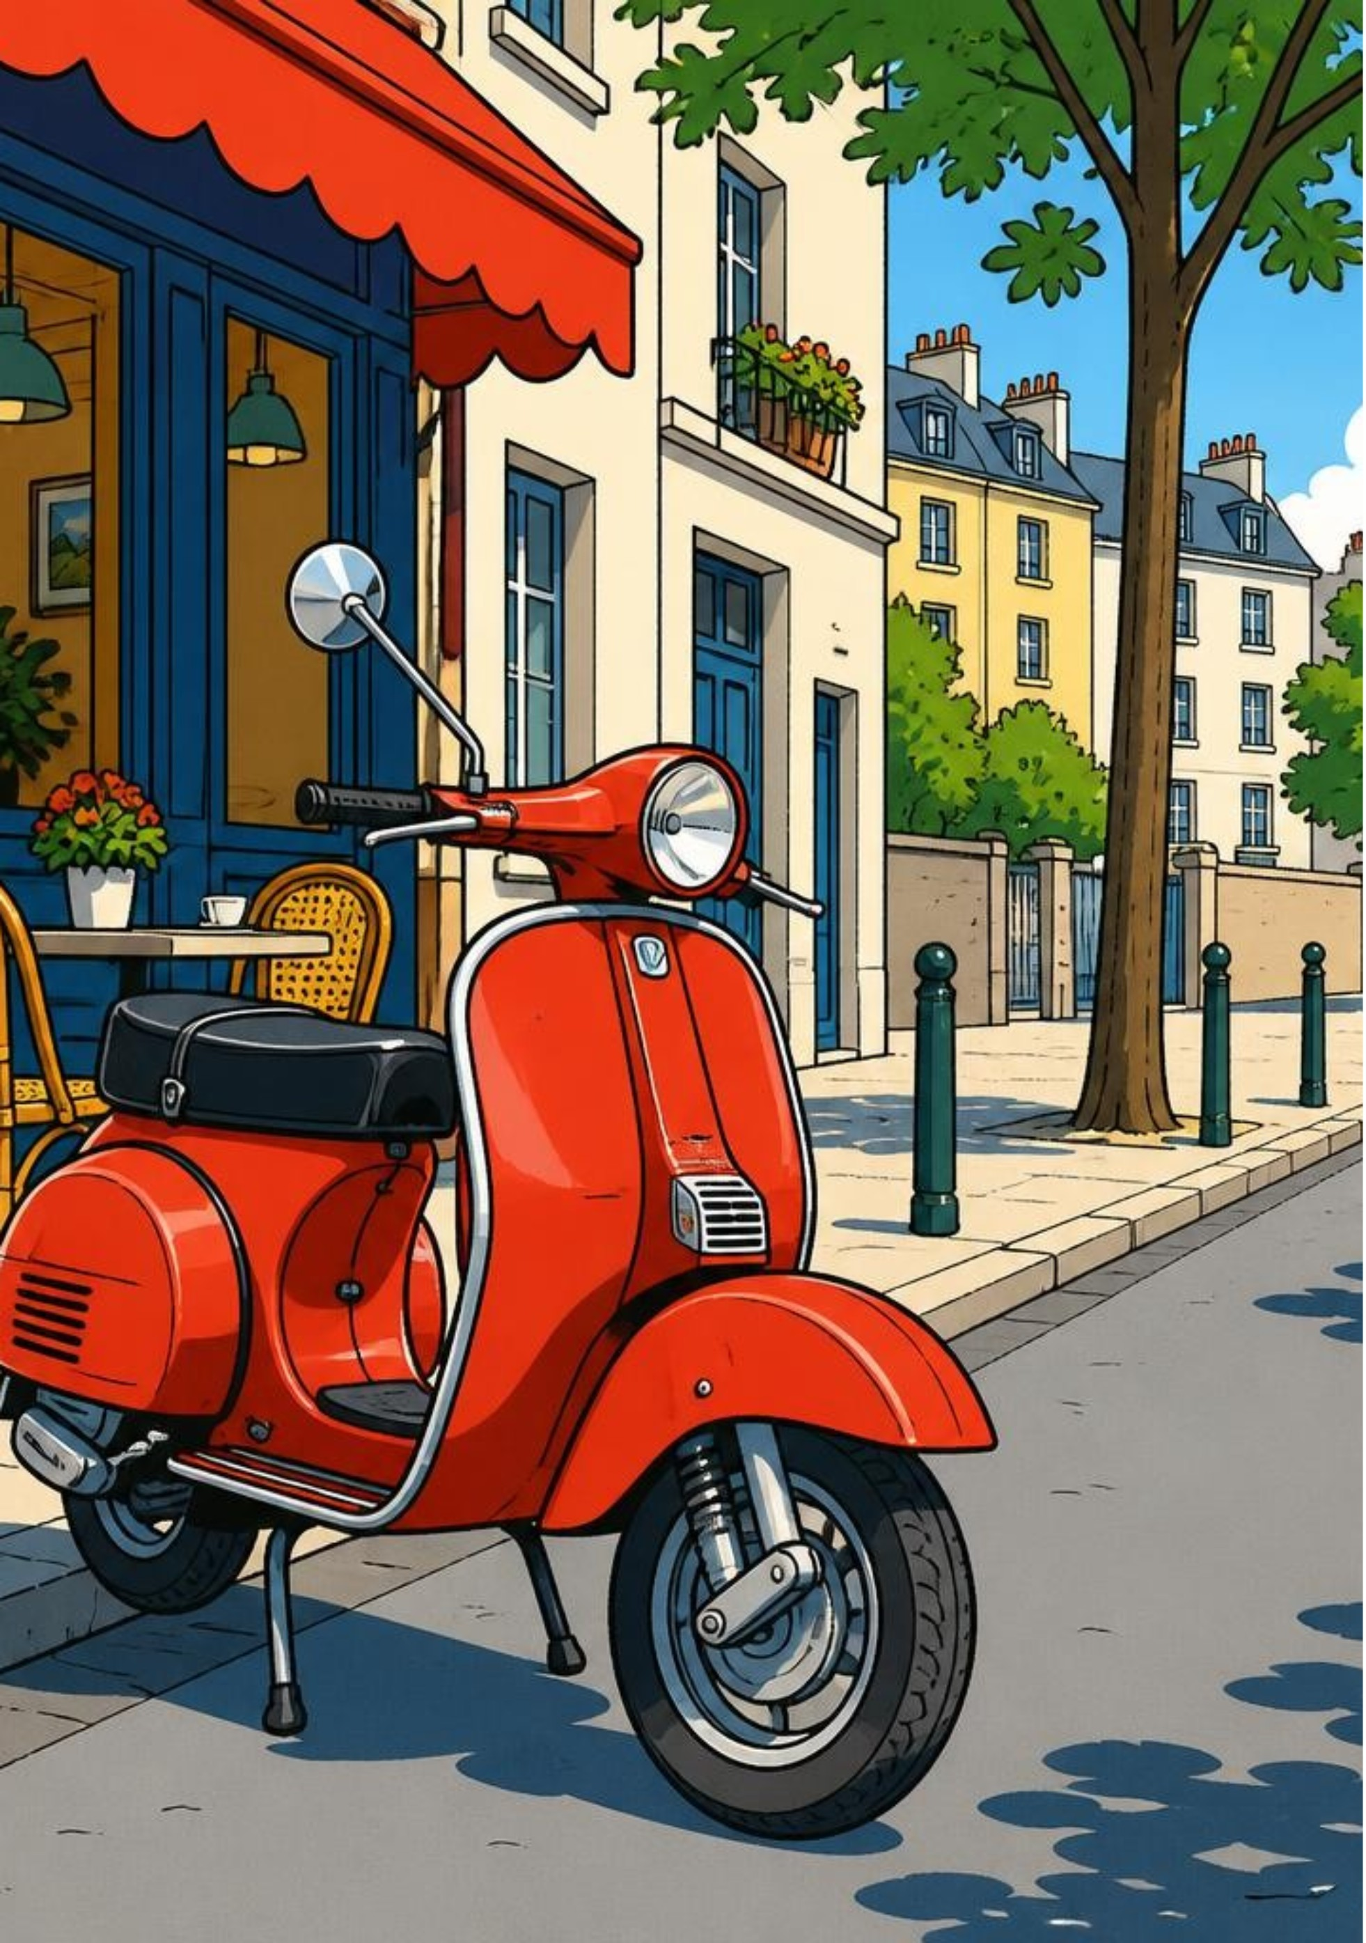
Tomcat: small, fast, no fuss
Lightweight servlet container
Supports Servlets and JSP
No EJB, JMS or JPA out of the box
The scooter of Java servers.
6
Notes:
Light, nimble, parks anywhere.

Slide 7


Tomcat: easy to start, great for simple apps
Strengths
Typical use
Light, simple, easy to configure.
Simple apps and dynamic websites.
7
Notes:
Start small.

Slide 8
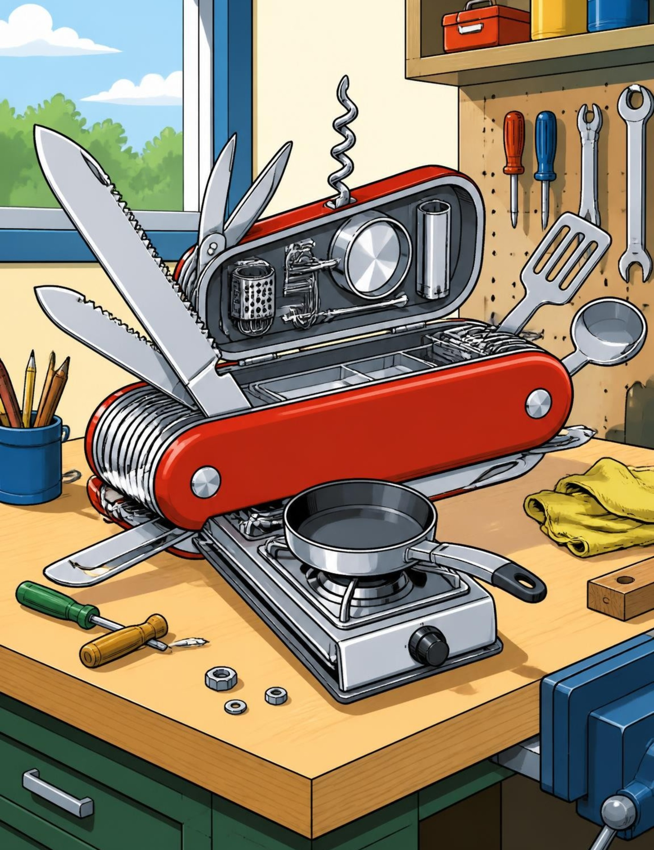
GlassFish: the full Java EE toolbox
Complete Java EE application server
Servlets, JSP, EJB, JPA, JMS, Web Services
The Swiss Army knife that comes with a kitchen.
8
Notes:
Everything included.

Slide 9



GlassFish: standards first, enterprise ready
Administration — web console or config files
Strength — fully compliant with Java EE standards
Typical use — enterprise apps needing EJB and full services
9
Notes:
Standards first.

Slide 10
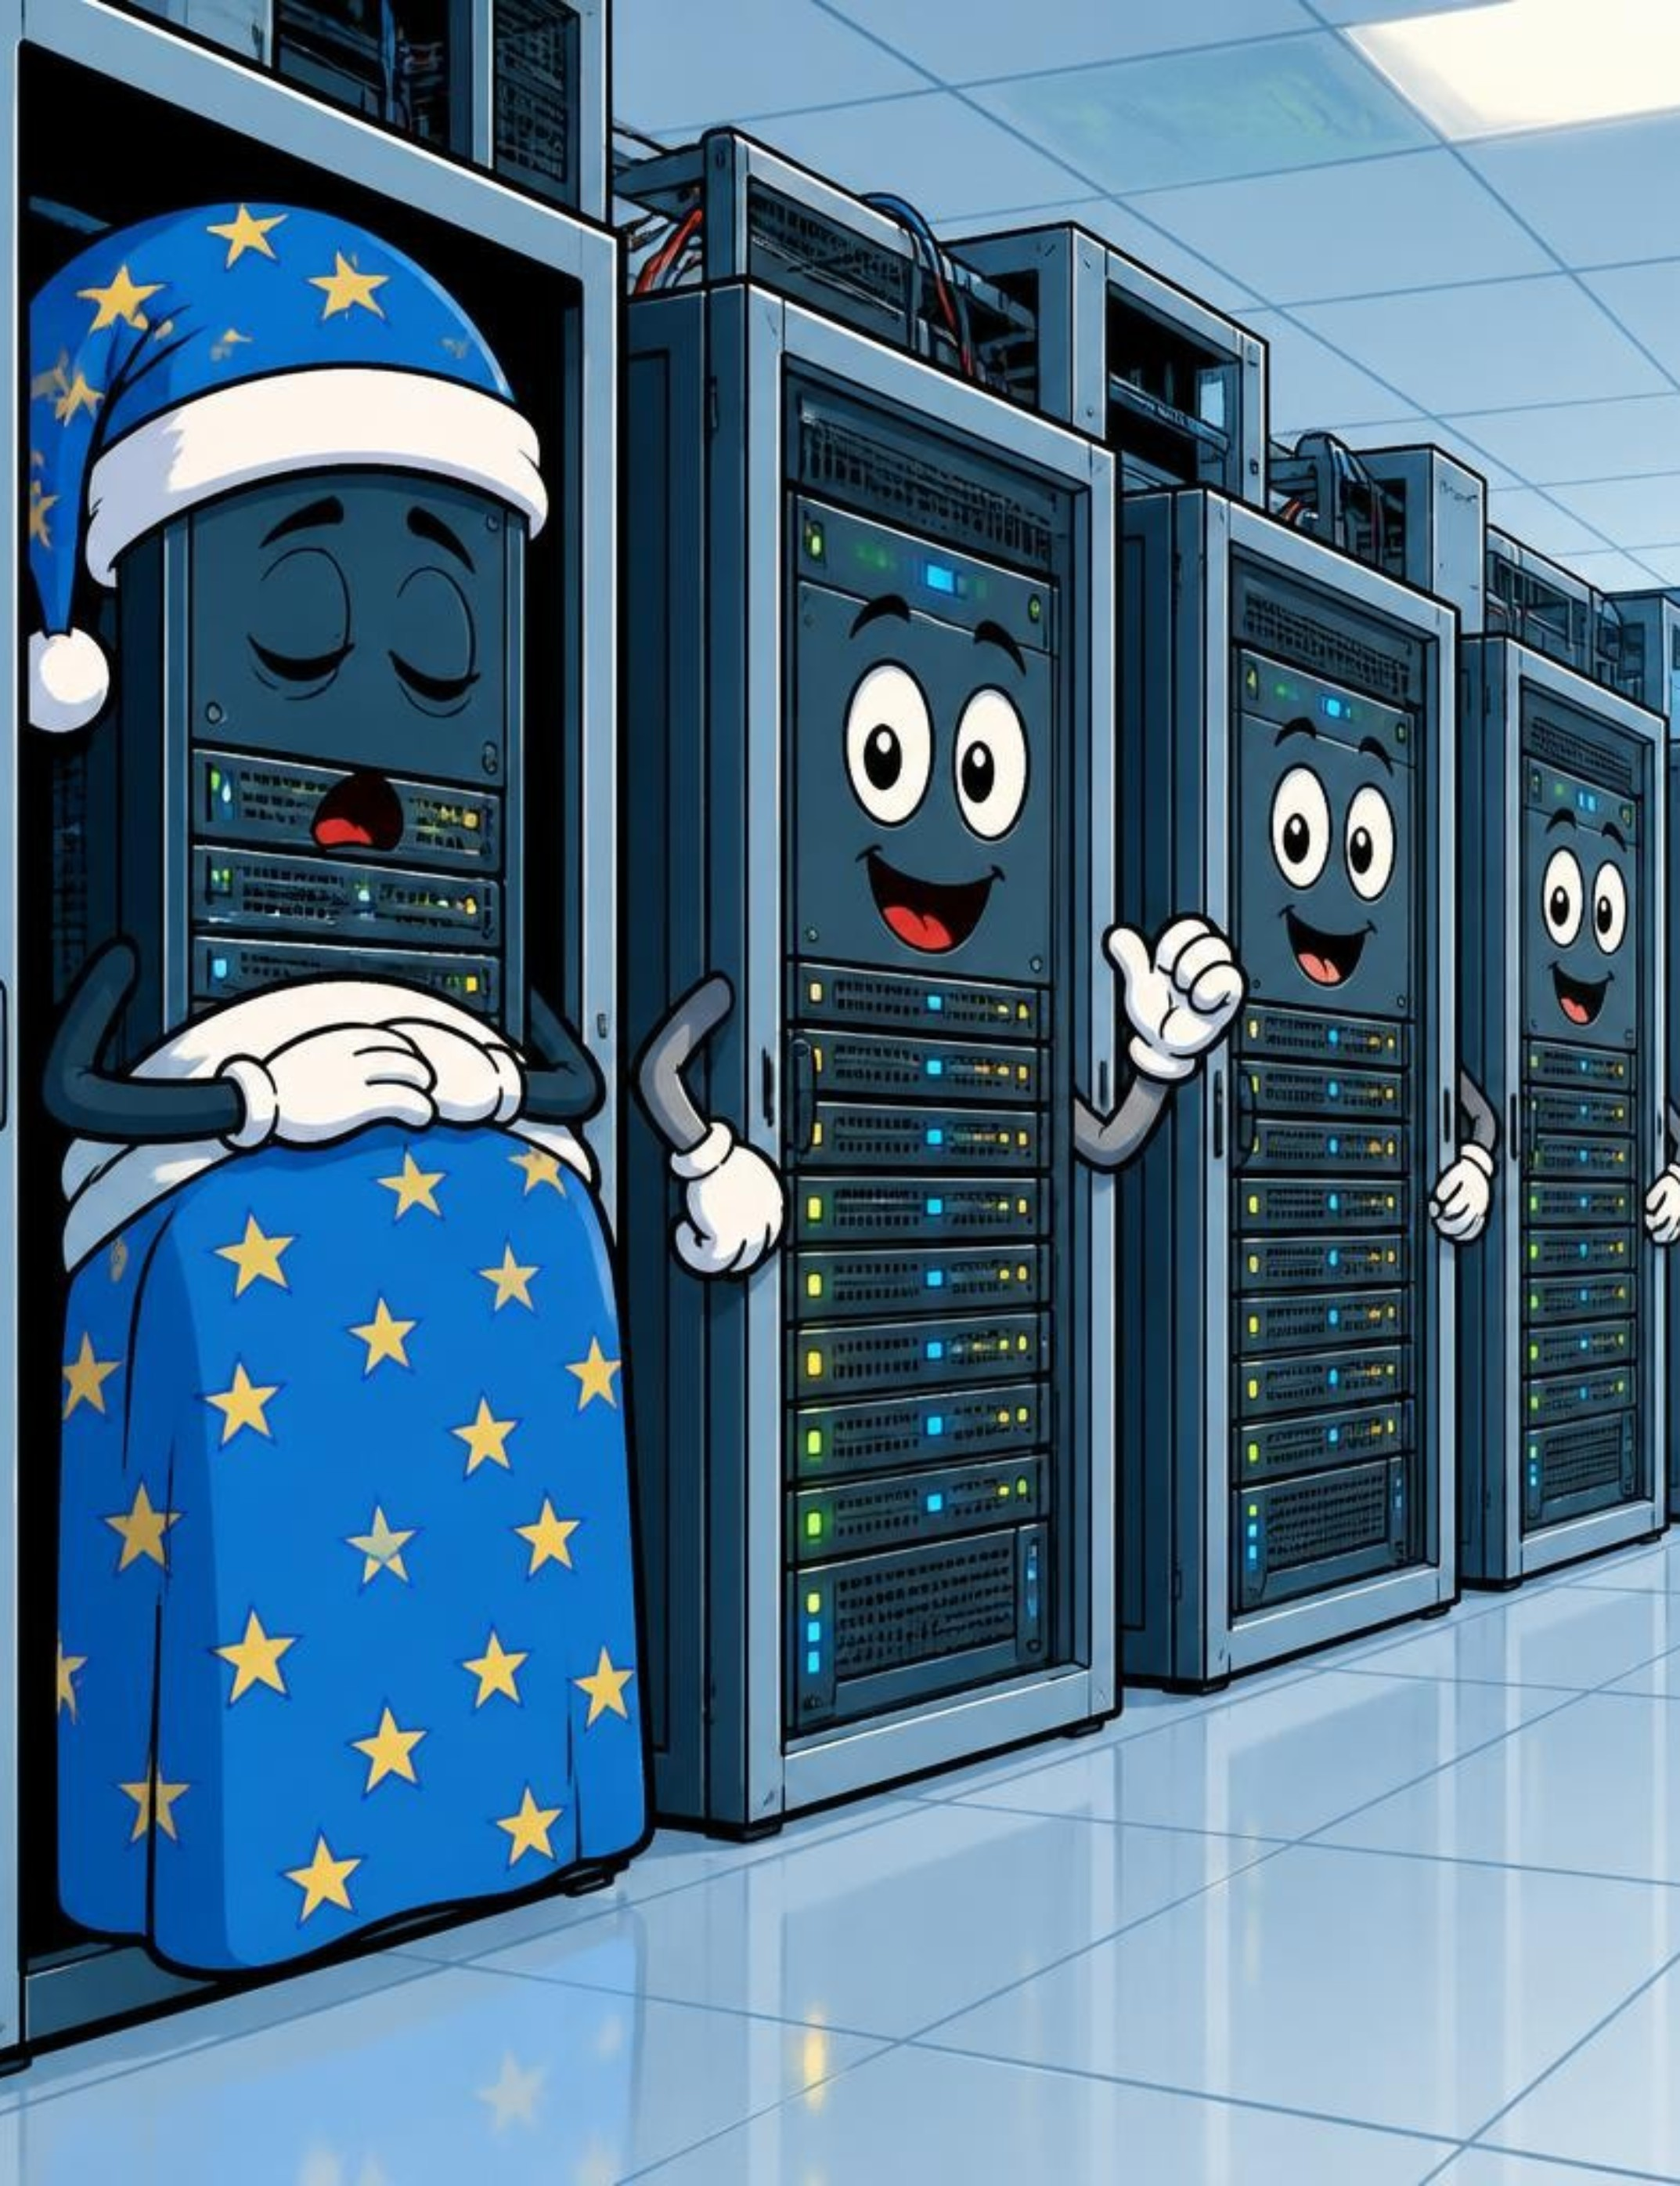
WildFly: modern and built to scale
Modern Java EE / Jakarta EE server
Full support plus clustering and high availability
It never sleeps, and when one node does, another takes over.
10
Notes:
Always on.

Slide 11
WildFly: fast, flexible, distributed
Strengths
Typical use
Fast, flexible, fully distributed.
Big clustered systems that never go down.
It never sleeps — so you finally can.
11
Notes:
Distributed, and it never sleeps. Pause for the joke.

Slide 12
Which one should you pick?
Tomcat
GlassFish
WildFly
The scooter — light, quick, easy to park.
Swiss Army knife — every tool in the box.
Never sleeps — for big, always-on loads.
No best server — only the best fit for the job.
12
Notes:
Scooter, knife, night shift — match the tool to the job.

Slide 13
Key takeaways and questions?
Tomcat — small apps and simple sites; light and fast
GlassFish — the full toolbox when you need every feature
WildFly — big clustered systems that never sleep
Match the server to the job — don't use a truck to deliver a pizza.
Your turn — which one fits your project?
13
Notes:
The pizza rule. Then open the floor.

