Slide 1

Data Warehousing
Muchake Brian
brain.muchake@gmail.com

Slide 2
Objectives
At the end of the topic, students will be able to discuss:
Discuss Overview of Data warehousing
Explore Benefits of a Data warehouse
Describe Challenges of a Data warehouse
Explain Components of a Data warehouse
Explicate the Types of Data Warehousing Architectures

Slide 3
Overview of Data Warehousing
A data warehouse is a centralized repository that stores large amounts of structured data from various sources.
It is designed to support reporting, analysis, and decision-making processes in an organization.
Data in a warehouse is typically historical, integrated, and organized in a way that makes it easy to perform complex queries and analyses.

Slide 4
Overview of Data Warehousing [Cont’d]
Key features of a data warehouse include:
Subject-oriented: Data is organized around key subjects, such as customers, sales, or products, rather than being focused on individual transactions.
Integrated: Data from different sources is cleaned and standardized to provide a unified view of the information.
Time-variant: Data is maintained in a historical context, allowing for trend analysis and comparisons over time.
Non-volatile: Once data is entered into the warehouse, it does not change. It remains static, allowing for consistent analysis.

Slide 5
Overview of Data Warehousing [Cont’d]
Note:
Data warehouses are used in business intelligence (BI) and analytics applications to gain insights, create reports, and make informed decisions.
They are usually separate from operational databases that handle day-to-day transactions, focusing instead on long-term data storage and retrieval.

Slide 6
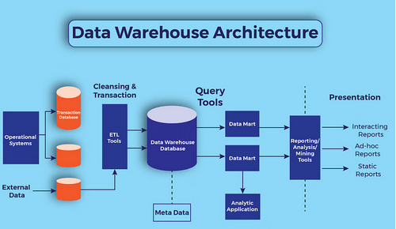
Overview of Data Warehousing [Cont’d]
Data Warehouse Architecture

Slide 7
Benefits of a Data warehouse
1. Improved Decision-Making
Benefit: Data warehouses consolidate information from multiple sources, providing a single source of truth for decision-makers. This ensures that all departments base decisions on the same data.
Example: A retail company uses a data warehouse to integrate sales data from online and physical stores. The management can analyze customer purchasing trends across different channels and regions, leading to more accurate inventory planning and targeted marketing.
2. Enhanced Data Quality and Consistency
Benefit: A data warehouse standardizes data across an organization, ensuring it is cleaned, transformed, and made consistent. This reduces discrepancies and errors in reporting.
Example: A bank integrates data from various financial systems (e.g., loan processing, customer accounts). Standardization in the data warehouse ensures accurate financial reporting and prevents errors when analyzing loan defaults across different branches.

Slide 8
Benefits of a Data warehouse [Cont’d]
3. Historical Data Storage for Trend Analysis
Benefit: A data warehouse stores historical data, enabling organizations to analyze past trends, forecast future performance, and make time-based comparisons.
Example: A healthcare organization can store patient records over many years in a data warehouse. This allows for analysis of long-term health trends, such as the increase in cases of chronic diseases, enabling better public health planning.
4. Faster Query Performance
Benefit: Data warehouses are optimized for query performance, enabling faster processing of complex queries, even on large datasets, without slowing down operational systems.
Example: An e-commerce platform uses a data warehouse to analyze customer behavior during high-traffic events (e.g., Black Friday sales). The warehouse processes queries quickly to generate real-time insights into which products are most popular, allowing the company to adjust promotions and inventory on the fly.

Slide 9
Benefits of a Data warehouse [Cont’d]
5. Integration of Multiple Data Sources
Benefit: A data warehouse integrates data from multiple, often disparate, sources (e.g., CRM, ERP, external data feeds) into a cohesive system. This enables comprehensive reporting.
Example: A global manufacturing company collects data from different factories using various systems. By consolidating this data into a data warehouse, they can easily generate reports on production efficiency, cost savings, and quality control across all locations.
6. Scalability
Benefit: Data warehouses can handle growing amounts of data, allowing organizations to scale their storage and analytical capabilities as they expand.
Example: A telecommunications company expands its customer base over several years. The company’s data warehouse scales to accommodate increasing data from new customers, allowing it to analyze service usage patterns and optimize network performance across multiple regions.

Slide 10
Benefits of a Data warehouse [Cont’d]
7. Support for Business Intelligence (BI) Tools
Benefit: A data warehouse serves as a foundation for business intelligence (BI) tools, enabling users to generate reports, dashboards, and visualizations.
Example: A marketing agency uses a data warehouse integrated with BI tools like Tableau to visualize client campaign performance. This allows real-time tracking of marketing metrics (e.g., conversions, ROI), helping adjust strategies based on data-driven insights.
8. Enhanced Data Security
Benefit: Data warehouses centralize data in a controlled environment, making it easier to implement robust security measures like encryption, access control, and monitoring.
Example: A healthcare provider centralizes patient records in a data warehouse with strict security protocols. This ensures compliance with regulations like HIPAA and protects sensitive patient data from breaches while enabling doctors to access it for better patient care.

Slide 11
Benefits of a Data warehouse [Cont’d]
9. Increased Productivity
Benefit: Employees can spend more time analyzing data and less time gathering it, as the data is already consolidated and cleaned in the warehouse.
Example: In an insurance company, data analysts can focus on finding patterns in claim submissions and fraud detection because the data warehouse has pre-integrated customer information, claims history, and risk analysis, reducing the time spent on data preparation.
10. Improved Compliance and Reporting
Benefit: A data warehouse ensures consistent data formats and makes it easier to generate reports required for regulatory compliance, audits, and financial reporting.
Example: A pharmaceutical company uses a data warehouse to store and report data related to drug trials. By having standardized, traceable records, they can generate compliance reports for regulatory bodies like the FDA efficiently and with full confidence in the data’s integrity.

Slide 12
Challenges of a Data warehouse
1. High Initial Costs
Challenge: Setting up a data warehouse requires significant investment in infrastructure, software, and skilled personnel. This may be prohibitive for smaller organizations.
Example: A medium-sized retailer might struggle to justify the upfront costs of purchasing hardware, licensing data warehousing software, and hiring skilled data engineers, especially when margins are tight.
2. Complex Data Integration
Challenge: Integrating data from multiple, disparate sources (e.g., legacy systems, cloud-based platforms, external data feeds) can be complex and time-consuming. Ensuring that the data is consistent and properly formatted for the warehouse is a significant challenge.
Example: A multinational bank with legacy systems in different countries faces difficulty consolidating its transaction data into a single warehouse. Each region has unique systems, data structures, and regulatory requirements, complicating the integration process.

Slide 13
Challenges of a Data warehouse [Cont’d]
3. Data Quality Issues
Challenge: Ensuring high-quality data in a data warehouse is crucial, but data might be incomplete, inconsistent, or outdated. Poor data quality can lead to inaccurate analysis and reporting.
Example: A healthcare organization might struggle to maintain data quality when integrating patient records from different departments. Missing or incorrect patient information could lead to poor analysis of treatment outcomes or errors in medical reporting.
4. Maintenance and Updates
Challenge: Data warehouses require ongoing maintenance, including updates to ensure they stay aligned with changes in the organization’s data sources and business requirements. This adds to operational costs and complexity.
Example: An airline company using a data warehouse to manage flight schedules and bookings must frequently update the warehouse with real-time data. Changes in systems, such as a new booking platform, require constant adjustments to maintain data accuracy.

Slide 14
Challenges of a Data warehouse [Cont’d]
5. Data Security and Privacy Concerns
Challenge: Data warehouses store vast amounts of sensitive data, making them attractive targets for cyberattacks. Ensuring proper security measures, such as encryption, access controls, and compliance with privacy regulations, is a constant challenge.
Example: A healthcare provider must secure its data warehouse, which contains sensitive patient information. Compliance with regulations like HIPAA or GDPR adds complexity, as they require strict data handling and security protocols.
6. Long Development Time
Challenge: Building a data warehouse can be a lengthy process, taking months or even years, depending on the scale and complexity of the organization’s data environment. During this time, business requirements may evolve, making the system outdated by the time it’s ready.
Example: A government agency working on a national tax data warehouse might take years to develop the system, but by the time it's complete, tax laws and reporting requirements may have changed, requiring additional work to adjust the system to new realities.

Slide 15
Challenges of a Data warehouse [Cont’d]
7. Scalability Issues
Challenge: While data warehouses are designed to handle large volumes of data, they may struggle to scale efficiently as data grows exponentially, especially if they aren’t designed with future growth in mind.
Example: A social media company might face challenges scaling its data warehouse to accommodate a sudden surge in user activity and data generation, requiring costly upgrades to infrastructure and software to handle the increased load.
8. Performance Degradation Over Time
Challenge: As the volume of data in the warehouse grows, query performance can degrade if the system is not optimized for efficient processing. Complex queries may take longer to execute.
Example: A retail chain's data warehouse might experience slower performance as it accumulates years of transaction data. Executing queries on historical sales data across multiple regions may take excessive time, frustrating business analysts who need real-time insights.

Slide 16
Challenges of a Data warehouse [Cont’d]
9. Difficulty in Adapting to Changes in Data Sources
Challenge: Changes in data sources (e.g., switching from an on-premise system to a cloud-based service) require significant adjustments in the warehouse’s architecture. This can be time-consuming and expensive.
Example: A logistics company that moves to a new cloud-based fleet management system might need to reconfigure its data warehouse to accommodate the new data formats and sources, leading to downtime and additional development costs.
10. User Adoption and Training
Challenge: Even after implementation, getting business users to adopt the data warehouse and fully utilize its capabilities can be challenging. Training users to understand and effectively use the data requires time and resources.
Example: A pharmaceutical company implements a data warehouse for research and development but faces resistance from scientists who are used to working with legacy systems. Significant training is required to help them trust and leverage the new system for drug development analysis.

Slide 17
Challenges of a Data warehouse [Cont’d]
11. Obsolescence Due to Evolving Technologies
Challenge: Rapid advancements in data storage, processing, and analytics technologies can quickly render a data warehouse obsolete, requiring costly upgrades or migrations to newer systems.
Example: A financial services company that built its data warehouse using traditional on-premise technologies finds that cloud-based data platforms offer better scalability and performance, forcing them to consider migrating to stay competitive.
12. Lack of Real-Time Data Support
Challenge: Traditional data warehouses are designed for batch processing and may not support real-time data analytics. This can be a limitation in environments where real-time insights are critical.
Example: An online gaming company wants to analyze user interactions in real-time to optimize the gaming experience but finds that their data warehouse cannot handle live data feeds, necessitating the implementation of additional real-time data processing systems.

Slide 18
Components of a Data warehouse
A data warehouse is made up of several key components that work together to ensure the efficient storage, management, and analysis of large amounts of data.
1. Data Sources
Description: Data sources are the origin points from where data is collected. These sources can be internal (such as transactional databases, CRM systems, ERP systems) or external (such as market data feeds, social media data, or third-party data).
Example: A retail company's data warehouse might pull data from point-of-sale (POS) systems, online e-commerce platforms, supply chain management systems, and external sources like market research reports.

Slide 19
Components of a Data warehouse [Cont’d]
2. Data Extraction, Transformation, and Loading (ETL)
Description: The ETL process involves three stages:
  Extraction: Data is extracted from multiple heterogeneous sources.
  Transformation: Data is cleaned, transformed, and formatted to ensure consistency and accuracy.
  Loading: Transformed data is loaded into the data warehouse for storage.
Example: A bank might extract data from customer transaction systems, transform it by standardizing date formats and removing duplicates, and then load it into a data warehouse for future analysis on customer behavior.

Slide 20
Components of a Data warehouse [Cont’d]
3. Data Staging Area
Description: This is a temporary storage area where data is processed and transformed before being loaded into the warehouse. The staging area helps in managing the intermediate steps of the ETL process.
Example: A telecom company might use a staging area to temporarily store raw data from its call records and billing systems before cleaning and transforming it for inclusion in the data warehouse.

Slide 21
Components of a Data warehouse [Cont’d]
4. Data Storage Layer (Data Warehouse Repository)
Description: This is the core component of the data warehouse where processed data is stored. It is optimized for query performance and is typically organized into:
  Fact Tables: Store quantitative data (metrics, measurements).
  Dimension Tables: Contain descriptive attributes related to the facts, such as time, location, or product information.
Example: A logistics company might have a fact table storing data on shipments (e.g., shipment ID, delivery time) and dimension tables with details on locations, delivery routes, and customer information.

Slide 22
Components of a Data warehouse [Cont’d]
5. Metadata
Description: Metadata is data about data. It provides information about the structure, meaning, and usage of data in the warehouse. Metadata helps users understand how data is organized and accessed.
Types:
  Technical Metadata: Information about the structure of the warehouse, such as table definitions, data types, and ETL processes.
  Business Metadata: Describes the meaning of the data in business terms, making it easier for non-technical users to understand.
Example: In an insurance company, technical metadata might detail the format of policy records in the warehouse, while business metadata would explain that "Premium Amount" refers to the payment made by a customer for their insurance policy.

Slide 23
Components of a Data warehouse [Cont’d]
6. Data Marts
Description: Data marts are specialized, smaller subsets of a data warehouse designed to serve the needs of specific business units or departments (e.g., marketing, finance). They contain data relevant to particular users and are often easier to query than the full warehouse.
Example: A marketing department at a multinational corporation may have a data mart that focuses on customer demographic data, campaign performance, and sales conversions, allowing them to generate targeted reports quickly.

Slide 24
Components of a Data warehouse [Cont’d]
7. OLAP (Online Analytical Processing) Engine
Description: OLAP engines support complex analytical queries and multidimensional analysis, allowing users to "slice and dice" data, drill down into details, and aggregate data at different levels.
OLAP Cube: A multidimensional array that allows fast querying and data aggregation.
Example: A retail company might use OLAP to analyze sales data by different dimensions like time (day, month, year), region, and product category. They can drill down from national sales data to specific store-level performance.

Slide 25
Components of a Data warehouse [Cont’d]
8. Data Access Tools
Description: These are tools that allow users to access and analyze the data in the warehouse. They range from simple reporting tools to more advanced business intelligence (BI) and data visualization tools.
Examples of tools:
  Reporting Tools: Tools like SQL queries or Crystal Reports allow users to generate standard reports.
  BI Tools: Tools like Tableau, Power BI, or QlikSense enable users to create dashboards and visualize data interactively.
  Data Mining Tools: Software like SAS or Apache Mahout helps to find patterns in large datasets.
Example: A financial services company uses Tableau to create interactive dashboards that show loan default trends and credit risk analysis for executive reporting.

Slide 26
Components of a Data warehouse [Cont’d]
9. Data Governance and Security
Description: This component ensures that data within the warehouse is properly managed, secured, and compliant with regulations. Data governance includes data policies, standards, access controls, and monitoring mechanisms to ensure data quality, security, and privacy.
Example: A healthcare provider must ensure that its data warehouse complies with HIPAA regulations, controlling who can access patient records and tracking all data access and usage to ensure compliance with privacy laws.

Slide 27
Components of a Data warehouse [Cont’d]
10. Data Backup and Recovery
Description: A data warehouse must have backup and recovery mechanisms in place to protect against data loss, system failures, or disasters. Backup strategies include regular snapshots and secure storage of data copies.
Example: A financial institution regularly backs up its data warehouse to ensure that critical transaction data is preserved in case of a system failure or cyberattack. This allows the bank to recover quickly without losing vital data.

Slide 28
Components of a Data warehouse [Cont’d]
11. Data Query and Reporting Layer
Description: This layer enables users to interact with the data warehouse by running queries, generating reports, and conducting analysis. It translates user requests into specific queries to retrieve data from the warehouse efficiently.
Example: A human resources team might use a query tool to generate reports on employee turnover by department, salary ranges, or performance metrics. They can retrieve data from the warehouse without needing technical expertise.

Slide 29
Components of a Data warehouse [Cont’d]
12. Data Warehouse Administrator (DWA)
Description: The DWA is responsible for maintaining the overall health of the data warehouse, ensuring performance, managing data storage, securing data, and ensuring the accuracy and timeliness of ETL processes. They also optimize query performance and ensure the warehouse is scalable.
Example: In an online retail company, the data warehouse administrator ensures that the daily ETL processes run smoothly, monitors system performance during peak shopping seasons, and manages access controls to protect sensitive customer data.

Slide 30
Types of Data Warehousing Architectures
1. Single-Tier Architecture
Description: In a single-tier architecture, the data warehouse is directly connected to the operational systems (OLTP - Online Transaction Processing) and analytics are performed on the same system. This architecture aims to minimize data redundancy and reduce complexity by combining transactional processing and analytical functions in one system.
Advantages: Simple and cost-effective, with minimal data redundancy and lower management overhead.
Disadvantages: Performance bottlenecks, as the system handles both transactions and analytical queries. This architecture is rarely used in large organizations due to scalability issues.
Example: A small business might use a single-tier architecture by directly querying their e-commerce system’s transaction database for sales reports. However, as the company grows, this approach may slow down both transactional and reporting processes.

Slide 31
Types of Data Warehousing Architectures [Cont’d]
2. Two-Tier Architecture
Description: In a two-tier architecture, there is a separation between the data warehouse and the operational systems. Data from multiple operational systems is extracted, transformed, and loaded (ETL) into the data warehouse. However, the data warehouse is not fully optimized for complex analysis, as it lacks the flexibility of advanced analytical tools.
Advantages: Moderate separation of transactional and analytical functions. Easier to implement than a three-tier architecture.
Disadvantages: Limited scalability and flexibility. As the data volume grows, performance may degrade, especially with complex queries.
Example: A mid-sized retail company might implement a two-tier architecture, where data is pulled nightly from sales, inventory, and customer management systems into a central database. The sales team runs daily reports from this database, but complex queries can slow down the system over time.

Slide 32
Types of Data Warehousing Architectures [Cont’d]
3. Three-Tier Architecture
Description: The three-tier architecture is the most widely used and consists of three layers:
  Data Source Layer: Contains the operational systems (OLTP) that generate data, such as ERP, CRM, and other transaction systems.
  Data Warehouse Layer: The central repository where data is stored after being cleaned, transformed, and integrated. This layer includes the ETL processes and the storage of historical data.
  Business Intelligence Layer: Contains the tools that allow users to analyze data, generate reports, and create visualizations. This layer provides access to data through reporting tools, OLAP engines, dashboards, and other BI applications.
Advantages: Scalability, flexibility, and performance optimization for complex analytics. It can handle large volumes of data and complex queries efficiently.
Disadvantages: Expensive and complex to implement. It requires ongoing maintenance and management to ensure smooth operation.

Slide 33
Types of Data Warehousing Architectures [Cont’d]
Example: A large multinational bank uses a three-tier architecture to pull data from its various banking systems (e.g., customer accounts, loans, ATMs), store it in a data warehouse, and use BI tools like Tableau to analyze customer behavior and detect fraud. This architecture allows for detailed insights without impacting daily banking operations.

Slide 34
Types of Data Warehousing Architectures [Cont’d]
4. Cloud Data Warehouse Architecture
Description: Cloud-based data warehouses leverage cloud infrastructure to store, manage, and analyze data. These architectures are fully managed by cloud providers and offer on-demand scalability, meaning organizations can scale up or down based on their needs without having to manage physical infrastructure.
Advantages:
  Flexibility and scalability
  Lower upfront costs (pay-as-you-go models)
  Reduced management overhead, as the cloud provider handles infrastructure, upgrades, and maintenance.
Disadvantages: Data security and privacy concerns, as sensitive data is stored off-premise. Data transfer costs can also add up if large amounts of data need to be moved frequently.

Slide 35
Types of Data Warehousing Architectures [Cont’d]
Example: A global media company might use a cloud data warehouse like Amazon Redshift, Google BigQuery, or Snowflake to store and analyze vast amounts of data generated from streaming services, customer subscriptions, and advertising analytics. These cloud services can handle spikes in demand (e.g., during major events) without significant performance degradation.

Slide 36
Types of Data Warehousing Architectures [Cont’d]
5. Federated Data Warehouse Architecture
Description: A federated data warehouse integrates data from multiple independent data warehouses or databases without physically storing all the data in one central repository. Instead, it provides a unified view of the data while leaving it in its original locations.
Advantages:
  No need for data replication, which reduces storage requirements and the complexity of maintaining a centralized system.
  Easier integration with legacy systems and databases.
Disadvantages: Performance may be slower, as data is fetched in real-time from different sources. The complexity of managing multiple databases can also increase.

Slide 37
Types of Data Warehousing Architectures [Cont’d]
Example: A government agency might implement a federated data warehouse that connects multiple departments’ data (e.g., tax records, social security, healthcare data) without needing to centralize all data. This enables them to access a unified view of citizens' information for analysis, even though the data resides in separate systems.

Slide 38
Types of Data Warehousing Architectures [Cont’d]
6. Hub-and-Spoke Architecture
Description: The hub-and-spoke model consists of a central data warehouse (hub) and smaller, specialized data marts (spokes) that serve specific business units or departments. The data warehouse stores cleansed, integrated data, while the data marts are tailored to meet the analytical needs of specific teams (e.g., finance, marketing).
Advantages:
  Data centralization with decentralized access, allowing for flexibility and custom analysis for different departments.
  Scalability: additional spokes (data marts) can be added as needed without disrupting the central warehouse.
Disadvantages: Complex to manage, as both the central warehouse and individual data marts must be maintained. Can lead to data redundancy between the warehouse and marts.

Slide 39
Types of Data Warehousing Architectures [Cont’d]
Example: A large manufacturing company might use a hub-and-spoke architecture where the central data warehouse integrates data from production, supply chain, and sales, while individual data marts serve the finance and human resources teams. Each department accesses the data relevant to their needs without overloading the central system.

Slide 40
Types of Data Warehousing Architectures [Cont’d]
7. Virtual Data Warehouse Architecture
Description: A virtual data warehouse doesn’t physically store data in a central repository. Instead, it uses middleware to create a virtual layer that allows users to query and analyze data from different sources without moving the data. This approach relies on real-time access to the source systems for data retrieval.
Advantages:
  Reduces storage costs by avoiding data duplication.
  Provides real-time data access.
Disadvantages: Performance can suffer due to real-time queries across disparate systems. It may also lack some advanced analytical capabilities, and ensuring data consistency can be challenging.
Example: A healthcare organization might use a virtual data warehouse to give doctors access to real-time patient records from various hospital systems (e.g., EMR systems, lab systems). Instead of moving the data to a central repository, the virtual layer pulls in the data from each system when needed for analysis.

Slide 41
Types of Data Warehousing Architectures [Cont’d]
8. Data Lake and Data Warehouse Hybrid Architecture
Description: A hybrid architecture combines the structured, query-optimized storage of a traditional data warehouse with the flexibility of a data lake, which stores raw, unstructured, or semi-structured data. Data lakes are typically used for big data processing, while data warehouses handle structured, business-critical data for analysis.
Advantages:
  Flexibility to store both structured and unstructured data.
  Scalability for big data workloads.
Disadvantages: Managing both a data lake and data warehouse adds complexity. Data governance and ensuring data quality across both systems can be challenging.
Example: A social media company might use a hybrid architecture, where the data lake stores raw user interactions, social posts, and clickstream data, while the data warehouse stores structured ad campaign data. This setup allows for both big data analysis and traditional business intelligence reporting.

Slide 42
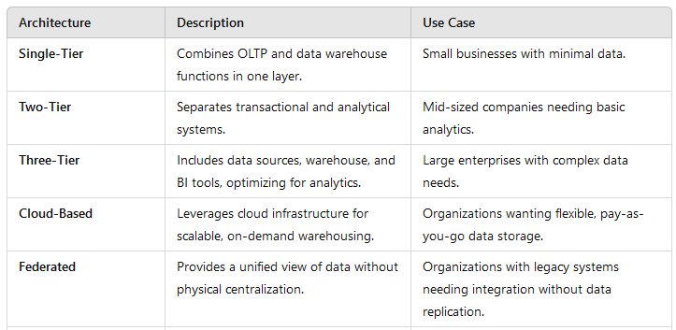
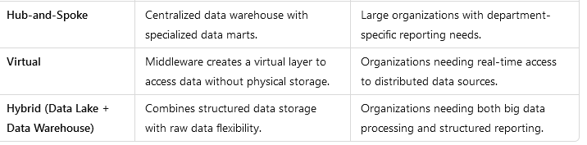
Types of Data Warehousing Architectures [Cont’d]
Summary of Common Architectures:

Slide 43
Common Applications of Data Warehousing
Data warehouses are powerful tools for storing, managing, and analyzing large volumes of data, and they have a wide range of applications across various industries.
1. Business Intelligence (BI) and Analytics
Description: Data warehouses are fundamental to BI platforms, enabling organizations to perform complex data analysis and reporting. Data warehouses store historical and current data, allowing businesses to gain insights into performance, trends, and patterns, helping decision-makers make data-driven decisions.
Example: A retail company uses a data warehouse to track sales performance over time. By analyzing data from various stores, the company can identify trends such as which products sell best during certain seasons or in specific regions, helping them optimize inventory and marketing strategies.

Slide 44
Common Applications of Data Warehousing [Cont’d]
2. Customer Relationship Management (CRM)
Description: A data warehouse can aggregate customer data from various sources (sales, support, marketing interactions) to provide a 360-degree view of the customer. This helps businesses better understand customer behavior, preferences, and buying patterns.
Example: A telecommunications company might use a data warehouse to track customer usage patterns and analyze customer support interactions. By combining this data, the company can identify high-value customers who are likely to churn and offer personalized promotions or support to retain them.

Slide 45
Common Applications of Data Warehousing [Cont’d]
3. Financial Management and Reporting
Description: Financial departments use data warehouses for consolidating financial data from multiple systems (e.g., accounts payable, accounts receivable, payroll, sales) to create reports and ensure compliance with regulatory requirements. Data warehouses also help in budgeting, forecasting, and financial analysis.
Example: A global bank might use a data warehouse to compile data from its various branches worldwide. This helps the bank generate real-time financial reports, ensure regulatory compliance (e.g., Basel III for risk management), and conduct stress testing to predict how financial shocks might impact the institution.

Slide 46
Common Applications of Data Warehousing [Cont’d]
4. Supply Chain Management
Description: Supply chain management systems benefit from data warehouses by integrating data from procurement, inventory, logistics, and production to ensure efficient supply chain operations. Data warehousing helps organizations track the movement of goods, manage inventory, and forecast demand.
Example: A manufacturing company uses a data warehouse to monitor its supply chain performance. By integrating data from suppliers, warehouses, and shipping partners, the company can optimize production schedules, reduce inventory costs, and identify potential bottlenecks in the supply chain.

Slide 47
Common Applications of Data Warehousing [Cont’d]
5. Healthcare Data Analysis
Description: Healthcare providers use data warehouses to integrate and analyze patient data, medical records, billing information, and clinical outcomes. This helps in improving patient care, optimizing resource allocation, and ensuring compliance with regulations (e.g., HIPAA in the U.S.).
Example: A hospital system uses a data warehouse to track patient admissions, treatment outcomes, and staff performance. By analyzing this data, the hospital can improve patient care quality, identify trends in patient demographics, and manage resources such as staffing and equipment more efficiently.

Slide 48
Common Applications of Data Warehousing [Cont’d]
6. Marketing Campaign Management
Description: Data warehouses enable companies to track the effectiveness of their marketing campaigns by integrating data from various channels (social media, email marketing, advertisements) and customer interactions. This helps marketers measure campaign performance, segment audiences, and personalize messaging.
Example: An e-commerce company uses a data warehouse to track customer interactions across its website, social media, and email campaigns. By analyzing this data, the company can segment its customers and send personalized promotions, leading to higher conversion rates and customer retention.

Slide 49
Common Applications of Data Warehousing [Cont’d]
7. Retail and E-commerce
Description: Retailers and e-commerce companies use data warehouses to analyze sales, customer preferences, and inventory levels. This helps in demand forecasting, pricing optimization, and customer behavior analysis.
Example: A grocery chain uses a data warehouse to analyze point-of-sale (POS) data, customer loyalty program interactions, and supply chain data. This enables the chain to predict customer buying patterns, optimize product placement in stores, and manage inventory more effectively, reducing waste and stockouts.

Slide 50
Common Applications of Data Warehousing [Cont’d]
8. Fraud Detection and Risk Management
Description: Data warehouses play a critical role in detecting and preventing fraud by enabling organizations to store and analyze large volumes of transactional data in real-time. Data from various systems is integrated to spot unusual patterns or anomalies, helping organizations mitigate risks.
Example: A credit card company uses a data warehouse to analyze millions of transactions daily. By applying advanced analytics and machine learning models, the company can detect potential fraud by identifying unusual spending patterns, such as purchases made in two different countries within a short period.

Slide 51
Common Applications of Data Warehousing [Cont’d]
9. Government and Public Sector
Description: Government agencies use data warehouses to manage large datasets related to public services, such as social welfare programs, taxation, public health, and law enforcement. This helps in making informed policy decisions, monitoring programs, and improving transparency.
Example: A national tax agency uses a data warehouse to integrate data from tax returns, social security, and employment records. This allows the agency to identify tax evasion patterns and optimize resource allocation for tax audits.

Slide 52
Common Applications of Data Warehousing [Cont’d]
10. Human Resources (HR) Management
Description: HR departments use data warehouses to store and analyze data on employee performance, payroll, attendance, and recruitment. This helps in workforce planning, talent management, and ensuring compliance with labor laws.
Example: A multinational corporation uses a data warehouse to track employee performance reviews, salary history, and training programs across different regions. The HR department can analyze trends in employee turnover, identify high-performing employees for promotion, and ensure compliance with regional labor laws.

Slide 53
Common Applications of Data Warehousing [Cont’d]
11. Energy Sector Analytics
Description: Energy companies use data warehouses to manage data from power plants, smart meters, and energy consumption patterns. This helps them optimize energy production, improve grid management, and reduce operational costs.
Example: A utility company uses a data warehouse to analyze data from smart meters installed in homes and businesses. By tracking energy consumption patterns, the company can offer personalized energy-saving recommendations to customers and optimize power generation to meet peak demand.

Slide 54
Common Applications of Data Warehousing [Cont’d]
12. Telecommunications
Description: Telecom companies use data warehouses to manage data from customer usage patterns, call records, network performance, and billing systems. This helps them optimize network performance, reduce churn, and improve customer satisfaction.
Example: A telecom provider uses a data warehouse to analyze call detail records (CDRs) and identify network issues in real-time. By monitoring call drop rates, data usage patterns, and customer complaints, the company can proactively address network problems and reduce customer churn.

Slide 55
Common Applications of Data Warehousing [Cont’d]
13. Education
Description: Educational institutions use data warehouses to track student performance, enrollment trends, and financial data. This helps in improving academic programs, managing resources, and ensuring compliance with accreditation standards.
Example: A university uses a data warehouse to analyze student data, such as grades, attendance, and course enrollment. By analyzing this data, the administration can identify students who are at risk of dropping out, optimize course offerings, and ensure efficient use of faculty and classroom resources.

Slide 56
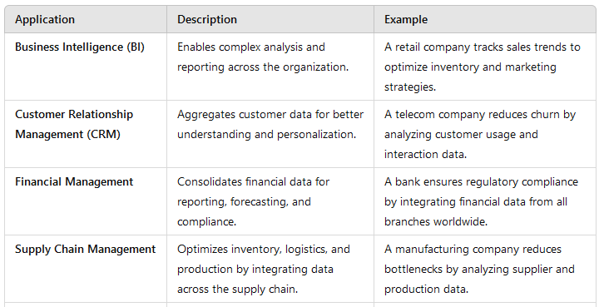
Common Applications of Data Warehousing [Cont’d]
Summary of Common Applications:

Slide 57
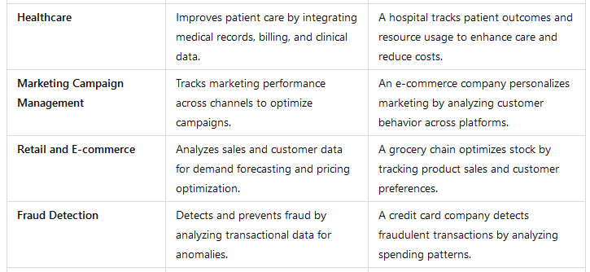
Common Applications of Data Warehousing [Cont’d]
Summary of Common Applications:

Slide 58
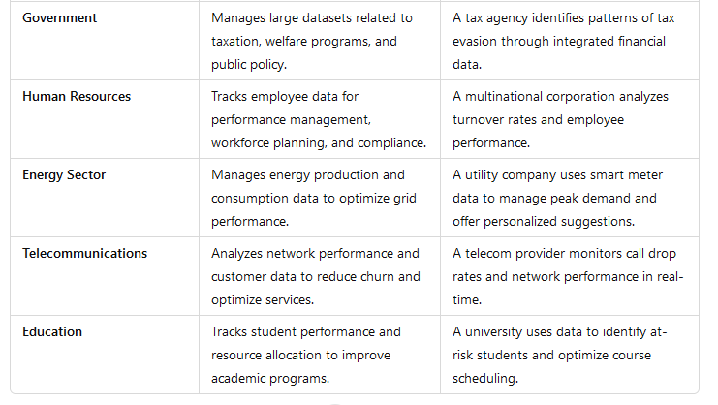
Common Applications of Data Warehousing [Cont’d]
Summary of Common Applications:

Slide 59
Outcomes
At the end of the topic, students will be able to discuss:
Discuss Overview of Data warehousing
Explore Benefits of a Data warehouse
Describe Challenges of a Data warehouse
Explain Components of a Data warehouse
Explicate the Types of Data Warehousing Architectures

