Slide 1

Introduction to Data Mining
Muchake Brian
brain.muchake@gmail.com

Slide 2
Objectives
At the end of this topic, students will be able to:
Understand the Overview of DM Techniques and Algorithm
Explore applications of DM
Discuss Benefits of DM
Demonstrate the DM Process
Challenges of DM

Slide 3
1. Overview of DM Techniques and Algorithm
Data mining is the process of automatically discovering patterns, relationships, and insights from large datasets, using various statistical and mathematical techniques.
Data mining involves:
1. Data exploration: Identifying relevant data sources and understanding data structures.
2. Data preprocessing: Cleaning, transforming, and formatting data for analysis.
3. Pattern discovery: Applying algorithms to identify relationships, trends, and anomalies.
4. Pattern evaluation: Validating and interpreting discovered patterns.
5. Knowledge representation: Presenting findings in a meaningful and useful way.

Slide 4
1. Overview of DM Techniques and Algorithm [Cont’d]
Algorithms are well-defined procedures that solve computational problems or perform specific tasks.
They are essential in computer science, data analysis, and machine learning.
Types of Algorithms:
1. Sorting algorithms (e.g., Bubble sort, Quick sort)
2. Searching algorithms (e.g., Linear search, Binary search)
3. Graph algorithms (e.g., Dijkstra's algorithm, Bellman-Ford algorithm)
4. Dynamic programming algorithms (e.g., Fibonacci sequence, Knapsack problem)
5. Greedy algorithms (e.g., Huffman coding, Activity selection problem)
6. Divide and conquer algorithms (e.g., Merge sort, Fast Fourier transform)
7. Backtracking algorithms (e.g., N-Queens problem, Sudoku)8. Machine learning algorithms (e.g., Linear regression, Decision trees)

Slide 5
1. Overview of DM Techniques and Algorithm [Cont’d]
Data mining techniques and algorithms are used to extract meaningful patterns, trends, and relationships from large datasets.
These techniques are essential in various domains, such as business intelligence, healthcare, finance, marketing, and more.
1. Classification
Classification is a supervised learning technique that categorizes data into predefined classes or labels. It is widely used in spam detection, credit scoring, and medical diagnosis.

Slide 6
1. Overview of DM Techniques and Algorithm [Cont’d]
Common Algorithms:
Decision Trees: Builds a model in the form of a tree structure where each node represents a feature, and each branch represents a decision rule. Popular algorithm: C4.5, CART.
Random Forest: An ensemble method using multiple decision trees to improve classification accuracy.
Support Vector Machines (SVM): Finds the hyperplane that best separates data points into different classes.
Naive Bayes: Based on Bayes' theorem, it assumes independence between features.
K-Nearest Neighbors (KNN): Classifies data points by looking at the nearest 'k' neighbors.

Slide 7
1. Overview of DM Techniques and Algorithm [Cont’d]
2. Clustering
Clustering is an unsupervised learning technique that groups data points based on their similarity. It is used for market segmentation, customer profiling, and anomaly detection.
Common Algorithms:
  K-Means: Partitions the dataset into 'k' clusters by minimizing the variance within each cluster.
  Hierarchical Clustering: Creates a hierarchy of clusters either in an agglomerative (bottom-up) or divisive (top-down) manner.
  DBSCAN (Density-Based Spatial Clustering of Applications with Noise): Groups data points based on density, which is useful for detecting outliers.
  Gaussian Mixture Models (GMM): Assumes data is generated from multiple Gaussian distributions and estimates their parameters.

Slide 8
1. Overview of DM Techniques and Algorithm [Cont’d]
3. Regression
Regression is used to predict a continuous value (real number) rather than categories. It’s commonly used in finance (e.g., stock price prediction) and healthcare (e.g., risk prediction).
Common Algorithms:
  Linear Regression: Establishes a linear relationship between the dependent and independent variables.
  Ridge and Lasso Regression: Regularized versions of linear regression that add penalties to the model to reduce overfitting.
  Polynomial Regression: Fits a nonlinear relationship by transforming the features into polynomial terms.
  Support Vector Regression (SVR): Extends SVM to regression tasks.

Slide 9
1. Overview of DM Techniques and Algorithm [Cont’d]
4. Association Rule Learning
This technique discovers interesting relationships between variables in large datasets. It is most commonly used in market basket analysis.
Common Algorithms:
  Apriori Algorithm: Identifies frequent itemsets and then generates association rules.
  Eclat Algorithm: Uses a depth-first search to find frequent itemsets and is generally faster than Apriori.
  FP-Growth: Uses a tree structure to represent frequent patterns and reduces the time complexity of finding frequent itemsets.

Slide 10
1. Overview of DM Techniques and Algorithm [Cont’d]
5. Anomaly Detection
Anomaly detection identifies outliers or rare items that do not conform to expected patterns. It’s used in fraud detection, cybersecurity, and fault detection.
Common Algorithms:
  Isolation Forest: Randomly selects features and splits data to isolate anomalies.
  Local Outlier Factor (LOF): Measures the local deviation of a data point with respect to its neighbors.
  Autoencoders: Neural networks used to compress and reconstruct data, detecting anomalies based on reconstruction error.

Slide 11
1. Overview of DM Techniques and Algorithm [Cont’d]
6. Dimensionality Reduction
Dimensionality reduction techniques reduce the number of variables or features in a dataset while preserving as much information as possible.
This is useful for visualizing high-dimensional data and reducing computational complexity.
Common Algorithms:
  Principal Component Analysis (PCA): Transforms the data into new dimensions that maximize variance.
  t-SNE (t-Distributed Stochastic Neighbor Embedding): Reduces dimensionality for visualization, particularly useful for high-dimensional data.
  Linear Discriminant Analysis (LDA): A classification-based dimensionality reduction technique that maximizes class separability.

Slide 12
1. Overview of DM Techniques and Algorithm [Cont’d]
7. Deep Learning
Deep learning algorithms are a subset of machine learning that mimic the human brain's neural networks. They are powerful in handling unstructured data like images, audio, and text.
Common Algorithms:
  Convolutional Neural Networks (CNN): Mainly used for image recognition and computer vision tasks.
  Recurrent Neural Networks (RNN): Used for sequential data, such as time-series data and natural language processing (NLP).
  Autoencoders: Learn data representations in an unsupervised manner, often used for feature learning and anomaly detection.

Slide 13
1. Overview of DM Techniques and Algorithm [Cont’d]
8. Ensemble Methods
Ensemble methods combine the predictions of multiple models to improve accuracy and robustness.
Common Algorithms:
  Boosting: Combines weak learners to form a strong learner. Algorithms include AdaBoost, Gradient Boosting, XGBoost.
  Bagging: Averages the predictions of multiple models. Random Forest is a popular bagging algorithm.
  Stacking: Combines multiple models by training another model (meta-learner) on their predictions.

Slide 14
2. Applications of DM
Data mining has diverse applications across industries, where it plays a crucial role in uncovering insights and patterns from large datasets.
1. Business and Marketing
Objective: Understanding customer behavior, optimizing marketing strategies, and improving business operations.
A. Customer Segmentation:
  Example: Retailers use clustering algorithms like K-Means to group customers based on purchasing behavior. This helps in identifying high-value customers, optimizing inventory, and targeting marketing campaigns more effectively. For instance, Amazon uses this to recommend products based on customers' previous purchases.

Slide 15
2. Applications of DM [Cont’d]
B. Market Basket Analysis:
  Example: Market basket analysis is used to find associations between products in retail. For example, a supermarket may find that customers who buy bread often also buy butter. The Apriori Algorithm or FP-Growth is often used to derive these patterns, enabling cross-selling and product bundling strategies.
C. Customer Churn Prediction:
  Example: Telecommunication companies use classification algorithms like Decision Trees and Random Forest to predict which customers are likely to switch to competitors. By identifying at-risk customers, companies like Verizon can offer special retention deals and improve customer loyalty.
D. Sales Forecasting:
  Example: Companies like Walmart use time series analysis and regression models to predict future sales based on past sales data and seasonal patterns. This helps in optimizing stock levels and logistics planning.

Slide 16
2. Applications of DM [Cont’d]
2. Healthcare
Objective: Enhancing patient care, optimizing clinical operations, and improving public health.
A. Disease Diagnosis and Risk Prediction:
  Example: Hospitals use classification techniques like Support Vector Machines (SVM) or Neural Networks to analyze patient data (e.g., blood pressure, age, cholesterol levels) and predict the risk of diseases like diabetes or heart disease. For example, IBM Watson Health uses data mining to assist in cancer diagnosis by analyzing patient history and genetic data.
B. Drug Discovery and Development:
  Example: Pharmaceutical companies like Pfizer use data mining to analyze massive amounts of biomedical data for discovering new drug candidates. They apply clustering and association rule learning to identify relationships between chemical compounds and biological targets.

Slide 17
2. Applications of DM [Cont’d]
C. Electronic Health Records (EHR) Analysis:
  Example: Data mining tools are applied to large EHR datasets to identify patterns in treatment outcomes. Hospitals like Mayo Clinic analyze these records to improve treatment protocols and personalize healthcare recommendations using machine learning algorithms such as Naive Bayes and Logistic Regression.
D. Pandemic Prediction and Public Health:
  Example: During the COVID-19 pandemic, governments and research institutions used data mining on health records, mobility data, and population statistics to predict infection spikes and assess the effectiveness of lockdown measures. Tools like RNN (Recurrent Neural Networks) were used to forecast the virus's spread based on time-series data.

Slide 18
2. Applications of DM [Cont’d]
3. Finance and Banking
Objective: Managing risk, detecting fraud, and optimizing financial performance.
A. Fraud Detection:
  Example: Banks like HSBC use data mining techniques such as Anomaly Detection and Isolation Forest to identify fraudulent credit card transactions by monitoring unusual spending behavior in real time. For example, a sudden high-value purchase in a foreign country might trigger a fraud alert.
B. Credit Scoring:
  Example: Credit agencies such as FICO apply classification techniques like Logistic Regression and Random Forest to evaluate customer creditworthiness. These models predict the likelihood of default based on factors such as income, loan amount, and payment history.

Slide 19
2. Applications of DM [Cont’d]
C. Algorithmic Trading:
Example: Investment firms like Goldman Sachs use machine learning models, including Regression and Reinforcement Learning, to analyze market data and execute trades in milliseconds based on predicted price movements. This helps in making fast, informed decisions that maximize profits.
D. Risk Management:
Example: Financial institutions use data mining techniques such as Monte Carlo simulations and Scenario Analysis to forecast market risks, assess loan risks, and manage investment portfolios. For instance, J.P. Morgan applies these techniques to model potential losses under different economic scenarios.

Slide 20
2. Applications of DM [Cont’d]
4. Retail
Objective: Optimizing inventory, improving customer experience, and enhancing supply chain management.
A. Personalized Marketing:
  Example: Netflix uses recommendation systems based on Collaborative Filtering and Content-Based Filtering to suggest movies and shows to users. These systems rely on analyzing users' viewing histories and preferences to make personalized recommendations.
B. Inventory Management:
  Example: Retailers like Zara use data mining to optimize their supply chains by predicting product demand based on historical sales data and external factors such as holidays or economic conditions. Techniques like Time Series Analysis and Forecasting Models are commonly used.

Slide 21
2. Applications of DM [Cont’d]
C. Customer Sentiment Analysis:
Example: Retailers analyze customer feedback, reviews, and social media posts using Natural Language Processing (NLP) to gauge customer sentiment. For example, companies like H&M use sentiment analysis to understand customer opinions about new clothing lines and make adjustments based on this feedback.

Slide 22
2. Applications of DM [Cont’d]
5. Telecommunications
Objective: Enhancing customer experience, reducing churn, and optimizing network performance.
A. Customer Churn Prediction:
  Example: Telecom companies like Vodafone use predictive modeling and machine learning algorithms (e.g., Logistic Regression, Random Forest) to identify customers who are likely to leave the service. By analyzing usage patterns, call durations, and complaints, they can offer targeted retention campaigns.
B. Network Optimization:
  Example: Telecom companies apply clustering techniques to optimize cell tower placements. By analyzing call data and user density patterns, they can reduce dropped calls and improve network coverage. For instance, AT&T uses such methods to enhance 5G network planning.

Slide 23
2. Applications of DM [Cont’d]
6. Manufacturing
Objective: Improving production efficiency, reducing waste, and predictive maintenance.
A. Predictive Maintenance:
  Example: Manufacturers like General Electric use data mining to predict equipment failures before they occur. Using Regression and Time Series Analysis, companies monitor sensor data from machines and identify anomalies that could signal impending breakdowns. This minimizes downtime and repair costs.
B. Quality Control:
  Example: In automotive manufacturing, companies like Toyota apply data mining to detect defects in the production process. By analyzing real-time data from sensors and quality control inspections, Anomaly Detection algorithms can flag faulty products or machines.

Slide 24
2. Applications of DM [Cont’d]
7. Education
Objective: Enhancing student learning experiences and improving administrative efficiency.
A. Student Performance Prediction:
  Example: Educational institutions use data mining techniques such as Decision Trees and Neural Networks to predict student performance based on past academic records, attendance, and participation. Universities like Stanford use this to offer personalized learning paths and support.
B. Curriculum Recommendation:
  Example: E-learning platforms like Coursera use data mining to recommend courses to learners based on their past interactions and course completions. Collaborative Filtering is commonly used to suggest content similar to what the student has previously engaged with.

Slide 25
2. Applications of DM [Cont’d]
8. E-Government and Public Administration
Objective: Improving government services and policy-making through data-driven insights.
A. Crime Prediction:
  Example: Law enforcement agencies like the Chicago Police Department use data mining techniques, including Predictive Analytics and Machine Learning, to identify high-crime areas and allocate resources efficiently. Predictive policing algorithms help in reducing crime rates by proactively addressing potential crime hotspots.
B. Smart City Management:
  Example: Cities like Barcelona apply data mining in smart city initiatives to optimize traffic management, energy consumption, and public services. Data from IoT devices and sensors is analyzed using clustering and regression models to improve urban planning.

Slide 26
3. Benefits of DM
1. Improved Decision-Making
Data mining helps organizations make informed decisions by uncovering hidden patterns and trends from large datasets.
Example:
  In banking, credit risk analysis can be enhanced through data mining. By analyzing customer financial data (e.g., income, loan history, and spending patterns), banks can make better lending decisions, minimizing the risk of bad loans. Banks like Wells Fargo use classification algorithms like Logistic Regression and Random Forest to assess the probability of loan default.
  In retail, companies like Walmart use data mining to optimize their supply chain and inventory management. By predicting product demand through Time Series Analysis, they can prevent stockouts and overstocking, leading to better inventory management and cost savings.

Slide 27
3. Benefits of DM [Cont’d]
2. Cost Reduction
By identifying inefficiencies and enabling process optimization, data mining helps reduce operational costs.
Example:
  In manufacturing, data mining can improve the efficiency of production processes through Predictive Maintenance. For example, companies like Siemens use Anomaly Detection algorithms to predict machine failures by monitoring real-time sensor data. This proactive approach reduces downtime and repair costs, as maintenance is performed before breakdowns occur.
  In telecommunications, service providers like Verizon use data mining to reduce network operation costs by optimizing resource allocation and minimizing network failures. By analyzing network traffic patterns, providers can predict when and where service disruptions are likely to occur, allowing for preventative actions.

Slide 28
3. Benefits of DM [Cont’d]
3. Customer Insights and Personalization
Data mining helps businesses understand customer behavior, enabling them to provide personalized products and services, which leads to higher customer satisfaction and loyalty.
Example:
  In e-commerce, companies like Amazon and Alibaba use Collaborative Filtering and Content-Based Filtering algorithms to recommend products to customers based on their past purchases and browsing history. This personalization increases customer engagement and boosts sales.
  In streaming services, platforms like Netflix and Spotify use data mining to recommend movies, shows, and songs based on individual preferences. These recommendations enhance user experience, increasing retention rates.

Slide 29
3. Benefits of DM [Cont’d]
4. Fraud Detection and Prevention
Data mining helps organizations detect and prevent fraud by identifying unusual patterns or behaviors that indicate potential fraud.
Example:
  In the financial sector, credit card companies like Visa use data mining techniques like Anomaly Detection to monitor transaction patterns in real-time. When transactions deviate from a customer’s typical spending habits, the system flags them as potentially fraudulent, prompting further investigation or immediate action.
  In insurance, companies like Allstate analyze customer claims data using machine learning techniques to identify fraudulent claims. By detecting patterns associated with fraudulent activities, insurance firms can minimize financial losses and improve claims processing.

Slide 30
3. Benefits of DM [Cont’d]
5. Predictive Analytics for Future Trends
Data mining enables businesses to predict future trends by analyzing historical data, helping them prepare for future scenarios.
Example:
  In healthcare, hospitals use Predictive Analytics to forecast patient outcomes. For instance, analyzing historical data from patients with chronic conditions (e.g., diabetes, heart disease) can help healthcare providers predict the likelihood of complications and enable early interventions. Organizations like Cleveland Clinic use data mining to improve patient care and reduce readmission rates.
  In financial markets, investment firms like Goldman Sachs use Time Series Analysis and Reinforcement Learning to forecast stock prices, currency fluctuations, and market movements. This allows them to make strategic investment decisions and manage portfolio risks.

Slide 31
3. Benefits of DM [Cont’d]
6. Enhanced Marketing and Sales Strategies
By analyzing customer data, businesses can create targeted marketing campaigns, improving conversion rates and customer retention.
Example:
  In retail, Starbucks uses data mining to analyze purchasing patterns, customer preferences, and location-based data. This allows the company to offer personalized promotions and loyalty programs, leading to increased sales and improved customer loyalty.
  In telecommunications, companies like T-Mobile use data mining to analyze customer usage data, identifying trends in call durations, data consumption, and service usage. Based on this analysis, they offer personalized plans and packages, increasing customer satisfaction and reducing churn.

Slide 32
3. Benefits of DM [Cont’d]
7. Improved Risk Management
Data mining helps businesses identify potential risks and mitigate them through predictive modeling and trend analysis.
Example:
  In insurance, companies use data mining techniques like Regression Analysis to assess the risk associated with individual customers based on their personal details and claim history. This allows insurers like State Farm to determine premiums more accurately, minimizing risks of underwriting losses.
  In banking, financial institutions use data mining to assess credit risk. For instance, JPMorgan Chase analyzes customer financial data using classification algorithms to predict the likelihood of loan defaults, ensuring more prudent lending practices.

Slide 33
3. Benefits of DM [Cont’d]
8. Efficient Resource Allocation
Data mining can help organizations optimize their resources by identifying areas where they are needed most, thus improving overall efficiency.
Example:
  In telecommunications, data mining can be used to optimize network infrastructure. Companies like AT&T analyze customer usage data and network traffic patterns to allocate resources more efficiently, improving service reliability and reducing congestion.
  In logistics, companies like DHL use data mining to analyze delivery routes and optimize the allocation of delivery trucks. By predicting traffic patterns and demand surges, they can reduce delivery times and fuel costs, improving overall efficiency.

Slide 34
3. Benefits of DM [Cont’d]
9. Product and Service Innovation
Data mining can uncover unmet customer needs or market gaps, helping companies innovate and develop new products or services.
Example:
  In technology, Apple uses data mining to analyze user behavior, feedback, and product usage data to guide the development of new products and software updates. By understanding how customers interact with their products, they can introduce innovative features that meet customer demands.
  In pharmaceuticals, companies like Pfizer use data mining to analyze biomedical research and clinical trial data, leading to the discovery of new drug compounds or the repurposing of existing ones. This accelerates drug development and allows for more targeted treatments.

Slide 35
3. Benefits of DM [Cont’d]
10. Data-Driven Policy Making
Data mining helps governments and public organizations make data-driven decisions, improving policy formulation and public services.
Example:
  In e-government, cities like Barcelona use data mining to optimize public services such as waste management, traffic control, and energy consumption in smart city initiatives. By analyzing sensor data from IoT devices, local governments can enhance urban planning and sustainability.
  In law enforcement, police departments like New York City Police Department (NYPD) use predictive policing models to analyze crime data and predict where future crimes are likely to occur. This helps law enforcement agencies allocate resources efficiently and reduce crime rates.

Slide 36
3. Benefits of DM [Cont’d]
11. Improved Healthcare Outcomes
Data mining enables better diagnosis, treatment, and healthcare management by analyzing patient data and medical records.
Example:
  In hospitals, data mining techniques like Support Vector Machines (SVM) and Neural Networks are used to predict patient outcomes, such as the risk of developing a specific condition (e.g., heart disease or diabetes). Hospitals like Johns Hopkins apply these models to personalize treatment plans and improve patient outcomes.
  In public health, data mining has been used to analyze the spread of infectious diseases. During the COVID-19 pandemic, data mining was crucial in identifying infection hotspots, predicting the spread of the virus, and helping governments implement timely interventions.

Slide 37
3. Benefits of DM [Cont’d]
12. Faster and More Accurate Data Analysis
Data mining automates the process of analyzing large datasets, reducing the time and effort needed for manual data processing.
Example:
  In financial auditing, accounting firms like Deloitte use data mining to analyze transaction data for anomalies and fraud detection. By automating the process, they can audit thousands of transactions more efficiently and accurately than traditional manual reviews.
  In retail analytics, companies like Target use data mining tools to quickly analyze sales and customer data, helping them react faster to market changes, stock demand fluctuations, and promotional campaign effectiveness.

Slide 38
4. DM Process
The data mining process is a structured approach used to extract useful information and patterns from large datasets.
It consists of several key stages, often iterative, which help organizations turn raw data into actionable insights.
It involves multiple stages to ensure that raw data can be transformed into useful information that drives decision-making.
One of the most commonly used frameworks for data mining is CRISP-DM (Cross Industry Standard Process for Data Mining), which outlines six key steps: business understanding, data understanding, data preparation, modeling, evaluation, and deployment.

Slide 39
4. DM Process [Cont’d]
Steps of the Data Mining Process
1. Business Understanding
Objective: Clearly define the problem, objectives, and success criteria from a business perspective.
Tasks:
  Define the business goal (e.g., increase customer retention).
  Translate business objectives into data mining goals.
Example: A retail company wants to reduce customer churn by identifying customers likely to leave within the next quarter.

Slide 40
4. DM Process [Cont’d]
2. Data Understanding
Objective: Gather and understand the available data that is necessary to solve the business problem.
Tasks:
  Collect data from relevant sources.
  Perform an initial exploration and analysis of the data.
  Assess data quality and identify issues like missing values, outliers, or duplicates.
Example: The retail company collects customer data, including purchase history, demographic information, and customer service interactions.

Slide 41
4. DM Process [Cont’d]
3. Data Preparation
Objective: Clean, transform, and format the data to be used for analysis and modeling.
Tasks:
  Handle missing values, clean noisy data, and remove outliers.
  Normalize, aggregate, or create new features (feature engineering).
  Split data into training and testing sets.
Example: The retail company cleans the data by removing duplicate customer records, filling missing demographic information, and generating a new feature: "average purchase value."

Slide 42
4. DM Process [Cont’d]
4. Modeling
Objective: Apply suitable data mining algorithms to uncover patterns in the data.
Tasks:
  Select the appropriate algorithm (e.g., classification, clustering, regression).
  Train the model using the prepared data.
  Fine-tune the model to improve performance (e.g., hyperparameter tuning).
Example: The retail company applies a Random Forest classifier to predict which customers are likely to churn. They also try other models, like Logistic Regression and Support Vector Machines (SVM).

Slide 43
4. DM Process [Cont’d]
5. Evaluation
Objective: Assess the performance of the models and ensure that they meet the business goals.
Tasks:
  Evaluate the model using metrics like accuracy, precision, recall, F1-score, and AUC-ROC.
  Compare multiple models and choose the best one.
  Ensure that the model is generalizable and avoids overfitting.
Example: The retail company compares the performance of the Random Forest model with the Logistic Regression model. After evaluation, they find that Random Forest has a higher recall, making it better at predicting potential churn.

Slide 44
4. DM Process [Cont’d]
6. Deployment
Objective: Implement the model into the production environment for practical use.
Tasks:
  Integrate the model into the business system (e.g., CRM, ERP).
  Monitor the model’s performance in real-time.
  Make adjustments or retrain the model as necessary.
Example: The retail company integrates the churn prediction model into its CRM. Every week, the system flags customers who are likely to churn, allowing the marketing team to offer them special promotions.

Slide 45
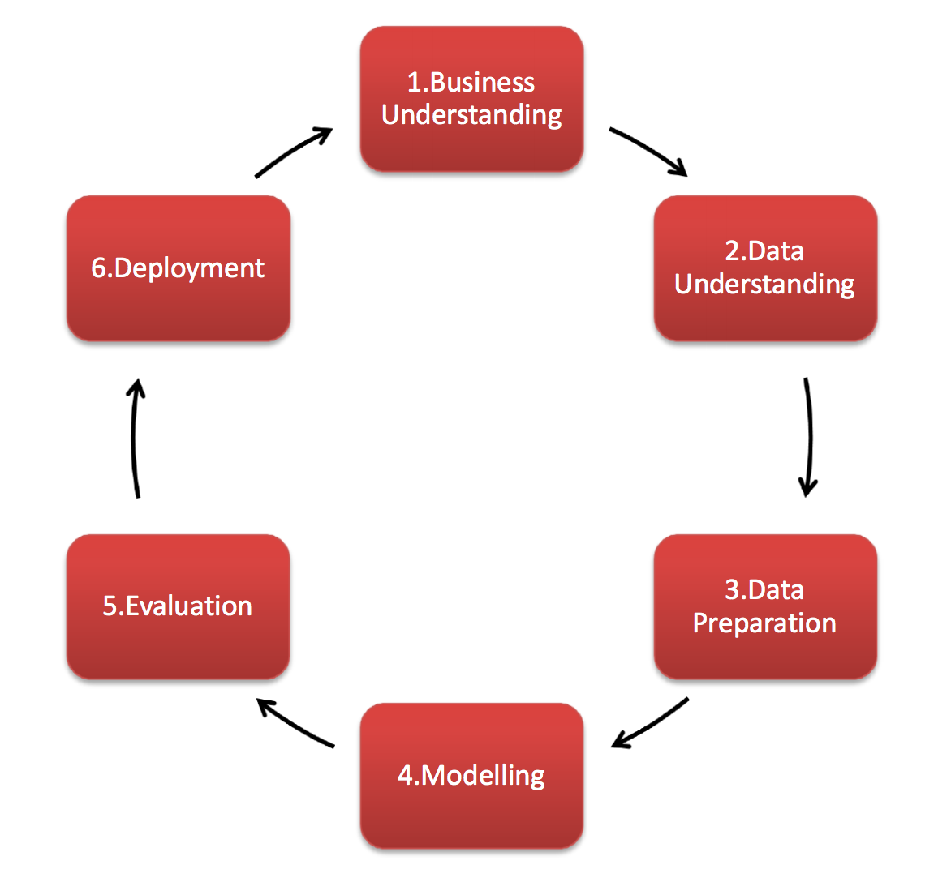
4. DM Process [Cont’d]

Slide 46
4. DM Process [Cont’d]
Example: Customer Churn Prediction in Retail
Business Understanding: A retail company wants to predict which customers will churn in the next quarter to retain them through targeted marketing campaigns.
Data Understanding: The company gathers customer-related data such as demographics, purchase history, frequency of purchases, and customer support interactions.
Data Preparation: The company cleans the data by filling in missing information (e.g., age, location), removes duplicate records, and creates a new feature: "average purchase value over the last 12 months." The data is then split into training and testing sets.
Modeling: The company uses various algorithms, including Random Forest and Logistic Regression, to create a predictive model. The target variable is whether a customer churned or not.

Slide 47
4. DM Process [Cont’d]
Evaluation: The Random Forest model performs the best with an accuracy of 85% and a recall of 80%, meaning it correctly identifies 80% of customers likely to churn.
Deployment: The model is deployed into the company's CRM system. It flags customers likely to churn, and the marketing team reaches out to these customers with retention offers.

Slide 48
4. DM Process [Cont’d]
Algorithms Used in Data Mining
Classification: Predicting categorical outcomes, such as whether a customer will churn or not. Algorithms include Random Forest, Decision Trees, and Support Vector Machines (SVM).
Clustering: Grouping similar data points together. Algorithms include K-Means and DBSCAN. Useful for customer segmentation.
Regression: Predicting continuous values, such as future sales or prices. Algorithms include Linear Regression and Ridge Regression.
Association Rule Learning: Discovering relationships between variables, often used in market basket analysis (e.g., products frequently bought together). Algorithms include Apriori and FP-Growth.
Anomaly Detection: Identifying outliers in the data. Useful for fraud detection. Algorithms include Isolation Forest and One-Class SVM.

Slide 49
4. DM Process [Cont’d]
Note:
The data mining process, following the CRISP-DM framework, is a structured approach that guides organizations through the transformation of raw data into valuable insights.
It begins with defining the business problem, understanding the data, preparing it for analysis, applying appropriate models, and then deploying and monitoring these models in real-world applications.
Through this process, businesses can uncover patterns and trends to drive decision-making, improve operations, and create value.

Slide 50
5. Challenges of DM
1. Data Quality Issues
Poor data quality can severely impact the success of data mining projects. If the data contains errors, missing values, outliers, or duplicates, the mining process may lead to inaccurate or misleading insights.
Challenge: Incomplete, noisy, or inconsistent data.
Example: In a retail dataset, if there are missing customer purchase records or duplicate entries, any model developed to predict customer churn might perform poorly because the training data does not accurately represent reality. For instance, missing customer demographics (e.g., age, gender) can lead to a biased prediction model that doesn’t consider key factors driving churn.

Slide 51
5. Challenges of DM
2. Data Privacy and Security
With the increasing focus on data privacy laws and regulations (such as GDPR in Europe), mining large datasets that include personal or sensitive information requires careful handling.
Challenge: Ensuring data privacy while still extracting useful patterns.
Example: A healthcare organization might want to use patient data to predict the likelihood of certain diseases. However, using sensitive health data requires strict anonymization and compliance with regulations like HIPAA (Health Insurance Portability and Accountability Act). Failing to anonymize the data properly can lead to legal issues or breaches of confidentiality.

Slide 52
5. Challenges of DM
3. High Dimensionality of Data
As datasets grow in size and complexity, the number of features (or variables) also increases. This phenomenon, known as high dimensionality, can make data mining more difficult because it increases the computational complexity and can lead to overfitting.
Challenge: Handling datasets with too many features or dimensions.
Example: In genomics, researchers deal with datasets that have thousands of genes as features. Identifying the key genes related to a particular disease can be challenging due to the vast number of possible combinations and the risk of creating a model that overfits the training data, leading to poor generalization.

Slide 53
5. Challenges of DM
4. Scalability and Efficiency
The size of modern datasets can reach terabytes or even petabytes. Traditional data mining algorithms may not be scalable enough to handle such large volumes of data efficiently, especially when real-time or near-real-time insights are required.
Challenge: Mining large datasets in a timely manner.
Example: Social media platforms like Facebook or Twitter generate massive amounts of data every second. Analyzing this data in real-time to detect trends, such as a viral topic or sentiment analysis, requires highly scalable data mining systems. Algorithms that don’t scale well may take too long to process the data and deliver results that are no longer timely.

Slide 54
5. Challenges of DM
5. Choosing the Right Data Mining Methodology
Selecting the most appropriate algorithm or methodology for a given data mining task is not straightforward. Different problems require different approaches, and a method that works well for one dataset may fail for another.
Challenge: Selecting the right algorithm or model for the problem.
Example: In fraud detection, classification models like decision trees, neural networks, or random forests might be used. However, identifying which algorithm will yield the best results depends on the specific dataset characteristics, and it often requires trial and error. Using an unsuitable model may result in inaccurate fraud predictions or missed fraudulent cases.

Slide 55
5. Challenges of DM
6. Integration with Business Processes
Even if a data mining model is successful in uncovering insights, integrating those insights into the decision-making processes of a business can be difficult. This includes convincing stakeholders, aligning results with business strategies, and ensuring the model fits seamlessly into existing workflows.
Challenge: Aligning data mining insights with business objectives and workflows.
Example: A predictive model might suggest that certain high-risk loans in a bank's portfolio should be avoided, but if the model’s predictions aren’t easily interpretable or if the results are misaligned with the bank’s existing risk management strategies, the insights may be ignored by stakeholders. This can limit the overall impact of the data mining project.

Slide 56
5. Challenges of DM
7. Data Integration from Multiple Sources
In many organizations, data comes from various sources—databases, spreadsheets, social media platforms, sensors, and more. Integrating these disparate data sources into a single, unified dataset for mining is often complex and time-consuming.
Challenge: Integrating and harmonizing data from different sources with varying formats.
Example: An e-commerce company may have sales data in one system, customer behavior data from website tracking, and product reviews from social media. To predict which products are likely to be successful, the company must integrate these diverse data sources. However, differences in data formats, structures, and even semantics (e.g., varying definitions of "sales") can pose major integration challenges.

Slide 57
5. Challenges of DM
8. Interpretation and Use of Results
Interpreting the results of data mining models can be complex, especially for non-technical stakeholders. Understanding the patterns found in the data and translating them into actionable business decisions requires expertise.
Challenge: Making data mining results interpretable and actionable.
Example: A complex neural network model might predict customer churn with high accuracy, but it could be difficult for business leaders to understand how the model arrived at its prediction. This can lead to reluctance in using the model for decision-making, even though it provides accurate results. Decision trees, on the other hand, are easier to interpret but might not perform as well on complex datasets.

Slide 58
5. Challenges of DM
9. Evolving Data
Data changes over time, a phenomenon known as data drift. Models built on historical data may become obsolete if the underlying patterns change, requiring continuous model updates and retraining.
Challenge: Adapting to data drift and evolving patterns in the data.
Example: In the financial sector, a model built to detect fraudulent transactions might become ineffective over time as fraud tactics evolve. If the model is not updated with new data and retrained regularly, it may fail to identify new types of fraud, leading to an increased risk of undetected fraud in the future.

Slide 59
5. Challenges of DM
10. Lack of Skilled Professionals
Data mining requires specialized knowledge in areas such as data science, statistics, machine learning, and domain-specific expertise. A lack of skilled personnel can limit the ability of organizations to effectively mine data and generate insights.
Challenge: Shortage of skilled data scientists and analysts.
Example: A small healthcare organization may want to use machine learning to predict patient readmissions, but they don’t have in-house data scientists who can clean the data, develop a predictive model, and interpret the results. Without the necessary skills, the project may not succeed or deliver the desired impact.

Slide 60
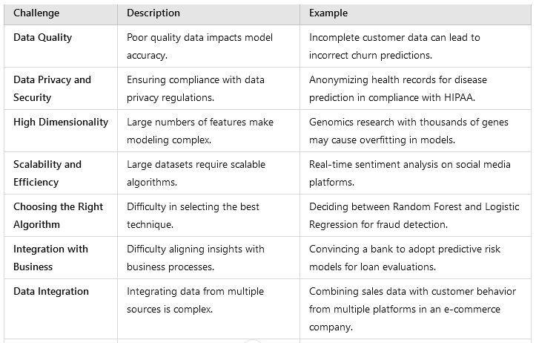
5. Challenges of DM
Summary of Challenges and examples

Slide 61
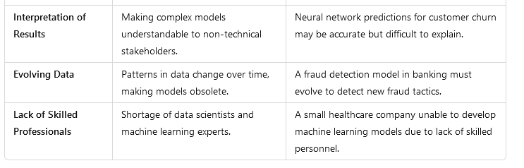
5. Challenges of DM

Slide 62
Outcomes
At the end of this topic, students should be able to:
Understand the Overview of DM Techniques and Algorithm
Explore applications of DM
Discuss Benefits of DM
Demonstrate the DM Process
Describe challenges of DM

