Slide 1
Calorimeter Design

Slide 2


Assumptions
Qloss
System
Pin
Pout
Air is ideal gas why? => Compressibility factor(Z) is around 1 between 250-300K
du = dq - dW and dW=Pdv
U=U(Q,V) differentiate => for dv=0 =>
Another thing=> internal energy of ideal gases depends only temperature
du=dWein-dWeout-dQwall-loss => CvdT/dt=Pin-Pout-Pwall-loss
Using Newton’s cooling law dT/dt= kΔT =>Pin-Pout=kCv ΔT +Pwall-loss
Constant volume
Constant ambient is constant

Slide 3

Assumptions
Qloss
Air in
System
Air out
Pin
Pout
No accumulation of air =>Control Volume process
No KE and PE change => Steady State Flow
Then dQwall-loss + dWein-dWeout=m*dh where dh=du+Pdv+VdP and dv=0 no change in volüme
P=RT/V => dP=R/V*dT and du=CvdT if we put this into above eq. => dh=(Cv+R)dT=CpdT
Eventualy => Ploss=mCpΔT+Pwall-loss

Slide 4
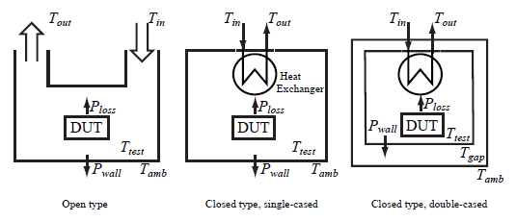
Proposed Methods

Slide 5
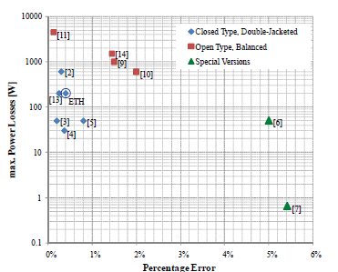
Errors

Slide 6
Conclusion&Remarks
A major error source of all calorimeter types is heat leakage through the walls of the calorimeter.
Volume and response time are inversely proportional.
In higher volume container, air diffuse heterogeneously.
Heating foils are being used for to diffuse the air in the gap between inner and outer cases.
Heat capacity changes with changing in temperature, humidity, volume flow.

Slide 7
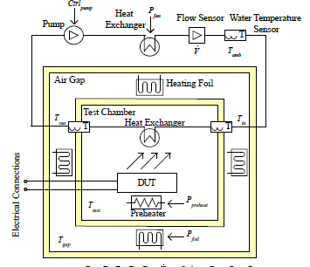
Combined Method

