Slide 1

I T
The Internet of Things
by Kara Barleta

Slide 2
Agenda
What is IoT?
Introduction of Concept
Examples of IoT applications
IoT Demo

Slide 3
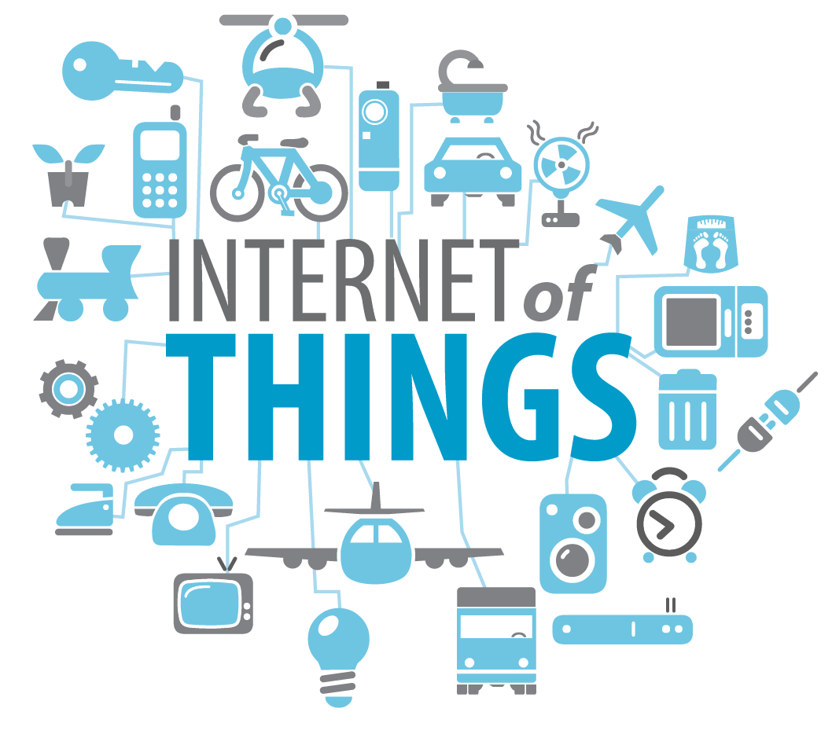
What is IoT?
Very simply put, the Internet of Things refers to the rapidly growing network of connected objects that are able to collect, exchange and leverage data using the internet.

Slide 4
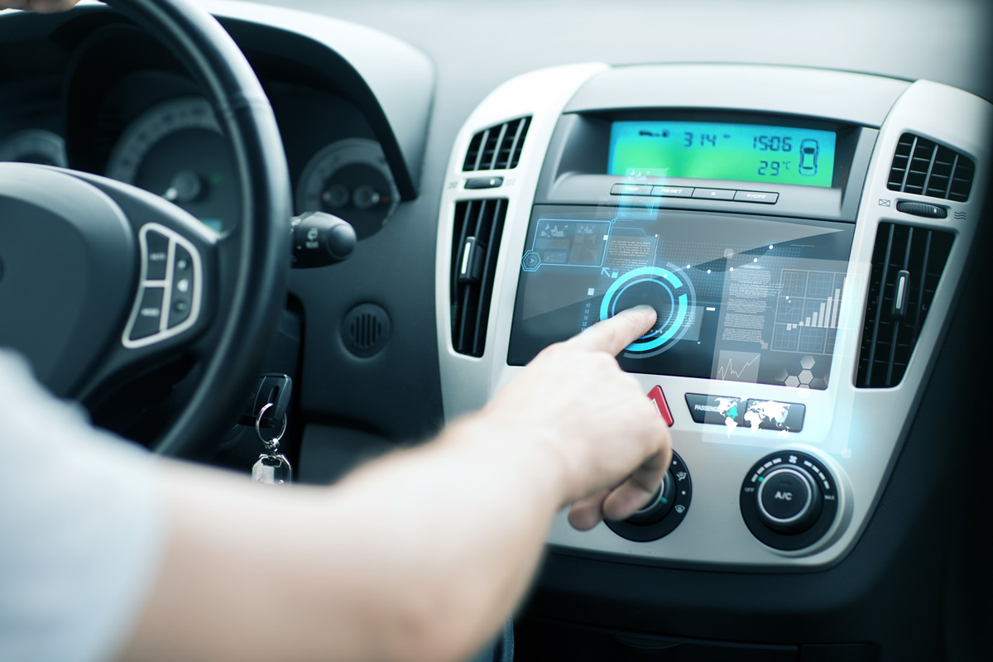
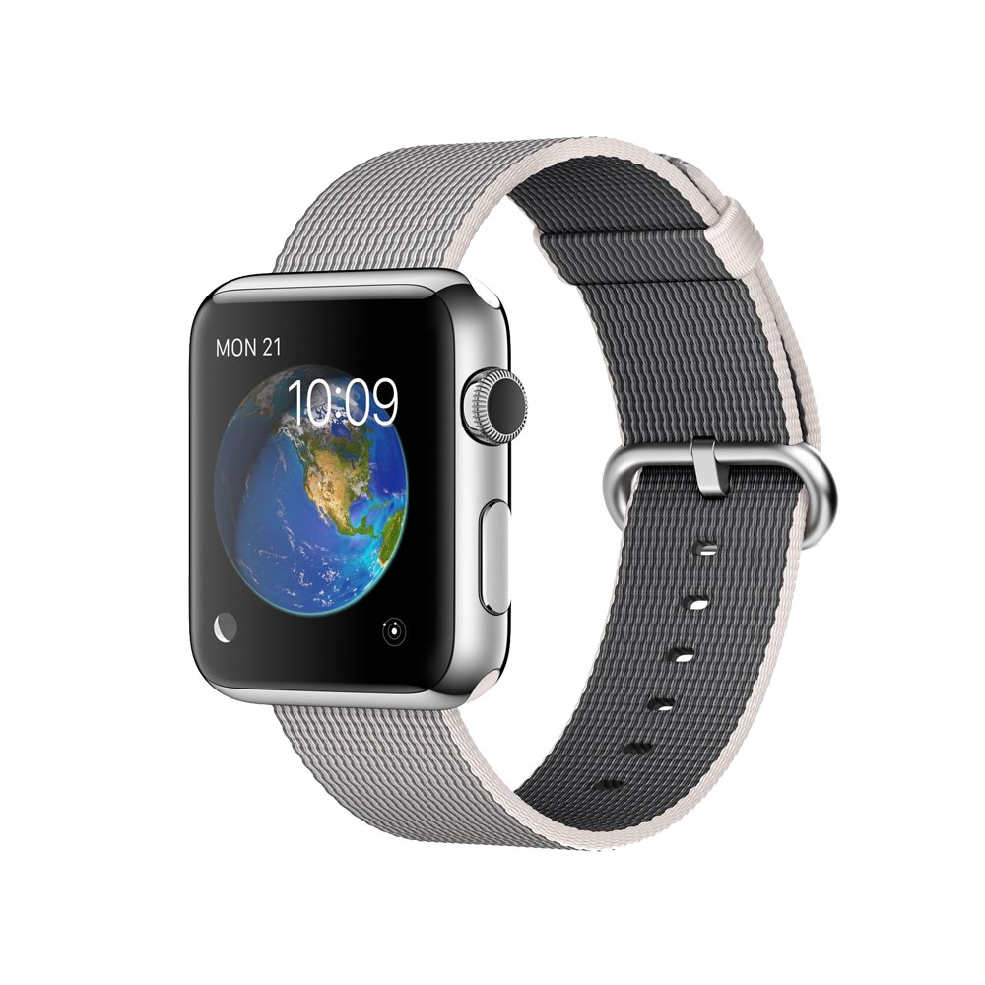

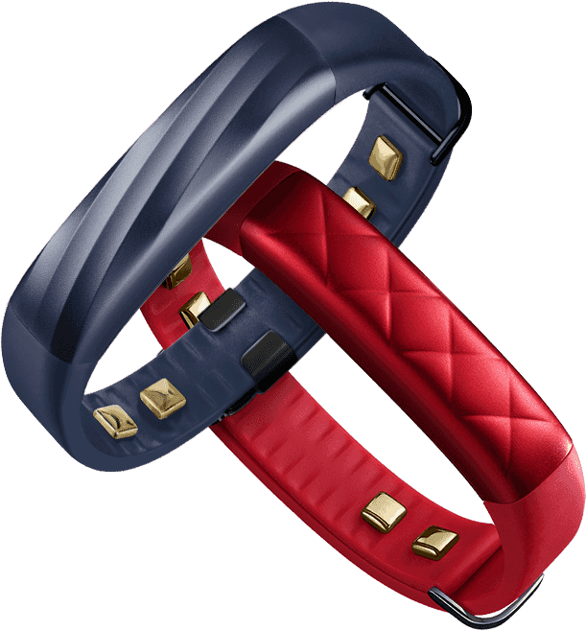
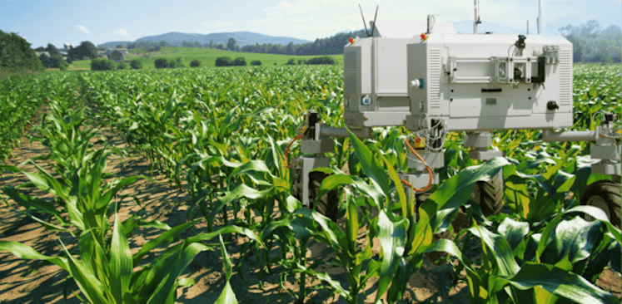
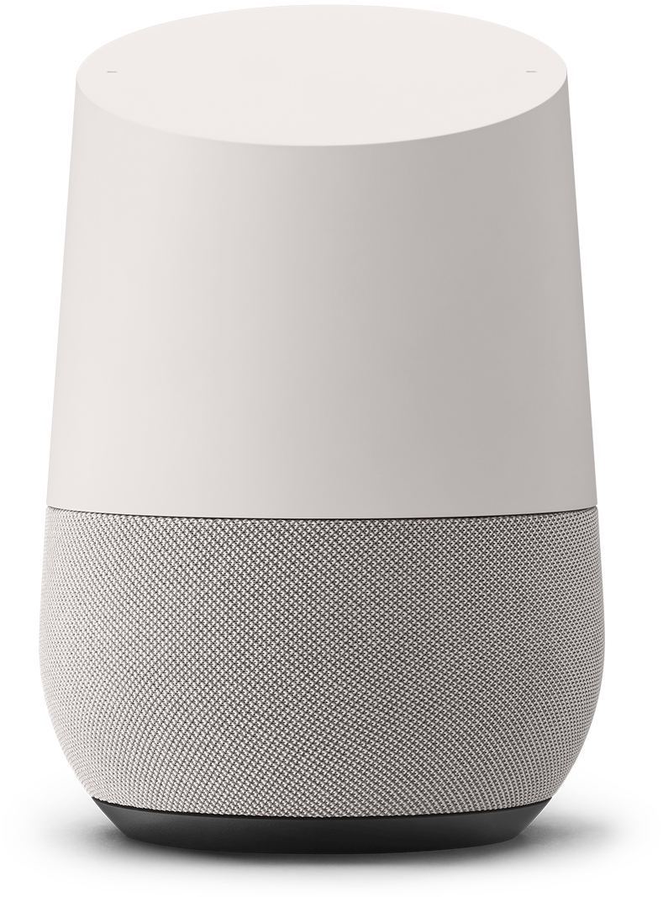
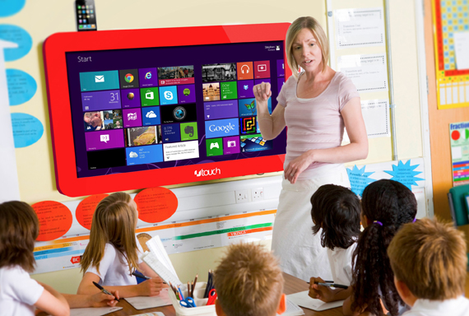
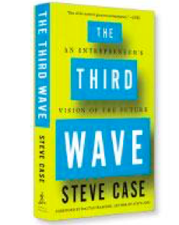
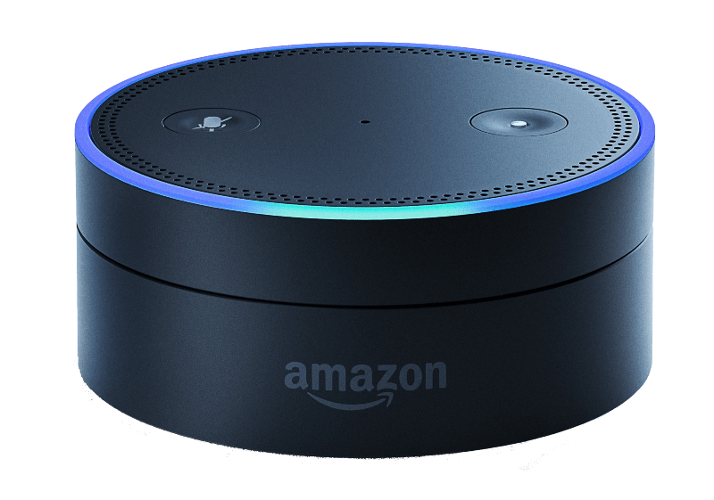
IoT Applications

Slide 5
Why should we care?
12 Popular Programming Languages for IOT Development
Assembly
B#
C
C++
Go
Parasail
Java
JavaScript
PHP
Python
Rust
Swift
Go
Source: https://www.upwork.com/hiring/for-clients/programming-languages-for-iot-development/

Slide 6

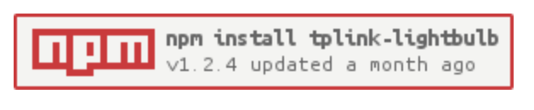
Demo
Documentation thanks to konsumer https://github.com/konsumer/tplink-lightbulb
Setup
Download
Index.js
Install
Connect to the same network

Slide 7
Key Takeaways
IoT creates new a kind opportunity for us as developers.
It’s also kind of cool that JavaScript is one of the programming languages!
This lightbulb demo is just basically IoT in its most basic and limited form. In a much larger scale, it has a lot of potential to impact how we live our lives and experience the internet.

