Slide 1

GERMANFRENCHFOOD

Slide 2
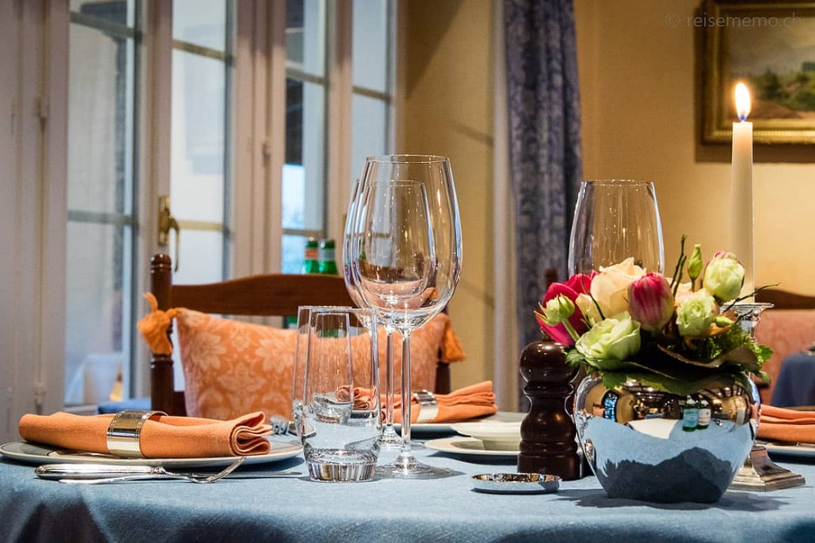
Presentation of the concept
Target : people curious of other food cultures
Device target
Franchise

Slide 3
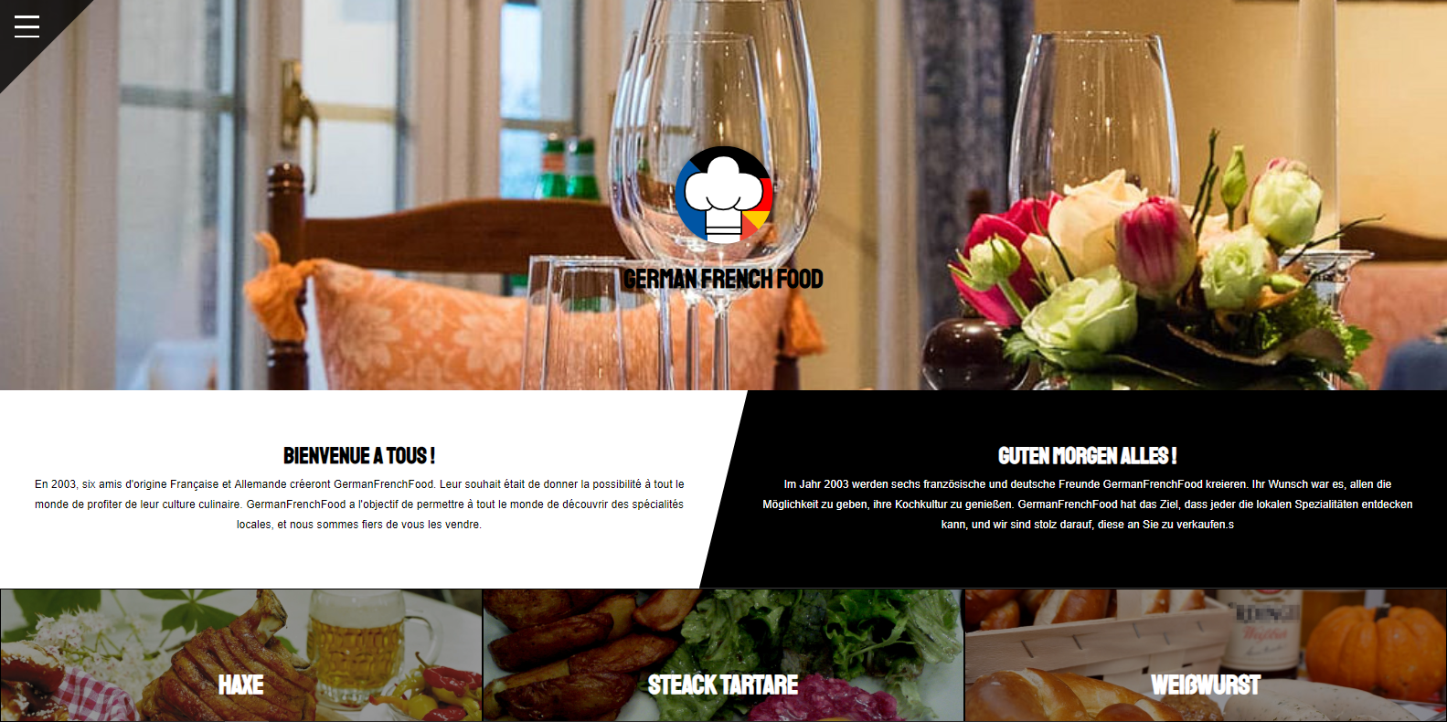
Site content

Slide 4

Work distribution
Front end
Back end
Containt search

Slide 5
Conclusion
Difficulties encountered and how to solve them
Progress noted

Slide 6
Thank you for your attention

Slide 7


