Slide 1

GERMANFRENCHFOOD

Slide 2
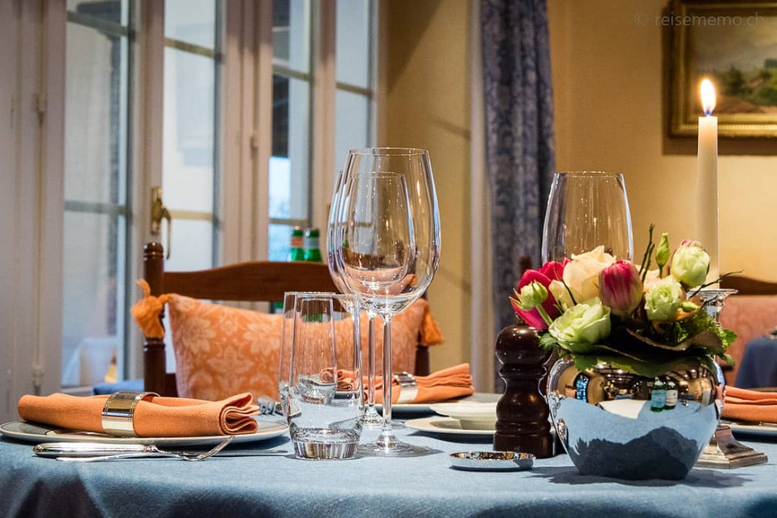
Presentation of the concept
Target : people curious of other food cultures
Device target
Franchise

Slide 3
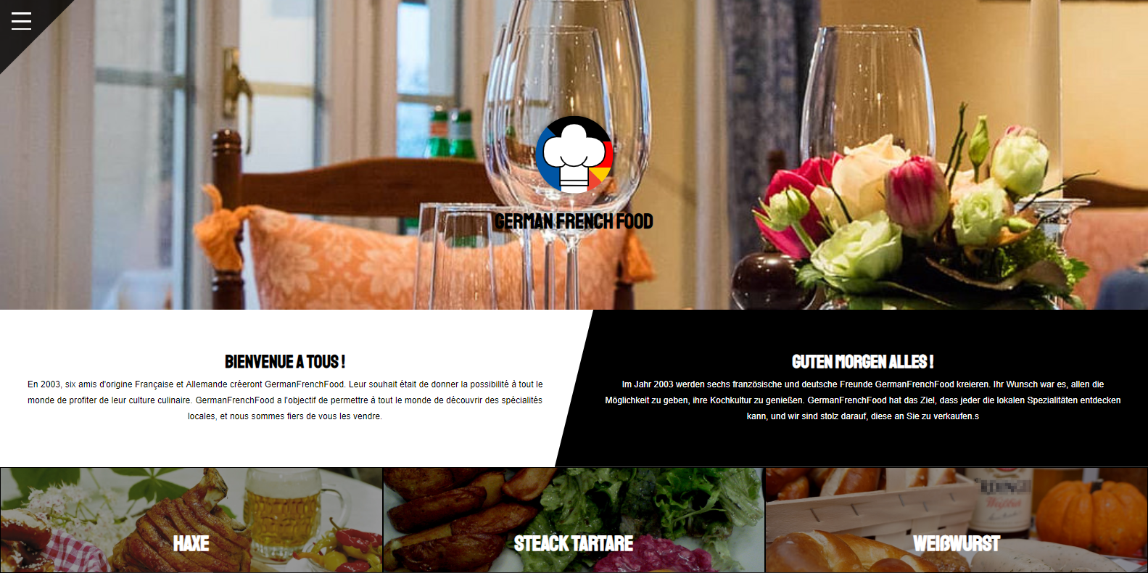
Site content

Slide 4







Tools & Technologies

Slide 5

Work distribution
Front end
Back end
Containt search

Slide 6
Conclusion
Difficulties encountered and how to solve them
Progress noted

Slide 7
Thank you for your attention

Slide 8


