Slide 1
MSKLEH001
File created on: 2024/01/07 01:55:27

Slide 2
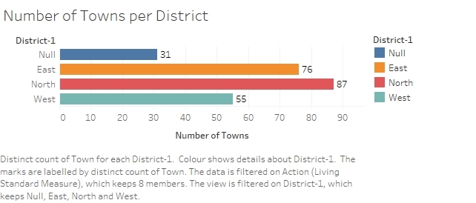

Slide 3
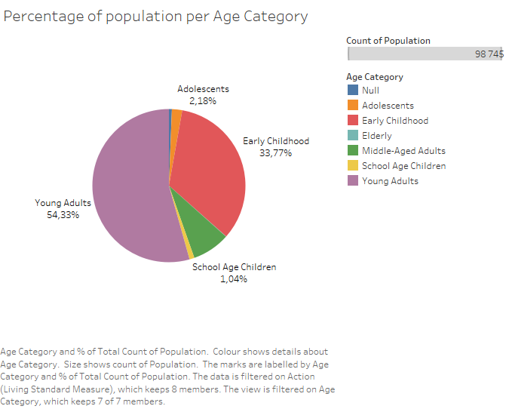

Slide 4
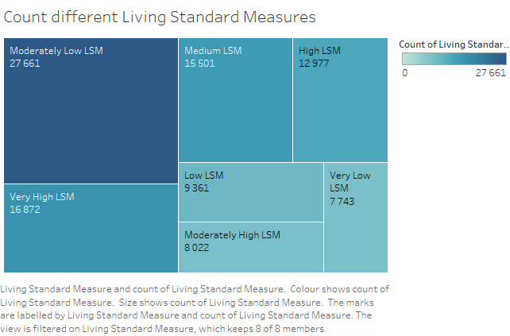

Slide 5
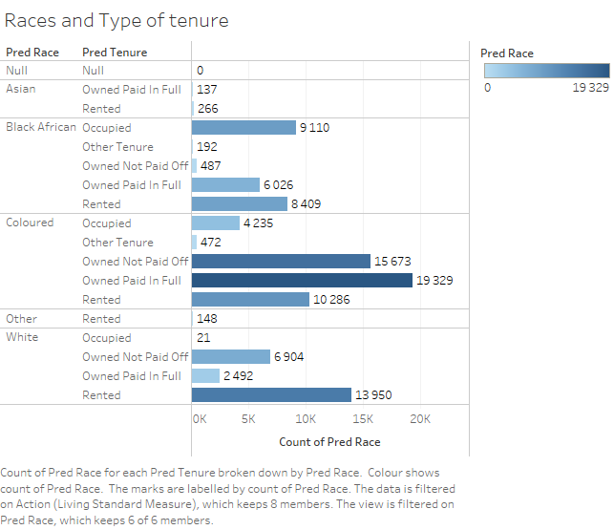

Slide 6
