Slide 1

HACKYEAH 2026 / KRAKÓW
BiKing
The shortest route
is not always
the best route.
Cycling routes adapted to
the city around you.
CITY CONTEXT
Air · Heat · UV · Shade
SPORT & HEALTHCARE
SMART CITY
BiKing / HackYeah 2026
01 / 10
Notes:
Opening: BiKing makes city and environmental context part of bicycle route selection. The current product is the Flask/Leaflet app, not the obsolete Streamlit demo. Original logo: app/static/logo.png. No team roster was found, so no names were invented. This deck serves both requested categories. No medical outcome is claimed.

Slide 2
THE PROBLEM
Two routes. Two different rides.
Similar distance and time can hide very different conditions.
THE USUAL COMPARISON
THE CONDITIONS OF THE RIDE
How far?
How long?
Air
Heat
PM2.5 · PM10 · NO₂
Felt temperature / UTCI
UV
Shade
Shade-adjusted UV
Buildings + trees
Distance and travel time
A route is also an environmental exposure.
BiKing / HackYeah 2026
02 / 10
Notes:
This is a conceptual comparison, not a claim that a particular measured pair has similar time or a given exposure reduction. Implemented factors: PM2.5, PM10, NO₂, UTCI/felt temperature, shade-adjusted UV, buildings and trees. Sources: app/env/exposure.py:compute_edge_exposure; app/engine/metrics.py:route_metrics. Pollution and thermal fields are model estimates, not sensors on every street. Shade does not guarantee cleaner air; the factors remain distinct.

Slide 3
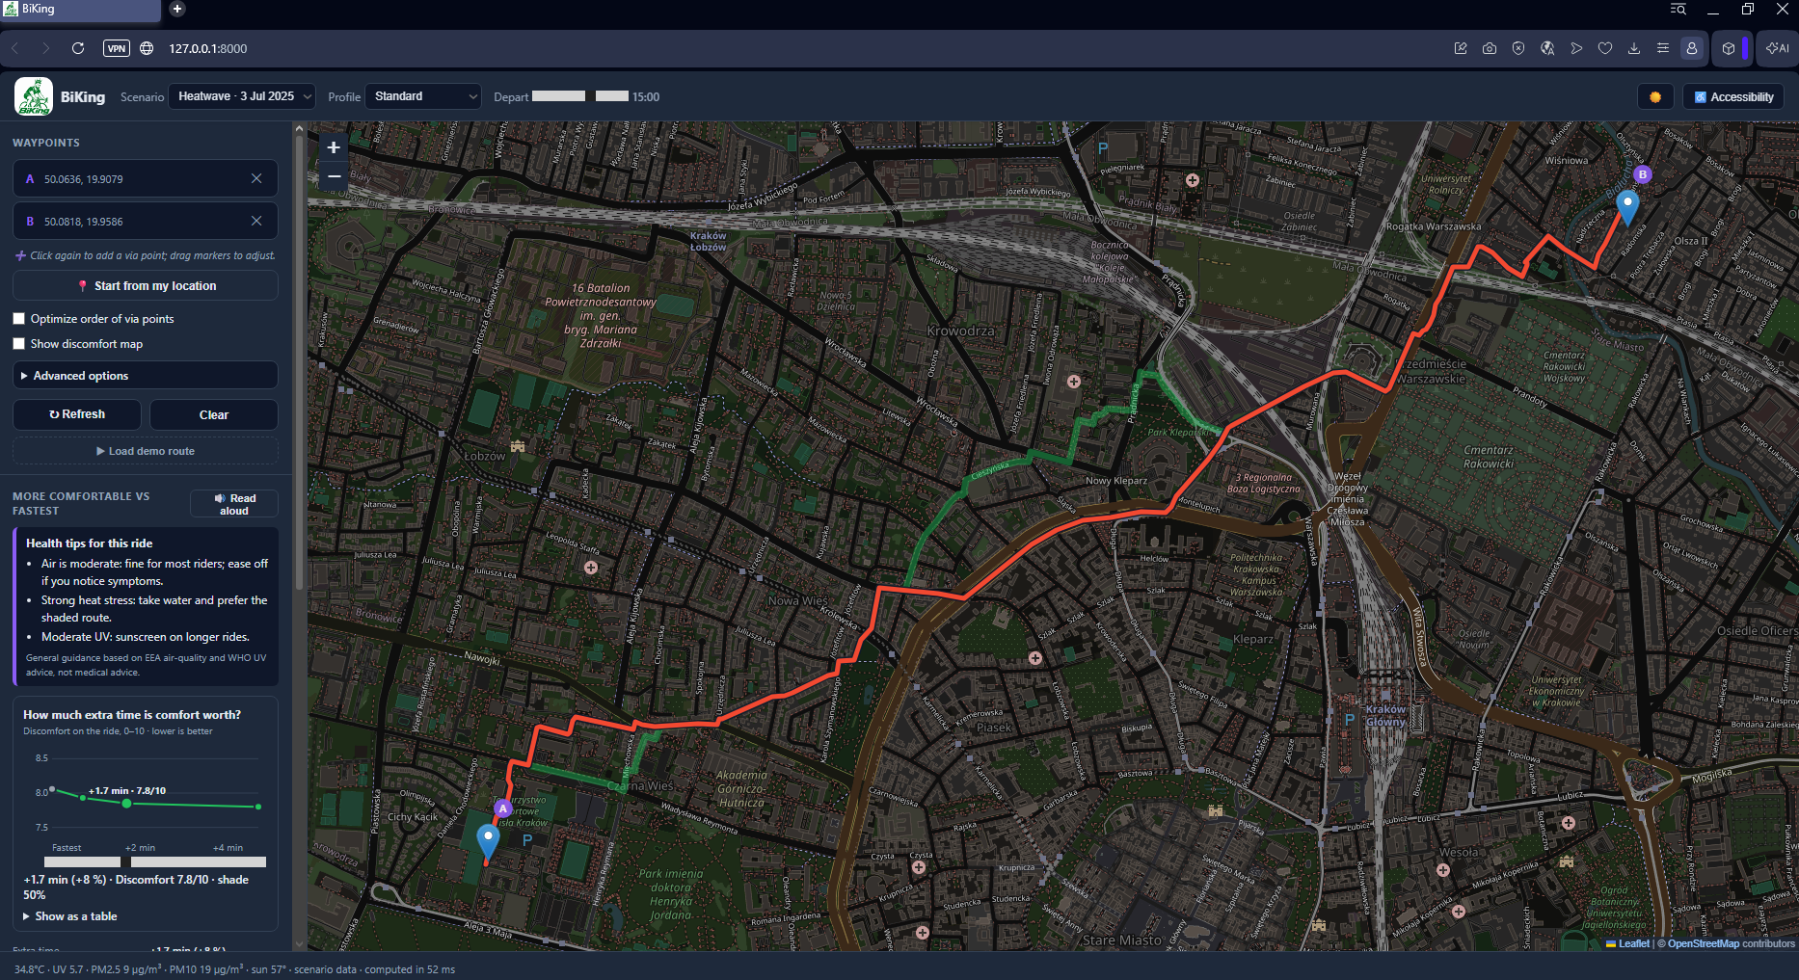
THE PRODUCT
From A to B, with context.
1
Choose points
Start, destination
+ optional via points
2
Set context
Scenario, departure time
and rider profile
3
Compare routes
Fastest vs
More comfortable
4
Adjust the trade-off
Choose how much extra
time comfort is worth
5
Ride
Export GPX to
your cycling app
BiKing / HackYeah 2026
03 / 10
Notes:
UI source: app/static/index.html and app/static/app.js. Users click or drag map waypoints; the route automatically recalculates. Up to five points are accepted. Scenario/profile/departure controls and selected heat/air/UV factors are implemented. POST /api/route/tradeoff powers the comfort/time slider. GPX export is implemented in routeToGpx/exportGpx. Screenshot: presentation/main_ui.png, supplied by the user. The browser toolbar is cropped in PowerPoint; the source image is preserved. This overview shows a separate slider selection from the route cards on slide 8.

Slide 4
THE SYSTEM
The city becomes part of the routing model.
ENVIRONMENT
CITY GEOMETRY
BICYCLE NETWORK
Open-Meteo + GIOŚ
GUGiK LoD1 / OSM / MSIP
OpenStreetMap
Weather · UV
PM2.5 · PM10 · NO₂
Footprints · building heights
Tree / green-cover geometry
pyosmium → OSMnx
Directed streets · road classes
PER-EDGE EXPOSURE MODEL
USER CONTEXT
Shade → UTCI + air index + effective UV → fuzzy discomfort
Time · profile · selected factors
Road-segment costs
Dijkstra route search
BiKing route choices
BiKing / HackYeah 2026
04 / 10
Notes:
Implemented data paths: app/env/fetch.py queries Open-Meteo weather, air-quality (CAMS) and GIOŚ. GIOŚ supplies a city correction and an IDW spatial background; road-class factors are calibrated in pipeline/calibrate_road.py. Geometry adapters in pipeline/p03_buildings.py and pipeline/shade_build.py handle GUGiK LoD1 2024, OSM and MSIP 2015 green cover, with documented fallbacks. Building heights may be measured, tagged, inferred from floors, or defaults; tree heights are assumptions. Graph construction is offline OSM PBF → pyosmium → OSMnx → SciPy CSR. No Airly, Sentinel or Google Maps integration is claimed. The optional Landsat heat-map pipeline adds a surface-temperature anomaly correction to the model.

Slide 5
THE INNOVATION / EDGE WEIGHTS
Routing beyond distance.
FASTEST
BIKING / MORE COMFORTABLE
Edge cost = travel time
C = t × (1 + αX + wP)
Minimise total ride time.
Time × a profile-specific environmental penalty
PENALISE THE AVOIDABLE PART
Same graph.
Different edge costs.
X = clip((D − D₁₀) / (1 − D₁₀), 0, 1)
D: fuzzy discomfort D₁₀: today's city baseline
SciPy Dijkstra
on a directed CSR graph
α / w: rider weights P: relative air + hotspot penalty
Weights are applied before path search.
BiKing / HackYeah 2026
05 / 10
Notes:
Actual formula: app/engine/variants.py:eco_cost. C_e = t_e * (1 + alpha * X_e + w * P_e). D10 is the 10th percentile of current discomfort over every graph edge. X = clip((D-D10)/max(1-D10, 1e-6), 0, 1). P = A/median(A) + clip(A-A10, 0, 1), with A cleaned/clipped to [0.1,6]. w = 6 for Asthma and 0 for other profiles; alpha is 5/5/4/3 for standard/asthma/senior/athlete. Profile speeds set t = length/speed. D comes from profile-specific Mamdani fuzzy LUTs with 11 rules. The time/comfort slider scales both environmental weights. app/graph/routing.py uses scipy.sparse.csgraph.dijkstra, not A* or NetworkX at request time. Summed edge costs select the path; this is not post-hoc colouring. The displayed baseline expression omits only the 1e-6 division guard for clarity.

Slide 6
THE TECHNICAL HIGHLIGHT / PHYSICAL SHADE
We actually calculate the shadows.
SCHEMATIC / ROAD CROSS-SECTION
A POINT IS SHADED WHEN
H(d) > 1.5 m + d · tan(θ)
Trace toward the sun
θ = solar elevation; d = ray distance
Ray blocked by the building
Sun position
01
Solar geometry
pvlib elevation + azimuth
1.5 m eye height
02
City geometry
Building + tree height raster
03
Shade fraction
Shaded / total road samples
04
Routing effect
Shaded road samples
Building / H
UTCI + UV → fuzzy cost → path
Precompute 16 × 8 solar bins → look up shade at departure time
2 m raster / ray steps · 120 m ray range · road samples at most 15 m apart
BiKing / HackYeah 2026
06 / 10
Notes:
Hero implementation: pipeline/p04_height_raster.py rasterizes footprints and heights in EPSG:2180 at 2 m. pipeline/p05_shade.py:shaded_points traces road sample rays toward the sun: obstacle height > EYE + d*tan(elevation), EYE=1.5 m, d=2..120 m in 2 m steps. Points inside obstacles of at least 3 m are also marked shaded. Equal-length edge cells have midpoint samples no farther than 15 m apart, minimum two. Their shaded fraction is stored as uint8 in (E,16,8), indexed by eid. These are model settings, not measured performance. app/shade/sun.py uses pvlib NREL apparent elevation and azimuth. app/shade/model.py uses nearest circular azimuth bin, linear elevation interpolation; daylight elevation is clamped to 5..65 degrees, night returns 1. Runtime uses prepared tables, not fresh GIS ray-marching per request. The native diagram is explanatory geometry, not a fabricated app screenshot or Kraków measurement. No polygon-shadow generation, full 3D ray tracing, terrain effects or measured tree heights are claimed.

Slide 7
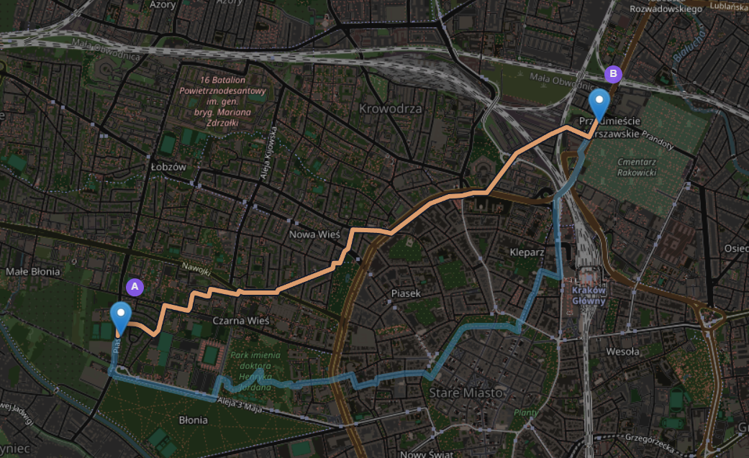
THE DEMO / ROUTE COMPARISON
Same city. Different route.
Fastest
More comfortable
Travel time
Fastest 17.3 / BiKing 22.2
min
Shade
Fastest 12 / BiKing 47
% of ride
Felt temperature
Fastest 36.9 / BiKing 34.8
°C / UTCI model
PM2.5 dose
Fastest 5.1 / BiKing 6.0
µg / model estimate
Same A/B points. Map © OpenStreetMap contributors.
Values from the route cards
Environmental conditions can change the path itself.
BiKing / HackYeah 2026
07 / 10
Notes:
User-supplied map: presentation/route_comparison.png. The active Fastest route has orange discomfort segments; the More comfortable alternative is blue in the accessibility palette. The legend matches the supplied image. Values are transcribed from presentation/route_detail.png, shown on slide 8: Fastest 4.3 km / 17.3 min / 12% shade / 36.9°C / 5.1 µg PM2.5; More comfortable 5.5 km / 22.2 min / 47% shade / 34.8°C / 6.0 µg PM2.5. BiKing here means More comfortable. The metrics are implemented fields in app/engine/metrics.py: time_min, shade_pct, utci_avg_c, pm25_dose_ug. Shade and UTCI are time-weighted; PM2.5 dose is concentration × profile ventilation × travel time. The screenshots show model estimates for one demo. The Fastest route is a BiKing baseline at profile speed, not a Google Maps benchmark. If both routes coincide, the app explicitly reports that rather than forcing a detour. The main UI screenshot on slide 3 is a separate application overview. No API response accompanied the supplied images; numbers use the visible card precision.

Slide 8
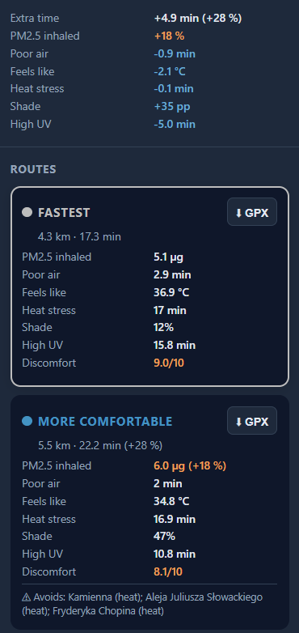
THE EXPERIENCE
Complexity under the hood.
Simple for the cyclist.
What does the detour buy?
+35 pp
−2.1°C
+4.9 min
Shade on the ride
Felt temperature / UTCI
Travel time / +28%
PM2.5 dose: 5.1 → 6.0 µg (+18%)
Longer exposure can increase the total inhaled dose.
You control the balance.
Comfort slider · street explanations · GPX export
ACCESSIBLE COLOURS + TEXT
BiKing / HackYeah 2026
08 / 10
Notes:
Usability implemented in app/static/app.js and index.html: route comparison cards, metric glossary, avoided-street explanations, segment colours, comfort/time slider and chart, GPX export. Accessibility options include colour-vision palettes, increased text size, high contrast, reduced motion, dashed vs solid routes and browser speech synthesis. Selected factors only change route scoring; the metric cards retain all modelled factors. This is route planning with informed selection; no clinical validation or built-in live navigation is claimed. Screenshot: presentation/route_detail.png, supplied by the user and preserved in its portrait aspect ratio. The card values show +4.9 min (+28%), +35 percentage points of shade, −2.1°C UTCI, −5.0 min high UV, and +18% modelled PM2.5 dose. Show the trade-off explicitly. The slider is visible in the main UI screenshot on slide 3; this crop shows the route cards, GPX buttons and avoided-street explanation.

Slide 9
IMPLEMENTATION / INTEGRATED PROTOTYPE
What we actually built.
A working code path from city data to a cyclist's route choice.
OUR IMPLEMENTATION
01
Browser interface
THIRD-PARTY LIBRARIES
HTML / CSS / JS · comparison · slider · GPX export
Leaflet · Flask · Pydantic
SciPy · pvlib · scikit-fuzzy
GeoPandas · Rasterio · OSMnx
02
API + application engine
Validation · orchestration · route metrics · explanations
03
Routing + environment model
EXTERNAL APIs / DATA
Profile costs · fuzzy discomfort · directed path search
OpenStreetMap · GUGiK LoD1
MSIP green cover · Open-Meteo
GIOŚ monitoring stations
04
GIS preprocessing + cache
Graph export · height raster · shade tables · LRU cache
4
integrated layers
Real-module integration verified on fixture graphs.
Application screenshots show the Kraków demo.
BiKing / HackYeah 2026
09 / 10
Notes:
Four integrated layers: browser interface, API/application engine, routing/environment model, and GIS preprocessing/cache. The full real-module integration chain is tested with small fixture networks in tests/test_integration.py; those are not measured city routes. app/providers.py makes modules injectable and discloses mock/fallback status through /api/health. Offline geometry: OSM filtering including bicycle contraflow, deterministic eid indexing, CRS transformations, height raster and shade LUTs with graph fingerprints. Online: cached conditions, cost LRU, vector exposure and SciPy route search. Live refresh and stale fallback are implemented; recorded heatwave/smog days exist as 24-hour JSON scenarios with spatial weather grids. Optional pipeline/heat_map_build.py implements Landsat 8/9 surface-anomaly processing via Microsoft Planetary Computer, with edge_heat.npz prepared alongside the graph and shade artifacts in data/processed. No machine-learned microclimate model, NSGA-II, streaming evolutionary search, or reproducible city benchmark is claimed.

Slide 10
ONE PRODUCT / CONNECTED VALUE
One product. Two impacts.
SPORT & HEALTHCARE
SMART CITY
Make outdoor rides
more informed.
Turn urban data
into a daily decision.
Support cycling and active travel
Understand air, heat, UV and shade
Choose conditions that suit the ride
Plan bicycle journeys on the road network
Connect geometry with environmental data
Use city infrastructure with context
BiKing gives every journey
the context of the city around it.
BiKing / HackYeah 2026
10 / 10
Notes:
The final category mapping expresses intended practical value: support cycling/outdoor activity and informed route selection; turn urban geometry, the bicycle network and environmental data into individual journey decisions. No user study, increase in cycling, citywide benefit measurement, disease prevention, medical effect or guaranteed exposure reduction is claimed. Closing line connects both categories through the same product story.

