Slide 1
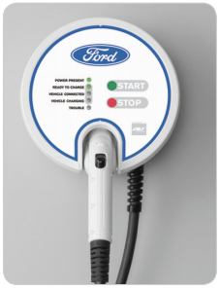

Smarthome ford CHARGING Station UX/UI PROJECT
EDU project
karacankos@gmail.com
https://www.linkedin.com/in/omer-karacan/
https://www.instagram.com/karacanos/

Slide 2
FORDCS V1.0

Slide 3


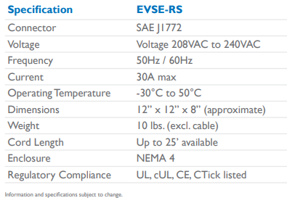


FORD Charging station V1.0 Device characteristics SYSTEM Black-BOX
Use Case
Report Factory Setting V1.0
Domain Model
Web Service
guest
service
https://www.evsolutions.com/Upload/Product/635652466512570000.pdf

Slide 4

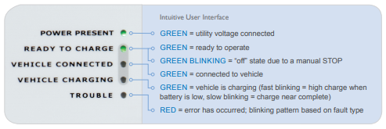


FORD Charging station V1.0 SYSTEM BEHAVIOR SYSTEM Black-BOX
Web Service
Use Case
Run-time Status Report V1.0
UX
guest
Use Case
Monitor and Control Run-time Status V1.0
V1.0
W/O LED STATUS
service
https://www.evsolutions.com/Upload/Product/635652466512570000.pdf

Slide 5
V1.0 SYSTEM Behavior (W/o GREEN STATUS) SYSTEM WHITE-BOX
V1.0 Model version: 2022.03
e: power_on
t: power_on
Events:
Power_on
Ready_to_charge
Vehicle_disconnected
Start_charging
Stop_charging
Vehicle_connected
Failure
Power_off
POWER OFF
e: ready_to_charge
t: ready_to_charge
e: power_off
t: power_off
e: vehicle_disconnected
t: ready_to_charge
power present
ready to charge
INITIAL_STATE
e: vehicle_connected
t: vehicle_connected
vehicle connected
e: failure_fixed
t: ready_to_charge
States:
INITIAL_STATE
POWER_OFF
UX_POWER_PRESENT
UX_ READY_TO_CHARGE
UX_ VEHICLE_CONNECTED
UX_ VEHICLE_CHARGING
UX_ TROUBLE
e: failure
t: failure
e: stop_charging
t: vehicle_connected
trouble
vehicle charging
e: start_charging
t: start_charging

Slide 6
FORDCS V2.0

Slide 7

FORD Charging station V2.0 SYSTEM Behavior SYSTEM Black-BOX
Web Service
Use Case
Run-time Status Report V2.0
UX
guest
Use Case
Monitor and Control Run-time Status V2.0
V2.0
CONSIDERING LED STATUS
GREEN_BLINKING (manuel stop)
VEHICLE_CHARGING GREEN STATUS LED
FAST BLINKING, SLOW BLINKING
TROUBLE RED STATUS LED
PERMENANT, FAST BLINKING, SLOW BLINKING
service
Use Case
Run-time Failure V2.0
incident
https://www.evsolutions.com/Upload/Product/635652466512570000.pdf

Slide 8
SYSTEM Behavior V2.0 (W/ RED & GREEN STATUS) SYSTEM WHITE-BOX
Events:
Power_on
Ready_to_charge
Ready_to_charge_manuel_stop
Vehicle_disconnected
Start_charging
Stop_charging
Vehicle_connected
Failure_fixed
Failure_internal
Failure_data
Failure_hw
Power_off
V2.0 Model version: 2022.01
ready to charge stopped
e: power_on
t: power_on
e: ready_to_charge_manuel_stop
t: ready_to_charge_stop
e: ready_to_charge
t: ready_to_charge
POWER OFF
e: ready_to_charge
t: ready_to_charge
e: power_off
t: power_off
power present
ready to charge
e: failure_fixed
t: power_on
e: vehicle_disconnected
t: ready_to_charge
States:
INITIAL_STATE
POWER_OFF
UX_ POWER_PRESENT
UX_ READY_TO_CHARGE
READY_TO_CHARGE_STOPPED
UX_ VEHICLE_CONNECTED
UX_ VEHICLE_CHARGING
UX_ TROUBLE
INITIAL_STATE
e: vehicle_connected
t: vehicle_connected
e: failure_fixed
t: ready_to_charge
vehicle connected
trouble
e: stop_charging
t: vehicle_connected
e: failure_internal, failure_data, failure_hw
t: failure
e: start_charging
t: start_charging
vehicle charging

Slide 9
HOW to Implement

Slide 10





FORD CHARGER ApplIcatIon
CHECK: https://objectbox.io/how-ev-charging-benefits-from-edge-computing/
T.b.d.
ca. 15 min.
<SpringBootApplication,
charger-station-application>
cs
3 roles
<external-db>
UX/UI
<Repository>
GappRepository
<Service>
GappService
<Controller>
GappController
Tester
Java Persistence (JAP) API
<entity>
GappData
<embedded-db>
Hibernate
Developer
<external-db>
MySQL
<persistency>
data storage
<algorithm>
business logic
<endpoints>
gapp APIs

Slide 11
HOW TO TEST

Slide 12
Car charging state State/Event Table test cases
REVISIT
Test Case | TC #1 | TC #2 | TC #3 | TC #4
Start state | Ready to charge | Vehicle connected | vehicle charging | Vehicle connected
Event/Input | Vehicle_connected | Start_charging | Stop_charging | Vehicle_disconnected
Expected Output | «Vehicle connected» | «vehicle charging» | «Vehicle connected» | «Vehicle disconnected»
End state | Vehicle connected | vehicle charging | Vehicle connected | Ready to charge

Slide 13
Demo – Generıc (SprIng-)ApplIcatIon
UX/UI for BEX Projects

Slide 14
Demo – Generıc (SprIng-)ApplIcatIon
ca. 15 min.
<SpringBootApplication,
generic-application>
gapp
3 roles
<external-db>
UX/UI
<Repository>
GappRepository
<Service>
GappService
<Controller>
GappController
Tester
Java Persistence (JAP) API
<entity>
GappData
<embedded-db>
Hibernate
Developer
<external-db>
MySQL
<persistency>
data storage
<algorithm>
business logic
<endpoints>
gapp APIs

Slide 15
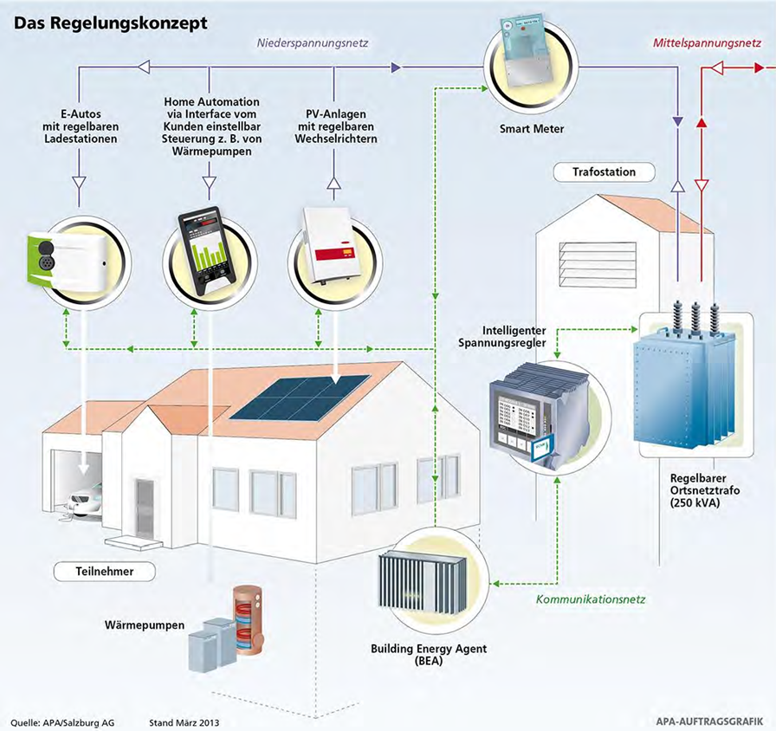
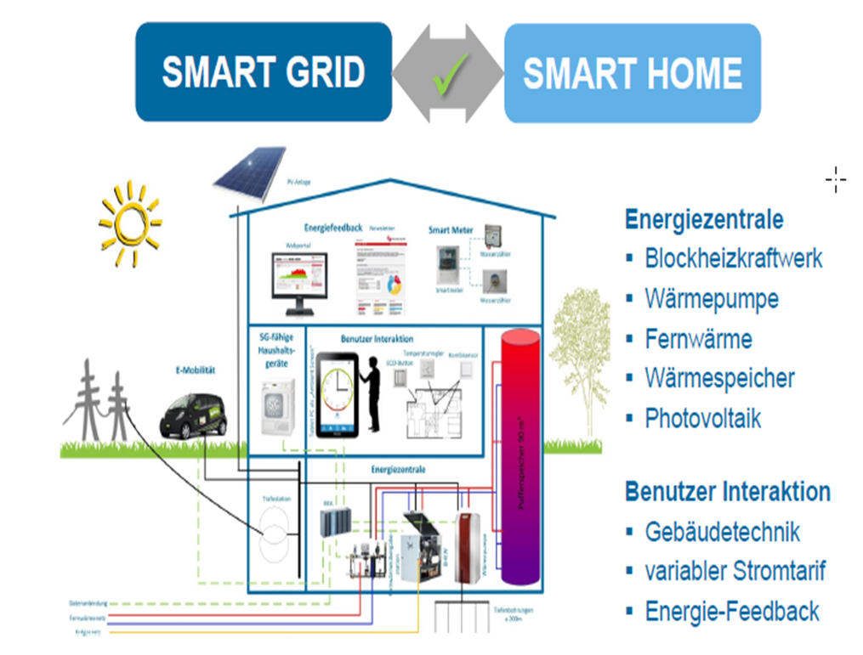
GAPP KONTEXT – SMART HOME
Charging Station

Slide 16
FORD CHARGER based on Generıc SprIng ApplIcatIon
Backend for Ford Charger UX/UI Project

Slide 17
BACKYARD
Wichtige Informationen

Slide 18
Notes
FORD – Charging Station
https://www.evsolutions.com/Upload/Product/635652466512570000.pdf

