Slide 1
Review of Low-Cost Sensors for Air Quality (Administrative Arrangement AQSens Commission internal project between DG ENV and DG JRC)
Federico Karagulian¹, Michel Gerboles¹, Annette Borowiak¹
¹ EC - JRC
Workshop:
The use of sensors and their possible role in air quality assessment
Brussels, 22 January 2019

Slide 2
Purpose of the review work:
selecting the best sensor system candidate
for the AQSens project
Gathering quantitative information about sensor systems including:
Agreement between Low-Cost Sensors (LCSs) and reference measurements
Availability of raw data, transparent data treatment and, possibility of a-posteriori calibration
Capability to measure multiple pollutants
Value for money of sensor systems
Interoperability of data according to the INSPIRE directive
Automatic data-transfer and web visualization of sensor data

Slide 3
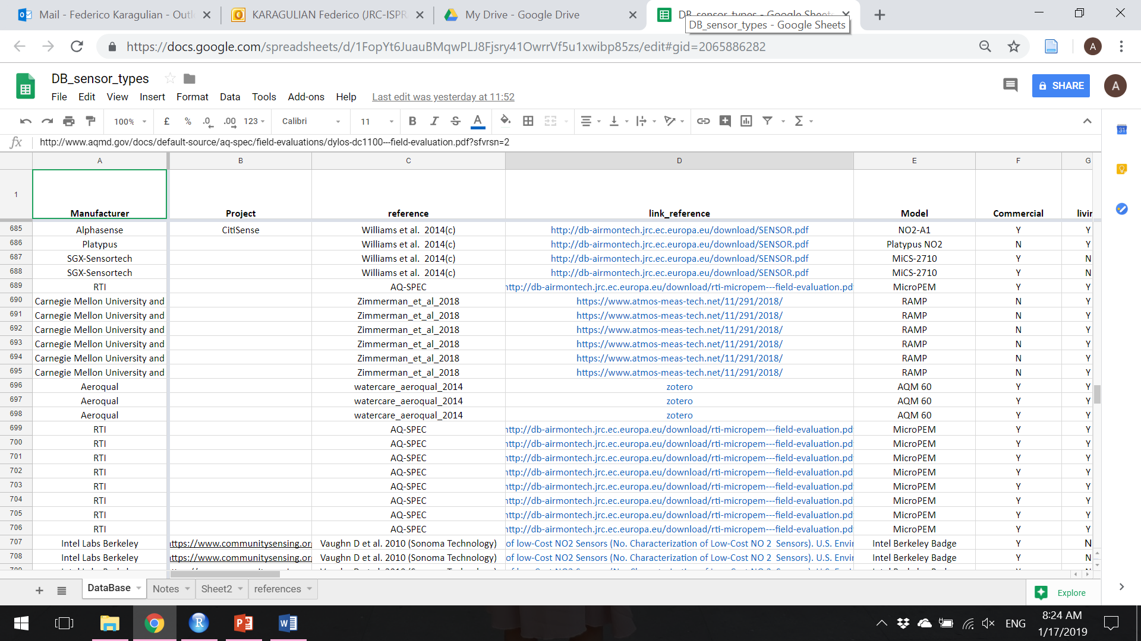

Methodology
Review was focused on sensors measuring PM, O₃, NO₂, NO and CO concentrations
Review about the use of Low Cost Sensors (LCSs) for Air Quality has been carried out using:
Scopus database (collected into a Zotero DB and AirMonTech web site (JRC http://db-airmontech.jrc.ec.europa.eu/search.aspx, supplied with Scopus and ResearchGate websites)
Reports provided by AQ-SPEC, US-EPA, EC, and relevant testing laboratories
Records were created for each laboratory and field test about calibration and validation of sensors
e-reporting
Comparison of sensor
based on their metrics
Google-sheet (pwd. protected)

Slide 4
Main classification of LCS:
OEM sensor
Chemical cell or physical unit that produces an analytically useful signal by detecting or measuring the analyte.
Sensor System (SS) or sensor node
Integrated set of hardware that uses one or more sensors to detect and/or measure a chemical concentration or quantity that is able to supply real time measurements.
“open source”
Data acquisition and data processing can be operated by an “open source” software tuned according to different calibration parameters and environmental conditions.
n. LSCs
OEM | 39
SS | 70
open source sensors | 40
black box sensors | 73
“black box”
Impossibility to change any parameters of the sensor set by the manufacturer and data treatment.
commercial
Possibility to be purchased by any end-user
non-commercial
Only used for research studies

Slide 5
Evaluation criteria
Collection of relevant metric parameters to check performance of sensor
Comparison of same metrics from different sensors
Records on calibration and validation of sensors were created for each laboratory and field test
metrics |  | n. records
 |  | Field tests | Laboratory tests
 |  | 1144 | 137
R² | calibration | 213 | 64
 | comparison | 1022 | 72
Slope of reg. line |  | 922 | 55
RMSE |  | 159 | 5
Uncertainty (U) |  | 42 | 30
Price |  | 114
Limit of R²: measure of strength of associations and not accuracy of measurement. R² change with the range of measurements → use together with slope
Strength of R²: it is always available

Slide 6
Types of sensors
Pollutant | Type | n. records | n. references
CO | electrochemical | 64 | 19
CO | MOs | 23 | 3
NO | electrochemical | 47 | 15
NO₂ | electrochemical | 134 | 29
NO₂ | MOs | 34 | 8
O₃ | electrochemical | 61 | 17
O₃ | MOs | 55 | 7
O₃ | UV | 10 | 2
PM_{2.5} | Electrical | 6 | 1
PM_{2.5} | nephelometer | 216 | 22
PM_{2.5} | OPC | 346 | 25
PM1 | Electrical | 6 | 1
PM1 | OPC | 92 | 4
PM₁₀ | nephelometer | 32 | 3
PM₁₀ | OPC | 155 | 13
Every single reference might contain multiple tests (records)

Slide 7
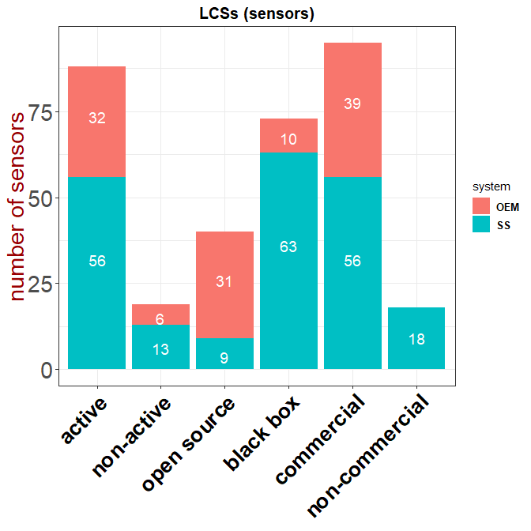
Type of LCS and number of tests
Large availability of active (“living”) & commercial sensors
All OEMs and most SS are commercially available. SS that are not commercial are for publication purposes
Most of commercial SS are “black box” systems

Slide 8
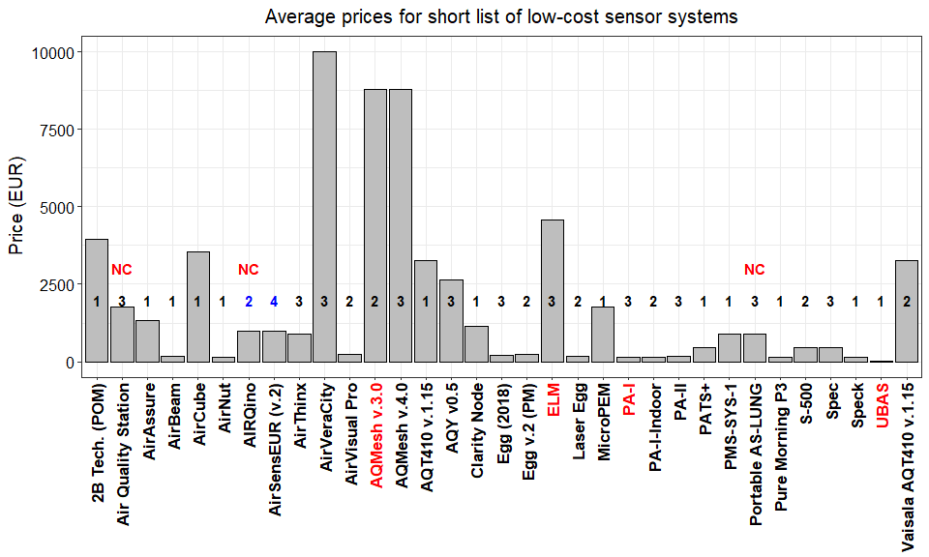
Price of sensor systems with best R² and slope recorded
Number of pollutant
measured by each sensor
With R²>0.7 and 0.5<slope< 1.5
non commercially
available
*Vailsala 5000E , South cost Science, KUNAKAIR and Bettair were not included in the comparison because of unavailability of
Peer reviewed works
* Black number -> black box
* Blue number -> open source
Shortlist of sensor systems (SS) showing R² > 0.75 and 0.5 < slope < 1.2 when compared against reference measurements (names of 'living' and 'non-living' sensors are indicated in black and red color, respectively)

Slide 9
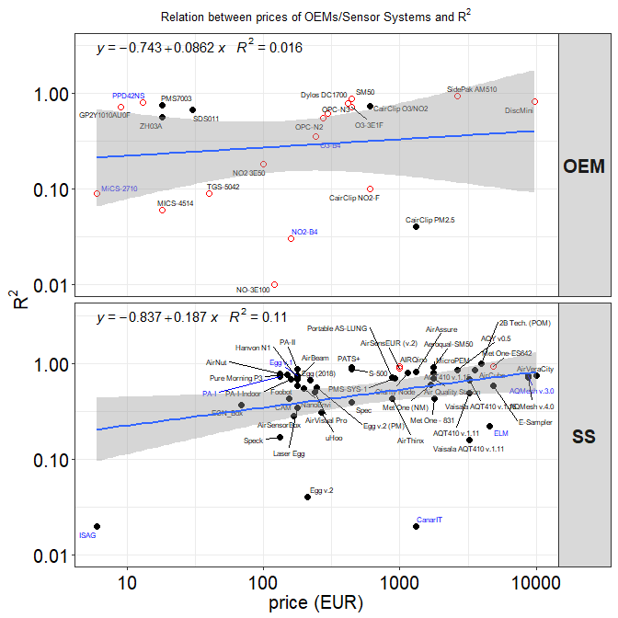
Price for value (only field tests)
R² is not accuracy
Non-relevant dependency of R² with the price was observed for OEMs
Validation of sensors systems against reference measurement showed a slight dependency of R² with the price of the sensor.
* full circles -> “black box”
* Open circles -> “open source”
* Living/non-living sensors are indicated
with black and blue colors, respectively

Slide 10
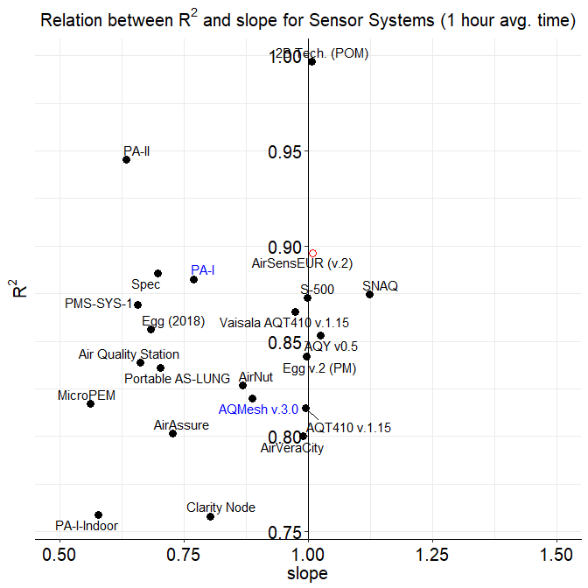
Towards the best performing sensor
Targeting sensor showing mean R² ~ 1 and mean slope ~ 1 when compared with reference systems
Not all sensor showing mean R² ~ 1 had necessarily mean slope ~ 1
*names of 'living'/'non-living' sensors are indicated in black/blue color, respectively

Slide 11
Conclusions
Availability of an open-access repository reporting
relevant metric for OEMs and Sensor Systems.
Possibility to share the above-mentioned repository
among Entities performing laboratory and field tests
according to a well-defined protocol to calculate
relevant metrics.
Necessity to target the best sensor system by its
openness, agreement with reference systems,
number of measured pollutants and price.
The information reported in this work about price of sensors, is merely indicative and might change with time. The authors do not take any responsibility should prices and performances of sensors should vary.

Slide 12
Towards the best choice of sensor system
We have shortlisted sensor systems showing good agreement with reference systems (R² > 0.85; 0.8 < slope < 1.2)
Only few sensors are “open source” and are able to measure multiple pollutants
Model | pollutant | *R² | *slope | open/close | living | commercial | price (EUR)
AirNut | PM2.5 | 0.8692 | 0.8647 | black box | Y | commercial | 132
PA-I | PM1 | 0.9579 | 0.9166 | black box | N | commercial | 132
PA-II | PM1 | 0.9882 | 0.8228 | black box | Y | commercial | 176
Egg (2018) | PM1 | 0.8731 | 0.8375 | black box | Y | commercial | 219
Egg v.2 (PM) | PM2.5 | 0.9375 | 1.001 | black box | Y | commercial | 246
PATS+ | PM2.5 | 0.96 | 0.92 | black box | Y | commercial | 440
S-500 | NO2, O3 | 0.88 | 1.03 | black box | Y | commercial | 440
AirThinx | PM1 | 0.8858 | 0.8483 | black box | Y | commercial | 880
PMS-SYS-1 | PM2.5 | 0.93 | 0.84 | black box | Y | commercial | 880
Portable AS-LUNG | PM1 | 0.8957 | 0.8709 | black box | Y | non commercial | 880
AIRQino | PM2.5, PM10 | 0.909 | 0.972 | open source | Y | non commercial | 1000
Bettair | NO2, O3, NO | 0.95 | 0.9974 | black box | Y | commercial | 1000
AirSensEUR (v.2) | NO2, O3, CO, NO | 0.8811 | 0.9457 | open source | Y | commercial | 1000
Air Quality Station | PM1 | 0.8993 | 0.8973 | black box | Y | non commercial | 1760
CairClip O3/NO2 | O3 | 0.88 | 0.88 | black box | Y | commercial | 2000
AQM 60 | O3 | 0.9765 | 0.9824 | black box | Y | commercial | 2640
AQY v0.5 | PM2.5, NO2 | 0.9477 | 0.9477 | black box | updated | commercial | 2640
Vaisala AQT410 v.1.15 | CO | 0.8693 | 0.9502 | black box | Y | commercial | 3256
AirCube | NO2 | 0.87 | 0.85 | black box | Y | commercial | 3538
2B Tech. (POM) | O3 | 0.9946 | 0.9756 | black box | Y | commercial | 3960
ELM | O3 | 0.9624 | 1.099 | black box | N | commercial | 4576
AQMesh v.3.0 | NO | 0.87 | 0.883 | black box | N | commercial | 8800
*mean value

Slide 13
Thanks for your attention!

Slide 14
Summary
 | Total | OEM | SS
Total num. of records | 1301 | 351 | 950
Total num. of records (living) | 1148 | 304 | 844
Total num. of records (non-living) | 153 | 47 | 106
Total num. of manufacturers | 72 | 19 | 53
Open source records | 406 | 315 | 91
“Black box” records | 892 | 48 | 844
Open source models | 43 | 31 | 12
“Black box” models | 81 | 10 | 71
Total number of sensor models | 114 | 40 | 79
“active” sensors | 96 | 31 | 65
“non-active” sensors | 18 | 6 | 12
Commercial | 100 | 39 | 61
Non-commercial | 22 | 2 | 22

