Slide 1
Business case presented by Federico Karagulian 29th June 2016

Slide 2
Preamble
My client recently launched a multi-platform advertising campaign
I wanted to help him measuring the campaign effectiveness and to learn what can be improved for the next campaigns

Slide 3
Campaign and research objectives
Campaign Objectives
Research Objectives
Educate
Excite
Habit Form (understanding)
The key objective is to measure the effectiveness of each platform within the campaign
The specific research objectives are as follows:
Measure impact of channel media on KPIs
Measure the interaction between all platforms
Notes:
Educate (WAVE 1 ONLY)
We’re moving!
We’re moving to give you more content, flexibility, a voice
You can find us on any of these platforms (web, iPlayer, social, BBC One and Two)
Change happens mid Feb
Excite (WAVE 1 AND WAVE 2)
Our new channel for you is here!
With a POV unlike any other
Quality content that will make you laugh and think
Come and look now
Habit Form (WAVE 2 ONLY)
We’ve got new amazing content you’ll love
In a variety of formats to make you laugh and think

Slide 4

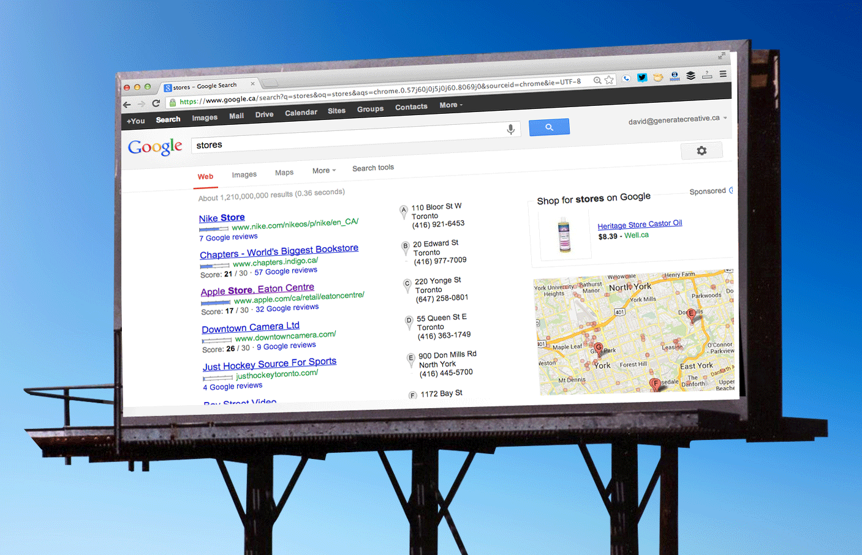
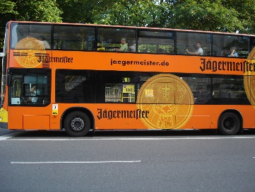
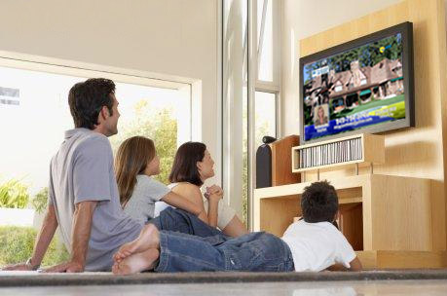
Platforms used
OOH
Social
Out of home advertising
Social media
Online
TV
Web services
Television channels
Radio
Radio channel (in/our home)

Slide 5
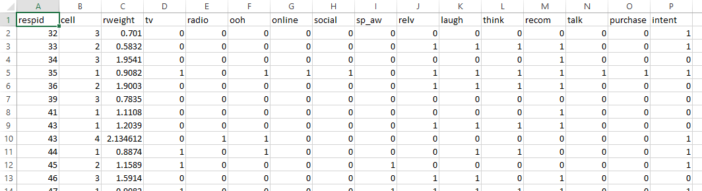
Data
3043 records
answers from a questionnaire
(yes/no == 0/1)
Technical variables (respondent ID, respondent source (age & gender), weight)
Exposure to each of the media platforms (TV, radio, OOH, online, social)
Client’s KPIs
spontaneous brand awareness;
brand perception measures: relevance, laugh, think;
intention to recommend;
intention to talk about the brand;
purchase of the brand during the campaign;
intention to purchase in the future)

Slide 6
My objectives
Explore the data
Estimate what was a relative impact of each of the channels into driving of each of the KPIs
Estimate if there are any interactions between the channels which can be utilized to improve campaign effectiveness

Slide 7
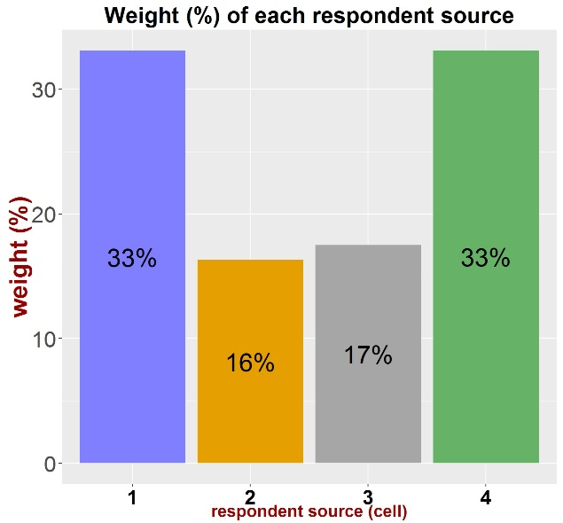
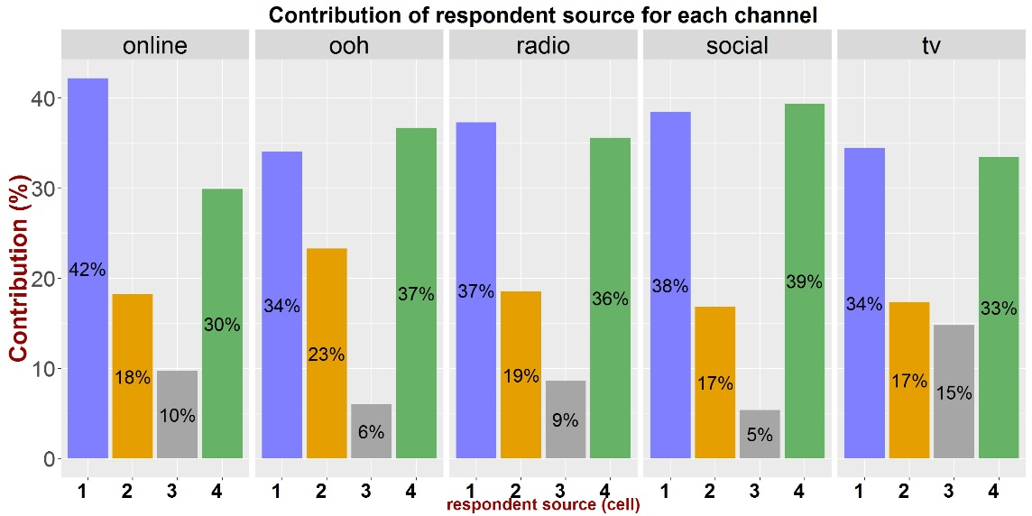
Data exploration
Records referred to 3041 respondent IDs have been gathered from 4 respondent sources
Overall, respondent sources 1 and 4 covered 66% of the respondent IDs.
Sources 1 and 4 were dominant in all media channels
Sum of weights = 3041

Slide 8
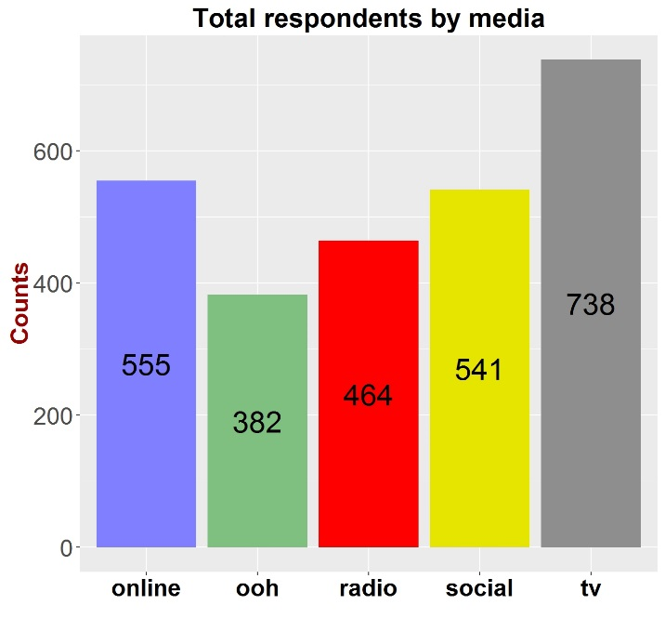
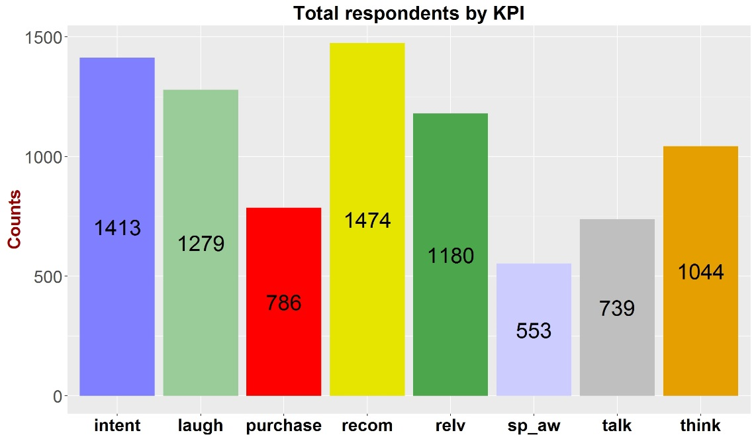
Data exploration
Among KPIs, intention to recommend, intention to purchase in the future and perception with laugh were the first 3 channels with the larger number (counts) of respondents
Among media platforms, TV, online media and social media were the first 3 channels with the larger number (counts) of respondents
0 < Counts < 3041

Slide 9
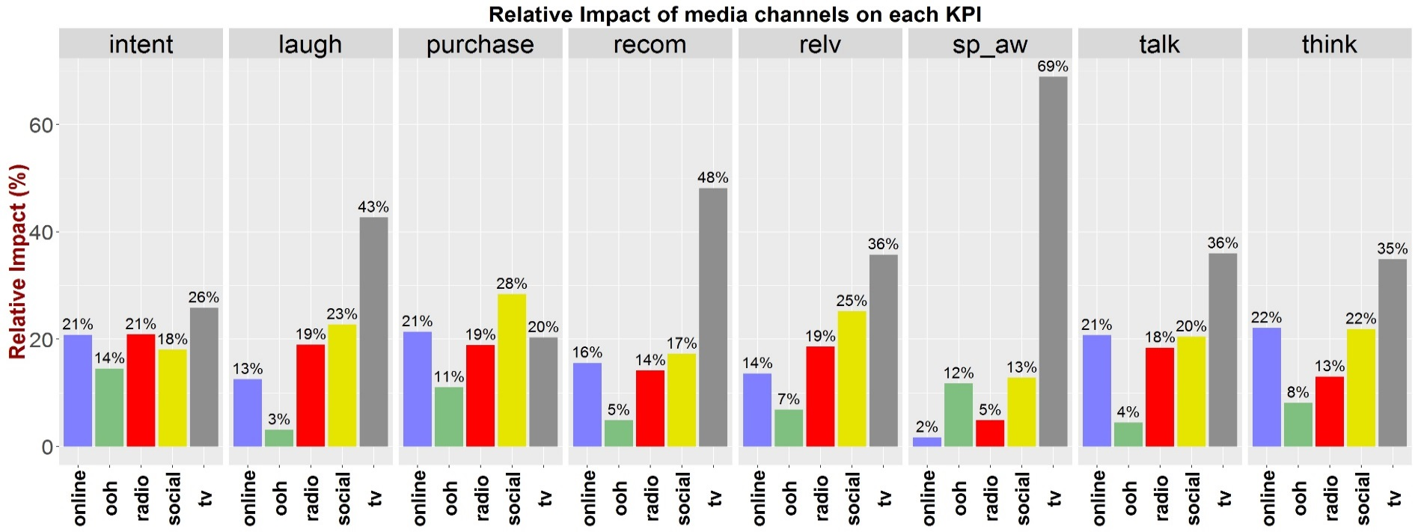
Relative impact of channels into driving of KPIs
TV is the channel media having the higher impact into driving most of KPIs, above all on spontaneous brand awareness in the measure of 70%
Surprising, social media had dominant impact (28%) on the purchase of a brand during the campaign itself

Slide 10
First relevant finding
social media has shown to be the most channel through which respondents made their purchase during the campaign compared to TV channels
Possible reason
Time!
People who spend time on social media channels has more time to “deeper” assimilate the message from the advertisement.

Slide 11
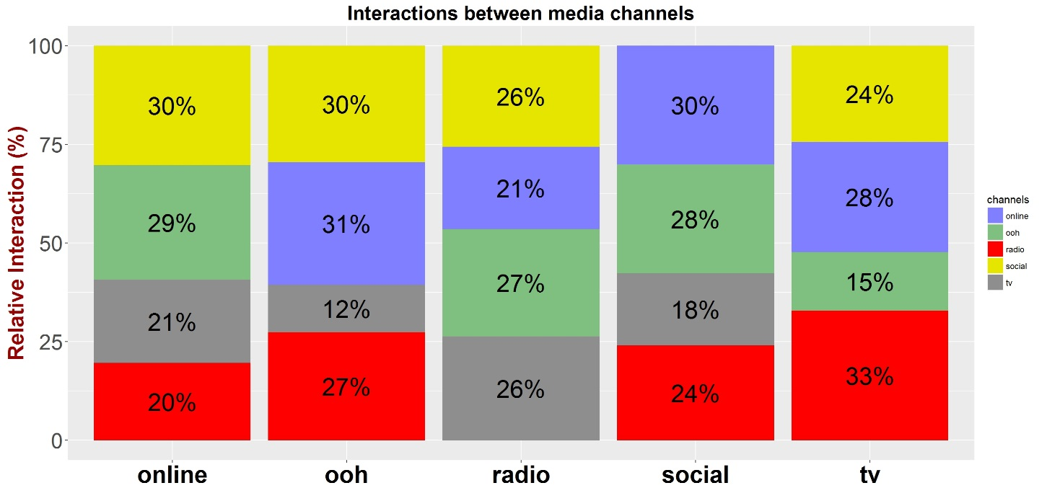
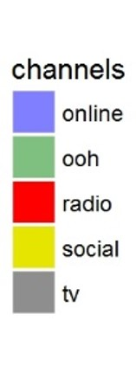
Interaction between channels media
Overall channels media has interaction between 12% and 33%:
TV trend interacts with radio (33%) and online media (28%)
ooh interacts with online media (31%) and social media (30%)

Slide 12
Second relevant finding
TV and Out Of Home advertising have the biggest interaction with other media platforms
TV and OOH can easily drive the increase of all other media platforms
Possible reasons
TV and OOH are the two platforms for channel media which deliver a passive message to the respondents

Slide 13
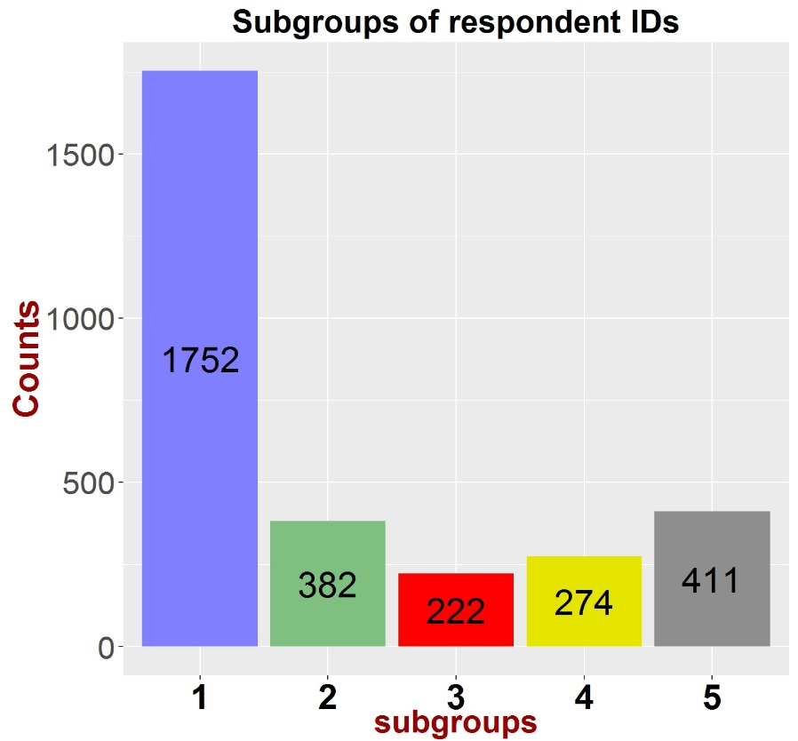
Subcategories of respondent IDs
5 subgroups of respondent IDs were identified
The larger subgroup of respondent IDs (58%) has not been “captured” by any media platform (see next slide)
Who are respondents in all subgroup ? Metadata about them enclose more information (reserved data)
with media
channels
No media
channels

Slide 14
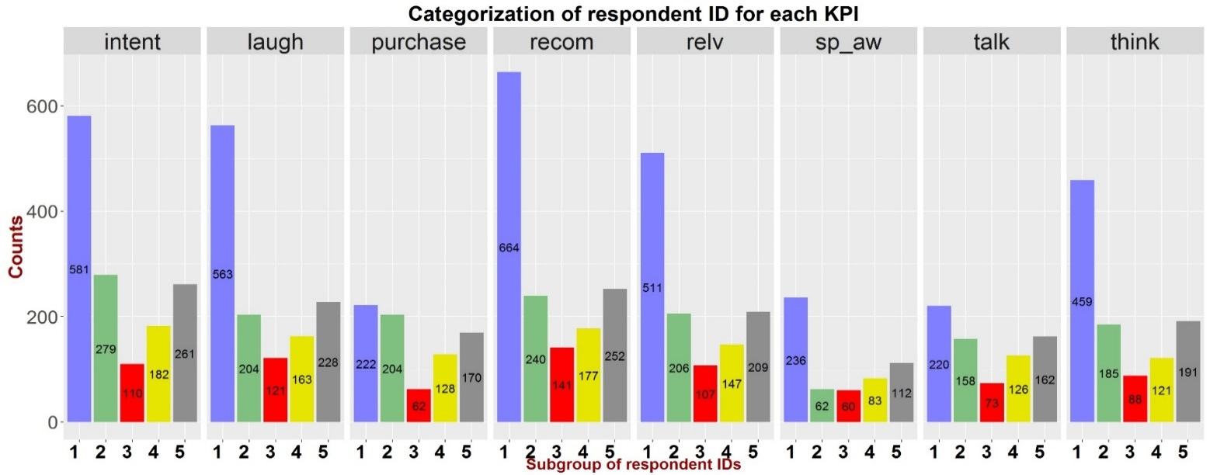
The majority of KPIs were not entirely driven by channel media
Subgroup 1 (not captured by any media platform) was the largest contributor to most client KPI’s except for purchase

Slide 15
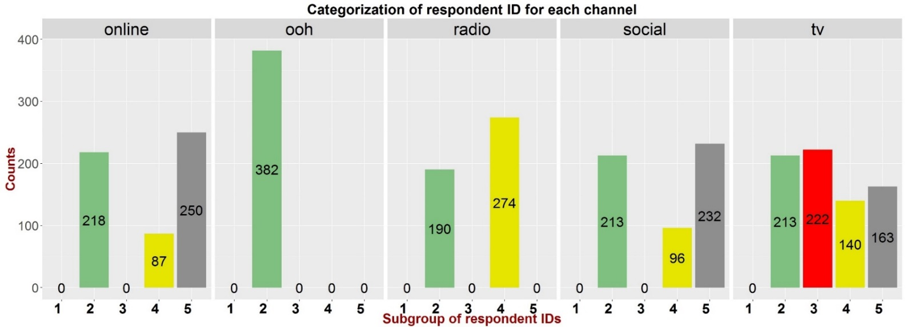
Final remarks and suggestions
ooh had only impact on subgroup 2
TV is the platform having impact on all the subcategories for respondents (except subgroup 1)
Channel media can tackle focused subcategories of respondent to increase their performances on KPI’s

Slide 16
Outlook
It is worth to have a deeper look at respondents’ habits.
Metadata could provide valuable information about subcategories of respondents in order to better understanding their preferences and perceptions towards channel media
Purchase can be improved by improving social media channels
Our client can improve the effectiveness of his campaign by targeting the most relevant channel used in the purchase KPI. This can be done by increasing the advertisement in the channel media which have showed more higher interaction with this channel.

