Slide 1
—new style of parking
UPark
Notes:
I’m Yilun, from group 3, our project name is UPark.

Slide 2
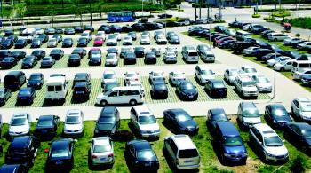
In nowadays, there are so many cars that many people cannot find a place to park their cars.
Notes:
As everyone knows, there so many cars today, it’s really annoying that you can’t find a parking space. For example, The parking lots of shopping malls in country are always full of car at weekend, you have to waste a lot of time parking your car before you can d some shopping.

Slide 3
OBJECTIVE
In order to solve this problem especially when some mass rally happens, we decided to develop a software about parking space rental. With this web application, customers can rent a parking space in advance, after they arrive at the destination, they can park their car at the reserved parking space.
Notes:
So, in order to solve this problem, especially when some large-scale activities happens, we decided to develop the UPark, a web based parking space rental information provider. With this web application, customers can rent a parking space near the destination in advance, after they arrive there, what they need to do is get to the reserved parking space and park their cars on it.

Slide 4



ENVIRONMENT
Notes:
This is the development environment.
We take Java as the main implement language, and JSP means Java Server Page, one kind of dynamic web page implemented with Java.
MySQL is a very popular open source database system, it is easy to operate and very reliable.
Tomcat is the most common server system to support JSP service.

Slide 5
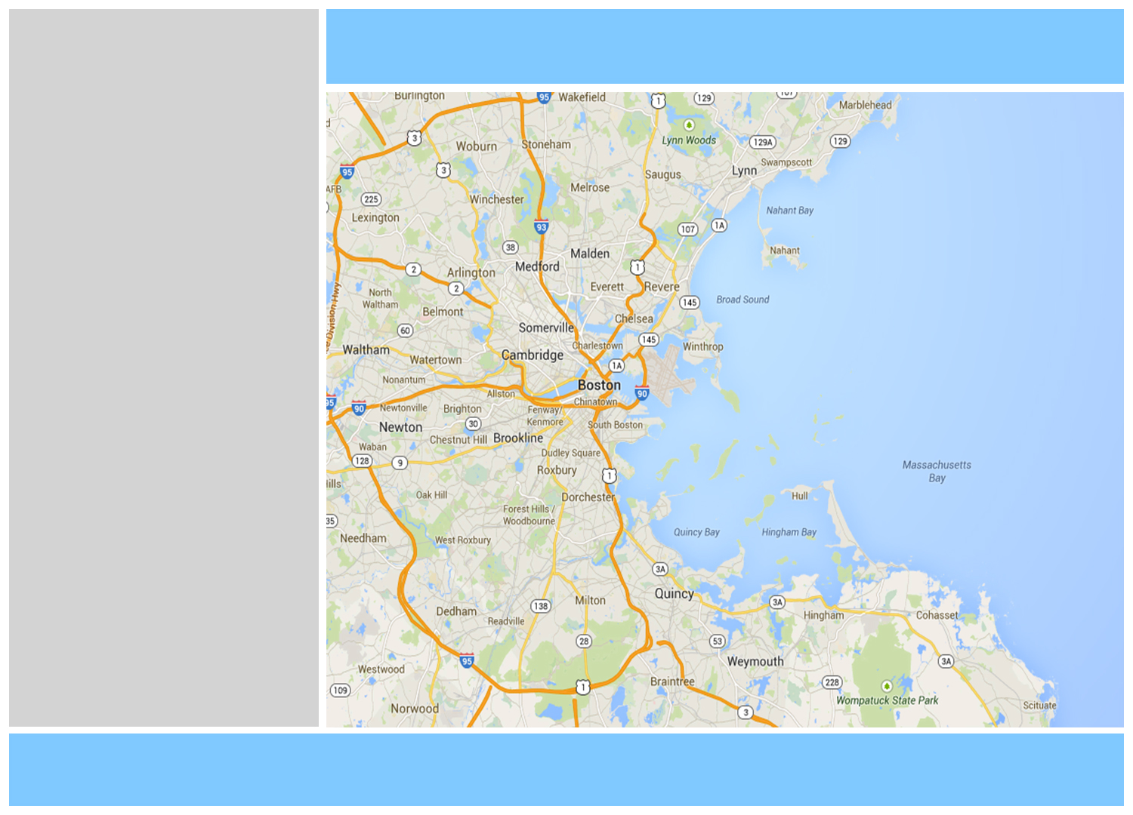

UPark
SEARCH & FILTER
GOOGLE
MAP
PARKING SPACE INFO
PHOTO
NAVIBAR
PROCEDURE
PHOTO
LOGIN
CONFIRM
FOOTER
Notes:
Then I’m going to introduce the main procedure of our application. Here is a demo of the procedure.
When you enter the website, you will see a login panel, after you input the right username and the corresponding password, you can get to the main inter face.
The up-right of the main interface is the most important function area, search and filter area. You can set the search information here. When you click the search button after you set up your searching information, the locations of requirements matched parking space will shows on the map. You can click any of it to see the details. After you decide to take one of them, you can click the confirm button, it will lead to a chat channel between you and the renter, so you can talk about more details with the renter.

Slide 6
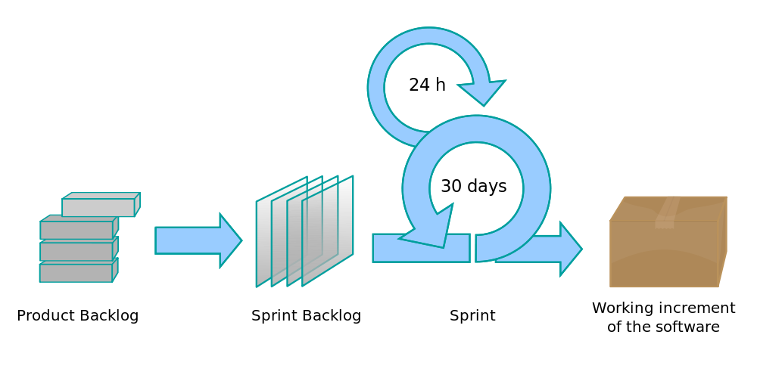
SCRUM
MONITORING
MECHANISM
Track man-hour costs
Track Schedule
Track Scope
CONTROLLING
MECHANISM
Requirements Control
Schedule Control
Quality Control
Reporting Control
PROJECT MANAGEMENT
Notes:
Here is the project management plan.
Scrum is our process model, every one know this picture, so I just skip it.
And The Monitoring Mechanism, it mainly consist of track man-hour costs, track schedule and track scope.
About the controlling mechanism, we have requirements control plan,
(Any changes that are to be made will be with the prior approval of the group members)schedule control plan(the developer is ready to spend extra time on the project in between and after the schedules ), quality control plan(it is such a long story so I will not detail this one here) and reporting control plan.

Slide 7
SCHEDULE
WEEK 1 – WEEK 2
kick off, detail requirement, environment configuration
WEEK 3 – WEEK 4
UI design, database design, framework set up
WEEK 5 – WEEK 6
UI implement, database implement, server-end prototype implement
WEEK 7 – WEEK 8
Risk management, test, debug, gracing the prototype
WEEK 9 – WEEK 10
UI-Server combine, 2nd version of prototype implement
WEEK 11 – WEEK 12
PROJECT MANAGEMENT
Risk management, test, debug, gracing the prototype
Notes:
This is our schedule, the first 4 weeks are the preparation phrase, mainly about detail requirements, UI and database design, environment and framework set up.
And then, we will have a 4-week iteration to implement and test the prototype, the 4-week iteration will not stop until we believe that we can release our product.

Slide 8
THANK YOU
Notes:
That’s all, thank you very much!

