Slide 1

Upark-BackEnd
Speaker: Mingli Li

Slide 2

Abstract
ER Diagram
Architecture
Login Example

Slide 3
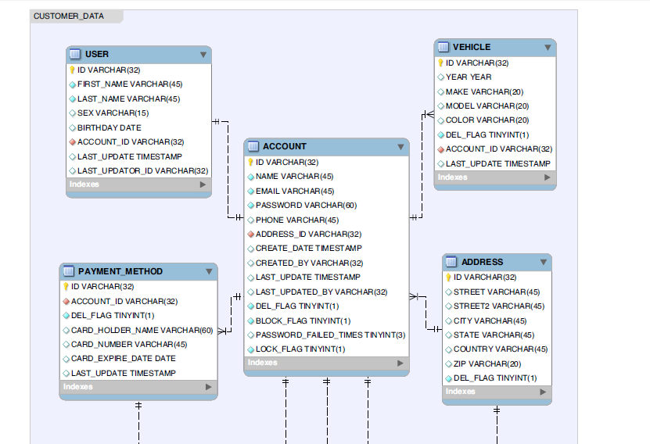
ER-Diagram (1/2)
UUID--ID

Slide 4
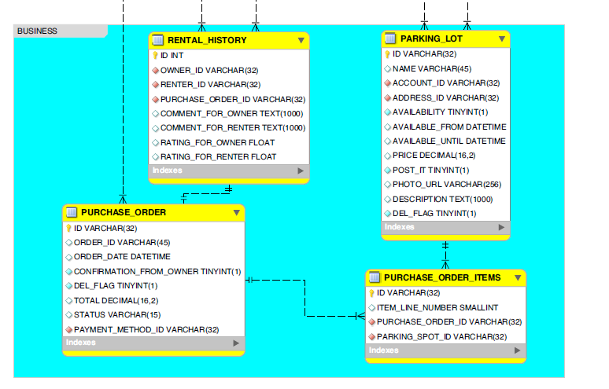
ER-Diagram(2/2)

Slide 5
Interface - Oriented Programing
RESTful API with JSON
@Controller
@Service: Interfcace
ServiceImpl
Spring
@Repository:Interface
RepositoryImpl
DI
@Entity
Hibernate
ORM
DB

Slide 6
Login
Username Password
/login
Auth Interceptor
loginController
otherController
loginService
Session
otherService
...
Repository
Entity
DB

