Slide 1
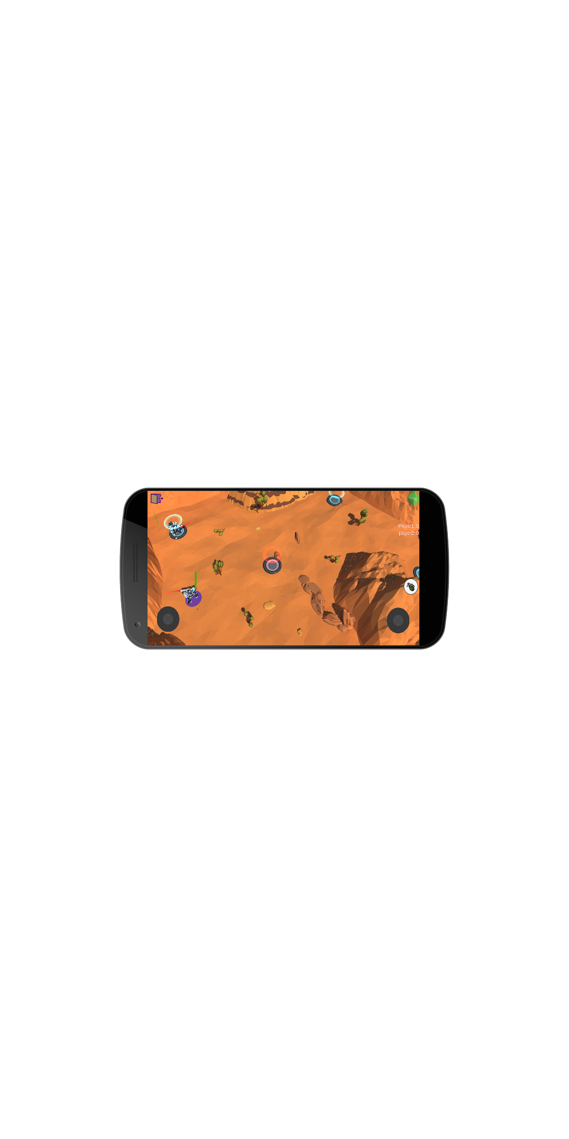

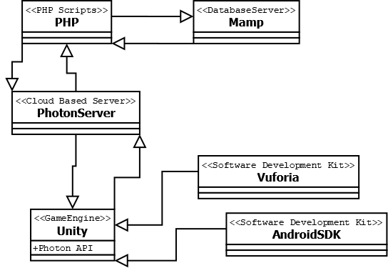
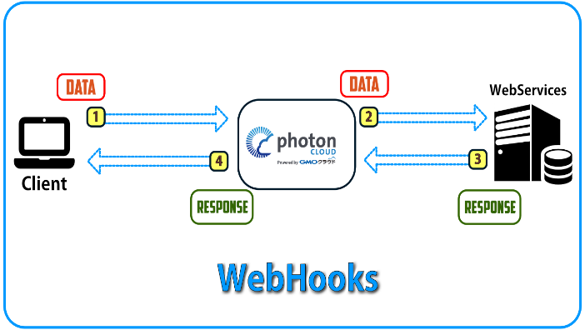
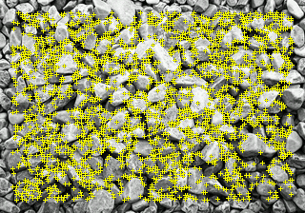
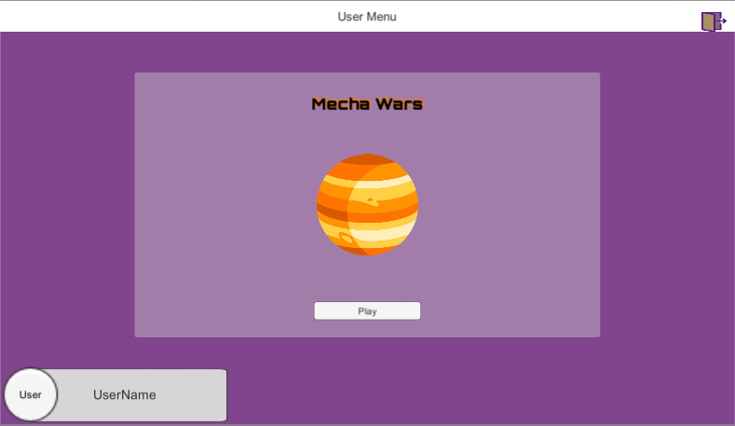
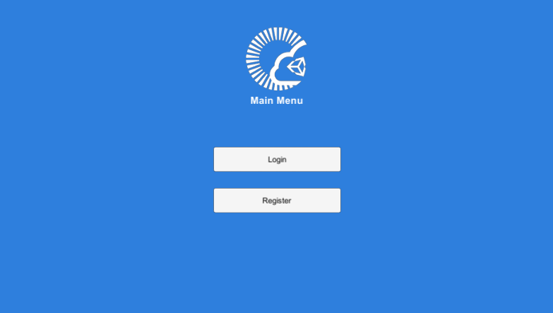
Department of Computer & Software Engineering
Social App for Gamers
Author: Maciej Karakula
Supervisors: John Barrett, Mark Daly
A social mobile application where players can play games together either at home or at any location.
Context Rationale Escaping from real world to Multiplayer Games Neglating social communications AR games to connect people Creating a social app to fix this problem
Diagrams
My Application
Faculty of Engineering & Informatics

