Slide 1

IBM Data Science
Capstone Project

Slide 2
1. What is Data Science ?
2. Open Source tools for Data Science
3. Data Science Methodology
4. Python for Data Science and AI
5. Databases and SQL for Data Science
6. Data Analysis with Python
7. Data visualization with Python
8. Machine Learning with Python
9. Applied Data Science Capstone
There are 9 courses in this certification

Slide 3
1. What is Data Science?
Data science is the art of uncovering the insights and trends that are hiding behind data. It's when you translate data into a story. So use storytelling to generate insight. And with these insights, you can make strategic choices for a company or an institution.

Slide 4
In this course, I have learned about various open source tools for Data Science.
Skill Network Labs
Jupyter Notebooks
Apache Zeppelin Notebooks
Rstudio IDE
IBM Watson studio
2. Open Source tools for Data Science

Slide 5
3. Data Science Methodology
In this course I have learned about the major steps involved in tackling a data science problem. - The major steps involved in practicing data science, from forming a concrete business or research problem, to collecting and analyzing data, to building a model, and understanding the feedback after model deployment. - How data scientists think!.

Slide 6
4. Python for Data Science and AI
In this course I have learned about Python Basics like types, expressions, variables, string operations, lists, tuples, sets, dictionaries, Loops, objects and classes, file handling, pandas and numpy.

Slide 7
In this course, I have learned about relational database concepts that helps to apply foundational knowledge of the SQL language, performing SQL access in a data science environment. The emphasis in this course is on hands-on and practical learning. I have also created some database instances in the cloud. I have done series of hands-on labs, practice building and running SQL queries in this lab. I have also learned how we can access databases from Jupyter notebooks using SQL and Python.
5. Databases and SQL for Data Science

Slide 8
6. Data Analysis with Python
In this course I have learned about Importing Datasets, Cleaning the Data , Data frame manipulation, Summarizing the Data. It includes following parts: Data Analysis libraries, use of Pandas, Numpy and Scipy libraries to work with a sample dataset. I have used this library to load, manipulate, analyze, and visualize cool datasets.

Slide 9
7. Data visualization with Python
This course was all about several data visualization libraries in Python like Matplotlib, Seaborn, and Folium and how we can tell a compelling story by visualizing the data and findings from the data

Slide 10
In this course I have learned about some of machine learning topics like supervised and unsupervised learning, classification, clustering and some Python libraries like Sci-kit learn and Scipy.
8. Machine Learning with Python

Slide 11
In this course I have learned about FourSquare API ( It is a restful API to retrieve the data about venues in different neighborhoods around the world and I have applied this learnings to complete my Capstone Project
9. Applied Data Science Capstone

Slide 12
Capstone Project

Slide 13
Throughout its history, New York City has been a major point of entry for immigrants; the term "melting pot" was coined to describe densely populated immigrant neighbourhoods on the Lower East Side. As many as 800 languages are spoken in New York, making it the most linguistically diverse city in the world. English remains the most widely spoken language, although there are areas in the outer boroughs in which up to 25% of people speak English as an alternate language, and/or have limited or no English language fluency. English is least spoken in neighbourhoods such as Flushing, Sunset Park, and Corona.
With it's diverse culture , comes diverse food items. There are many restaurants in New York City, each belonging to different categories like Italian, Chinese , Indian , French etc.
Background
New York City's demographics show that it is a large and ethnically diverse metropolis. It is the largest city in the United States with a long history of international immigration. New York City was home to nearly 8.5 million people in 2014, accounting for over 40% of the population of New York State and a slightly lower percentage of the New York metropolitan area, home to approximately 23.6 million. Over the last decade the city has been growing faster than the region. The New York region continues to be by far the leading metropolitan gateway for legal immigrants admitted into the United States.

Slide 14
There is much than more that, of course. Italian restaurants come in many guises these days, adapting to an ever-changing and -growing dining landscape, if seemingly always well-suited for the ever-growing waistlines. Today there are various different types that wave the banner of Italian food: sleek trattorias advertising a regional cuisine, national chains serving “Italian immigrant” fare, “Italian grilles,” long-lasting family-run favourites owned by a second- or third generation, Italian steakhouses, pizzerias, creative fine-dining temples that rival the top Michelin-starred restaurants in Italy, and even the humble hoagie shops.
Background
Italian restaurants have been an especially beloved fixture in America for at least a century. Featuring flying pizzas, slippery strands of spaghetti paired with plump meatballs that most have savoured since childhood, tomato sauce ladled and consumed by the pint, garlicky and buttered toasted bread quick to leave a grease stain, tender slices of veal, gooey eggplant Parmesan, gregarious owners, the air filled with Sinatra and Martin or Verdi and Donizetti, a lively and comfortable dining room, generous mounds of food, copious amounts of wine….one from this cluttered group of images might be the first evoked in the average American concerning Italian food.

Slide 15
Introduction
In one or more of its manifestations, Italian restaurants remain a common sight in New York. Serving as an introduction to Italian food for many, these have encouraged life-long infatuations, not just for the food served in these, but for food in general. Italian restaurants have also helped to broaden the palate of countless diners. This is probably especially so for Italian-Americans, who explored beyond a familiar base. With about 30% of diners claiming Italian as their favourite cuisine, new Italian-themed eateries continuing to open from coast-to-coast, and even French and resolutely American restaurants serving pastas and risottos, this popularity shows no sign of abating, even as Americans become more sophisticated and far-ranging in their dining habits. Reflecting that, Italian restaurants are even better than ever. These are also more diffuse and diverse, and continue to evolve.
Although it is easy to simply find Italian food in New York, it remains a difficult task to spot the best places, based on ratings and the most interesting neighbourhoods to experience great Italian food in the Big Apple.
Moreover it is interesting to propose the best areas for stakeholders considering to open a new venue in NY.
So as part of this project, we will list and visualize all major parts of New York City that provide great Italian restaurants, compare ratings , put in the map the best ones, finding how the Italian Restaurant scene in placed in NY today

Slide 16
Data to be used
1. Data source : https://cocl.us/new_york_dataset
Description - data set containing New York City data that contains list Boroughs, Neighbourhoods along with their latitude and longitude. And we will use this data set to explore various neighborhoods of New York city. Italian restaurants in each neighborhood of New York city.
2. Data source : Foursquare API
Description : By using this API we will get all the venues in each neighborhood. We can filter these venues to get Italian Restaurants only. Also we will pull Premium FourSquare data from each venue such as ratings, likes, tips etc
3. Data source : https://data.cityofnewyork.us/City-Government/Borough-Boundaries/tqmj-j8zm
Description : By using this geo space data we will get the New York Borough boundaries that will help us to visualize choropleth map and map the strongest/weakest NY bouroughs regarding Italian food landscape.

Slide 17
Approach
Collect the New York city data from https://cocl.us/new_york_dataset
Using FourSquare API we will find all venues for each neighborhood.
Filter out all venues that are Indian Restaurants.
Find rating , tips and like count for each Indian Restaurants using FourSquare API.
Using rating for each restaurant , we will sort that data.

Slide 18
Libraries to be used
pandas and numpy for handling data.
request module for using FourSquare API.
geopy to get co-ordinates of City of New York.

Slide 19
Analysis
(week 2)

Slide 21
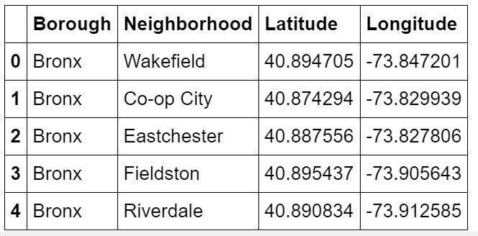
Step 1
Load data from https://cocl.us/new_york_dataset
in pandas Dataframe.
Getting Latitude and Longitude for each address geopy library.
As result –
We have 306 rows like this.

Slide 22
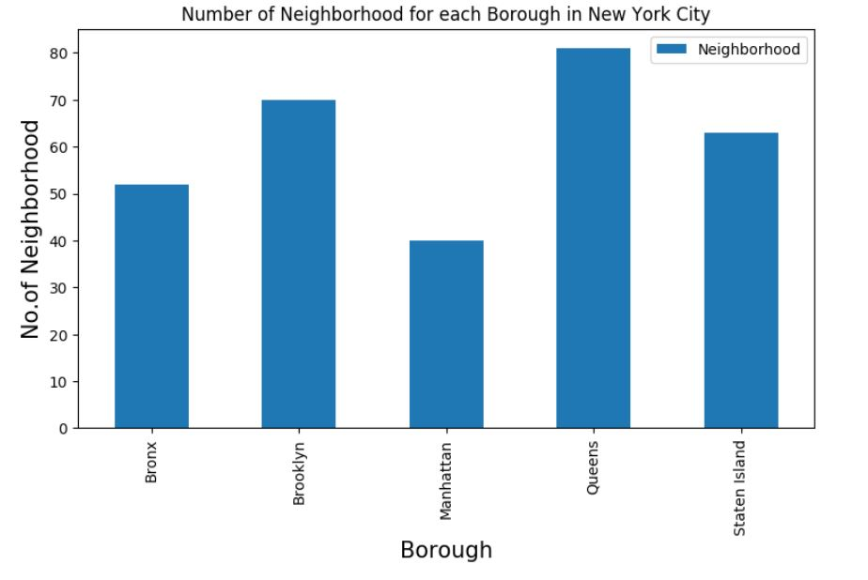
Number of neighborhoods in each Borough

Slide 23
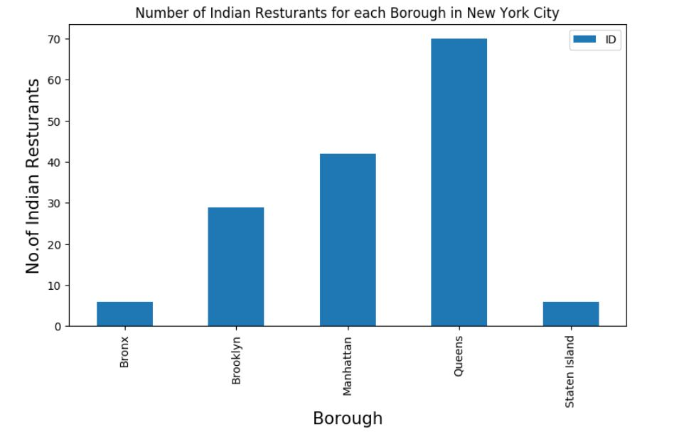
Step 2
Filter out which Borough and Neighborhood have maximum number of Indian Restaurants using FourSquare API.
Result – Queens has maximum number of Restaurants

Slide 24
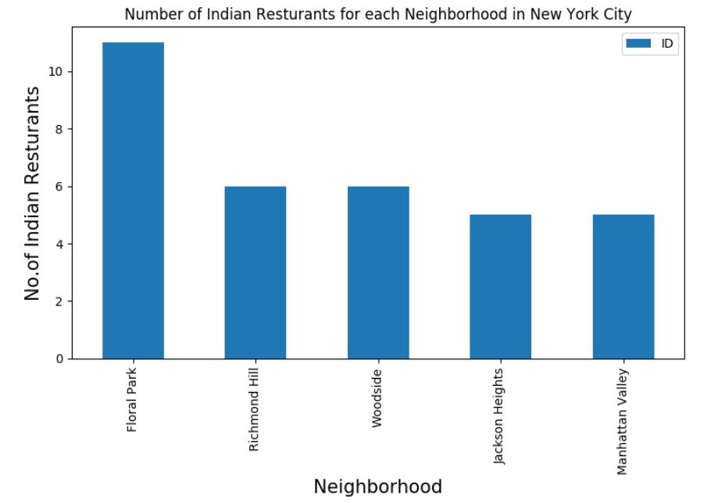
Step 2
Filter out which Borough and Neighborhood have maximum number of Indian Restaurants using FourSquare API.
Result – Floral Park has maximum number of Restaurants

Slide 25
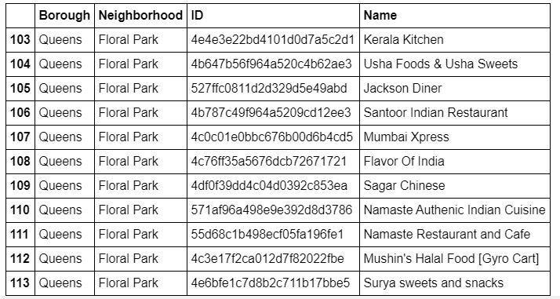
List of Restaurants in Floral Park

Slide 26
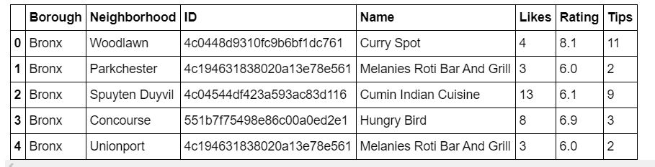
Step 3
Get likes, ratings, tips on each of Indian Restaurant using FourSquare API

Slide 27
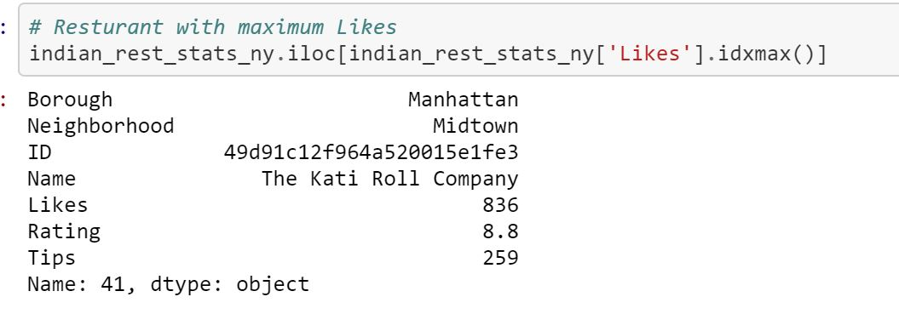
Result
Restaurant with maximum like

Slide 28
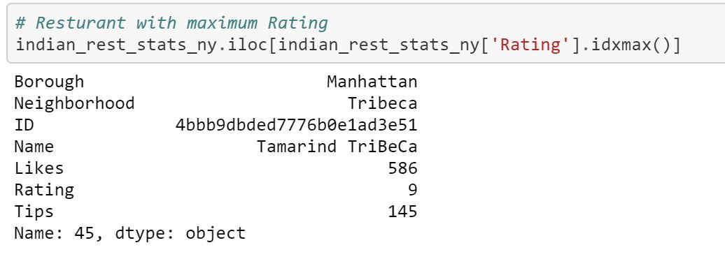
Result
Restaurant having maximum Rating

Slide 29
Conclusion
Astoria(Queens), Blissville(Queens), Civic Center(Manhattan) are some of the best neighborhoods for indian cuisine.
Manhattan have potential Indian Resturant Market
Staten Island ranks last in average rating of Indian Restaurants.
Manhattan is the best place to stay if you prefer Indian Cuisine.

Slide 30

The accuracy of data depends purely depends on the data provided by FourSquare
Limitation

Slide 31

Thank you
Any queries ?

