Slide 1

Chapter 14
Wireless LANs
14.<number>
Copyright © The McGraw-Hill Companies, Inc. Permission required for reproduction or display.

Slide 2
14-1 IEEE 802.11
IEEE has defined the specifications for a wireless LAN, called IEEE 802.11, which covers the physical and data link layers.
Topics discussed in this section:
Architecture
MAC Sublayer
Physical Layer
14.<number>

Slide 3

Note
A BSS (Basic Service Subset) without an AP is called an ad hoc network;
a BSS with an AP is called an infrastructure network.
14.<number>

Slide 4
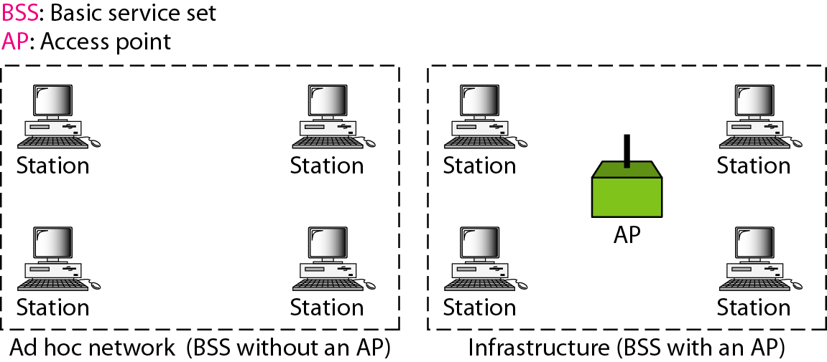
Figure 14.1 Basic service sets (BSSs)
14.<number>

Slide 5
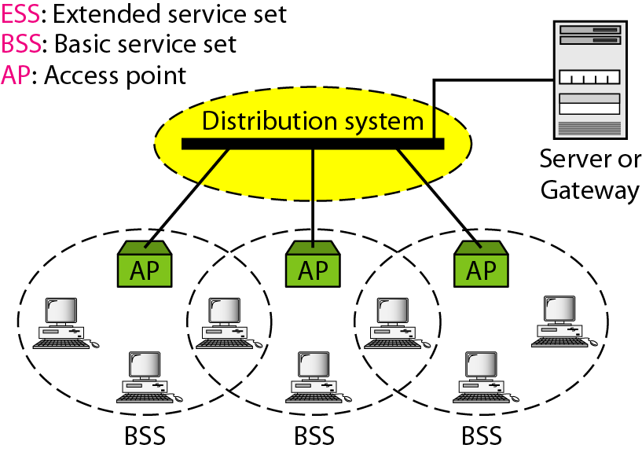
Figure 14.2 Extended service sets (ESSs)
14.<number>

Slide 6
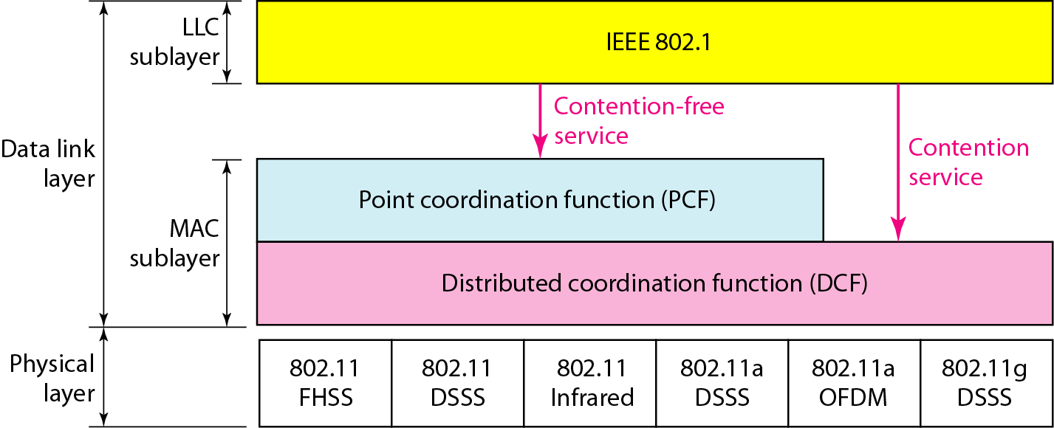
Figure 14.3 MAC layers in IEEE 802.11 standard
14.<number>

Slide 7

Figure 14.4 DCF: CSMA/CA flowchart
distributed interframe space (DCF)
short interframe space (SIFS),
14.<number>

Slide 8
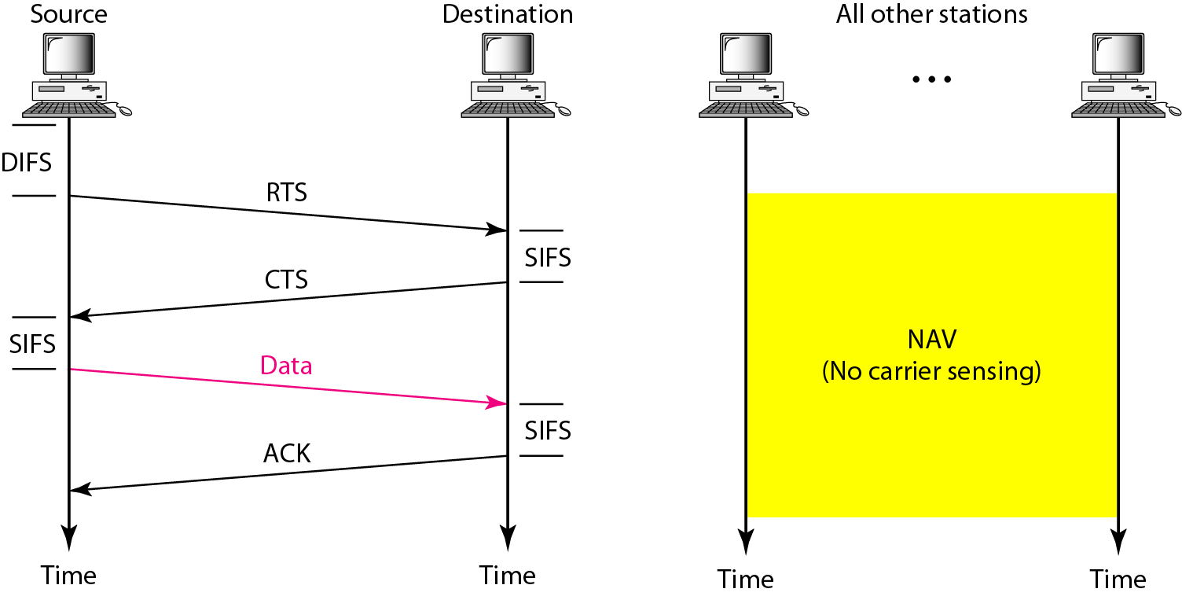
Figure 14.5 CSMA/CA and NAV
14.<number>

Slide 9
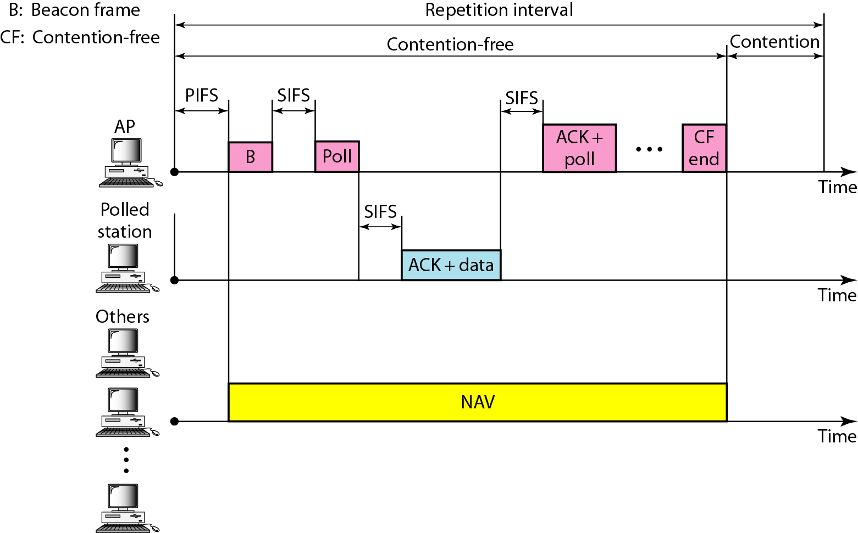
Figure 14.6 PCF: Example of repetition interval
14.<number>

Slide 10

Figure 14.7 Frame format
14.<number>

Slide 11
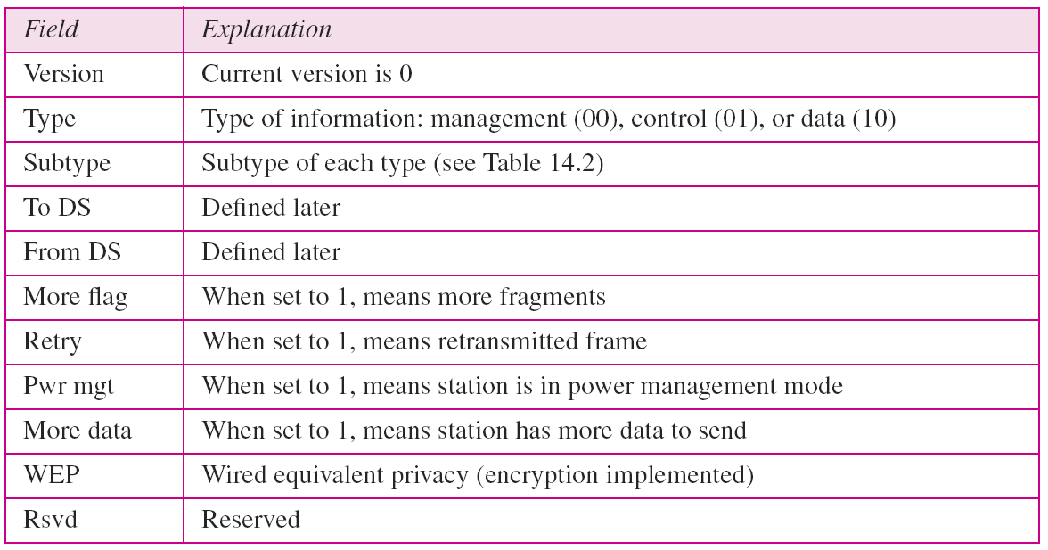
Table 14.1 Subfields in FC field
14.<number>

Slide 12
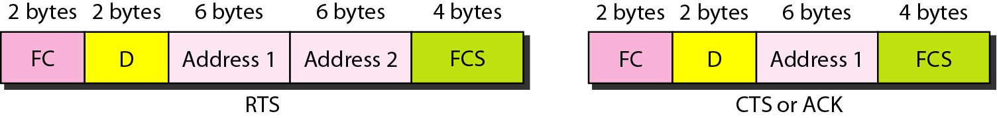
Figure 14.8 Control frames
14.<number>

Slide 13
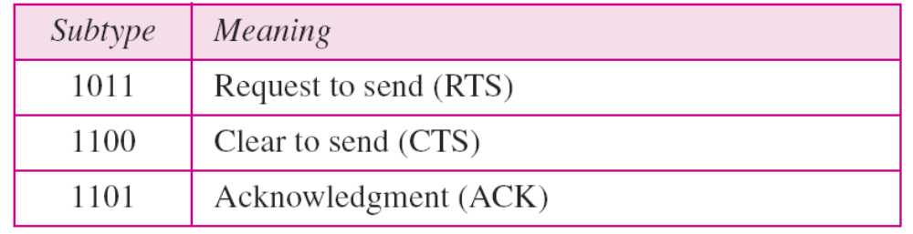

Table 14.2 Values of subfields in control frames
14.<number>

Slide 14
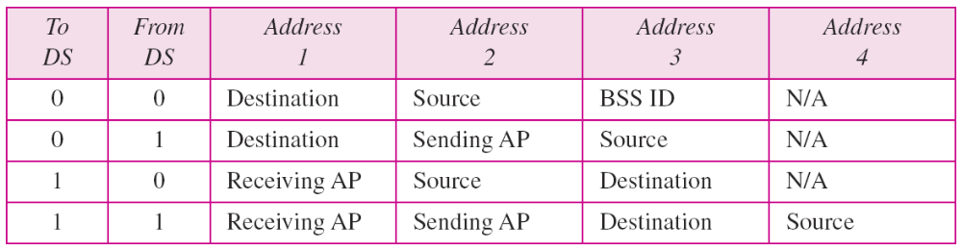
Table 14.3 Addresses
14.<number>

Slide 15
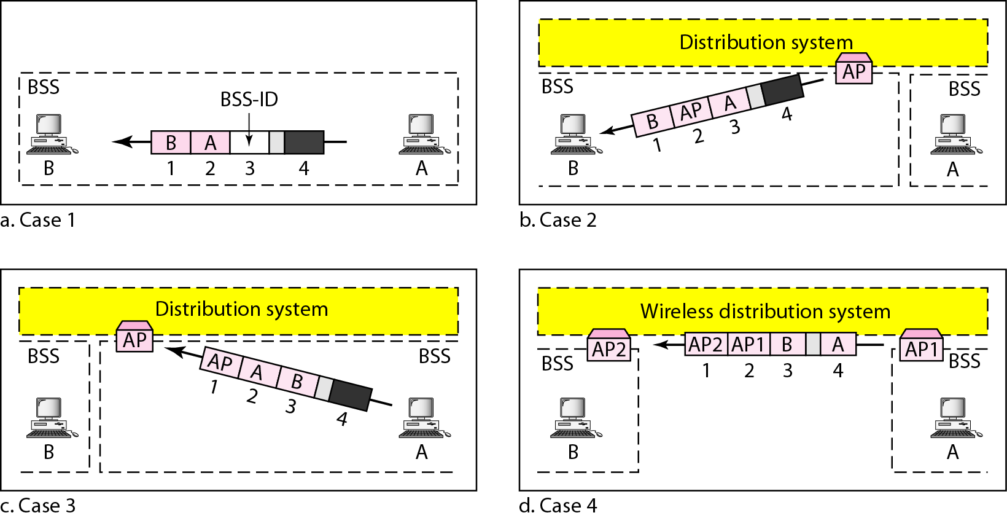
Figure 14.9 Addressing mechanisms
14.<number>

Slide 16
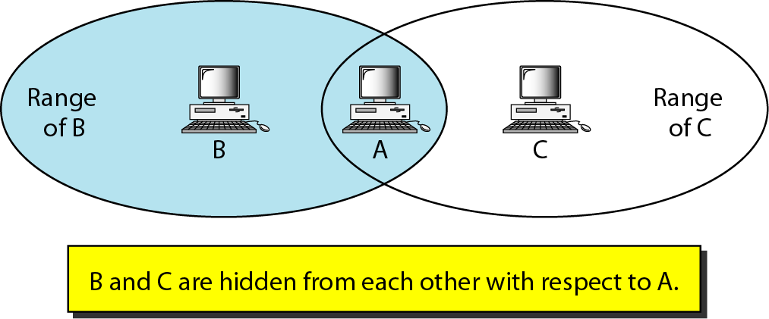
Figure 14.10 Hidden station problem
Assume that station B is sending data to station A. In the middle of this transmission, station C also has data to send to station A. However, station C is out of B's range and transmissions from B cannot reach C. Therefore C thinks the medium is free. Station C sends its data to A, which results in a collision at A because this station is receiving data from both B and C. In this case, we say that stations Band C are hidden from each other with respect to A. Hidden stations can reduce the capacity of the network because of the possibility of collision.
14.<number>

Slide 17
Note
The CTS frame in CSMA/CA handshake can prevent collision from
a hidden station.
14.<number>

Slide 18
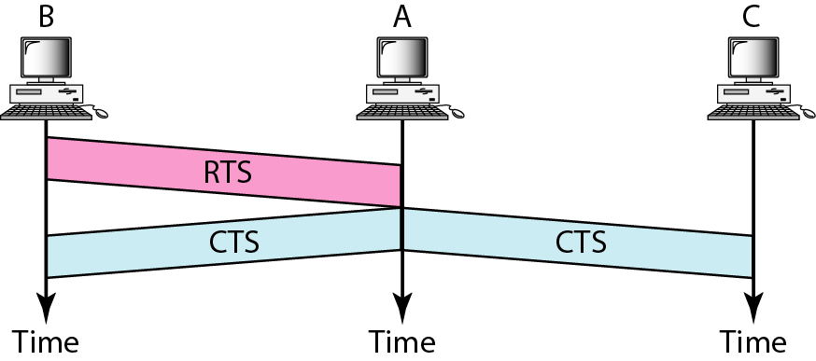
Figure 14.11 Use of handshaking to prevent hidden station problem
14.<number>

Slide 19
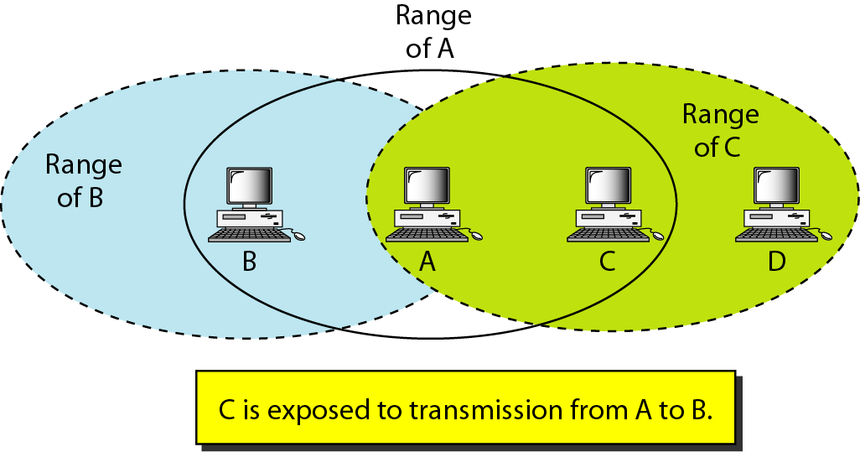
Figure 14.12 Exposed station problem
Now consider a situation that is the inverse of the previous one: the exposed station problem. In this problem a station refrains from using a channel when it is, in fact, available. In Figure 14.12, station A is transmitting to station B. Station C has some data to send to station D, which can be sent without interfering with the transmission from A to B. However, station C is exposed to transmission from A; it hears what A is sending and thus refrains from sending. In other words, C is too conservative and wastes the capacity of the channel.
14.<number>

Slide 20
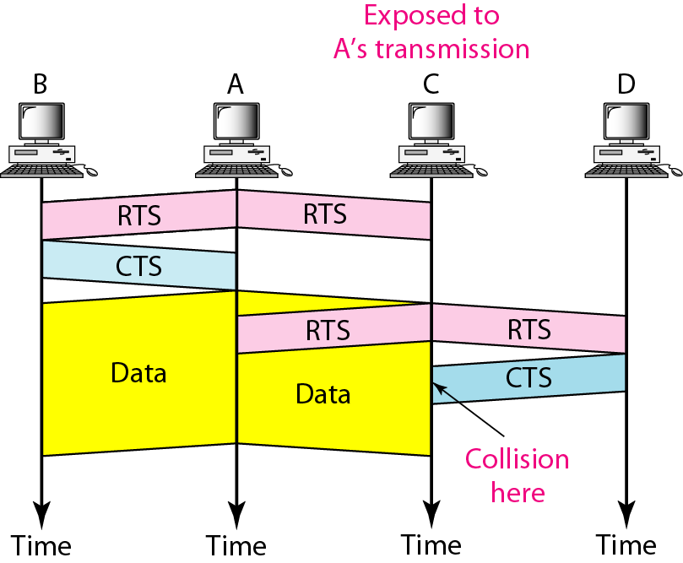
Figure 14.13 Use of handshaking in exposed station problem
14.<number>

Slide 21
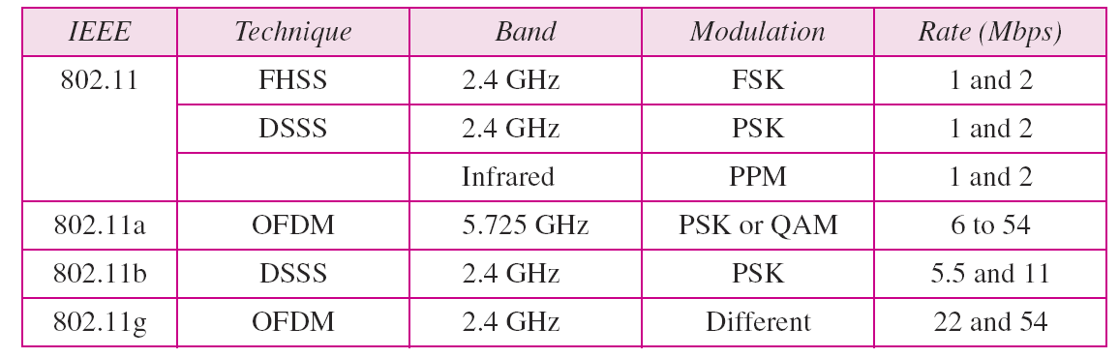
Table 14.4 Physical layers
14.<number>

Slide 22
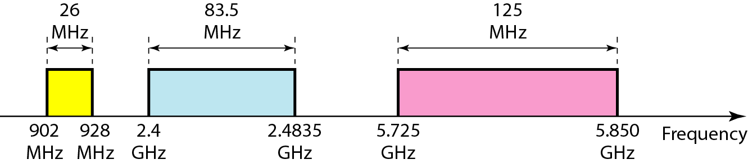
Figure 14.14 Industrial, scientific, and medical (ISM) band
14.<number>

Slide 23
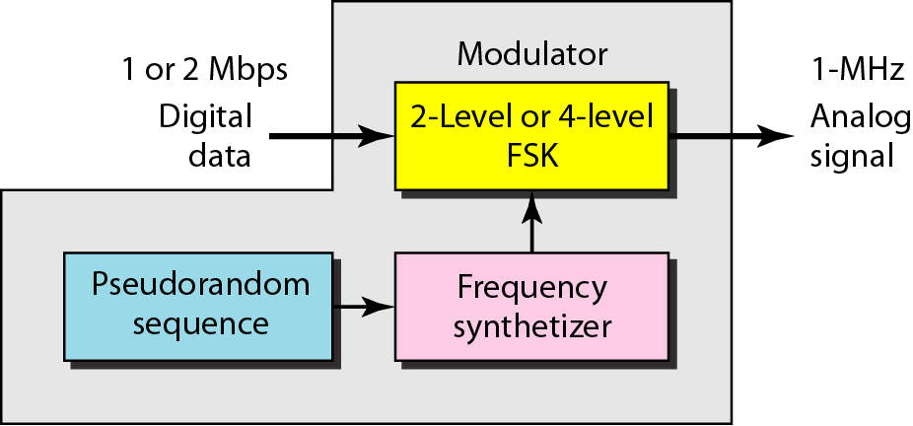
Figure 14.15 Physical layer of IEEE 802.11 FHSS
14.<number>

Slide 24
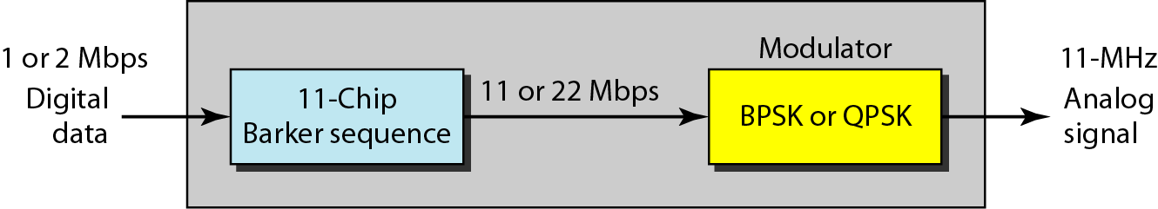
Figure 14.16 Physical layer of IEEE 802.11 DSSS
14.<number>

Slide 25
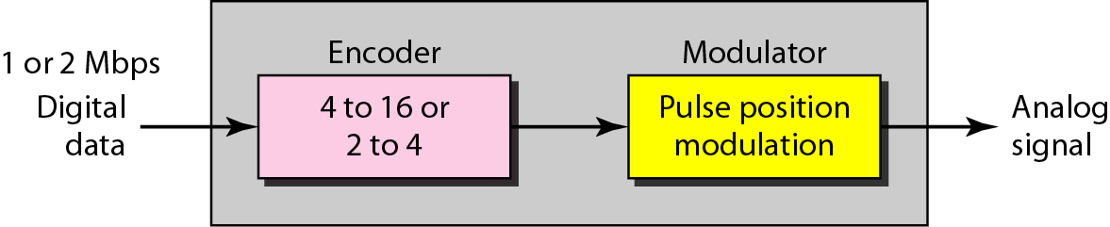
Figure 14.17 Physical layer of IEEE 802.11 infrared
14.<number>

Slide 26
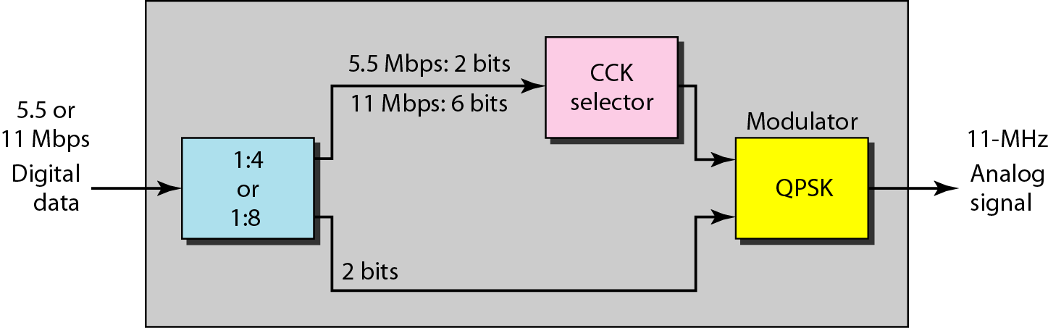
Figure 14.18 Physical layer of IEEE 802.11b
14.<number>

