Slide 1

Chapter 21
Network Layer:
Address Mapping,
Error Reporting,
and Multicasting
21.<number>
Copyright © The McGraw-Hill Companies, Inc. Permission required for reproduction or display.

Slide 2
21-1 ADDRESS MAPPING
The delivery of a packet to a host or a router requires two levels of addressing: logical and physical. We need to be able to map a logical address to its corresponding
physical address and vice versa. This can be done by using either static or dynamic mapping.
Topics discussed in this section:
Mapping Logical to Physical Address
Mapping Physical to Logical Address
21.<number>

Slide 3

Figure 21.1 ARP operation
21.<number>

Slide 4

Figure 21.2 ARP packet
Ethernet Type 1
IPv4 0x800
IPv4=4
Eth =6
21.<number>

Slide 5
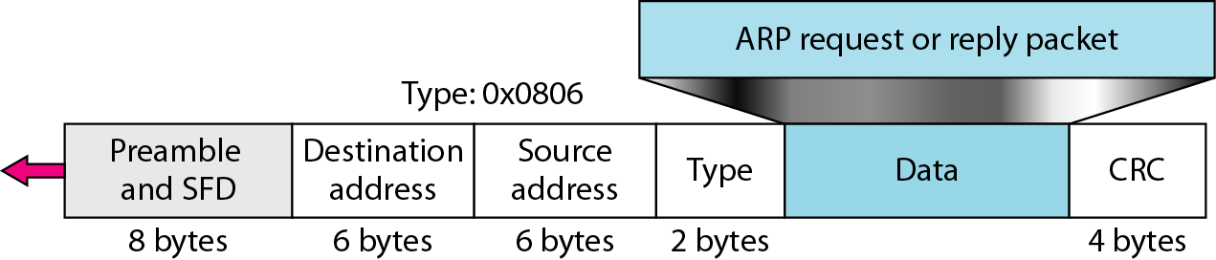
Figure 21.3 Encapsulation of ARP packet
21.<number>

Slide 6

Figure 21.4 Four cases using ARP
21.<number>

Slide 7

Note
An ARP request is broadcast;
an ARP reply is unicast.
21.<number>

Slide 8
Example 21.1
A host with IP address 130.23.43.20 and physical address B2:34:55:10:22:10 has a packet to send to another host with IP address 130.23.43.25 and physical address A4:6E:F4:59:83:AB. The two hosts are on the same Ethernet network. Show the ARP request and reply packets encapsulated in Ethernet frames.
Solution
Figure 21.5 shows the ARP request and reply packets. Note that the ARP data field in this case is 28 bytes, and that the individual addresses do not fit in the 4-byte boundary. That is why we do not show the regular 4-byte boundaries for these addresses.
21.<number>

Slide 9

Figure 21.5 Example 21.1, an ARP request and reply
21.<number>

Slide 10

Figure 21.6 Proxy ARP
A technique called proxy ARP is used to create a subnetting effect. A proxy ARP is an ARP that acts on behalf of a set of hosts. Whenever a router running a proxy ARP receives an ARP request looking for the IP address of one of these hosts, the router sends an ARP reply announcing its own hardware (physical) address. After the router receives the actual IP packet, it sends the packet to the appropriate host or router.
21.<number>

Slide 11
Note
DHCP provides static and dynamic address allocation that can be
manual or automatic.
21.<number>

Slide 12
Dynamic Address Allocation DHCP has a second database with a pool of available IP addresses. This second database makes DHCP dynamic. When a DHCP client requests a temporary IP address, the DHCP server goes to the pool of available (unused) IP addresses and assigns an IP address for a negotiable period of time.
DHCP provides temporary IP addresses for a limited time.
21.<number>

Slide 13
21-2 ICMP
The IP protocol has no error-reporting or error-correcting mechanism. The IP protocol also lacks a mechanism for host and management queries. The Internet Control Message Protocol (ICMP) has been designed to compensate for the above two deficiencies. It is a companion to the IP protocol.
Topics discussed in this section:
Types of Messages
Message Format
Error Reporting and Query
Debugging Tools
21.<number>

Slide 14

Figure 21.8 General format of ICMP messages
21.<number>

Slide 15
Note
ICMP always reports error messages to the original source.
21.<number>

Slide 16
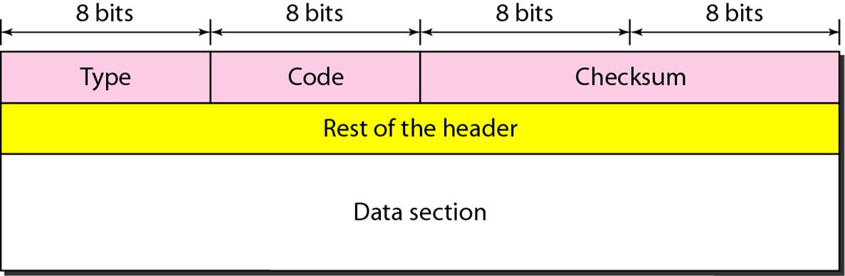
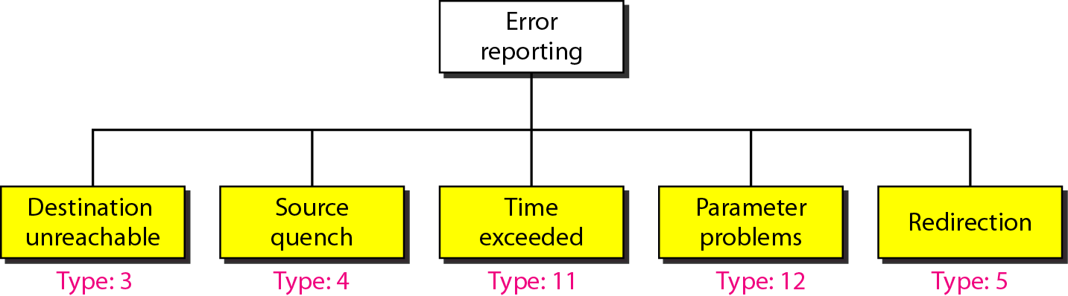
Figure 21.9 Error-reporting messages
21.<number>

Slide 17
Destination Unreachable
When a router cannot route a datagram or a host cannot deliver a datagram, the datagram is discarded and the router or the host sends a destination-unreachable message back to the source host that initiated the datagram.
21.<number>

Slide 18
Source Quench
When a router or host discards a datagram due to congestion, it sends a source-quench message to the sender of the datagram.
This message has two purposes. First, it informs the source that the datagram has been discarded. Second, it warns the source that there is congestion somewhere in the path and that the source should slow down (quench) the sending process.
21.<number>

Slide 19
21.<number>

Slide 20
Note
Important points about ICMP error messages:
❏ No ICMP error message will be generated in
response to a datagram carrying an ICMP error
message.
❏ No ICMP error message will be generated for a
fragmented datagram that is not the first fragment.
❏ No ICMP error message will be generated for a
datagram having a multicast address.
❏ No ICMP error message will be generated for a
datagram having a special address such as
127.0.0.0 or 0.0.0.0.
21.<number>

Slide 21
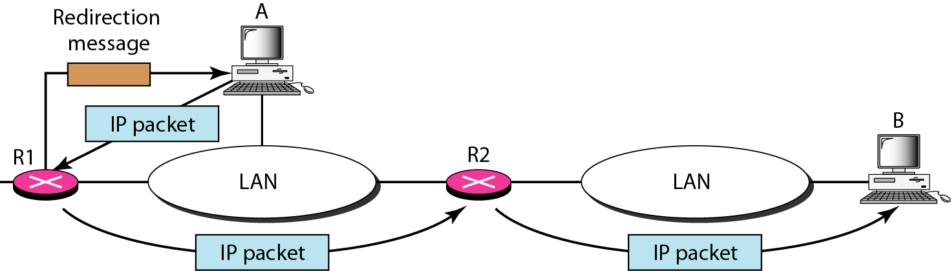
Figure 21.11 Redirection concept
Host A wants to send a datagram to host B.
Router R2 is obviously the most efficient routing choice, but host A did not choose router R2. The datagram goes to R1 instead. Router R1, after consulting its table, finds that the packet should have gone to R2. It sends the packet to R2 and, at the same time, sends a redirection message to host A. Host A's routing table can now be updated.
21.<number>

Slide 22

Figure 21.12 Query messages
In addition to error reporting, ICMP can diagnose some network problems. This is accomplished through the query messages, a group of four different pairs of messages, as shown
21.<number>

Slide 23
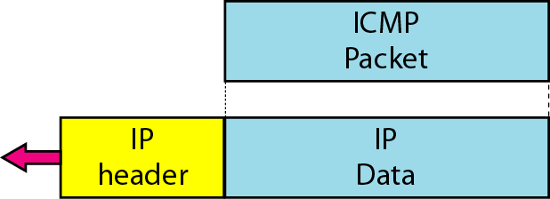
Figure 21.13 Encapsulation of ICMP query messages
21.<number>

Slide 24
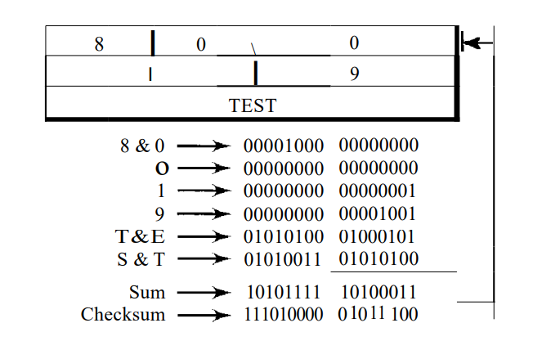
Example 21.2
Figure 21.14 shows an example of checksum calculation for a simple echo-request message. We randomly chose the identifier to be 1 and the sequence number to be 9. The message is divided into 16-bit (2-byte) words. The words are added and the sum is complemented. Now the sender can put this value in the checksum field.
21.<number>

Slide 25
Example 21.3
We use the ping program to test the server fhda.edu. The result is shown on the next slide. The ping program sends messages with sequence numbers starting from 0. For each probe it gives us the RTT time. The TTL (time to live) field in the IP datagram that encapsulates an ICMP
message has been set to 62. At the beginning, ping defines the number of data bytes as 56 and the total number of bytes as 84. It is obvious that if we add 8 bytes of ICMP header and 20 bytes of IP header to 56, the result is 84. However, note that in each probe ping defines the number of bytes as 64. This is the total number of bytes in the ICMP packet (56 + 8).
21.<number>

Slide 26
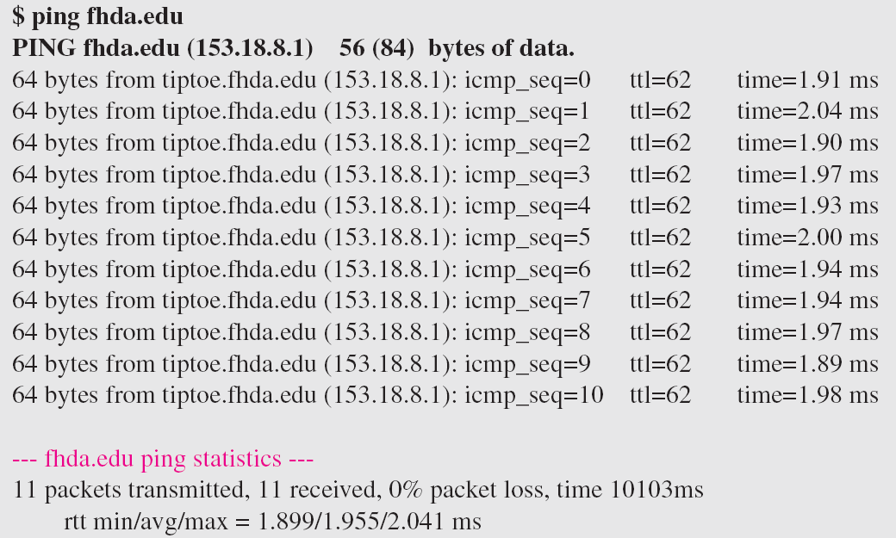
Example 21.3 (continued)
21.<number>

Slide 27
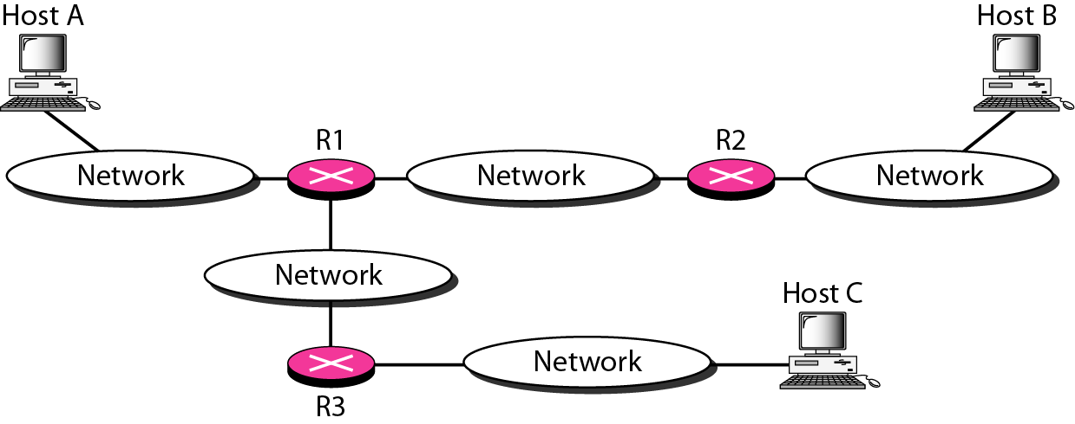
Figure 21.15 The traceroute program operation
The traceroute program in UNIX or tracert in Windows can be used to trace the route of a packet from the source to the destination.
21.<number>

Slide 28
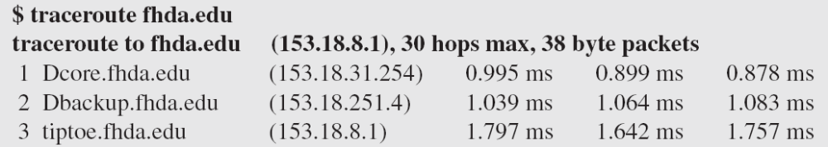
Example 21.4
We use the traceroute program to find the route from the computer voyager.deanza.edu to the server fhda.edu. The following shows the result:
The unnumbered line after the command shows that the destination is 153.18.8.1. The packet contains 38 bytes: 20 bytes of IP header, 8 bytes of UDP header, and 10 bytes of application data. The application data are used by traceroute to keep track of the packets.
21.<number>

Slide 29
Example 21.4 (continued)
The first line shows the first router visited. The router is named Dcore.fhda.edu with IP address 153.18.31.254. The first round-trip time was 0.995 ms, the second was 0.899 ms, and the third was 0.878 ms. The second line shows the second router visited. The router is named Dbackup.fhda.edu with IP address 153.18.251.4. The three round-trip times are also shown. The third line shows the destination host. We know that this is the destination host because there are no more lines. The destination host is the server fhda.edu, but it is named tiptoe.fhda.edu with the IP address 153.18.8.1. The three round-trip times are also shown.
21.<number>

Slide 30
Example 21.5
In this example, we trace a longer route, the route to xerox.com (see next slide). Here there are 17 hops between source and destination. Note that some round-trip times look unusual. It could be that a router was too busy to process the packet immediately.
21.<number>

Slide 31
The netstat utility can be used to find the multicast addresses supported by an interface.
We use netstat (see next slide) with three options: -n, -r, and -a. The -n option gives the numeric versions of IP addresses, the -r option gives the routing table, and the -a option gives all addresses (unicast and multicast). Note that we show only the fields relative to our discussion. “Gateway” defines the router, “Iface” defines the interface.
Note that the multicast address is shown in color. Any packet with a multicast address from 224.0.0.0 to 239.255.255.255 is masked and delivered to the Ethernet interface.
21.<number>

Slide 32
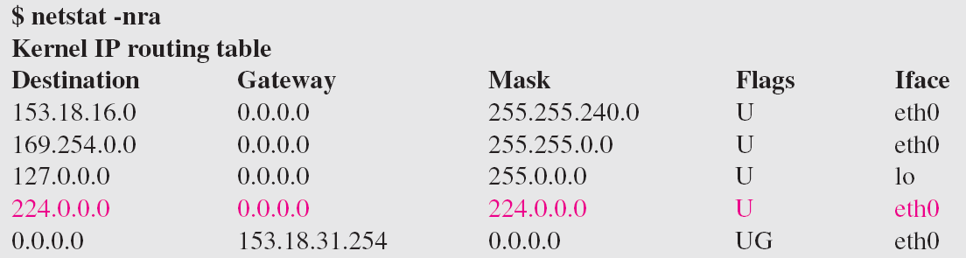
Example 21.9 (continued)
21.<number>

