Slide 1

Chapter 22
Network Layer:
Delivery, Forwarding,
and Routing
22.<number>
Copyright © The McGraw-Hill Companies, Inc. Permission required for reproduction or display.

Slide 2
22-1 DELIVERY
The network layer supervises the handling of the packets by the underlying physical networks. We define this handling as the delivery of a packet.
Topics discussed in this section:
Direct Versus Indirect Delivery
22.<number>

Slide 3

Figure 22.1 Direct and indirect delivery
22.<number>

Slide 4
22-2 FORWARDING
Forwarding means to place the packet in its route to its destination. Forwarding requires a host or a router to have a routing table. When a host has a packet to send or when a router has received a packet to be forwarded, it looks at this table to find the route to the final destination.
Topics discussed in this section:
Forwarding Techniques
Forwarding Process
Routing Table
22.<number>

Slide 5

Figure 22.2 Route method versus next-hop method
22.<number>

Slide 6

Figure 22.3 Host-specific versus network-specific method
22.<number>

Slide 7

Figure 22.4 Default method
22.<number>

Slide 8

Figure 22.5 Simplified forwarding module in classless address
22.<number>

Slide 9

Note
In classless addressing, we need at least four columns in a routing table.
22.<number>

Slide 10
Example 22.1
Make a routing table for router R1, using the configuration in Figure 22.6.
Solution
Table 22.1 shows the corresponding table.
22.<number>

Slide 11

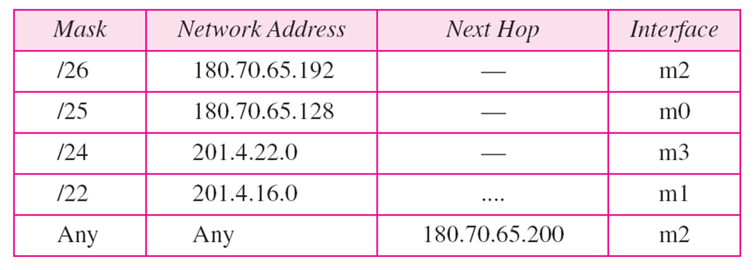
Figure 22.6 Configuration for Example 22.1
22.<number>

Slide 12

Table 22.1 Routing table for router R1 in Figure 22.6
22.<number>

Slide 13
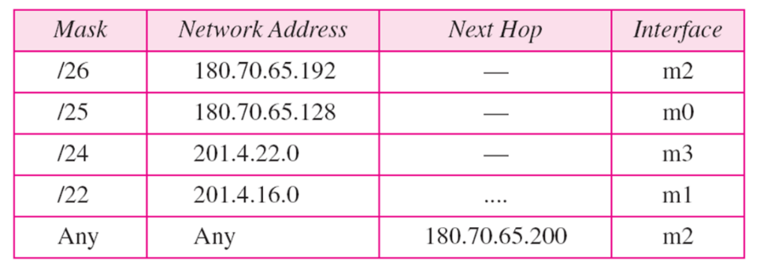

Example 22.2
Show the forwarding process if a packet arrives at R1 in Figure 22.6 with the destination address 180.70.65.140.
Solution
The router performs the following steps:
1. The first mask (/26) is applied to the destination address.
The result is 180.70.65.128, which does not match the
corresponding network address.
2. The second mask (/25) is applied to the destination
address. The result is 180.70.65.128, which matches the
corresponding network address. The next-hop address
and the interface number m0 are passed to ARP for
further processing.
22.<number>

Slide 14


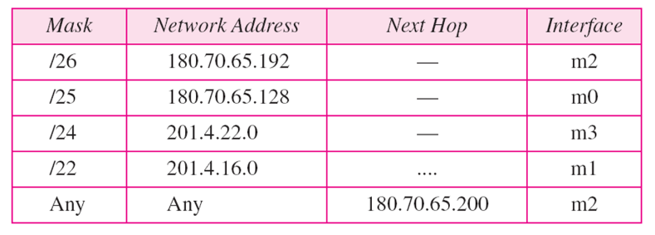
Example 22.3
Show the forwarding process if a packet arrives at R1 in Figure 22.6 with the destination address 201.4.22.35.
Solution
The router performs the following steps:
1. The first mask (/26) is applied to the destination
address. The result is 201.4.22.0, which does not
match the corresponding network address.
2. The second mask (/25) is applied to the destination address. The result is 201.4.22.0, which does not match the corresponding network address (row 2).
22.<number>

Slide 15
Example 22.3 (continued)
3. The third mask (/24) is applied to the destination
address. The result is 201.4.22.0, which matches the
corresponding network address. The destination
address of the packet and the interface number m3 are
passed to ARP.
22.<number>

Slide 16

Example 22.4
Show the forwarding process if a packet arrives at R1 in Figure 22.6 with the destination address 18.24.32.78.
Solution
This time all masks are applied, one by one, to the destination address, but no matching network address is found. When it reaches the end of the table, the module gives the next-hop address 180.70.65.200 and interface number m2 to ARP. This is probably an outgoing package that needs to be sent, via the default router, to someplace else in the Internet.
22.<number>

Slide 17
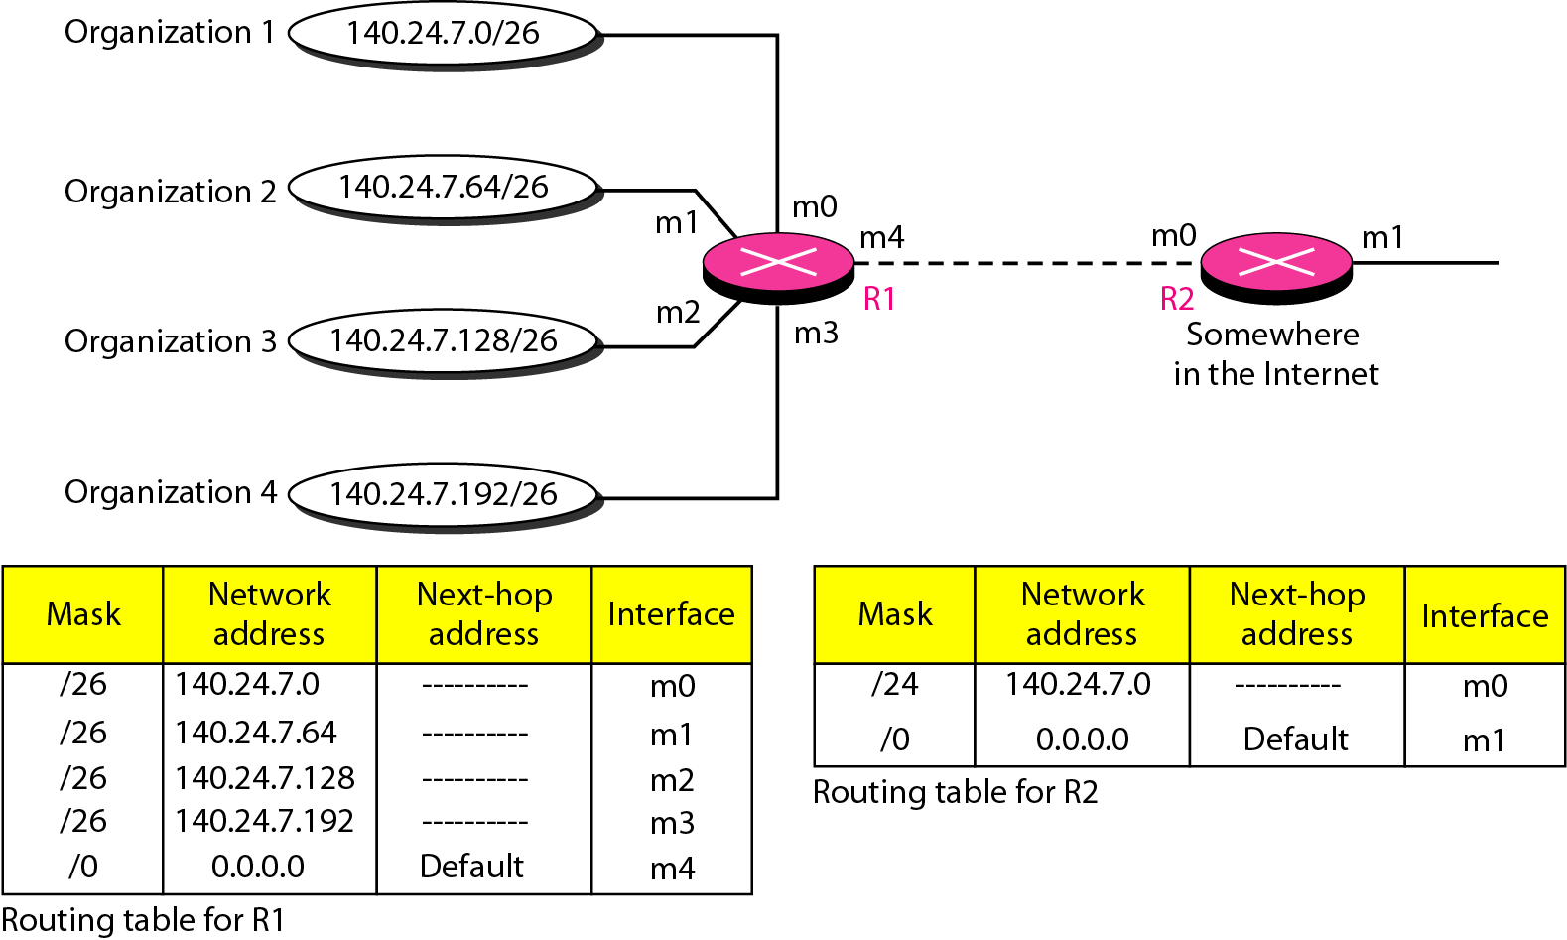
Address aggregation
The increased size of the table results in an increase in the amount of time needed to search the table. To alleviate the problem, the idea of address aggregation was designed.
For R2, any packet with destination 140.24.7.0 to 140.24.7.255 is sent out from interface m0 regardless of the organization number.
This is called address aggregation because the blocks of addresses for four organizations are aggregated into one larger block.
Router R2 would have a longer routing table if each organization had addresses that could not be aggregated into one block.
22.<number>

Slide 18
Figure 22.7 Address aggregation
For R2, any packet with destination 140.24.7.0 to 140.24.7.255 is sent out from interface m0 regardless of the organization number.
This is called address aggregation because the blocks of addresses for four organizations are aggregated into one larger block.
Router R2 would have a longer routing table if each organization had addresses that could not be aggregated into one block.
22.<number>

Slide 19
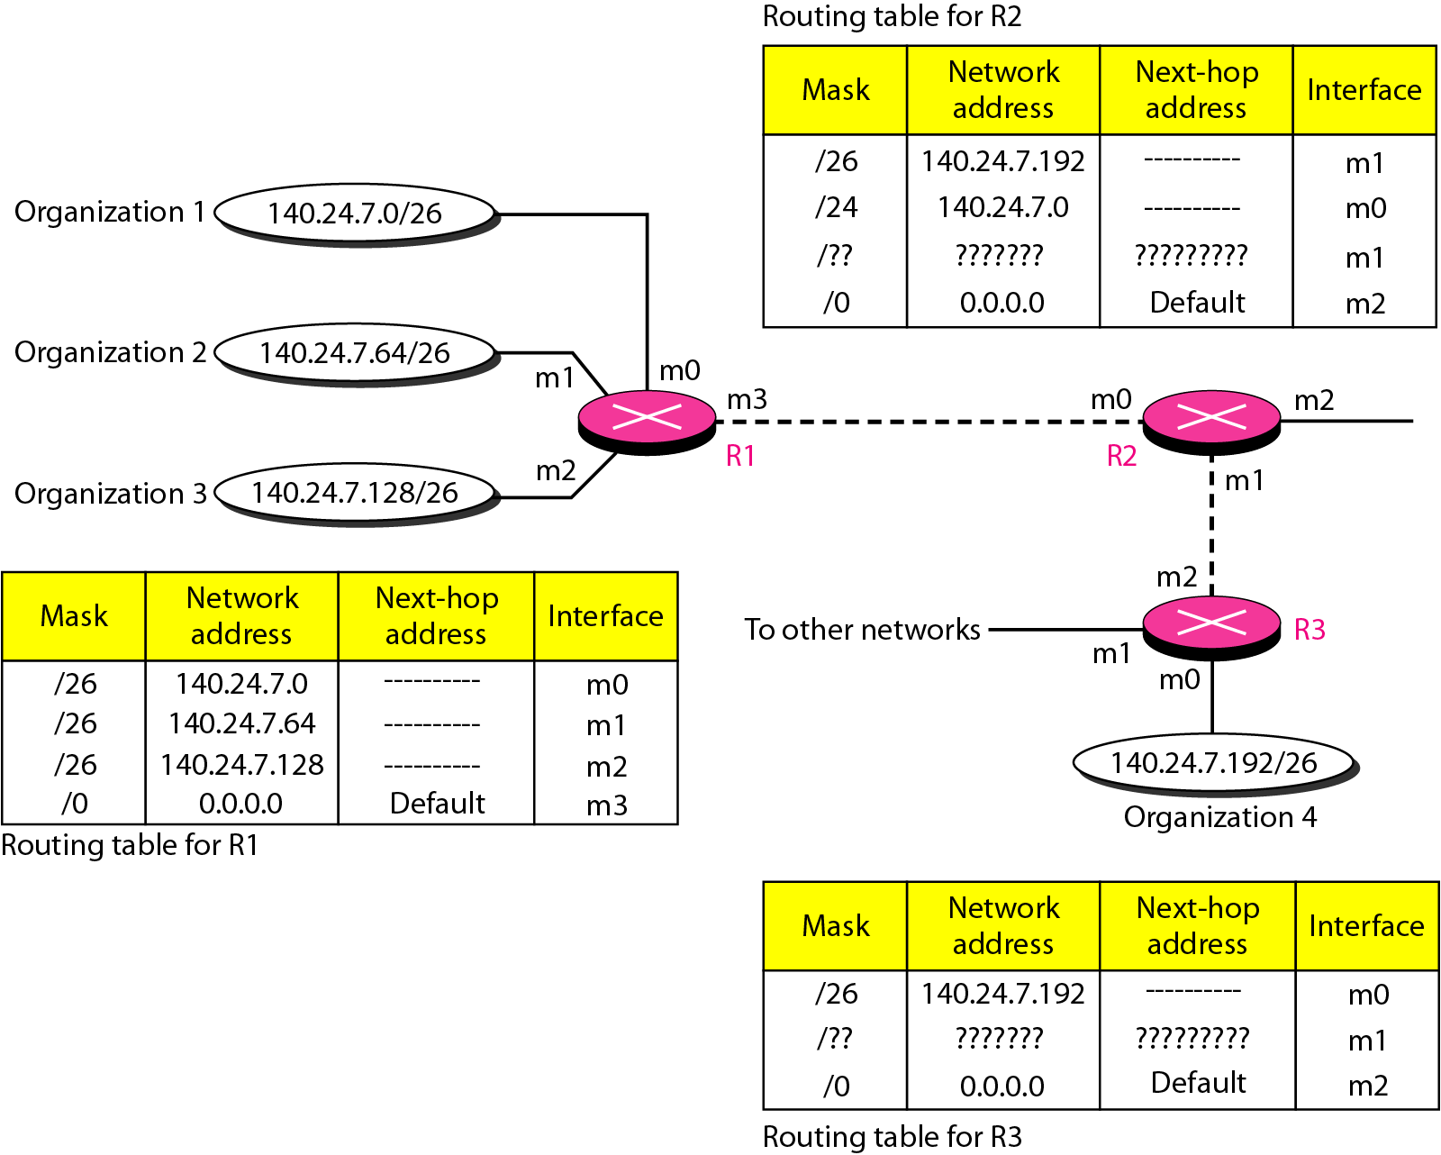
Figure 22.8 Longest mask matching
longest mask matching. This principle states that the routing table is sorted from the longest mask to the shortest mask. In other words, if there are three masks /27, /26, and /24, the mask /27 must be the first entry and /24 must be last.
22.<number>

Slide 20
Example 22.5
As an example of hierarchical routing, let us consider Figure 22.9. A regional ISP is granted 16,384 addresses starting from 120.14.64.0. The regional ISP has decided to divide this block into four subblocks, each with 4096 addresses. Three of these subblocks are assigned to three
local ISPs; the second subblock is reserved for future use. Note that the mask for each block is /20 because the original block with mask /18 is divided into 4 blocks.
The first local ISP has divided its assigned subblock into 8 smaller blocks and assigned each to a small ISP. Each small ISP provides services to 128 households, each using four addresses.
22.<number>

Slide 21
Example 22.5 (continued)
The second local ISP has divided its block into 4 blocks and has assigned the addresses to four large organizations.
The third local ISP has divided its block into 16 blocks and assigned each block to a small organization. Each small organization has 256 addresses, and the mask is /24.
There is a sense of hierarchy in this configuration. All routers in the Internet send a packet with destination address 120.14.64.0 to 120.14.127.255 to the regional ISP.
22.<number>

Slide 22
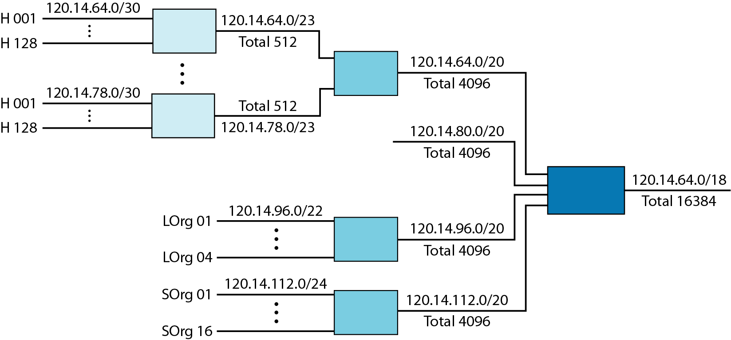
Figure 22.9 Hierarchical routing with ISPs
The regional ISP sends every packet with destination address 120.14.64.0 to 120.14.79.255 to local ISP1. Local ISP1 sends every packet with destination address 120.14.64.0 to 120.14.64.3 to H001.
22.<number>

Slide 23
The routing table can be either static or dynamic.
A static routing table contains information entered manually. The table must be manually altered by the administrator
A dynamic routing table is updated periodically by using one of the dynamic routing protocols such as RIP, OSPF, or BGP. Whenever there is a change in the Internet, such as a shutdown of a router or breaking of a link, the dynamic routing protocols update all the tables in the routers (and eventually in the host) automatically.
22.<number>

Slide 24
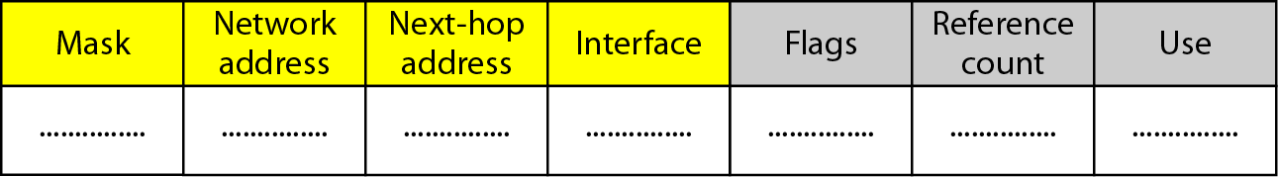
As mentioned previously, a routing table for classless addressing has a minimum of four columns. However, some of today's routers have even more columns. We should be aware that the number of columns is vendor-dependent, and not all columns can be found in all routers.
Figure 22.10 Common fields in a routing table
22.<number>

Slide 25
Figure 22.10 Common fields in a routing table
O Mask. This field defines the mask applied for the entry.
O Network address. This field defines the network address to which the packet is finally delivered. In the case of host-specific routing, this field defines the address of the destination host.
O Next-hop address. This field defines the address of the next-hop router to which the packet is delivered.
O Interface. This field shows the name of the interface.
22.<number>

Slide 26
O Flags. This field defines up to five flags. Flags are on/off switches that signify either presence or absence. The five flags are U (up), G (gateway), H (host-specific), D (added by redirection), and M (modified by redirection).
a. U (up). The U flag indicates the router is up and running. If this flag is not present, it means that the router is down. The packet cannot be forwarded and is discarded.
b. G (gateway). The G flag means that the destination is in another network. The packet is delivered to the next-hop router for delivery (indirect delivery). When this flag is missing, it means the destination is in this network (direct delivery).
c. H (host-specific). The H flag indicates that the entry in the network address field is a host-specific address. When it is missing, it means that the address is only the network address of the destination.
d. D (added by redirection). The D flag indicates that routing information for this destination has been added to the host routing table by a redirection message from ICMP.
e. M (modified by redirection). The M flag indicates that the routing information for this destination has been modified by a redirection message from ICMP.
22.<number>

Slide 27
Reference count. This field gives the number of users of this route at the moment. For example, if five people at the same time are connecting to the same host from this router, the value of this column is 5.
o Use. This field shows the number of packets transmitted through this router for the corresponding destination.
22.<number>

Slide 28
utility
Example 22.6
One utility that can be used to find the contents of a routing table for a host or router is netstat in UNIX or LINUX. The next slide shows the list of the contents of a default server. We have used two options, r and n. The option r indicates that we are interested in the routing table, and the option n indicates that we are looking for numeric addresses. Note that this is a routing table for a host, not a router. Although we discussed the routing table for a router throughout the chapter, a host also needs a routing table.
22.<number>

Slide 29
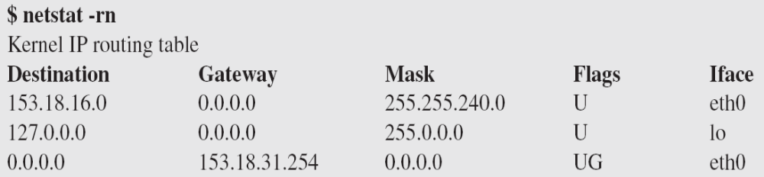
Example 22.6 (continued)
The destination column here defines the network address. The term gateway used by UNIX is synonymous with router. This column actually defines the address of the next hop. The value 0.0.0.0 shows that the delivery is direct. The last entry has a flag of G, which means that the destination can be reached through a router (default router). The Iface defines the interface.
22.<number>

Slide 30
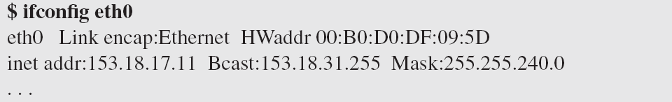
Example 22.6 (continued)
More information about the IP address and physical address of the server can be found by using the ifconfig command on the given interface (eth0).
22.<number>

Slide 31
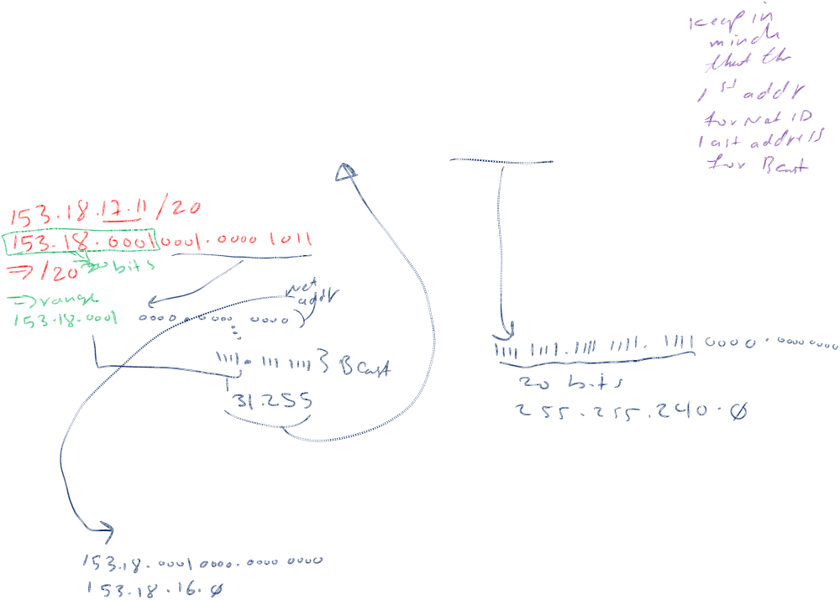
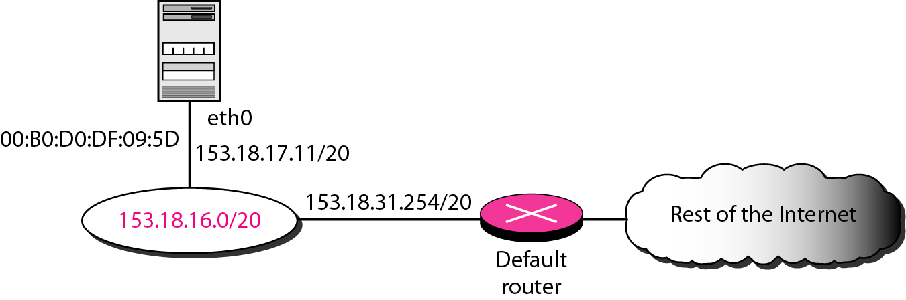
Figure 22.11 Configuration of the server for Example 22.6
From the above information, we can deduce the configuration of the server, as shown in Figure 22.11.
22.<number>

Slide 32
22-3 UNICAST ROUTING PROTOCOLS
A routing table can be either static or dynamic. A static table is one with manual entries. A dynamic table is one that is updated automatically when there is a change somewhere in the Internet. A routing protocol is a combination of rules and procedures that lets routers in the Internet inform each other of changes.
Topics discussed in this section:
Optimization
Intra- and Interdomain Routing
Distance Vector Routing and RIP
Link State Routing and OSPF
Path Vector Routing and BGP
22.<number>

Slide 33

Figure 22.12 Autonomous systems
22.<number>

Slide 34

Figure 22.13 Popular routing protocols
22.<number>

Slide 35

Figure 22.14 Distance vector routing tables
22.<number>

Slide 36

Figure 22.15 Initialization of tables in distance vector routing
22.<number>

Slide 37
Note
In distance vector routing, each node shares its routing table with its
immediate neighbors periodically and when there is a change.
22.<number>

Slide 38


Figure 22.16 Updating in distance vector routing
22.<number>

Slide 39
Link State Routing
Link state routing has a different philosophy from that of distance vector routing. In link state routing, if each node in the domain has the entire topology of the domain– the list of nodes and links, how they are connected including the type, cost (metric), and condition of the links (up or down)-the node can use Dijkstra's algorithm to build a routing table.
22.<number>

Slide 40

Figure 22.22 Link State Routing: Dijkstra algorithm
22.<number>

Slide 41

Figure 22.23 Example of formation of shortest path tree
22.<number>

Slide 42
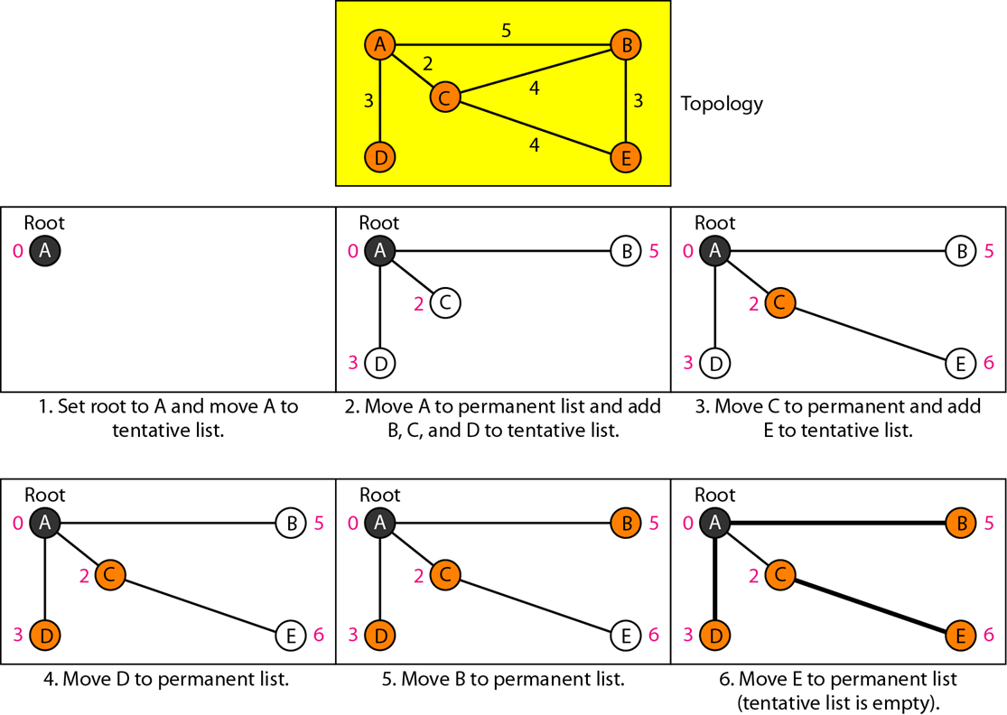
We make node A the root of the tree and move it to the tentative list. Our two lists are
Permanent list: empty Tentative list: A(0)
22.<number>

Slide 43
1. We make node A the root of the tree and move it to the tentative list. Our two lists are Permanent list:
empty Tentative list: A(0)
2 Node A has the shortest cumulative cost from all nodes in the tentative list. We move A to the permanent list and add all neighbors of A to the tentative list. Our new lists are
Permanent list: A(0) Tentative list: B(5), C(2), D(3)
3. Node C has the shortest cumulative cost from all nodes in the tentative list. We move C to the permanent list. Node C has three neighbors, but node A is already processed, which makes the unprocessed neighbors just B and E. However, B is already in the tentative list with a cumulative cost of 5. Node A could also reach node B through C with a cumulative cost of 6. Since 5 is less than 6, we keep node B with a cumulative cost of 5 in the tentative list and do not replace it. Our new lists are
Permanent list: A(0), C(2) Tentative list: B(5), D(3), E(6)
22.<number>

Slide 44
4. Node D has the shortest cumulative cost of all the nodes in the tentative list. We move D to the permanent list. Node D has no unprocessed neighbor to be added to the tentative list. Our new lists are Permanent list: A(0), C(2), D(3) Tentative list: B(5), E(6)
22.<number>

Slide 45
5. Node B has the shortest cumulative cost of all the nodes in the tentative list. We move B to the permanent list. We need to add all unprocessed neighbors of B to the tentative list (this is just node E). However, E(6) is already in the list with a smaller cumulative cost. The cumulative cost to node E, as the neighbor of B, is 8. We keep node E(6) in the tentative list. Our new lists are Permanent list: A(0), B(5), C(2), D(3) Tentative list: E(6)
6. Node E has the shortest cumulative cost from all nodes in the tentative list. We move E to the permanent list. Node E has no neighbor. Now the tentative list is empty. We stop; our shortest path tree is ready. The final lists are Permanent list: A(0), B(5), C(2), D(3), E(6) Tentative list: empty
22.<number>

Slide 46

Table 22.2 Routing table for node A
22.<number>

