Slide 1

Chapter 26
Remote Logging,
Electronic Mail,
and File Transfer
26.<number>
Copyright © The McGraw-Hill Companies, Inc. Permission required for reproduction or display.

Slide 2
The main task of the Internet is to provide services for users. Among the most popular applications are remote logging, electronic mail, and file transfer.
In the Internet, users may want to run application programs at a remote site and create results that can be transferred to their local site. For example, students may want to connect to their university computer lab from their home to access application programs for doing homework assignments or projects.
TELNET was designed at a time when most operating systems, such as UNIX, were operating in a timesharing environment. In such an environment, a large computer supports multiple users.
26.<number>

Slide 3

Note
TELNET is a general-purpose client/server application program.
When a user wants to access an application program or utility located on a remote machine, he/she performs remote log-in. Here the TELNET client and server programs come into use.
When a user logs into a local timesharing system, it is called local log-in.
26.<number>

Slide 4
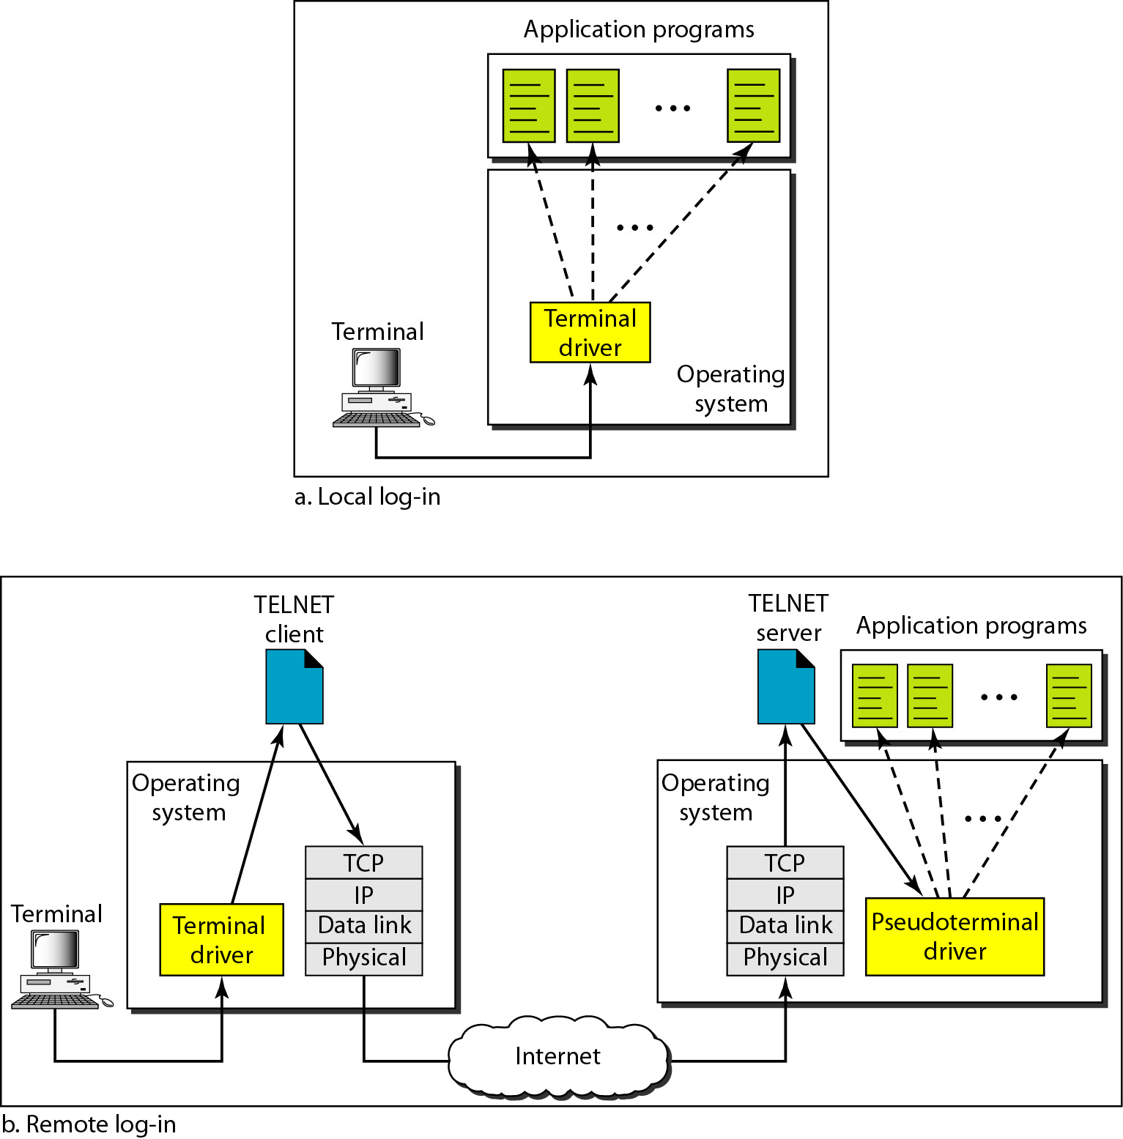
Figure 26.1 Local and remote log-in
26.<number>

Slide 5
26-2 ELECTRONIC MAIL
One of the most popular Internet services is electronic mail (e-mail). The designers of the Internet probably never imagined the popularity of this application program. Its architecture consists of several components that we discuss in this chapter.
Topics discussed in this section:
Architecture
User Agent
Message Transfer Agent: SMTP
Message Access Agent: POP and IMAP
Web-Based Mail
26.<number>

Slide 6

Figure 26.6 First scenario in electronic mail
26.<number>

Slide 7
Note
When the sender and the receiver of an e-mail are on the same system,
we need only two user agents.
26.<number>

Slide 8

Figure 26.7 Second scenario in electronic mail
26.<number>

Slide 9
Note
When the sender and the receiver of an e-mail are on different systems, we
need two UAs and a pair of
MTAs (client and server).
26.<number>

Slide 10

Figure 26.11 Services of user agent
26.<number>

Slide 11
Note
Some examples of GUI-based user agents are Eudora, Outlook, and Netscape.
26.<number>

Slide 12

Figure 26.13 E-mail address
26.<number>

Slide 13
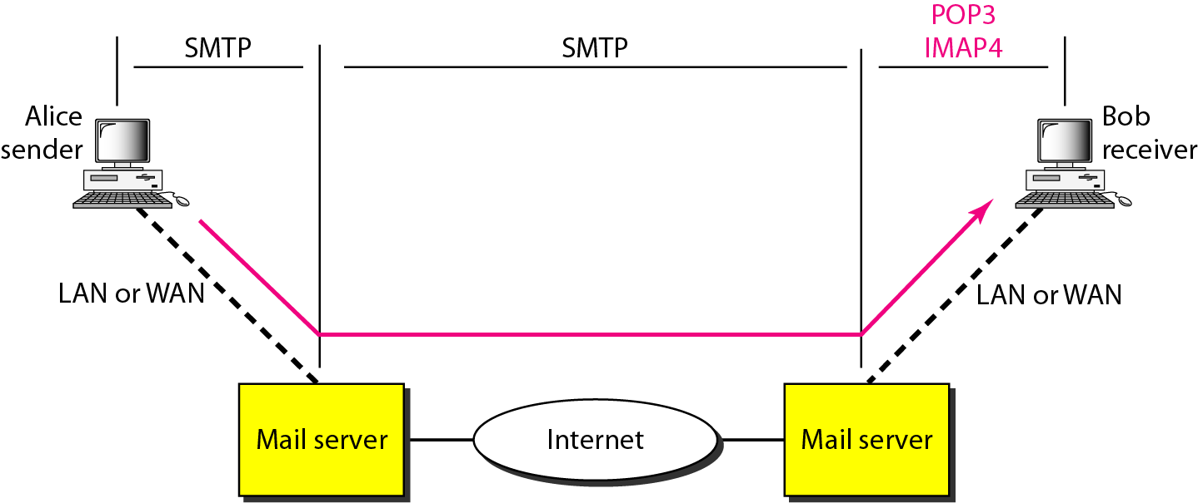
Figure 26.19 POP3 and IMAP4
26.<number>

Slide 14
Message Transfer Agent
The actual mail transfer is done through message transfer agents. To send mail, a system must have the client MTA, and to receive mail, a system must have a server MTA. The formal protocol that defines the MTA client and server in the Internet is called the Simple Mail Transfer Protocol (SMTP).
The process of transferring a mail message occurs in three phases: connection establishment, mail transfer, and connection termination.
Currently two message access protocols are available: Post Office Protocol, version 3 (POP3) and Internet Mail Access Protocol, version 4 (IMAP4).
26.<number>

Slide 15
26-3 FILE TRANSFER
Transferring files from one computer to another is one of the most common tasks expected from a networking or internetworking environment. As a matter of fact, the greatest volume of data exchange in the Internet today is due to file transfer.
Topics discussed in this section:
File Transfer Protocol (FTP)
26.<number>

Slide 16
Note
FTP uses the services of TCP. It needs two TCP connections.
The well-known port 21 is used for the control connection and the well-known port 20 for the data connection.
26.<number>

Slide 17
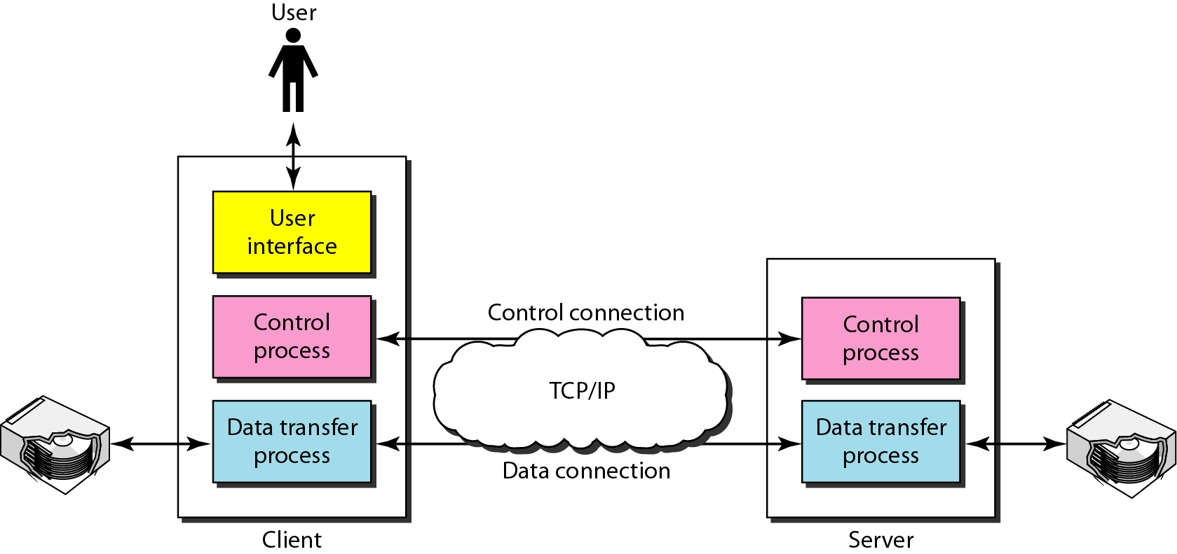
Figure 26.21 FTP
26.<number>

Slide 18
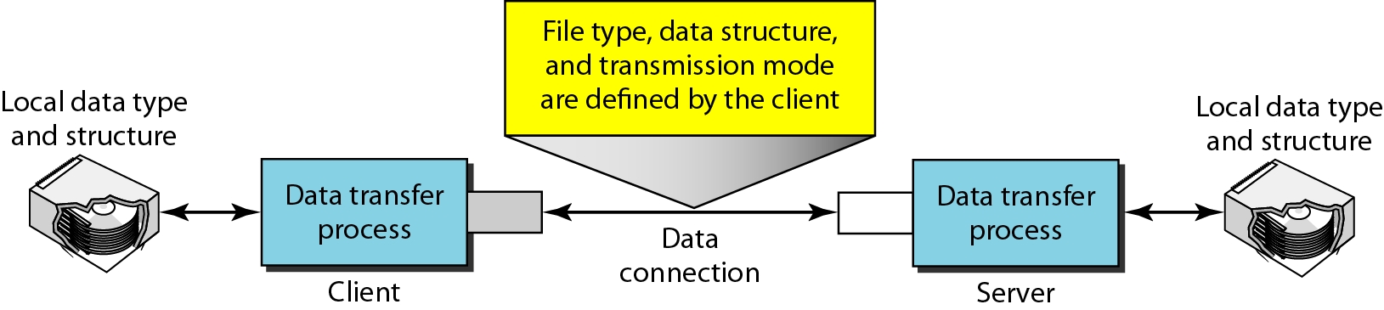
Figure 26.23 Using the data connection
26.<number>

