Slide 1

Chapter 27
WWW and HTTP
27.<number>
Copyright © The McGraw-Hill Companies, Inc. Permission required for reproduction or display.

Slide 2
27-1 ARCHITECTURE
The WWW today is a distributed client/server service, in which a client using a browser can access a service using a server. However, the service provided is distributed over many locations called sites.
Topics discussed in this section:
Client (Browser)
Server
Uniform Resource Locator
Cookies
27.<number>

Slide 3
The World Wide Web
The World Wide Web (WWW) is a repository of information linked together from points all over the world. The WWW has a unique combination of flexibility, portability, and user-friendly features that distinguish it from other services provided by the Internet.
The WWW project was initiated by CERN (European Laboratory for Particle Physics) to create a system to handle distributed resources necessary for scientific research. In this chapter we first discuss issues related to the Web.
27.<number>

Slide 4

Figure 27.1 Architecture of WWW
The WWW today is a distributed client/server
Service, in which a client using a browser can access a service using a server.
the service provided is distributed over many locations called sites,
27.<number>

Slide 5
Browser
The WWW today is a distributed client/server service, in which a client using a browser can access a service using a server.
Client (Browser) A variety of vendors offer commercial browsers that interpret and display a Web document, and all use nearly the same architecture.
Each browser usually consists of three parts: a controller, client protocol, and interpreters.
The controller receives input from the keyboard or the mouse and uses the client programs to access the document.
After the document has been accessed, the controller uses one of the interpreters to display the document on the screen.
The client protocol can be one of the protocols such as FTP or HTIP The interpreter can be HTML, Java, or JavaScript, depending on the type of document
27.<number>

Slide 6
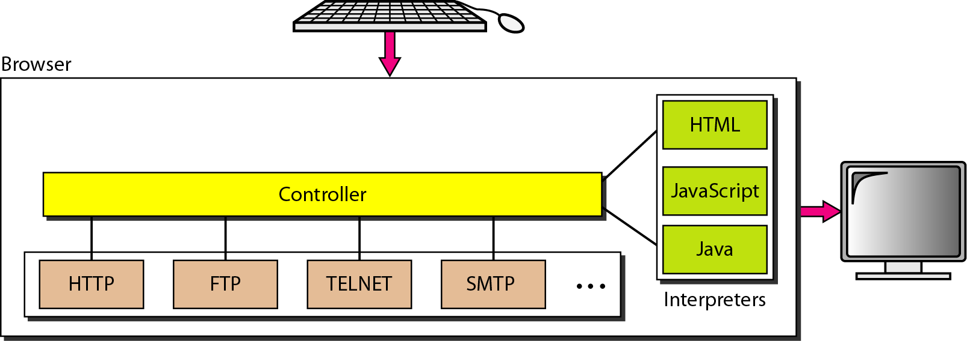
Figure 27.2 Browser
27.<number>

Slide 7
Figure 27.3 Uniform Resource Locator :URL
A client that wants to access a Web page needs the address. To facilitate the access of documents distributed throughout the world, HTTP uses locators.
27.<number>

Slide 8
27-2 WEB DOCUMENTS
The documents in the WWW can be grouped into three broad categories: static, dynamic, and active. The category is based on the time at which the contents of the document are determined.
Topics discussed in this section:
Static Documents
Dynamic Documents
Active Documents
27.<number>

Slide 9
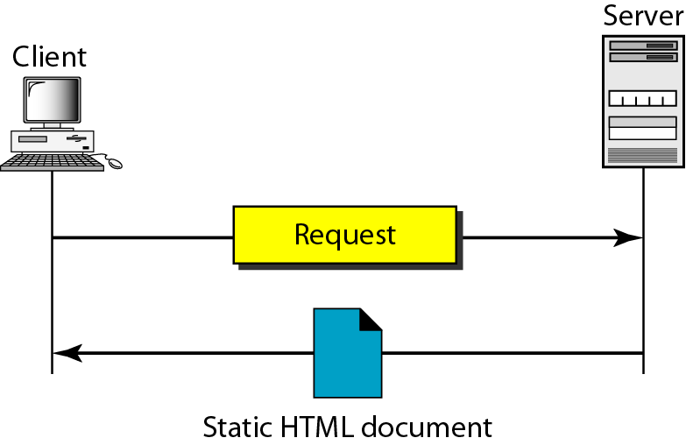
Figure 27.4 Static document
Static documents are fixed-content documents that are created and stored in a server.
27.<number>

Slide 10
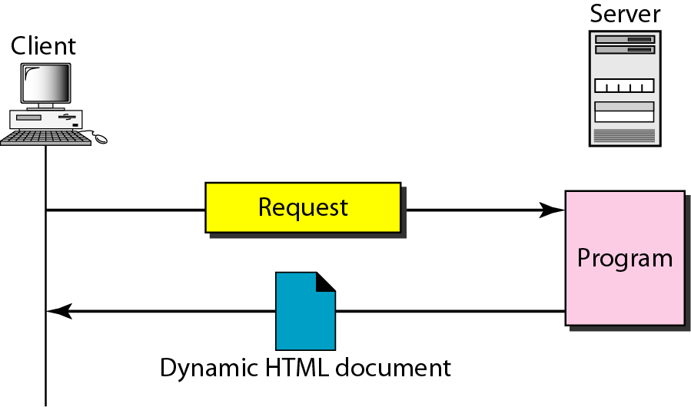
Figure 27.8 Dynamic document using CGI
The Common Gateway Interface (CGI) is a technology that creates and handles dynamic documents.
A dynamic document is created by a Web server whenever a browser requests the document. As a request arrives, the Web server runs an application program or a script that creates the dynamic document. The server returns the output of the program or script as a response to the browser that requested the document.
27.<number>

Slide 11
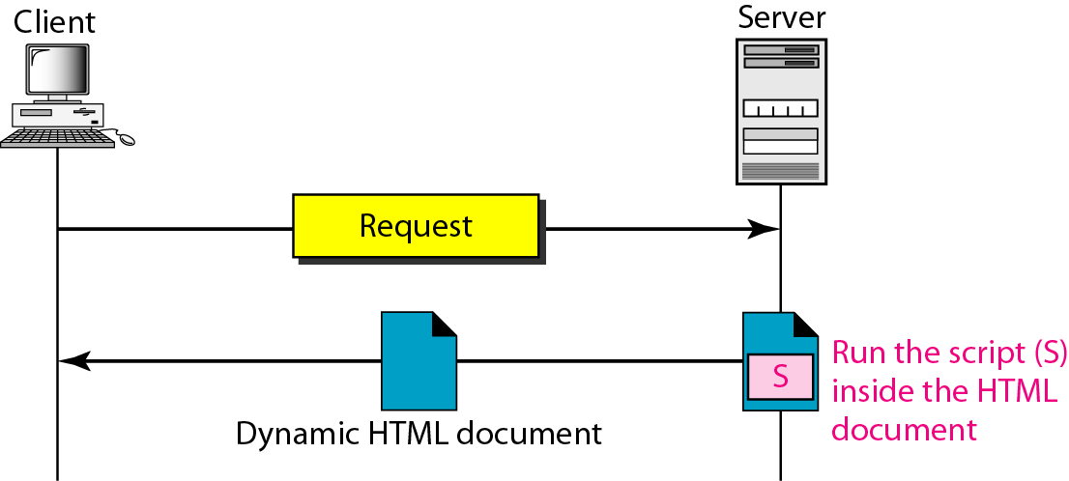
Figure 27.9 Dynamic document using server-site script
27.<number>

Slide 12
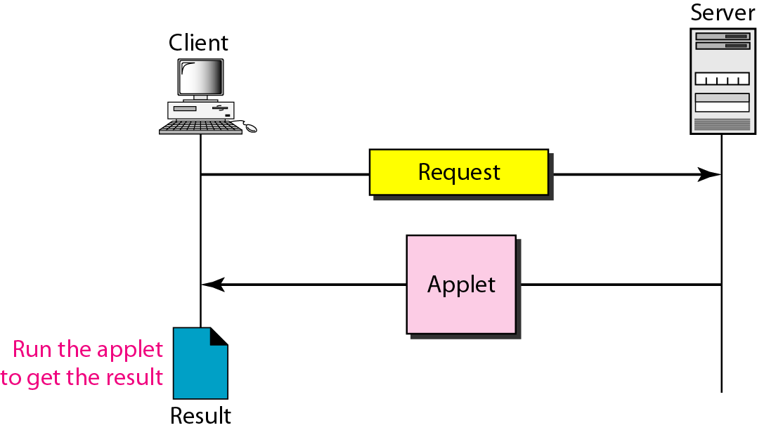
Figure 27.10 Active document using Java applet
27.<number>

Slide 13
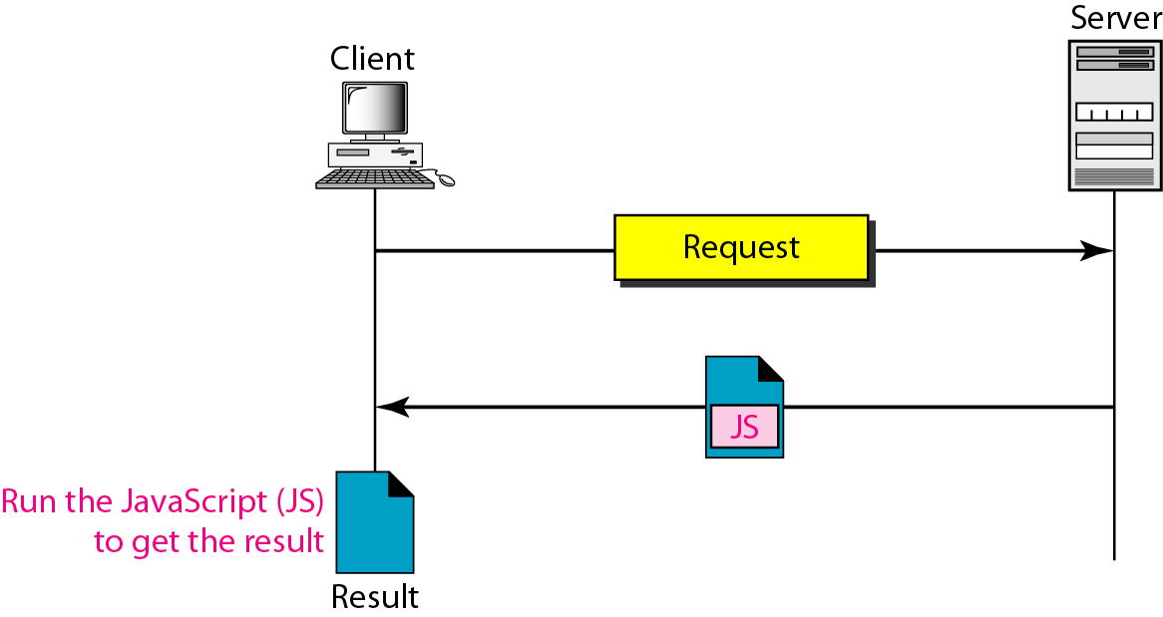
Figure 27.11 Active document using client-site script
27.<number>

Slide 14
27-3 HTTP
The Hypertext Transfer Protocol (HTTP) is a protocol used mainly to access data on the World Wide Web. HTTP functions as a combination of FTP and SMTP.
Topics discussed in this section:
HTTP Transaction
Persistent Versus Nonpersistent Connection
27.<number>

Slide 15

Note
HTTP uses the services of TCP on well-known port 80.
27.<number>

Slide 16
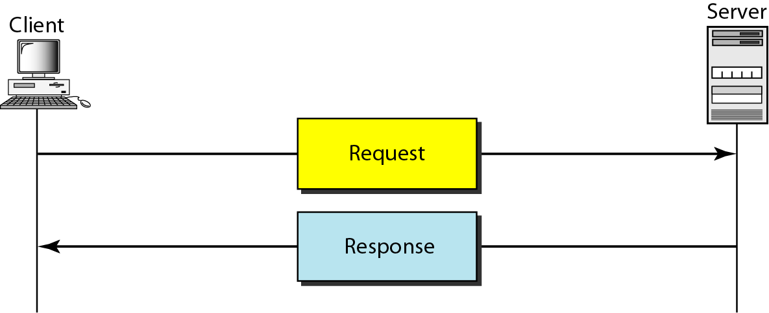
Figure 27.12 HTTP transaction
27.<number>

Slide 17
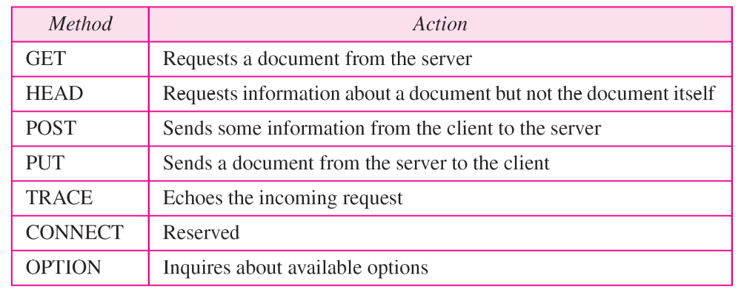
Request type
Request type: This field is used in the request message. In version 1.1 of HTTP, several request types are defined. The request type is categorized into methods as defined in the Table.
27.<number>

Slide 18
Status code. This field is used in the response message. The status code field is similar to those in the FTP and the SMTP protocols. It consists of three digits. Whereas the codes in the 100 range are only informational, the codes in the 200 range indicate a successful request. The codes in the 300 range redirect the client to another URL, and the codes in the 400 range indicate an error at the client site. Finally, the codes in the 500 range indicate an error at the server site.
27.<number>

Slide 19
Table 27.2 Status codes (continued)
27.<number>

Slide 20
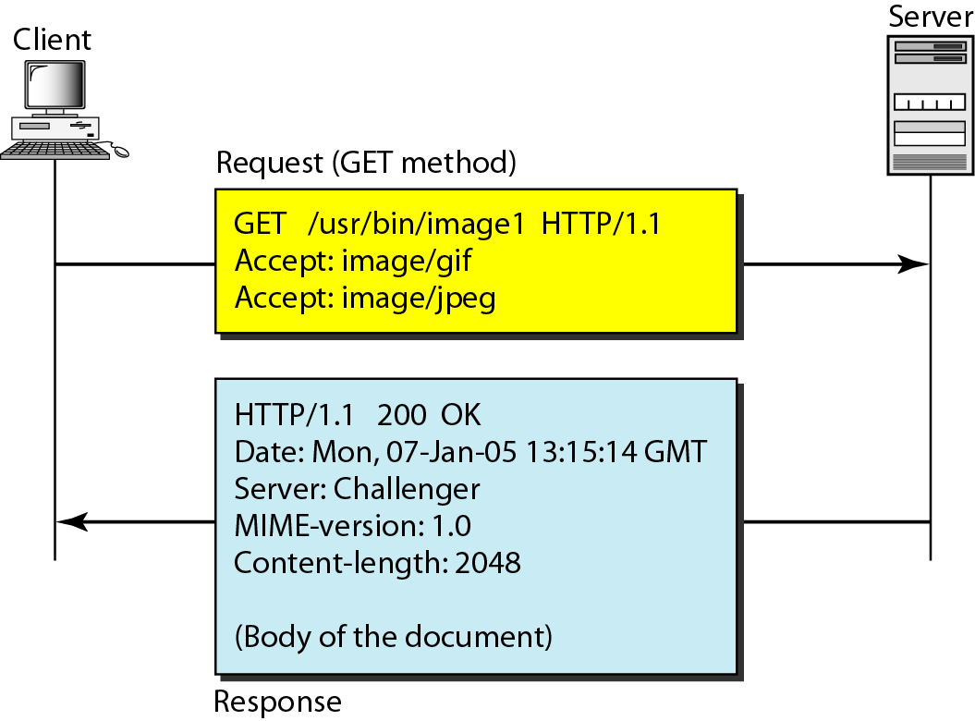
Example
27.<number>

Slide 21
Persistent Connection
HTTP version 1.1 specifies a persistent connection by default. In a persistent connection, the server leaves the connection open for more requests after sending a response. The server can close the connection at the request of a client or if a time-out has been reached. The sender usually sends the length of the data with each response. However, there are some occasions when the sender does not know the length of the data. This is the case when a document is created dynamically or actively. In these cases, the server informs the client that the length is not known and closes the connection after sending the data so the client knows that the end of the data has been reached.
27.<number>

Slide 22
Proxy Server
HTTP supports proxy servers.
A proxy server is a computer that keeps copies of responses to recent requests.
The HTTP client sends a request to the proxy server.
  The proxy server checks its cache.
  If the response is not stored in the cache, the proxy server sends the request to the corresponding server.
  Incoming responses are sent to the proxy server and stored for future requests from other clients.
  The proxy server reduces the load on the original server, decreases traffic, and improves latency. However, to use the proxy server, the client must be configured to access the proxy instead of the target server.
27.<number>

