Slide 1


KaraMo Diaby
Project-1
Cohort: 23/05/22

Slide 2

Agenda
About Project 1
Technologies Used
Code Snippet
Demo
Best Practices
Future Plans
Questions?

Slide 3

About Project 1 Fifa API
Project 1 is a reservoir of FIFA World Cup Teams
We used Swagger in order to implement a RESTful API where we can:
Add a team
Add Players to the team
Delete players
Transfer a player to another team
Get players on a specific team
Get number of players playing in a position

Slide 4

Technologies used
REST API
C#
Microsoft Visual Studio
Microsoft Server Management SQL
Swagger

Slide 5
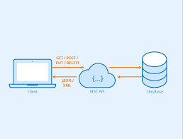
Rest api

Slide 6
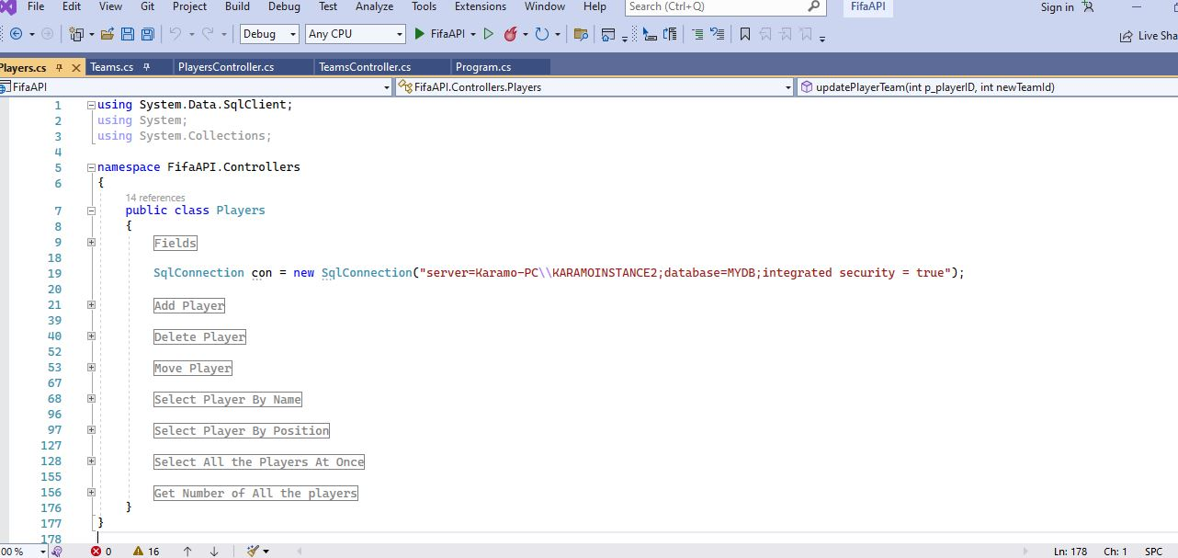
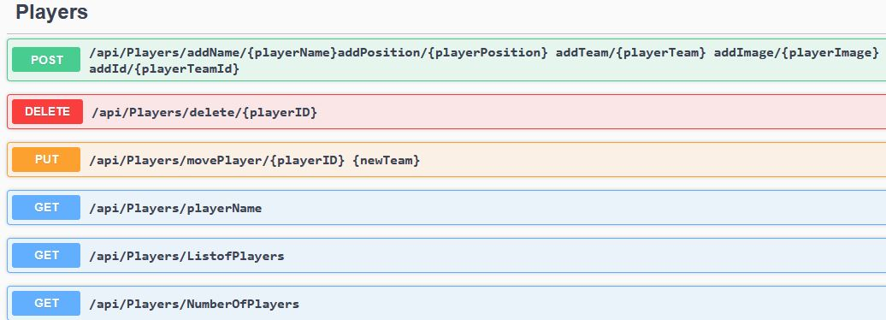
Code snippet Players Class

Slide 7
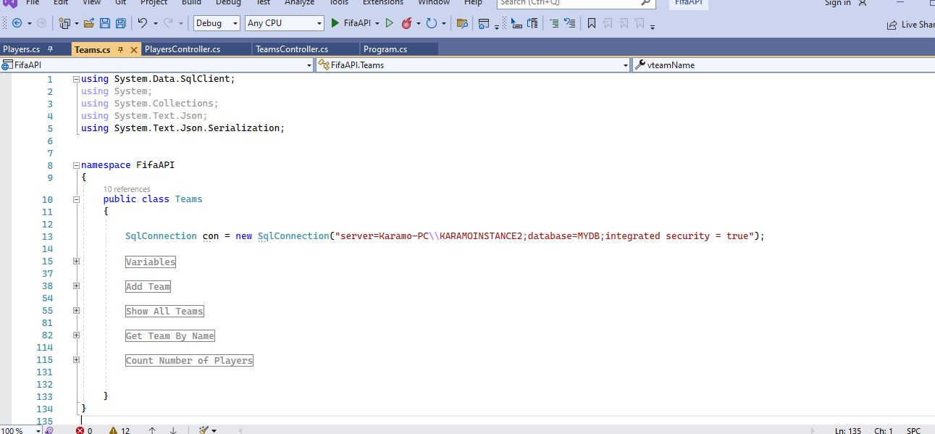
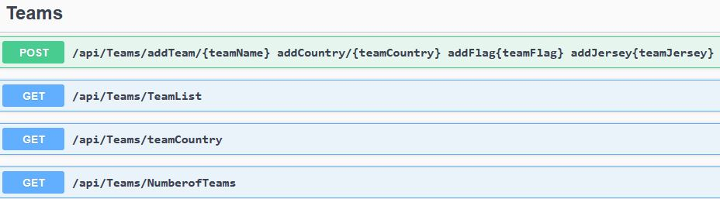
TEAMS CLASS

Slide 8
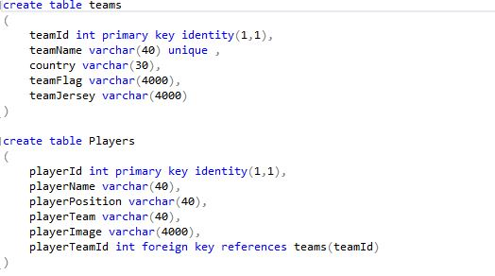
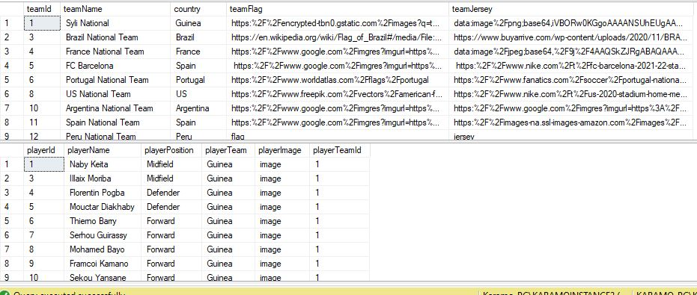
SQL DATABASE

Slide 9
Demo

Slide 10
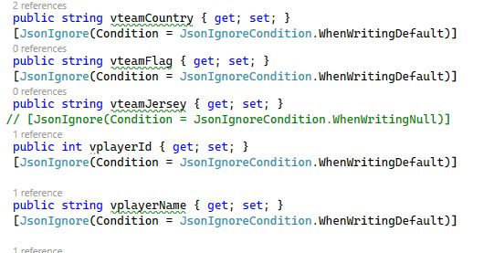
Best Practices
Just starting the program and then revising it as I go along.

Slide 11
Future Plans
Add a transfer fee in order to move player
Add jersey numbers

Slide 12
Thank You Any questions?

