Slide 1

Karamo Diaby
Projec0 – Banking app
Cohort : 23/05/2022

Slide 2
Agenda
About Project 0
Demo
Showing the Code
Best Practices
Future Plans
Questions?

Slide 3
About project0
C#
.NET Framework
SQL Databases
OOPS
3 Tier Application

Slide 4
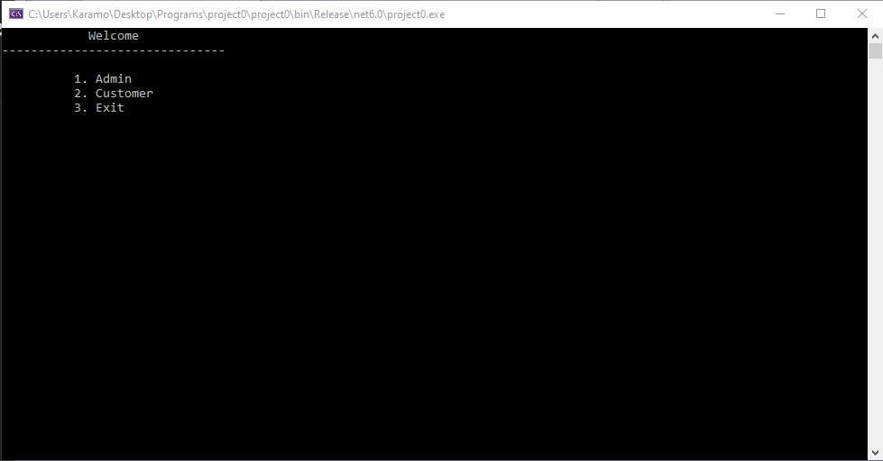
DEMo
Show Main
Admin Menu
Customer Menu
SQL Database

Slide 5
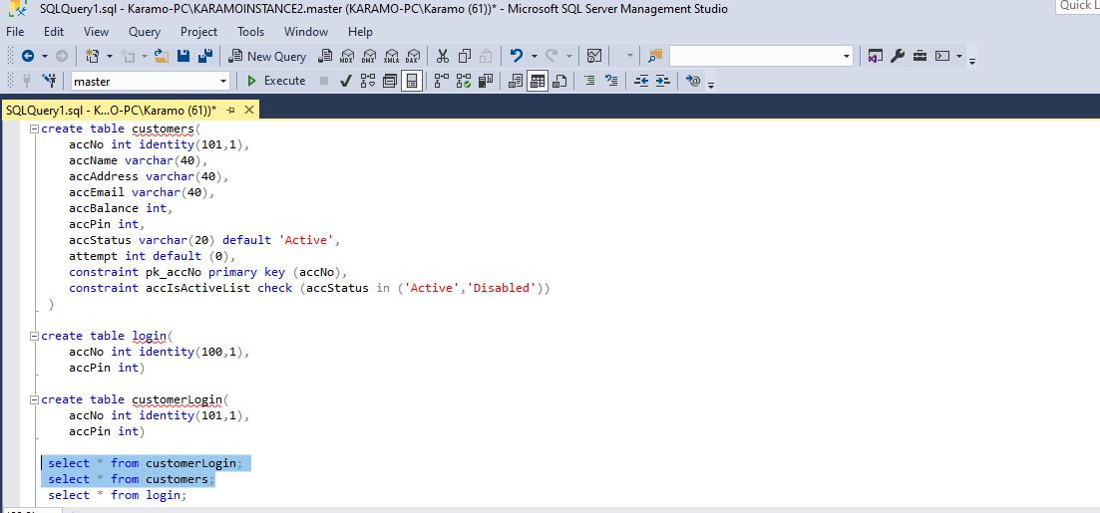
Demo

Slide 6
Best practices
Used Inheritance for code reusability
Used methods for displaying menus

Slide 7
Any Questions ?

Slide 8
Future plans
Sending Alert to user using the email.
Set up account minimum alerts.

