Slide 1
E-COMMERCE SALES ANALYTICS
An End-to-End Power BI Portfolio Project
Star Schema Data Modeling
DAX Measures
Power Query ETL
Interactive Drillthrough
Karan Pawar
B.Sc. Computer Science | PowerBI Developer & Data Analyst

Slide 2
Business Objective
1
Track Revenue & Growth
Monitor overall revenue, order volume, and monthly trend across FY24-25.
Indian e-commerce companies generate huge volumes of order-level data but struggle to convert it into fast, decision-ready insight for leadership, category, and operations teams.
2
Understand Product Mix
Identify top categories, brands, and customer segments driving sales.
3
Monitor Operations
Track warehouse performance, delivery time, shipping cost, and returns.
This project builds a 3-page Power BI solution — from raw CSVs to a governed star-schema model to an interactive, drillthrough-enabled dashboard.
4
Enable Self-Service
Let stakeholders slice by region and date without touching raw data.
2

Slide 3
Data Model — Star Schema
DIM_DATE
Five source CSVs modeled into one fact table and four dimension tables for clean, fast DAX.
Date · Month
Year · Quarter
DIM_PRODUCT
Category · Brand
Product Name
FACT_SALES
DIM_PAYMENT
OrderID · Quantity · TotalBill
ReturnFlag · IsFestiveSale
DeliveryDays · ShippingCost
PaymentMethod
DIM_CUSTOMER
CustomerID
Segment
DIM_REGION
Region · State
Warehouse
3

Slide 4
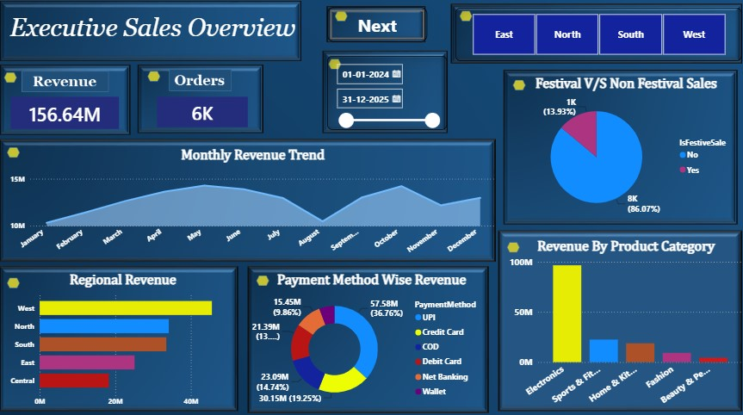
PAGE 01 · SALES OVERVIEW
Executive Sales Overview
₹156.64M
6K
West
Total Revenue
Total Orders
Top Region
Key Insights
West and North regions together drive over half of total revenue, led by West at ~₹42M.
UPI is the dominant payment method at 36.76% of revenue, ahead of Wallet and Net Banking.
Electronics alone contributes close to 90% of category revenue — a heavy category concentration.
Only 13.93% of orders are festive-sale, yet the monthly trend still peaks sharply around Oct–Nov.
4

Slide 5
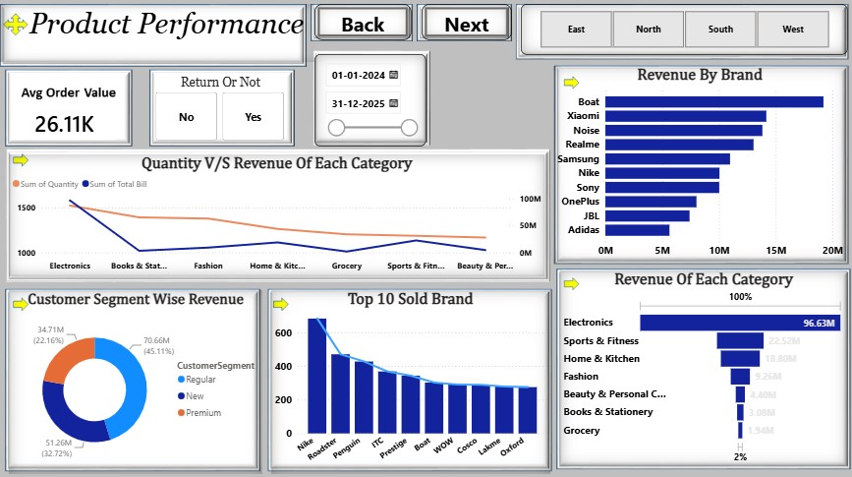
PAGE 02 · PRODUCT PERFORMANCE
Product Performance
₹26.11K
45.1%
Boat
Avg Order Value
Regular Segment
Top Brand
Key Insights
Boat leads brand-wise revenue at ~₹20M, followed by Xiaomi, Noise, and Realme.
Electronics dominates revenue share in the category funnel at 96.63%, dwarfing every other category.
Regular customers generate 45.11% of revenue, with Premium customers close behind at 32.72%.
By units sold, Nike is the top-selling brand, well ahead of Roadster and Penguin.
5

Slide 6
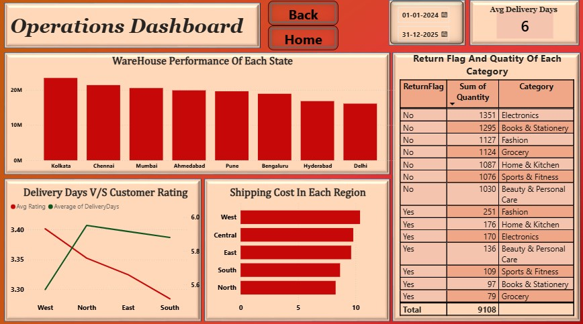
PAGE 03 · OPERATIONS
Operations Dashboard
6 days
Kolkata
9,108
Avg Delivery
Top Warehouse
Units Tracked
Key Insights
Kolkata warehouse leads throughput at ~₹23M, with Delhi trailing all listed warehouses.
Customer rating and delivery days move inversely from North to South — slower delivery, lower rating.
West region carries the highest shipping cost, despite also being the top revenue region.
Fashion has the highest return count (251 units) among returned orders, ahead of Home & Kitchen.
6

Slide 7
Key DAX Measures
A sample of measures written to power the KPI cards and % breakdowns above.
Total Revenue
Festive Sales %
Total Revenue = SUM(Fact_Sales[TotalBill])
Festive Sales % =
([Total Revenue], Fact_Sales[IsFestiveSale]="Yes"),
[Total Revenue]
)
Avg Order Value
Return Rate %
Avg Order Value =
[Total Revenue]/COUNT(Fact_Sales[OrderID]))
Return Rate % =
(Fact_Orders[Total Return]/
Fact_Orders[Total Orders])*100
7

Slide 8
Thank You
E-Commerce Sales Analytics — Power BI Portfolio Project
Karan Pawar
karanp3341@gmail.com
https://www.linkedin.com/in/karan-pawar-9a645a2ab

