Slide 1

Interim Presentation
Course Title: M.B.A. Thesis and Publication
Course Code: BAP602A

Slide 2

Student Details
Student Name: [Your Name]
Reg. No.: [Your Registration Number]
Faculty: Faculty of Management and Commerce
Department : Management Studies
Programme : MBA in Business Analytics
Batch : FT 2024

Slide 3
Title of the Dissertation
Title of the Thesis: An Explainable Machine Learning Framework for Financial Distress Prediction in Indian Manufacturing Companies.
Supervisor: [Supervisor Name]
Proposed Place of Work: [Place of Work]

Slide 4
Outline
Introduction
Literature Review
Summary of Literature Review
Identified Research Gaps | Research Questions
Title and Aim
Objectives
Methods and Methodology
Conceptual Framework
Summary of the Dissertation Work Progress
Key Results and Discussions
Findings and Conclusions
Gantt Chart
References

Slide 5
Introduction
Manufacturing financial distress remains a persistent global problem because high fixed asset intensity and debt dependence amplify cash-flow shocks (e.g., General Motors, 2009; Arrium Limited, 2016; Thomas Cook, 2019).
Indian manufacturing is the worst-hit sector for corporate failure: Bhushan Steel, Essar Steel, Bhushan Power & Steel and Videocon have all gone through IBC proceedings.
Manufacturing accounts for ~37% of all Corporate Insolvency Resolution Process (CIRP) cases in India — more than any other sector, including real estate.
December 2024: 8,175 CIRPs initiated; only 56% ended in resolution/settlement, while 44% moved to liquidation — evidence that delayed detection causes irrecoverable losses.
Average CIRP resolution time is 683 days (vs. the 270-day statutory limit); recovery ratios remain low at ~32% (secured) and ~25% (unsecured) creditors.
In several cases, assets were found to be worth only ~7% of outstanding debt by the time insolvency began — underscoring the need for early, reliable warning systems.

Slide 6
Regulation alone cannot solve this problem – robust empirical, data-driven early-warning models are required.
Classical models (Altman’s Z-score, Springate’s S-score) were built decades ago on Western economies and have been shown to lose relevance for Indian firms (Singh & Singla, 2023).
Machine learning models improve predictive accuracy, but critics note they sacrifice explainability — a serious concern for lenders, regulators and boards who must justify decisions (Liu et al., 2023).
A credible solution must therefore:
i. Identify India-specific financial and firm-level indicators,
ii. Benchmark ML against classical models,
iii. Explain predictions using XAI techniques,
iv. Test robustness across industries, economic cycles and regulatory regimes.

Slide 7
Literature Review
SL. No. | Author, Year of Publication | Research Focus | Methods and Methodologies | Research Findings | Conclusions Drawn | Limitations of Study | Critical Appraisal of Published Work
1 | Altman (1968) | Develop Z-score MDA model for bankruptcy prediction | MDA; 33 bankrupt / 33 non-bankrupt US mfg firms | High classification accuracy up to 2 years before failure | MDA/Z-score is a foundational early-warning tool | US-centric; MDA linearity assumptions | Benchmark for Obj 2; coefficients may be obsolete for Indian mfg
2 | Springate (1978) | S-score for insolvency classification | Stepwise MDA; 4 ratios from 19 candidates | S-score captures short-term debt-servicing pressure | S-score is a prevalent baseline in comparative literature | Single-country Canadian context; MDA assumptions | Used alongside Altman as benchmark in Obj 2
3 | Ohlson (1980) | Probabilistic logit bankruptcy model | Conditional logit; 105+2,058 US firms | Size, leverage, performance, liquidity significant | Probabilistic logit preferable to rigid MDA | US industrial firms only; no market-price data | Supports logit benchmarking under Obj 2
4 | Barboza, Kimura & Altman (2017) | Compare ML vs. traditional bankruptcy models | RF, Bagging, Boosting, SVM; ~10,000 firm-years; AUC | ML (esp. Random Forest) substantially outperformed Z-score models | Ensemble learning improves distress prediction over classical models | North America focus; no XAI testing | Supports Obj 2 ML vs. traditional design
5 | Sehgal et al. (2021) | Micro determinants of Indian listed firm distress | Logit, SVM, ANN; NSE firms 2010–2016 | SVM/ANN beat logit; 1-yr forecasts more accurate | ML improves Indian distress prediction; key micro ratios identified | Cross-sector; no manufacturing-only validation | Supports Obj 1–2; mfg-specific gap remains
6 | Mishra, Ashok & Tandon (2021) | Indian bank distress prediction | LR, LDA, ANN; 75 Indian banks; CAMELS | ANN competitive with statistical models | Multi-model comparison valuable for early-warning design | Banking-only; not transferable to manufacturing | Supports multi-model Obj 2; sector differs
7 | Tran et al. (2022) | XAI for financial distress in Vietnam | LR, SVM, RF, ANN, XGBoost + SHAP | Ensemble/boosting highest accuracy; SHAP identifies key ratios | Transferable XAI framework for emerging Asian markets | Vietnamese market only; not tested in India | Methodological anchor for Obj 3 SHAP

Slide 8
Literature Review (Continued)
SL. No. | Author, Year of Publication | Research Focus | Methods and Methodologies | Research Findings | Conclusions Drawn | Limitations of Study | Critical Appraisal of Published Work
8 | Gupta (2023) | Compare accounting vs. Merton model under IBC | ROC/Gini; 30 IBC + 30 solvent matched firms | Ohlson best accounting model; Merton best overall | Legacy models need Indian recalibration post-IBC | Small matched sample; limited sector disaggregation | Informs Obj 4 post-IBC robustness testing
9 | Singh & Singla (2023) | Re-estimate Altman for Indian manufacturing | Stepwise logistic regression; ROC/AUROC on mfg data | Five-factor logit outperformed original Altman Z-score | India-specific recalibration materially improves mfg classification | Needs broader sub-sector and multi-period testing | Closest mfg-India prior; directly motivates this study
10 | Liu et al. (2023) | SHAP interpretability for gradient boosting distress models | XGBoost/LightGBM + SHAP; Chinese listed firms | Leverage, profitability, liquidity top SHAP predictors | XAI can reconcile ML accuracy with interpretability | China focus; Indian mfg application absent | Methodological anchor for Obj 3 SHAP-based XAI
11 | Deng et al. (2025) | Explainable early-warning for Chinese A-shares | NSGA-II optimized XGBoost + SHAP + ISM | 3.32% accuracy gain; profitability influence varies with lead time | Rapidly growing govt-influenced market addressed explainability | Chinese A-share market specific | Supports explainability goal of this project
12 | Mahesh et al. (2025) | Indian small enterprise distress with macro variables | Panel logit; firm ratios + GDP, inflation, EPU | EPU significantly raises distress probability beyond firm ratios | Macro/policy uncertainty should enter emerging-market models | Small-enterprise focus; contradicts Sethi (2025) | Supports Obj 4 on macro/regime robustness
13 | Sethi & Mahadik (2025) | Indian service firm distress prediction | LR, LDA, ANN; 42,900 firm-years (2012–2022) | LR 87.28%; macro variables insignificant | Macro effects may be sector-contingent, not universal | Service-sector; no SHAP; contested vs. Mahesh | Motivates mfg-specific re-test of macro (Obj 4)
14 | Tabatabaei & Mousavi (2026) | Regime-dependent XAI for US leverage risk | RF, XGBoost + regime-specific SHAP; S&P 100 | Feature importance shifted across GFC, COVID, inflation regimes | Distress drivers are non-linear and regime-dependent | US large-cap only; not applied to India | Supports dynamic explainability goal for India

Slide 9
Summary of Literature Review
Foundational works (Altman, 1968; Ohlson, 1980) established ratio-based bankruptcy prediction using discriminant and logit models, but were built on Western data.
Recent comparative studies (Barboza et al., 2017; Sehgal et al., 2021) demonstrate that machine learning models (RF, SVM, ANN) consistently outperform traditional Z-score and logit models.
Indian context studies (Gupta, 2023; Singh & Singla, 2023) confirm the need for locally recalibrated models, with Ohlson and revised logit models showing best performance.
Explainability research (Liu et al., 2023; Deng et al., 2025) using SHAP values reveals leverage, profitability, and liquidity as the most influential predictor categories.
Macroeconomic inclusion remains contested: Mahesh et al. (2025) found EPU significant for small firms, while Sethi & Mahadik (2025) found macro variables insignificant for services.
Overall, the literature supports a shift toward machine learning, but gaps remain in sector-specific (manufacturing) focus, XAI application in India, and macroeconomic robustness testing.

Slide 10
Identified Research Gaps
Gap 1: No Manufacturing-Specific Indian Distress Model at Scale
Despite manufacturing contributing ~37% of IBC CIRPs, most Indian studies are cross-sector, banking, services, or small-enterprise focused.
In simple terms: the sector with the most insolvencies has the least tailored early-warning model.
Gap 2: Limited Explainable AI (SHAP) in Indian Distress Research
High-accuracy ML models exist, but Indian literature rarely shows which financial-indicator categories drive predictions in an interpretable way.
In simple terms: models may be accurate, yet stakeholders cannot see why a firm is flagged as distressed.
Gap 3: Unsettled Robustness Across Regimes and Macro Factors
Evidence conflicts on macroeconomic predictors, and few models are stress-tested across pre-IBC, post-IBC and COVID-19 periods for manufacturing.
In simple terms: we do not yet know whether today’s distress signals remain valid when policy and crisis conditions change.

Slide 11
Title and Aim
Title: An Explainable Machine Learning Framework for Financial Distress Prediction in Indian Manufacturing Companies
Aim: To develop and validate an explainable machine-learning framework for predicting financial distress in Indian listed manufacturing companies using financial and macroeconomic indicators, benchmarked against traditional models and interpreted using SHAP.

Slide 12
Objectives
Objective 1: To identify the firm-level financial ratios, firm characteristics, and macroeconomic indicators significantly associated with financial distress among Indian manufacturing companies.
Objective 2: To develop machine learning models for one-year-ahead financial distress prediction and to benchmark their predictive accuracy against the traditional Altman Z″-score and Springate S-score models.
Objective 3: To determine, through explainable artificial intelligence (SHAP) techniques, which individual indicators and categories of indicators contribute most significantly to the machine learning model’s predictions.
Objective 4: To evaluate the robustness and generalisability of the developed model across manufacturing sub-sectors, the pre-/post-IBC regulatory regimes, and the COVID-19 period.

Slide 13
Methods and Methodology
Obj No. | Statement of the Objective | Method / Methodology | Resources Required
1 | Identify firm-level financial ratios, firm characteristics, and macroeconomic indicators associated with distress in Indian manufacturing. | Year-wise winsorization (1st/99th percentile); Mann-Whitney U comparison; Multivariate logistic regression with industry & year fixed effects (Spec A); Second specification replacing year FE with four macro regressors (Spec B). | CMIE ProwessIQ (FY2014–FY2025); RBI Handbook; policyuncertainty.com; Python (pandas, NumPy, statsmodels, SciPy).
2 | Develop ML models for one-year-ahead prediction and benchmark against Altman Z″ and Springate S-score. | Chronological train (FY2014–2021) / test (FY2022–2024) split; Logistic Regression, Random Forest (400 trees), XGBoost (300 estimators); Altman Z″ and Springate S computed from fixed formulae; AUC-ROC evaluation. | Python (scikit-learn, XGBoost); Google Colab.
3 | Determine relative importance of predictors using explainable AI across indicator categories. | SHAP values on winning XGBoost model; feature-level ranking by mean |SHAP|; aggregation into 8 indicator categories; beeswarm direction analysis. | SHAP library; model artefacts from Obj 2; matplotlib.
4 | Evaluate robustness across manufacturing sub-sectors, pre-/post-IBC regimes, and COVID-19 period. | Within-subgroup re-estimation + full-sample transfer AUC across 10 sectors; within-period 70/30 COVID split; macro-mechanism logistic regression with COVID dummy. | Same CMIE ProwessIQ + macro data; Python (scikit-learn, XGBoost, statsmodels).

Slide 14
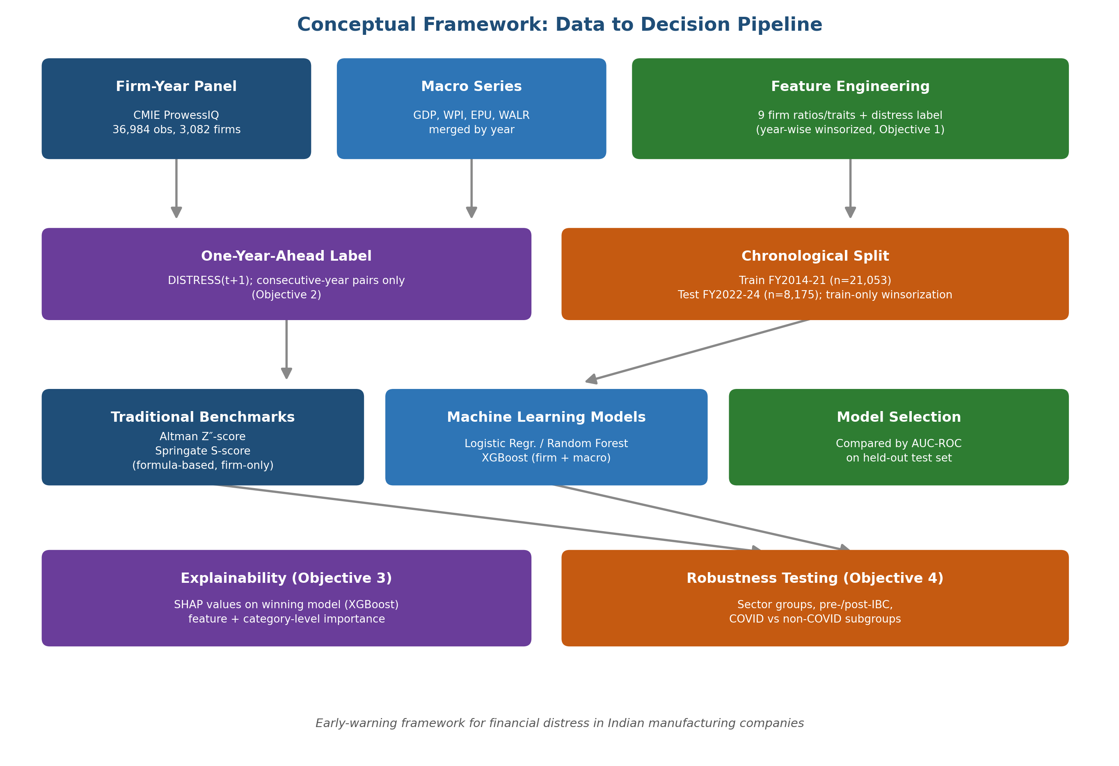
Conceptual Model / Framework

Slide 15
Summary of the Dissertation Work Progress
Obj No. | Statement of the Objective | Method / Methodology | Status (Completed / On-going / Yet to commence)
1 | Identify firm-level financial ratios, firm characteristics, and macroeconomic indicators associated with distress. | Winsorization; Mann-Whitney U; Multivariate logistic regression with industry & year fixed effects. | Completed
2 | Develop ML models for one-year-ahead prediction; benchmark against Altman Z″ and Springate S-score. | Chronological train/test split; LR, RF, XGBoost vs. formula-based benchmarks; AUC-ROC comparison. | Completed
3 | Determine relative importance of distress predictors using explainable AI (SHAP) across indicator categories. | SHAP values on XGBoost; feature-level ranking; 8-category aggregation; beeswarm direction analysis. | Completed
4 | Evaluate robustness across manufacturing sub-sectors, pre-/post-IBC regimes, and the COVID-19 period. | Subgroup & full-model transfer AUC (10 sectors); within-period 70/30 COVID split; macro-mechanism logistic regression. | Completed
**At least 2 objectives should be completed — All 4 objectives are completed in this study.

Slide 16
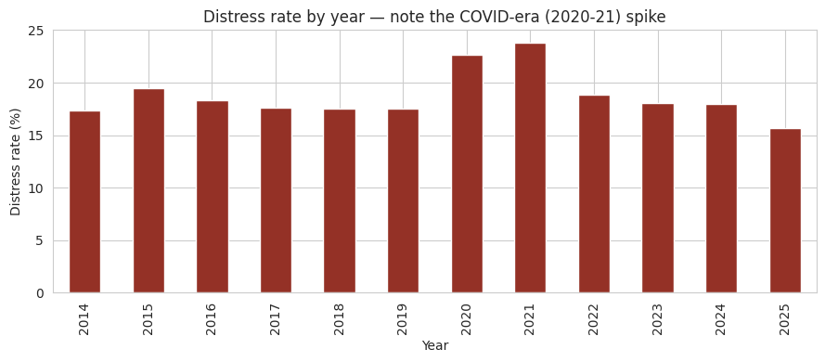
Key Results and Discussions — Objective 1
Table 5.1: Univariate Comparison of Winsorized Financial Ratios, Distressed vs. Non-Distressed (n=36,984)
Variable | Mean (Healthy) | Mean (Distressed) | Mann-Whitney p-value | Sig. at 5%
Current Ratio | 2.367 | 1.608 | < 0.001 | Yes
Working Capital / Total Assets | 0.209 | –0.131 | < 0.001 | Yes
Net Worth / Total Assets | 0.501 | 0.029 | < 0.001 | Yes
EBIT / Total Assets | 0.106 | –0.036 | < 0.001 | Yes
Return on Assets (PAT/TA) | 0.060 | –0.083 | < 0.001 | Yes
Sales / Total Assets | 1.130 | 0.648 | < 0.001 | Yes
Interest Coverage Ratio | 38.828 | –0.592 | < 0.001 | Yes
CFO / Total Assets | 0.065 | 0.017 | < 0.001 | Yes
Log (Total Assets) | 5.732 | 5.174 | < 0.001 | Yes
Firm Age (years) | 33.834 | 35.832 | < 0.001 | Yes
Key Findings (Objective 1):
• All 10 variables statistically significant at 5% level.
• Largest separation: Interest Coverage (38.83 vs –0.59) — consistent with distress definition.
• Net Worth/TA (0.50 vs 0.03): distressed firms are near balance-sheet insolvency.
• Multivariate logistic regression (Spec A): 8 of 9 variables remained significant after industry + year fixed effects.
• Current ratio lost significance (p=0.840) once industry/year effects are controlled — its univariate association reflected industry variation.
• Distress rate spiked to 23.8% in FY2021 (COVID peak), then fell to 15.6% by FY2025.
H1 substantially supported.

Slide 17
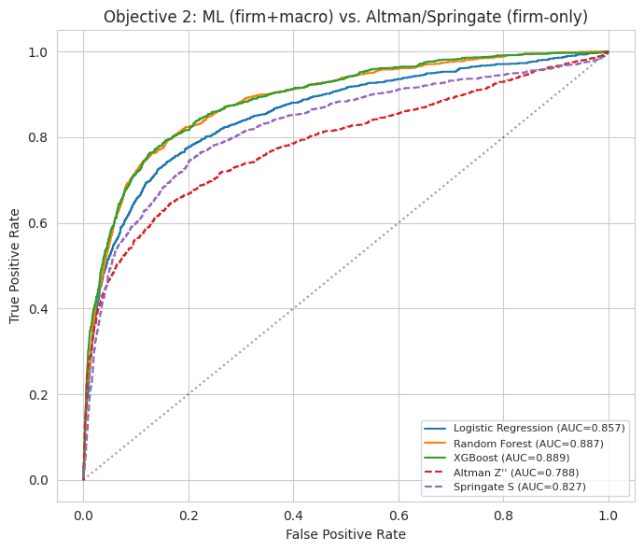
Key Results and Discussions — Objective 2
Table 5.5: One-Year-Ahead Distress Prediction Accuracy (AUC), ML Models vs. Benchmarks, FY2022–2024 Test Set
Model | AUC | Feature Set | Rank
XGBoost | 0.889 | Firm + Macro | 1
Random Forest | 0.887 | Firm + Macro | 2
Logistic Regression | 0.857 | Firm + Macro | 3
Springate S | 0.827 | Firm only (formula) | 4
Altman Z″ | 0.788 | Firm only (formula) | 5
Analysis:
• XGBoost achieved the highest AUC (0.889), outperforming Altman Z″ by 0.101 and Springate S by 0.062 AUC points on the held-out test set.
• Firm-Only Ablation: Removing 4 macro features increased AUC to 0.891 (ΔAUC = –0.002), proving macro variables add negligible predictive value when firm ratios are already known.
• This means all discriminative power comes from firm-level financial fundamentals — the macro environment is already embedded in the ratios by the time annual data is reported.
H2 supported: ML significantly outperforms traditional models.

Slide 18
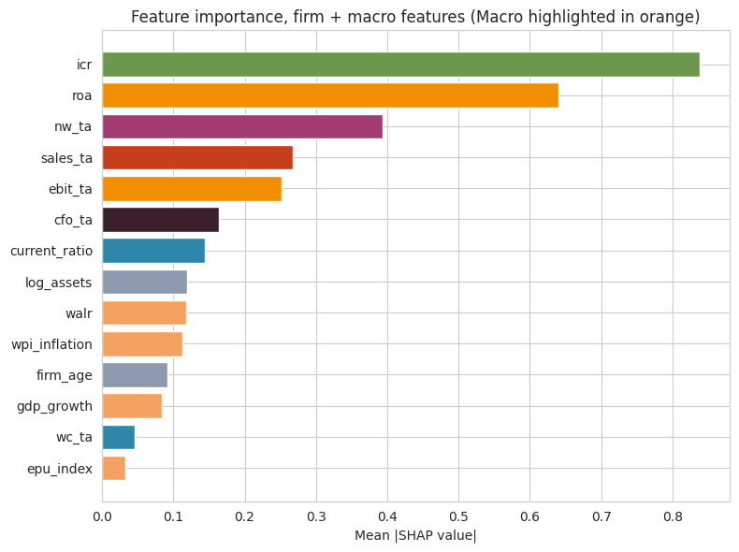
Key Results and Discussions — Objective 3 (Feature-Level)
Table 5.9: Feature Ranking by Mean |SHAP|
Rank | Feature | Category | Mean |SHAP|
1 | Interest Coverage (ICR) | Debt Service | 0.838
2 | Return on Assets (ROA) | Profitability | 0.640
3 | Net Worth / TA | Leverage/Solvency | 0.394
4 | Sales / TA | Efficiency | 0.268
5 | EBIT / TA | Profitability | 0.251
6 | CFO / TA | Cash Flow | 0.164
7 | Current Ratio | Liquidity | 0.144
8 | Log(Assets) | Firm Char. | 0.120
9 | Industry WALR | Macro | 0.118
10 | WPI Inflation | Macro | 0.112
Interest coverage ratio emerges as the single most important predictor of one-year-ahead distress (mean |SHAP| = 0.838), 30% higher than the second-ranked feature. For a credit officer, ICR is the lead monitoring variable.

Slide 19
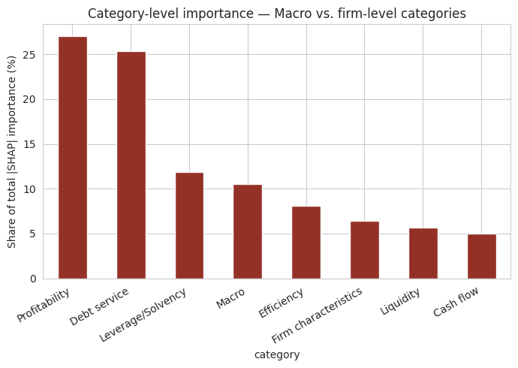
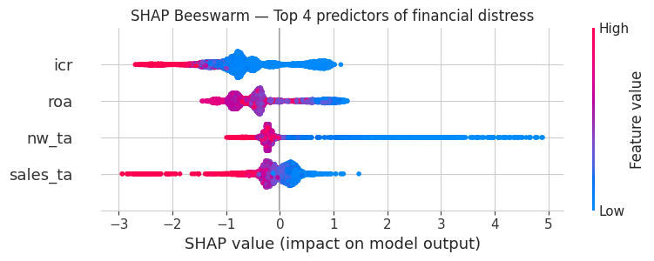
Key Results — Objective 3 (Category-Level & Direction)
Category-Level SHAP Importance:
• Profitability (27.0%) and Debt Service (25.4%) together account for >52% of total SHAP importance, confirming they are the primary drivers of distress predictions.
• Leverage/Solvency follows at 11.9%; Macro category = 10.5% but the ablation shows this is redistributed importance, not incremental forecasting value.
• Liquidity (5.7%) and Cash Flow (5.0%) are the least important categories — current ratio is not a reliable standalone signal.
Beeswarm Direction (top 4 predictors): High ICR, ROA, NW/TA, and Sales/TA values push SHAP negative (lower distress risk); low values push positive (higher distress risk). No sign reversals observed — consistent with financial intuition.
H3 supported: Indicator categories contribute unequally to model predictions.

Slide 20
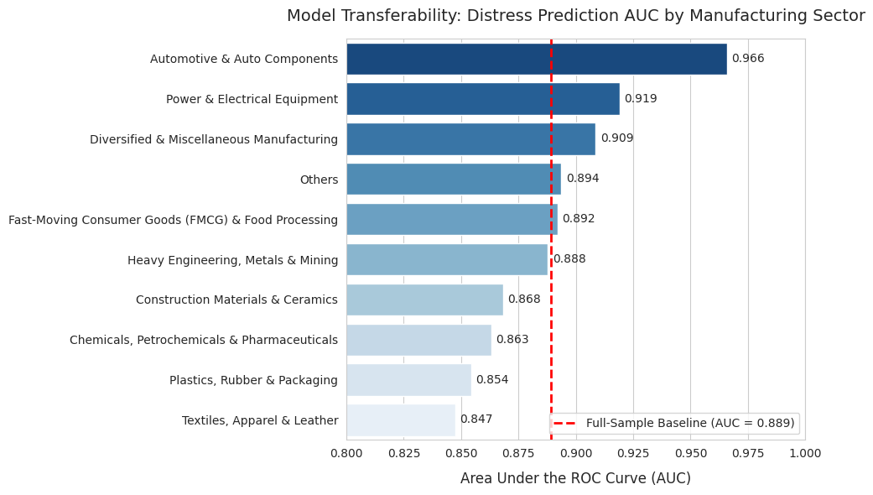
Key Results and Discussions — Objective 4 (Sectors)
Table 5.11: AUC by Manufacturing Sector Group
Sector Group | n (Test) | Within- Subgroup | Full-Model Transfer
Automotive & Auto Comp. | 385 | 0.867 | 0.966
Power & Electrical | 446 | 0.922 | 0.919
Diversified & Misc. Mfg | 351 | 0.902 | 0.909
FMCG & Food Processing | 564 | 0.888 | 0.892
Heavy Eng., Metals & Mining | 974 | 0.867 | 0.888
Chemicals, Petrochem & Pharma | 1,078 | 0.858 | 0.863
Plastics, Rubber & Packaging | 484 | 0.819 | 0.854
Textiles, Apparel & Leather | 645 | 0.851 | 0.847
Analysis:
• Transfer AUCs range from 0.847 (Textiles) to 0.966 (Automotive) — spread of 0.118 points.
• All sectors exceed 0.80; 9 of 10 beat the Springate S baseline (0.827).
• Textiles, Apparel & Leather needs more cautious threshold-setting.
• Automotive’s transfer AUC (0.966) >> within-subgroup (0.867), suggesting the pooled model generalises better than overfitted sector-specific models.

Slide 21
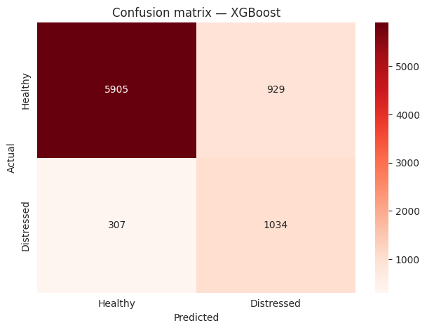
Key Results — Objective 4 (COVID-19 & IBC Regime)
Table 5.13: COVID vs. Non-COVID Prediction Accuracy
XGBoost Confusion Matrix at 0.5 Threshold
Period | n (Test) | AUC (Within-Subgroup)
COVID (FY2020–2021) | 1,614 | 0.892
Non-COVID (all other years) | 7,154 | 0.911
Table 5.14: COVID Dummy Coefficient With/Without Macro Controls
Specification | COVID Dummy Coefficient | p-value | Sig. at 5%
Without macro controls | 0.252 | < 0.001 | Yes
With macro controls (GDP, WPI, EPU, WALR) | 0.099 | 0.479 | No
Analysis:
• Model remained highly discriminatory in both periods: COVID AUC (0.892) vs. Non-COVID (0.911) — both well above the Springate S benchmark (0.827).
• COVID dummy drops 61% (0.252 → 0.099) and becomes insignificant (p=0.479) after adding macro controls — proving the COVID distress spike was driven by GDP collapse and EPU surge, not a pandemic-specific structural mechanism.
• Pre-/post-IBC comparison could not be completed: all test observations (FY2022–2024) fall in the post-IBC regime. Left for future research.
H4 partially supported: meaningful sector differences exist, but period differences are macro-driven.

Slide 22
Summary of Results
Objective | Hypothesis | Key Result | Verdict
Obj 1: Association of financial ratios with distress | H1 | All 10 variables significant univariately (Mann-Whitney U, p<0.001 each); 8 of 9 remained significant after industry + year FE. Current ratio lost significance (p=0.840). Overall distress rate = 18.73%, peaking at 23.8% in COVID FY2021. | Supported
Obj 2: ML vs. traditional benchmarks | H2 | XGBoost AUC = 0.889, outperforming Random Forest (0.887), Logistic Regression (0.857), Springate S (0.827), and Altman Z″ (0.788). Macro ablation showed ΔAUC = –0.002: firm ratios alone suffice for prediction. | Supported
Obj 3: SHAP explainability | H3 | Interest coverage ratio = #1 predictor (|SHAP| = 0.838). Profitability (27%) + Debt Service (25.4%) = >52% of total SHAP importance. Macro category = 10.5% but adds negligible AUC. SHAP directions consistent with financial intuition. | Supported
Obj 4: Robustness across sectors & periods | H4 | Sector AUCs range 0.847–0.966 (all >0.80); COVID AUC=0.892 (stable); COVID spike explained by macro shock (dummy drops 61% with macro controls, p=0.479). IBC comparison untestable. | Partially Supported

Slide 23
Findings and Conclusions
Conclusion 1: The Supremacy of Machine Learning Over Traditional Models
Non-linear ML models (XGBoost, AUC 0.889) significantly outperform traditional linear scoring models (Altman Z″ at 0.788, Springate S at 0.827) for Indian manufacturing. The SHAP analysis confirmed these models capture genuine non-linear interactions, particularly in the interest coverage ratio, that linear models cannot grasp.
Conclusion 2: Macro Variables Explain Contemporaneous Distress but Not One-Year-Ahead Prediction
GDP growth and EPU explain why distress cycles occur (the COVID dummy became insignificant after adding macro controls), but they add negligible value to one-year-ahead firm-level prediction (ΔAUC = –0.002). By the time financial statements are reported, the macro shock is already embedded in the firm’s ratios.
Recommendations:
Banks/RBI: Transition from static Z-scores to ML-based systems; prioritize interest coverage ratio as lead monitoring variable. CFOs: Maintain strong NW/TA and disciplined interest coverage. Policymakers: Countercyclical monetary policy and regulatory certainty directly reduce manufacturing distress.

Slide 24
Gantt Chart
Major Activities | Status | 1 | 2 | 3 | 4 | 5 | 6 | 7 | 8 | 9 | 10 | 11 | 12 | 13 | 14
Literature Review | Planned
 | Achieved
Gap Identification & Problem Statement | Planned
 | Achieved
Variables, Aim, Objectives | Planned
 | Achieved
Data Collection & Preprocessing | Planned
 | Achieved
Model Development (Obj 1–2) | Planned
 | Achieved
SHAP Explainability (Obj 3) | Planned
 | Achieved
Robustness Testing (Obj 4) | Planned
 | Achieved
Conclusion & Report Writing | Planned
 | Achieved
Rewriting & Corrections | Planned
 | Achieved
Planned
Achieved

Slide 25
References
1. Altman, E.I. (1968) ‘Financial ratios, discriminant analysis and the prediction of corporate bankruptcy’, The Journal of Finance, 23(4), pp. 589–609.
2. Springate, G.L.V. (1978) Predicting the Possibility of Failure in a Canadian Firm. Unpublished MBA Research Project, Simon Fraser University.
3. Ohlson, J.A. (1980) ‘Financial ratios and the probabilistic prediction of bankruptcy’, Journal of Accounting Research, 18(1), pp. 109–131.
4. Barboza, F., Kimura, H. and Altman, E. (2017) ‘Machine learning models and bankruptcy prediction’, Expert Systems with Applications, 83, pp. 405–417.
5. Sehgal, S., Mishra, R.K., Deisting, F. and Vashisht, R. (2021) ‘On the determinants and prediction of corporate financial distress in India’, Managerial Finance, 47(10), pp. 1428–1447.
6. Mishra, N., Ashok, S. and Tandon, D. (2021) ‘Predicting financial distress in the Indian banking sector: a comparative study’, Global Business Review.
7. Tran, L., Le, H., Nguyen, T. and Nguyen, V. (2022) ‘Explainable machine learning for financial distress prediction: evidence from Vietnam’.
8. Gupta, V. (2023) ‘Evaluating the accuracy of prediction in accounting-based models for companies in India under IBC’, JCAR, 12(1), pp. 8–17.
9. Singh, G. and Singla, R. (2023) ‘Prediction of financial distress in the Indian corporate sector: an improvement over Altman’s Z-score model’, IJBCRM, 13(1).
10. Liu, J., Li, C., Ouyang, P., Liu, J. and Wu, C. (2023) ‘Interpreting the prediction results of tree-based gradient boosting models for financial distress prediction’, Journal of Forecasting, 42(5), pp. 1112–1137.
11. Deng, X., Li, Z., Zhu, Y., Wang, J., Ning, H., Yi, G. and Shimada, T. (2025) ‘Financial distress warning and risk path analysis for Chinese listed companies’, Cogent Economics & Finance.
12. Mahesh, R., Kumari, S., Sharma, N. and Ramesh, G. (2025) ‘Predicting financial distress in emerging markets: the case of Indian small enterprises’, Cogent Economics & Finance, 13(1), 2489708.
13. Sethi, S.R. and Mahadik, D.A. (2025) ‘Forecasting financial distress for organizational sustainability: an empirical analysis’, Sustainable Futures, 9, 100429.
14. Tabatabaei, S.A. and Mousavi, S.M. (2026) ‘Explainable AI for financial distress: evidence from market volatility and regime dynamics’.

Slide 26
Conference / Journal Submission Details
Outcome | Yes | No
Research Publication | Yes
Patent |  | No
Publication and Patent |  | No

Slide 27
Thank You

