Slide 1
PIZZA SALES
PERFORMANCE ANALYSIS
An end-to-end SQL + Power BI business intelligence project — from raw transaction
data to an interactive executive dashboard.
SQL Server
Power BI
DAX
Data Modeling
Business Analytics
Personal Portfolio Project

Slide 2
What I'll Walk You Through
01
Business Problem
02
Data & Tools
Why the store needed this analysis and what leadership asked for
The dataset, and the SQL Server + Power BI pipeline I built
03
KPIs & SQL Logic
04
Dashboard Walkthrough
Five core metrics, calculated directly in T-SQL
The interactive report — trends, category & size breakdowns, best/worst sellers
05
Key Insights
06
Skills Demonstrated
What the numbers actually told the business
What this project shows about how I work
Pizza Sales Performance Analysis | SQL + Power BI Project
2

Slide 3
The Business Problem
Leadership needed a single source of truth for pizza sales performance — before this, insights lived in scattered spreadsheets with no consistent metrics.
MY ROLE
Modeled and cleaned the raw order-level CSV export
Wrote all T-SQL queries for KPIs and chart datasets
Two things were requested:
KPI Requirements
Designed the Power BI data model and DAX measures
Total Revenue, Average Order Value, Total Pizzas Sold, Total Orders, and Average Pizzas per Order — calculated reliably from raw order data.
Built an interactive, filterable executive dashboard
Charts Requirements
Seven visuals covering daily, hourly and monthly trends, category and size mix, and best/worst sellers by revenue, quantity and orders.
Interpreted results into business recommendations
“ Turn raw transaction data into an interactive report that lets
management see performance at a glance and drill into detail. ”
Pizza Sales Performance Analysis | SQL + Power BI Project
3

Slide 4
Data Source & Pipeline
One year of pizza-store order data (Jan – Dec), flowing through three stages:
1
2
3
Raw Data
→
SQL Server
→
Power BI
CSV export of order-level pizza transactions (order id, date, time, pizza, size, category, quantity, unit price)
Imported into a SQL Server database (Pizza_Store). Wrote T-SQL to calculate KPIs and shape data for every chart
Connected Power BI to the query results; built the data model, DAX measures, and an interactive report
Table: pizza_sales
order_id • order_date • order_time • pizza_name • pizza_category • pizza_size • quantity • unit_price • total_price
Pizza Sales Performance Analysis | SQL + Power BI Project
4

Slide 5
Five KPIs, Calculated in T-SQL
$817.86K
$38.31
49,574
21,350
2.32
Total Revenue
Avg Order Value
Total Pizzas Sold
Total Orders
Avg Pizzas / Order
SUM(quantity × unit_price)
Revenue ÷ distinct orders
SUM(quantity)
COUNT(DISTINCT order_id)
Pizzas sold ÷ orders
Sample query — Average Order Value
SELECT
ROUND(
SUM(quantity * unit_price) / COUNT(DISTINCT order_id), 2
) AS Average_Order_Value
FROM pizza_sales;
-- Same pattern used for Total Revenue, Total Pizzas Sold,
-- Total Orders, and Avg Pizzas per Order.
Pizza Sales Performance Analysis | SQL + Power BI Project
5

Slide 6
Seven Charts, Mapped to Business Questions
Bar
Daily trend for total orders
Line
Hourly trend for total orders
Which days drive the most orders?
When are the peak order hours?
Line
Monthly trend for total orders
Pie
% of sales by pizza category
How does demand shift across the year?
Which category drives revenue?
Donut
% of sales by pizza size
Funnel
Pizzas sold by category
What size do customers prefer?
How does volume compare by category?
Bar
Top 5 sellers (revenue/qty/orders)
Bar
Bottom 5 sellers (revenue/qty/orders)
What should we promote and stock?
What's underperforming on the menu?
Pizza Sales Performance Analysis | SQL + Power BI Project
6

Slide 7
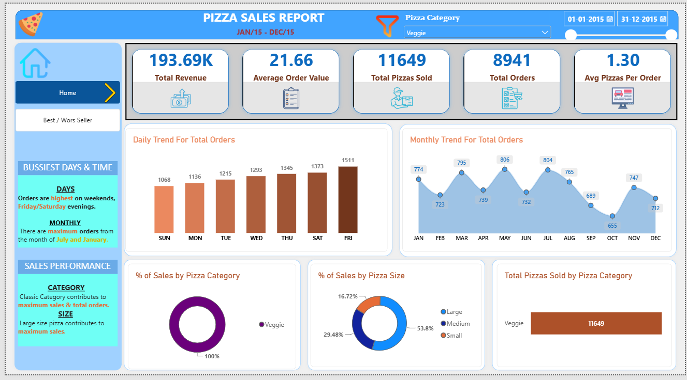
The Dashboard — Home Overview
Filterable by pizza category and date range — KPI cards, daily/monthly trends, and category/size mix
Pizza Sales Performance Analysis | SQL + Power BI Project
7

Slide 8
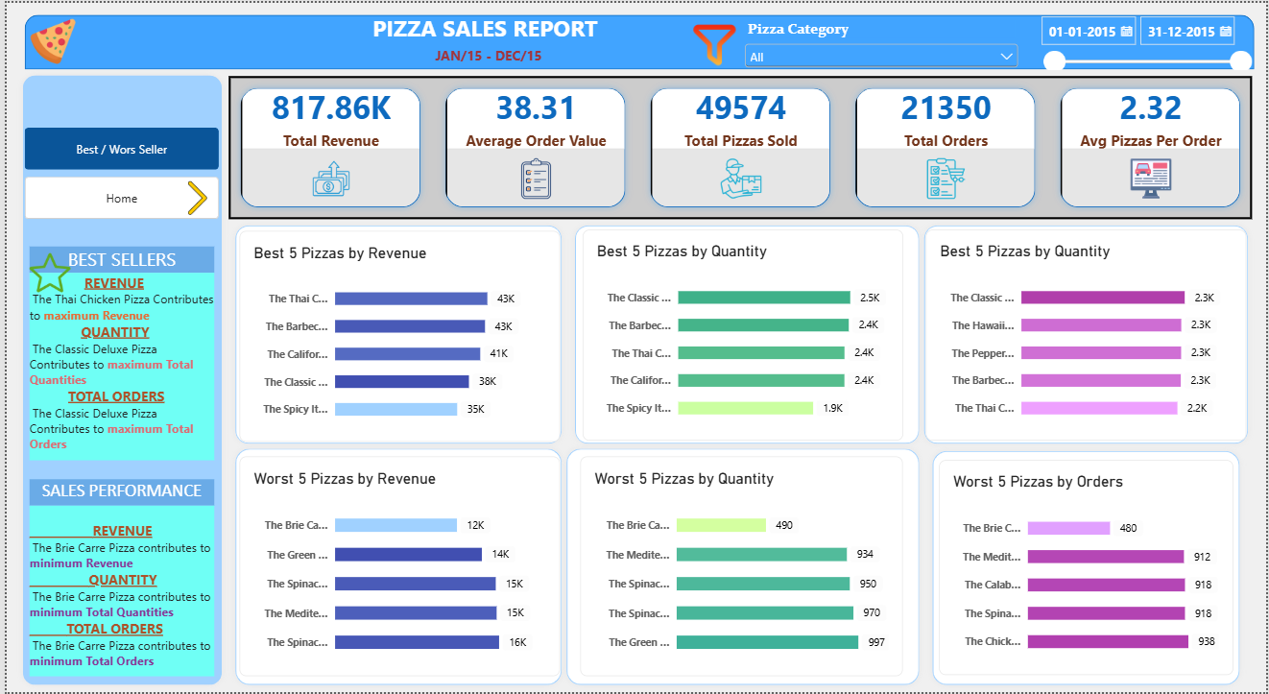
The Dashboard — Best / Worst Sellers
Drill-down page ranking every pizza by revenue, quantity sold, and total orders
Pizza Sales Performance Analysis | SQL + Power BI Project
8

Slide 9
Key Insights I Delivered to the Business
1
TIMING
2
CATEGORY MIX
Orders peak on Friday & Saturday evenings; July and January are the busiest months — useful for staffing and inventory planning.
The Classic category contributes the most to both total sales and total orders — the menu's proven core.
3
SIZE PREFERENCE
4
TOP PERFORMER
Large pizzas drive the largest share of sales, ahead of Medium and Small — pricing and promos can lean into this.
The Thai Chicken Pizza leads on revenue; the Classic Deluxe Pizza leads on quantity and total orders.
5
UNDERPERFORMERS
6
BASKET SIZE
The Brie Carre Pizza ranks lowest across revenue, quantity, and orders — a candidate for menu review or a relaunch.
Customers order 2.32 pizzas per order on average — a benchmark for future upsell or bundling efforts.
Pizza Sales Performance Analysis | SQL + Power BI Project
9

Slide 10
Skills This Project Demonstrates
S
D
P
SQL
Data Modeling
Power BI
Aggregate functions, window functions (OVER), CASE-based custom sorting, date/time functions, subqueries
Structuring raw transactional data into clean, query-ready tables for reporting
Interactive dashboards, slicers, DAX measures, drill-through pages, mobile-friendly layout
B
D
A
Business Analysis
Data Storytelling
Attention to Detail
Translating stakeholder requirements into KPIs, charts, and actionable recommendations
Presenting complex data simply — busiest days, top/bottom sellers, category performance
Matching every deliverable back to the original requirements document, end to end
Pizza Sales Performance Analysis | SQL + Power BI Project
10

Slide 11
Thank You
Happy to walk through the full SQL script, the Power BI data model, or any
metric on the dashboard in more depth.
Pizza Sales Performance Analysis • SQL + Power BI

